Slide 1
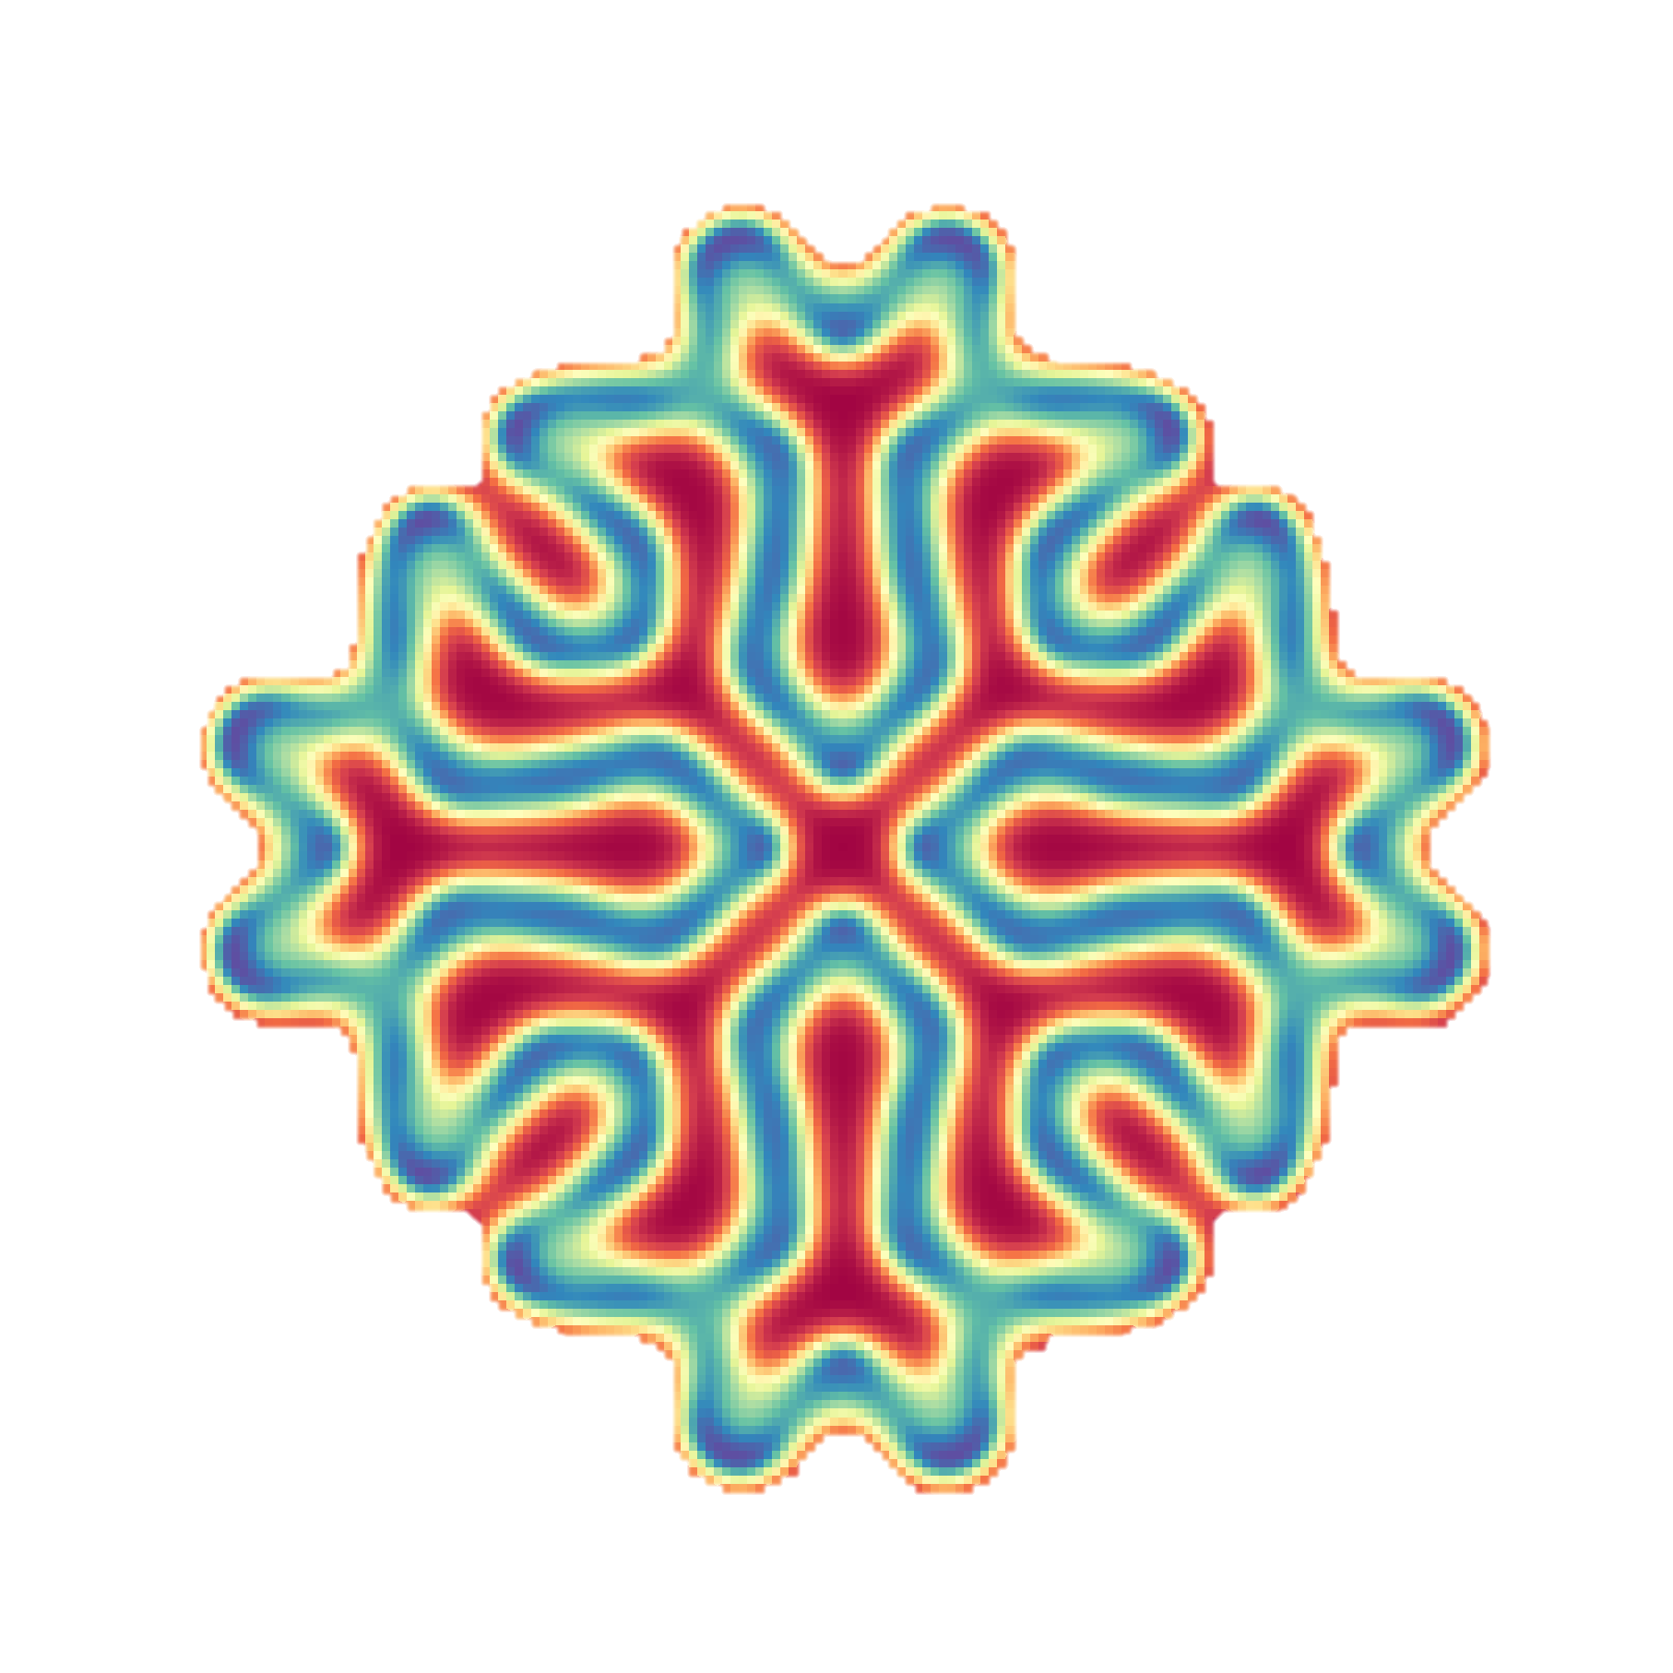
Biological Modeling A Short Tour
Phillip Compeau
with Mert Inan, Noah Lee, Chris Lee, and Shuanger Li
© 2022

Slide 2
Biological Modeling A Short Tour

