Slide 1
Enhancing 3D Spatial Reasoning in Vision-Language Models through Multi-View Augmentation
A Course Project under Multiple View Geometry for Spatial AI
Seung Pil Lee 20251050
Dae Yeon Kim 20251196
Notes:
Hello, my name is Seungpil Lee. Today, I will present our course project titled "Enhancing 3D Spatial Reasoning in Vision-Language Models through Multi-View Augmentation." This is joint work with Daeyeon Kim.

Slide 2
Research goal
Due to the inherent ambiguity of 3D orientation reasoning from single 2D images, existing Vision-Language Models exhibit poor performance on orientation-related tasks.
The objective of this research is to mitigate this limitation by training models on multi-view augmented data, enabling more robust and viewpoint-aware 3D spatial reasoning.
Contribution
Seung Pil Lee : Ideation, Data augmentation, Training, Evaluation, Slide Preparation, Presentation
Dae Yeon Kim : Data augmentation, Slide preparation
Notes:
The core challenge in 3D spatial reasoning stems from the inherent ambiguity when inferring three-dimensional orientation from a single two-dimensional image. Current Vision-Language Models achieve below 50% accuracy on orientation-related tasks, which is essentially random guessing. Our research objective is to address this limitation through multi-view data augmentation. By training models on images rendered from multiple viewpoints, we aim to enable more robust and viewpoint-aware spatial reasoning capabilities. For this project, Seungpil Lee was responsible for data augmentation pipeline development, model training, evaluation, and this presentation, while Daeyeon Kim contributed to data augmentation and slide preparation.

Slide 3


Vision-Language Model (VLM)
Image
encoder
Image
extract visual features
Multimodal
fusion layer
Text output
Text
decoder
reasoning
Visual Q&A
Image Captioning
Multi-modal Reasoning
Text
It is a multimodal AI model trained on both images and text, enabling computers to understand and reason about visual information as if it were language.
Notes:
A Vision-Language Model, or VLM, is a multimodal AI architecture that processes both visual and textual information. The model consists of an image encoder for extracting visual features, a multimodal fusion layer, and a text decoder for generating responses. Among various VLM applications, we focus specifically on Visual Question Answering, where the model must understand spatial relationships within images to answer questions accurately. This task is particularly challenging because it requires genuine 3D understanding from 2D observations.

Slide 4
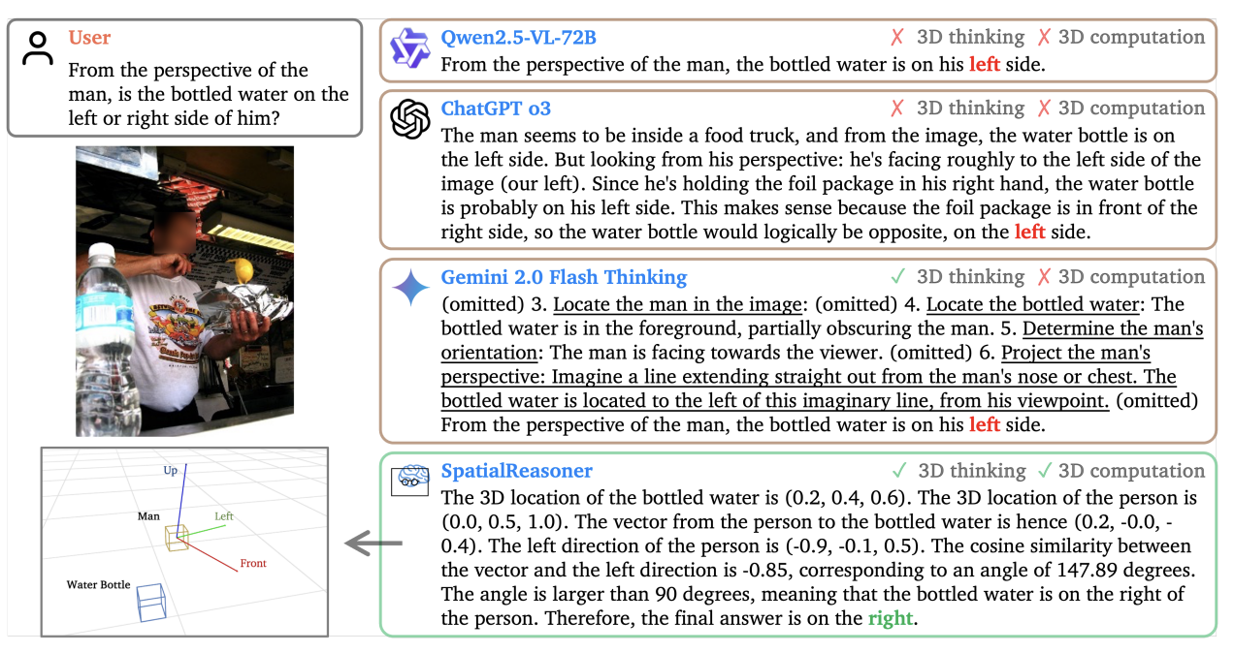
Related Work (SpatialReasoner)
To enhance perception ability, SpatialReasoner augmented data to train model use
‘Explicit 3d Perception’ process
[1] Ma, Wufei, et al. "Spatialreasoner: Towards explicit and generalizable 3d spatial reasoning." arXiv preprint arXiv:2504.20024 (2025).
Notes:
The recently proposed SpatialReasoner attempts to solve this problem through an explicit 3D perception process. Instead of models simply looking at images and reasoning implicitly, it first computes 3D coordinates and vectors, then provides answers based on these calculations. For example, when asked "from the man's perspective, is the water bottle on the left or right," while conventional models make vague guesses, SpatialReasoner calculates the 3D positions of the person and bottle, then provides accurate answers through vector operations.

Slide 5
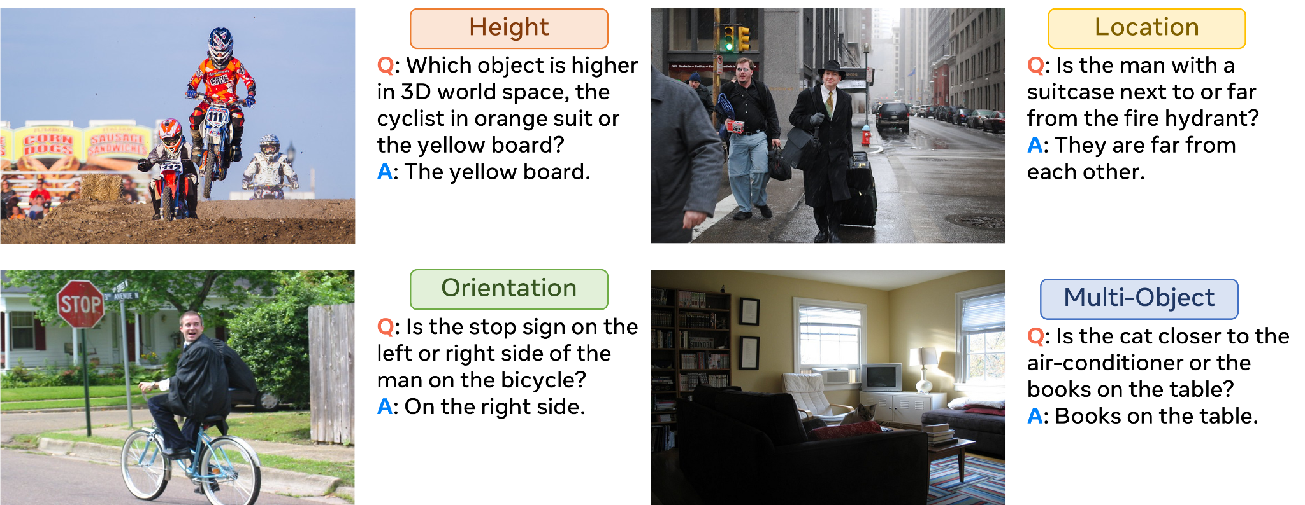
Problem Statement
3D understanding with 2D image is challenge in Vision-Language Models (VLM)
Especially 3D perception is keep being a problem (orientation, distance etc)
[2] Ma, W., Chen, H., Zhang, G., Chou, Y. C., de Melo, C. M., & Yuille, A. (2024). 3dsrbench: A comprehensive 3d spatial reasoning benchmark. ICCV 2025.
Notes:
Understanding 3D space from 2D images remains challenging for Vision-Language models. As shown in 3DSRBench, models struggle with questions about height, location, orientation, and multi-object relationships. Especially on rotation benchmarks, like SpinBench, VLM has shown significant weakness, showing accuracy under 50%.

Slide 6
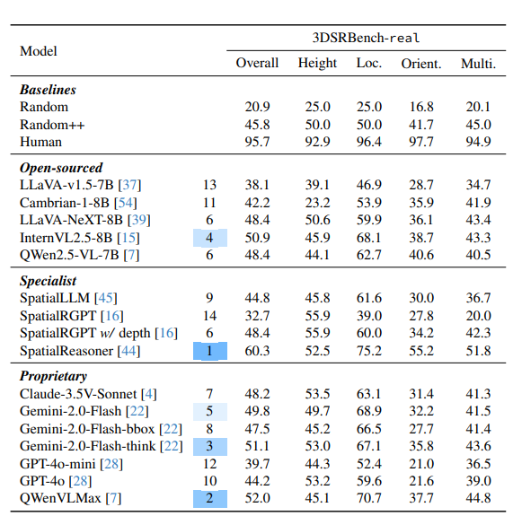
Benchmark results table (3DSR)
Among multiple 3D spatial reasoning tasks, models show particularly poor performance on orientation-related questions.
Therefore, we focus on improving performance on the following orientation tasks in 3DSRBench:
orientation_in_front_of: Whether an object is in front of another object.
orientation_on_the_left: Whether an object is to the left of another object.
orientation_viewpoint: From which side the camera is viewing the object.
[2] Ma, W., Chen, H., Zhang, G., Chou, Y. C., de Melo, C. M., & Yuille, A. (2024). 3dsrbench: A comprehensive 3d spatial reasoning benchmark. ICCV 2025.
Notes:
The 3DSRBench results reveal that orientation tasks exhibit the lowest performance among all spatial reasoning categories. Looking at the table, while height and location tasks achieve 55 to 68 percent accuracy, orientation tasks drop to around 39 percent. We specifically target three orientation subtasks. First, orientation_in_front_of determines whether one object is positioned in front of another. Second, orientation_on_the_left assesses lateral positioning from an object's perspective. Third, orientation_viewpoint identifies which side of an object faces the camera. These tasks require understanding of intrinsic object orientations, which is fundamentally ambiguous from single-view observations.

Slide 7

Proposed Method - novel view image augmentation
1. We generate rotated novel views for the Spatial Reasoner, a state-of-the-art model for 3D spatial reasoning, using MVGenMaster on its original image dataset.
2. We modify the direction vectors, bounding boxes, and chain-of-thought annotations that describe object relationships in the images.
3. We aim to train on this augmented dataset to improve performance on the orientation tasks in the 3DSRBench benchmark.
[3] Cao, Chenjie, et al. "MVGenMaster: Scaling Multi-View Generation from Any Image via 3D Priors Enhanced Diffusion Model." (CVPR)2025.
Notes:
Our proposed method consists of three main components. First, we leverage MVGenMaster, a state-of-the-art multi-view diffusion model, to generate rotated novel views from the original SpatialReasoner dataset. This model preserves geometric consistency by using depth-aligned 3D priors. Second, we modify the corresponding spatial annotations including direction vectors, 3D bounding boxes, and chain-of-thought reasoning to match each synthesized viewpoint. Third, we train the model on this augmented dataset with the goal of improving performance specifically on orientation tasks in the 3DSRBench benchmark. The key insight is that exposure to multiple viewpoints during training should help the model develop better internal representations of 3D spatial structure.

Slide 8
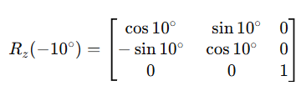
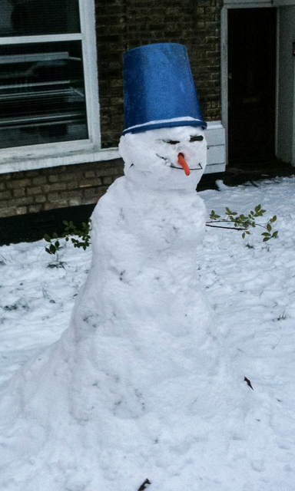
Pipeline
{
bounding_box,
direction,
}
spatial information editing
<MVGenMaster>
Spatial Reasoner original dataset
Generate rotated novel views
Spatial Reasoner
training
<Qwen2.5-VL>
{
bounding_box,
direction,
answer_cot
}
spatial information editing
[3] Cao, Chenjie, et al. "MVGenMaster: Scaling Multi-View Generation from Any Image via 3D Priors Enhanced Diffusion Model." (CVPR)2025.
[4] Qwen Team. “Qwen2.5-VL: Advancing Vision-Language Models with Strong Multimodal Reasoning.” arXiv Technical Report.
Notes:
The pipeline is as follows. We first augment novel-view images using MVGenMaster. Then, we perform label augmentation in two ways:
A geometry-based method, where we consider only horizontal rotation and apply a rotation matrix around the Z-axis.
A model-based method, where we use Qwen2.5-VL to generate a reasoning format and derive labels inferred from the ground truth, which are then used as supervision.

Slide 9
Data format
Column Name | Description
question_index | Unique ID string that identifies each question
question | Natural language question about 3D spatial relationships
bounding_box | List of 3D positions and names of objects in the image (bbox_3d coordinates + label)
direction | List of front/left direction vectors and names for each object (front_dir, left_dir, label)
answer | Index character of the correct answer choice ("A", "B", "C", or "D")
answer_cot | Chain-of-thought text explaining the reasoning process to reach the answer
answer_name | Human-readable name of the correct answer choice (e.g., A. the microphone.)
category | Spatial reasoning type tag for the question (e.g., orientation_in_front_of)
image_filename | Original image filename that this question references
Notes:
The SpatialReasoner dataset follows a structured format with nine fields. Each sample contains a question about spatial relationships, corresponding answer choices, and chain-of-thought reasoning that explains the solution process. Crucially for our augmentation approach, three fields contain geometric information that must be transformed when generating novel views. The bounding_box field stores 3D coordinates for each object. The direction field contains front and left direction vectors defining object orientations. The answer_cot field includes numerical computations referencing these spatial quantities. When we rotate the viewpoint, all three fields must be consistently updated to maintain annotation accuracy.

Slide 10

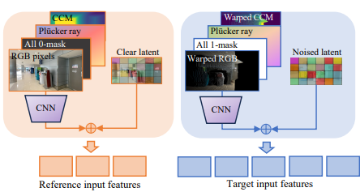
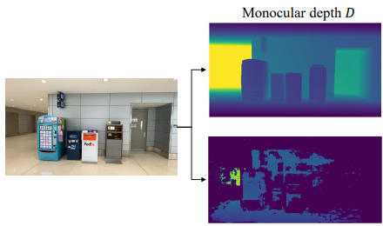
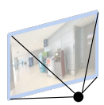
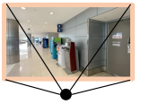
Novel view image augmentation (MVGenMaster)
MVGenMaster is a multi-view diffusion model that leverages 3D priors to generate up to dozens to around one hundred novel views in a single pass, given one or multiple reference images as input.
We align monocular depth to metric scale using MVS or COLMAP points via RANSAC.
=> enables geometrically valid 3D warping
The model uses depth information to understand 3D structure, generating geometrically consistent novel views while preserving spatial relationships.
Novel View Generation
[3] Cao, Chenjie, et al. "MVGenMaster: Scaling Multi-View Generation from Any Image via 3D Priors Enhanced Diffusion Model." (CVPR)2025.
Notes:
Next, we introduce the pipeline of MVGenMaster, the diffusion model used for image augmentation. After obtaining a high-quality depth map from monocular depth estimation, we align it to a metric scale using MVS or COLMAP. This means that the image generation process preserves real-world spatial information.
Reference views are kept clean and used as conditioning signals, while diffusion is applied only to the target views to preserve geometric consistency, thereby generating novel views.
This is done to prevent noise from being added to the reference views.

Slide 11
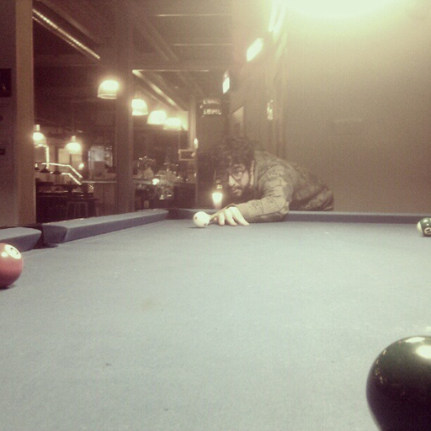
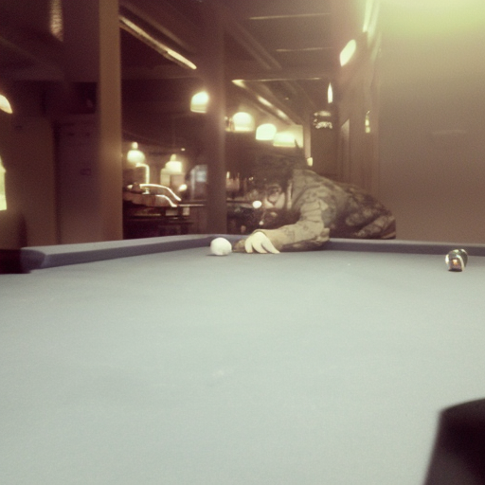
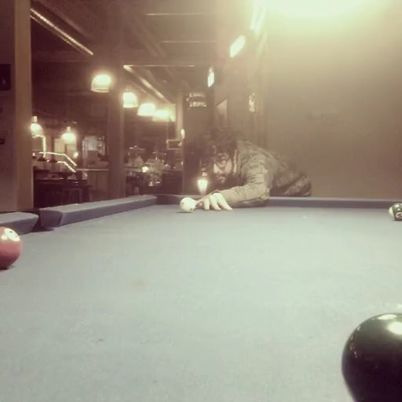
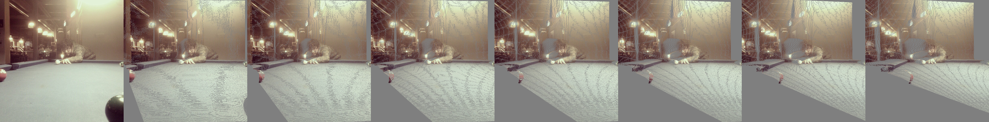

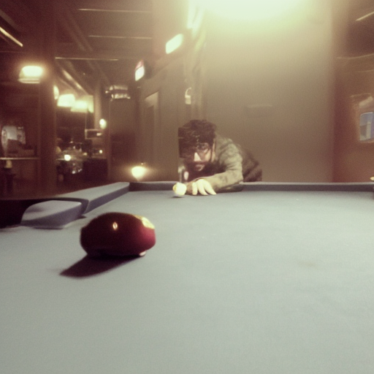
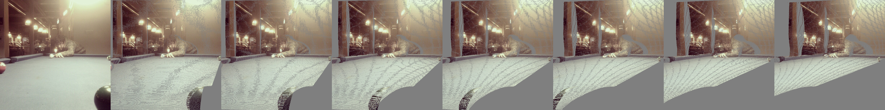
Novel view image augmentation
<prompt>
Reference image (single)
nframe : How many novel views to generate
cam_traj :Camera trajectory
(swing, free, bi_direction, rotation)
d_phi : How much to rotate
[3] Cao, Chenjie, et al. "MVGenMaster: Scaling Multi-View Generation from Any Image via 3D Priors Enhanced Diffusion Model." (CVPR)2025.
Notes:
The model’s inference prompt consists of a single input image, the number of views to generate, the camera trajectory, and the rotation angle along that trajectory. Using this setup, the novel views are generated.

Slide 12
Spatial information editing (HF-Aug)
<direction>
{ "front_dir": [ 0.1, 0, -1 ], "label": "the person", "left_dir": [ -1, 0, -0.1 ] }
[ { "front_dir": [ 0.099, -0.017, -1 ], "label": "the person",
"left_dir": [ -0.99, 0.17, -0.1 ] } ]
<bounding box>
{ "bbox_3d": [ -0.3, 0.1, 2.3 ], "label": "the person" }, { "bbox_3d": [ 0, 0, 1 ], "label": "the billiard table" }, { "bbox_3d": [ 2, 0.6, 4 ], "label": "the pillar" }
{ "bbox_3d": [ -0.28, 0.16, 2.3 ], "label": "the person" }, { "bbox_3d": [ 0, 0, 1 ], "label": "the billiard table" }, { "bbox_3d": [ 2.07, 0.24, 4 ], "label": "the pillar" }
12
Notes:
This is the first dataset we mentioned earlier. We augmented the labels by applying a rotation matrix, corresponding to the augmentation angle, to the direction vectors and 3D bounding box vectors.

Slide 13
Spatial information editing (MVGen-96k)
[SYSTEM MESSAGE]
A conversation between User and Assistant. The user asks a question,
and the Assistant solves it. The assistant first thinks about the
reasoning process in the mind and then provides the user with the answer.
The reasoning process and answer are enclosed within <think> </think>
and <answer> </answer> tags, respectively, i.e.,
<think> reasoning process here </think><answer> answer here </answer>
The system message formats the model’s reasoning process so that the data can be augmented into the desired form.
The <think> tag becomes the reasoning process, that is, the chain-of-thought (CoT) label, and the <answer> tag represents spatial information such as direction and bounding boxes
Notes:
The system message formats the model’s reasoning process so that the data can be augmented into the desired form.
The <think> tag becomes the reasoning process, that is, the chain-of-thought (CoT) label, and the <answer> tag represents spatial information such as direction and bounding boxes

Slide 14
Spatial information editing (MVGen-96k)
[USER MESSAGE]
<image>
Question: Consider the real-world 3D locations and orientations of
the objects. Which side of the child is facing the camera?
Options:
A. front
B. back
C. left
D. right
Please select the correct answer from the options above.
We feed the original dataset together with the camera poses of our augmented novel views, and then use them as inputs to run inference with the model.
Notes:
We feed the original dataset together with the camera poses of our augmented novel views, and then use them as inputs to run inference with the model.

Slide 15
Spatial information editing (MVGen-96k)
[ASSISTANT MESSAGE]
<think>The location of the child is <bounding_box>.The vector
from the child to camera is hence <direction>.The left
direction of the child is <direction>. The cosine similarity
between the vector pointing to camera and the left direction is <angle>,
corresponding to an angle of <angle> degrees. Thus the angle between
the vector pointing to camera and the right direction is <angle> degrees.
The front direction of the child is <direction>.
The model then outputs the next reasoning process as a chain-of-thought (CoT), together with the augmented labels, including the updated <bounding_box> and <direction>
Notes:
The model then outputs the next reasoning process as a chain-of-thought (CoT), together with the augmented labels, including the updated <bounding_box> and <direction>

Slide 16
Training
Data set : HF-Aug
Condition | Training Data | Label Method | CoT
Baseline | None (pretrained) | N/A | —
SFT-v2 | Original (24k) | Ground truth | ✓
HF-Aug | Original + rotated (26.4k) | Rotation matrix + CoT transform | ✓
MVGen-96k | Original + 3 rotations (96k) | Qwen2.5-VL generation | ✓
Update labels by applying rotation matrices to the direction vectors and 3D bounding boxes.
CoT labeling x
+10° rotation (counterclockwise) — 1,200 samples
−10° rotation (clockwise) — 1,200 samples
Total: 2,400 samples
Data set : MVGen-96k
Qwen2.5-VL–based reasoning labeling for direction, bounding boxes, and chain-of-thought (CoT)
24,000 original questions × 4 viewpoints = 96,000 samples
Viewpoints: 0° (original), 10°, 20°, 30°
Notes:
Here, we train the model using two augmented datasets. HF-Aug applies rotation matrices to direction vectors and 3D bounding boxes, generating 2,400 samples without chain-of-thought labels. MVGen-96k uses Qwen2.5-VL to generate reasoning-based labels, including directions, bounding boxes, and chain-of-thought, resulting in 96,000 samples across four viewpoints.

Slide 17
Evaluation
Category | Baseline | SFT-v2 | HF-Aug | MVGen-96k
height_higher | 46.2 | 57.9 | 61.7 | 46.8
location_above | 48.9 | 61.6 | 65.5 | 59.8
location_closer_to_camera | 69.8 | 81.7 | 82.7 | 72.3
location_next_to | 63.1 | 75.1 | 74.5 | 54.1
multi_object_closer_to | 58.0 | 68.9 | 69.9 | 53.0
multi_object_facing | 55.8 | 65.3 | 64.9 | 62.4
multi_object_parallel | 52.7 | 48.5 | 50.7 | 51.5
multi_object_same_direction | 46.2 | 48.5 | 50.7 | 52.0
multi_object_viewpoint_towards_object | 24.9 | 35.9 | 39.4 | 23.0
orientation_in_front_of | 56.0 | 63.2 | 65.7 | 60.3
orientation_on_the_left | 32.8 | 66.3 | 64.5 | 37.2
orientation_viewpoint | 38.6 | 38.3 | 41.6 | 38.0
OVERALL | 48.3 | 58.0 | 60.1 | 50.0
Notes:
The evaluation results show mixed outcomes across our target tasks. For HF-Aug, we observe modest improvements on orientation_in_front_of, increasing from 49.7 to 53.1 percent, and orientation_viewpoint, from 16.0 to 18.3 percent. However, orientation_on_the_left decreases from 52.6 to 44.6 percent. MVGen-96k demonstrates substantial gains on multi-object tasks, particularly multi_object_facing improving from 33.1 to 48.6 percent, and multi_object_same_direction from 32.0 to 42.9 percent. However, it shows degraded performance on location-based tasks. Overall, these results are insufficient to claim clear performance gains on our primary target tasks. The inconsistent improvements suggest that our augmentation strategy requires refinement to achieve reliable orientation reasoning enhancement.

Slide 18
Results analysis
Resolution mismatch The model is trained on low-resolution images (576×384) but evaluated on high-resolution images (1024×768), causing a significant loss of fine-grained visual details.
Data distribution imbalance Augmented rotated images dominate the training set, causing overfitting to rotated low-resolution views and poor generalization to original test images.
Viewpoint–label inconsistency (MVGen-96k) Although images are generated from different viewpoints (10°, 20°, 30°), the ground-truth answers remain identical, leading the model to incorrectly learn viewpoint-invariant labels.
No chain-of-thought (CoT) augmentation was applied. (HF-Aug)

Slide 19
Limitation, Future work
The quality of the dataset is highly dependent on the generation quality of MVGenMaster; in some cases, objects disappear in the generated images.
Moreover, even novel views guided by depth-based spatial structure can still contain geometric errors.
=> To mitigate these issues, future work will explore incorporating explicit spatial features and multi-view–based augmentation to build higher-quality training datasets
Notes:
We identified four main factors that may explain the limited performance gains. First, there is a resolution mismatch between training and evaluation. The model was trained on low-resolution images at 576 by 384 pixels but evaluated on high-resolution images at 1024 by 768 pixels, causing significant loss of fine-grained visual details. Second, the data distribution is imbalanced. Augmented rotated images dominate the training set, leading to overfitting on rotated low-resolution views and poor generalization to original test images. Third, for MVGen-96k specifically, there exists a viewpoint-label inconsistency. Although images are generated from different viewpoints, the ground-truth answers remain identical across all views, which may confuse the model during training. Fourth, for HF-Aug, no chain-of-thought augmentation was applied, limiting the model's ability to learn the reasoning process.

Slide 20
Thank you
Notes:
Our approach has several limitations that warrant discussion. The dataset quality is highly dependent on MVGenMaster's generation quality. In some cases, objects disappear or become distorted in the generated images, introducing noise into the training data. Additionally, even depth-guided novel view synthesis can contain geometric errors, particularly in regions with complex occlusions or transparent materials. For future work, we plan to explore incorporating explicit spatial features extracted from depth estimation directly into the model architecture. We also aim to investigate more sophisticated multi-view augmentation strategies that can produce higher-quality, geometrically consistent training datasets.

