Slide 1
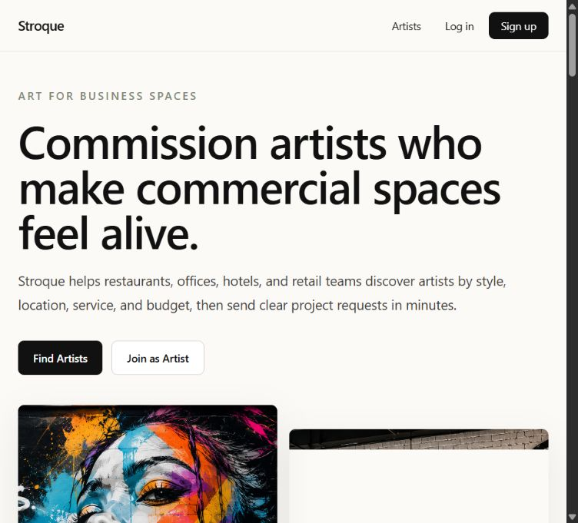
PRO PRESENTATION
Stroque Art Portal
A test-mode website walkthrough using live screenshots of the public pages, authentication screens, dashboards, and project request workflow.
Evidence captured from the deployed site and local test-mode dashboard.

Slide 2
NAVIGATION AND HERO
The first screen positions Stroque as a marketplace for commercial art projects.
The navigation keeps the primary routes visible while the hero explains who the product serves and what action to take next.
What the screen proves
Navbar: brand, Artists, Log in, Sign up.
Hero: clear business-space positioning.
Calls to action: Find Artists and Join as Artist.
Source: stroque-art-portal.vercel.app and test-mode local dashboard
02

Slide 3
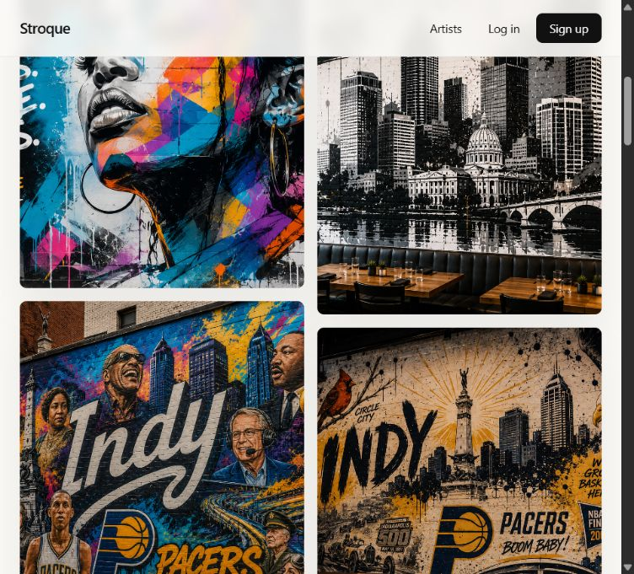
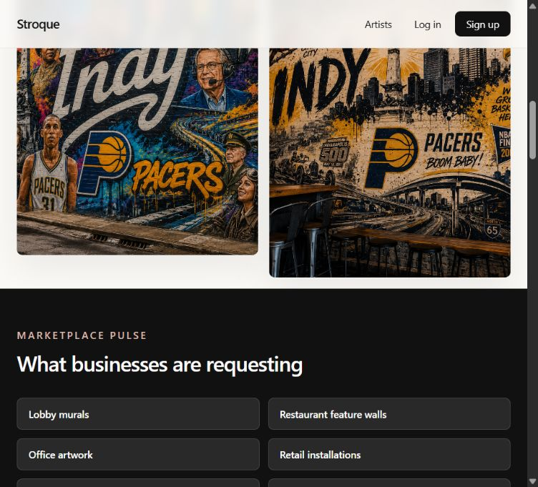
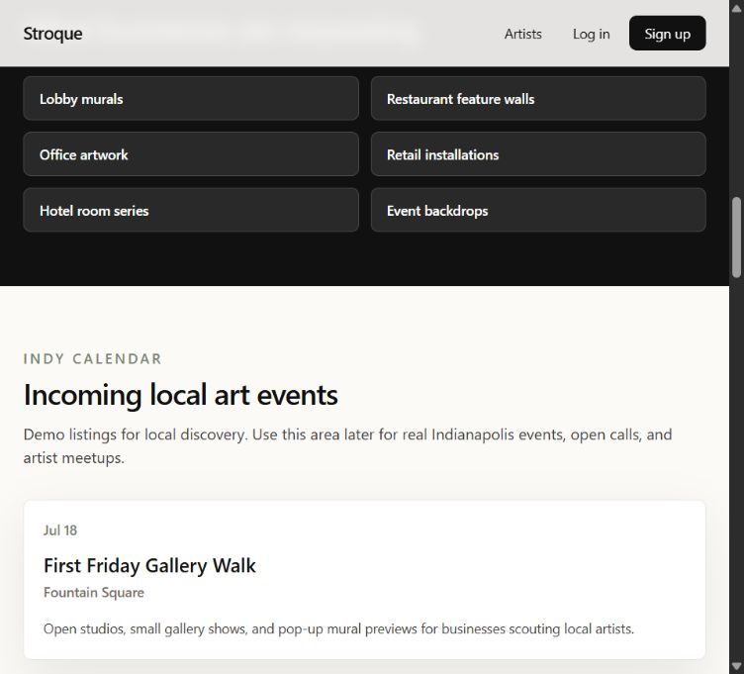
HOMEPAGE PROOF POINTS
The homepage uses market signals and local events to make discovery feel active.
The content is not only a landing page; it gives buyers categories, local context, and reasons to continue exploring.
Project demand categories Local art calendar Artist of the week
Source: stroque-art-portal.vercel.app and test-mode local dashboard
03

Slide 4
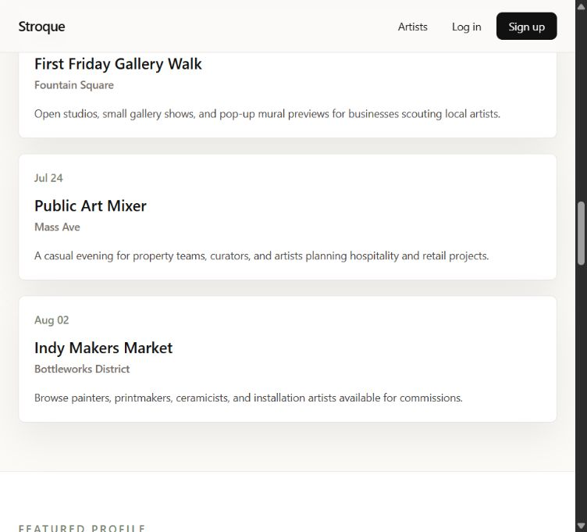
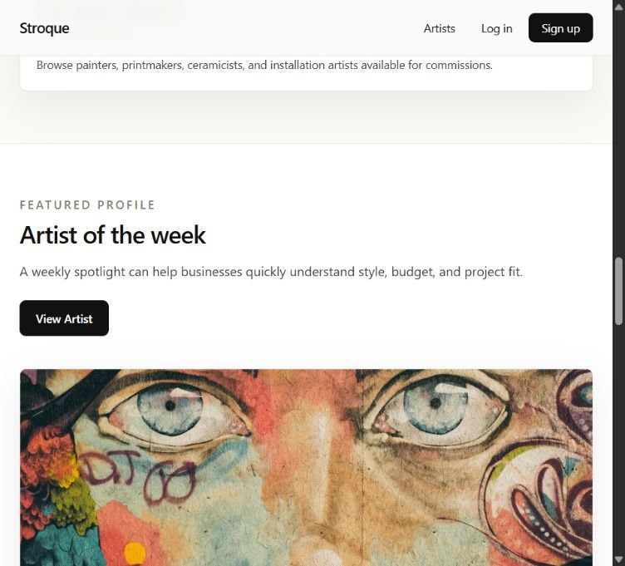
HOMEPAGE EDUCATION
The lower homepage turns browsing into a simple buyer workflow.
Art news explains why local art matters, and the process section reduces the commissioning path to three clear steps.
Presentation takeaway
This is useful for a demo because it lets the presenter move from brand story to concrete product workflow without leaving the homepage.
Source: stroque-art-portal.vercel.app and test-mode local dashboard
04

Slide 5
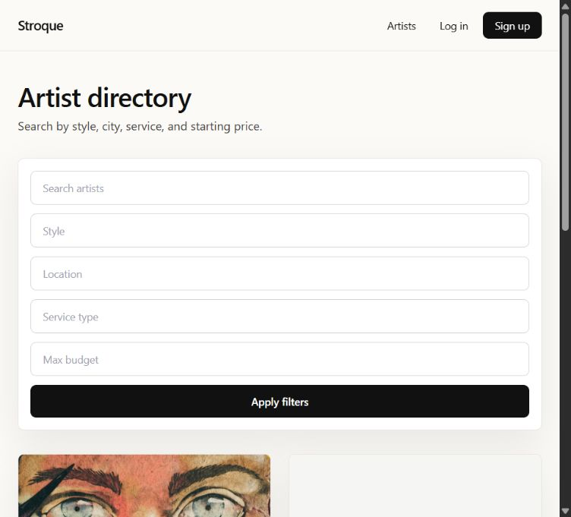
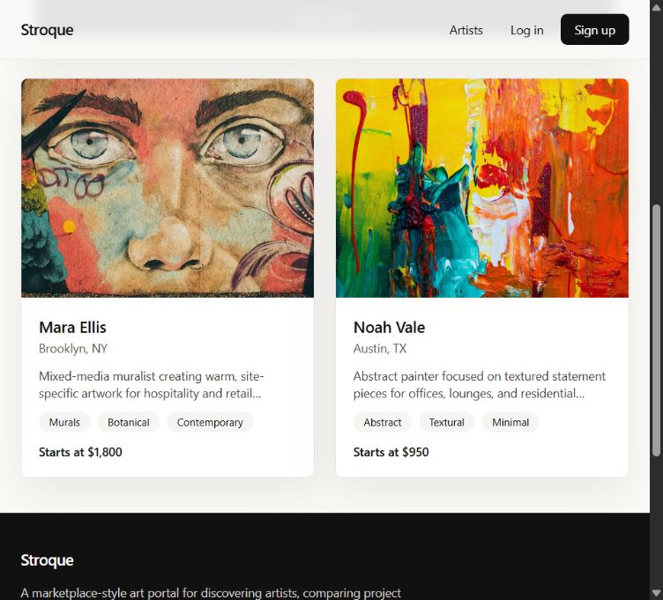
ARTIST DISCOVERY
The directory makes artist selection filterable instead of purely visual.
Buyers can search by term, style, service, location, and budget. The result cards summarize the fields needed for a first shortlist.
Source: stroque-art-portal.vercel.app and test-mode local dashboard
05

Slide 6
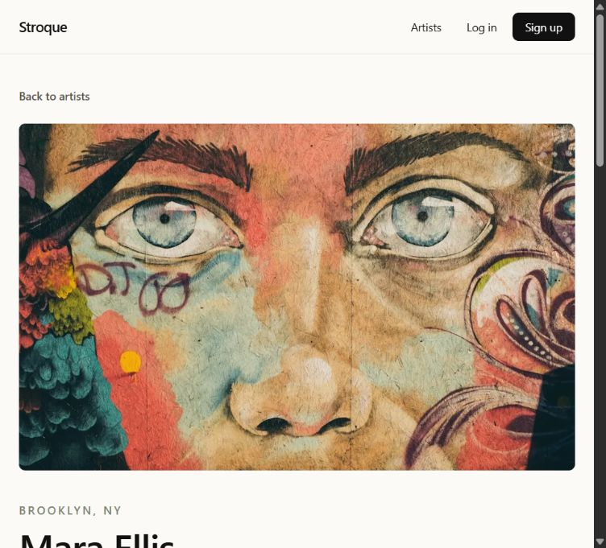
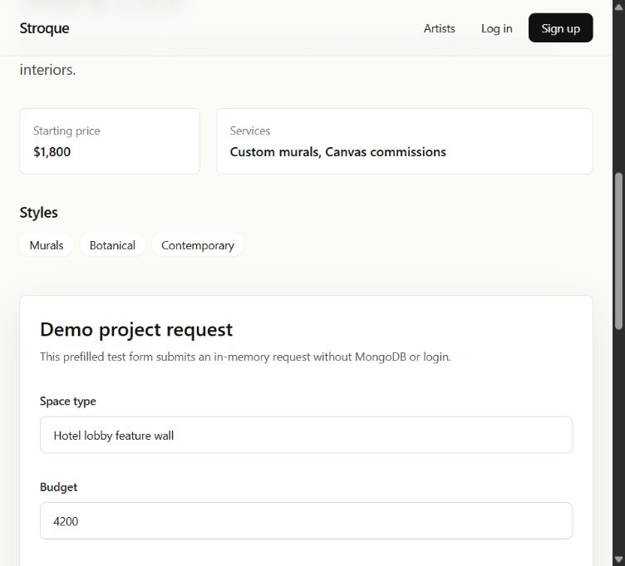
ARTIST PROFILE AND REQUEST
The artist profile connects visual proof to a structured project request.
The page shows portfolio evidence, services, price, location, styles, and a demo request form with the project details artists need.
Source: stroque-art-portal.vercel.app and test-mode local dashboard
06

Slide 7
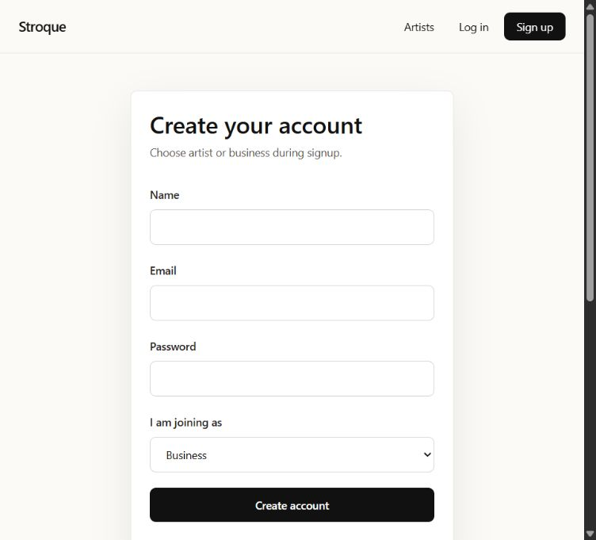
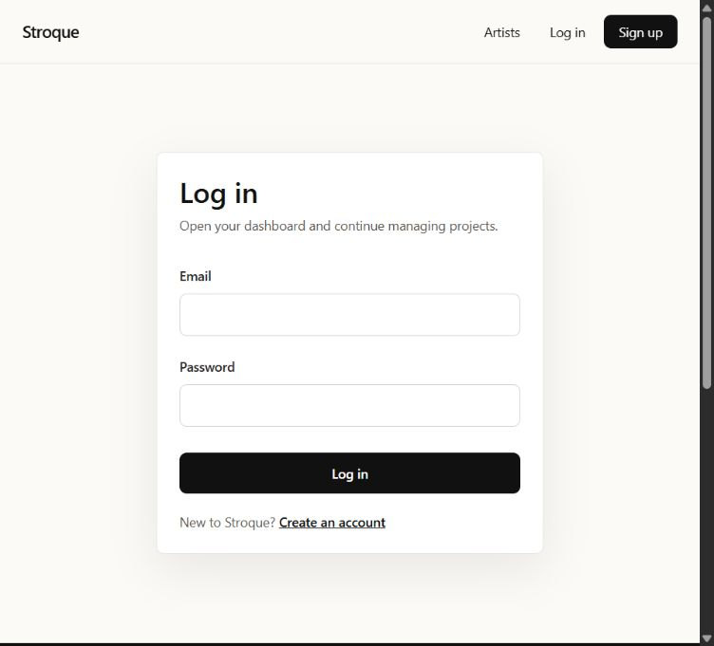
AUTHENTICATION
Sign up and login separate the two sides of the marketplace.
The auth screens establish role selection for new users and provide demo credentials in the footer for portfolio review.
Sign up captures name, email, password, and role. Login opens the right dashboard for the account.
Source: stroque-art-portal.vercel.app and test-mode local dashboard
07

Slide 8
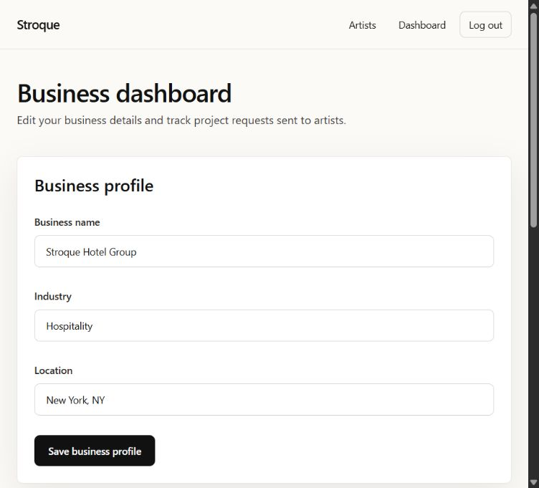
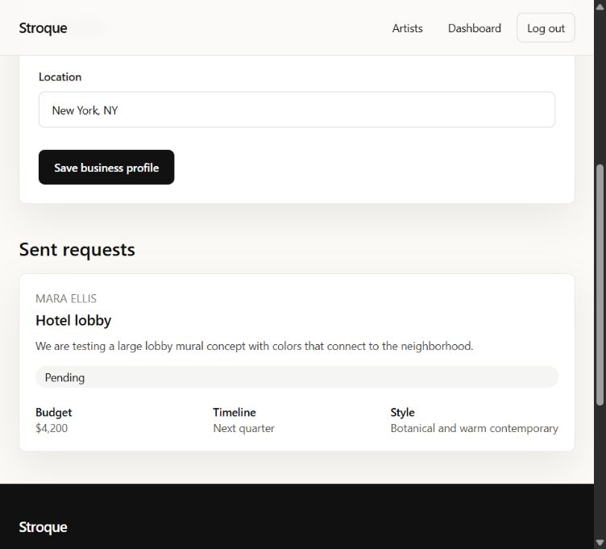
BUSINESS DASHBOARD
Businesses can maintain profile context and track sent requests.
The test-mode business account shows saved business data and a request card with artist, space type, description, status, budget, timeline, and style.
Source: stroque-art-portal.vercel.app and test-mode local dashboard
08

Slide 9
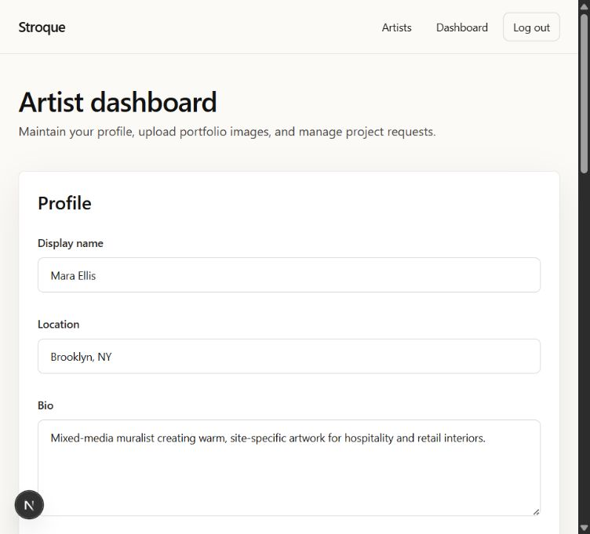
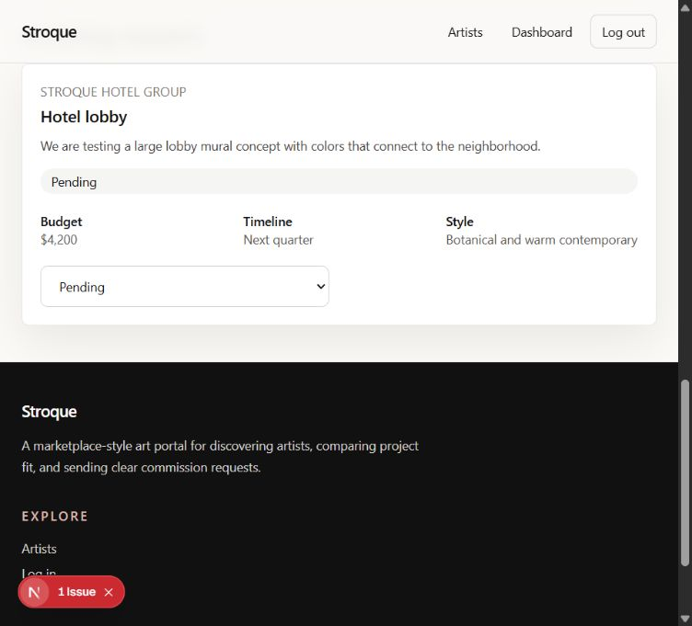
ARTIST DASHBOARD
Artists manage profiles and incoming requests.
The artist dashboard supports profile updates, portfolio images, pricing, services, and request status management in test mode.
Source: stroque-art-portal.vercel.app and test-mode local dashboard
09

Slide 10
SYNTHESIS
The test-mode site is ready to present as an end-to-end marketplace prototype.
Buyer path
Artist path
Demo value
Homepage framing -> artist discovery -> profile review -> structured project request.
Signup/login -> profile and portfolio management -> incoming request status updates.
Test-mode data makes the core workflow presentable without production accounts or a database setup.
Recommended live demo order: hero, artist directory, artist profile, request form, business dashboard, artist dashboard.
Source: stroque-art-portal.vercel.app and test-mode local dashboard
10

