Slide 1
MIRACULON-B
Does the new drug beat the
standard of care?
A late-phase oncology trial analysis · 752 patients · 2 treatment arms
Path A · Data Analysis & Modelling
GSK x DigData Step Up Career Challenge

Slide 2
The question we set out to answer
What the regulator and prescribers need to know
THE BRIEF
THE DATA
GSK has finished a late-phase clinical trial for Miraculon-B, a candidate cancer drug for solid tumours. We compared it head-to-head against the current standard of care to find out: 1. Do patients respond more often to Miraculon-B than to control? 2. Can we predict who will respond from age, weight, BMI, sex or biomarker?
772
Rows in clinical-study.csv
subject_id, age, sex, weight, height, trt_grp, response
768
Rows in protein-levels.csv
participant_id, protein_concentration (μg/L)
752
Patients after cleaning
1 duplicate · 3 paediatric · 16 missing values removed
Miraculon-B Clinical Trial Analysis • GSK x DigData Step Up
2 / 11

Slide 3
Our analytical pipeline
From raw CSV to clinical insight in seven steps
1
Load
2
Inspect
Read both CSVs into pandas data frames
Check shape, types, distributions, missingness
3
Clean
4
Engineer
1 duplicate row · 3 paediatric (age <18) · 16 NAs
Create BMI = weight / height²; merge protein data on subject_id
5
Aggregate
6
Visualise
Means and crosstabs by treatment arm and response
Boxplots, histograms — see the shape of the data
7
Model
Logistic regression + random forest to rank predictors
Miraculon-B Clinical Trial Analysis • GSK x DigData Step Up
3 / 11

Slide 4
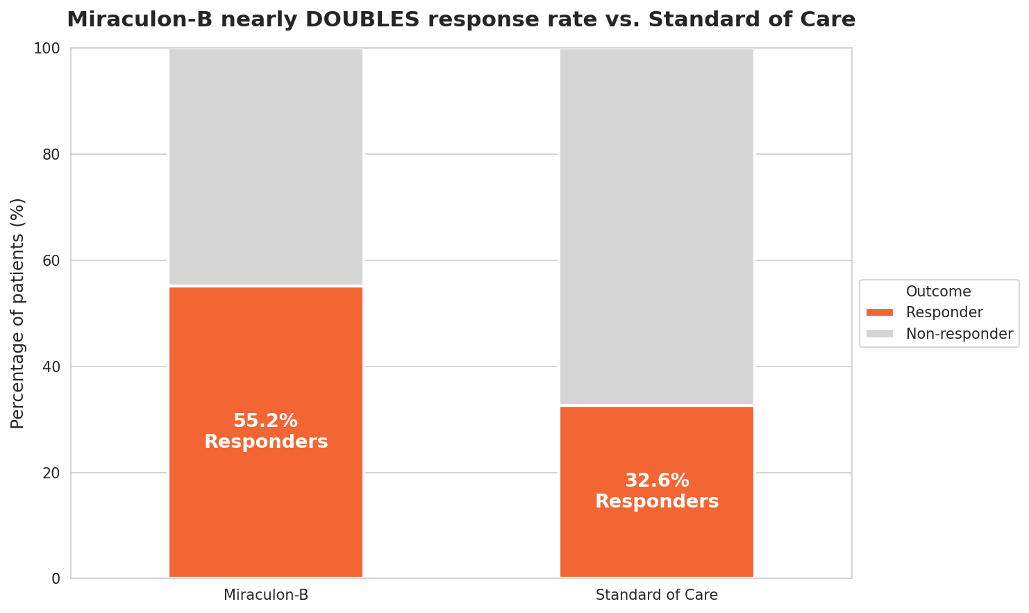
Headline finding
Miraculon-B nearly doubles the response rate
32.6%
Standard of care
123 of 377 patients responded
55.2%
Miraculon-B
207 of 375 patients responded
Highly statistically significant • χ² = 38.0, p < 0.0000001
Miraculon-B Clinical Trial Analysis • GSK x DigData Step Up
4 / 11

Slide 5
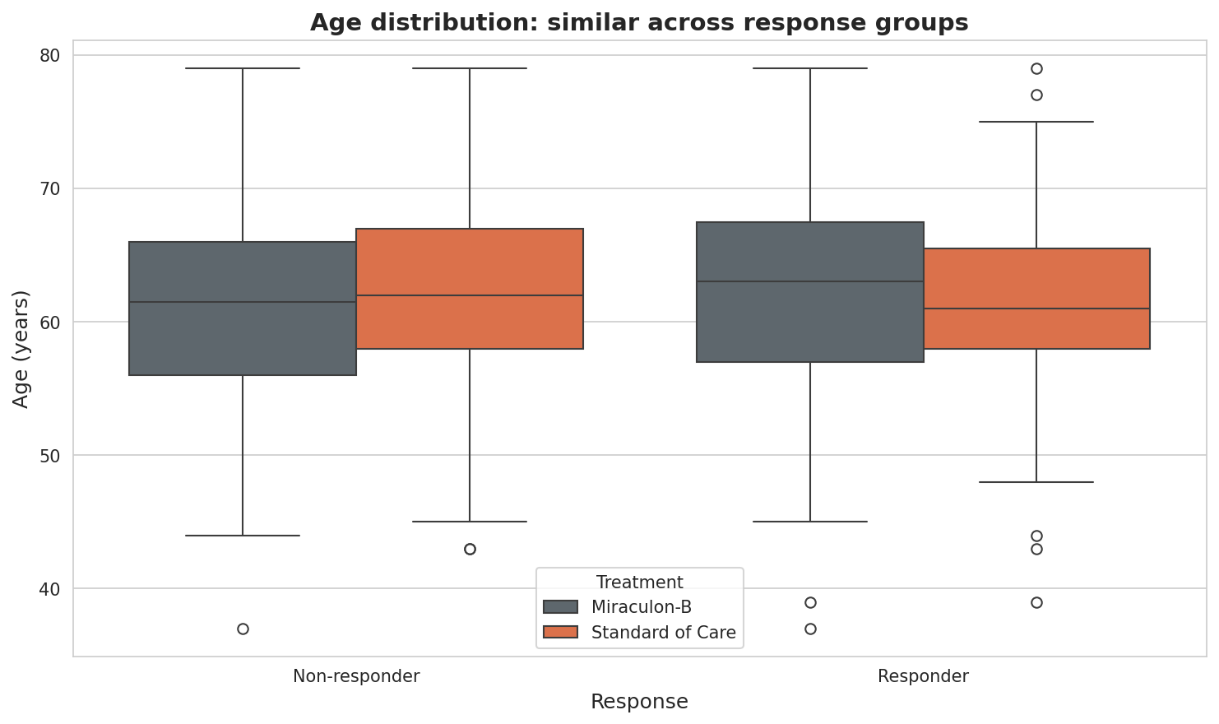
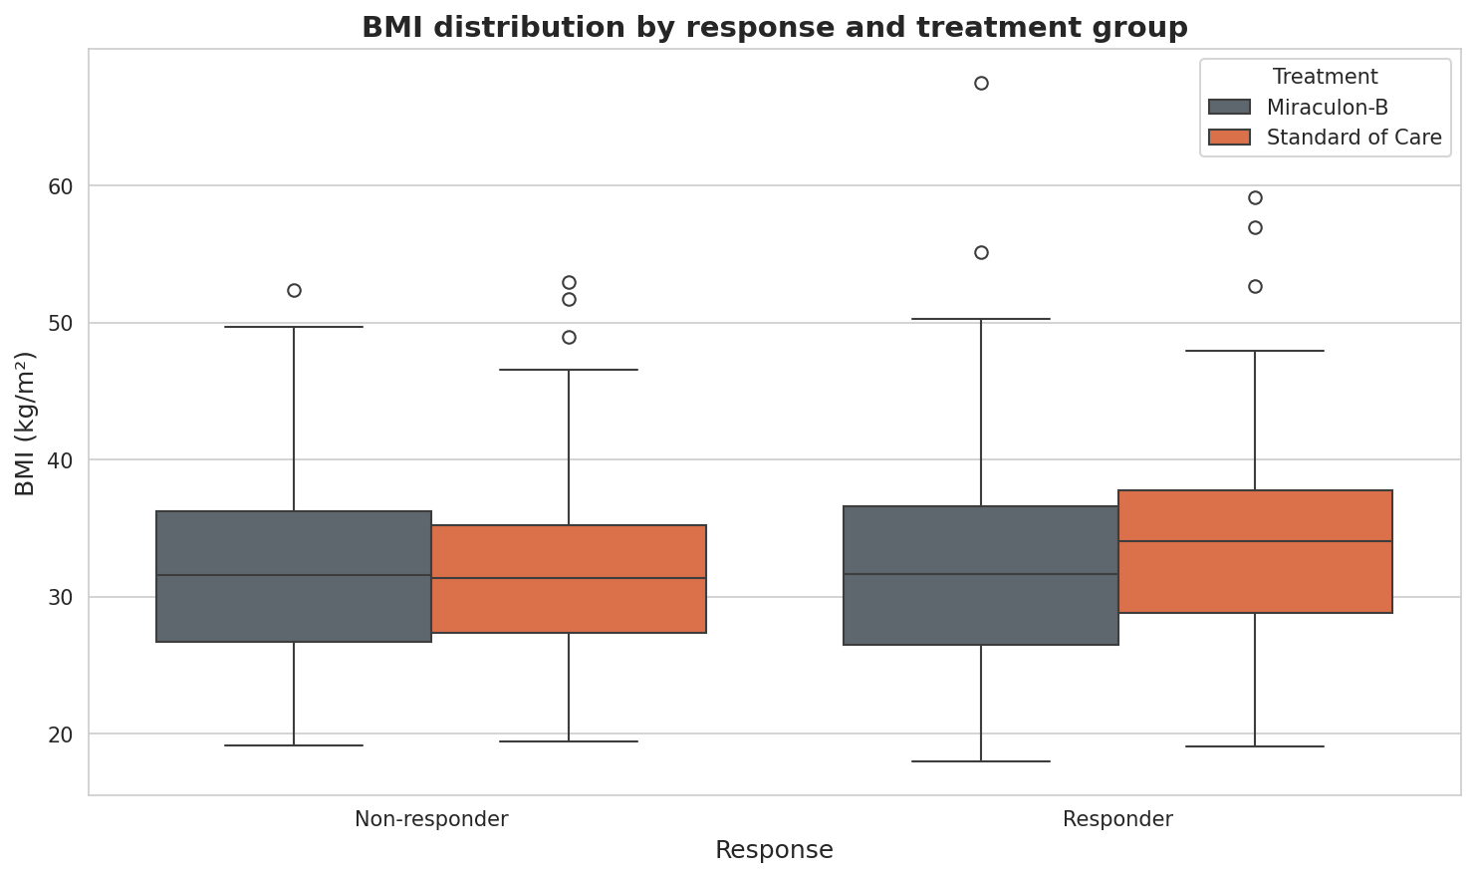
Age, weight and BMI tell us little
Demographics do not separate responders from non-responders
Takeaway
Distributions are virtually identical across responders and non-responders in both arms. We cannot use age, weight or BMI alone to identify who will benefit. We need a sharper signal.
Miraculon-B Clinical Trial Analysis • GSK x DigData Step Up
5 / 11

Slide 6
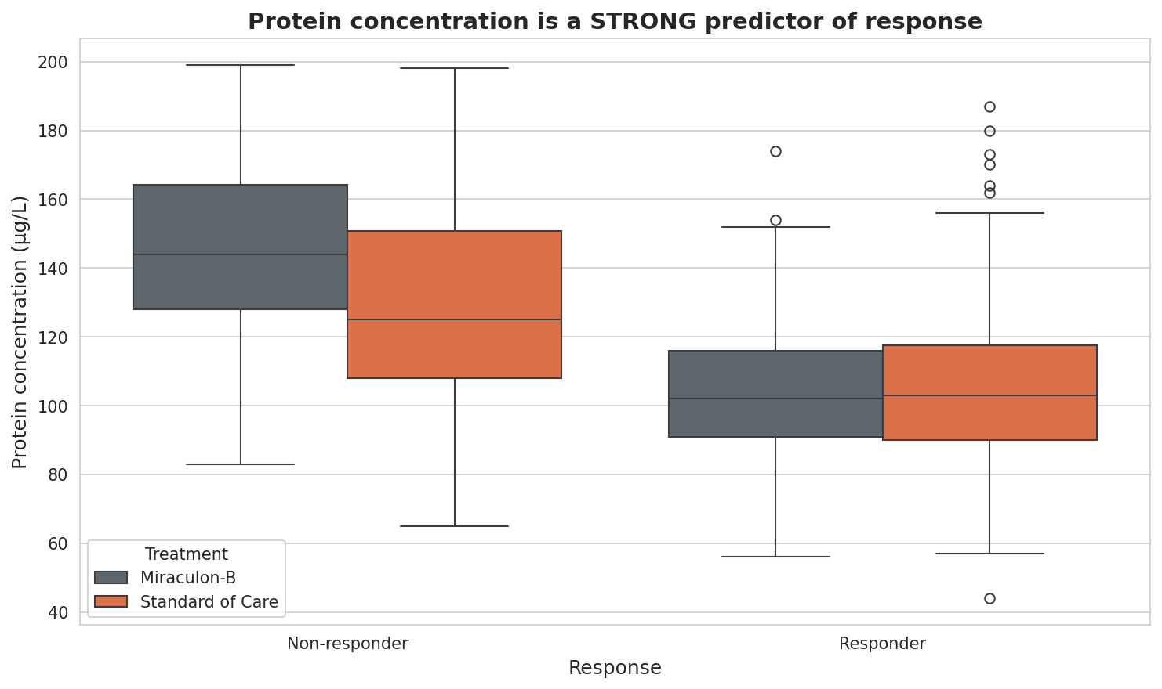
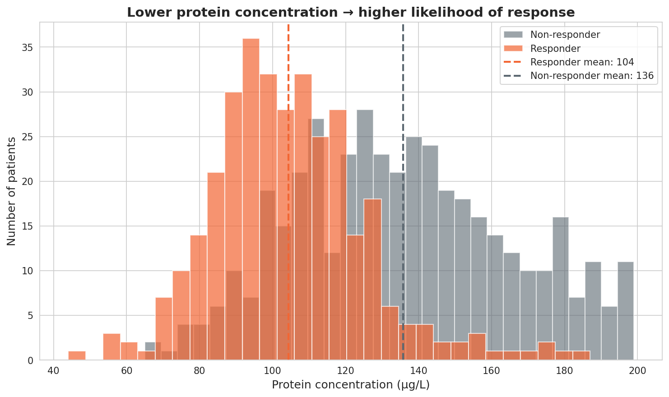
The biomarker: protein concentration
Lower baseline protein → much higher chance of responding
104 μg/L
136 μg/L
≈ 30%
p < 10⁻⁵⁰
mean in responders
mean in non-responders
lower in responders
two-sample t-test, t = -16.2
Miraculon-B Clinical Trial Analysis • GSK x DigData Step Up
6 / 11

Slide 7
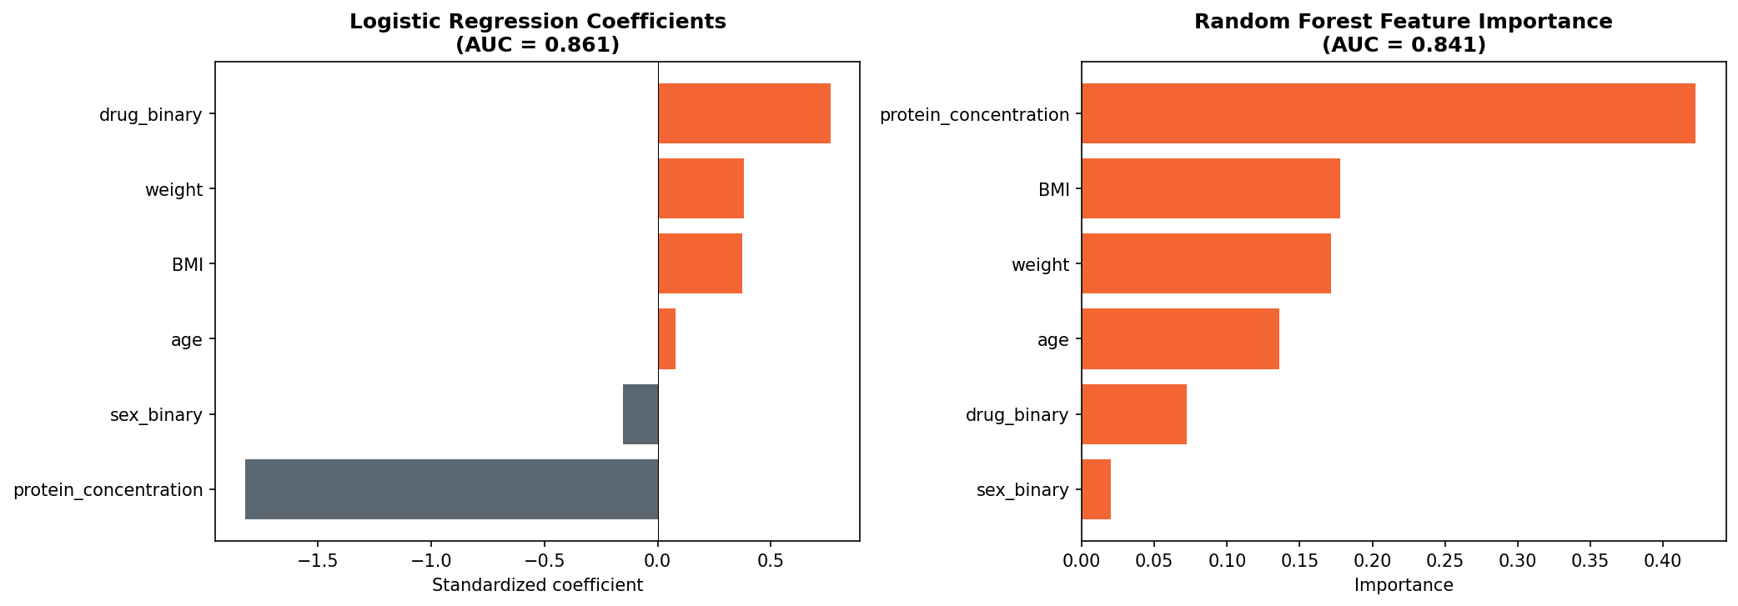
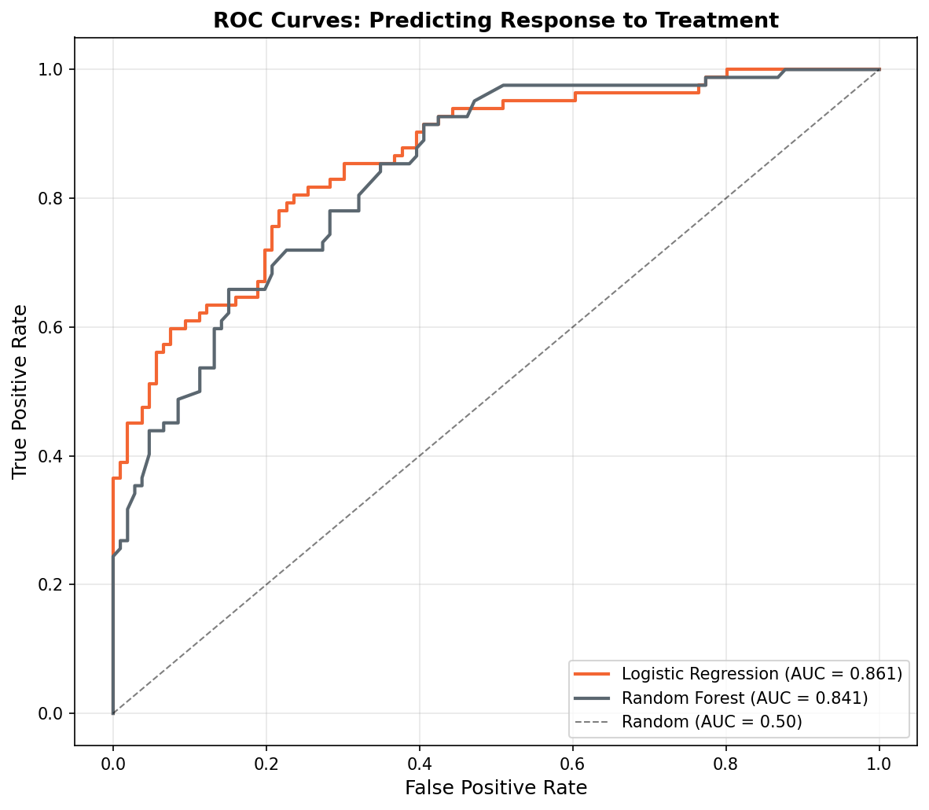
Predictive model: who will respond?
Logistic regression and random forest agree on what matters
0.86
#1
#2
AUC
Top feature
Second-strongest
5-fold CV: 0.861 ± 0.023 — strong discrimination
Protein concentration dominates both models
Treatment arm — Miraculon-B helps overall
Miraculon-B Clinical Trial Analysis • GSK x DigData Step Up
7 / 11

Slide 8
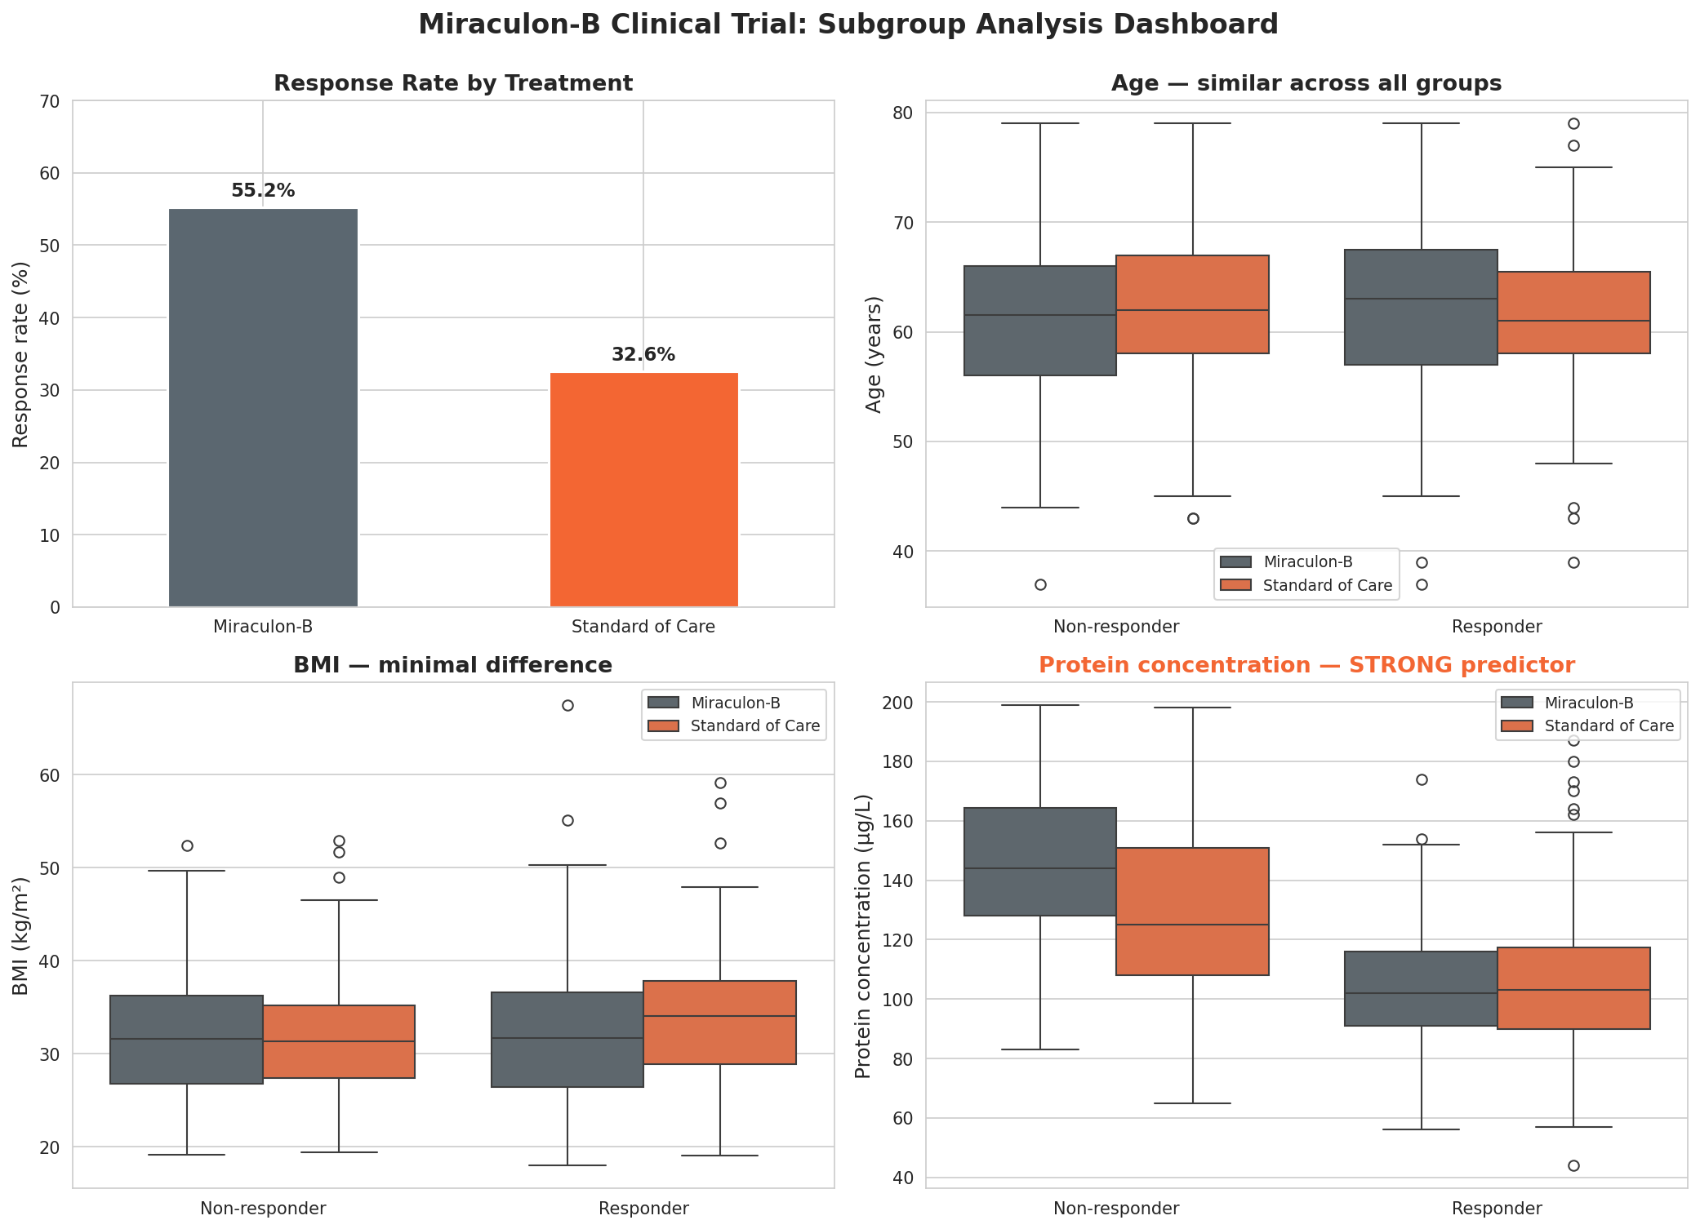
Putting it together
All four variables, all sub-groups — one panel
Miraculon-B Clinical Trial Analysis • GSK x DigData Step Up
8 / 11

Slide 9
What this means for prescribers
From a data answer to a clinical recommendation
EFFICACY
Miraculon-B works
Across the trial population, response rate of 55% comfortably beats 33% on standard of care. The 22-percentage-point gap is highly statistically significant (p < 10⁻⁹).
SUB-GROUP
Some patients benefit far more than others
A patient's baseline protein concentration explains most of the variation in response — far more than age, weight, BMI or sex. Patients with lower baseline protein are the strongest responders.
PRESCRIBING
Personalise on the biomarker
Combining treatment arm with protein concentration gives an AUC of 0.86. That is enough discriminative power to support a companion-diagnostic style prescribing aid.
Miraculon-B Clinical Trial Analysis • GSK x DigData Step Up
9 / 11

Slide 10
What we did not do — yet
Honest limitations and a path to a regulator-ready package
LIMITATIONS
NEXT STEPS
•
Synthetic data
01
Combine response + safety
This is a teaching dataset, not the real GSK trial — magnitude of effects may differ in production.
Rerun the analysis on the full taskB dataset (adds severe AE flag).
•
Adverse events excluded
02
Define a clinical cut-off
Path A focused on efficacy. The same protein is also linked to side effects (see Path B).
Pick a protein threshold that maximises net benefit, not just AUC.
•
No survival analysis
03
Build the prescriber tool
We measured tumour-shrinkage response only — not progression-free or overall survival.
Ship the model behind a simple UI (covered in Path B).
•
No external validation
04
External validation
Models trained and tested in one trial; would need replication in an independent cohort.
Validate on a held-out trial cohort before regulatory submission.
Miraculon-B Clinical Trial Analysis • GSK x DigData Step Up
10 / 11

Slide 11
In one sentence
Miraculon-B nearly doubles response rates vs. standard of care, and a single blood biomarker — protein concentration — predicts who will benefit with AUC = 0.86.
55% vs 33%
−30%
0.86
response rate
protein in responders
model AUC
Thank you
Questions welcome. · GSK x DigData Step Up Career Challenge

