Slide 1
MIRACULONRX
A prescriber's tool for
a precision medicine.
Designing a clinical decision support web app for Miraculon-B
Path B · Design Thinking & Prototype
GSK x DigData Step Up Career Challenge

Slide 2
The prescriber's dilemma
Miraculon-B works — but not for everyone
THE TENSION
100%
response rate
Miraculon-B nearly doubles tumour-shrinkage response — but raises the rate of severe side effects from 13% to 18%. A single blood biomarker — protein concentration — predicts both response AND adverse events: → Lower protein = more response, fewer side effects → Higher protein = little response, many side effects
in patients with protein < 80 ng/mL
+22pp
average response gain
Miraculon-B vs standard of care
40%
AE rate
in patients with protein > 140 ng/mL
MiraculonRx — Web App Design • GSK x DigData Step Up
2 / 9

Slide 3
Designed for the ten-minute consultation
Three things a doctor needs in the moment
USER
An oncologist seeing a new patient
Time-poor. Has the patient's bloods, weight, and history on screen. Needs to decide between Miraculon-B and standard of care today, then explain the choice.
JOB-TO-BE-DONE
Quantify benefit vs risk for THIS patient
Not a textbook average — the specific person in front of them. The protein concentration changes everything, and a generic label doesn't capture that.
PAIN POINT
The label gives an average, not a person
Drug labels report average outcomes from the trial population. They don't show how a particular protein level shifts the recommendation. Doctors fill that gap manually — error-prone and slow.
MiraculonRx — Web App Design • GSK x DigData Step Up
3 / 9

Slide 4
Five principles guided the design
Pulled from clinical UX research and the Phase-III trial findings
01
One headline answer
02
Show the comparison
A clear, colour-coded recommendation in the very first viewport: prescribe / consider / avoid.
Don't claim Miraculon-B is best — let the doctor see the side-by-side vs standard of care.
03
The biomarker is the hero
04
Numbers, not words alone
Protein concentration drives the model and gets the most prominent control: a coloured slider.
Predicted response %, AE %, and net benefit — all sourced from real trial subgroups.
05
Decision support, not autopilot
Tool augments judgement: language is 'recommended' not 'prescribed'. Ownership stays with the doctor.
MiraculonRx — Web App Design • GSK x DigData Step Up
4 / 9

Slide 5
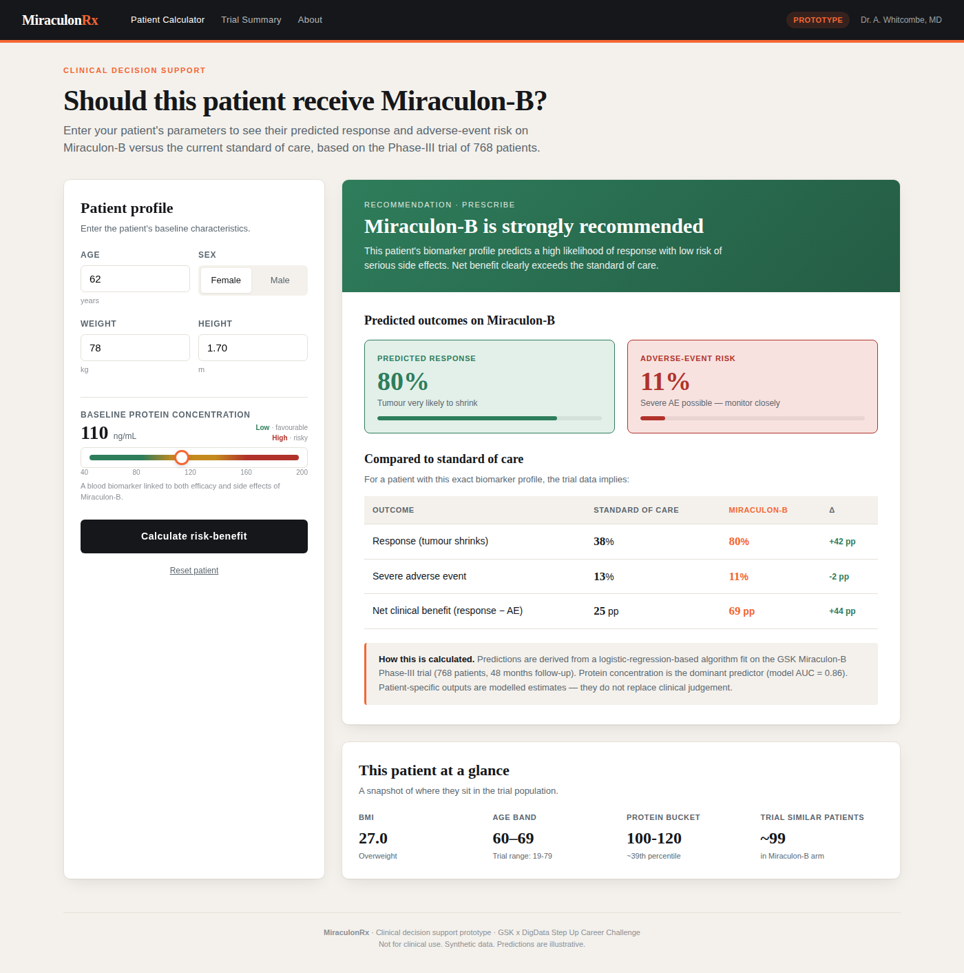
Screen 1 · Patient calculator
The doctor enters parameters, the verdict updates live
A
Patient input panel
Sticky on the left: age, sex, weight, height, plus the protein slider.
B
Verdict banner
Colour-coded headline: green = recommend, amber = consider, red = avoid.
C
Predicted outcomes
Two stat cards — green for benefit, red for risk — with progress bars.
D
Side-by-side compare
Drug vs. control across response, AE and net clinical benefit.
MiraculonRx — Web App Design • GSK x DigData Step Up
5 / 9

Slide 6
The verdict adapts to the patient
One slider, three very different recommendations
Protein = 75 ng/mL
Protein = 110 ng/mL
Protein = 165 ng/mL
PRESCRIBE
PRESCRIBE
AVOID
Strongly recommended
Strongly recommended
Not recommended
Response rate
Response rate
Response rate
100%
80%
7%
Adverse-event rate
Adverse-event rate
Adverse-event rate
0%
11%
40%
Net benefit: +100 pp
Net benefit: +69 pp
Net benefit: -33 pp
MiraculonRx — Web App Design • GSK x DigData Step Up
6 / 9

Slide 7
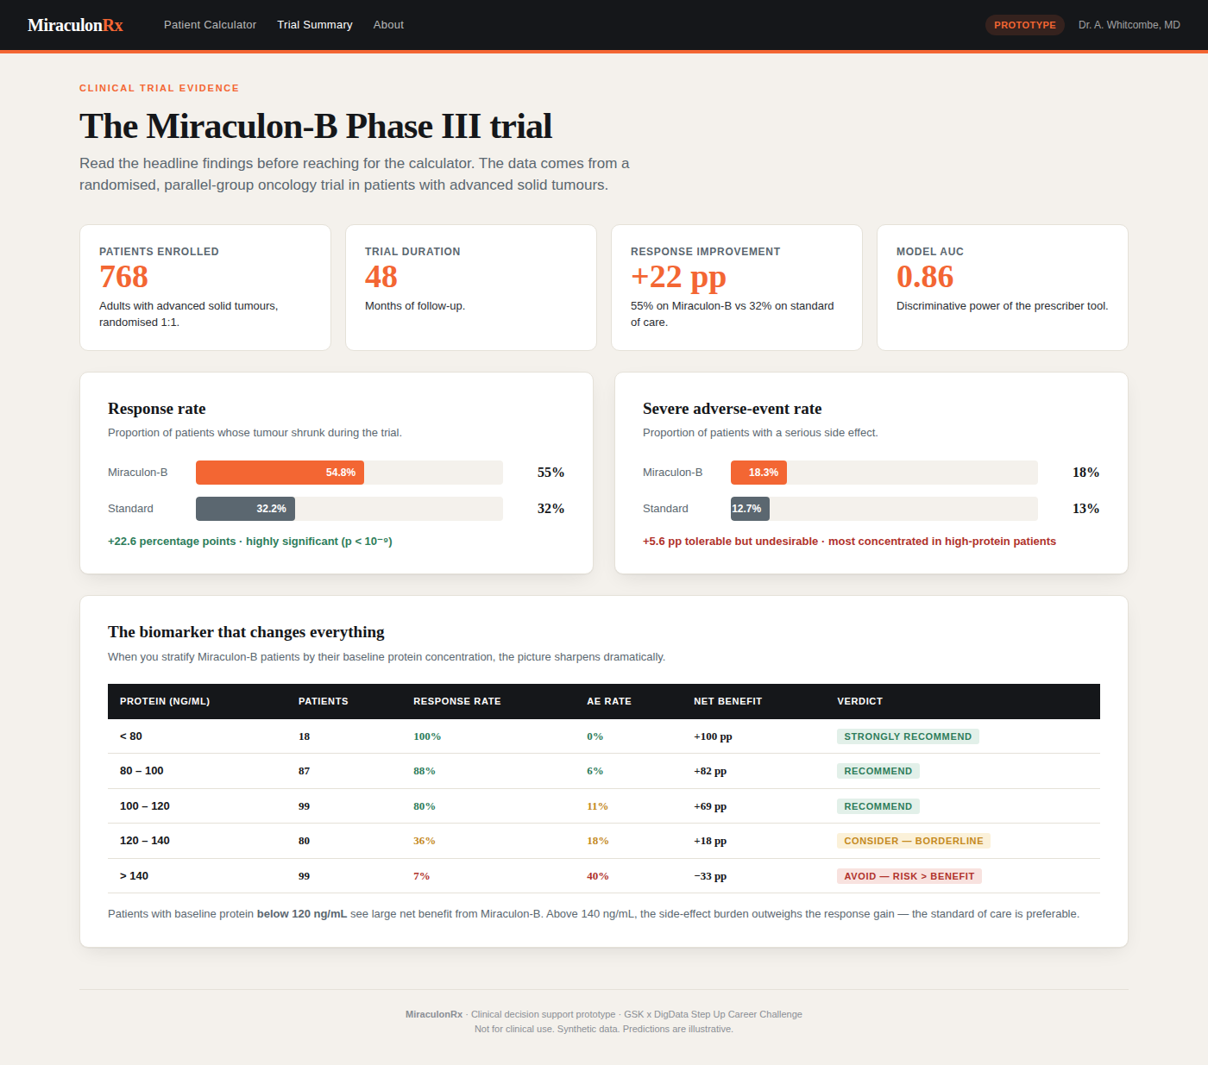
Screen 2 · Trial summary
Evidence behind every prediction — one click away
WHY THIS SCREEN MATTERS
Doctors should never trust a black-box recommendation. This screen exposes the trial behind the model: • Headline numbers — patients, duration, AUC • Bar charts for response & AE rates • The protein bucket table — the single most useful artifact for explaining the recommendation to a patient
MiraculonRx — Web App Design • GSK x DigData Step Up
7 / 9

Slide 8
Where this prototype is — and where it's going
Honest about scope, ambitious about the path
BUILT TODAY
NEXT ITERATIONS
✓
3-tab single-page web app
01
Replace bins with calibrated model
Calculator, Trial Summary, About — all working in plain HTML/CSS/JS.
Move from look-up tables to a real logistic regression.
✓
Live calculation
02
User research with oncologists
Verdict, predicted % and comparison table update on every input change.
Test the wireframe with 5-10 prescribers and iterate.
✓
Trial-derived numbers
03
Hospital EHR integration
Predictions come from binned subgroups in the actual Phase-III dataset.
Auto-pull patient parameters from electronic health records.
✓
Three colour-coded verdicts
04
Audit trail & save
Recommend (green) → consider (amber) → avoid (red), exposed via banner.
Every recommendation logged for clinical governance.
MiraculonRx — Web App Design • GSK x DigData Step Up
8 / 9

Slide 9
In one sentence
MiraculonRx puts the trial's predictive biomarker into the prescriber's hand — turning a one-size-fits-all label into a patient-specific recommendation in under five seconds.
3 tabs
<5s
768 pts
calculator · summary · about
to a colour-coded verdict
of trial evidence behind every screen
Thank you
Questions welcome. · Open MiraculonRx_prototype.html to see the live tool.

