Slide 1
BREAST CANCER
MANAGEMENT
Visual Study Deck — Triple Assessment, Stage-wise Algorithms, Adjuvant Therapy & Recurrence
Sources: Schwartz's Principles of Surgery • DeVita, Hellman & Rosenberg's Cancer • NCCN Breast Cancer Guidelines (JNCCN) • Ethiopian National Breast Cancer Guideline 2024–2028 (MoH)
Prepared for: Dr. Muluamlak — GSR-3 | EBS Unit
September 2026
Breast Cancer Management
September 2026

Slide 2
Table of Contents
I
Foundations & Benign Disease
II
Risk, Genetics & Pathology
History • anatomy • axilla • physiology • gynecomastia • infections • ANDI • benign lesions
Risk factors & models • screening • chemoprevention • BRCA • global & Ethiopian epidemiology • early detection • in situ & invasive types
III
Diagnosis & Staging
IV
Management by Stage
Triple assessment • Ethiopian 60-day pathway • imaging • biopsy • nipple discharge • TNM • work-up • biomarkers • gene assays
Master map & MoH 60:60:80 roadmap • LCIS • DCIS • stage I–II • axilla • stage III • inflammatory • stage IV • recurrence • summary
V
Surgery & Adjuvant Therapy
VI
Special Situations & Review
Indications per operation • techniques • reconstruction • radiotherapy • chemotherapy • endocrine • anti-HER2
Pregnancy • male • phyllodes • rare cancers • prognosis • pitfalls & rapid recall
Breast Cancer Management
September 2026

Slide 3
The Ten Key Points at a Glance
Ethiopia: Leading cancer (16,133 cases, 2020); 65–75% present at stage III–IV → MoH 60:60:80 targets: early stage • 60-day diagnosis • treatment completion
Lymph drainage: >75% → axillary nodes; remainder (mainly medial breast) → internal mammary (parasternal) nodes
1
2
Trophic hormones: Estrogen (ducts), progesterone (lobules), prolactin (lactogenesis) are essential
Benign disease: ANDI spectrum: normal → disorder → disease, tracking reproductive life and involution
3
4
Risk models: Gail: 5-y + lifetime risk vs population — NOT for BRCA carriers or LCIS/DCIS
Screening: Mammography ≥50 y → −25% mortality; MRI for BRCA carriers / lifetime risk >20–25%
5
6
Diagnosis: Core-needle biopsy is preferred — palpable or non-palpable
Before local therapy: Know clinical stage + histology + biomarkers (ER, PR, HER2)
7
8
Axilla: SLNB for cN0; ALND avoidable with 1–2 +SLNs + BCS + whole-breast RT + systemic therapy
Multidisciplinary: MDT decides local-regional and systemic therapy; sequence by patient, tumour and subtype
9
10
Breast Cancer Management
September 2026

Slide 4
S E C T I O N
01
01
Foundations & Benign Disease
History • anatomy & axilla • physiology • gynecomastia • infections • ANDI • benign lesions
Foundations & Benign Disease
September 2026

Slide 5
History of Therapy — From Halsted to Biology
Halsted & Meyer: radical mastectomy
Haagensen & Stout: "grave signs"
NSABP B-04: radical vs total mastectomy
WHI: HRT raises breast cancer risk
Tomosynthesis (3D) approved
Surgical Evolution
Halsted & Meyer (1894): radical mastectomy + ALND I–III → superior local control, became standard
Grave signs (1943): skin oedema, ulceration, chest-wall fixation, node >2.5 cm, fixed nodes → ≥2 signs = 42% local recurrence, 2% 5-y DFS → beyond cure by surgery
Patey & Dyson (1948): MRM keeps pectoralis major; replaced Halsted in 1970s (no gain from removing it in stage I–II; stage III needed RT)
Fisher: cancer is systemic at diagnosis — nodes are a marker, not a barrier
1894
1943
1971
2002
2011
1937
1948
1991
2006
Keynes: breast conservation + radium
Patey & Dyson: modified radical mastectomy
Giuliano: blue-dye SLN
Trastuzumab approved (adjuvant)
Trial / evidence | Design | Key result
NSABP B-04 (n = 1,665) | cN0: Halsted vs total mastectomy ± RT; cN+: Halsted vs total mastectomy + RT | No survival difference in any arm — still equal at 25 years
NSABP B-06 (n = 1,851) | Total mastectomy vs lumpectomy vs lumpectomy + RT | Same DFS, distant DFS, OS; lumpectomy alone → far more in-breast recurrence
EBCTCG overviews | Meta-analyses of local and systemic therapy | Avoid 4 local recurrences → prevent ~1 breast-cancer death (15 y). Anthracycline > CMF; taxane ↓ mortality by ⅓; tamoxifen ↓ mortality up to 30% (ER+ only)
Biology era | IHC (1980s) → gene arrays | ≥5 intrinsic subtypes; proportional benefit constant → treat by absolute risk
Note: B-06 caveats — palpable axillary nodes excluded; positive frozen-section margins converted to mastectomy yet analysed as BCS; in-breast recurrences were non-events for DFS. Perspective: 50% of women see a surgeon for breast disease, 25% are biopsied, 12% develop cancer.
Foundations & Benign Disease
September 2026

Slide 6
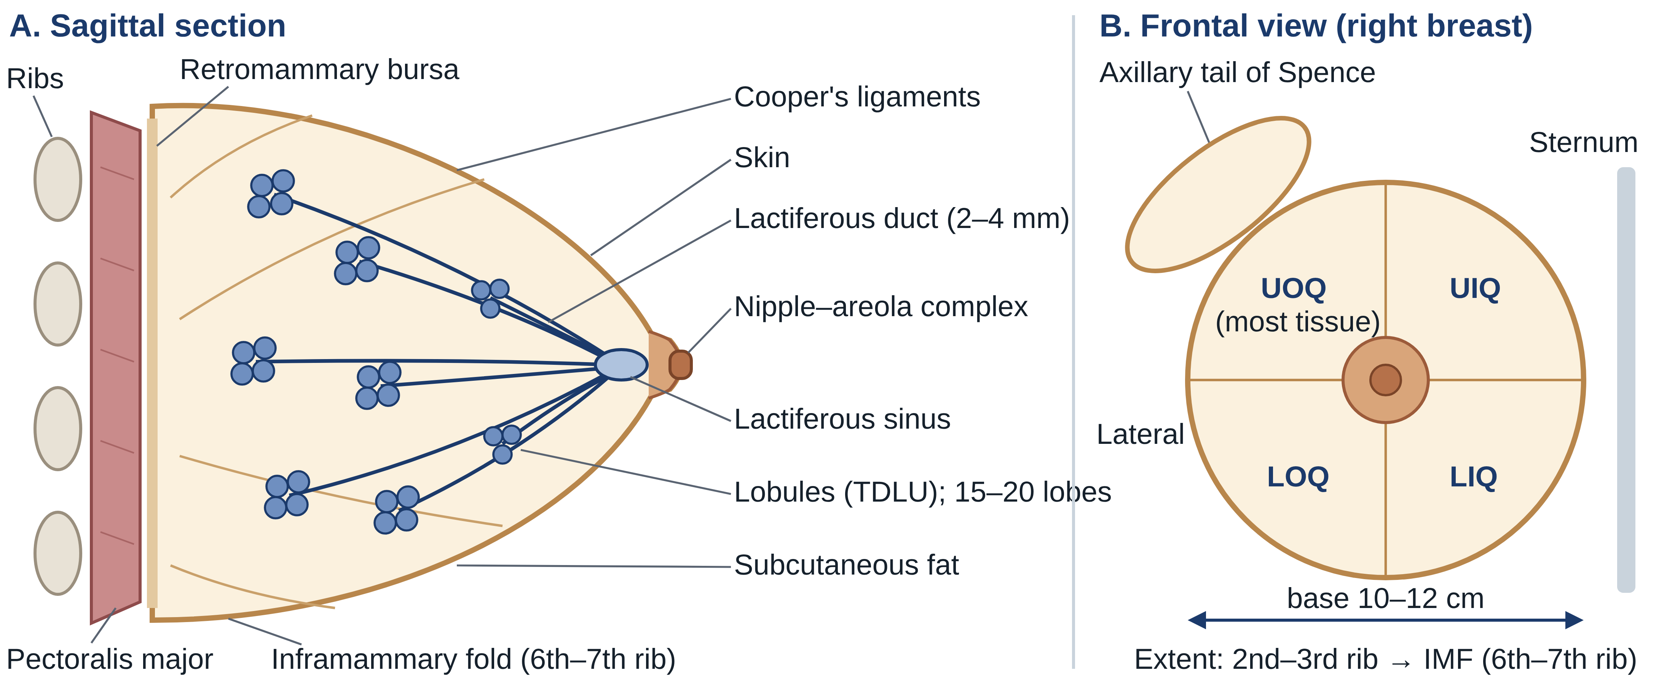
Embryology & Gross Anatomy
Gross Anatomy & Nipple–Areola Complex
15–20 lobes; Cooper's ligaments insert perpendicularly into dermis
Extent: 2nd/3rd rib → IMF (6th/7th rib); sternal edge → anterior axillary line; base 10–12 cm
Lies on pectoralis major, serratus, ext. oblique, rectus sheath; retromammary bursa behind
Axillary tail of Spence; UOQ has most tissue
Duct 2–4 mm (orifice 0.4–0.7 mm) → lactiferous sinus (squamous); Montgomery tubercles; smooth muscle → erection
Anomaly | What it is | Key note
Inverted nipple | Mammary pit fails to elevate | 4% of infants; congenital
Amastia | Absent breast — ridge arrest in 6th fetal week | Rare
Poland's syndrome | Hypoplasia/absence of breast + costal cartilage/rib defects + chest-wall subcutaneous hypoplasia + brachysyndactyly | Hypoplasia can also be iatrogenic (trauma, infection, RT before puberty)
Symmastia | Webbing across the midline | Rare
Polythelia | Accessory nipple on the milk line | <1% of infants; may accompany urinary/cardiovascular anomalies
Polymastia | Supernumerary breast on the milk line | Commonest nipple → pubis; Turner/Fleischer syndromes; axillary tissue usually bilateral
Milk lines appear at 5–6 weeks (axilla → groin) and mostly regress; breasts identical at birth ("witch's milk"); female breast completes only in pregnancy.
Foundations & Benign Disease
September 2026

Slide 7
Blood Supply, Nerves & Lymphatic Drainage
System | Key facts
Arteries | Internal mammary perforators (2nd–4th = medial mammary arteries); lateral branches of posterior intercostals; axillary branches — highest thoracic, lateral thoracic (lateral mammary branches), pectoral branch of thoracoacromial
Veins | Follow arteries toward axilla: internal thoracic perforators, posterior intercostals, axillary tributaries. Batson's vertebral plexus → vertebrae, skull, pelvis, CNS metastases
Sensory nerves | Lateral cutaneous branches of intercostals 3–6; supraclavicular nerve (upper skin). Intercostobrachial n. (T2) cut in ALND → medial upper-arm numbness
Lymphatics | Interlobular + ductal plexus → subareolar plexus → round lateral pectoralis major, through clavipectoral fascia → external mammary nodes (some direct to subscapular/apical)
Why it matters
Breast state | Histology / function
Inactive | Sparse, mostly ductal epithelium in loose stroma; dense tissue around TDLUs; alveolar height rises at ovulation then regresses
Pregnancy | Minor ducts branch, alveoli develop; lymphocytes, plasma cells, eosinophils gather in stroma
Lactation | Alveolar cells rich in ER, mitochondria, Golgi: protein by merocrine, lipid by apocrine secretion; colostrum (low fat, antibody-rich) → lipid-rich milk
Medial tumours may drain to internal mammary nodes
Spread is usually sequential: level I → II → III
Veins explain lung (axillary/intercostal) and spine (Batson) metastases
Foundations & Benign Disease
September 2026

Slide 8
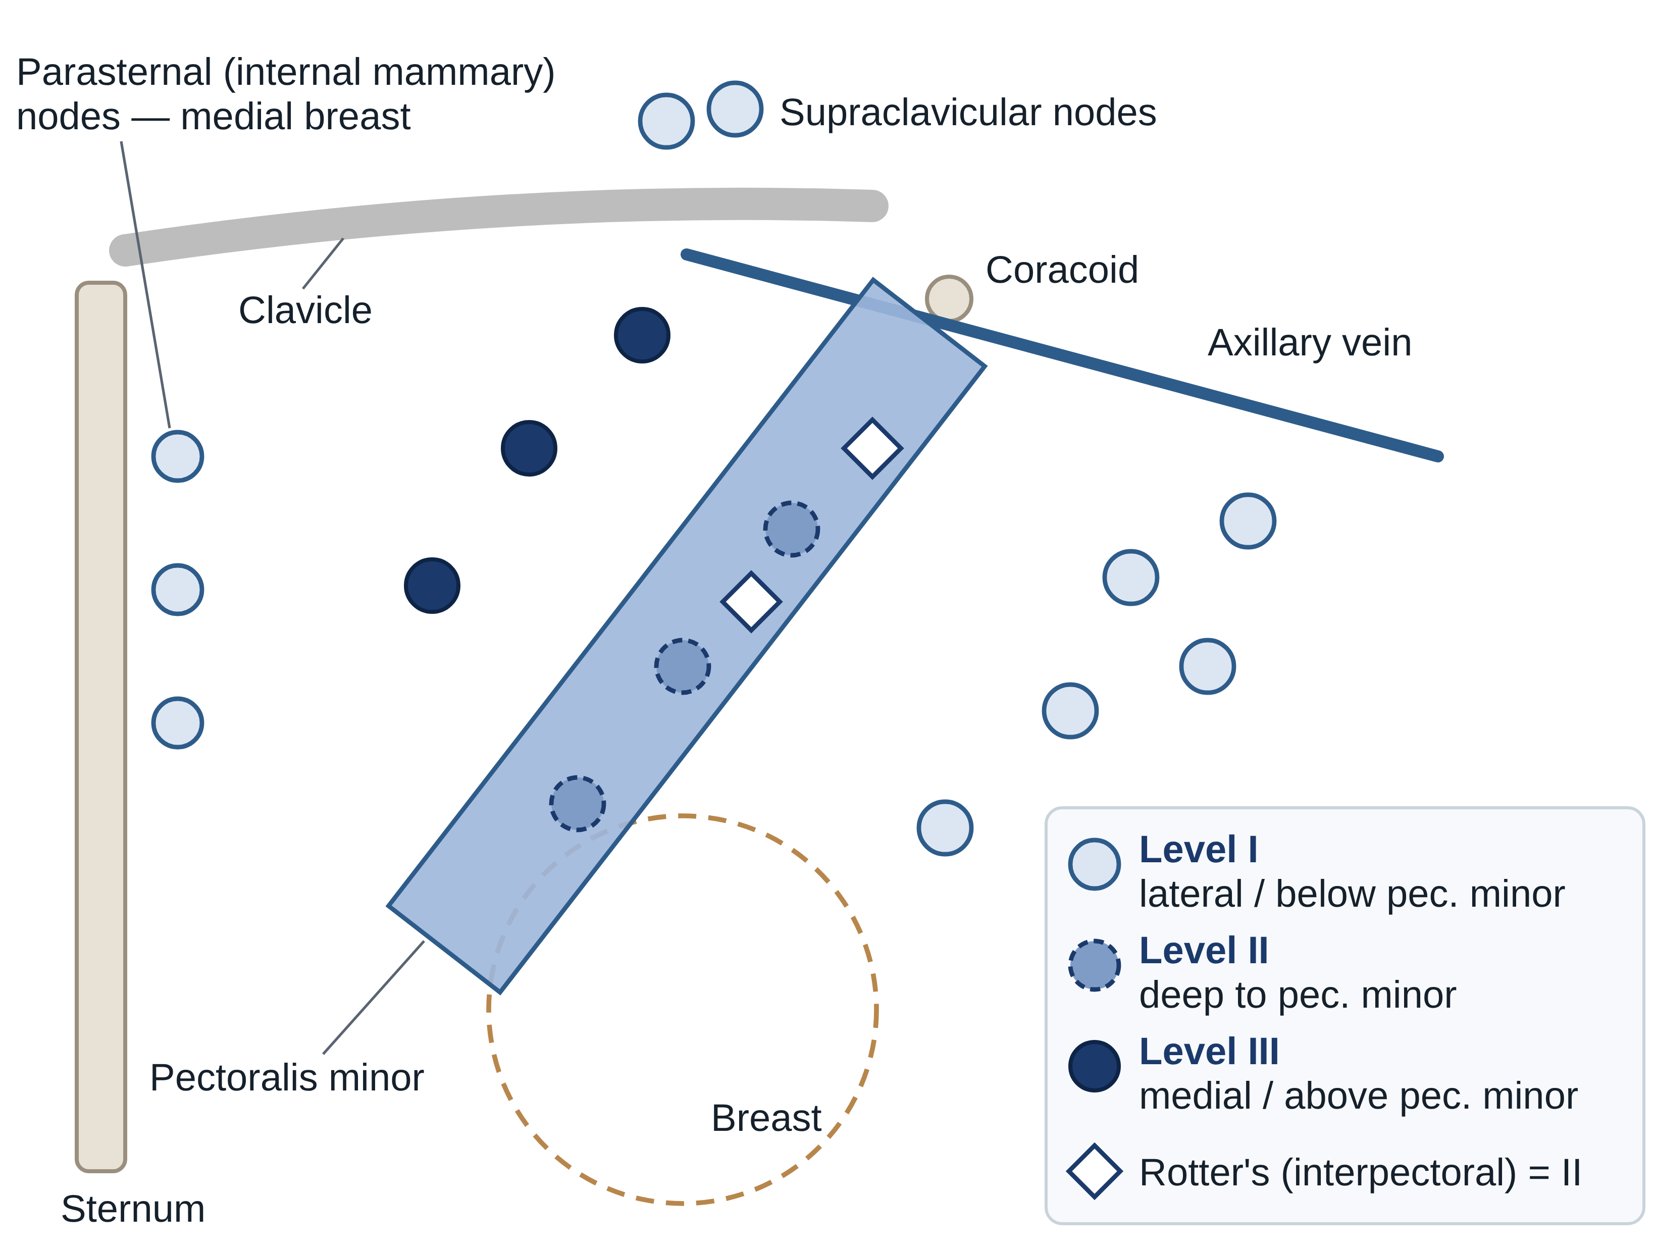
Axillary Lymph Node Groups → Surgical Levels
Group (n) | Position | Drains | Lvl
Axillary vein (4–6) | Medial/posterior to vein | Most of upper limb | I
External mammary (5–6) | Lower border pec. minor, with lateral thoracic vessels | Lateral breast (most) | I
Scapular (5–7) | Posterior wall, lateral scapular border | Posterior neck, trunk, shoulder | I
Central (3–4) | In fat behind pec. minor | Three groups above + breast | II
Interpectoral / Rotter's (1–4) | Between pec. major & minor | Breast direct → central, subclavicular | II
Subclavicular / apical (6–12) | Above upper border of pec. minor | All other groups | III
Note: Level I = lateral/below the lower border of pectoralis minor; Level II = deep to it; Level III = medial/above its upper border. Metastasis is usually sequential I → II → III. Clinical examination of the axilla is only ~33% accurate — stage the axilla surgically or by imaging-guided biopsy.
Foundations & Benign Disease
September 2026

Slide 9
Physiology of the Breast & Gynecomastia
Hypothalamus → GnRH (and other releasing factors)
Gynecomastia — Physiological Peaks
Neonatal (placental estrogen) • Adolescent 12–15 y, often unilateral • Senescent 50–70 y, often bilateral
Needs ≥2 cm tissue in non-obese man; mammography/US separate it from cancer — dominant, irregular or asymmetric mass → suspect cancer
Not itself a cancer risk — but Klinefelter (XXY) is
Anterior pituitary
LH + FSH
Anterior pituitary
Prolactin
Posterior pituitary
Oxytocin
Ovary → estrogen (ductal development) + progesterone (lobular development, differentiation)
Lactogenesis (late pregnancy, postpartum); epithelial development
Milk let-down: myoepithelial contraction expels milk into sinuses
Grade | I | IIa | IIb | III
Size / skin | Mild, no redundancy | Moderate, no redundancy | Moderate + redundancy | Marked + redundancy + ptosis
E/P feed back on hypothalamus–pituitary; suckling → nipple nerves → prolactin + oxytocin release
Cause | Examples
Estrogen excess | Testicular (Leydig, Sertoli, germ-cell), adrenal, lung, HCC; thyroid; cirrhosis; re-feeding
Androgen deficiency | Senescence; Klinefelter, Kallmann, Reifenstein; orchitis, trauma, RT; renal failure
Drugs | Digitalis, estrogens, steroids, marijuana, hCG; cimetidine, ketoconazole, phenytoin, spironolactone, chemo; tricyclics, verapamil…
Stage | Changes
Pregnancy | Ductal + lobular proliferation; T1–2 ducts branch; T3 colostrum; prolactin drives milk synthesis
Lactation | E/P fall at delivery → prolactin acts; nipple reflex; oxytocin expels milk; weaning → atrophy
Menopause | Involution of ducts/alveoli; fibrous stroma → fat
Management
Treat cause (testosterone, stop drug) → progressive/unresponsive: excision, liposuction or subcutaneous mastectomy; danazol works but androgenic
Foundations & Benign Disease
September 2026

Slide 10
Infectious & Inflammatory Disorders
Condition | Key features | Treatment
Staphylococcal abscess | S. aureus; point tenderness, erythema, heat; lactational in first weeks; may be deep | Antibiotics + repeated US-guided aspiration; drain if fails / thin necrotic skin; biopsy wall if non-resolving; chronic → culture AFB, anaerobes, fungi
Streptococcal | Diffuse, superficial | Warm compresses, IV penicillin/cephalosporin
Puerperal — epidemic | MRSA spread by suckling neonate; purulent discharge | Stop breastfeeding, antibiotics, surgery as needed
Puerperal — sporadic | Nipple fissure + milk stasis → retrograde infection | Empty breast (pump) + antibiotics → >95% success
Zuska's disease | Recurrent retro-areolar abscess; smoking | Antibiotics + drainage; terminal duct resection can cure
Fungal | Blastomycosis, sporotrichosis near NAC; Candida in folds | Antifungals; Candida: remove maceration + nystatin
Hidradenitis suppurativa | Montgomery/axillary sebaceous glands; mimics Paget's/cancer | Antibiotics + I&D; excision ± flaps/grafts if extensive
Mondor's disease | Thrombophlebitis of lateral thoracic / thoracoepigastric vein: tender cord; benign | NSAIDs + warm compresses (4–6 wk); biopsy if doubt; excise if refractory
Pitfalls: A non-resolving or recurrent "abscess" may be cancer — biopsy the wall. Postpartum remains the commonest time for breast infection; non-lactational infection is intrinsic (periductal mastitis) or extrinsic (infected sebaceous cyst).
Foundations & Benign Disease
September 2026

Slide 11
ANDI — Aberrations of Normal Development & Involution
Period | Normal | Disorder | Disease
Early reproductive (15–25 y) | Lobular & stromal development; nipple eversion | Fibroadenoma; adolescent hypertrophy; nipple inversion | Giant fibroadenoma; gigantomastia; subareolar abscess; duct fistula
Later reproductive (25–40 y) | Cyclical change; pregnancy hyperplasia | Cyclical mastalgia; nodularity; bloody discharge | Incapacitating mastalgia
Involution (35–55 y) | Lobular & duct involution; epithelial turnover | Macrocysts; sclerosing lesions; duct ectasia; nipple retraction; hyperplasia | Periductal mastitis; epithelial hyperplasia with atypia
Fibroadenoma — size defines the category
Normal ≤1 cm
Disorder 1–3 cm
Disease >3 cm (giant) or >5 lesions/breast
Principles
Mastalgia & Discharge
Involution
Benign conditions follow reproductive life & involution
Spectrum: normal → disorder → disease
Covers pathogenesis + degree of abnormality
Premenstrual pain/nodularity = normal; >1 week of cycle = disorder
Bilateral bloody discharge may come from pregnancy epithelium
Fibroadenoma age 15–25; screening now finds them in older women
Stroma involutes too fast → micro → macrocysts (common, no treatment)
Periductal fibrosis → nipple retraction
~60% of women ≥70 y show some hyperplasia
Foundations & Benign Disease
September 2026

Slide 12
Benign Breast Disease — Histology Decides Cancer Risk
Page classification of benign lesions
NONPROLIFERATIVE (70%)
Cysts, apocrine metaplasia, duct ectasia, mild hyperplasia, calcifications, fibroadenoma
PROLIFERATIVE, NO ATYPIA
Sclerosing adenosis, radial scar/CSL, florid ductal hyperplasia, intraductal papilloma
ATYPICAL PROLIFERATIVE
ADH, ALH (low-grade DCIS / LCIS look-alikes)
No increased risk
Florid hyperplasia 1.5–2×
≈4× → counsel on risk reduction
ADH vs DCIS: ≤2–3 mm = ADH; >3 mm = DCIS. E-cadherin is lost in lobular neoplasia, kept in most ductal lesions.
Foundations & Benign Disease
September 2026

Slide 13
Benign Lesions — Features & What To Do
Lesion | Defining features | Action / risk
Cysts | Involutional, often multiple | Simple: rarely concerning; complex may hide cancer
Duct ectasia / periductal mastitis | Dilated subareolar ducts, thick discharge; stasis → irritant leakage → inflammation → fibrosis → retraction | Spectrum: discharge, retraction, mass, abscess
Calcifications | Mostly benign (secretions, debris, trauma) | Suspicious: <0.5 mm, varied shape/density, fine linear branching
Fibroadenoma / adenoma | FA: abundant stroma, hormone-dependent; adenoma: sparse stroma (tubular, lactating); hamartoma 2–4 cm | Benign; see treatment
Sclerosing adenosis | Distorted lobules ± mass; mimics cancer on exam, imaging, gross | Observe only if imaging–pathology concordant; else excise
Radial scar / complex sclerosing lesion | ≤1 cm vs >1 cm; spiculated, cancer-like | "Benign" core = discordant → vacuum-assisted or open excision
Ductal hyperplasia | Mild 3–4 layers; moderate ≥5; florid fills ≥70% of lumen | Florid: risk 1.5–2×
Intraductal papilloma | Major ducts, usually <0.5 cm; serous/bloody discharge | No added risk unless atypia; multiple papillomas can transform
ADH | Resembles low-grade DCIS; ≤2–3 mm | Often excise after core; risk 4× → risk-reduction counselling
ALH / LCIS | Lobular units distended by monomorphic cells; E-cadherin lost | Risk marker — see LCIS algorithm
"Fibrocystic disease" is a non-specific label — name the actual histology.
Foundations & Benign Disease
September 2026

Slide 14
Treating Common Benign Problems
Problem | Approach
Cyst | 21-G needle + 10 mL syringe (image first; most US-guided). Non-bloody → aspirate to dryness, discard, re-palpate. Bloody → cytology. Residual mass / mass on US → core biopsy
Fibroadenoma | US + core biopsy (may skip biopsy <25 y). Excision, cryoablation, vacuum excision (<3 cm) or observe; >2 cm often stay palpable
Sclerosing lesions | Excision or large-volume (stereotactic/vacuum) sampling to exclude cancer
Periductal mastitis / subareolar abscess | Aspirate (21-G), culture incl. anaerobes, polymicrobial antibiotics, repeat US aspiration; young → simple drainage
Nipple inversion | Short ducts → complete duct division; warn: altered sensation, necrosis, re-retraction
Fistulectomy | Total duct excision
Small abscess, one segment | Abscess >50% of areola
Recurrence same segment | Recurrence different segment
Mild/no inversion | Marked inversion / wants correction
Younger; no other discharge; no prior fistulectomy | Older; purulent discharge other ducts; recurrence after fistulectomy
Rule of thumb
Localized sepsis → fistulectomy at any age
Diffuse sepsis or >1 fistula → total duct excision
Give 2–4 weeks of antibiotics before total duct excision
Foundations & Benign Disease
September 2026

Slide 15
S E C T I O N
02
02
Risk, Genetics & Pathology
Risk factors & models • screening • chemoprevention • BRCA • epidemiology • natural history • histopathology
Risk, Genetics & Pathology
September 2026

Slide 16
Risk Factors & Hormone Replacement Therapy
Type | Factors | Mechanism
Hormonal ↑ | Early menarche, nulliparity, late menopause, late first birth, obesity | More cycles = more estrogen; term pregnancy differentiates; post-menopause fat aromatises androstenedione → estrone
Hormonal ↓ | Moderate exercise, longer lactation | Fewer cycles
Radiation | Mantle RT for Hodgkin (75×), atomic-bomb survivors | Worst during adolescence
Lifestyle | Alcohol (dose-related), long-term high-fat diet | ↑ estradiol / serum estrogen
HRT | WHI: 3–4× after >4 y combined; E + P ↑ 26% vs placebo | Risk in current users, rises with duration, not past users; falling HRT use → falling incidence
Remember: Baseline US lifetime risk: 12% at birth, 11% at 50 y, 7% at 70 y — the longer you live cancer-free, the lower the remaining risk. HRT gave no significant coronary or cerebrovascular protection; estrogen + progesterone is worse than other regimens.
Risk, Genetics & Pathology
September 2026

Slide 17
Risk Assessment Models
Model | Inputs | Output / limits
Gail (BCDDP) | Age, menarche, age at 1st birth, biopsies, atypia, 1st-degree relatives | 5-y & lifetime risk; adapted for African American, Asian/Pacific; excludes BRCA; not for LCIS/DCIS
Claus | 1st/2nd-degree relatives + ages | Risk by decade; ignores other factors
BRCAPRO | Detailed breast/ovarian family history | Mutation probability → age-specific risk; laborious
Tyrer–Cuzick | Family history + menarche, parity, menopause, atypia/LCIS, height, BMI | Mutation probability adjusted for personal factors
Manchester, BOADICEA | Family history | Carrier probability → genetic referral
Gail relative risk | Value
Menarche ≥14 / 12–13 / <12 | 1.00 / 1.10 / 1.21
Biopsies <50 y: 0 / 1 / ≥2 | 1.00 / 1.70 / 2.88
Biopsies ≥50 y: 0 / 1 / ≥2 | 1.02 / 1.27 / 1.62
1st birth <20 y (0/1/≥2 rel.) | 1.00 / 2.61 / 6.80
1st birth 20–24 y | 1.24 / 2.68 / 5.78
1st birth 25–29 y | 1.55 / 2.76 / 4.91
1st birth ≥30 y | 1.93 / 2.83 / 4.17
Decisions that depend on estimated risk
HRT use • age to start mammography / add MRI • tamoxifen chemoprevention • prophylactic mastectomy — communicate risk against competing risks and comorbidity
Risk, Genetics & Pathology
September 2026

Slide 18
Screening — Who, When & With What
Body | Average-risk recommendation
USPSTF | Biennial mammography 50–74 y
ACS (2015) | Annual 45–54 (option 40–44); ≥55 biennial or annual while life expectancy ≥10 y; no routine CBE
NCCN (as cited) | Annual mammography ≥40 y + annual CBE + breast awareness; CBE ≥3-yearly from 20
All agree "high risk" | Prior breast cancer, chest RT at young age, known/suspected pathogenic mutation
Ethiopia MoH (no population mammography) | Breast awareness + monthly BSE >20 y • annual CBE by trained provider ≥30 y • diagnostic US/mammography >40 y every 2 y • high risk: imaging earlier, annually
MRI screening (ACS)
Lifetime risk ≥20–25% (family-history models)
BRCA carrier or untested 1st-degree relative of carrier
Chest RT between ages 10–30
Li-Fraumeni, Cowden, Bannayan-Riley-Ruvalcaba (or 1st-degree relative)
Very sensitive, density-independent; moderate specificity → more biopsies
Benefit vs harm
Why <50 y is debated
≥50 y: −25% mortality (HIP/BCDDP 33%)
Overdiagnosis ~11% vs ~20% mortality reduction → screening continues
Denser breasts → ↓ sensitivity
More false positives; lower incidence
Family history → abnormal mammogram 3× likelier cancer at 40–49
Density
Density independently predicts risk
Ultrasound can supplement dense breasts — no proven mortality benefit
Risk, Genetics & Pathology
September 2026

Slide 19
Chemoprevention & Risk-Reducing Surgery
Tamoxifen (SERM) — first proven preventive drug
P-1 (>13,000; Gail ≥1.66% or LCIS): −49% invasive cancer — ER+ only; no mortality effect shown
Indication: Gail 5-y risk ≥1.66% age 35–59 (and older), or LCIS / ADH / ALH
Harms: DVT ×1.6, PE ×3.0, endometrial cancer ×2.5, cataract ~2×, hot flashes
Alternatives after menopause
Risk-reducing surgery
Raloxifene (STAR, n = 19,747): 76% of tamoxifen efficacy, fewer adverse events, less endometrial cancer; does NOT reduce LCIS/DCIS
Aromatase inhibitors: MAP.3 −65%; IBIS-II ~−50%; arthralgia, hot flashes
ASCO: tamoxifen pre/post-menopause; raloxifene or exemestane post-menopause
Prophylactic mastectomy: >90% risk reduction (retrospective); poor QoL data; some regret cosmetic results
BRCA carriers: ~3 years of life gained; highly effective in BRCA1 and 2
Salpingo-oophorectomy ↓ ovarian + breast cancer and breast/ovarian/all-cause mortality
Survival benefit unproven in non-carriers
Risk, Genetics & Pathology
September 2026

Slide 20
Hereditary Breast Cancer — BRCA1 vs BRCA2 & Other Genes
Feature | BRCA1 | BRCA2
Gene | 17q; 22 exons; >500 variants | 13q; 26 exons; >250 mutations
Share of hereditary BC | 45% (≥80% of hereditary ovarian) | 35%
Lifetime breast risk | Up to 85%; average 60–70% | Close to 85%
Lifetime ovarian risk | Up to 40% | ~20%
Tumour type | Poorly differentiated, mostly triple-negative/basal, medullary; ~66% of DCIS ER− | Better differentiated, HR+ more often
Other cancers | Ovary; possibly colon, prostate | Ovary, colon, prostate, pancreas, biliary, stomach, melanoma; male BC 6%
Founder mutations | 185delAG, 5382insC (Ashkenazi) | 6174delT (Ashkenazi); 999del5 (Iceland)
Gene | Associated
PALB2 | BC 33–58% by 70 y (≈BRCA2); mammogram + MRI from 30; consider RRM
PTEN (Cowden) | Thyroid, GI cancers, skin nodules
TP53 (Li-Fraumeni) | Sarcoma, lymphoma, adrenocortical
CDH1 | Diffuse gastric + lobular BC
STK11, MLH1/MSH2, ATM | Panel testing — use a genetic counsellor
Note: Up to 5% of breast cancers are BRCA-driven: autosomal dominant, variable penetrance, tumour-suppressor genes needing loss of both alleles (DNA repair, transcription, cell-cycle control). Sporadic 65–75%, familial 20–30%, hereditary 5–10%.
Risk, Genetics & Pathology
September 2026

Slide 21
Genetic Testing Pathway & Managing BRCA Carriers
Suspect hereditary risk: Ashkenazi ancestry • 1st-degree relative <50 y • ovarian cancer (any age) • breast + ovarian in one person • ≥2 affected relatives • bilateral BC • male BC in family
Four risk-management strategies for carriers
1. Surveillance
CBE every 6 mo + mammogram yearly from 25 y; annual MRI (young dense breasts)
Counselling → test an affected relative first (Ashkenazi: 3 founder mutations first) → relatives tested for that mutation only
2. Chemoprevention
Tamoxifen −62% in BRCA2; no benefit in BRCA1 started ≥35 y — not uniformly advised
POSITIVE
Carrier strategies →
NEGATIVE
False-negative <5%; phenocopy if affected ≥60 y
INDETERMINATE
~12% (missense variants)
3. Risk-reducing mastectomy
>90% reduction; some tissue + the germline defect remain
Lower the testing threshold in high-prevalence ethnic groups. US HIPAA (1996) bars treating genetic information as a pre-existing condition.
4. Salpingo-oophorectomy
Pitfalls: Do not use Gail in carriers • avoid HRT if breasts retained (no data) • a negative test in an unaffected person is uninformative unless the family mutation is known.
At 35–40 y after childbearing (ovarian risk 20–40%); ↓ ovarian + breast cancer & mortality. Deferred → yearly TVUS + CA-125 from 25
Risk, Genetics & Pathology
September 2026

Slide 22
Epidemiology & Natural History
Epidemiology — global & Ethiopia
Global 2020: >2.2 million cases — commonest cancer; 11.7% of new cancers and 15% of cancer deaths in women, mostly in low/middle-income countries
Ethiopia: leading cancer — 16,133 cases (20.9% of all; ⅓ of cancers in women); mortality/incidence ratio ≈0.6 (late stage)
65–75% present at stage III–IV (high-income: >70% at stage I–II) — low awareness, traditional medicine, misdiagnosis, distance, cost, waiting times
Sub-Saharan women: younger, more ER-negative, higher mortality; male cancer up to 6% (0.5–1% elsewhere)
US: lifetime risk 1 in 8; 5-y survival 63→92% (White), 46→78% (African American) with screening + adjuvant therapy
Natural history
Untreated: median survival 2.7 y; 5-y 18%, 10-y 3.6%
Desmoplasia shortens Cooper's ligaments → dimpling; lymphatic block → peau d'orange → ulceration, satellites
Node-negative <30% vs node-positive up to 75% recurrence; ~95% of deaths have distant disease
Angiogenesis at 20th doubling; implantation >0.5 cm (27th); 60% of metastases within 5 y, some at 20–30 y
Sites: bone > lung > pleura > soft tissue > liver; brain more in TNBC/HER2+
Risk, Genetics & Pathology
September 2026

