Slide 1
THE BREAST
Study Notes with Illustrations, Graphs and Flowcharts
Condensed from Schwartz's Principles of Surgery -- Chapter 17, “The Breast”
(book pages 541–603)
Chapter authors: C. C. Parker, S. Damodaran, K. I. Bland, K. K. Hunt
Prepared for: Dr. Muluamlak -- GSR-3
EBS Unit • Surgical residency study aid

Slide 2
How to Use These Notes
These slides follow the chapter’s own order, so they can be read beside the book. Each slide gives the facts that are testable or that change management, with numbers in bold and a figure wherever a picture explains faster than a paragraph.
[p.552]
Book page in Schwartz (PDF page = book page - 540).
Blue box
Management at a glance -- what to do.
Amber box
Exam pearl.
Red box
Caution / common mistake / contraindication.
Fig. n
Original illustration, chart or flowchart drawn from the chapter’s data.
Three things to know before you start
Edition: 11th edition (2019). Landmark trials (Z0011, B-32, TAILORx, B-24...) are explained in full; newer drugs/guideline updates are not -- use these notes for understanding and check current guidelines for practice.
One misprint in the source: the PRIME-2 result is printed as "41%" on p.583; it is evidently 4.1% (the published trial value). These notes use 4.1% and flag it.
Scope: only pages 1-63 of the supplied PDF (chapter text plus the start of the reference list) were used.
Schwartz's Principles of Surgery -- Ch.17: The Breast
2

Slide 3
SECTION 01
A Brief History of Breast Cancer Therapy
Schwartz, pp. 541-543

Slide 4
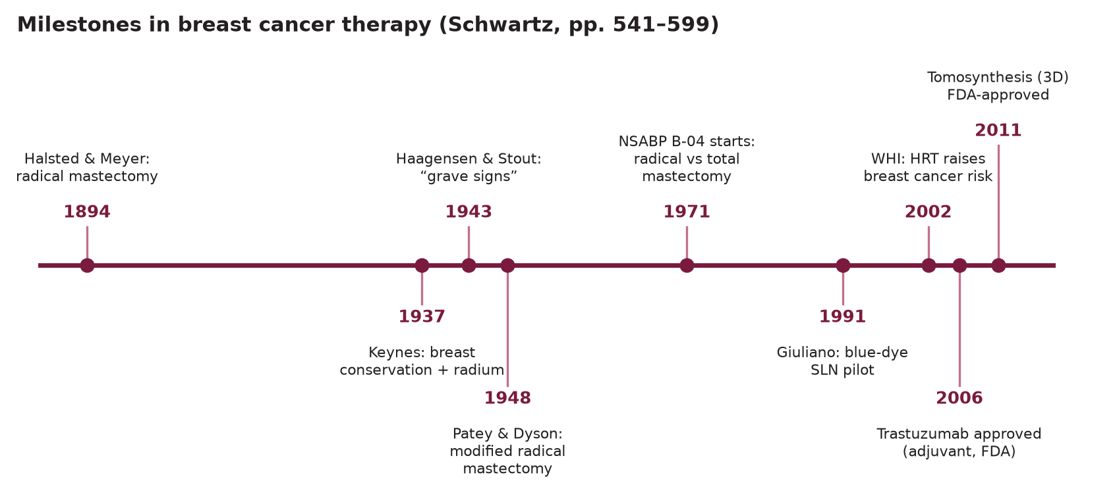
A Brief History of Breast Cancer Therapy
Sec. 1
Fig. 1 --- Milestones in breast cancer therapy.
Schwartz's Principles of Surgery -- Ch.17: The Breast
3

Slide 5
From "there is no treatment" to the Halsted operation
Sec. 1
From "there is no treatment" to the Halsted operation
Edwin Smith papyrus (3000-2500 BC): earliest breast-cancer record (a man); verdict "there is no treatment". Celsus: only early cancer could be removed. Galen: crab-like tumour; humoral theory. [p.541]
Le Dran: breast cancer is a local disease spreading via lymphatics to axillary nodes -> removed enlarged nodes. Moore: remove the whole breast; palpable nodes too. Banks (1877): remove nodes even when impalpable. [p.542]
Halsted & Meyer (1894): radical mastectomy with complete axillary dissection levels I-III (long thoracic nerve and thoracodorsal bundle sacrificed) --- superior local-regional control made it standard. [p.542]
Haagensen & Stout (1943) "grave signs": skin oedema, ulceration, chest-wall fixation, axillary node >2.5 cm, fixed nodes. >=2 signs -> 42% local recurrence and only 2% 5-year DFS -> "beyond cure by radical surgery". [p.542]
Patey & Dyson (1948): modified radical mastectomy --- preserve pectoralis major, remove pectoralis minor for level III access. 1970s: MRM replaces Halsted (less advanced presentations, pectoralis major removal added nothing stage I-II, neither operation controlled stage III -> radiation added). [p.542]
Schwartz's Principles of Surgery -- Ch.17: The Breast
4

Slide 6
The trials that dismantled the Halstedian idea
Sec. 1
The trials that dismantled the Halstedian idea
Trials dismantling the Halstedian radical-surgery paradigm
Trial | Design | Result
NSABP B-04 (1971-74; n=1,665) | Cl. N0: Halsted vs total mastectomy +/- RT vs total mastectomy alone. Cl. N+: Halsted vs total + RT. | No survival difference in any comparison, still equal at 25 years (era before effective systemic therapy).
Keynes (1937) | First breast conservation + radium. | Origin of breast-conserving therapy.
NSABP B-06 (n=1,851) | Total mastectomy vs lumpectomy vs lumpectomy + RT. | Same DFS, distant DFS, OS; lumpectomy alone had much more in-breast recurrence.
Fisher's "alternative hypothesis": breast cancer is systemic at diagnosis; nodes are a marker, not a barrier. EBCTCG challenge: avoiding a breast recurrence avoids about one breast-cancer death per four recurrences avoided over 15 years --- so local control matters. [p.542-543]
Exam pearl
B-06 caveats: palpable axillary nodes excluded; positive frozen-section margins were converted to mastectomy but analysed as breast conservation (intention-to-treat); in-breast recurrences were "non-events" for DFS.
Schwartz's Principles of Surgery -- Ch.17: The Breast
5

Slide 7
Systemic therapy and the biology era (EBCTCG overviews)
Sec. 1
Systemic therapy and the biology era (EBCTCG overviews)
Anthracycline regimens > CMF; adding a taxane cuts breast-cancer mortality by one-third. Tamoxifen helps only ER-positive disease (mortality down up to 30%). [p.543]
Proportional risk reduction is not altered by tumour size, ER status or nodes -> treat according to absolute risk (spare low-risk women the toxicity). [p.543]
Immunohistochemistry (1980s) -> gene arrays: at least five intrinsic subtypes with different outcomes -> molecular subtype now steers local-regional and systemic decisions. [p.543]
Perspective: 50% of American women see a surgeon for breast disease, 25% have a biopsy, 12% develop breast cancer. [p.543]
Schwartz's Principles of Surgery -- Ch.17: The Breast
6

Slide 8
SECTION 02
Embryology and Functional Anatomy
Schwartz, pp. 543-547

Slide 9
Embryology and congenital anomalies
Sec. 2
Embryology and congenital anomalies
5th-6th week: ventral ectodermal thickenings (mammary ridges / milk lines) run from axilla to inguinal region; in humans most regress. Primary bud -> 15-20 secondary buds -> epithelial cords -> lactiferous ducts opening into a mammary pit; infancy: mesenchyme lifts pit into nipple. [p.543-544]
At birth male and female breasts are identical (major ducts only); transient enlargement and "witch's milk" from maternal hormones. Female breast stays undeveloped until puberty (estrogen + progesterone) and is incomplete until pregnancy. [p.544]
Schwartz's Principles of Surgery -- Ch.17: The Breast
7

Slide 10
Embryology and congenital anomalies
Sec. 2
Congenital breast anomalies
Anomaly | What it is | Note
Inverted nipple | Pit fails to elevate | In 4% of infants; congenital
Amastia | Absent breast; arrest of ridge in 6th fetal week | Rare
Poland's syndrome | Breast hypoplasia/absence + costal cartilage and rib defects + chest-wall subcutaneous hypoplasia + brachysyndactyly | Hypoplasia can also be iatrogenic (trauma, infection, RT before puberty)
Symmastia | Webbing between breasts across the midline | Rare
Polythelia (accessory nipple) | Extra nipple along milk line | <1% of infants; may go with urinary/cardiovascular anomalies
Polymastia (supernumerary breast) | Extra breast anywhere along milk line | Commonest between normal nipple and symphysis pubis; Turner and Fleischer syndromes; axillary tissue usually bilateral
Schwartz's Principles of Surgery -- Ch.17: The Breast
8

Slide 11
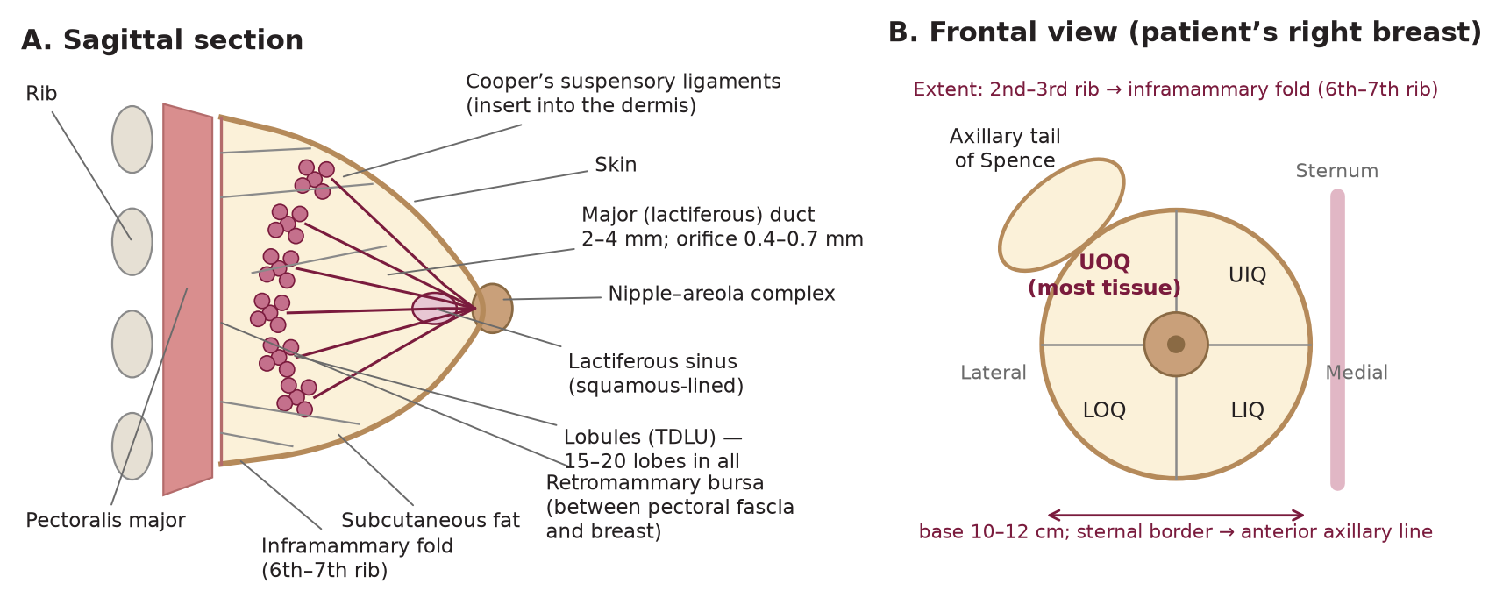
Gross anatomy
Sec. 2
Gross anatomy
Fig. 2 --- Breast anatomy: (A) sagittal section, (B) frontal view with quadrants.
Schwartz's Principles of Surgery -- Ch.17: The Breast
9

Slide 12
Gross anatomy
Sec. 2
15-20 lobes, each of several lobules; Cooper's suspensory ligaments run through the breast and insert perpendicularly into the dermis. [p.544]
Extent: 2nd/3rd rib -> inframammary fold (6th/7th rib); lateral sternal border -> anterior axillary line. Posterior surface lies on pectoralis major, serratus anterior, external oblique and upper rectus sheath fascia; the retromammary bursa lies between breast fascia and pectoral fascia. [p.544]
Axillary tail of Spence passes across the anterior axillary fold. Upper outer quadrant holds the most tissue. Base 10-12 cm. Nulliparous = hemispheric with flattening above nipple; pregnancy/lactation increase volume/density; senescence = flat and pendulous. [p.544]
Schwartz's Principles of Surgery -- Ch.17: The Breast
10

Slide 13
Nipple-areola complex
Sec. 2
Nipple-areola complex
Pigmented, corrugated; darkens at puberty and again in pregnancy. Montgomery's tubercles = sebaceous, sweat and accessory glands of the areola. [p.544-545]
Circumferential and longitudinal smooth muscle -> nipple erection; dermal papillae with Meissner's corpuscles -> rich sensation driving the suckling-milk let-down reflex. [p.545]
Each lobe ends in a lactiferous duct (2-4 mm) opening through a 0.4-0.7 mm orifice; beneath the NAC each duct dilates as the lactiferous sinus (stratified squamous epithelium). Major ducts: 2 layers of cuboidal cells; minor ducts: 1 layer; myoepithelial cells lie in the basal lamina. [p.545]
Schwartz's Principles of Surgery -- Ch.17: The Breast
11

Slide 14
Inactive vs active breast
Sec. 2
Inactive vs active breast
Histology/function by physiological state
State | Histology / function
Inactive | Sparse epithelium, mostly ductal, in loose stroma; dense tissue around TDLU. Menstrual cycle: minor ducts cord-like early; at ovulation estrogen raises alveolar epithelial height and lumina; regresses as hormones fall.
Pregnancy | Minor ducts branch, alveoli develop (asymmetrically); lymphocytes, plasma cells and eosinophils accumulate in stroma.
Lactation | Alveolar epithelium (rich in ER, mitochondria, Golgi): protein by merocrine secretion, lipid by apocrine secretion. Colostrum (first days): low fat, antibody-rich (from plasma cells) -> then lipid-rich milk.
Schwartz's Principles of Surgery -- Ch.17: The Breast
12

Slide 15
Blood supply, nerves and lymphatics
Sec. 2
Blood supply, nerves and lymphatics
Vascular, neural and lymphatic supply of the breast
System | Key facts [p.545-547]
Arteries | Perforating branches of internal mammary artery (2nd-4th anterior intercostal perforators = medial mammary arteries); lateral branches of posterior intercostals; axillary artery branches --- highest thoracic, lateral thoracic (also supplies serratus, pectorals, subscapularis; gives lateral mammary branches), pectoral branch of thoracoacromial.
Veins | Follow arteries, draining toward axilla: perforating branches of internal thoracic vein, posterior intercostal perforators, axillary vein tributaries. Batson's vertebral plexus (skull base to sacrum) = route to vertebrae, skull, pelvis and CNS metastases.
Sensory nerves | Lateral cutaneous branches of intercostals 3-6 (exit between serratus slips); supraclavicular nerve (cervical plexus) supplies upper breast skin. Intercostobrachial nerve (lateral cutaneous of T2): cut in axillary dissection -> numbness of medial upper arm.
Lymphatics | Plexus in interlobular tissue and duct walls -> subareolar plexus. Efferents pass round lateral edge of pectoralis major, pierce clavipectoral fascia -> external mammary nodes; some go direct to subscapular or apical nodes. >75% axillary; remainder (mainly medial breast) -> internal mammary (parasternal) nodes.
Schwartz's Principles of Surgery -- Ch.17: The Breast
13

Slide 16
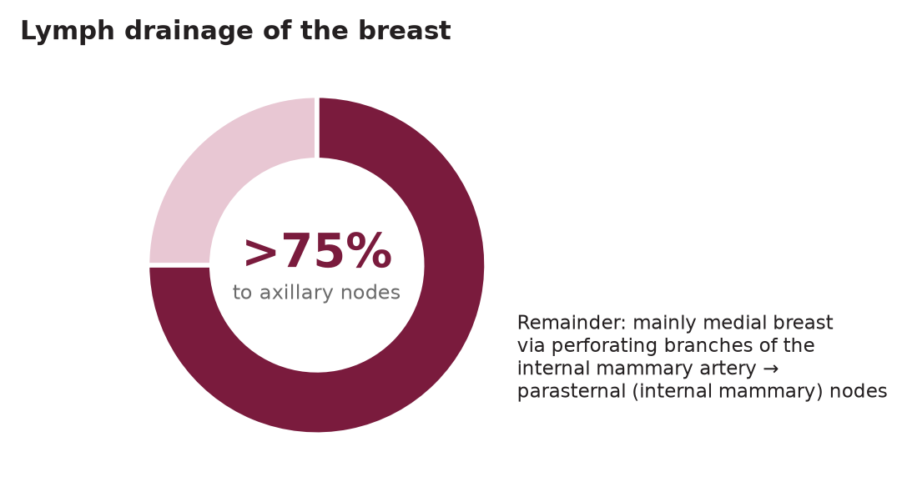
Blood supply, nerves and lymphatics
Sec. 2
Fig. 3 --- Proportion of breast lymph draining to the axilla.
Schwartz's Principles of Surgery -- Ch.17: The Breast
14

Slide 17
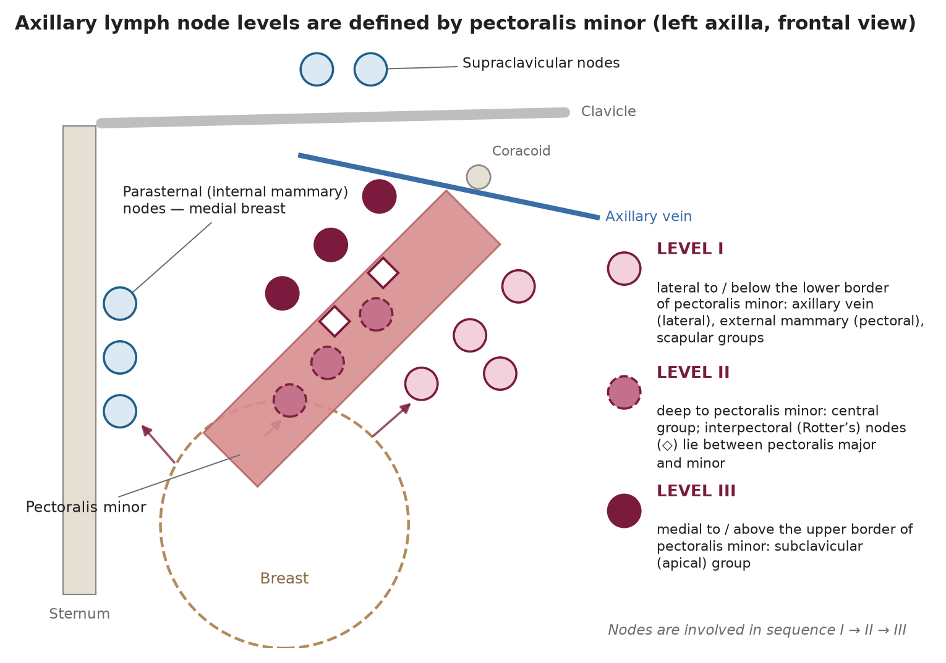
The six axillary node groups -> three surgical levels
Sec. 2
The six axillary node groups -> three surgical levels
Fig. 4 --- Axillary levels I-III relative to pectoralis minor; parasternal and supraclavicular nodes.
Schwartz's Principles of Surgery -- Ch.17: The Breast
15

Slide 18
The six axillary node groups -> three surgical levels
Sec. 2
Axillary lymph node groups and surgical levels
Group | Number | Position | Receives lymph from | Level
Axillary vein (lateral) | 4-6 | Medial/posterior to the vein | Most of the upper limb | I
External mammary (anterior/pectoral) | 5-6 | Lower border of pectoralis minor, with lateral thoracic vessels | Lateral breast (most) | I
Scapular (posterior/subscapular) | 5-7 | Posterior axillary wall, lateral scapular border | Lower posterior neck, posterior trunk, shoulder | I
Central | 3-4 | Embedded in fat behind pectoralis minor | Vein, external mammary, scapular groups + breast directly | II
Interpectoral (Rotter's) | 1-4 | Between pectoralis major and minor | Directly from breast -> central and subclavicular | II
Subclavicular (apical) | 6-12 | Behind and above upper border of pectoralis minor | All other axillary groups | III
Schwartz's Principles of Surgery -- Ch.17: The Breast
16

Slide 19
The six axillary node groups -> three surgical levels
Sec. 2
Exam pearl
Level I = lateral to/below the lower border of pectoralis minor; II = deep/superficial to it; III = medial to/above its upper border. Metastasis usually spreads sequentially I -> II -> III. [p.547, 563]
Schwartz's Principles of Surgery -- Ch.17: The Breast
17

Slide 20
SECTION 03
Physiology of the Breast; Gynecomastia
Schwartz, pp. 547-549

Slide 21
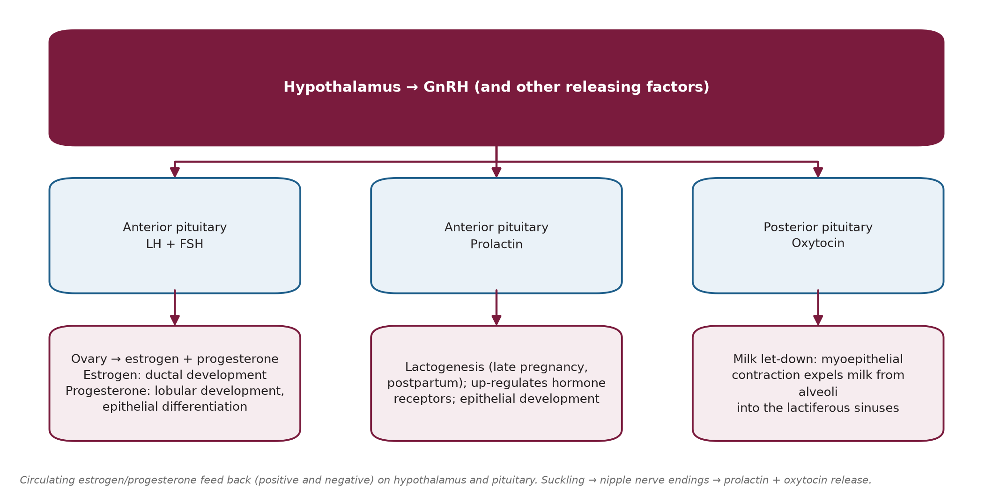
Physiology of the Breast; Gynecomastia
Sec. 3
Fig. 5 --- Neuroendocrine control of the breast.
Schwartz's Principles of Surgery -- Ch.17: The Breast
18

Slide 22
Physiology of the Breast; Gynecomastia
Sec. 3
Many hormones act (estrogen, progesterone, prolactin, oxytocin, thyroid hormone, cortisol, GH) but estrogen, progesterone and prolactin are essential. Estrogen -> ductal development; progesterone -> lobular development and epithelial differentiation; prolactin -> lactogenesis (late pregnancy/postpartum). [p.547]
Childhood: low estrogen because hypothalamic-pituitary axis is very sensitive to negative feedback. Puberty: less negative-feedback sensitivity and more positive-feedback sensitivity -> increased GnRH, FSH, LH -> ovarian estrogen/progesterone -> menstrual cycle. Breast size/density rise premenstrually, then engorgement and proliferation subside with menses. [p.547-548]
Breast changes across life stages
Life stage | Changes [p.548-549]
Pregnancy | Ovarian + placental estrogen/progestin increase -> ductal and lobular proliferation, areolar darkening, Montgomery glands prominent. Trimesters 1-2: minor ducts branch; trimester 3: fat droplets in alveolar cells, colostrum fills ducts; late pregnancy: prolactin drives milk fat and protein synthesis.
Lactation | Placental delivery -> estrogen/progesterone fall -> prolactin acts fully. Nipple neural reflex maintains prolactin; oxytocin (from sight, sound, smell of nursing) contracts myoepithelial cells -> expels milk into sinuses. After weaning, dormant milk raises duct pressure -> epithelial atrophy.
Senescence | Menopause: estrogen/progesterone fall -> involution of ducts and alveoli, denser fibrous stroma, replacement by fat.
Schwartz's Principles of Surgery -- Ch.17: The Breast
19

Slide 23
Gynecomastia
Sec. 3
Gynecomastia
Enlarged male breast. Physiological in 3 phases: neonatal (placental estrogen), adolescence (estradiol excess relative to testosterone; usually unilateral, age 12-15), senescence (falling testosterone; usually bilateral; men 50-70). Diagnosis in a non-obese man needs >=2 cm of breast tissue. [p.548]
Mammography/ultrasound separate gynecomastia from cancer. Dominant, irregular or asymmetric mass -> suspect cancer. Gynecomastia does not itself raise cancer risk, but Klinefelter's (XXY) --- hypoandrogenic --- does. [p.548]
Gynecomastia grading
Grade | Description
I | Mild enlargement, no skin redundancy
IIa | Moderate enlargement, no skin redundancy
IIb | Moderate enlargement with skin redundancy
III | Marked enlargement, skin redundancy and ptosis
Causes of gynecomastia (Table 17-1, p.549)
Cause group | Examples
Estrogen excess | Testicular tumours (Leydig, Sertoli, germ-cell: choriocarcinoma, seminoma); adrenal cortical tumours; lung and hepatocellular carcinoma; thyroid disease; cirrhosis; malnutrition/re-feeding
Androgen deficiency | Senescence; primary testicular failure (Klinefelter, Kallmann, Reifenstein); secondary failure (trauma, orchitis, cryptorchidism, irradiation); renal failure
Drugs | Estrogenic: digitalis, estrogens, anabolic steroids, marijuana; increase estrogen synthesis: hCG; anti-androgen: cimetidine, ketoconazole, phenytoin, spironolactone, chemotherapy, diazepam; idiopathic: reserpine, theophylline, verapamil, tricyclics, furosemide
Schwartz's Principles of Surgery -- Ch.17: The Breast
20

Slide 24
Gynecomastia
Sec. 3
Management
Treat the cause: replace testosterone if deficient; stop the drug; treat the endocrine defect.
Progressive, unresponsive gynecomastia -> surgery (local excision, liposuction or subcutaneous mastectomy). Danazol works but has considerable androgenic side effects. [p.549]
Schwartz's Principles of Surgery -- Ch.17: The Breast
21

Slide 25
SECTION 04
Infectious and Inflammatory Disorders
Schwartz, pp. 550

Slide 26
Infectious and Inflammatory Disorders
Sec. 4
Page 550. Postpartum is still the commonest time for breast infection; non-lactational infections are intrinsic (e.g., periductal mastitis) or extrinsic (e.g., infected sebaceous cyst).
Schwartz's Principles of Surgery -- Ch.17: The Breast
22

Slide 27
Infectious and Inflammatory Disorders
Sec. 4
Infectious/inflammatory breast conditions
Condition | Key features | Treatment
Staphylococcal abscess | S. aureus (also Streptococcus). Point tenderness, erythema, heat. Lactational abscess in first weeks of feeding. Subcutaneous, subareolar, interlobular, retromammary; localised, may be deep. | Antibiotics + repeated ultrasound-guided aspiration; operative drainage only if it fails or skin is thin/necrotic. Biopsy the abscess wall if it will not resolve (exclude cancer). Chronic/recurrent -> cultures for AFB, anaerobes, fungi; long antibiotics.
Streptococcal infection | Diffuse, superficial. | Warm compresses, local care, IV penicillin or cephalosporin.
Puerperal mastitis --- epidemic | Virulent MRSA spread by the suckling neonate; purulent nipple discharge; real morbidity. | Stop breastfeeding, antibiotics, surgery as needed.
Puerperal mastitis --- sporadic | Nipple fissure + milk stasis -> retrograde infection of interlobular tissue. | Empty the breast (pump) + antibiotics -> success in >95%.
Zuska's disease (recurrent periductal mastitis) | Recurrent retro-areolar infection/abscess; smoking implicated. | Antibiotics + drainage; wide debridement/terminal duct resection can cure but may be frustrated by infection.
Fungal | Blastomycosis, sporotrichosis (from infant's mouth); abscess near NAC, blood-stained pus, sinuses. Candida: red scaly inframammary/axillary skin. | Antifungals (usually avoids surgery; sometimes drainage/partial mastectomy). Candida: remove maceration + topical nystatin.
Hidradenitis suppurativa | Chronic inflammation of Montgomery glands or axillary sebaceous glands; acne predisposes; mimics Paget's or cancer at NAC. | Antibiotics + incision/drainage; excision +/- flaps or grafts if extensive.
Mondor's disease | Superficial thrombophlebitis ("string phlebitis") of lateral thoracic / thoracoepigastric / superficial epigastric vein: acute lateral chest/breast pain + tender cord. Benign, self-limited, not a cancer sign. | NSAIDs + warm compresses; resolves in 4-6 weeks; biopsy if diagnosis uncertain or mass nearby; excise vein if refractory.
Schwartz's Principles of Surgery -- Ch.17: The Breast
23

Slide 28
SECTION 05
Benign Breast Disorders and Diseases
Schwartz, pp. 550-554

Slide 29
Benign Breast Disorders and Diseases
Sec. 5
Goal for the surgeon: explain clearly, treat appropriately, and avoid unnecessary long-term follow-up.
Schwartz's Principles of Surgery -- Ch.17: The Breast
24

Slide 30
ANDI --- Aberrations of Normal Development and Involution
Sec. 5
ANDI --- Aberrations of Normal Development and Involution
Three principles: (a) benign conditions track normal reproductive life and involution; (b) they form a spectrum normal -> disorder -> disease; (c) the classification covers pathogenesis and degree of abnormality. [p.550]
Schwartz's Principles of Surgery -- Ch.17: The Breast
25

Slide 31
ANDI --- Aberrations of Normal Development and Involution
Sec. 5
ANDI classification by life period
Period | Normal | Disorder | Disease
Early reproductive (15-25 y) | Lobular and stromal development; nipple eversion | Fibroadenoma; adolescent hypertrophy; nipple inversion | Giant fibroadenoma; gigantomastia; subareolar abscess; mammary duct fistula
Later reproductive (25-40 y) | Cyclical menstrual change; epithelial hyperplasia of pregnancy | Cyclical mastalgia; nodularity; bloody nipple discharge | Incapacitating mastalgia
Involution (35-55 y) | Lobular involution; duct involution: dilatation, sclerosis; epithelial turnover | Macrocysts; sclerosing lesions; duct ectasia; nipple retraction; epithelial hyperplasia | Periductal mastitis; epithelial hyperplasia with atypia
Schwartz's Principles of Surgery -- Ch.17: The Breast
26

Slide 32
ANDI --- Aberrations of Normal Development and Involution
Sec. 5
Fibroadenoma: age 15-25; usually 1-2 cm then stable. <=1 cm normal; up to 3 cm disorder; >3 cm giant = disease; >5 lesions in one breast = disease. Screening now finds asymptomatic ones in older women. [p.550-551]
Mastalgia/nodularity: premenstrual = normal; painful nodularity persisting >1 week of the cycle = disorder. Bilateral bloody discharge can come from papillary projections of pregnancy epithelium. [p.552]
Involution: if stroma involutes too fast, alveoli remain -> microcysts -> macrocysts (common, often subclinical, need no treatment). Periductal fibrosis after periductal mastitis -> nipple retraction. ~60% of women >=70 y show some epithelial hyperplasia. [p.552]
Schwartz's Principles of Surgery -- Ch.17: The Breast
27

Slide 33
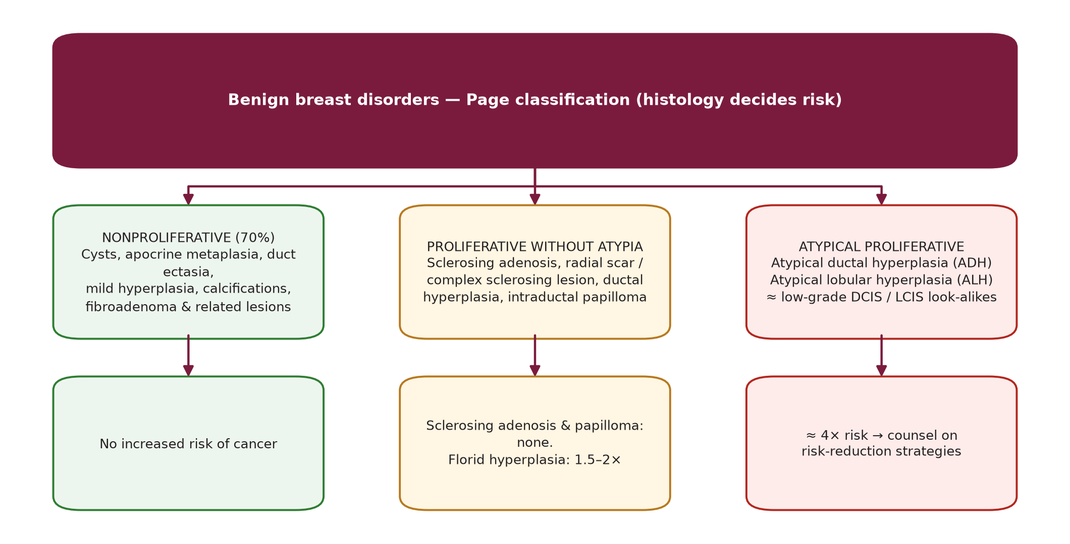
Histological classification and cancer risk (Page)
Sec. 5
Histological classification and cancer risk (Page)
Fig. 6 --- Page classification of benign breast disease.
Schwartz's Principles of Surgery -- Ch.17: The Breast
28

Slide 34
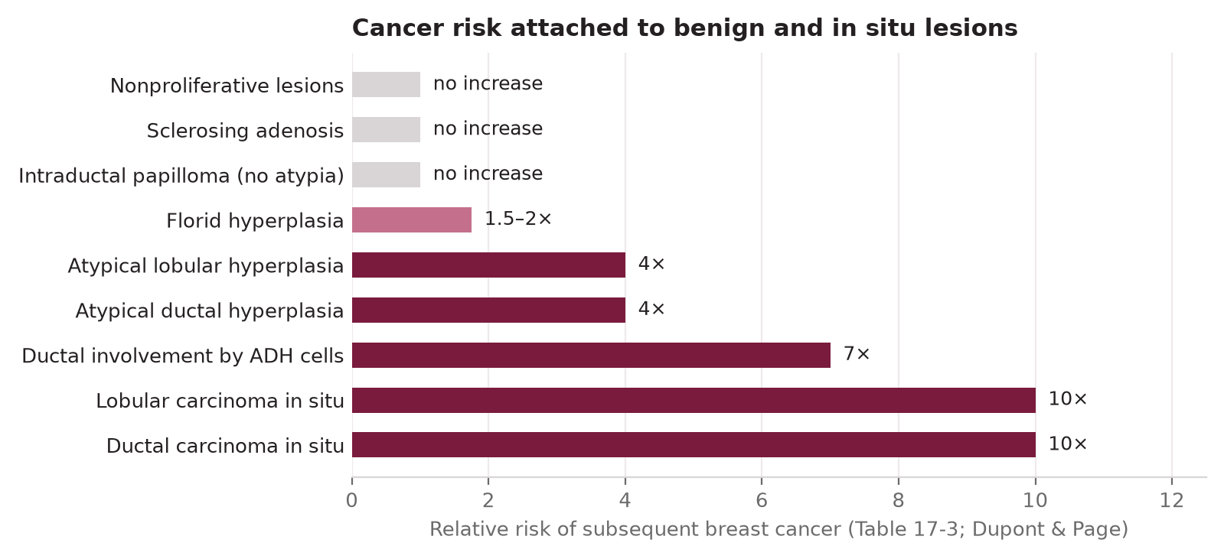
Histological classification and cancer risk (Page)
Sec. 5
Fig. 7 --- Relative risk of breast cancer (Dupont & Page, Table 17-3).
Schwartz's Principles of Surgery -- Ch.17: The Breast
29

Slide 35
Histological classification and cancer risk (Page)
Sec. 5
Benign breast lesions: features and behaviour [p.552-554]
Lesion | Defining features and behaviour
Cysts, macrocysts | Involutional, frequently multiple; simple cyst rarely of concern, complex cyst may hide malignancy.
Duct ectasia / periductal mastitis | Dilated palpable subareolar ducts, thick discharge. Haagensen: ectasia -> stasis -> leakage of irritant fatty acids -> periductal inflammation -> fibrosis -> nipple retraction; alternative: periductal mastitis primary. Both may occur; spectrum = discharge, retraction, inflammatory mass, abscess.
Calcifications | Mostly benign (secretions, debris, trauma). Cancer-associated: microcalcifications <0.5 mm of varying shape/density, and fine linear branching.
Fibroadenoma vs adenoma | Fibroadenoma: abundant stroma, hormone-dependent (lactates in pregnancy, involutes after menopause). Adenoma: sparse stroma; tubular (young, non-pregnant) or lactating. Hamartoma: 2-4 cm firm circumscribed. Adenolipoma: fat nodule with normal lobules/ducts.
Sclerosing adenosis | Childbearing/perimenopausal; distorted lobules with microcysts +/- palpable mass; benign calcifications; no malignant potential but mimics cancer clinically, on imaging and grossly -> observe only if imaging and pathology concordant, otherwise excise.
Radial scar / complex sclerosing lesion | Central fibrosis with radiating change at terminal duct branching; <=1 cm = radial scar, >1 cm = complex sclerosing lesion (adds papilloma, apocrine metaplasia, +/- sclerosing adenosis). Spiculated mass looks like cancer -> core result "benign" is discordant -> vacuum-assisted or open excision.
Ductal hyperplasia | Mild = 3-4 cell layers above basement membrane; moderate = >=5; florid = fills >=70% of the minor-duct lumen (>20% of specimens; risk 1.5-2x).
Intraductal papilloma | Major ducts, premenopausal, usually <0.5 cm (up to 5 cm); serous/bloody discharge; pinkish friable lesion on a stalk; no added risk unless atypia. Multiple papillomas (younger women, less discharge) can transform.
ADH | Looks like low-grade DCIS: monotonous round cells, rare mitoses. <=2-3 mm = ADH; >3 mm = DCIS. Hard on core -> often needs excision. Risk 4x; counsel on risk reduction.
ALH / LCIS | ALH: minimal distension of lobular units by LCIS-like cells. LCIS: small monomorphic cells distend the TDLU, acini full, architecture kept. E-cadherin lost in lobular neoplasia, present in most ductal lesions.
"Fibrocystic disease" | A non-specific label (many synonyms); better to name the actual histology.
Schwartz's Principles of Surgery -- Ch.17: The Breast
30

Slide 36
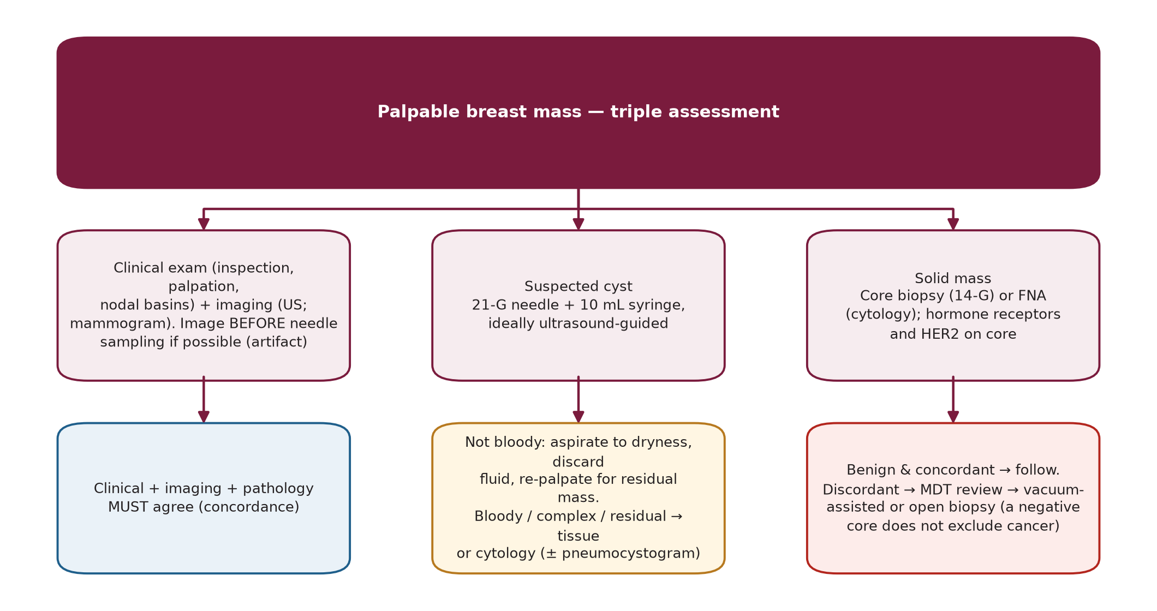
Treating the common benign problems
Sec. 5
Treating the common benign problems
Fig. 8 --- Palpable mass: triple assessment, cyst vs solid, and concordance.
Schwartz's Principles of Surgery -- Ch.17: The Breast
31

Slide 37
Treating the common benign problems
Sec. 5
Management of common benign problems [p.554-555]
Problem | Approach
Cyst | 21-G needle, 10 mL syringe (mass fixed with the other hand). Cyst 5-10 mL (up to >=75 mL). Non-bloody fluid: aspirate to dryness, discard (cytology not cost-effective), re-palpate for residual mass. Bloody fluid -> cytology. Image first when possible (needle artifacts); most cysts now US-guided. Mass on US or residual mass -> core biopsy. Pneumocystogram (air, repeat mammogram) shows wall irregularity.
Fibroadenoma | Mostly self-limiting; US + core biopsy diagnoses; under ~25 y biopsy may be unnecessary. Options: excision, cryoablation, US-guided vacuum-assisted excision (<3 cm), or observation. Many shrink; those >2 cm often remain palpable.
Sclerosing lesions | Excisional biopsy or larger (stereotactic, vacuum) sample to exclude cancer.
Periductal mastitis / subareolar abscess | Aspirate with 21-G, culture (anaerobes); polymicrobial antibiotics; repeated US-guided aspiration; surgery in a proportion. Subareolar abscess usually unilocular, single duct system. Young/childbearing: simple drainage preferred; recurrent abscess + fistula: fistulectomy + primary closure with antibiotics (or lay-open/granulation if recurrent).
Nipple inversion | Caused by short subareolar ducts -> permanent correction needs complete division of the ducts; warn of altered sensation, nipple necrosis, fibrosis with retraction.
Fistulectomy vs total duct excision criteria (Table 17-5)
Fistulectomy suitable | Total duct excision suitable
Small abscess in one segment | Large abscess >50% of areolar circumference
Recurrence in the same segment | Recurrence in a different segment
Mild/no nipple inversion | Marked nipple inversion or patient wants it corrected
Younger patient; no discharge from other ducts; no prior fistulectomy | Older patient; purulent discharge from other ducts; recurrence after fistulectomy
Localized sepsis -> fistulectomy irrespective of age; diffuse sepsis or >1 fistula -> total duct excision. Give a 2-4 week antibiotic course before total duct excision. [p.555]
Schwartz's Principles of Surgery -- Ch.17: The Breast
32

Slide 38
SECTION 06
Risk Factors, Risk Models, Screening and Prevention
Schwartz, pp. 555-558

Slide 39
Risk factors
Sec. 6
Risk factors
Breast cancer risk factors and reasoning [p.555]
Type | Factors | Reasoning
Hormonal increased risk | Early menarche, nulliparity, late menopause, older age at first live birth, obesity | More lifetime menstrual cycles = more estrogen exposure; a full-term pregnancy causes terminal differentiation (protective); after menopause adipose aromatisation of androstenedione -> estrone is the main estrogen source.
Hormonal decreased risk | Moderate exercise, longer lactation | Fewer cycles.
Radiation | Mantle RT for Hodgkin lymphoma (75x risk vs age-matched controls); atomic-bomb survivors | Adolescence (active breast development) magnifies the effect.
Lifestyle | Alcohol (increases with amount; raises estradiol); long-term high-fat diet (increases serum estrogen)
Baseline | US lifetime risk at birth 12%; at age 50 = 11%; at age 70 = 7% | The longer you live cancer-free, the lower the remaining risk.
Schwartz's Principles of Surgery -- Ch.17: The Breast
33

Slide 40
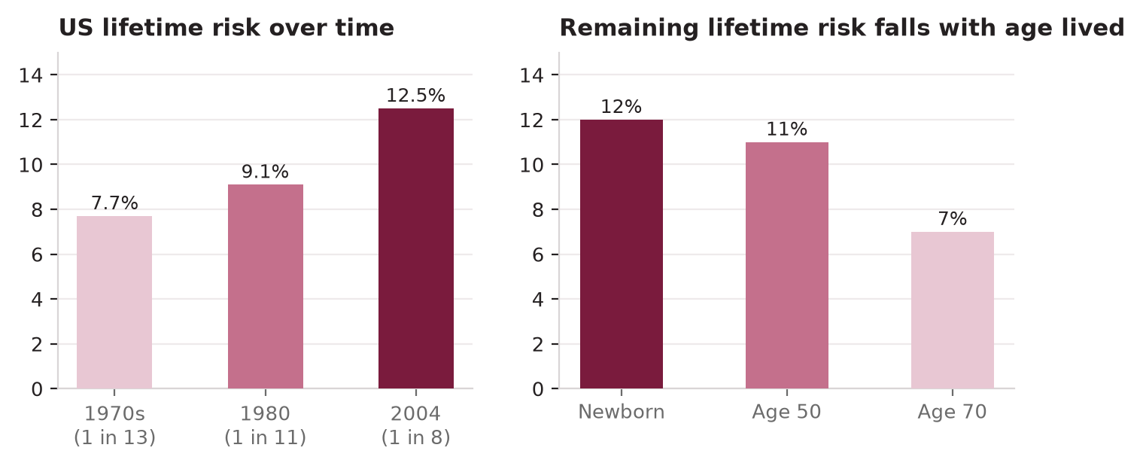
Risk factors
Sec. 6
Fig. 9 --- US lifetime risk over time and by age.
Schwartz's Principles of Surgery -- Ch.17: The Breast
34

Slide 41
Risk assessment models
Sec. 6
Risk assessment models
Breast cancer risk assessment models [p.555-556]
Model | Inputs | Output / limits
Gail (most used in US; from BCDDP) | Age, age at menarche, age at first live birth, number of biopsies, atypical hyperplasia, number of first-degree relatives | Multiplies relative risks -> score vs adjusted population risk -> 5-year and lifetime risk. Modified for African American and Asian/Pacific Island women; revised version adds weight and mammographic density, drops menarche. Does not include BRCA. Not appropriate for LCIS/DCIS or BRCA carriers.
Claus | First- and second-degree relatives with breast cancer, their ages | Risk by decade; more family detail but excludes other factors.
BRCAPRO | Detailed breast/ovarian family history (Mendelian model) | Probability of carrying a BRCA mutation -> age-specific cancer risk; laborious in clinic.
Tyrer-Cuzick | Family history + menarche, parity, age at first birth, menopause age, atypia/LCIS, height, BMI | Mutation probability adjusted for personal factors.
Manchester score, BOADICEA | Family history | Carrier probability to decide referral for genetic testing.
Schwartz's Principles of Surgery -- Ch.17: The Breast
35

Slide 42
Risk assessment models
Sec. 6
Gail relative risk values (Table 17-6)
Variable | Value
Menarche >=14 / 12-13 / <12 y | 1.00 / 1.10 / 1.21
Biopsies, age <50: 0 / 1 / >=2 | 1.00 / 1.70 / 2.88
Biopsies, age >=50: 0 / 1 / >=2 | 1.02 / 1.27 / 1.62
First birth <20 y with 0 / 1 / >=2 first-degree relatives | 1.00 / 2.61 / 6.80
First birth 20-24 y (0 / 1 / >=2 relatives) | 1.24 / 2.68 / 5.78
First birth 25-29 y (0 / 1 / >=2 relatives) | 1.55 / 2.76 / 4.91
First birth >=30 y (0 / 1 / >=2 relatives) | 1.93 / 2.83 / 4.17
Schwartz's Principles of Surgery -- Ch.17: The Breast
36

Slide 43
Risk assessment models
Sec. 6
Decisions that depend on risk: use of HRT, when to start mammography or add MRI, when to give tamoxifen, when to consider prophylactic mastectomy. Communicate risk with competing risks and comorbidity in mind. [p.556]
Schwartz's Principles of Surgery -- Ch.17: The Breast
37

Slide 44
Hormone replacement therapy
Sec. 6
Hormone replacement therapy
WHI (2002): breast-cancer risk 3-4-fold higher after >4 years of combined therapy in the source text; no significant coronary or cerebrovascular protection. Collaborative Group reanalysis (52,705 cases, 108,411 controls): risk in current users, rising with duration, not in past users. Million Women study: estrogen + progesterone worse than other regimens. Estrogen + progestin increased breast cancer by 26% vs placebo. [p.556-557, 577]
Falling HRT use is thought to explain the recent fall in incidence. [p.561]
Schwartz's Principles of Surgery -- Ch.17: The Breast
38

Slide 45
Screening mammography
Sec. 6
Screening mammography
Screening at >=50 y lowers breast-cancer mortality by about 25% (older estimates 20-25%; HIP/BCDDP 33%). Overdiagnosis: UK panel estimated ~11% of cancers in invited women, yet ~20% mortality reduction, so screening continues. [p.557, 570]
Why <50 y is controversial: denser breasts (lower sensitivity), more false positives (lower specificity), lower incidence (fewer benefit). Targeting higher-risk younger women improves balance; in women 40-49 an abnormal mammogram was 3x more likely to be cancer with a family history. [p.557]
Density independently predicts risk; ultrasound may be used in dense breasts but no proof it reduces mortality. [p.557]
Screening mammography recommendations by body [p.557]
Body | Average-risk recommendation
USPSTF | Biennial mammography, 50-74 y.
American Cancer Society (2015) | Annual from 45 y (option from 40-44); annual 45-54; from 55 biennial or continue annual; while health good and life expectancy >=10 y. No routine clinical breast exam.
NCCN (as cited) | Annual mammography from >=40 y + annual clinical exam + breast awareness. (Chapter also: CBE at least every 3 y from age 20, yearly from 40 [p.570].)
All three agree on "high risk" | Personal breast cancer history, chest radiation at a young age, known/suspected pathogenic mutation.
Who gets MRI
MRI screening (ACS): lifetime risk >=20-25% (family-history models); BRCA carriers; untested first-degree relative of a carrier; chest RT between ages 10-30; Li-Fraumeni, Cowden or Bannayan-Riley-Ruvalcaba syndrome (or first-degree relative). MRI is very sensitive and unaffected by density, but specificity is moderate -> more false positives and biopsies. [p.557]
Schwartz's Principles of Surgery -- Ch.17: The Breast
39

Slide 46
Chemoprevention
Sec. 6
Chemoprevention
Tamoxifen (SERM) was the first drug to reduce breast cancer in healthy women. NSABP P-1 (BCPT): >13,000 women with 5-year Gail risk >=1.66% or LCIS -> -49% invasive cancer at ~4 y, all in ER-positive disease; ER-negative unchanged. Royal Marsden, Italian and IBIS-I confirmed reduction of ER+ cancers; no mortality effect (underpowered). [p.557-558]
Tamoxifen harms: DVT x1.6, PE x3.0, endometrial cancer x2.5 (early stage, postmenopausal), cataract surgery ~2x, vasomotor symptoms. Recommended for Gail >=1.66% aged 35-59 (and older women), or LCIS / ADH / ALH. [p.558]
STAR (P-2), n=19,747 postmenopausal: tamoxifen vs raloxifene -> raloxifene kept 76% of tamoxifen's efficacy with fewer adverse events (less endometrial cancer); raloxifene does not reduce LCIS/DCIS. [p.558]
Aromatase inhibitors: MAP.3 (exemestane, n=4,560): -65% at 35 months; IBIS-II (anastrozole, n=3,864): ~-50% at 5 years; more arthritis and hot flashes. ASCO: tamoxifen for pre- or postmenopausal; consider raloxifene or exemestane after menopause. [p.558]
Schwartz's Principles of Surgery -- Ch.17: The Breast
40

Slide 47
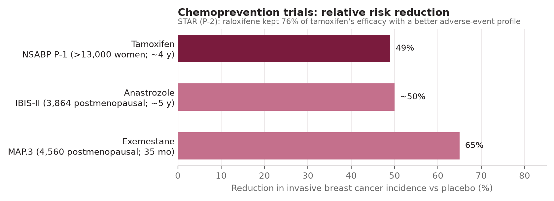
Chemoprevention
Sec. 6
Fig. 10 --- Chemoprevention trials.
Schwartz's Principles of Surgery -- Ch.17: The Breast
41

Slide 48
Risk-reducing surgery
Sec. 6
Risk-reducing surgery
Retrospective data: prophylactic mastectomy reduces risk by >90%; quality-of-life data are poor. BRCA carriers with 40% lifetime risk gain ~3 years of life, with 85% risk >5 years. Prospective BRCA cohort: risk-reducing mastectomy highly effective in BRCA1 and 2; risk-reducing salpingo-oophorectomy cuts ovarian and breast cancer and breast-, ovarian- and all-cause mortality. Survival benefit is unproven in non-carriers. Some patients regret cosmetic/reconstructive results. [p.558]
Schwartz's Principles of Surgery -- Ch.17: The Breast
42

Slide 49
SECTION 07
Hereditary Breast Cancer --- BRCA and Other Genes
Schwartz, pp. 558-561

Slide 50
Hereditary Breast Cancer --- BRCA and Other Genes
Sec. 7
Up to 5% of breast cancers are caused by germline BRCA1/BRCA2 mutations (autosomal dominant, variable penetrance; both are tumour-suppressor genes needing loss of both alleles; roles in transcription, cell-cycle control and DNA repair).
Schwartz's Principles of Surgery -- Ch.17: The Breast
43

Slide 51
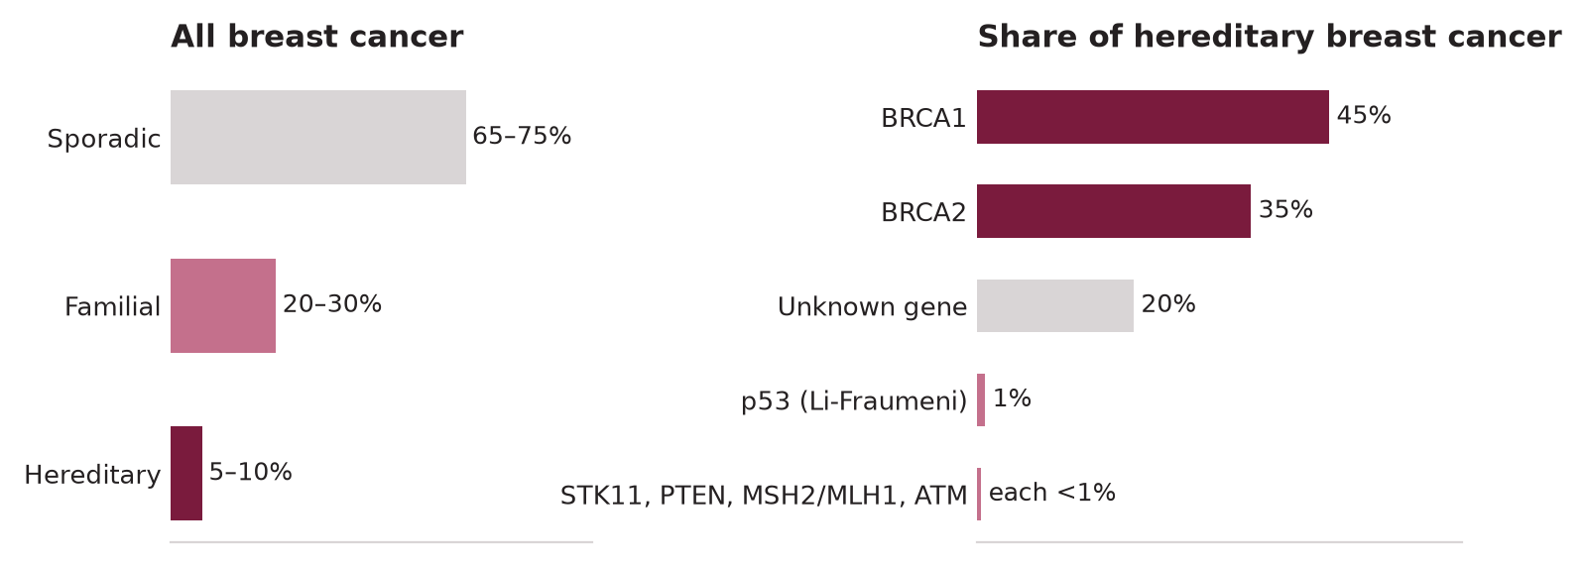
Hereditary Breast Cancer --- BRCA and Other Genes
Sec. 7
Fig. 11 --- Sporadic, familial and hereditary breast cancer; genes involved (Table 17-7).
Schwartz's Principles of Surgery -- Ch.17: The Breast
44

Slide 52
Hereditary Breast Cancer --- BRCA and Other Genes
Sec. 7
BRCA1 vs BRCA2 (Table 17-7)
Feature | BRCA1 | BRCA2
Chromosome / size | 17q; ~100 kb; 22 coding exons; 1,863 amino acids; >500 variants | 13q; ~70 kb; 26 exons; 3,418 amino acids; >250 mutations; no homology to known genes
Share of hereditary breast cancer | 45% (>=80% of hereditary ovarian) | 35%
Lifetime breast risk | Up to 85% (some families); average 60-70% | Close to 85%
Lifetime ovarian risk | Up to 40% | ~20%
Tumour type | IDC, poorly differentiated, mostly triple-negative/basal; medullary phenotype frequent; ~66% of BRCA1 DCIS is ER-negative | IDC, better differentiated, hormone-receptor positive more often
Other features | Early onset, bilateral breast cancer, ovarian; possibly colon and prostate | Early onset, bilateral; ovarian, colon, prostate, pancreas, gallbladder, bile duct, stomach, melanoma; male breast cancer risk 6% (x100)
Founder mutations | 185delAG and 5382insC (10% of BRCA1 mutations; Ashkenazi carrier frequency of 185delAG 1%; ~20% of Jewish women with breast cancer <40 y carry it); also Dutch, Polish, Finnish, Russian | 6174delT (Ashkenazi 1.2%; 60% of ovarian and 30% of early-onset breast cancers in Ashkenazi women); 999del5 (Icelandic, Finnish); 3036delACAA (Spanish)
Schwartz's Principles of Surgery -- Ch.17: The Breast
45

Slide 53
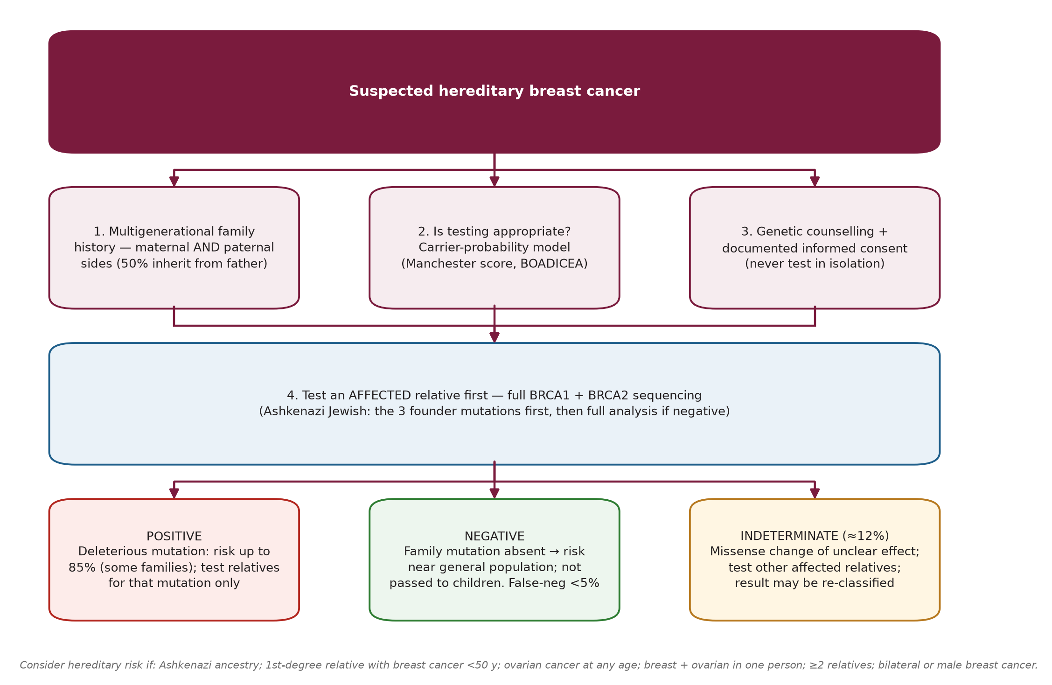
Identifying and testing carriers
Sec. 7
Identifying and testing carriers
Fig. 12 --- Genetic risk assessment pathway.
Schwartz's Principles of Surgery -- Ch.17: The Breast
46

Slide 54
Identifying and testing carriers
Sec. 7
Reasons to suspect hereditary risk: Ashkenazi ancestry, first-degree relative with breast cancer <50 y, ovarian cancer at any age (patient, first- or second-degree relative), breast + ovarian in one person, >=2 first/second-degree relatives, bilateral breast cancer, male breast cancer in a relative. Lower the testing threshold in high-prevalence ethnic groups. [p.559]
Test an affected family member first; relatives are then tested for that mutation only. Ashkenazi: the three founder mutations first. Result interpretation: false-negative <5%; phenocopy possible if the tested person developed cancer at >=60 y; indeterminate variants ~=12% (missense changes may not disable the protein). [p.559-560]
US HIPAA (1996): group plans may not treat genetic information as a pre-existing condition; little documented genetic discrimination. [p.560]
Schwartz's Principles of Surgery -- Ch.17: The Breast
47

Slide 55
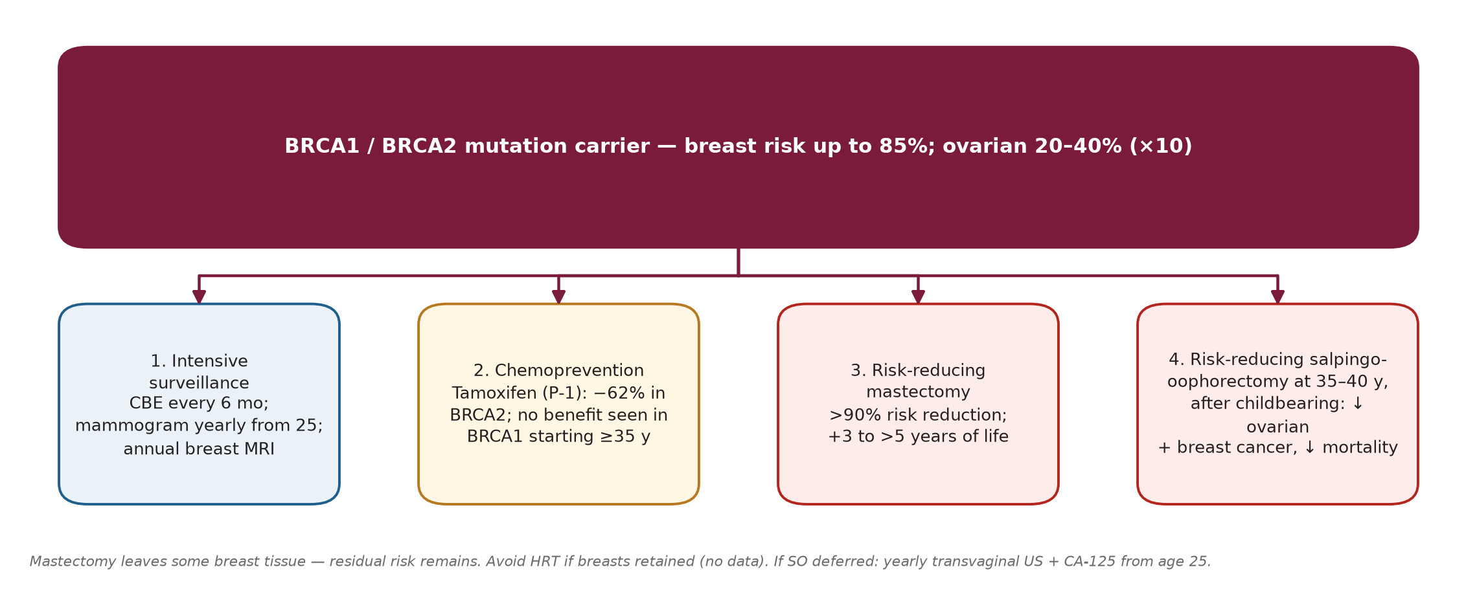
Managing BRCA carriers
Sec. 7
Managing BRCA carriers
Fig. 13 --- The four risk-management strategies for BRCA1/2 carriers.
Schwartz's Principles of Surgery -- Ch.17: The Breast
48

Slide 56
Managing BRCA carriers
Sec. 7
Surveillance: clinical exam every 6 months and mammogram every 12 months from age 25 (risk rises after 30) --- mammograms look the same as in non-carriers; annual MRI is more sensitive in young dense breasts (ACS criteria above). [p.560]
Chemoprevention: P-1 showed a 62% reduction in BRCA2 carriers but no reduction in BRCA1 carriers who started at >=35 y; overall tamoxifen is not recommended uniformly for BRCA1 carriers; it prevents mainly ER-positive cancers. [p.560-561]
Surgery: mastectomy leaves some tissue and the germline mutation persists; consider bilateral salpingo-oophorectomy at age 35-40 after childbearing (ovarian risk 20-40% = 10x general population); discuss HRT at that time; if deferred, yearly transvaginal US + CA-125 from age 25. Avoid HRT if the breasts are retained (no data). [p.560-561]
Schwartz's Principles of Surgery -- Ch.17: The Breast
49

Slide 57
Other hereditary syndromes
Sec. 7
Other hereditary syndromes
Other hereditary breast cancer genes/syndromes [p.561]
Gene / syndrome | Associated cancers and notes
PALB2 | Absolute breast risk to age 70: 33% (no family history) to 58% (>=2 affected first-degree relatives <50 y); 5-9x general population --- comparable to BRCA2. Mammogram + MRI from age 30; consider risk-reducing mastectomy; ovarian risk unclear.
PTEN (Cowden) | Thyroid and GI cancers, benign skin/subcutaneous nodules.
TP53 (Li-Fraumeni) | Sarcomas, lymphomas, adrenocortical tumours.
CDH1 | Hereditary diffuse gastric cancer + lobular breast cancer.
Breast-melanoma; STK11, MSH2/MLH1, ATM | See Table 17-7; panel testing now available --- interpretation is complex, use a genetic counsellor.
Schwartz's Principles of Surgery -- Ch.17: The Breast
50

Slide 58
SECTION 08
Epidemiology and Natural History
Schwartz, pp. 561-563

Slide 59
Epidemiology
Sec. 8
Epidemiology
Commonest site-specific cancer in women; leading cause of cancer death for women aged 20-59. US 2018 estimates: 266,120 new cases, 40,920 deaths = 30% of new cancers and 14% of cancer deaths in women. Lung cancer overtook it as leading cancer killer in 1987. [p.560-561]
Lifetime risk rose from 1 in 13 (1970s) to 1 in 11 (1980) to 1 in 8 (2004); the jump of the 1980s reflected mammographic detection of small cancers in women >=55. Incidence has fallen since ~2000, attributed to less HRT after WHI. [p.561]
Five-year survival rose from 63% (white) / 46% (African American) in 1960-63 to 92% / 78% in 2002-08. 10-fold international variation in incidence (Cyprus/Malta highest mortality 29.6/100,000; Haiti lowest 2.0; US 19.0). [p.561]
Schwartz's Principles of Surgery -- Ch.17: The Breast
51

Slide 60
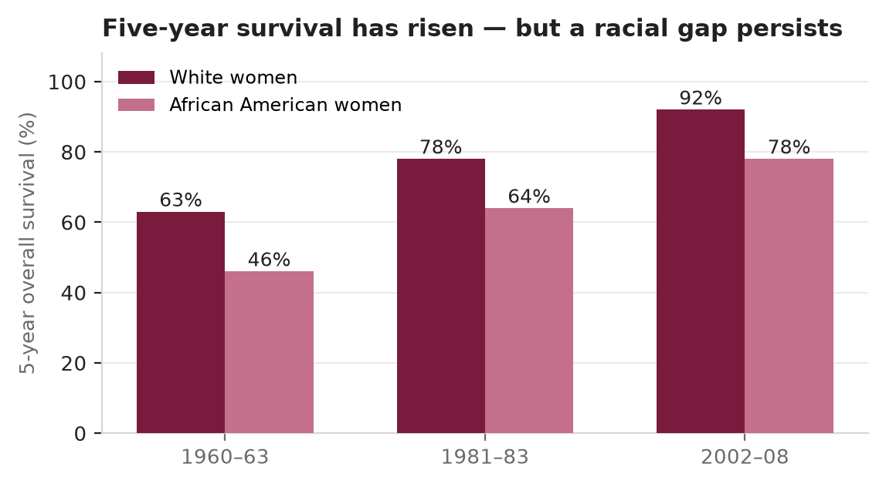
Epidemiology
Sec. 8
Fig. 14 --- Five-year survival by era and race (Schwartz, p.561).
Schwartz's Principles of Surgery -- Ch.17: The Breast
52

Slide 61
Epidemiology
Sec. 8
Lower incidence in less industrialised nations (early, multiple pregnancies with long lactation) --- except Japan; also Mormons, Seventh Day Adventists, Native Americans, Hispanic/Latina and Japanese/Filipino women in Hawaii. Higher: nuns (nulliparity), Ashkenazi Jewish women; incidence rises in second/third-generation Asian Americans. [p.561-562]
Mortality is worsened in poorer settings by no organised mammographic screening and limited multidisciplinary care --- delays, later stage, less complete treatment. [p.562]
African American women: lower lifetime risk but higher mortality; highest incidence under 45 y; more ER-negative tumours --- pattern also seen in West/sub-Saharan African populations; male breast cancer more frequent in both groups. Disparities are multifactorial (socioeconomic, access, comorbidity, biology). [p.562]
Schwartz's Principles of Surgery -- Ch.17: The Breast
53

Slide 62
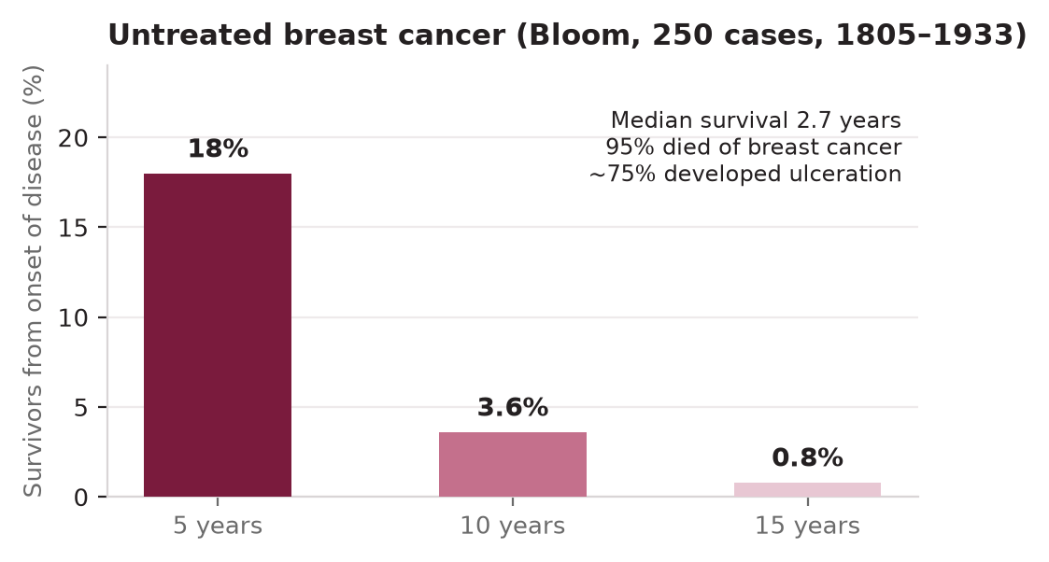
Natural history
Sec. 8
Natural history
Fig. 15 --- Survival of untreated breast cancer (Bloom series).
Schwartz's Principles of Surgery -- Ch.17: The Breast
54

Slide 63
Natural history
Sec. 8
Local growth: >80% show productive fibrosis; desmoplasia shortens Cooper's ligaments -> skin retraction/dimpling; lymphatic obstruction -> peau d'orange; then skin invasion, ulceration, satellite nodules. Tumour size correlates with survival and with nodal involvement. Recurrences: up to 20% local-regional only, >60% distant, 20% both. [p.562]
Axilla: nodes first soft and ill-defined, then firm/hard, matted, through the capsule and fixed to chest wall. Sequence I -> II -> III. About 95% of women who die have distant metastases. Nodal status was the top prognostic factor: node-negative <30% recurrence vs node-positive up to 75%. [p.562-563]
Schwartz's Principles of Surgery -- Ch.17: The Breast
55

Slide 64
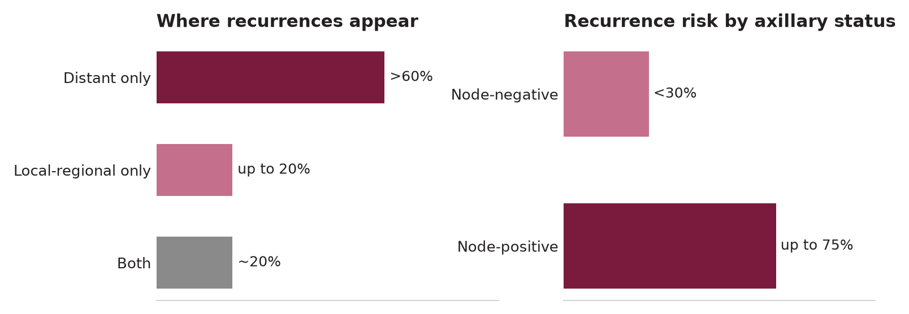
Natural history
Sec. 8
Fig. 16 --- Pattern of recurrence and effect of axillary status.
Schwartz's Principles of Surgery -- Ch.17: The Breast
56

Slide 65
Natural history
Sec. 8
Distant spread: blood supply (neovascularisation) at ~20th cell doubling; shed cells reach lungs via axillary/intercostal veins or the spine via Batson's plexus; successful implantation once tumour >0.5 cm (27th doubling). Distant metastases are the commonest cause of death for 10 years, so trials need 5-10 years' follow-up. 60% of metastases appear within 60 months but may appear at 20-30 years. [p.563]
ER-negative cancers relapse earlier (3-5 years); ER-positive risk falls off more slowly beyond 5 years. Tumour size and nodal status remain strong predictors of late recurrence (better than IHC4, Recurrence Score or PAM50). [p.563]
Metastatic sites, in order of frequency: bone, lung, pleura, soft tissue, liver. Brain is less common but more likely in triple-negative or HER2-positive disease after chemotherapy plus HER2 therapy. [p.563]
Schwartz's Principles of Surgery -- Ch.17: The Breast
57

Slide 66
SECTION 09
Histopathology of Breast Cancer
Schwartz, pp. 563-567

Slide 67
Histopathology of Breast Cancer
Sec. 9
In situ = confined by the basement membrane; invasive = crossed it. Minute invasion is easily missed -> examine multiple sections to call in-situ disease.
Schwartz's Principles of Surgery -- Ch.17: The Breast
58

Slide 68
Carcinoma in situ: LCIS vs DCIS
Sec. 9
Carcinoma in situ: LCIS vs DCIS
LCIS vs DCIS comparison
Feature | LCIS | DCIS
Mean age | 44-47 y (~15-25 y younger than invasive cancer) | 54-58 y
Incidence in biopsies | 2-5% | 5-10%
Clinical / mammographic signs | None; incidental finding; calcifications occur in adjacent tissue | Mass, pain, nipple discharge; microcalcifications
Premenopausal | 2/3 | 1/3
Synchronous invasive cancer | 5% | 2-46%
Multicentricity | 60-90% | 40-80%
Bilaterality | 50-70% | 10-20%
Axillary metastasis | 1% | 1-2%
Later invasive cancer | 25-35%, bilateral, after 15-20 y | 25-70%, ipsilateral (same quadrant), after 5-10 y
Invasive type that follows | Up to 65% are ductal, not lobular | Ductal
Concept | Marker of risk (not precursor); female only | Anatomic precursor of IDC (RR of invasive cancer ~5x); ~5% of male breast cancers
Schwartz's Principles of Surgery -- Ch.17: The Breast
59

Slide 69
Carcinoma in situ: LCIS vs DCIS
Sec. 9
Multicentric = second cancer outside the quadrant (>=4 cm away); multifocal = within the quadrant or within 4 cm. Before mammography in situ cancers were <6% of cancers (LCIS > DCIS 2:1); with screening in situ disease reached 45% (14-fold rise; DCIS > LCIS 2:1). [p.564]
Schwartz's Principles of Surgery -- Ch.17: The Breast
60

Slide 70
LCIS histology
Sec. 9
LCIS histology
Distension and distortion of terminal duct lobular units by large cells with normal nuclear-cytoplasmic ratio; cytoplasmic mucoid globules; racial predilection (12x more in white than African American women). Pleomorphic LCIS can show calcifications and resembles high-grade DCIS. [p.564, 553-554]
Schwartz's Principles of Surgery -- Ch.17: The Breast
61

Slide 71
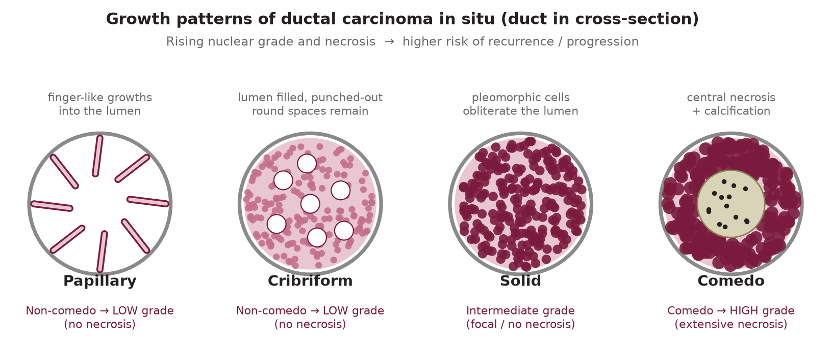
DCIS --- growth patterns and grade
Sec. 9
DCIS --- growth patterns and grade
Fig. 17 --- Papillary -> cribriform -> solid -> comedo growth patterns.
Schwartz's Principles of Surgery -- Ch.17: The Breast
62

Slide 72
DCIS --- growth patterns and grade
Sec. 9
Sequence: epithelial proliferation lines minor ducts (papillary) -> growths coalesce leaving round spaces with hyperchromasia and loss of polarity (cribriform) -> pleomorphic cells with mitoses fill the lumen (solid) -> growth outstrips blood supply, necrosis (comedo) with calcification visible on mammography. Early DCIS lacks atypia and is hard to tell from hyperplasia. [p.564]
Schwartz's Principles of Surgery -- Ch.17: The Breast
63

Slide 73
DCIS --- growth patterns and grade
Sec. 9
DCIS histologic subtype, nuclear grade, necrosis and DCIS grade
Histologic subtype | Nuclear grade | Necrosis | DCIS grade
Comedo | High | Extensive | High
Intermediate (often mixed non-comedo) | Intermediate | Focal or absent | Intermediate
Non-comedo (solid, cribriform, papillary, micropapillary) | Low | Absent | Low
Schwartz's Principles of Surgery -- Ch.17: The Breast
64

Slide 74
Invasive carcinoma
Sec. 9
Invasive carcinoma
Special types (about 10%) need >=90% of the tumour to show the defining feature. NST (ductal) ~80% --- generally worse prognosis than special types. [p.565]
Schwartz's Principles of Surgery -- Ch.17: The Breast
65

Slide 75
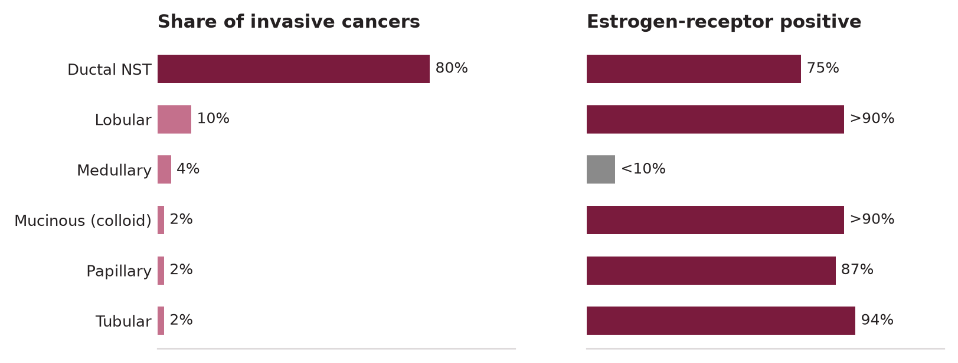
Invasive carcinoma
Sec. 9
Fig. 18 --- Invasive breast cancer types: frequency and ER positivity.
Schwartz's Principles of Surgery -- Ch.17: The Breast
66

Slide 76
Invasive carcinoma
Sec. 9
Invasive breast cancer histologic types [p.565-567]
Type | Key points
Invasive ductal, NST (80%) | Scirrhous; 5th-6th decade; hard solitary mass, poorly defined, stellate cut surface with chalky streaks. Nodes positive in up to 25% of screen-detected and up to 60% of symptomatic cases. 75% ER-positive.
Invasive lobular (10%) | Small cells, round nuclei, scant cytoplasm, single-file ("Indian file") growth; signet-ring variants (intracytoplasmic mucin). Clinically inapparent to whole-breast replacement; often multifocal, multicentric, bilateral; subtle on mammography. >90% ER+.
Medullary (4%) | Soft, haemorrhagic, bulky, deep; rapid growth (necrosis). Dense lymphoplasmacytic infiltrate, large poorly differentiated pleomorphic nuclei with active mitosis, sheet-like growth; ~50% with peripheral DCIS; bilateral 20%; <10% hormone-receptor positive; BRCA1 phenotype; reactive axillary nodes can mislead staging; better 5-year survival than NST or lobular.
Mucinous / colloid (2%) | Older women, bulky; glistening gelatinous; extracellular mucin around low-grade cells; >90% receptor-positive; nodes 33%; 5-/10-year survival 73% / 59%; needs multiple sections.
Papillary (2%) | 7th decade, non-white women; small (<3 cm); fibrovascular stalks; 87% ER+; low nodal rate; survival like mucinous/tubular.
Tubular (2%) | Up to 20% of screen-detected; perimenopausal; haphazard small tubules; 94% ER+; nodes ~10% (1-2 nodes do not worsen survival); distant metastases rare; survival approaches 100%. Cribriform is a close relative.
Paget's disease of the nipple | Chronic eczematous, then ulcerated weeping nipple; large pale vacuolated Paget cells in rete pegs; usually with extensive DCIS +/- invasion; mass may/may not be present. Nipple biopsy. Differential: pagetoid melanoma --- S-100 positive in melanoma, CEA positive in Paget's. Surgery: lumpectomy or mastectomy depending on NAC/parenchymal disease.
Rare | Adenoid cystic, squamous, apocrine (see section 15).
Schwartz's Principles of Surgery -- Ch.17: The Breast
67

Slide 77
SECTION 10
Diagnosis: Examination, Imaging and Biopsy
Schwartz, pp. 567-575

Slide 78
Presentation
Sec. 10
Presentation
~30% of women find a lump. Other presentations: enlargement/asymmetry, nipple change/retraction/discharge, skin ulceration or erythema, axillary mass, musculoskeletal discomfort. Up to 50% of women with breast complaints have no physical sign; pain usually means benign disease. [p.567]
Missed breast cancer = the commonest diagnostic-error malpractice claim (often young women). Age <=45 with a palpable mass and equivocal mammogram -> ultrasound + biopsy to avoid delay. [p.567]
Schwartz's Principles of Surgery -- Ch.17: The Breast
68

Slide 79
Clinical examination
Sec. 10
Clinical examination
Inspect seated with arms at sides, arms raised, hands on hips (with/without pectoral contraction), and leaning forward: symmetry, size, shape, peau d'orange, nipple/skin retraction, erythema. [p.567]
Palpate supine with the palmar surface of the fingers (no pinching) from sternum to latissimus and clavicle to rectus sheath; mould the breast to reveal retraction. Then examine all three axillary levels (support the arm), supraclavicular and parasternal areas. Record on a diagram: site, size, consistency, shape, mobility, fixation. [p.567]
Clinical assessment of axillary nodes is only ~33% accurate. [p.575]
Schwartz's Principles of Surgery -- Ch.17: The Breast
69

Slide 80
Imaging modalities
Sec. 10
Imaging modalities
Breast imaging modalities [p.567-574]
Modality | Key facts
Mammography | Dose 0.1 cGy/study (chest X-ray = 25% of that); no measurable cancer risk from screening. Screening = CC + MLO (MLO shows the most tissue incl. upper outer quadrant and axillary tail; CC shows medial breast and allows more compression). Diagnostic adds 90 degree lateral (triangulation), spot compression (+/- magnification x1.5). Cancer signs: solid mass +/- stellate/spiculated, asymmetric thickening, clustered microcalcifications (fine, stippled; up to 50% of non-palpable cancers; sometimes the only sign in young women). True-positive rate 90%; only 20% of non-palpable vs 50% of palpable cancers have node metastases.
Film -> digital -> DBT | Screen-film replaced xeromammography. DMIST (>42,000): digital = film overall but better <50 y, dense breasts, pre/perimenopause. Tomosynthesis (DBT): slices as thin as 0.5 mm; FDA 2011 with digital mammography; dose about double; STORM: increased detection and decreased recalls; synthetic 2D-3D (STORM-2) equals dual acquisition with less radiation. CEDM (iodinated contrast): detects cancers like MRI; cheaper, faster, usable with pacemakers/expanders.
Ductography | For nipple discharge (especially bloody): cannulate one duct, inject 0.1-0.2 mL contrast, CC + MLO without compression. Papilloma = small filling defect; cancer = irregular mass or multiple filling defects.
Ultrasound | Resolves equivocal mammograms; separates cyst from solid; guides FNA/core/localisation. Cyst: well-circumscribed, echo-free, smooth. Benign solid: smooth, round/oval, weak echoes. Cancer: irregular walls (may be smooth with enhancement). Misses lesions <=1 cm. Axilla: sensitivity 35-82%, specificity 73-97%; abnormal node = cortical thickening, rounder shape, >10 mm, absent fatty hilum, hypoechoic.
MRI | Use dedicated coils and BI-RADS; an MRI-only finding needs focused US, then MRI-guided biopsy. Finds contralateral cancer in 5.7% of women with known cancer and extra ipsilateral (multifocal/multicentric) disease. COMICE (n=1,623): MRI did not lower re-operation (19% vs 19%); meta-analysis: MRI -> more mastectomies without proven benefit. Useful for: axillary metastasis with occult primary, response to neoadjuvant therapy, selecting partial-breast RT, recurrence in treated breast, screening high-risk women.
Schwartz's Principles of Surgery -- Ch.17: The Breast
70

Slide 81
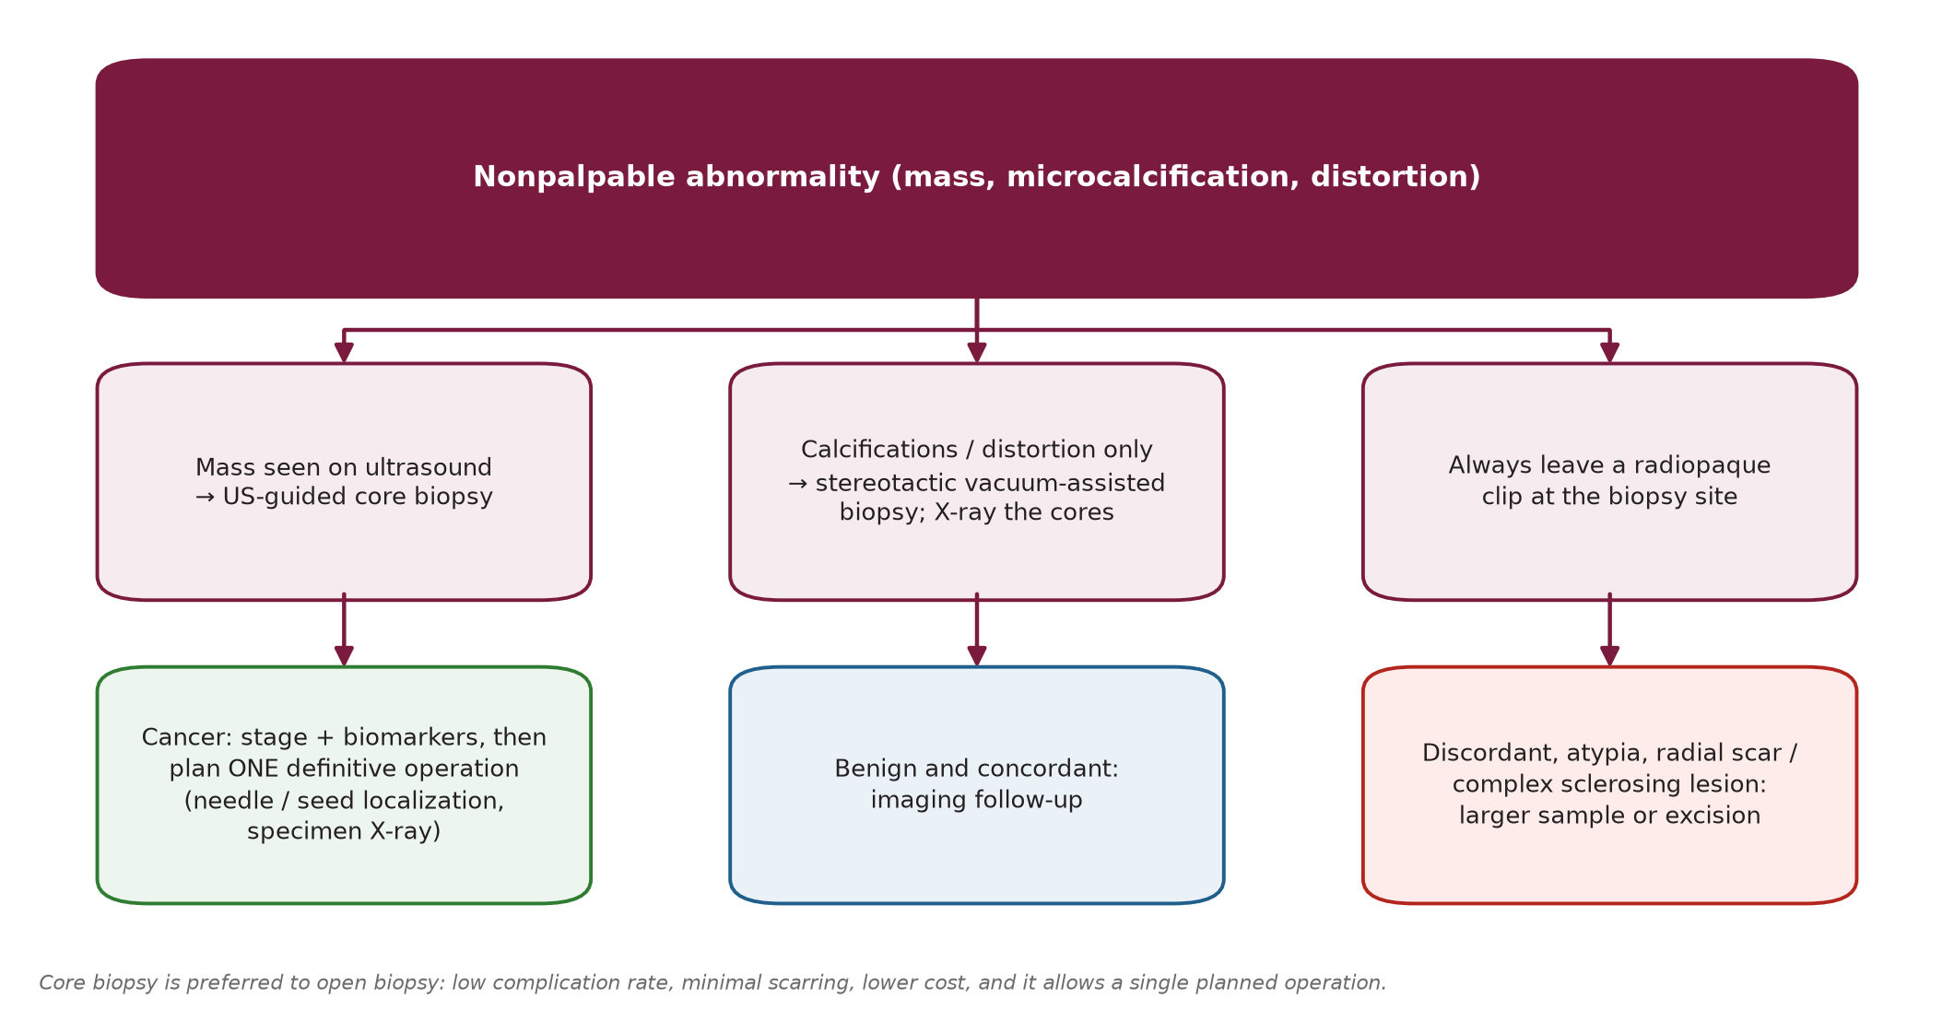
Biopsy
Sec. 10
Biopsy
Fig. 19 --- Work-up of a non-palpable abnormality.
Schwartz's Principles of Surgery -- Ch.17: The Breast
71

Slide 82
Biopsy
Sec. 10
Non-palpable: ultrasound localisation if a mass; stereotactic if only calcifications/distortion. Core biopsy is preferred to open biopsy --- lower complication rate, minimal scar, cheaper, and one operation can be planned from the result. Diagnostic mammography + US/stereotactic FNA together reach almost 100% accuracy. [p.574]
Palpable: outpatient FNA (1.5-in 22-G needle, 10-mL syringe, syringe holder; suction while moving in the mass; make air-dried and 95% ethanol-fixed smears) or core (14-G Tru-Cut/automated). For a clinically and mammographically suspicious mass FNA sensitivity/specificity approach 100%. Core shows architecture and whether the cancer is invasive. [p.574-575]
Vacuum-assisted core (8-10 G) takes 4-12 samples; X-ray calcification cores; always leave a radiopaque clip (marks the site if the lesion is removed entirely). Fix in formalin -> paraffin. [p.575]
Caution
A benign core biopsy does not exclude cancer (sampling error). Clinical + radiological + pathological findings must be concordant. If not -> multidisciplinary review -> image-guided or open biopsy. [p.575]
Schwartz's Principles of Surgery -- Ch.17: The Breast
72

Slide 83
SECTION 11
Staging and Biomarkers
Schwartz, pp. 575-580

Slide 84
Staging and Biomarkers
Sec. 11
Clinical stage = physical examination of skin, breast and regional nodes (axillary, supraclavicular, internal mammary) +/- imaging. Pathologic stage adds the resected tumour and nodes. Fisher: accurate prediction of distant disease needs >=10 level I-II nodes examined. [p.575]
Schwartz's Principles of Surgery -- Ch.17: The Breast
73

Slide 85
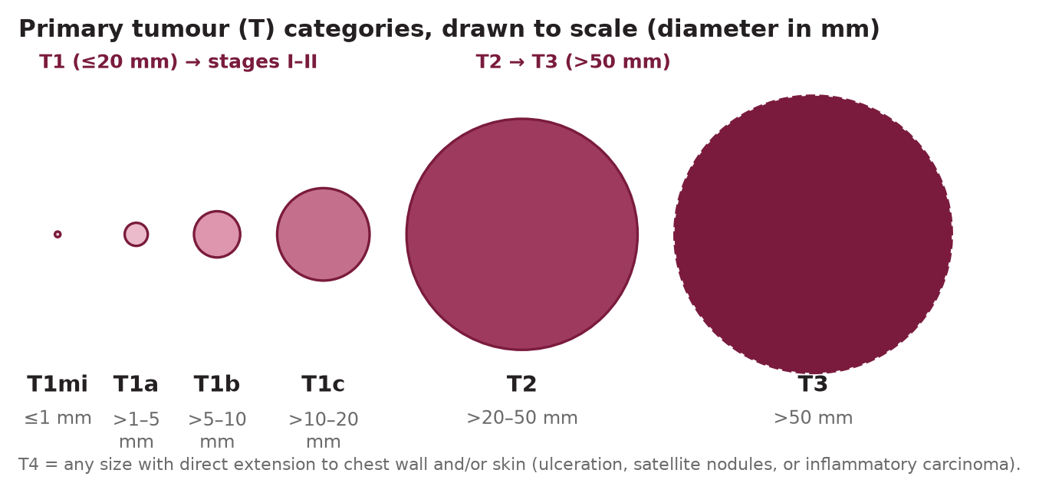
AJCC 8th edition TNM (Schwartz Table 17-10)
Sec. 11
AJCC 8th edition TNM (Schwartz Table 17-10)
Fig. 20 --- T categories drawn to scale.
Schwartz's Principles of Surgery -- Ch.17: The Breast
74

Slide 86
AJCC 8th edition TNM (Schwartz Table 17-10)
Sec. 11
AJCC 8th edition T categories
T | Definition
Tis (DCIS) / Tis (Paget) | DCIS; Paget disease of the nipple not associated with invasive carcinoma/DCIS in the underlying breast (if there is, stage by the parenchymal tumour). LCIS is now considered benign and removed from TNM.
T1 (<=20 mm) | T1mi <=1 mm; T1a >1-5 mm; T1b >5-10 mm; T1c >10-20 mm.
T2 / T3 | T2 >20-50 mm; T3 >50 mm.
T4 | Any size with direct extension to chest wall and/or skin (ulceration or macroscopic nodules; dermal invasion alone is not T4). T4a chest wall (pectoralis adherence alone does not qualify); T4b ulceration and/or ipsilateral macroscopic satellite nodules and/or skin oedema (peau d'orange) not meeting inflammatory criteria; T4c = a + b; T4d inflammatory carcinoma.
Measure to the nearest mm; subscript c or p shows clinical vs pathological measurement; pathological size takes precedence. [p.576]
AJCC 8th edition N (nodal) categories, clinical vs pathological [p.576-577]
Category | Clinical (c) | Pathological (p)
N0 | No regional metastasis by imaging or exam | None found; pN0(i+) = isolated tumour cells <=0.2 mm; pN0(mol+) = RT-PCR positive only
N1 | cN1: movable ipsilateral level I-II nodes. cN1mi: micrometastases (~200 cells, >0.2 to <=2.0 mm), rarely used | pN1mi micromets; pN1a 1-3 axillary nodes with >=1 deposit >2 mm; pN1b internal mammary sentinel nodes (micro/macro), axilla negative; pN1c = a + b
N2 | cN2a: level I-II nodes fixed/matted; cN2b: internal mammary nodes only, axilla clear | pN2a: 4-9 axillary nodes (>=1 deposit >2 mm); pN2b: clinically detected internal mammary nodes, axilla pathologically negative
N3 | cN3a: infraclavicular (level III) nodes; cN3b: internal mammary nodes + level I-II nodes; cN3c: ipsilateral supraclavicular nodes | pN3a: >=10 axillary nodes or infraclavicular nodes; pN3b: pN1a/pN2a with cN2b, or pN2a with pN1b; pN3c: supraclavicular
M | M0 (incl. cM0(i+): tumour cells/deposits <=0.2 mm in blood, marrow or non-regional nodes without symptoms); cM1 distant metastases by clinical/radiographic means | pM1 histologically proven >0.2 mm. pM0 is not a valid category.
Suffixes (sn) and (f) mark confirmation by sentinel node biopsy or FNA/core. Supraclavicular nodal disease is no longer stage IV (now N3c), but routine scalene/supraclavicular biopsy is not indicated. The 8th edition allows staging from internal mammary sentinel nodes (drainage there is commoner with central and medial cancers). Number of involved axillary nodes is a top predictor of 10- and 20-year survival. [p.575]
Schwartz's Principles of Surgery -- Ch.17: The Breast
75

Slide 87
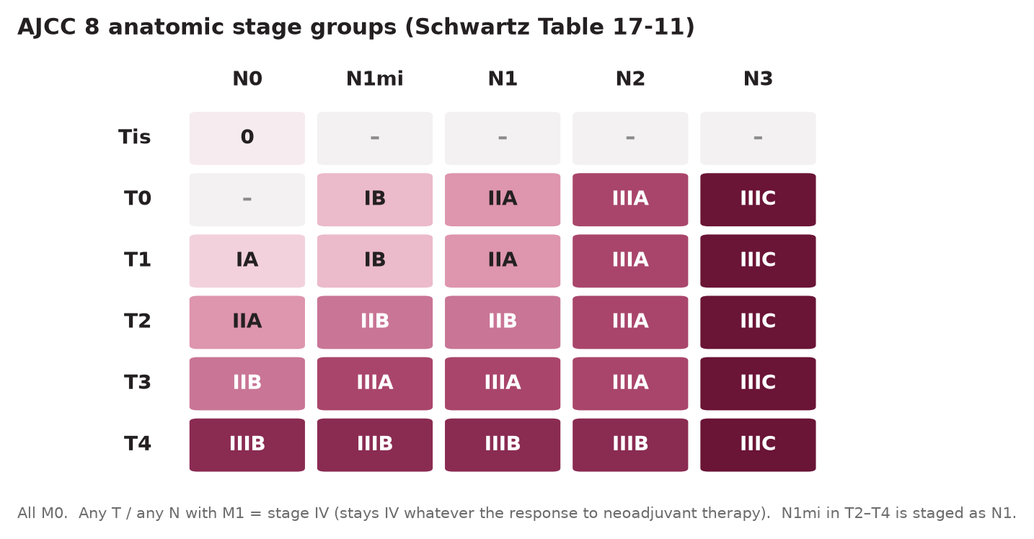
AJCC 8th edition TNM (Schwartz Table 17-10)
Sec. 11
Fig. 21 --- Anatomic stage groups (Table 17-11).
Schwartz's Principles of Surgery -- Ch.17: The Breast
76

Slide 88
AJCC 8th edition TNM (Schwartz Table 17-10)
Sec. 11
Exam pearl
Micrometastatic nodes: T0-T1 with N1mi = IB; in T2-T4 tumours N1mi is staged as N1. If M1 exists before neoadjuvant therapy the stage stays IV whatever the response. Post-neoadjuvant staging uses the yc/yp prefix; complete pathological response (ypT0 ypN0 cM0) has no anatomic stage group. Post-surgical imaging that shows metastases within 4 months of diagnosis (no progression, no neoadjuvant therapy) can change the stage. [p.578]
Schwartz's Principles of Surgery -- Ch.17: The Breast
77

Slide 89
Work-up by stage (Table 17-13)
Sec. 11
Work-up by stage (Table 17-13)
Recommended work-up investigations by clinical stage
Investigation | 0 | I | II | III | IV
History and physical | checked | checked | checked | checked | checked
Complete blood count, platelets | - | - | checked | checked | checked
Liver function tests and alkaline phosphatase | - | - | checked | checked | checked
Chest radiograph | - | - | checked | checked | checked
Bilateral diagnostic mammograms (US as indicated) | checked | checked | checked | checked | checked
Hormone receptor status | checked | checked | checked | checked | checked
HER2/neu expression | - | checked | checked | checked | checked
Bone scan | - | - | - | checked | checked
Abdominal CT / US / MRI (+/- pelvis) | - | - | - | checked | checked
Schwartz's Principles of Surgery -- Ch.17: The Breast
78

Slide 90
Work-up by stage (Table 17-13)
Sec. 11
Abdominal imaging and bone scanning are also indicated at any stage for symptoms or abnormal laboratory tests. (Table adapted in the book from NCCN 2006 data.) [p.580]
Schwartz's Principles of Surgery -- Ch.17: The Breast
79

Slide 91
Biomarkers
Sec. 11
Biomarkers
Types: risk (familial, germline, atypia, density), exposure (DNA adducts), surrogate endpoint (used in short chemoprevention trials), prognostic (outcome regardless of therapy) and predictive (response to therapy). The three that decide therapy are ER, PR and HER2. [p.575-579]
Schwartz's Principles of Surgery -- Ch.17: The Breast
80

Slide 92
Biomarkers
Sec. 11
Key biomarkers and clinical meaning [p.577-579]
Biomarker | Clinical meaning
ER / PR | Test every invasive cancer (pre- and postmenopausal), on core or FNA material by IHC. ER/PR-positive tumours respond more to endocrine therapy; HR-positive metastatic patients live 2-3x longer than HR-negative. ER and PR both negative -> no endocrine therapy.
HER2/neu (ErbB family) | Overexpression -> poorly differentiated, high proliferation, node-positive, low HR, increased recurrence/death. Test all invasive cancers by IHC (protein) or FISH (gene amplification); RT-PCR/Oncotype mRNA is not recommended for decisions (high false-negative rate). Positive -> anti-HER2 therapy. Trastuzumab + chemotherapy: -40-50% recurrence, ~1/3 lower mortality. HER2 is a co-receptor without its own ligand.
EGFR | Overexpression correlates with ER-negativity and p53 overexpression.
Ki-67 / PCNA (proliferation) | Correlate with p53, high S-phase, aneuploidy, mitotic index, high grade; inverse with ER. IHC4 (ER, PR, HER2, Ki-67) approximately equals Recurrence Score prognostically, but Ki-67 is poorly reproducible between labs.
VEGF / angiogenesis index | VEGF increases with microvessel density and recurrence in node-negative disease. Bevacizumab + paclitaxel (ECOG E2100) raised PFS from 5.8 to 11.3 months but was not reproduced; FDA revoked the indication in 2011.
Apoptosis (bcl-2, bax) | Bcl-2 = the only oncogene acting by inhibiting apoptosis; increased bcl-2 and decreased bax:bcl-2 ratio correlate with high grade, node metastases, poor survival.
Others | mTOR pathway, p53, cyclins/CDKs, proteasome, COX-2, PPARs --- preclinical/trial stage at the time of writing.
Schwartz's Principles of Surgery -- Ch.17: The Breast
81

Slide 93
Biomarkers
Sec. 11
Traditional prognostic and predictive factors (Table 17-12)
Tumour factors | Host factors
Nodal status, tumour size, histologic/nuclear grade, lymphovascular invasion, pathologic stage, hormone receptor status, DNA content (ploidy, S-phase), extent of intraductal component, HER2/neu | Age, menopausal status, family history, previous breast cancer, immunosuppression, nutrition, prior chemotherapy, prior radiation
Individual markers do not improve on combined clinicopathologic risk; using combined factors alone, up to 70% of early-cancer patients receive chemotherapy that is unnecessary or ineffective. Tools: Adjuvant! Online, Nottingham Prognostic Index, PREDICT. [p.579]
Schwartz's Principles of Surgery -- Ch.17: The Breast
82

Slide 94
Multigene assays
Sec. 11
Multigene assays
Multigene assays [p.580]
Assay | What it is | Evidence and use
Oncotype DX | 21-gene RT-PCR; node-negative, ER-positive | High score -> benefits from chemotherapy; low score -> endocrine therapy alone. TAILORx: RS 0-10 -> 98% 5-year OS and low local-regional/distant recurrence with endocrine therapy alone; intermediate (11-25) randomised to endocrine +/- chemotherapy. Retrospectively predicts chemo benefit in postmenopausal ER+ with 1-3 nodes. Changes treatment decisions.
MammaPrint | 70-gene profile, FDA-approved (also on paraffin); stage I-II, node-negative, ER+ or ER- | Low vs high risk of distant metastasis. RASTER: low-risk = 97% distant-recurrence-free at 5 y. MINDACT (node-negative or 1-3 nodes): clinically high-risk / genomically low-risk had 94.7% 5-y distant-metastasis-free survival (non-inferior; target >92%) but DFS/OS were higher with chemotherapy in the ITT population.
DCIS Score | Multigene assay from ECOG 5194 samples (Solin) | Low/intermediate/high risk of in-breast events (DCIS or invasive).
Schwartz's Principles of Surgery -- Ch.17: The Breast
83

Slide 95
SECTION 12
Overview of Therapy by Stage
Schwartz, pp. 580-588

Slide 96
Overview of Therapy by Stage
Sec. 12
Treatment depends on stage, biologic subtype and general health. Before local therapy the surgeon must know the clinical stage, histologic characteristics and biomarker levels and share a clear plan with the patient.
Schwartz's Principles of Surgery -- Ch.17: The Breast
84

Slide 97
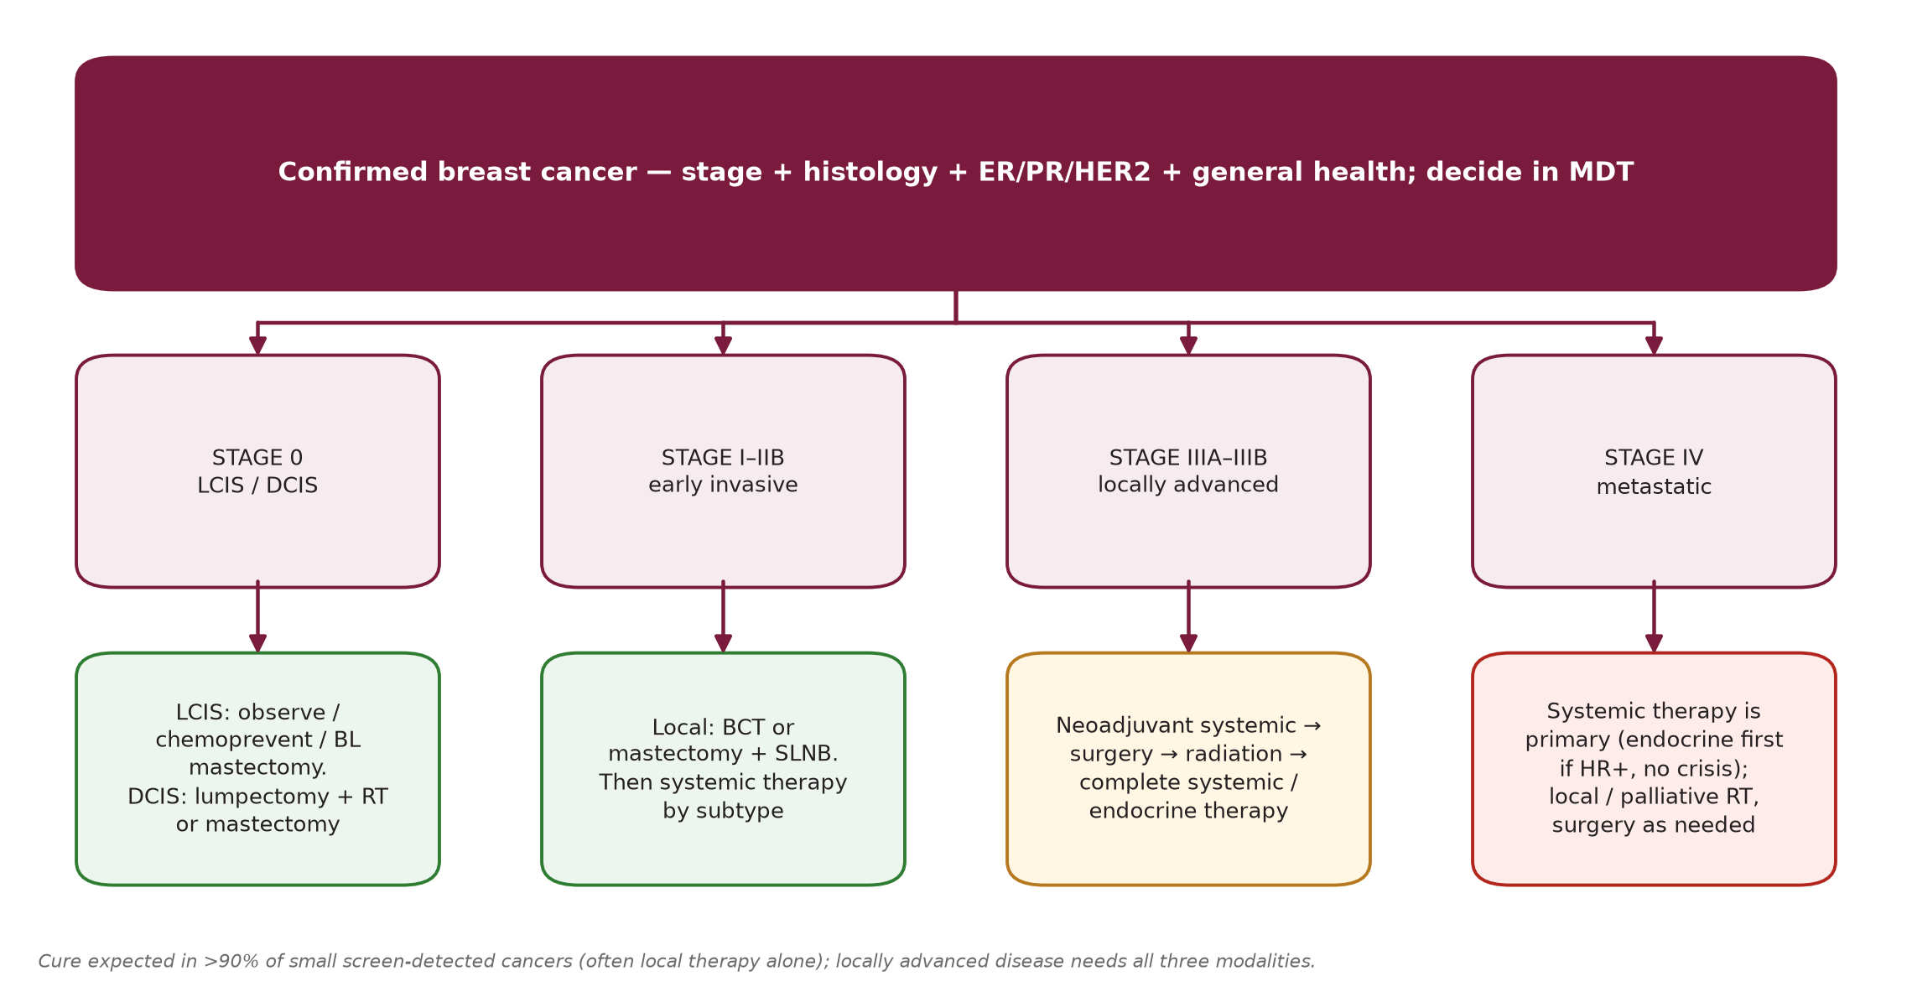
Overview of Therapy by Stage
Sec. 12
Fig. 22 --- Master map of management by stage.
Schwartz's Principles of Surgery -- Ch.17: The Breast
85

Slide 98
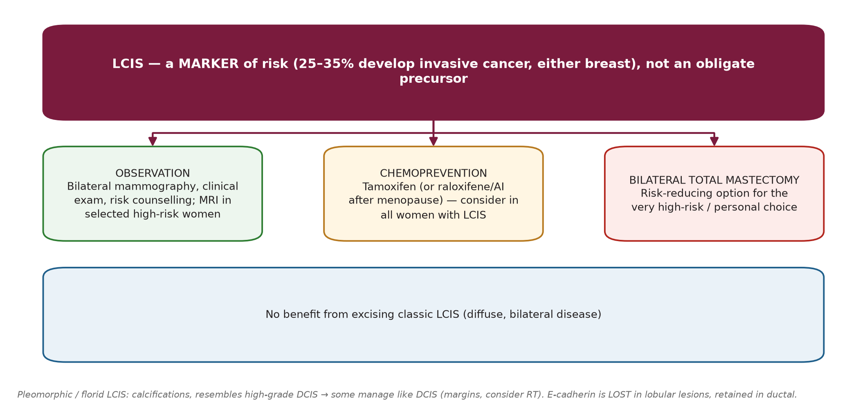
LCIS
Sec. 12
LCIS
Fig. 23 --- LCIS management.
Schwartz's Principles of Surgery -- Ch.17: The Breast
86

Slide 99
LCIS
Sec. 12
Options: observation, chemoprevention (tamoxifen), bilateral total mastectomy. Aim: prevent or detect early the invasive cancer that follows in 25-35%. Excision does not help because disease is diffuse and risk is equal in both breasts. Expert pathology review is essential (difficult to separate from ADH or early invasion). Bilateral mammography first. [p.580]
Pleomorphic LCIS behaves more like DCIS; some manage it as DCIS (attention to margins, consider RT with breast conservation). [p.554]
Schwartz's Principles of Surgery -- Ch.17: The Breast
87

Slide 100
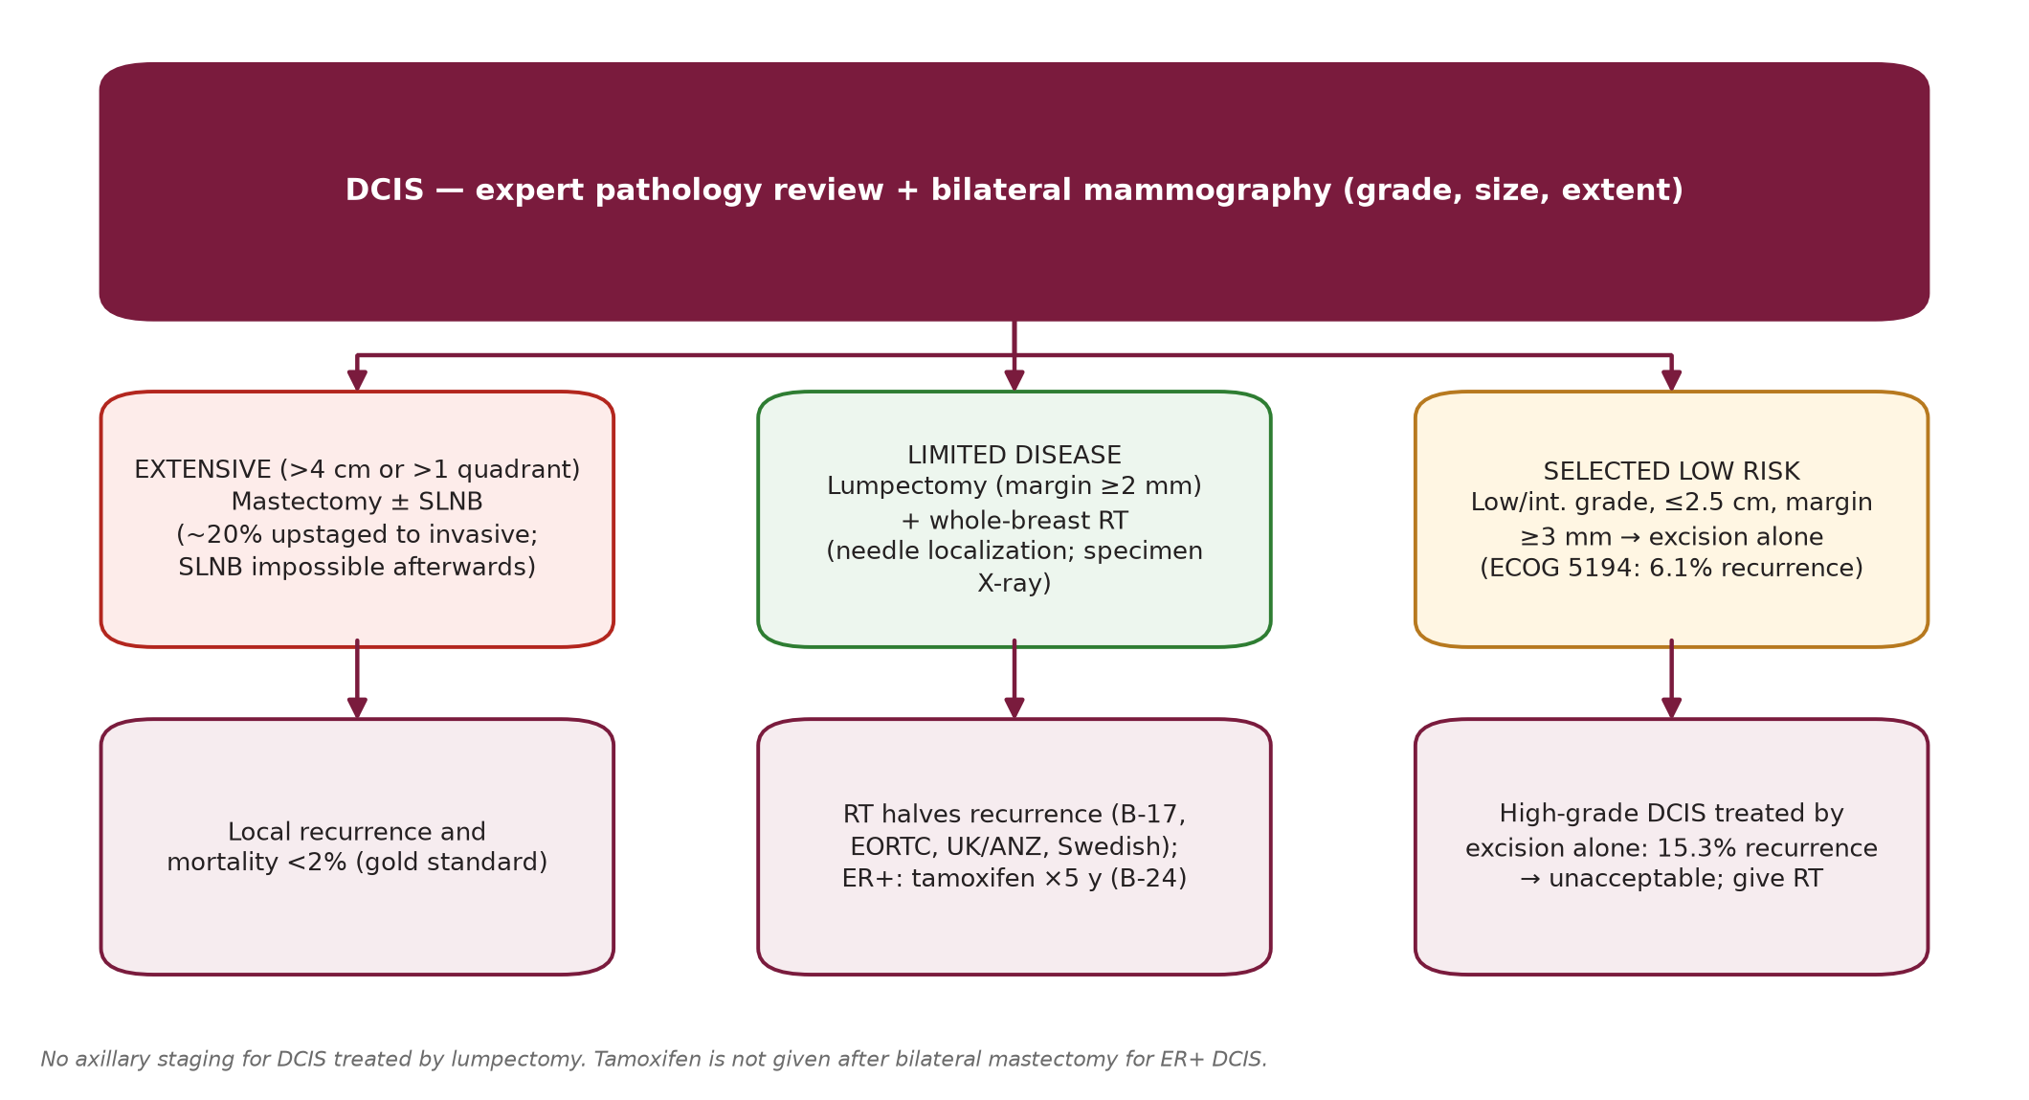
DCIS
Sec. 12
DCIS
Fig. 24 --- DCIS management by extent, margin and grade.
Schwartz's Principles of Surgery -- Ch.17: The Breast
88

Slide 101
DCIS
Sec. 12
Extensive (>4 cm or >1 quadrant) -> mastectomy; limited disease -> lumpectomy + radiation. Non-palpable DCIS: needle/image-guided localisation and specimen mammography. Mastectomy is the gold standard: local recurrence and mortality <2%. No randomised trial compares mastectomy with breast conservation. Without RT ~45% of recurrences are invasive. [p.580-581]
Radiation benefit proven in all subgroups: NSABP B-17 (margins not prospectively assessed; up to half may have had positive margins), EORTC 10853, UK/ANZ and Swedish trials (margins assessed). 2016 SSO-ASTRO-ASCO: a 2-mm margin is adequate with whole-breast RT. Silverstein: with margins >10 mm no extra RT benefit; relative recurrence risk 1.49 for margins 1-10 mm vs 2.54 for <1 mm. [p.581]
Omitting radiation: ECOG 5194 (registry): low/intermediate grade <=2.5 cm or high grade <=1 cm, margin >=3 mm -> in-breast recurrence 6.1% (low/int.) vs 15.3% (high grade) at 6.2 y, contralateral cancer ~4% -> acceptable only for low/intermediate. RTOG 9804 (good-risk, n=585): 5-y local recurrence 0.4% with RT vs 3.2% without. [p.581-582]
Axilla: limited role. About 20% of core-diagnosed DCIS proves invasive at final pathology; because SLN cannot be done after mastectomy, SLNB with mastectomy is usually recommended (not with lumpectomy). [p.582]
Tamoxifen (NSABP B-24, n=1,804 lumpectomy + RT +/- tamoxifen): events 8.2% vs 13.4% at 74 months (P=0.0009); benefit greater in ER-positive DCIS (76% of tested cases); but 15% had positive margins, so tamoxifen may partly treat inadequate excision. Offer 5 years to ER+ DCIS without contraindication; not after bilateral mastectomy. [p.582, 596]
Schwartz's Principles of Surgery -- Ch.17: The Breast
89

Slide 102
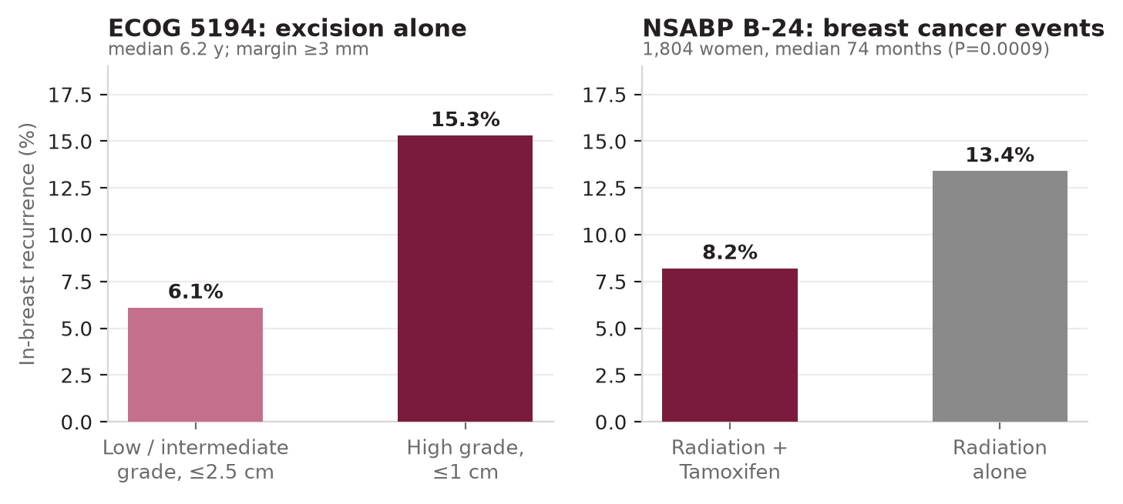
DCIS
Sec. 12
Fig. 25 --- DCIS trial outcomes (ECOG 5194 and NSABP B-24).
Schwartz's Principles of Surgery -- Ch.17: The Breast
90

Slide 103
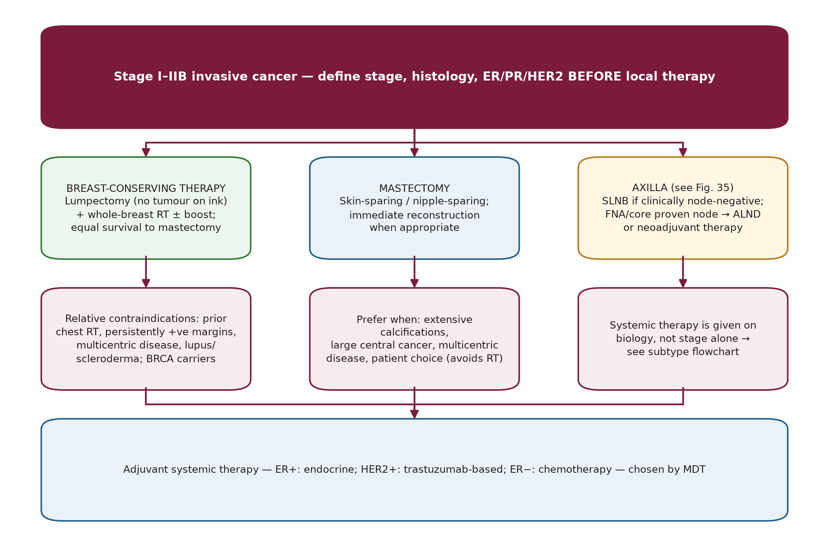
Early invasive cancer (stage I, IIA, IIB)
Sec. 12
Early invasive cancer (stage I, IIA, IIB)
Fig. 26 --- Stage I-IIB: local therapy, axilla, systemic therapy.
Schwartz's Principles of Surgery -- Ch.17: The Breast
91

Slide 104
Early invasive cancer (stage I, IIA, IIB)
Sec. 12
Six randomised trials show equal survival for breast conservation and mastectomy. Size limits: most 2-2.5 cm; B-06 4 cm; NCI trial up to 5 cm. B-06 at 20 years: same DFS after total mastectomy and lumpectomy +/- RT, but in-breast recurrence 39.2% (lumpectomy alone) vs 14.3% (with RT). EBCTCG (15 y): RT after lumpectomy lowers mortality by 5.1% (node-negative) and 7.1% (node-positive) --- RT improves survival, not just local control. [p.582]
Preferred treatment: lumpectomy + RT for unifocal disease in non-carriers. Equivalent: mastectomy + axillary staging vs BCS + axillary staging + RT; BCS offers cosmetic advantages. [p.582-583]
Schwartz's Principles of Surgery -- Ch.17: The Breast
92

Slide 105
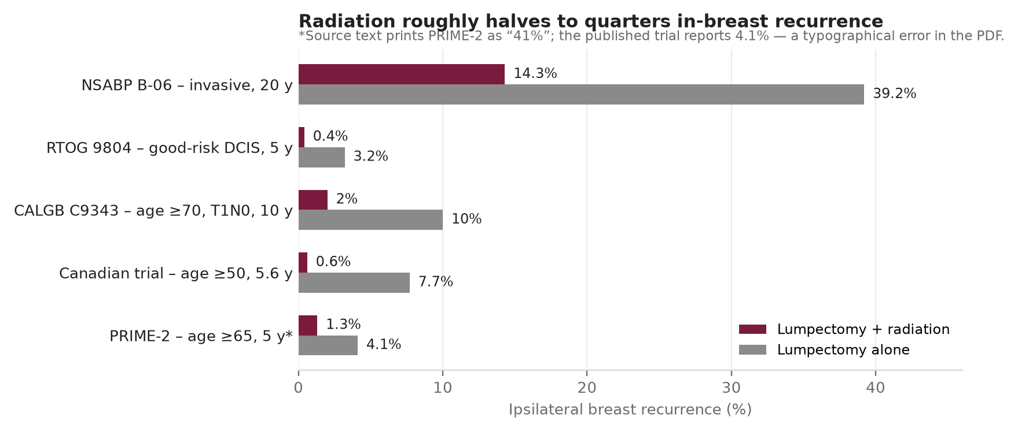
Early invasive cancer (stage I, IIA, IIB)
Sec. 12
Fig. 27 --- Radiation lowers in-breast recurrence after lumpectomy.
Schwartz's Principles of Surgery -- Ch.17: The Breast
93

Slide 106
Early invasive cancer (stage I, IIA, IIB)
Sec. 12
Selected older women with small, ER-positive tumours may omit RT: CALGB C9343 (>=70 y, T1N0, all on tamoxifen): local recurrence 1% vs 4% at 5 y, 2% vs 10% at 10 y, no difference in distant disease, cancer-specific or overall survival. Canadian trial (>=50 y, mean 68, 80% ER+): 0.6% vs 7.7%, no DFS/OS difference. PRIME-2 (>=65 y, ER+, N0, <=3 cm, on endocrine therapy): 1.3% vs 4.1% (misprinted as 41% on p.583; corrected to 4.1%, the published trial value). [p.582-583]
Accelerated partial breast irradiation (APBI) --- ASTRO groups [p.583]
Group | Criteria
Suitable | Age >=60 y, unifocal T1, ER-positive, no lymphovascular invasion, margins >=2 mm
Cautionary | Invasive lobular histology, size 2.1-3 cm, ER-negative, focal LVI, margins <2 mm
Unsuitable | T3 or T4, ER-negative (in this group), multifocal, multicentric, extensive LVI, positive margins
APBI = 5 days twice daily, lower total dose vs 50 Gy +/- boost over 5-6 weeks; recurrences are mostly at/near the tumour bed. RTOG 04-13/NSABP B-39 (whole-breast vs APBI) awaited; TARGIT (n=3,451; intra-operative RT vs external beam): 3.3% vs 1.3% recurrence at 2.4 years. [p.583]
Contraindications
Relative contraindications to breast conservation: (a) prior breast/chest-wall radiation, (b) persistently positive margins after re-excision, (c) multicentric disease, (d) scleroderma or lupus. Known BRCA carriers: not advised (high risk of new cancers). [p.583]
Nipple-sparing mastectomy: poor choice if post-mastectomy RT is planned (radiation effect on the preserved nipple).
Schwartz's Principles of Surgery -- Ch.17: The Breast
94

Slide 107
Early invasive cancer (stage I, IIA, IIB)
Sec. 12
Reconstruction: immediate for most early-stage patients (allows skin-sparing, single operation, cheaper, psychological benefit). Implant or autologous (TRAM, DIEP, latissimus +/- implant). If PMRT expected: tissue expander (deflate for RT), definitive reconstruction 6-12 months after RT. [p.583]
Schwartz's Principles of Surgery -- Ch.17: The Breast
95

Slide 108
The axilla in early breast cancer
Sec. 12
The axilla in early breast cancer
Immediate ALND vs delayed (when nodes became palpable) showed no survival difference; with screening, up to 75% of women with a negative axilla do not need ALND. Lymphatic mapping came from melanoma. [p.583]
Krag (early 1990s): radioisotope + gamma probe (SLN found in 18/22; positive in all 7 node-positive). Giuliano (1991): blue dye, SLN found in 65.5%, predicted axillary status in 95.6%. [p.584]
Landmark axillary/SLN trials [p.584-585]
Trial | Question | Findings
ALMANAC (n=1,031) | SLN dissection vs standard axillary surgery | Decreased lymphedema and sensory loss, shorter drain use, hospital stay and return to normal activity with SLN.
NSABP B-32 (n=5,611) | SLN dissection + ALND vs ALND only if SLN positive (cN0) | SLN identification 97%; false-negative 9.7%; 26% SLN-positive, of whom >60% had no other positive node. No difference in DFS, OS or local-regional recurrence with SLN alone; less arm swelling, better range of motion and quality of life.
ACOSOG Z0010 (n=5,539) | Prognostic value of occult metastases; T1-2 for BCS + WBI | 24% SLN+ on routine pathology; 10.5% of negative SLNs had occult IHC metastases; 3.0% bone-marrow positive -> not significant in multivariable analysis -> routine IHC of SLNs not warranted.
ACOSOG Z0011 | cT1-2 N0, 1-2 positive SLNs, BCS + tangential WBI, no other axillary/nodal RT; no neoadjuvant therapy; randomised to completion ALND vs no further surgery | At 6.3 y: OS 91.9% vs 92.5% (P=0.25), DFS 82.2% vs 83.8% (P=0.14); 10-y results confirm low local-regional failure. ALND arm: more infection, seroma, paresthesia; lymphedema at 1 y 13% vs 2%.
IBCSG 23-01 | SLN micrometastases only; ALND vs none; mastectomy allowed (~9% per arm) | No difference in OS or local-regional recurrence (endpoint definitions and power criticised).
Schwartz's Principles of Surgery -- Ch.17: The Breast
96

Slide 109
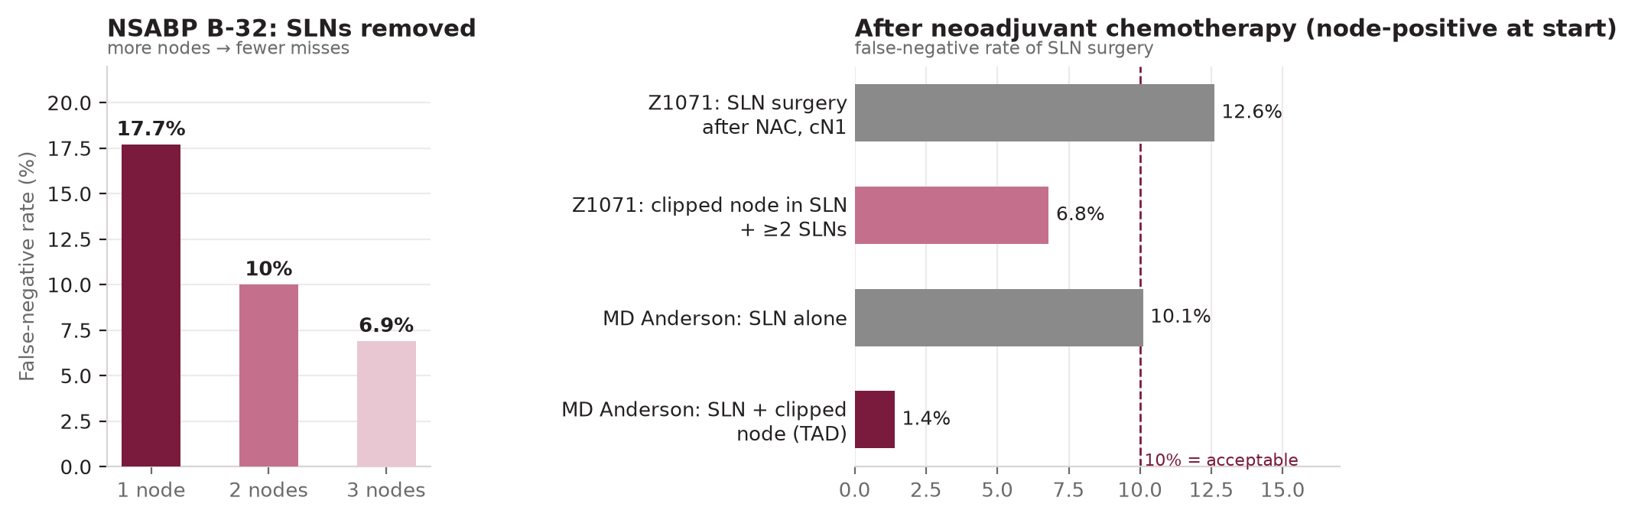
The axilla in early breast cancer
Sec. 12
Fig. 28 --- SLN false-negative rates: number of nodes removed, and after neoadjuvant chemotherapy.
Schwartz's Principles of Surgery -- Ch.17: The Breast
97

Slide 110
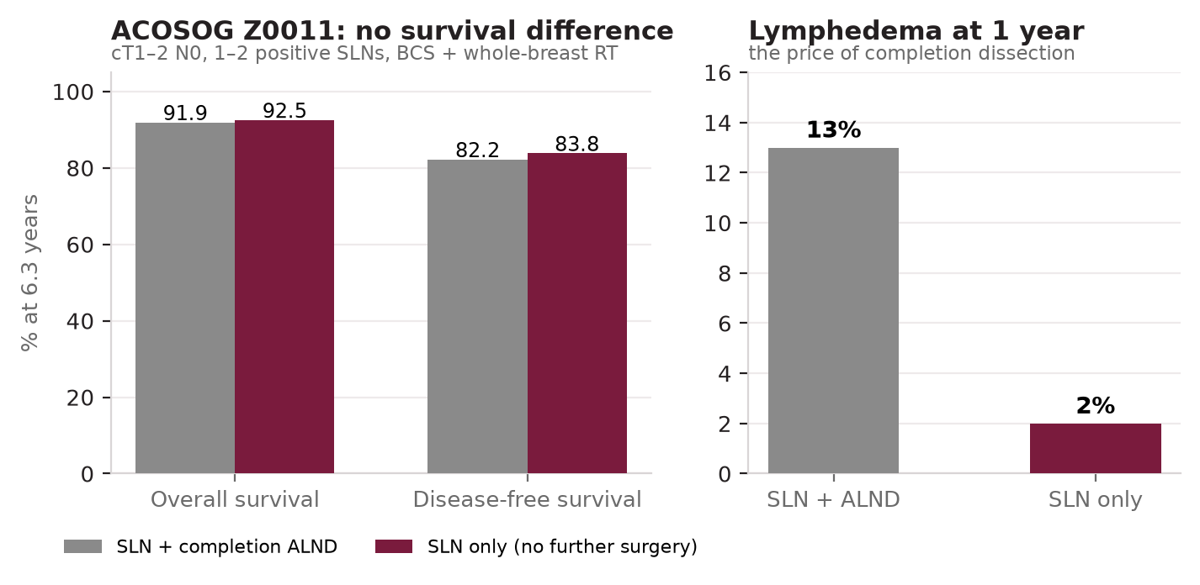
The axilla in early breast cancer
Sec. 12
Fig. 29 --- ACOSOG Z0011 outcomes and lymphedema.
Schwartz's Principles of Surgery -- Ch.17: The Breast
98

Slide 111
The axilla in early breast cancer
Sec. 12
Z0011 has changed practice (NCCN and American Society of Breast Surgeons endorse omission for eligible patients). Concerns: only about half the intended patients accrued; no standardisation of low-axillary irradiation by tangents. Z0010 morbidity of SLN alone: infection 1%, seroma 7.1%, hematoma 1.4%; at 6 months paresthesia 8.6%, reduced motion 3.8%, arm circumference >2 cm 6.9% (younger -> paresthesia; older/higher BMI -> lymphedema). [p.584-585]
Pathology of SLNs: step sections/IHC are common but not shown to matter. Intra-operative assessment options: touch-prep cytology, frozen section, GeneSearch (RT-PCR for mammaglobin + cytokeratin 19; FDA-approved; detects foci >0.2 mm). Many now skip intra-operative assessment because of Z0011. Nomograms estimate risk of further positive non-sentinel nodes. [p.585]
Proven nodal disease on FNA/core: omit SLNB -> ALND or neoadjuvant therapy. SLNB acceptable for T3 and after neoadjuvant chemo (ASCO); if the SLN is not found -> ALND. [p.585]
Schwartz's Principles of Surgery -- Ch.17: The Breast
99

Slide 112
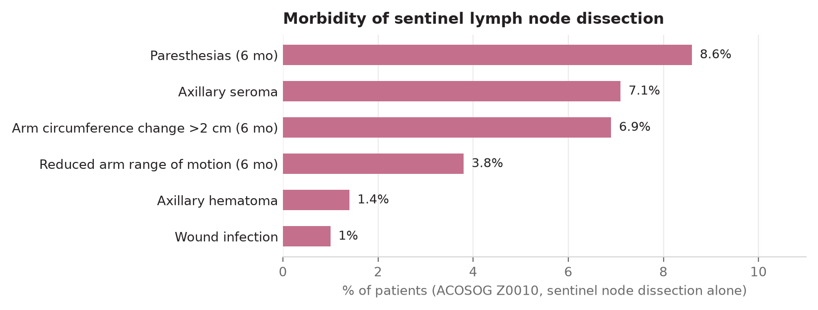
The axilla in early breast cancer
Sec. 12
Fig. 30 --- Morbidity of SLN dissection alone (Z0010).
Schwartz's Principles of Surgery -- Ch.17: The Breast
100

Slide 113
Adjuvant systemic therapy --- which patients?
Sec. 12
Adjuvant systemic therapy --- which patients?
ASCO: consider chemotherapy for node-positive, ER-negative, HER2-positive, Adjuvant! Online mortality >10%, grade 3 node-negative tumours >5 mm, triple-negative, lymphovascular invasion, or 21-gene-estimated distant relapse >15% at 10 years. Endocrine therapy for HR-positive disease; aromatase inhibitor if postmenopausal. HER2 testing in all; positive -> trastuzumab-based regimen. [p.585]
FDA approvals: trastuzumab (Nov 2006) with doxorubicin, cyclophosphamide and paclitaxel for HER2+, node-positive disease. BCIRG 006: trastuzumab concurrent with docetaxel + carboplatin works as well as after an anthracycline. Pertuzumab approved for adjuvant use in high-risk HER2-amplified cancers. [p.585]
Schwartz's Principles of Surgery -- Ch.17: The Breast
101

Slide 114
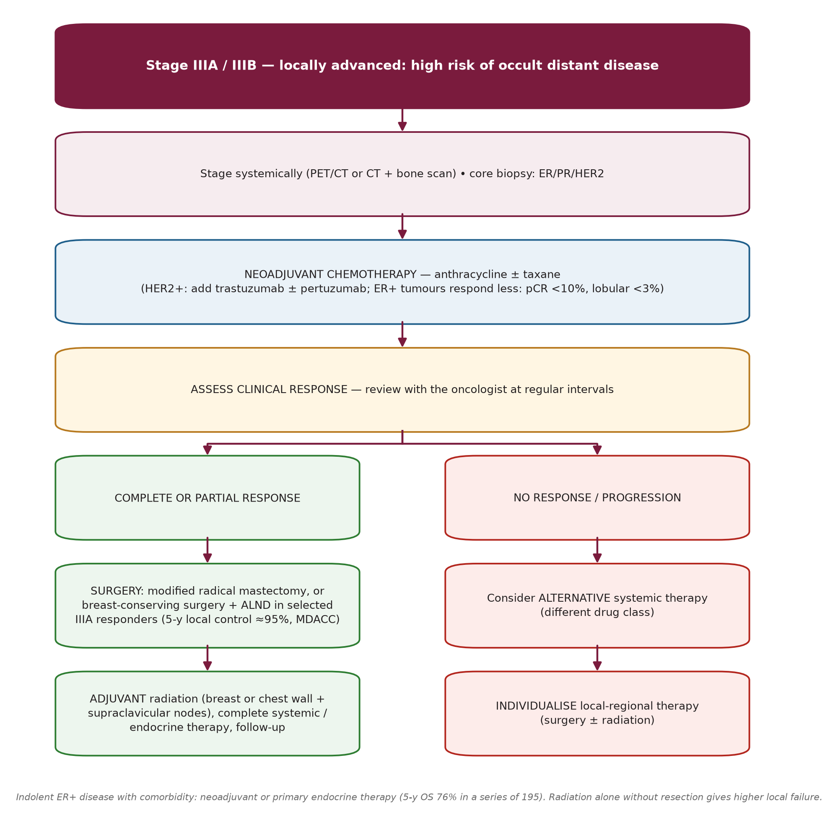
Advanced local-regional cancer (stage IIIA / IIIB)
Sec. 12
Advanced local-regional cancer (stage IIIA / IIIB)
Fig. 31 --- Treatment pathways for stage IIIA and IIIB (adapted from Schwartz Fig. 17-31).
Schwartz's Principles of Surgery -- Ch.17: The Breast
102

Slide 115
Advanced local-regional cancer (stage IIIA / IIIB)
Sec. 12
Locally advanced cancers have a high risk of occult metastases (staging PET/CT, CT and bone scan often show them) --- the "cure by local treatment" paradigm of small screen-detected cancers (>90% cure) does not apply. Surgery is integrated with radiation and chemotherapy. [p.585]
Neoadjuvant chemotherapy for stage III, especially ER-negative: chemotherapy maximises distant control, radiation maximises local-regional control. In selected IIIA it can shrink the tumour enough for breast conservation (MD Anderson: 5-y actuarial ipsilateral recurrence-free 95%; recurrence higher with cN2-N3, >2 cm residual disease, multifocal residual disease, LVI). [p.585-586]
Caution: Oxford overview: neoadjuvant vs adjuvant local recurrence HR 1.5; meta-analysis HR 1.3 (includes RT-alone-without-resection). German Breast Group (5,535 pts): local recurrence 7.6-19.5% (T1-T4) and 6.4-17.9% (N0-N3). Avoiding a recurrence in a conserved breast prevents about one death per four recurrences over 15 y. Minimal response IIIA and IIIB -> modified radical mastectomy; always followed by adjuvant radiation. Review with the oncologist at intervals because a few patients progress on treatment. [p.586-587]
Primary/neoadjuvant endocrine therapy for indolent ER-positive locally advanced disease, especially with comorbidity (series of 195 pts, median age 69, median size 6 cm: 5-y OS 76%, cancer-specific 86%, metastasis-free 77%). ACOSOG Z1031 supports neoadjuvant endocrine downstaging in strongly ER+ tumours; the PEPI score (post-endocrine prognostic index) helps decide on chemotherapy. [p.587]
Internal mammary nodes: may be occult, seen on CXR/CT, or a parasternal mass. No consensus on RT to clinically negative IMNs at risk (medial tumours, nodal disease); grossly involved IMNs get chemotherapy + radiation. [p.587]
Schwartz's Principles of Surgery -- Ch.17: The Breast
103

Slide 116
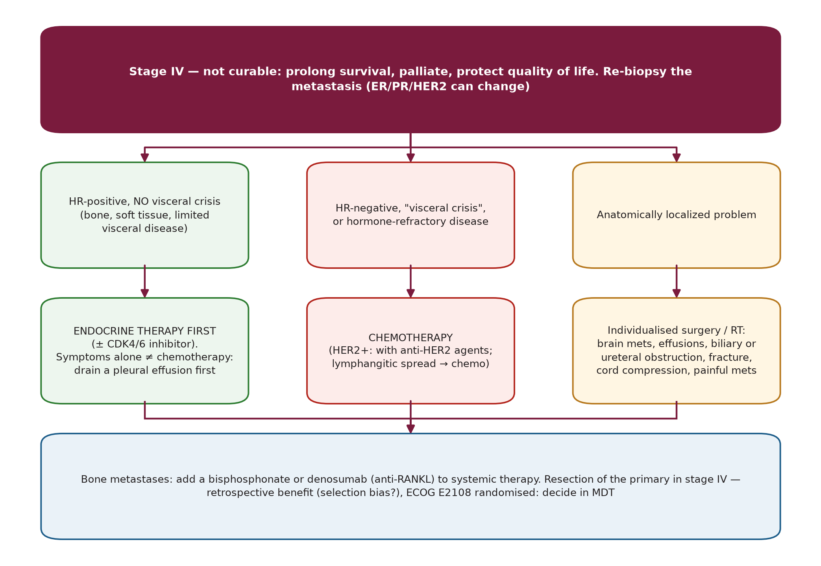
Distant metastases (stage IV)
Sec. 12
Distant metastases (stage IV)
Fig. 32 --- Stage IV management.
Schwartz's Principles of Surgery -- Ch.17: The Breast
104

Slide 117
Distant metastases (stage IV)
Sec. 12
Not curable; goal is longer survival and better quality of life. Low-toxicity endocrine therapy is preferred to chemotherapy in ER-positive disease unless there is visceral crisis (immediately life-threatening organ dysfunction) --- bone, soft-tissue and limited visceral disease can start on endocrine therapy. Symptoms per se (e.g., dyspnoea) are not an indication for chemotherapy: drain a pleural effusion and if relief follows, start endocrine therapy; if breathlessness is lymphangitic spread, chemotherapy. Same logic for pain. [p.586-587]
Chemotherapy indicated for: hormone-receptor-negative disease, visceral crisis, hormone-refractory metastases. Local problems needing individual surgery/RT: brain metastases, pleural or pericardial effusion, biliary or ureteric obstruction, impending/existing long-bone fracture, spinal cord compression, painful bone/soft-tissue metastases. Bisphosphonate or denosumab (anti-RANKL) for bone metastases. [p.587]
Resecting the primary in stage IV: NCDB and SEER analyses suggest better survival with negative-margin resection, but selection bias is likely; ECOG E2108 randomised trial addresses it; decide with multidisciplinary input and the patient's goals. [p.587]
Schwartz's Principles of Surgery -- Ch.17: The Breast
105

Slide 118
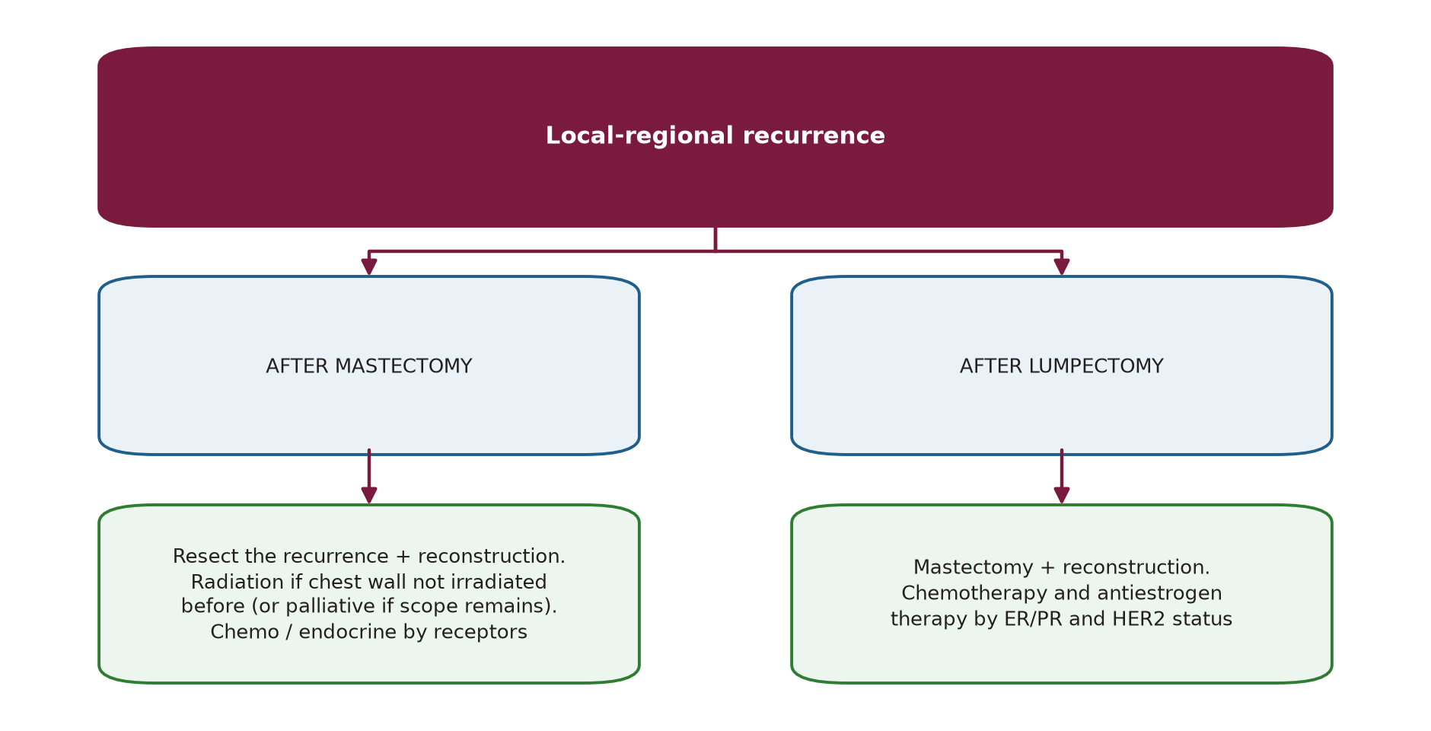
Local-regional recurrence
Sec. 12
Local-regional recurrence
Fig. 33 --- Local-regional recurrence.
Schwartz's Principles of Surgery -- Ch.17: The Breast
106

Slide 119
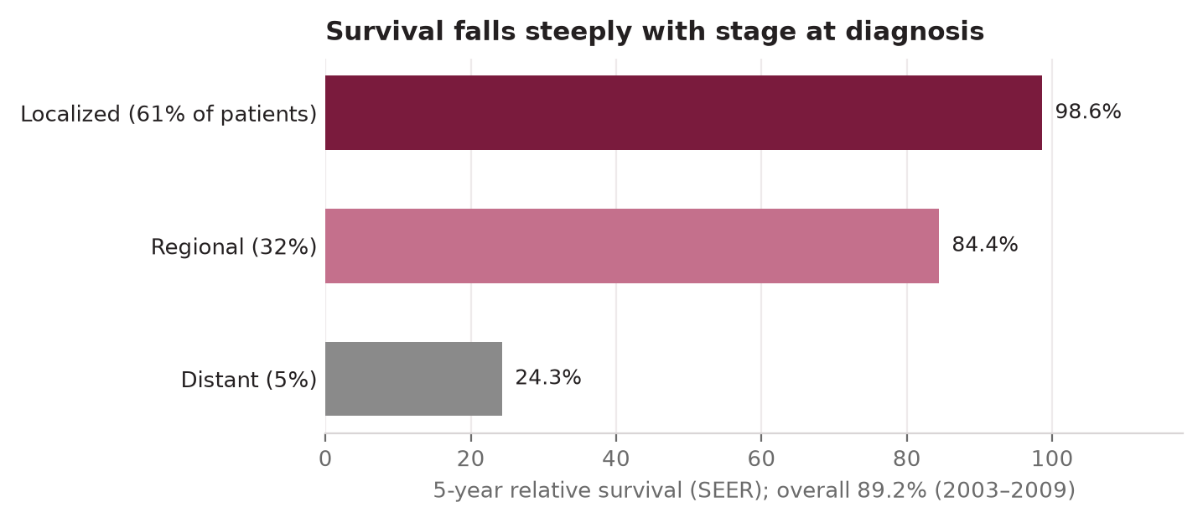
Prognosis
Sec. 12
Prognosis
Fig. 34 --- SEER 5-year relative survival by stage at diagnosis.
Schwartz's Principles of Surgery -- Ch.17: The Breast
107

Slide 120
Prognosis
Sec. 12
Overall 5-year relative survival (2003-2009, 18 SEER areas) 89.2%; white 90.4% vs black 78.7%. Localized (61% of patients) 98.6%; regional (32%) 84.4%; distant (5%) 24.3%. Improvement over two decades reflects screening and better local and systemic therapy. [p.587-588]
Schwartz's Principles of Surgery -- Ch.17: The Breast
108

Slide 121
SECTION 13
Surgical Techniques in Breast Cancer Therapy
Schwartz, pp. 588-594

Slide 122
Excisional biopsy with needle localisation
Sec. 13
Excisional biopsy with needle localisation
Excisional biopsy = complete removal of a lesion with a rim of normal breast. Needle core biopsy is the preferred diagnostic route; reserve excision for discordant needle results. Old "one-step" consent for mastectomy is obsolete --- options (lumpectomy vs mastectomy +/- reconstruction, SLN) must be planned first. [p.588]
Incisions: circumareolar for subareolar or near-NAC lesions; elsewhere along skin tension lines concentric with the NAC; radial in the lower half. Avoid radial incisions in the upper half (scar contracture displaces the NAC) and curvilinear in the lower half (pulls NAC down). A remote biopsy scar can be excised separately if mastectomy follows. [p.588]
Specimen X-ray to confirm the lesion and margins; orient the specimen (sutures, clips, dyes); take further superior/inferior/medial/lateral/superficial/deep margins if close. Hemostasis with cautery or ligatures; approximate the defect with 3-0 absorbable suture; subcuticular 4-0/5-0 monofilament; drain usually not needed. [p.588]
Localisation: pre-operative wire (hook tip near the lesion), or radioactive/magnetic seed found with a handheld probe, or ultrasound targeting; verify excision by specimen radiography before leaving theatre. [p.588]
Schwartz's Principles of Surgery -- Ch.17: The Breast
109

Slide 123
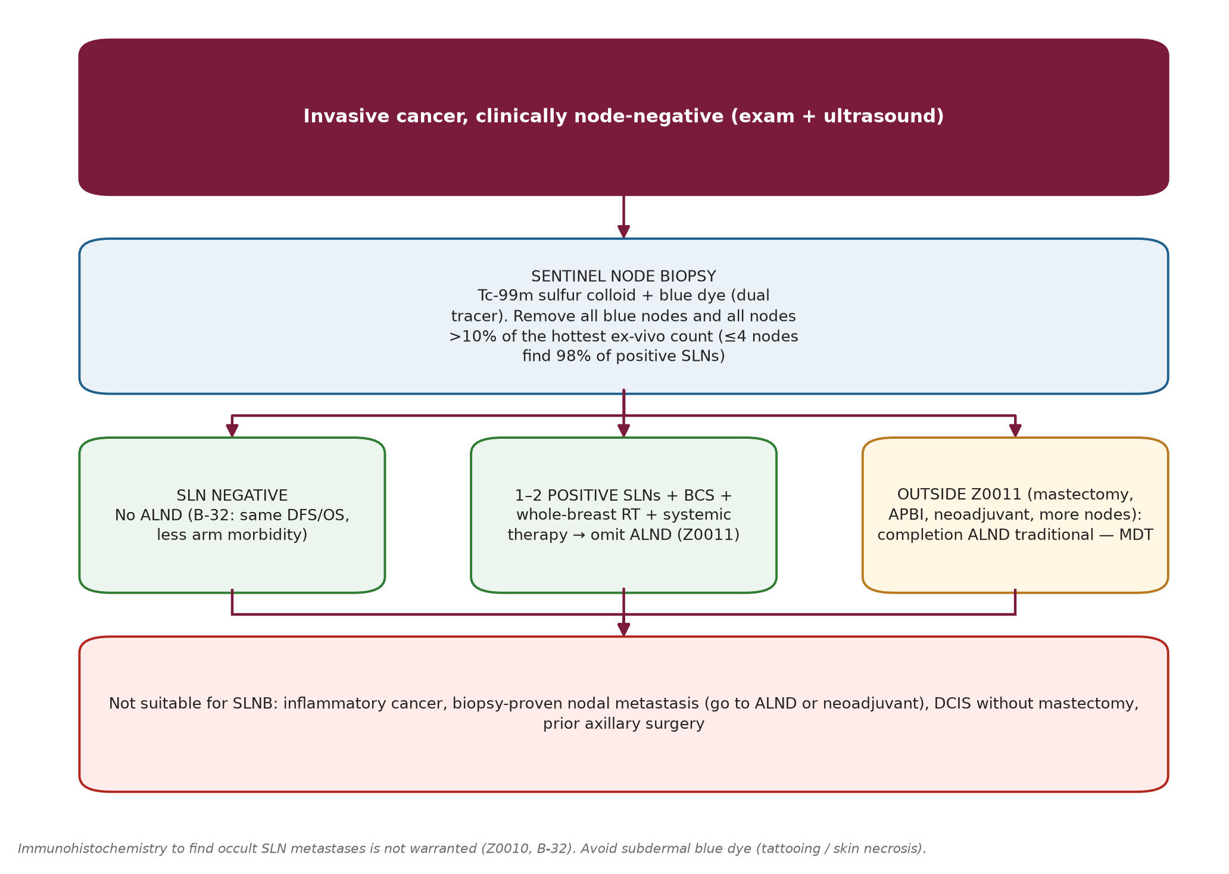
Sentinel lymph node dissection --- technique
Sec. 13
Sentinel lymph node dissection --- technique
Fig. 35 --- Sentinel node biopsy: technique and decisions.
Schwartz's Principles of Surgery -- Ch.17: The Breast
110

Slide 124
Sentinel lymph node dissection --- technique
Sec. 13
SLN biopsy technique details [p.590-591]
Step / topic | Details
Indication | Clinically node-negative (exam + imaging) early cancer; accurate in T3N0 but ~75% of these prove node-positive (better to detect pre-operatively). After chemotherapy in cN0 disease. Meta-analysis (449 cases): sensitivity 93%, false-negative 7%, NPV 94%, accuracy 95%.
Not recommended | Inflammatory cancer; biopsy-proven nodal metastasis; DCIS without mastectomy; prior axillary surgery. Safe in pregnancy with isotope alone.
Tracers | Dual technique (isotope + blue dye) is more accurate than either alone; lymphoscintigraphy optional. Technetium-99m sulfur colloid (0.2 micron): 25-G needle, 0.5 mCi same-day or 2.5 mCi day before; injected peritumoral, around the biopsy cavity (not into it), subareolar or subdermal; US/mammographic guidance if non-palpable. Blue dye 3-5 mL (isosulfan or methylene) into parenchyma or subareolar --- never subdermal (tattooing / skin necrosis). Allergy ~1 in 10,000; warn about blue urine.
Operation | Gamma probe transcutaneously -> 3-4 cm incision in line with an ALND incision (curved, low axilla below hairline) -> divide axillary fascia, follow blue lymphatics, probe signal rises near the node. 10-second in-vivo count, remove, 10-second ex-vivo count.
The 10% rule | Remove all blue nodes and all nodes with counts >10% of the hottest SLN's ex-vivo count; re-check the bed until residual activity <10% of the hottest ex-vivo count. Removal of 4 SLNs finds 98% of positive SLNs.
False-negative influences (B-32) | Lateral tumours; prior excisional biopsy; number of SLNs removed (1 node 17.7% -> 2 nodes 10% -> 3 nodes 6.9%). Extra-axillary SLNs in 1.4%: 0% with subareolar/periareolar injection vs 20% with peritumoral; internal-mammary drainage on lymphoscintigraphy predicts worse distant DFS.
Schwartz's Principles of Surgery -- Ch.17: The Breast
111

Slide 125
Breast-conserving therapy (BCT)
Sec. 13
Breast-conserving therapy (BCT)
BCT = resection of the cancer with a margin of normal tissue + adjuvant RT + assessment of regional nodes. Synonyms: segmental mastectomy, lumpectomy, partial mastectomy, wide local excision, tylectomy. Survival equals total mastectomy (six trials; EBCTCG: RT halves recurrence and improves 15-y survival by about a sixth) with better body image, sensation and aesthetics. It is the standard for stage 0, I or II. DCIS: resection + RT, no node assessment. [p.590]
Technique: incision concentric to the NAC for upper-breast tumours, radial for lower-breast tumours; skin excised only if involved; remove the cancer with an envelope of normal tissue; specimen X-ray; orient; further margins as needed; send ER/PR/HER2. SLN is done before removing the tumour (intra-operative node assessment can proceed meanwhile). If negative margins cannot be obtained -> mastectomy. [p.590-591]
Margins: SSO-ASTRO consensus --- "no tumour on ink" is a negative margin for invasive stage I-II with WBI (wider margins do not lower local recurrence). DCIS: 2 mm. [p.590]
Oncoplastic surgery (tissue rearrangement, pedicled flaps, reduction techniques) when: (a) skin must be resected, (b) a large volume of parenchyma is removed, (c) the tumour lies between the nipple and inframammary fold, (d) closure would malposition the nipple. [p.591]
Schwartz's Principles of Surgery -- Ch.17: The Breast
112

Slide 126
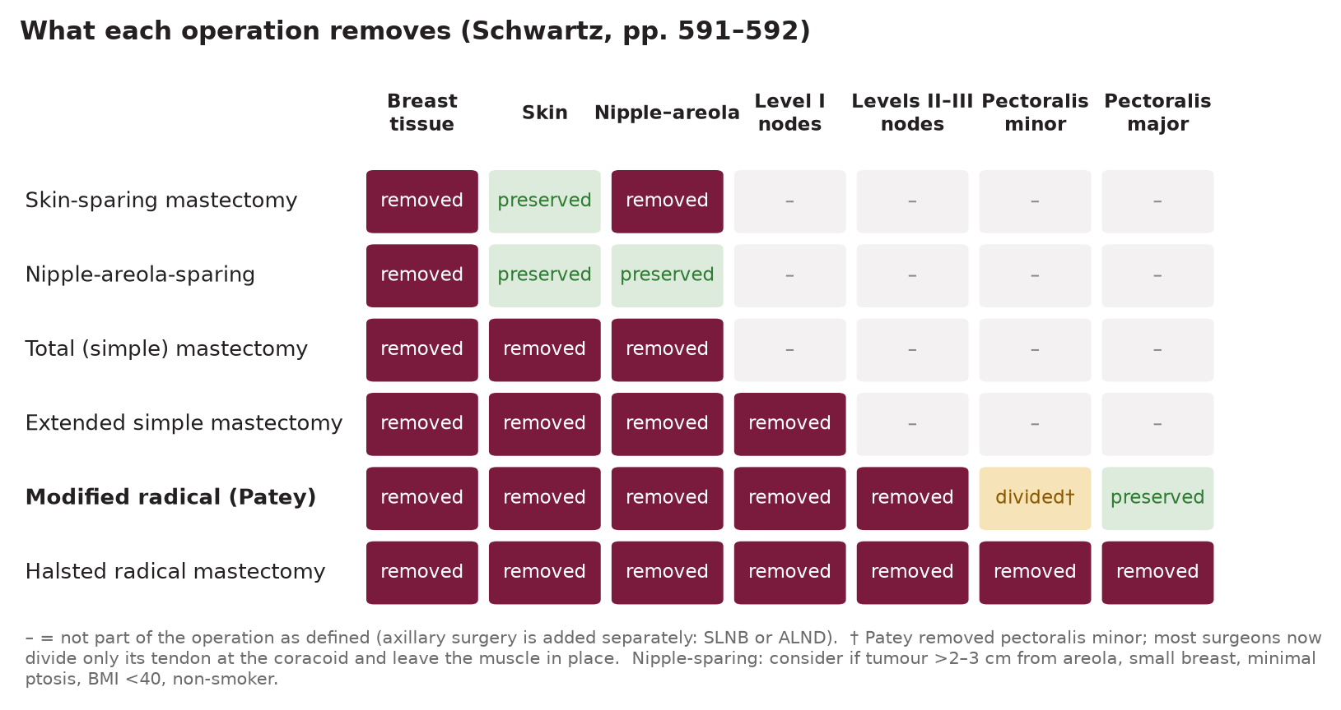
Mastectomy and axillary dissection
Sec. 13
Mastectomy and axillary dissection
Fig. 36 --- What each mastectomy removes.
Schwartz's Principles of Surgery -- Ch.17: The Breast
113

Slide 127
Mastectomy and axillary dissection
Sec. 13
Skin-sparing: recurrence <6-8% for Tis-T3, similar to standard mastectomy. Nipple-areola-sparing: used mainly for risk-reduction; for cancer consider tumour >2-3 cm from the areolar border, smaller breast, minimal ptosis, no prior periareolar surgery, BMI <40, non-smoker, no prior breast RT, no collagen-vascular disease. Radiation does not go with NAC preservation. [p.591]
Reasons for mastectomy: patient preference (avoids RT cost/inconvenience); cancer not excisable with acceptable cosmesis; extensive microcalcifications; large central/subareolar cancers; multicentric disease. [p.591-592]
Radical (Halsted) is now almost never needed because of systemic therapy and RT. [p.591]
Schwartz's Principles of Surgery -- Ch.17: The Breast
114

Slide 128
Modified radical (Patey) mastectomy --- key steps and landmarks
Sec. 13
Modified radical (Patey) mastectomy --- key steps and landmarks
Modified radical mastectomy technique [p.592-593]
Element | Detail
Boundaries | Latissimus dorsi (anterior edge) laterally, sternal midline medially, subclavius superiorly, 2-3 cm below the inframammary fold inferiorly. Skin flaps 7-8 mm thick (skin + tela subcutanea).
Breast removal | Raise the pectoralis major fascia with the breast off the muscle.
Axillary clearance | Identify the lateral extent of the axillary vein; clear its anterior and inferior surfaces; lateral/subscapular nodes (level I) at the vein-latissimus junction; dissect lateral -> medial through central (level II) to apical (level III). Pectoralis minor tendon divided near the coracoid (or muscle removed in the original) to reach the apex; medial limit costoclavicular (Halsted's) ligament.
Structures to preserve | Thoracodorsal neurovascular bundle; long thoracic nerve of Bell (on serratus anterior) --- injury -> winged scapula and shoulder weakness; nerves to pectoralis major; (intercostobrachial nerve is often sacrificed -> medial arm numbness).
Mastectomy complications [p.593]
Complication | Facts
Seroma | Commonest; up to 30%; closed suction drains reduce it; remove when output <30 mL/day.
Wound infection | Infrequent; mostly from skin-flap necrosis -> culture, debride, antibiotics.
Haemorrhage | Rare; explore early and re-establish drainage.
Lymphedema | ~20% after MRM (up to 50-60% with post-operative RT). Risks: extensive ALND, RT, positive nodes, obesity. Early physiotherapy, fitted sleeves, complex decongestive therapy.
Schwartz's Principles of Surgery -- Ch.17: The Breast
115

Slide 129
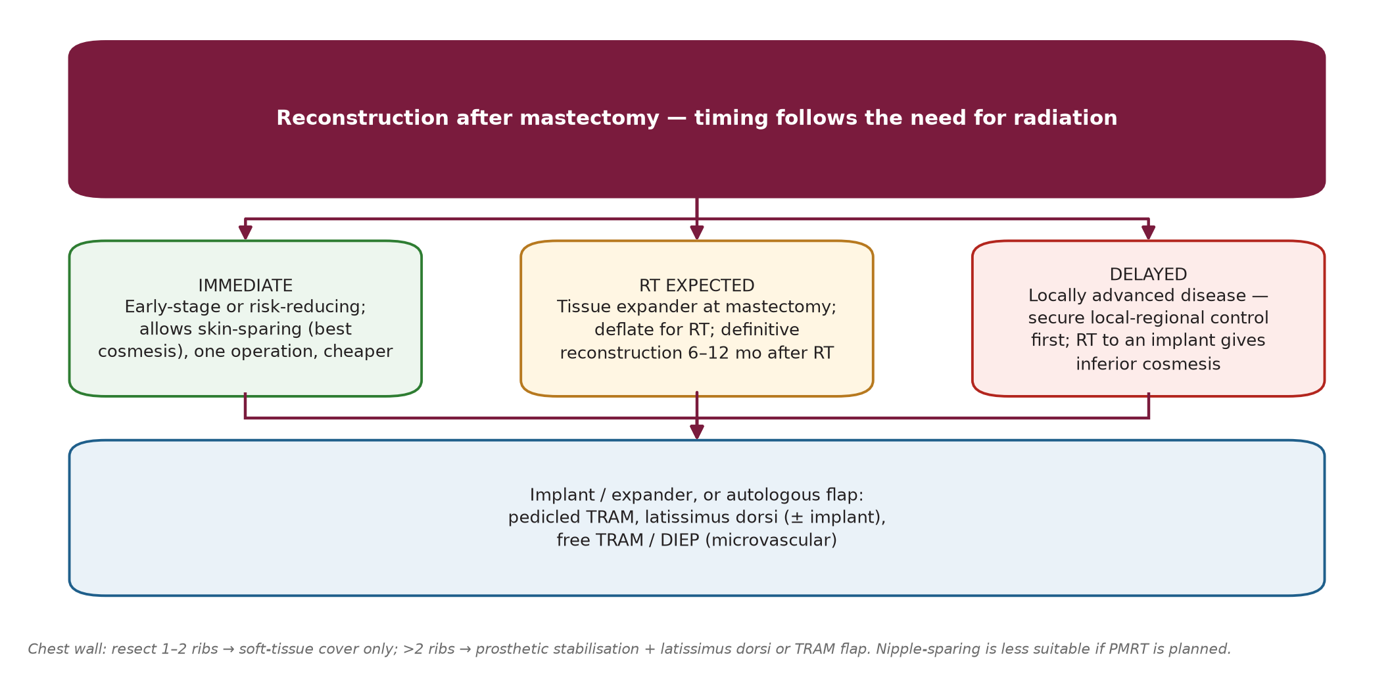
Reconstruction of the breast and chest wall
Sec. 13
Reconstruction of the breast and chest wall
Fig. 37 --- Timing and types of reconstruction.
Schwartz's Principles of Surgery -- Ch.17: The Breast
116

Slide 130
Reconstruction of the breast and chest wall
Sec. 13
Goals: wound closure + breast reconstruction (immediate or delayed). Simple closure usually; if a large skin/soft-tissue defect -> pedicled latissimus dorsi flap (thoracodorsal artery + posterior intercostal branches). Skin graft tolerates RT but is not preferred (poor take can delay RT). [p.593]
TRAM flap = skin paddle on rectus abdominis (deep inferior epigastric vessels); free TRAM uses microvascular anastomosis. Immediate reconstruction after risk-reducing or early-stage mastectomy permits skin-sparing (best cosmesis); locally advanced disease -> often delayed until after adjuvant RT; RT to a reconstructed breast gives inferior cosmesis. [p.593]
Bony chest wall involved: resect; 1-2 ribs -> soft tissue cover only (scar stabilises); >2 ribs -> prosthetic stabilisation + latissimus or TRAM flap. [p.594]
Schwartz's Principles of Surgery -- Ch.17: The Breast
117

Slide 131
SECTION 14
Nonsurgical Therapy: Radiation, Chemotherapy, Endocrine and Anti-HER2
Schwartz, pp. 594-599

Slide 132
Radiation therapy
Sec. 14
Radiation therapy
Used at all stages, depending on BCT vs mastectomy. After mastectomy: positive margin; >=4 positive axillary nodes; 1-3 positive nodes in premenopausal women -> chest-wall + supraclavicular RT. EBCTCG shows better local control and survival with PMRT for 1-3 positive nodes (trials from the ALND era; SLN-era disease volumes are smaller -> decide with the full multidisciplinary team). [p.594]
Stage IIIA/IIIB: (a) breast + supraclavicular RT after neoadjuvant chemotherapy and segmental mastectomy +/- ALND; (b) chest wall + supraclavicular RT after neoadjuvant chemotherapy and mastectomy +/- ALND; (c) chest wall + supraclavicular RT after mastectomy/segmental mastectomy with ALND and adjuvant chemotherapy. [p.594]
APBI: brachytherapy, 3D-conformal external beam, or IMRT; only in highly selected low-risk patients, per guidelines or trial. [p.594-595]
Schwartz's Principles of Surgery -- Ch.17: The Breast
118

Slide 133
Adjuvant chemotherapy
Sec. 14
Adjuvant chemotherapy
EBCTCG: reduced recurrence and death in women <=70 y with stage I-IIB; >70 y lack definitive data. Node-negative and <=0.5 cm: minimal benefit, not recommended. 0.6-1.0 cm N0: chemotherapy only with adverse features --- blood/lymphatic-vessel invasion, high nuclear or histologic grade, HER2 overexpression, negative hormone receptors. [p.595]
HR-negative >1 cm: chemotherapy. HR-positive, T1, node-negative: endocrine therapy +/- chemotherapy (guided by risk and the 21-gene assay). Special types (tubular, mucinous, medullary; usually strongly ER+): endocrine therapy if >1 cm; chemotherapy if node-positive or >3 cm. [p.595-596]
Adjuvant chemotherapy regimens by HER2 status (Table 17-14; NCCN 2006 data, historical)
HER2-negative | HER2-positive
Preferred: dose-dense AC -> paclitaxel every 2 weeks; dose-dense AC -> paclitaxel weekly; TC (docetaxel + cyclophosphamide) | Preferred: AC -> paclitaxel + trastuzumab +/- pertuzumab; TCH (docetaxel, carboplatin, trastuzumab +/- pertuzumab)
Other: CMF; AC -> docetaxel every 3 weeks; AC -> paclitaxel weekly; TAC | Other: AC -> docetaxel + trastuzumab +/- pertuzumab; docetaxel + cyclophosphamide + trastuzumab; FEC -> docetaxel (or paclitaxel) + trastuzumab + pertuzumab; paclitaxel + trastuzumab; paclitaxel (or docetaxel) + trastuzumab + pertuzumab -> FEC
A = doxorubicin (Adriamycin); C = cyclophosphamide; E = epirubicin; F = 5-fluorouracil; M = methotrexate; T = taxane (docetaxel or paclitaxel); -> = followed by. Regimens reproduced in the book from NCCN 2006 data --- today's lists differ. [p.595]
Schwartz's Principles of Surgery -- Ch.17: The Breast
119

Slide 134
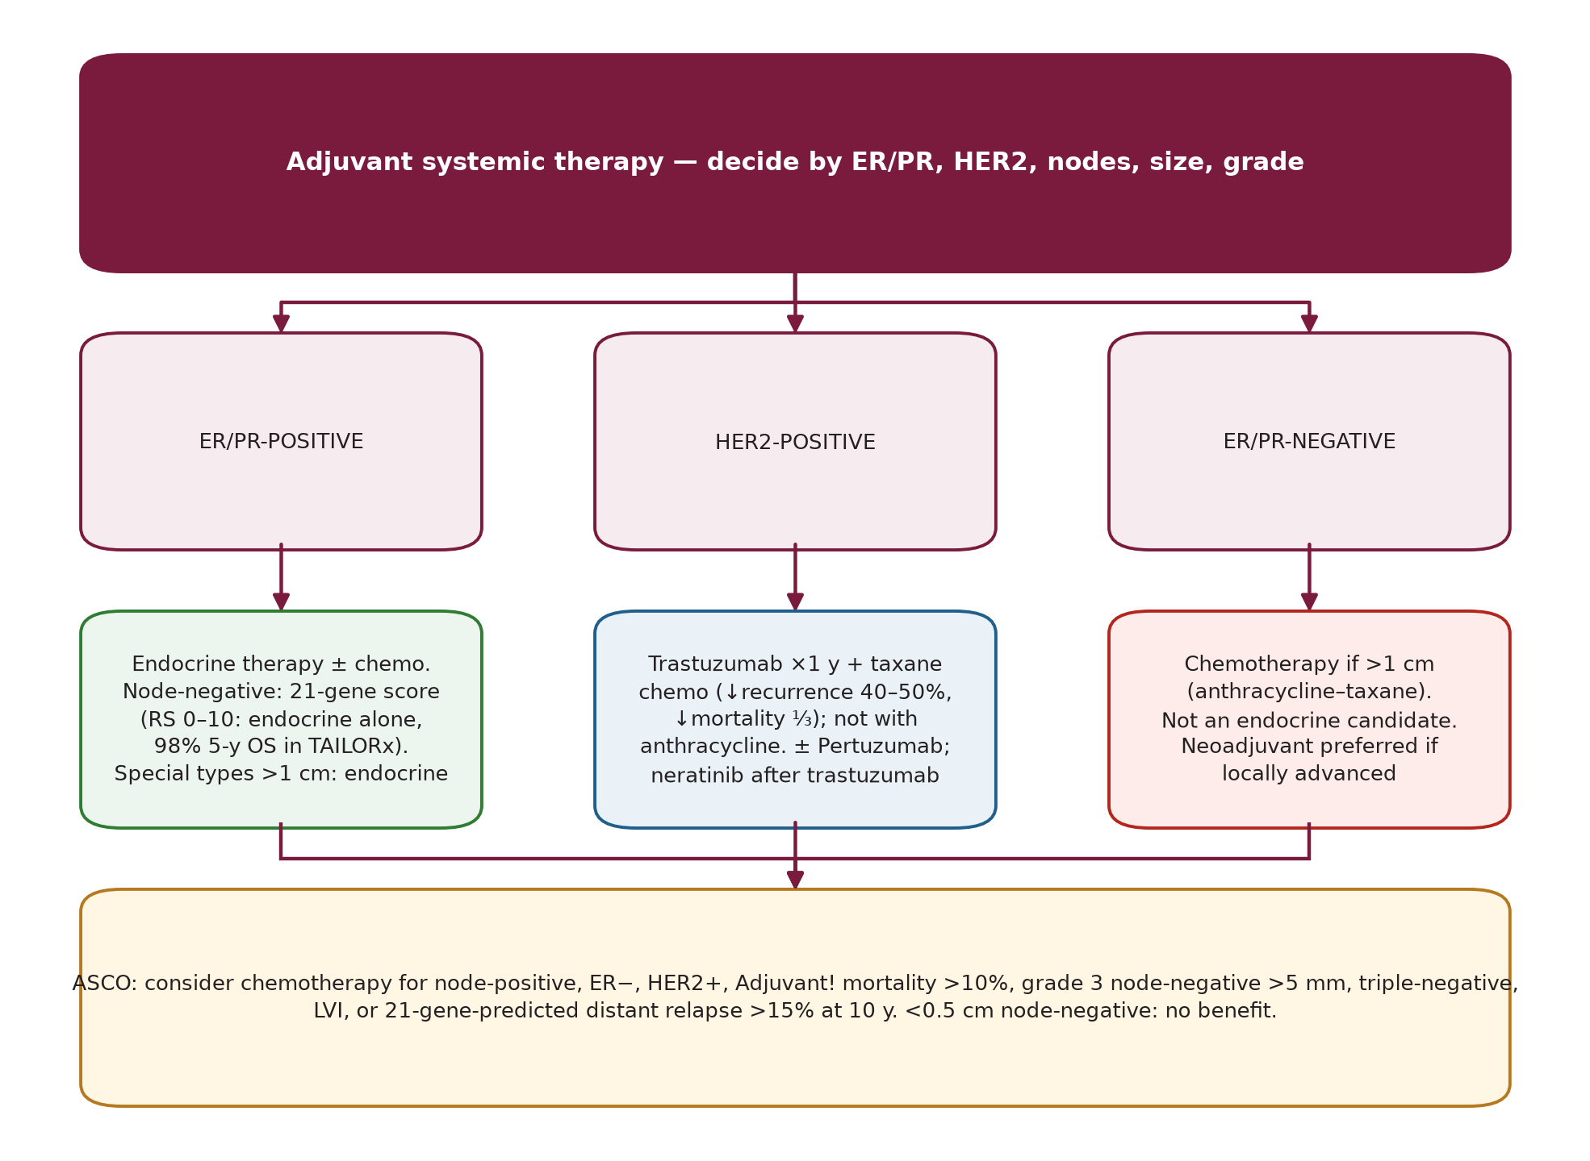
Adjuvant chemotherapy
Sec. 14
Fig. 38 --- Adjuvant systemic therapy by subtype (chapter-based).
Schwartz's Principles of Surgery -- Ch.17: The Breast
120

Slide 135
Neoadjuvant (preoperative) chemotherapy
Sec. 14
Neoadjuvant (preoperative) chemotherapy
Milan (1970s; T3/T4): best results when surgery was interposed between chemotherapy courses. NSABP B-18 (stage II-III): same 5-y DFS as adjuvant, but more lumpectomies and fewer positive nodes; neoadjuvant therapy suits cancers too large for lumpectomy. Meta-analyses: neoadjuvant = adjuvant for OS; local recurrence higher only when RT alone replaced surgery. Mittendorf (~3,000 pts): local-regional recurrence is driven by biology and stage, not timing. [p.594]
Advantages: watch the tumour respond; if stable/progressing, switch drug class (no randomised proof). pCR predicts better survival; residual cancer burden (RCB-0 to RCB-3, MD Anderson) predicts 10-year relapse-free survival in triple-negative, ER+ and HER2+ disease; progression on treatment has the worst survival. pCR is used by the FDA as an accelerated-approval endpoint but is not proven to predict DFS/OS. [p.595]
ER-positive tumours respond less (pCR <10%; lobular <3%); pCR rate in ER-negative is ~3x that of ER-positive. HER2+: trastuzumab + pertuzumab with chemotherapy increases pCR. Operable advanced disease: anthracycline +/- taxane -> mastectomy or lumpectomy +/- ALND -> RT; inoperable IIIA/IIIB: chemotherapy first to allow MRM/radical mastectomy -> RT. [p.595, 596]
Schwartz's Principles of Surgery -- Ch.17: The Breast
121

Slide 136
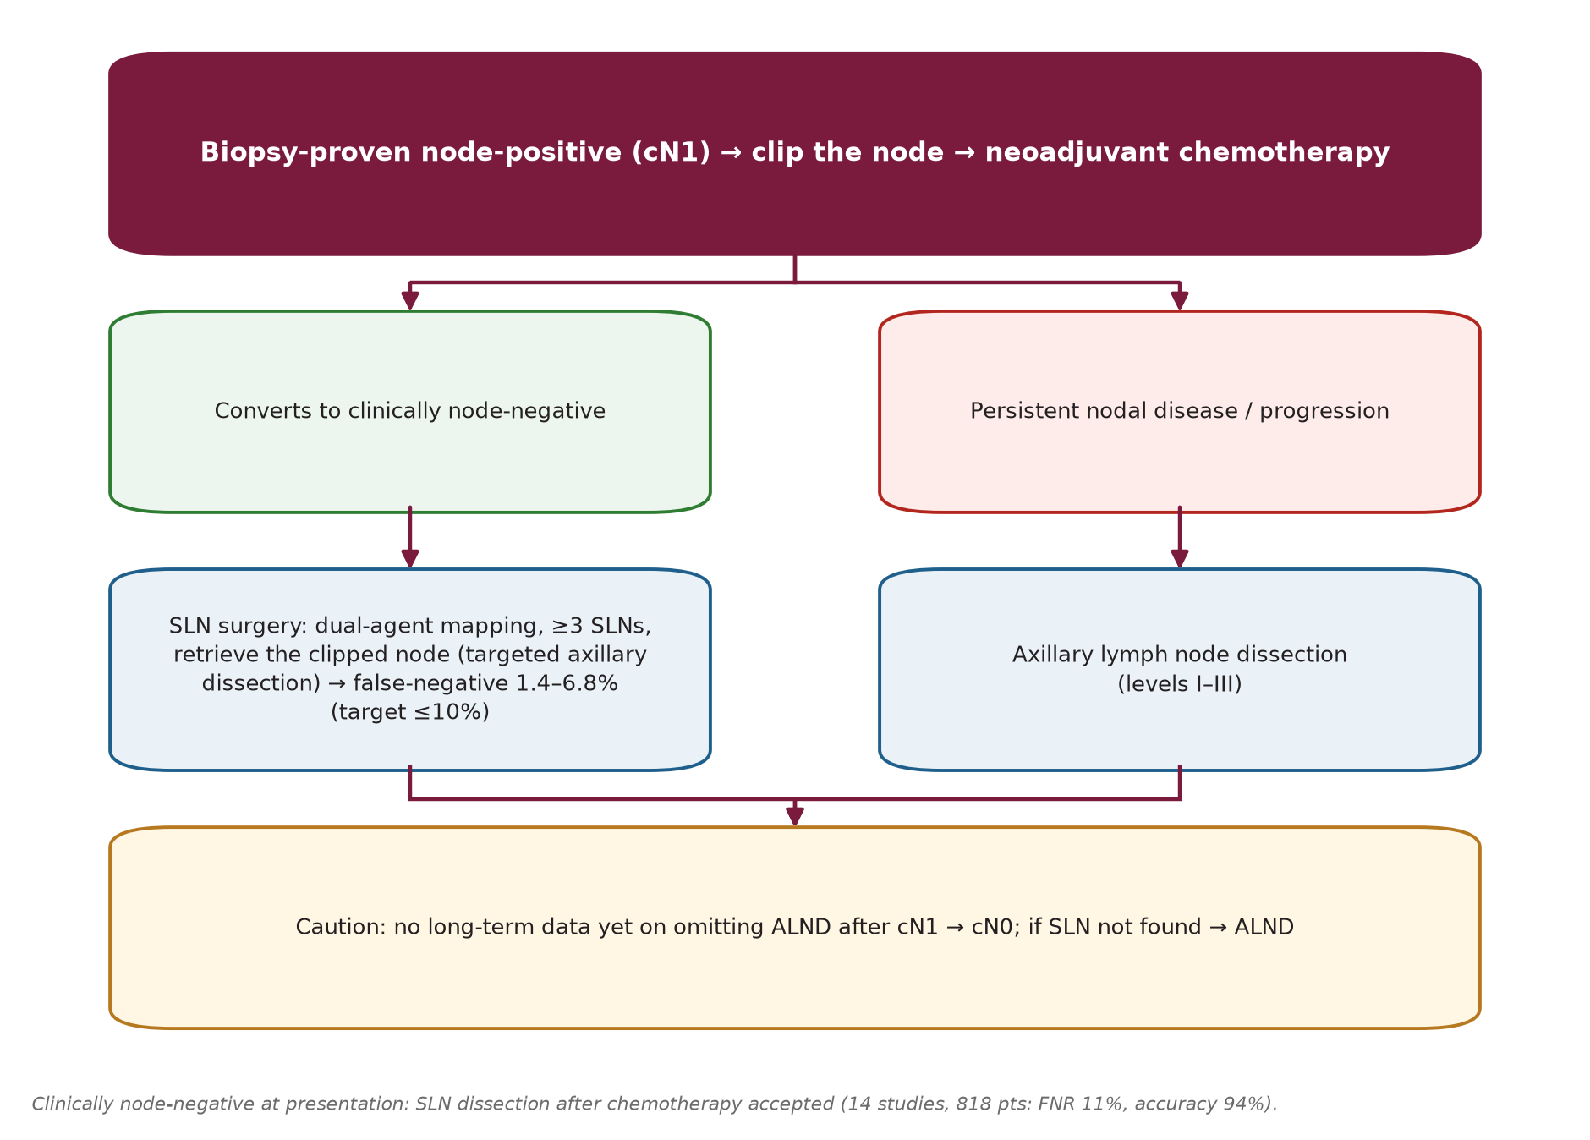
Nodal evaluation after neoadjuvant chemotherapy
Sec. 14
Nodal evaluation after neoadjuvant chemotherapy
Fig. 39 --- Axillary management around neoadjuvant chemotherapy.
Schwartz's Principles of Surgery -- Ch.17: The Breast
122

Slide 137
Nodal evaluation after neoadjuvant chemotherapy
Sec. 14
No randomised trial. Options: SLN before chemotherapy or ALND after. SLN after chemotherapy in cN0: 14 studies, 818 pts, FNR 11%, accuracy 94%. cN1 at presentation: ACOSOG Z1071 (cT0-4 N1-2 with SLN + ALND): FNR 12.6% (target <=10%), lower with dual tracer and >=3 SLNs; SENTINA and SN-FNAC agreed. Clipped node identified in the SLN specimen with >=2 SLNs -> FNR 6.8%. Targeted axillary dissection (MD Anderson, clipped node + SLN): FNR 1.4% vs 10.1% for SLN alone. No long-term data yet on omitting ALND after cN1->cN0. [p.595-596]
Schwartz's Principles of Surgery -- Ch.17: The Breast
123

Slide 138
Neoadjuvant endocrine therapy
Sec. 14
Neoadjuvant endocrine therapy
Started in elderly/unfit women; now studied widely. Aromatase inhibitors give response and conservation rates comparable with combination chemotherapy (meta-analysis, ~3,500 pts, 20 studies) with less toxicity, and beat tamoxifen; pCR <10% with both. IMPACT: BCS in mastectomy candidates 31% (tamoxifen) vs 44% (anastrozole). Lobular cancers respond poorly to chemotherapy and better to endocrine therapy. Adding everolimus (mTOR) or palbociclib (CDK4/6) lowers Ki-67 further; ALTERNATE compares fulvestrant/anastrozole. [p.596]
Schwartz's Principles of Surgery -- Ch.17: The Breast
124

Slide 139
Antiestrogen therapy
Sec. 14
Antiestrogen therapy
ER/PR are detectable in >90% of well-differentiated ductal and lobular cancers; status can change in metastases -> re-biopsy metastatic disease. Response to antiestrogens: >60% of HR-positive, <10% of HR-negative. [p.597]
Tamoxifen (blocks estrogen action in breast tissue): EBCTCG --- 5 years reduces breast-cancer mortality by about one-third for 15 years (carry-over effect: benefit continues in years 5-9 and 10-15) and contralateral cancer by 39%. Toxicity: bone pain, hot flashes, nausea, fluid retention, thrombosis (<3%), cataract; endometrial cancer with long use. B-14 stopped at 10 y (no added benefit, shorter follow-up); ATLAS (~13,000 women): 10 vs 5 y lowers recurrence and mortality, with benefit appearing from years 10-15; confirmed by aTTom. [p.597]
Aromatase inhibitors (AIs) --- first-line adjuvant in postmenopausal women: anastrozole, letrozole (reversible, non-steroidal), exemestane (irreversible, steroidal). EBCTCG (31,920 women): 5 years of AI vs tamoxifen -> -30% recurrence, ~-15% 10-year breast-cancer mortality. Less endometrial cancer; bone loss and fractures (prevent with bisphosphonates), arthralgia. NSABP B-42 and MA-17R: extended letrozole improves breast-cancer-free/disease-free survival but not overall survival; likely to help node-positive, chemotherapy-treated, prior-tamoxifen patients. Tamoxifen is now mainly for premenopausal women. [p.597]
Schwartz's Principles of Surgery -- Ch.17: The Breast
125

Slide 140
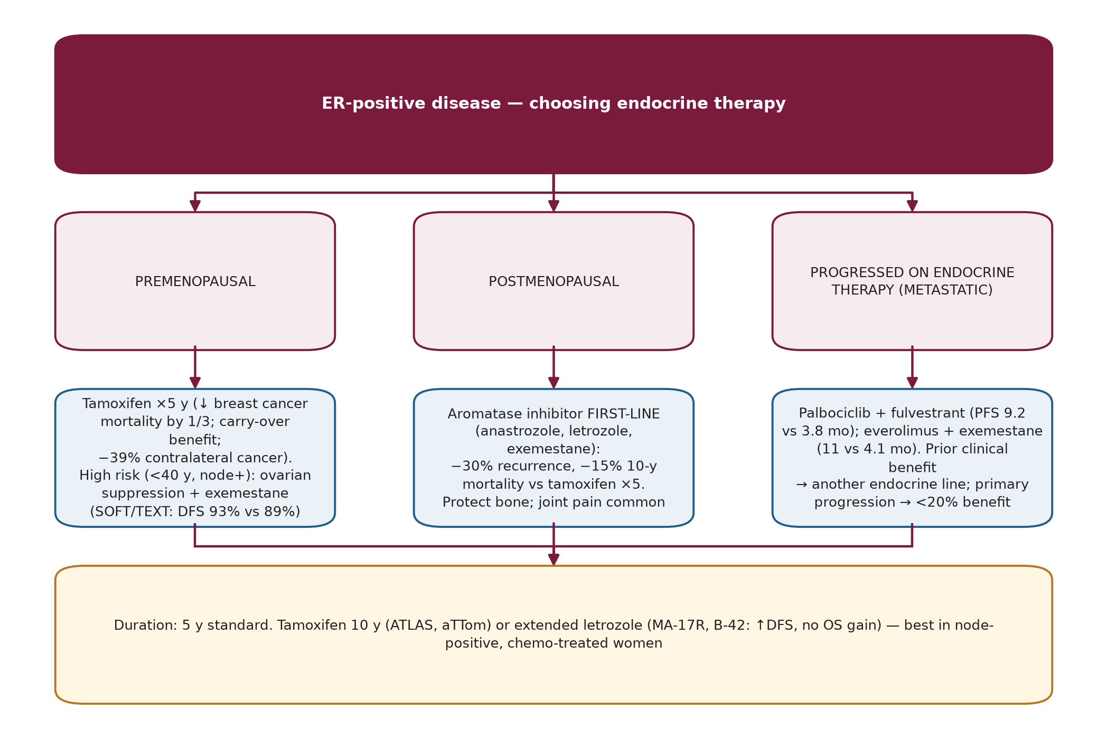
Endocrine therapy of metastatic disease
Sec. 14
Endocrine therapy of metastatic disease
Fig. 40 --- Choosing endocrine therapy.
Schwartz's Principles of Surgery -- Ch.17: The Breast
126

Slide 141
Endocrine therapy of metastatic disease
Sec. 14
Options (postmenopausal ER+/HER2-): anastrozole, letrozole, exemestane, tamoxifen/toremifene, fulvestrant (ER down-regulator), megestrol, fluoxymesterone, high-dose ethinyl estradiol. First line: AI or palbociclib + letrozole (PALOMA-1 PFS 20.2 vs 10.2 mo; phase 3: 24.8 vs 14.5 mo). Ribociclib and abemaciclib are also approved with endocrine therapy. [p.597-598]
After endocrine progression: palbociclib + fulvestrant (PALOMA-3; 9.2 vs 3.8 mo; premenopausal women also get goserelin); abemaciclib +/- fulvestrant; everolimus + exemestane (BOLERO-2; 11 vs 4.1 mo; PI3K/mTOR resistance pathway); tamoxifen + everolimus similar; temsirolimus + letrozole did not help. [p.598]
Premenopausal stage IV, endocrine-naive: tamoxifen, or ovarian suppression/ablation + AI +/- CDK4/6 inhibitor. [p.598]
"Clinical benefit" (response or long stable disease) -> give further endocrine therapy at progression (high chance of response). De novo progression on an agent -> <20% benefit from the next -> weigh endocrine vs chemotherapy by site, extent and fitness. ESR1 mutations (ligand-binding domain; 20-30% after AI exposure; rare in primary tumours) give ligand-independent ER activation, AI resistance and shorter survival. [p.598]
Schwartz's Principles of Surgery -- Ch.17: The Breast
127

Slide 142
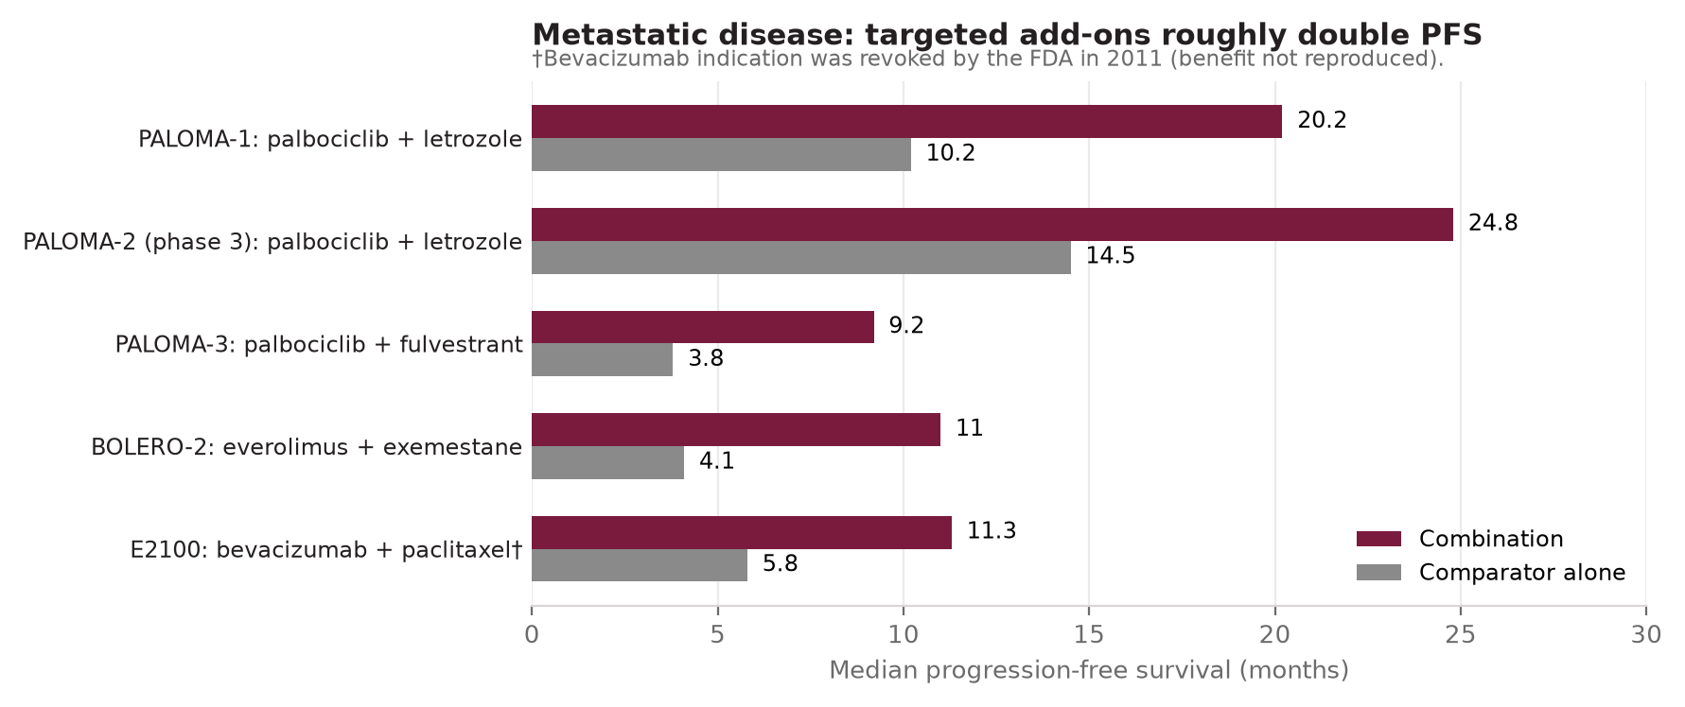
Endocrine therapy of metastatic disease
Sec. 14
Fig. 41 --- Progression-free survival in metastatic trials cited in the chapter.
Schwartz's Principles of Surgery -- Ch.17: The Breast
128

Slide 143
Ovarian ablation / suppression
Sec. 14
Ovarian ablation / suppression
Old adrenalectomy and hypophysectomy are seldom used. Premenopausal women: oophorectomy, ovarian radiation, or GnRH agonists (goserelin, leuprolide). Goserelin + tamoxifen beat CMF in ER+ premenopausal early cancer (relapse-free survival). SOFT/TEXT: exemestane + ovarian suppression vs tamoxifen + OS -> DFS 93% vs 89%, no OS difference; suppression helps mainly high-risk (<40 y, node-positive) women who needed chemotherapy; no meaningful benefit without chemotherapy. [p.598]
Schwartz's Principles of Surgery -- Ch.17: The Breast
129

Slide 144
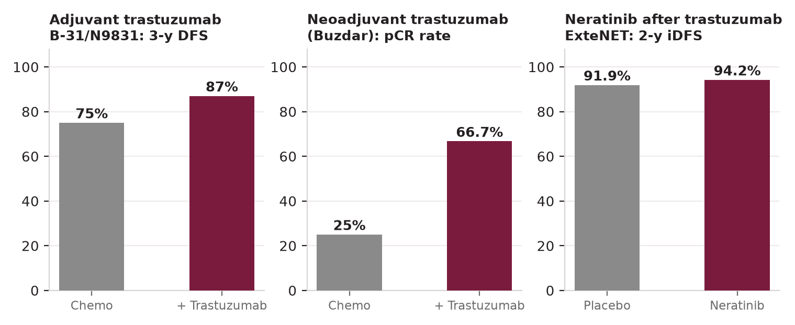
Anti-HER2 therapy
Sec. 14
Anti-HER2 therapy
Fig. 42 --- Anti-HER2 trials cited in the chapter.
Schwartz's Principles of Surgery -- Ch.17: The Breast
130

Slide 145
Anti-HER2 therapy
Sec. 14
Anti-HER2 agents and trials [p.598-599]
Agent / trial | Facts
Trastuzumab | Recombinant humanised anti-HER2 antibody. B-31/N9831 joint analysis: 3-y DFS 75% -> 87% (HR 0.48), mortality -33% (HR 0.67). 1 year = standard. 2 years: more effective but more toxic; PHARE: 6 months not shown non-inferior. Benefits when added to a taxane. Not given concurrently with anthracyclines (overlapping cardiotoxicity). BCIRG 006: TCH approximately equals AC-TH at 10 y (no significant DFS/OS difference; anthracycline arm had more leukemia and heart failure).
Neoadjuvant trastuzumab (Buzdar) | pCR 25% -> 66.7% when given concurrently with paclitaxel -> FEC-75; cardiac function preserved.
Pertuzumab | Binds HER2 subdomain II, blocks HER2-HER3 dimerisation. Metastatic first line with trastuzumab + docetaxel. Neoadjuvant (HER2+ >2 cm or node+): NeoSphere pCR increased ~17%; TRYPHAENA pCR 57-66%; NeoSphere: 27% pCR with pertuzumab + trastuzumab alone in ER-negative disease (interest in chemo-free regimens). APHINITY adjuvant: invasive-DFS event rates 7.1% vs 8.7%, HR 0.82 (OS immature).
Lapatinib | Dual HER2/EGFR tyrosine-kinase inhibitor; with capecitabine in metastatic disease; adjuvant lapatinib inferior to trastuzumab; combination with trastuzumab improved DFS.
T-DM1 (ado-trastuzumab emtansine) | Antibody-drug conjugate (trastuzumab + microtubule inhibitor DM1) for metastatic disease after trastuzumab + taxane.
Neratinib (ExteNET) | Irreversible EGFR/HER2/HER4 inhibitor for 1 y after trastuzumab-based adjuvant therapy: 2-y iDFS 94.2% vs 91.9% (HR 0.66). HER2 mutations (~2%; ER+, lobular/pleomorphic): neratinib clinical benefit 36% in a phase 2 study.
Schwartz's Principles of Surgery -- Ch.17: The Breast
131

Slide 146
SECTION 15
Special Clinical Situations, Inflammatory and Rare Cancers
Schwartz, pp. 599-602

Slide 147
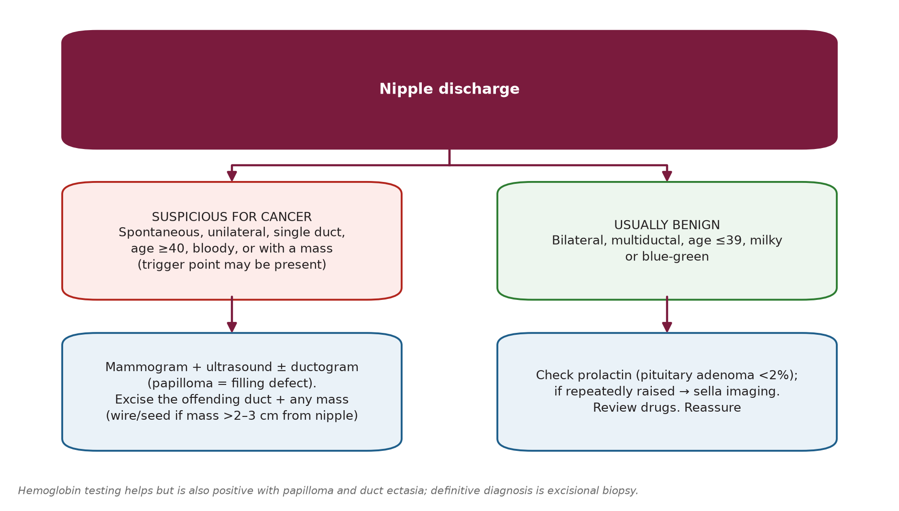
Nipple discharge
Sec. 15
Nipple discharge
Fig. 43 --- Nipple discharge.
Schwartz's Principles of Surgery -- Ch.17: The Breast
132

Slide 148
Nipple discharge
Sec. 15
Ductogram: cannulate the single discharging duct and inject ~1 mL water-soluble contrast. Cancer-related discharge may be clear, bloody or serous; hemoglobin tests help but are also positive with papilloma/ectasia. Definitive diagnosis = excision of the duct +/- mass. Find the duct with a 3.0 lacrimal probe or by methylene blue injected after ductography (seal the nipple with collodion). Wire/seed localisation when a mass lies >2-3 cm from the nipple. [p.599-600]
Bilateral discharge: prolactin-secreting pituitary adenoma in <2%; large adenomas cause optic nerve compression, visual-field loss, infertility. [p.600]
Schwartz's Principles of Surgery -- Ch.17: The Breast
133

Slide 149
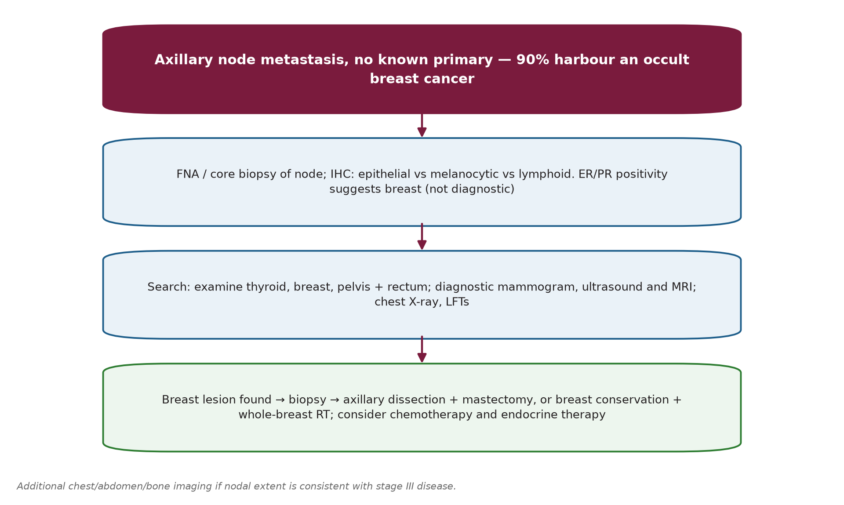
Axillary node metastasis with unknown primary
Sec. 15
Axillary node metastasis with unknown primary
Fig. 44 --- Axillary metastasis, occult primary.
Schwartz's Principles of Surgery -- Ch.17: The Breast
134

Slide 150
Axillary node metastasis with unknown primary
Sec. 15
90% harbour an occult breast cancer, yet only 1% of breast cancers present this way. Positive ER/PR suggests (does not prove) breast origin. [p.600]
Schwartz's Principles of Surgery -- Ch.17: The Breast
135

Slide 151
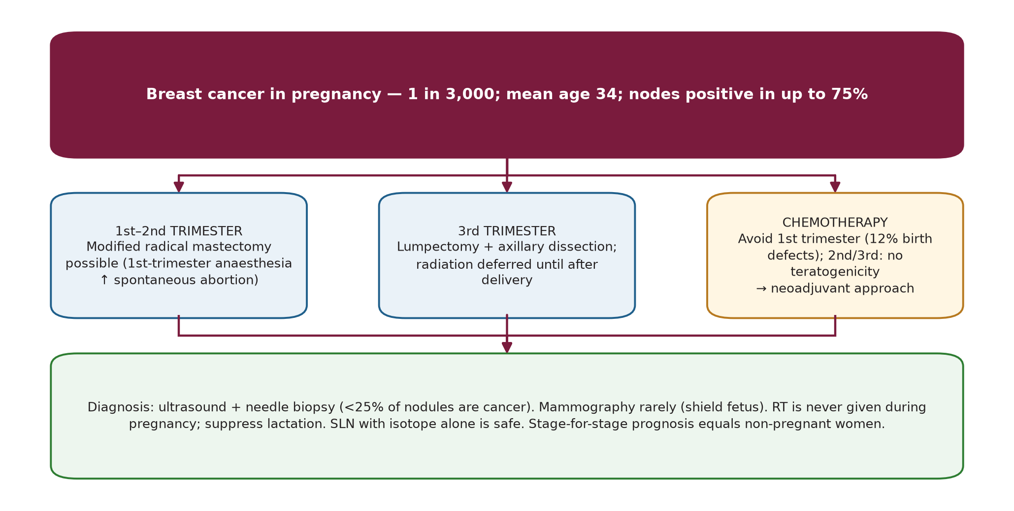
Breast cancer during pregnancy
Sec. 15
Breast cancer during pregnancy
Fig. 45 --- Breast cancer in pregnancy and lactation.
Schwartz's Principles of Surgery -- Ch.17: The Breast
136

Slide 152
Breast cancer during pregnancy
Sec. 15
Of nodules arising in pregnancy/lactation <25% are cancer; ~30% of benign findings are pregnancy-specific (galactocele, lobular hyperplasia, lactating adenoma, mastitis/abscess). Work-up: CBC, chest X-ray (abdomen shielded), LFTs. Late presentation is common because hormone-rich breast tissue masks early cancers. [p.600]
Schwartz's Principles of Surgery -- Ch.17: The Breast
137

Slide 153
Male breast cancer
Sec. 15
Male breast cancer
<1% of all breast cancers (up to 1.5% of male cancers in North Americans and British); highest in Jewish and African-American men. Preceded by gynecomastia in 20%; risk factors: radiation, estrogen therapy, testicular feminising syndromes, Klinefelter's. Peak incidence in the 6th decade. A firm, non-tender mass needs investigation; skin or chest-wall fixation is worrying. [p.600]
DCIS <15%; infiltrating ductal >85%; special types (lobular) occasionally. Stage as in women; stage for stage the same survival, but men present later (stage II-IV). Treatment is surgical --- usually modified radical mastectomy; SLNB is feasible and accurate; RT for high local-regional risk. ~80% hormone-receptor positive -> adjuvant tamoxifen; chemotherapy for HR-negative, large tumours, multiple positive nodes or locally advanced disease. [p.600]
Schwartz's Principles of Surgery -- Ch.17: The Breast
138

Slide 154
Phyllodes tumours
Sec. 15
Phyllodes tumours
Benign, borderline or malignant (cystosarcoma phyllodes); borderline has more local recurrence. Calcification and necrosis do not discriminate grade; hard to separate from fibroadenoma. Sharply demarcated, mixed gelatinous/solid/cystic; leaf-like cut surface; stroma more cellular than a fibroadenoma and always monoclonal (fibroadenoma: poly- or monoclonal). Malignant ones often have liposarcomatous or rhabdomyosarcomatous elements; mitoses and invasive margins help grade. [p.600-601]
Treatment: wide excision with a normal-tissue margin; if suspicious malignant elements -> re-excise to a 1-cm margin; large tumours may need mastectomy. No axillary dissection (nodal metastases are rare). [p.601]
Schwartz's Principles of Surgery -- Ch.17: The Breast
139

Slide 155
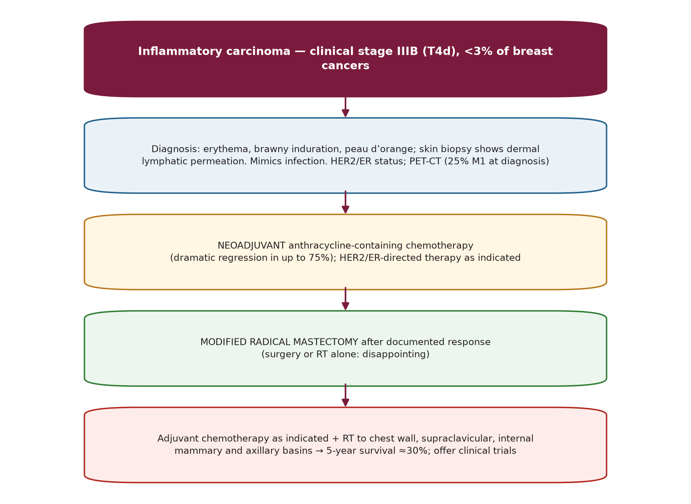
Inflammatory breast carcinoma
Sec. 15
Inflammatory breast carcinoma
Fig. 46 --- Inflammatory carcinoma pathway.
Schwartz's Principles of Surgery -- Ch.17: The Breast
140

Slide 156
Inflammatory breast carcinoma
Sec. 15
Inflammatory vs non-inflammatory locally advanced breast cancer
Feature | Inflammatory | Non-inflammatory (locally advanced)
Dermal lymphatic invasion | Present (with or without inflammatory change) | Inflammation without dermal lymphatic invasion
Delineation | Poor | Better delineated
Erythema / oedema | Often >33% of breast skin | Usually confined to lesion; less oedema
Node involvement | >75% | ~50%
Distant metastases at presentation | 25% | Less common
<3% of breast cancers; brawny induration, erythema with raised edge, peau d'orange; may mimic infection. >75% have palpable axillary nodes; PET-CT at diagnosis. Surgery alone or with RT is disappointing; anthracycline neoadjuvant chemotherapy gives dramatic regression in up to 75%; MRM after response; RT to chest wall and supraclavicular, internal mammary and axillary nodes; 5-year survival approaches 30%; encourage trials. [p.601-602]
Schwartz's Principles of Surgery -- Ch.17: The Breast
141

Slide 157
Rare breast cancers
Sec. 15
Rare breast cancers
Rare breast cancer types [p.602]
Type | Key points
Squamous cell (epidermoid) | From duct metaplasia; regional metastases 25%, distant rare.
Adenoid cystic | <0.1% of breast cancers; like salivary tumour; 1-3 cm, well circumscribed; axillary spread rare, but pulmonary metastases can kill.
Apocrine | Well differentiated, vesicular nuclei, prominent nucleoli, low mitoses; can behave aggressively.
Sarcomas | Large, painless, rapidly growing mass; core or open incisional biopsy; graded; wide local excision (may need mastectomy); no ALND unless nodes proven. Angiosarcoma: de novo, post-radiation (60% of cases had RT), or Stewart-Treves (lymphangiosarcoma in post-mastectomy lymphedema; mean 7-10 y after surgery); may need forequarter amputation for palliation.
Lymphoma | Two types: <=39 y, often bilateral, Burkitt-like; >=40 y, usually B-cell. May present with axillary nodes. Treatment by stage (lumpectomy/mastectomy, ALND, chemo-RT); 5-/10-year survival 74% / 51%. Implant-associated anaplastic large cell lymphoma: excise the implant capsule and mass; systemic therapy/RT if advanced.
Schwartz's Principles of Surgery -- Ch.17: The Breast
142

Slide 158
SECTION 16
Revision Tools
Schwartz, pp. N/A

Slide 159
Numbers to remember (from the chapter)
Sec. 16
Numbers to remember (from the chapter)
High-yield numbers with page references
Topic | Number | Page
Lymph to axilla / to internal mammary nodes | >75% / remainder | 547
Fibroadenoma size categories | <=1 cm normal; <=3 cm disorder; >3 cm giant | 550
Cancer risk: ADH/ALH; LCIS/DCIS; ductal involvement by ADH | 4x; 10x; 7x | 552
Gail: high-risk threshold / tamoxifen eligibility | 5-y risk >=1.66%; age 35-59 | 557-558
NSABP P-1 / MAP.3 / IBIS-II risk reduction | 49% / 65% / ~50% | 557-558
BRCA1 / BRCA2 breast risk; ovarian | <=85%; 40% / 20% | 558-559
BRCA-related share of hereditary cancer | 45% / 35% | 559
Screening benefit >=50 y | -25% mortality | 556
LCIS invasive risk; DCIS ipsilateral | 25-35% (bilateral); 25-70% | 564
Invasive types: ductal NST / lobular / medullary / mucinous / papillary / tubular | 80 / 10 / 4 / 2 / 2 / 2% | 565
Untreated breast cancer median survival | 2.7 y; 5-y 18%, 10-y 3.6% | 562
Neovascularisation / metastatic implantation | 20th / 27th doubling; >0.5 cm | 563
Clinical axillary node exam accuracy | 33% | 575
TAILORx low recurrence score | 0-10 -> 98% 5-y OS with endocrine alone | 580
DCIS recurrence: low/int vs high grade, excision alone | 6.1% vs 15.3% | 581-582
B-24: tamoxifen + RT vs RT | 8.2% vs 13.4% | 582
B-06 in-breast recurrence (20 y) | 39.2% (lumpectomy) vs 14.3% (+RT) | 582
B-32: SLN identification / false-negative | 97% / 9.7% | 584
SLN false-negative by nodes removed | 1 -> 17.7%; 2 -> 10%; 3 -> 6.9% | 590
Z0011 OS / lymphedema | 91.9 vs 92.5%; 13% vs 2% | 584
Trastuzumab 3-y DFS / mortality | 75->87%; -33% | 598
SLN: positive nodes found by 4 SLNs | 98% | 590
MRM skin flap thickness | 7-8 mm | 592
Seroma / lymphedema after MRM | up to 30% / ~20% (50-60% with RT) | 593
Inflammatory cancer: distant M1 at diagnosis; 5-y survival | 25%; ~30% | 601-602
SEER survival: local / regional / distant | 98.6 / 84.4 / 24.3% | 588
Schwartz's Principles of Surgery -- Ch.17: The Breast
143

Slide 160
High-yield distinctions
Sec. 16
High-yield distinctions
High-yield paired distinctions
Pair | Distinguish
LCIS vs DCIS | LCIS: risk marker, bilateral, multicentric, no calcification, E-cadherin lost, no excision needed. DCIS: precursor, ipsilateral, calcifications, excise + RT +/- tamoxifen. (Table 17-8)
BRCA1 vs BRCA2 | BRCA1: triple-negative/medullary, ovarian 40%; BRCA2: HR-positive, male breast cancer, pancreas etc.
Fibroadenoma vs phyllodes | Phyllodes: leaf-like, cellular monoclonal stroma, wide excision 1-cm margin, no ALND.
Radial scar vs complex sclerosing lesion | <=1 cm vs >1 cm. Both need enough tissue to exclude cancer.
ADH vs DCIS | Size cut-off 2-3 mm.
Multicentric vs multifocal | Outside vs inside the quadrant / within 4 cm.
Inflammatory vs neglected locally advanced | Dermal lymphatic invasion, rapid onset, poor delineation, more M1.
Fistulectomy vs total duct excision | Localized recurrent sepsis vs diffuse / multiple fistulae / other discharging ducts.
Neoadjuvant vs adjuvant chemotherapy | Equal OS; more BCS with neoadjuvant; local recurrence risk depends on biology/stage.
Schwartz's Principles of Surgery -- Ch.17: The Breast
144

Slide 161
Rapid-fire management recall
Sec. 16
Rapid-fire management recall
LCIS: observe / tamoxifen / bilateral mastectomy. DCIS: margin >=2 mm + RT; extensive -> mastectomy + SLNB; ER+ -> tamoxifen 5 y.
cN0 invasive: SLNB (dual tracer, 10% rule). 1-2 +SLN + BCS + WBI: no ALND (Z0011). Proven nodes: ALND or neoadjuvant therapy.
Stage III: neoadjuvant systemic -> response? -> surgery -> RT; no response -> change drug, individualise local therapy.
Stage IV: endocrine first if HR+ without visceral crisis; chemo for HR-/crisis; treat local problems; bone-modifying agent.
Endocrine: premenopausal tamoxifen (+/- suppression + exemestane if high risk); postmenopausal AI; extended therapy for node-positive.
HER2+: trastuzumab x1 y with taxane, not with anthracycline, +/- pertuzumab; neratinib after.
Schwartz's Principles of Surgery -- Ch.17: The Breast
145

Slide 162
Abbreviations
Sec. 16
Abbreviations
Abbreviation glossary
Abbreviation | Meaning
ADH/ALH | Atypical ductal/lobular hyperplasia
HRT | Hormone replacement therapy
ALND | Axillary lymph node dissection
IMN | Internal mammary nodes
ANDI | Aberrations of normal development and involution
MRM | Modified radical mastectomy
AI | Aromatase inhibitor
NAC | Nipple-areola complex (or neoadjuvant chemotherapy, by context)
APBI | Accelerated partial breast irradiation
NST | No special type
BCT/BCS | Breast-conserving therapy / surgery
pCR | Pathologic complete response
CBE | Clinical breast examination
PMRT | Post-mastectomy radiotherapy
CC/MLO | Craniocaudal / mediolateral oblique
RCB | Residual cancer burden
DBT | Digital breast tomosynthesis
RS | Recurrence score
DCIS/LCIS | Ductal / lobular carcinoma in situ
SERM | Selective estrogen receptor modulator
DFS/OS | Disease-free / overall survival
SLN(B) | Sentinel lymph node (biopsy)
EBCTCG | Early Breast Cancer Trialists' Collaborative Group
TAD | Targeted axillary dissection
ER/PR | Estrogen / progesterone receptor
TDLU | Terminal duct lobular unit
FNA/CNB | Fine-needle aspiration / core-needle biopsy
WBI/WBRT | Whole-breast irradiation / radiotherapy
Schwartz's Principles of Surgery -- Ch.17: The Breast
146

Slide 163
Source and scope note
Sec. 16
Source and scope note
These notes summarise Schwartz's Principles of Surgery, 11th ed., Chapter 17 (The Breast), book pages 541-603 as supplied. Trial names, percentages and dates are those printed in the chapter. The chapter predates several later developments (for example adjuvant CDK4/6 and PARP inhibition, immune checkpoint therapy, antibody-drug conjugates, and 2020s guideline revisions); consult current guidelines for practice.
Schwartz's Principles of Surgery -- Ch.17: The Breast
147

