Slide 1
BREAST CANCER
MANAGEMENT
Enhanced Presentation — Comprehensive Study Notes with Ethiopian Guideline & 2026 Updates
Sources: Schwartz 11th Ed. (Ch. 17) | DeVita 10th Ed. (Ch. 106) | ESMO 2026 MBC | NCCN v6.2026 | Ethiopian FMOH 2024
Parker CC, Damodaran S, Bland KI, Hunt KK | Burstein HJ, Harris JR, Morrow M
September 2026
Breast Cancer Management
September 2026
1

Slide 2
Table of Contents
01 History of Breast Cancer Therapy
02 Anatomy & Physiology (incl. Embryology)
03 Epidemiology & Natural History
04 Risk Factors
05 Hereditary Breast Cancer (BRCA)
06 Screening & Prevention
07 Diagnosis: Imaging & Biopsy
08 Pathology — In Situ Carcinomas
09 Pathology — Invasive Carcinomas
10 AJCC Staging (TNM)
11 Prognostic Factors & Subtypes
12 Local-Regional Therapy
13 Systemic Therapy (Adjuvant)
14 Management by Stage
15 ESMO 2026 — Metastatic BC Updates
16 Recurrence — Types & Management
17 Special Situations
18 Ethiopian Guideline 2024 Integration
19 Follow-Up & Quick Reference
★ Key differences marked throughout
🇪🇹 = Ethiopian guideline note ★ = ESMO/NCCN 2026 update
Breast Cancer Management
September 2026
2

Slide 3
SECTION
01
01
History of Breast Cancer Therapy
From Halsted radical mastectomy to precision oncology
History of Breast Cancer Therapy
September 2026
3

Slide 4
History of Breast Cancer Therapy
Era/Year | Key Contributor(s) | Milestone
~3000 BC | Edwin Smith Papyrus | Earliest recorded case (male); "there is no treatment"
1700s | Le Dran & Moore | Local spread via lymphatics; first node removal
1894 | Halsted & Meyer | Radical mastectomy: en-bloc skin, pec major/minor, axilla levels I–III
1943 | Haagensen & Stout | Defined "grave signs" of inoperability
1948 | Patey & Dyson | Modified radical: preserve pectoralis major
1976 | Veronesi & Fisher | Randomized trials proving BCS = mastectomy for survival (NSABP B-06)
1980s–90s | Multiple groups | Sentinel lymph node concept; tamoxifen era
2000s | HERA, NSABP B-31 | Trastuzumab for HER2+ BC; survival benefit proven
2010s | SOFT/TEXT, Z0011 | Ovarian suppression; SLNB alone safe in T1-2N1 BCS
2020s | DESTINY, MONARCH-3 | T-DXd for HER2-low/+; CDK4/6 inhibitors standard 1st line MBC
History of Breast Cancer Therapy
September 2026
4

Slide 5
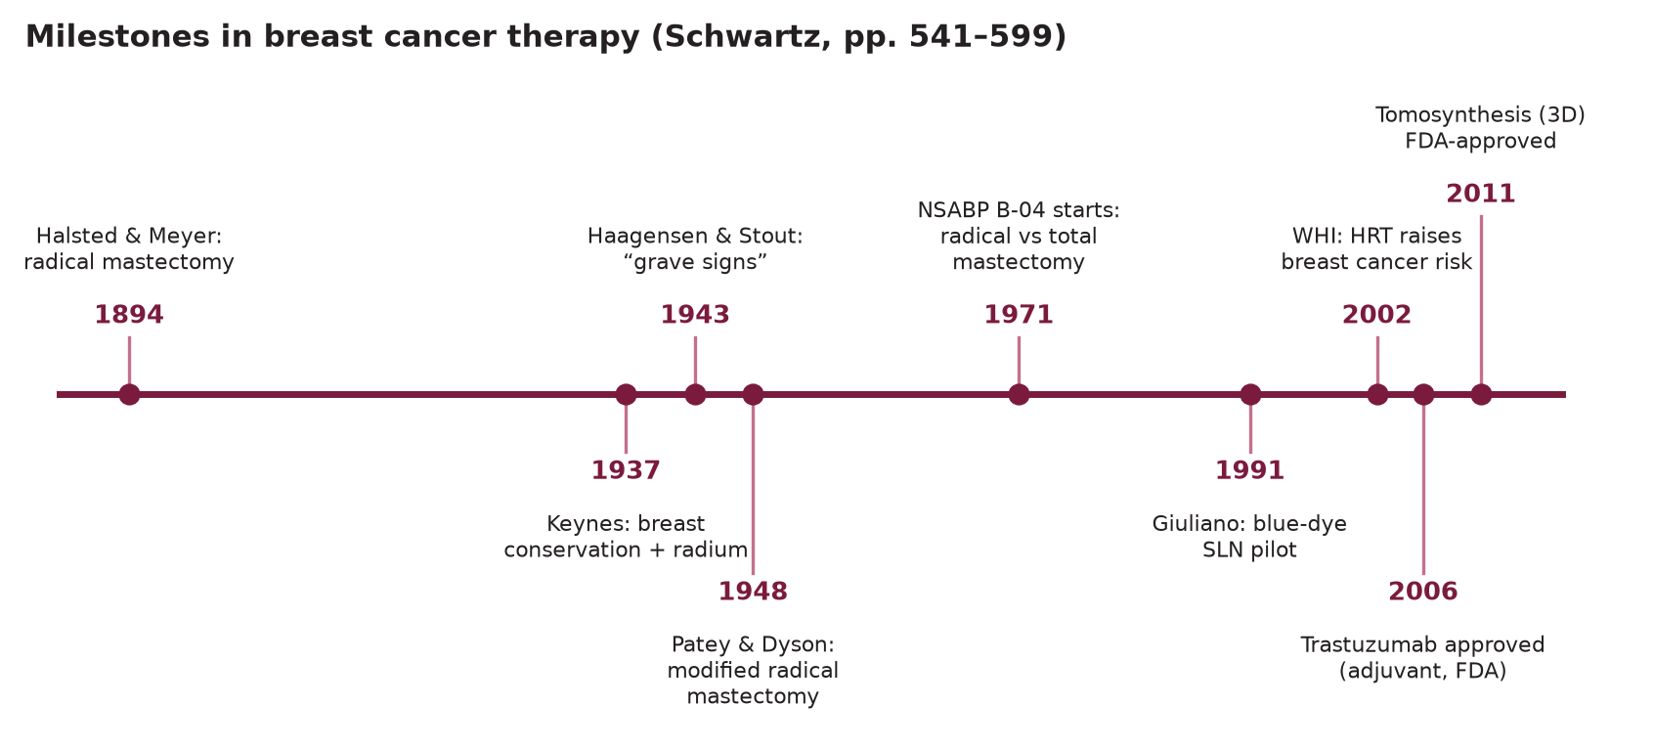
Illustration — Milestones in Breast Cancer Therapy
Timeline adapted from Schwartz Ch.17 (pp. 541–599)
History of Breast Cancer Therapy
September 2026
5

Slide 6
SECTION
02
02
Anatomy & Physiology
Breast structure, embryology, lymphatics, hormonal control
Anatomy & Physiology
September 2026
6

Slide 7
Embryology of the Breast
Embryologic Development
Milk Line & Clinical Correlation
Breast develops from ectoderm (milk line / galactic band) — bilateral ridges Week 4–6
Milk line: axilla → groin; normally involutes leaving single pectoral pair
Persistence → polymastia (extra breast) or polythelia (extra nipple) — 1–2% population
Breast buds appear Wk 6; 15–20 primary epithelial buds canalize → lactiferous ducts
Terminal ductal-lobular units (TDLU) form in late fetal/postnatal life
TDLU = primary site of origin for DCIS, invasive ductal carcinoma and LCIS
Nipple-areola complex forms by areolar skin condensation; nipple elevation at puberty
Accessory nipple along milk line: L2–T10 dermatome distribution
Axillary tail of Spence: functional breast tissue enters axilla through deep fascia opening
Inframammary fold: important surgical landmark; at 5th–6th rib midclavicular line
Retromammary space: loose areolar tissue between breast and pectoralis fascia — plane used in subglandular implant placement
Pathologic Relevance of Embryology
Physiologic Zones
Accessory breast tissue (axilla most common) can develop cancer — mimic lymph node
Inverted nipple if ductal tissue fails to canalize / fibrous tethering
Amazia (absent breast) vs amastia (absent nipple + breast) — rare surgical anomalies
Cooper's ligaments (fibrous septa) anchor skin → retraction = malignancy sign
Retroglandular fat plane — preserved in MRM; violated in Halsted radical
Upper outer quadrant (UOQ): 50% of breast volume → 50% of all breast cancers
Central zone: subareolar; Paget's disease arises here
Retroareolar: 15–20 major lactiferous ducts converge at nipple
Internal mammary nodes: 25–30% of medial tumors drain here → important for staging
TDLU undergoes cyclical proliferation/apoptosis with menstrual cycle
Anatomy & Physiology
September 2026
7

Slide 8
Breast Anatomy
Structural Anatomy
Pectoral Fascia & Muscles
Extent: 2nd–6th rib vertically; sternal edge to mid-axillary line
Axillary tail of Spence: breast tissue through clavipectoral fascia opening into axilla
Cooper's suspensory ligaments: attach skin to overlying dermis and deep fascia
Lymphatics: subdermal + parenchymal plexuses drain to axilla primarily
3 tissue types: glandular (15–20 lobes), stromal (fibrous), adipose
Pectoralis major: superficial to breast; preserved in MRM (Patey)
Pectoralis minor: removed in Halsted; divided in Patey for axillary access
Serratus anterior: critical to preserve long thoracic nerve during ALND
Intercostobrachial nerve: sensory arm inner surface — often sacrificed in ALND
Thoracodorsal nerve to latissimus: preserve in all axillary dissections
Blood Supply
Nerve Anatomy (Surgical Importance)
Internal mammary (pectoral branches): 60% medial breast → largest supply
Lateral thoracic artery (branch of axillary): upper outer quadrant
Intercostal perforators (2nd–4th): posterior supply
Thoracoacromial artery: pectoralis minor region
Venous drainage: internal mammary → subclavian → SVC; axillary vein
Long thoracic nerve (of Bell): serratus anterior → "winged scapula" if cut
Thoracodorsal nerve: latissimus dorsi → preserve for TRAM/LD flap reconstruction
Medial pectoral nerve: pec minor/part pec major → enters pec minor lateral border
Lateral pectoral nerve: larger; enters pec major at clavicular head
Intercostobrachial nerve: T2 → inner arm sensation — often sacrificed in full ALND
Anatomy & Physiology
September 2026
8

Slide 9
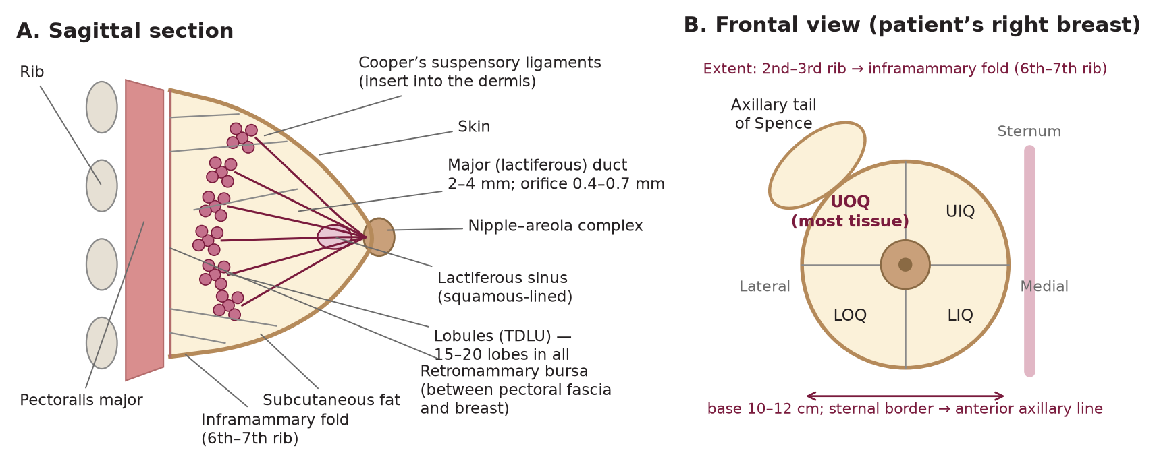
Illustration — Breast Anatomy: Sagittal & Frontal Views
Sagittal section (left) and frontal view of the patient's right breast (right) — Cooper's ligaments, lactiferous ducts, and quadrant nomenclature
Anatomy & Physiology
September 2026
9

Slide 10
Lymphatic Drainage
Axillary Node Levels (Berg Classification)
Node Group | Location | Clinical Significance
Axillary L1-III | Lateral→medial to pec minor | Primary drainage 85-90%
Internal mammary | Intercostals 1-6, <3cm sternal | Medial tumors; N3b if+ with IMN
Rotter's (interpectoral) | Between pec major/minor | Level II; removed in Patey not Halsted
Supraclavicular | Above clavicle | N3c; indicates regional not systemic
Level I (low axilla): lateral to pectoralis minor — first echelon; 60% breast drainage
Level II (mid-axilla): posterior to / behind pec minor — includes Rotter's nodes (interpectoral)
Level III (apical): medial to pec minor / subclavicular — Halsted's "complete dissection"
Skip metastasis to Level III without Level I/II: ~4% — clinically significant
Internal Mammary Nodes (IMN)
Lie in intercostal spaces 1–6, within 3 cm of sternal edge (usually spaces 1–3)
25–30% of medial/central tumors drain to IMN; 15% of outer quadrant tumors
IMN involvement: independent predictor of poor prognosis; included in Stage N3b
Extended radical mastectomy (Urban): included IMN; no survival benefit over MRM
Sentinel Node Concept
Sentinel node = first draining node(s) from tumor site — best reflects nodal status
False-negative rate (FNR): ~5–8% with dual tracer (blue dye + Tc-99m sulfur colloid)
Z0011 trial: 1–2 positive SLNs in cT1-2, BCS + WBRT → ALND not needed (non-inferior OS/DFS)
Anatomy & Physiology
September 2026
10

Slide 11
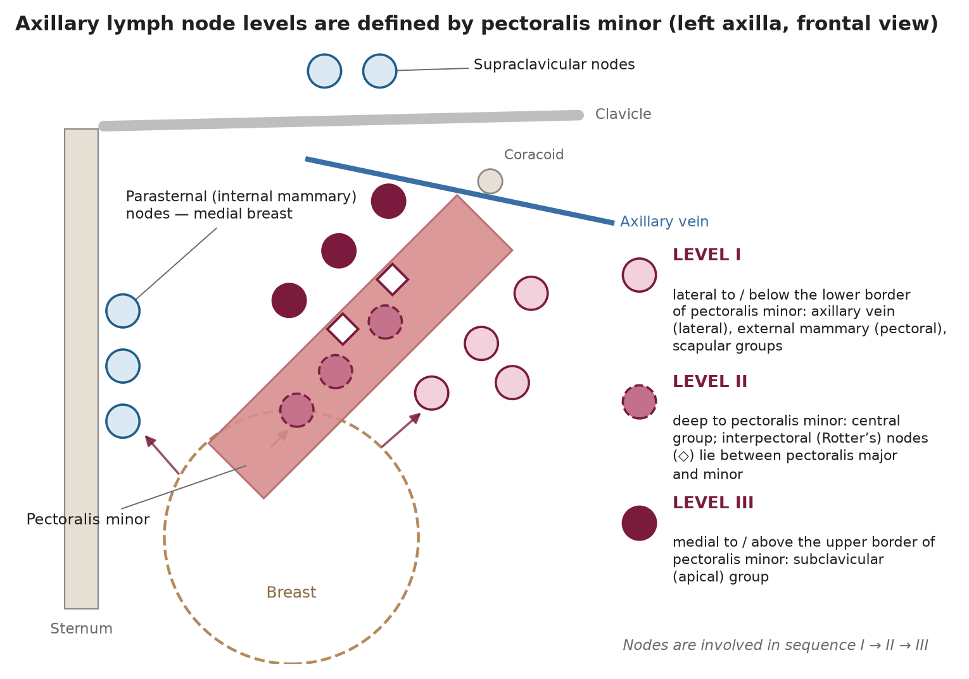
Illustration — Axillary Lymph Node Levels (Berg Classification)
Axillary levels are defined relative to pectoralis minor (frontal view, patient's right axilla)
Anatomy & Physiology
September 2026
11

Slide 12
Physiology & Gynecomastia
Hormonal Control of Breast Development
Gynecomastia
Thelarche (Tanner Stage 2): estrogen-driven ductal elongation, ~age 8–13
Progesterone: lobular development, alveolar differentiation
Prolactin: milk production; high levels → suppress ovulation
Puberty: estrogen + GH + IGF-1 → complete ductal growth
Pregnancy: progesterone + placental lactogen → full lobular development
Menopause: loss of E2/P → involution; increase adipose relative to gland
HRT: combined E+P → increased BC risk (WHI trial); E-alone → no significant increase
Definition: benign proliferation of breast gland in males (true glandular hypertrophy)
Physiologic: neonates (maternal estrogen), puberty, elderly (relative hyperestrogenism)
Pathologic causes: hyperthyroidism, cirrhosis, hypogonadism, Klinefelter's (XXY)
Drug causes: spironolactone, digitalis, marijuana, anabolic steroids, anti-androgens
Paraneoplastic: testicular/adrenal tumor (hCG-secreting), lung cancer
Pseudogynecomastia: adipose tissue — no glandular component
Male Breast Cancer
1% of all breast cancers; 6% in Sub-Saharan Africa (higher rate)
Risk factors: Klinefelter's, BRCA2 mutation, radiation, exogenous estrogen
Typically ER+ (90%), older age at diagnosis (avg 67 yrs)
Presents later: central location, nipple involvement more common
Treatment: MRM (BCS rarely used); tamoxifen preferred adjuvant endocrine
BRCA2: most important germline mutation in male BC (lifetime risk 6-8%)
Galactorrhea & Nipple Discharge Physiology
Prolactin (PRL) secreted by ant. pituitary; dopamine suppresses PRL
Causes of hyperprolactinemia: pituitary adenoma, hypothyroidism, drugs (antipsychotics, metoclopramide)
Bloody discharge: intraductal papilloma (most common); DCIS must be excluded
Persistent unilateral discharge → galactography / ductoscopy
Anatomy & Physiology
September 2026
12

Slide 13
SECTION
03
03
Epidemiology & Natural History
Incidence, mortality trends, racial disparities, Ethiopia context
Epidemiology & Natural History
September 2026
13

Slide 14
Epidemiology of Breast Cancer
Global Epidemiology
Ethiopian Epidemiology (FMOH 2024)
Most common cancer worldwide: 2.26 million new cases in 2020 (11.7% of all cancers)
Leading cause of cancer death in women globally: 685,000 deaths (2020)
Most common in high-income countries; mortality highest in LMIC due to late presentation
5-year survival: >90% in HIC vs 66% India, 40% South Africa
Incidence increasing: 0.5% per year in developed countries
Leading cancer in Ethiopia: 16,133 new cases/year (GLOBOCAN 2020)
ASI rate: 41.5/100,000 — BC accounts for 1 in 5 of ALL cancers in Ethiopia
One third of all female cancers are breast cancer
Age-standardized mortality: 24.1/100,000
65–75% present at Stage III or IV (vs <30% in HIC)
Male BC: 6% of all BC in Sub-Saharan Africa (vs 1% globally)
United States Data
Ethiopia 2024 Guideline Note
Ethiopia — Key Differences from HIC
Lifetime risk: 12.5% (1 in 8 women)
~310,720 new invasive + ~56,500 DCIS cases estimated 2024
Mortality: ~42,000 deaths/year; declining since 1989 peak (~1.9%/year)
Decline attributed to mammography screening + adjuvant therapy advances
Racial disparity: White women higher incidence; Black women higher mortality (HR 1.4)
TNBC: higher frequency in Black women (20–25% vs 10–15% White)
No population-based mammographic screening program — limited infrastructure
CBE as primary early detection modality (not mammography)
Majority diagnosed Stage III/IV → limited curative options
3 WHO GBCI 60:60:80 targets: 60% early stage, 60-day diagnosis, 80% treatment completion
Target 2030: shift diagnosis to ≥60% Stage I/II through CBE scale-up
Epidemiology & Natural History
September 2026
14

Slide 15
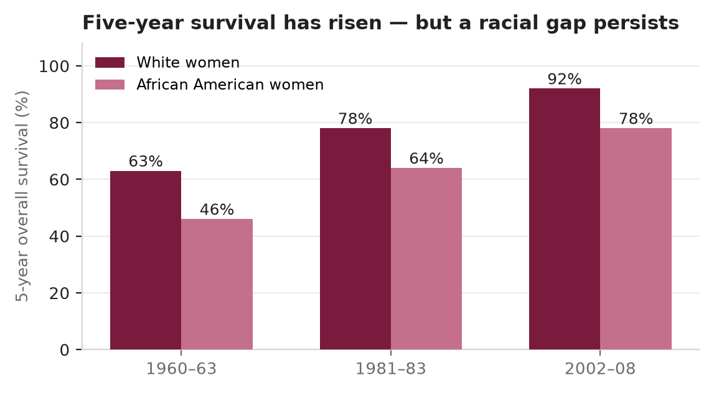
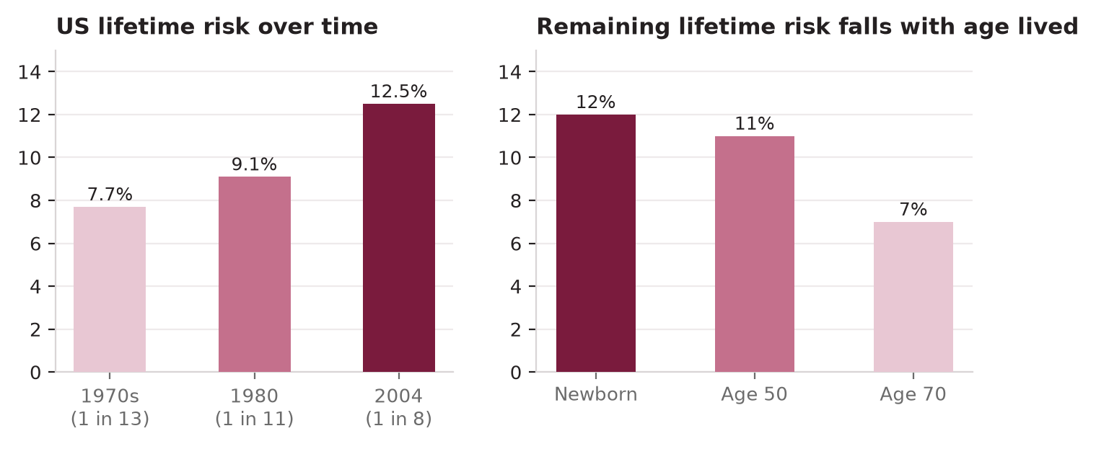
Illustration — Epidemiologic Trends: Lifetime Risk & Survival Disparities
US lifetime risk by decade and by attained age (left); five-year survival by era and by race (right)
Epidemiology & Natural History
September 2026
15

Slide 16
Natural History of Breast Cancer
Tumor Biology & Growth
Halsted vs Fisher Paradigm
Average doubling time: 100–200 days (range 44–1869 days) for invasive BC
Average tumor detectable by mammography at ~0.5–1.0 cm; clinically palpable at ~2 cm
Estimated 6–8 years of subclinical growth before detection by mammography
Cell kinetics: cell loss factor 50–70%; most cells die as they are produced
S-phase fraction (SPF) and Ki-67 index reflect proliferative rate
Halsted (centrifugal): cancer spreads orderly: local → regional → systemic
→ Surgical cure possible with wider resection (radical mastectomy rationale)
Fisher (systemic): cancer is systemic disease from early stages
→ Surgery for local control only; systemic therapy determines survival
Modern consensus: both apply — local control + systemic therapy are essential
Metastatic Cascade
Prognostic Milestones
Local invasion → lymphovascular invasion (LVI) → nodal spread → hematogenous
Key steps: EMT (epithelial-mesenchymal transition), anoikis resistance, extravasation
Preferential metastatic sites: bone (70%), liver, lung, brain, adrenal (Batson's plexus)
Breast cancer is the most common cause of malignant pleural effusion in women
Brain metastasis: highest in HER2+ and TNBC subtypes (~30–50% ultimately)
Bone-only metastasis: best prognosis among MBC; median OS 2–4 years with modern therapy
10-year survival by AJCC stage: I: ~85%, IIA: ~75%, IIB: ~65%, IIIA: ~55%, IIIB: ~40%, IV: ~5–25%
Nodal status: single most powerful pathologic predictor
0 nodes: 70% 10-yr DFS; 1–3 nodes: 55%; 4–9 nodes: 40%; ≥10 nodes: 20%
Dominant patterns: ER+ recurrences late (years 5–20); TNBC/HER2+ early (<3 years)
Annual hazard of recurrence: ER+ bimodal peaks; TNBC front-loaded peak at 2–3 years
Late recurrence (>5 years): ER+ only; motivation for extended adjuvant endocrine therapy
Epidemiology & Natural History
September 2026
16

Slide 17
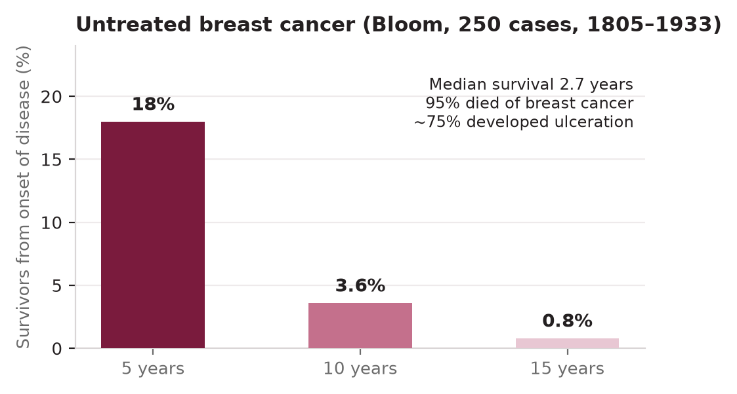
Illustration — Natural History of Untreated Breast Cancer
Bloom (1805–1933) cohort of 250 untreated cases: survivors from onset of disease at 5, 10, and 15 years
Epidemiology & Natural History
September 2026
17

Slide 18
SECTION
04
04
Risk Factors for Breast Cancer
Genetic, hormonal, environmental, benign breast disease
Risk Factors
September 2026
18

Slide 19
Risk Factors — Overview
Risk Factor | Relative Risk | Notes
BRCA1 mutation | 40–87× lifetime | Predominantly TNBC phenotype
BRCA2 mutation | 20–40× lifetime | Predominantly ER+ phenotype
Prior breast cancer (contralateral) | 3–4× | Annual 0.5% risk of second primary
LCIS | 8–10× lifetime | Bilateral marker; not obligate precursor
Atypical hyperplasia (ADH/ALH) | 4–5× | Multiplied 10× if + family history
First-degree relative BC | 2–3× (if 1) | 3–4× if 2 or more first-degree relatives
Prior chest radiation | 3–5× | Mantle RT for Hodgkin's lymphoma
Mammographic density (BIRADS 4) | 4–6× | Dense breast → ↓ sensitivity of mam.
Obesity (post-menopausal) | 1.5–2× | ↑ peripheral aromatization of androgens
Nulliparity or late first pregnancy (>35) | 1.5–2× | Hormonal exposure window effect
Risk Factors
September 2026
19

Slide 20
BRCA1 & BRCA2 Mutations
BRCA1 (17q21)
BRCA2 (13q12.3)
Tumor suppressor — BRCA1/2 involved in HR (homologous recombination) repair
BRCA1 mutations → predominantly TNBC (basal-like) phenotype; high-grade
Lifetime BC risk: 50–72% (by age 80)
Lifetime ovarian cancer risk: 40–46%
High-penetrance: AD inheritance, variable expression
BRCA1 associated cancers: breast, ovary, fallopian tube; lower risk pancreas/prostate
Lifetime BC risk: 45–69%; predominantly ER+ (higher luminal A/B frequency)
Lifetime ovarian cancer risk: 12–20%
Male BC risk: 6–8% lifetime (vs <1% general population)
Other cancers: pancreatic (4–7%), melanoma, prostate (7–24% depending on age)
NCCN 2026: BRCA2 carriers → annual prostate cancer screening from age 40–45
Biallelic BRCA2: Fanconi anemia — embryonic lethality / severe developmental defects
Ashkenazi Jewish Founder Mutations
Testing Criteria (NCCN 2026)
3 common founder mutations: 185delAG, 5382insC (BRCA1); 6174delT (BRCA2)
Prevalence: 1 in 40 Ashkenazi Jewish individuals (vs 1:400 general population)
Higher prior probability → expanded testing criteria in this population
TNBC at any age; BC diagnosed ≤50 years; ≥2 primary BC (bilateral or separate ipsilateral)
Ovarian/fallopian/peritoneal cancer at any age; male breast cancer
Specific ancestry (Ashkenazi Jewish); first/second degree relative meeting criteria
BRCA1/2 in germline: opens olaparib/talazoparib eligibility in metastatic setting
Risk Factors
September 2026
20

Slide 21
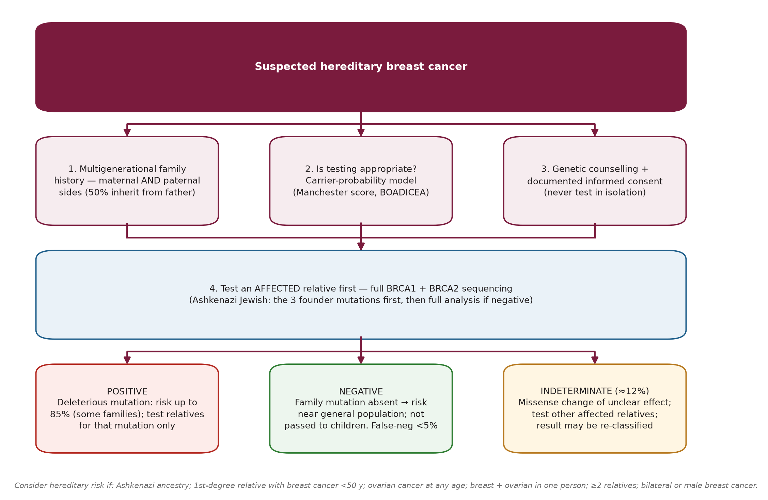
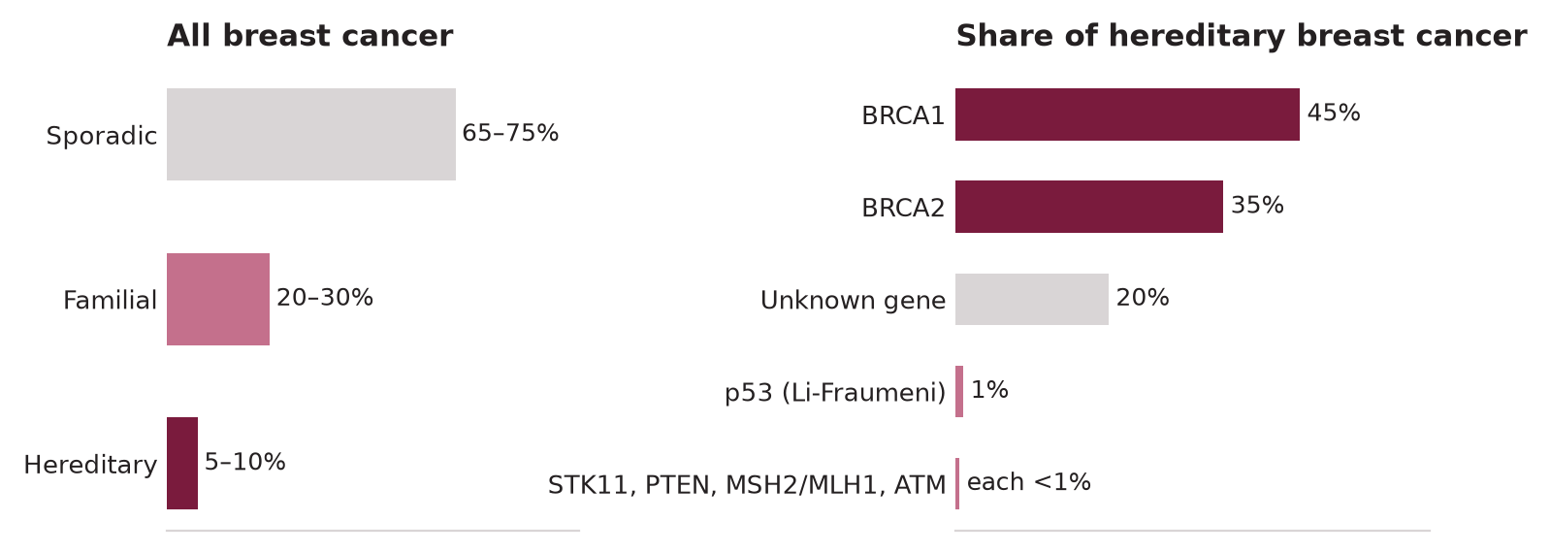
Illustration — Hereditary Breast Cancer: Proportions & Workup
Share of hereditary breast cancer by gene (left); suspected hereditary breast cancer workup algorithm (right)
Risk Factors
September 2026
21

Slide 22
Hormonal & Environmental Risk Factors
Reproductive & Hormonal
Benign Breast Disease (BBD)
Early menarche (<12): ↑ risk (↑ lifetime estrogen exposure)
Late menopause (>55): ↑ risk; nulliparity or first birth >35 → 1.5–2× ↑
Breastfeeding: protective — each year of breastfeeding → 4% ↓ BC risk
HRT (combined E+P): WHI → 1.24× ↑ risk for >5 yrs; absolute risk small (8 per 10,000)
Oral contraceptives: COCP slightly ↑ current use risk (RR 1.24); wanes after cessation
DES exposure (in utero): 2× ↑ risk in daughters (mothers who took DES 1940–1971)
Non-proliferative lesions (fibrocystic change, cysts, mild hyperplasia): NO increased risk
Proliferative without atypia (moderate hyperplasia, sclerosing adenosis, papilloma): 1.5–2× ↑
Proliferative with atypia: 4–5× ↑ (ADH and ALH have equal predictive value)
→ Atypical hyperplasia + first-degree relative BC: 10× ↑ lifetime risk
Radial scar / complex sclerosing lesion: independent 2× ↑ risk; requires excision
Environmental & Lifestyle
Other High-Risk Syndromes
Radiation: ionizing radiation to chest (Hodgkin's therapy, repeated fluoroscopy)
Alcohol: dose-dependent; each drink/day → ~7% ↑ risk; mechanism: ↑ estrogen + acetaldehyde
Obesity (BMI >30): 1.5–2× ↑ post-menopausal (adipose aromatase); protective pre-menopausal
Physical activity: 25–30% ↓ risk with regular moderate exercise
Night-shift work: possible ↑ risk (circadian disruption, ↓ melatonin — limited evidence)
Diet: no single food established; Mediterranean diet pattern associated with ↓ risk
Li-Fraumeni syndrome (TP53): lifetime BC risk 40–80%; often premenopausal
Cowden syndrome (PTEN): 25–85% lifetime BC risk; also thyroid/endometrial
Peutz-Jeghers (STK11): 30–50% BC risk + GI hamartomas
Hereditary diffuse gastric cancer (CDH1): 40–60% lobular BC risk
ATM heterozygotes: 2–3× risk; homozygous → ataxia-telangiectasia
PALB2 mutation: 14–35% lifetime BC risk — becoming routine in germline testing panels
Risk Factors
September 2026
22

Slide 23
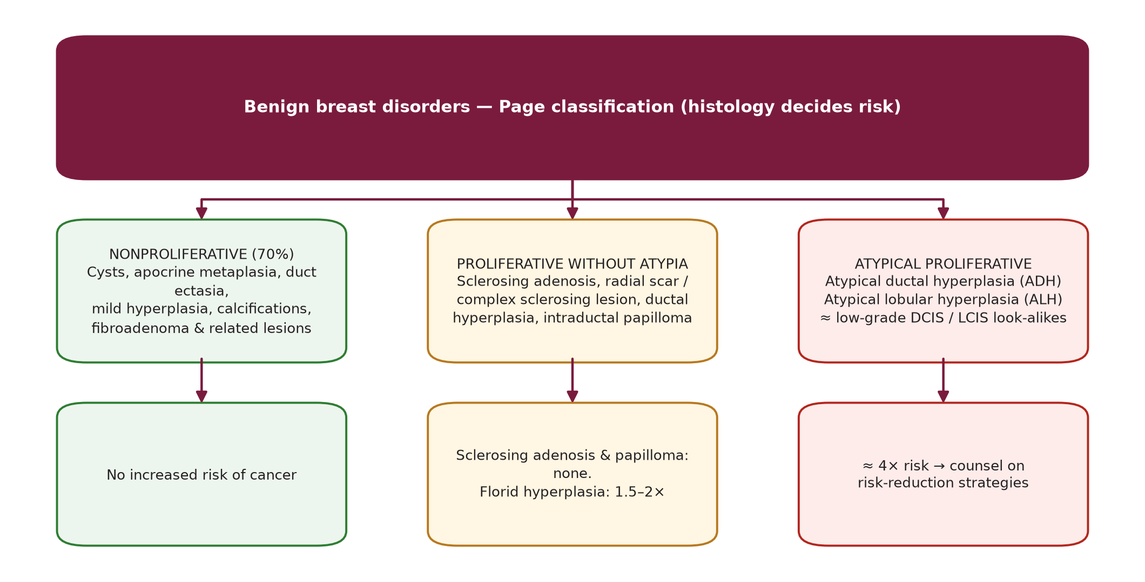
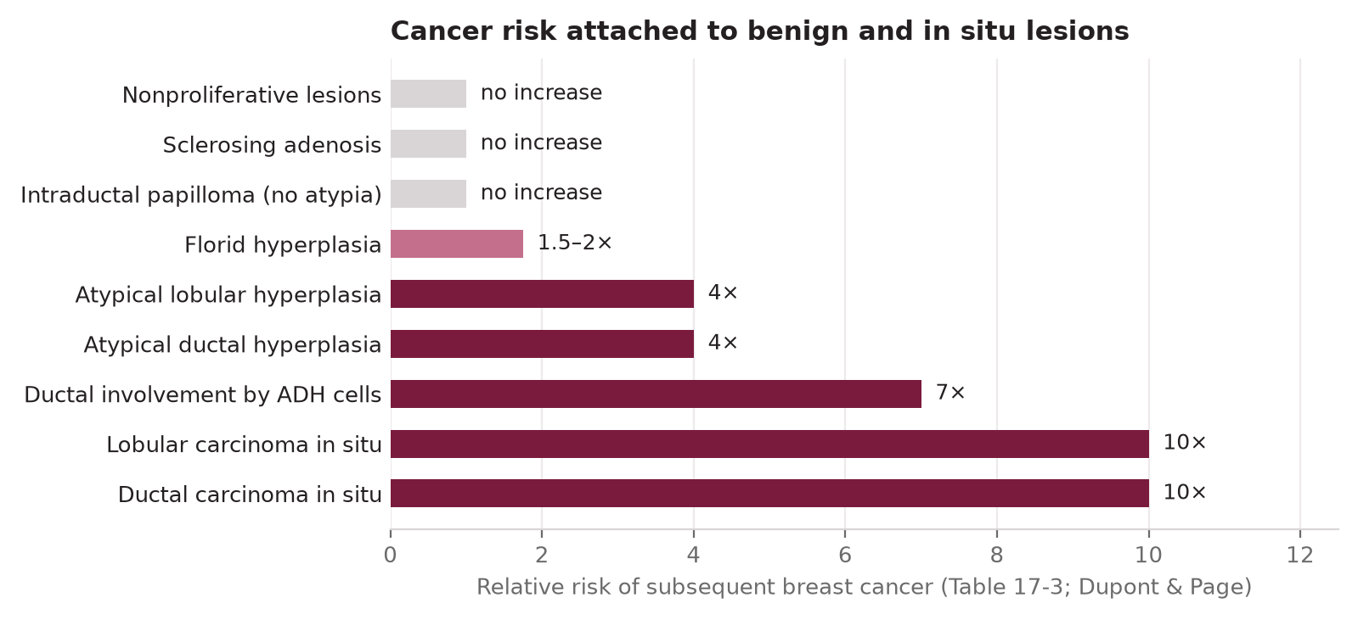
Illustration — Benign Breast Disease: Classification & Risk
Page classification of benign breast disorders (left) and relative risk of subsequent cancer by lesion type (right)
Risk Factors
September 2026
23

Slide 24
Risk Assessment Models
Model | Key Inputs | Best Use | Limitation
Gail / BCRAT | Age, menarche, first birth, family hx, biopsies, race | 5-year risk; eligibility for chemoprevention (Gail ≥1.7%) | Limited family hx detail; underestimates BRCA kindreds
Tyrer-Cuzick (IBIS) | Reproductive hx, density, family hx, BBD, BRCA probability | Lifetime risk; most accurate for strong family hx | Complex; can overestimate in some AH/LCIS populations
BRCAPro | Pedigree + BRCA1/2 test results | Probability of carrying BRCA1/2 variant | BRCA1/2 only; not PALB2, ATM, CHEK2
BOADICEA/CanRisk | Full pedigree, multiple susceptibility genes, PRS | Comprehensive hereditary risk incl. PALB2/ATM | PRS not yet standard of care (NCCN 2026)
BCSC | Age, race/ethnicity, density, family hx, biopsy | Population-based 5–10 year risk | Not designed for extensive family hx
NCCN 2026 Thresholds: Discuss chemoprevention if Gail 5-year risk ≥1.7%; stronger recommendation if Gail ≥3% or IBIS/Tyrer-Cuzick 10-year ≥5%
Risk Factors
September 2026
24

Slide 25
SECTION
05
05
Hereditary Breast Cancer
BRCA management strategies, prophylactic surgery, NCCN 2026 updates
Hereditary Breast Cancer
September 2026
25

Slide 26
BRCA Carrier Management Strategies
Surveillance (Non-Surgical)
Chemoprevention
Annual breast MRI + mammography (alternating every 6 months) from age 25–75
Clinical breast exam every 6–12 months from age 25
BRCA1: start MRI by age 25; BRCA2: by 25–30
Transvaginal ultrasound + CA-125: q6 months from 30–35 yrs or 5–10 yrs before earliest affected relative
PSA screening for male BRCA1/2 carriers: annual from age 40–45 (NCCN 2026)
Tamoxifen 20 mg/day × 5 years: reduces ER+ BC by 49% (NSABP P-1)
→ Less established benefit in BRCA1 (predominantly TNBC); clearer benefit for BRCA2
Raloxifene (postmenopausal): similar efficacy to tamoxifen, less uterine risk
Aromatase inhibitors (AIs): postmenopausal only; exemestane, anastrozole
Risk-benefit should include QoL, contraindications (VTE, endometrial cancer history)
Risk-Reducing Surgery
Germline Positive: Systemic Treatment Implications
Risk-reducing bilateral mastectomy (RRM): ↓ BC risk by ~90–95%
Risk-reducing bilateral salpingo-oophorectomy (RRBSO): ↓ ovarian Ca risk 80–96%
RRBSO also reduces BC risk ~50% if done before menopause (BRCA1 by age 40, BRCA2 by 45)
Nipple-sparing mastectomy: acceptable for appropriate candidates; residual risk ~5–10%
Reconstruction counseling: implant vs autologous; body image discussion essential
Olaparib (PARP inhibitor): FDA-approved for BRCA1/2 HER2-neg early BC (high-risk; residual dz after neoadj)
Talazoparib: alternative PARP inhibitor; similar indication
Neoadjuvant: BRCA1/2 → use platinum-based chemotherapy (cisplatin active)
Metastatic: olaparib/talazoparib preferred over single-agent chemo (OlympiAD/EMBRACA trials)
Children: autosomal dominant — 50% chance; genetic counseling for first-degree relatives
Hereditary Breast Cancer
September 2026
26

Slide 27
★ NCCN 2026 — Genetic Risk Assessment Updates
★ NCCN v2.2026 UPDATE: Genetic/Familial High-Risk — BRCA & Multi-Gene Panel Changes
BRCA1/2 & Prostate Cancer Risk (NCCN 2026)
Multi-Gene Panel Considerations
BRCA1 P/LP carriers: 7–26% cumulative lifetime prostate Ca risk
BRCA2 P/LP carriers: 19–61% cumulative lifetime prostate Ca risk
BRCA2 associated with aggressive prostate cancer (T4, Gleason ≥8, metastatic)
OR 3.19 (95% CI 1.94–5.25) for aggressive prostate Ca in BRCA2 carriers
NEW: Annual PSA screening recommended from age 40–45 for BRCA1/2 male carriers
Screen from age 40 with BRCA2 or positive family hx of prostate Ca
ATM P/LP variants: 2–4× BC risk; prostate Ca risk (moderate penetrance)
CHEK2 1100delC: 2–3× BC risk; also associated with prostate Ca risk
PALB2: 14–35% lifetime BC risk — now routinely tested alongside BRCA1/2
PRS (polygenic risk score): NOT recommended as standard of care by NCCN 2026
CanRisk/BOADICEA now includes PALB2, ATM, CHEK2 in comprehensive risk model
HOXB13 G84E Variant — New Recognition
Pancreatic & Ovarian Cancer Updates
HOXB13 P/LP variants found in 1.4–4.5% of prostate cancer patients
G84E missense variant: 60% lifetime prostate Ca risk by age 80 in carriers
HOXB13 associated with early-onset prostate cancer (age ≤55)
Now included in multi-gene panel testing for hereditary cancer syndromes
No strong association with aggressive disease phenotype (unlike BRCA2)
BRCA1/2 carriers: annual pancreatic Ca surveillance from age 50 recommended
Nonepithelial ovarian cancer (granulosa, Sertoli-Leydig): new testing criteria added
BRIP1, RAD51C/D: ovarian Ca risk; relevant for counseling surgical prevention
Germline testing cascade: all first-degree relatives of confirmed P/LP variant carrier
Hereditary Breast Cancer
September 2026
27

Slide 28
SECTION
06
06
Screening & Prevention
Mammography guidelines, MRI, chemoprevention, Ethiopia CBE approach
Screening & Prevention
September 2026
28

Slide 29
Screening Mammography
Mammography Evidence & Guidelines
3D Mammography (DBT)
Reduces BC mortality ~15–25% (meta-analyses of RCTs)
Sensitivity: 77–95%; lower in dense breasts (<50%) → supplemental US or MRI
Specificity: ~90%; recall rate 10%; biopsy rate ~1.5%
USPSTF 2024: biennial mammography ages 40–74 (updated from 50–74)
ACS: annual mammography from age 45 (optional 40–44); biennial option at 55+
NCCN/ACR: annual mammography from age 40 for average risk
Digital Breast Tomosynthesis: 15–30% ↑ cancer detection vs 2D
40% ↓ in recall rates; 27% ↑ in invasive cancer detection
Now standard at most screening centers in HIC
Slightly higher radiation dose — still well within safe range
BIRADS Classification
False Positives & Overdiagnosis
BIRADS 0: Incomplete — needs additional imaging
BIRADS 1: Negative — routine screening
BIRADS 2: Benign — routine screening
BIRADS 3: Probably benign — short-interval 6-month follow-up (0.5–2% malignancy)
BIRADS 4: Suspicious — biopsy recommended (4A 2–10%, 4B 10–50%, 4C 50–95%)
BIRADS 5: Highly suggestive of malignancy — biopsy required (>95%)
BIRADS 6: Known biopsy-proven malignancy
Cumulative 10-year FP risk with annual mammography: ~61%
Overdiagnosis estimate: 10–25% of screen-detected cancers (esp. DCIS)
Balance: early detection benefit vs unnecessary biopsy, anxiety, overtreatment
Benefits: highest in age 50–69; debate continues for 40–49 age group
Screening interval does not affect OS in most trials (annual vs biennial)
🇪🇹 Ethiopia: Mammography NOT yet available as population screening. CBE is primary screening tool (see Ethiopian Guideline slide)
Screening & Prevention
September 2026
29

Slide 30
MRI Screening Indications & Chemoprevention
Breast MRI — High-Risk Screening
Ultrasound Supplemental Screening
Annual MRI + mammography: ≥20% lifetime risk (BRCA1/2, other high-risk genes)
Sensitivity of MRI: 71–100% vs 33–60% for mammography in BRCA carriers
Contrast-enhanced MRI: evaluate extent of disease; preop planning; occult primary
Indications: BRCA carrier, prior chest RT, first-degree BRCA carrier, lifetime risk ≥20%
Not recommended for average-risk women (false positive rate too high)
Optional for: lifetime risk 15–20%, dense breasts with prior atypia (NCCN)
Recommended for dense breasts (BIRADS C/D) when MRI not available/affordable
Whole-breast US: detects additional 2–3 cancers per 1000 screened women
Automated whole-breast US (ABUS): reproducible; less operator-dependent
High FP rate: 85–90% of additional biopsies prompted by US are benign
Cannot replace mammography: misses calcifications (DCIS) entirely
Chemoprevention Agents
Risk-Reducing Mastectomy
Tamoxifen 20 mg/day × 5 yrs: 49% ↓ ER+ BC (NSABP P-1); pre+postmenopausal
Raloxifene 60 mg/day × 5 yrs: 38% ↓ ER+ BC (MORE trial); postmenopausal only; ↓ VTE vs Tam
STAR trial: Tamoxifen vs Raloxifene — similar invasive BC reduction; more uterine sarcoma with Tam
Exemestane 25 mg/day × 5 yrs: 65% ↓ risk (MAP.3 trial); postmenopausal only
Anastrozole 1 mg/day × 5 yrs: 50% ↓ (IBIS-II); postmenopausal; ↓ bone density
NCCN: discuss at Gail 5-year ≥1.7%; recommend at ≥3% or IBIS 10-yr ≥5%
NCCN: discuss RRM for P/LP variants in high-penetrance genes (BRCA1/2, TP53, CDH1)
Risk reduction: ~90–95% for BC; does not eliminate risk (residual chest wall tissue)
Survival benefit: shown in BRCA1/2 carriers with intact ovaries
Nipple-sparing RRM: acceptable in appropriate candidates; completeness is paramount
Reconstruction: immediate implant vs tissue expander vs LD/TRAM flap — individualized
Counseling: body image, sexuality, future screening, genetic implications
Screening & Prevention
September 2026
30

Slide 31
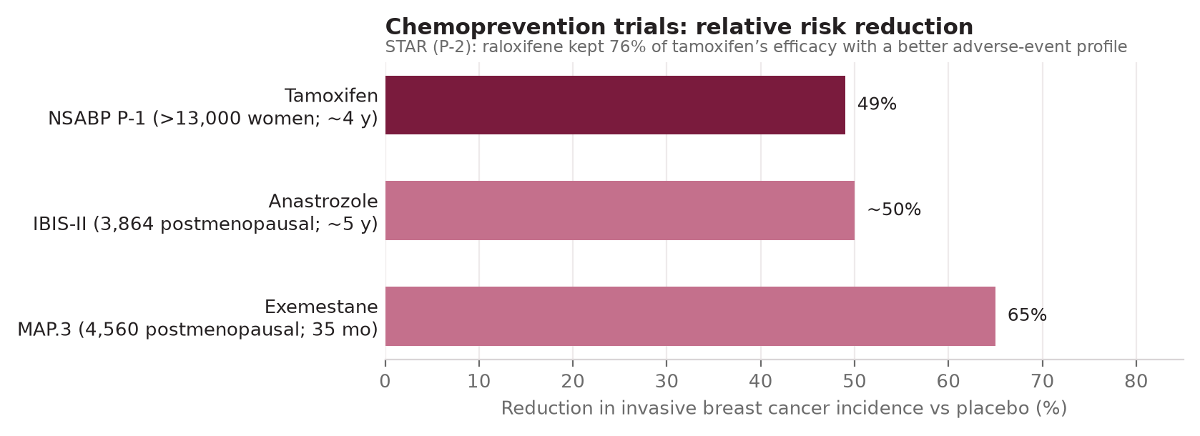
Illustration — Chemoprevention Trials: Relative Risk Reduction
Relative risk reduction in invasive breast cancer incidence vs placebo across NSABP P-1, IBIS-II, and MAP.3
Screening & Prevention
September 2026
31

Slide 32
🇪🇹 Ethiopian Guideline — Screening & Early Detection
🇪🇹 ETHIOPIAN GUIDELINE 2024 — Screening Note: CBE replaces population mammography as primary screening tool
Three Early Detection Methods (Ethiopia)
Screening Method | Ethiopia | International (HIC)
Primary modality | CBE (trained health worker) | Mammography (2D/3D)
Age to start | 30 years (CBE) | 40 years (mammography)
Frequency | Annual CBE; 2-yr mammogram if available | Annual or biennial mammo
Sensitivity for <1cm tumor | Low (CBE) | High (~85%)
Infrastructure needed | Minimal | Significant (equipment + radiologists)
Gap/difference | 65-75% present Stage III/IV | <30% in HIC present late
1. Breast Health Awareness (BHA): women ≥20 years; monthly BSE education
2. Clinical Breast Examination (CBE): women ≥30 years; annual by trained provider
3. Diagnostic Imaging (US/Mammography): women ≥40 years every 2 years, or diagnostic
CBE by trained health worker: identifies cancers as small as 1 cm
CBE integrated into existing MCH services (ANC, postnatal, FP clinics)
CBE Protocol in Ethiopia
Physical exam: breasts and underarms in upright and lying flat positions
Palpation looking for: lump/change in shape, fixed/hard mass, axillary lump
Skin changes: peau d'orange, ulceration, nipple retraction, bloody discharge
Confirmatory: if suspicious → refer for US ± mammography and FNAC/biopsy
Train all primary HCW; include CBE in medical and nursing curricula
Quality assurance: proficiency assessments and standardized protocols
Screening & Prevention
September 2026
32

Slide 33
SECTION
07
07
Diagnosis: Imaging & Biopsy
Clinical examination, imaging modalities, triple assessment, biopsy techniques
Diagnosis: Imaging & Biopsy
September 2026
33

Slide 34
Clinical Presentation & Examination
Presenting Signs & Symptoms
Physical Examination Technique
Painless lump (most common, 70%): new hard/fixed lump → high suspicion
Skin changes: peau d'orange (dermal lymphatic invasion), dimpling (Cooper's ligament tethering)
Nipple changes: inversion (new), eczematous rash (Paget's), bloody discharge
Axillary lymphadenopathy: hard, matted, fixed nodes → suspicious
Locally advanced: skin ulceration, chest wall fixation, erythema
Inflammatory BC: diffuse erythema >1/3 breast, peau d'orange, rapid onset (not a skin infection)
Arms above head + leaning forward: accentuates asymmetry, skin dimpling, nipple retraction
Lymph nodes: axillary levels I–III, supraclavicular, infraclavicular
Systematic palpation: 4 quadrants + subareolar; standing then supine
Note: size (cm), location (clock face, distance from nipple), mobility, consistency, borders
Skin: erythema, edema, satellite nodules, scars, visible veins
Contralateral breast: always examine both; bilateral synchronous BC ~1–3%
Triple Assessment — Gold Standard
Workup Algorithm
1. Clinical Breast Examination (history + physical)
2. Imaging (mammogram ± US ± MRI)
3. Pathology (FNAC or core needle biopsy)
All three concordant benign: 99.6% NPV; discordance → biopsy mandatory
Core needle biopsy preferred over FNAC: provides architecture, ER/PR/HER2
Age <30 with discrete mass: US first (dense breast, low malignancy risk)
Age ≥30 or suspicious mass: Diagnostic mammogram + US ± biopsy
Dominant solid mass any age: biopsy if ≥BIRADS 4
Nipple discharge: cytology of discharge + mammogram + US ± ductoscopy
Occult primary (axillary node + unknown primary): MRI breast before biopsy
Diagnosis: Imaging & Biopsy
September 2026
34

Slide 35
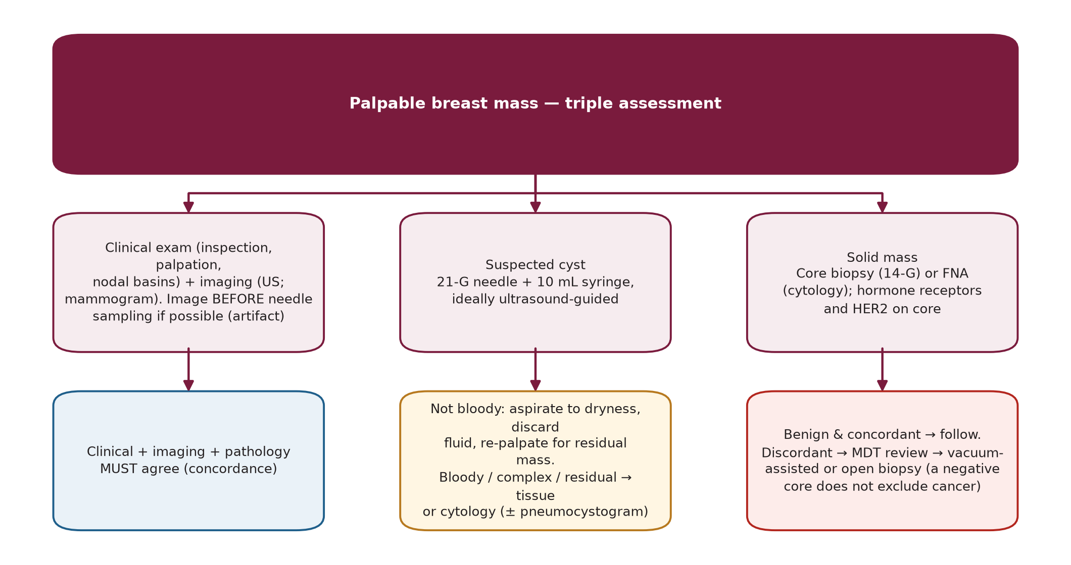
Illustration — Triple Assessment Algorithm for a Palpable Mass
Structured pathway from clinical exam through imaging to tissue diagnosis
Diagnosis: Imaging & Biopsy
September 2026
35

Slide 36
Imaging Modalities
Modality | Sensitivity | Specificity | Best Use | Limitations
Mammography (2D) | 75–85% | 90% | Screening; calcifications (DCIS) | Dense breasts ↓ sensitivity; radiation
DBT (3D Mammo) | 85–95% | 93% | Screening; dense breasts; spiculated lesions | Higher dose; longer read time
Breast Ultrasound | 90–95% | 88% | Cyst vs solid; dense breast; biopsy guidance | Operator dependent; misses calcifications
Breast MRI | 90–99% | 70–80% | High-risk screening; occult primary; extent | High FP rate; expensive; not for all
PET/CT | 70–85% | - | Stage III–IV; detect LN/distant mets; ambiguous sites | Low sensitivity small (<1cm) lesions
MRI — Specific Indications
Axillary Evaluation
Newly diagnosed BC: evaluate extent ipsilateral + contralateral synchronous
Occult primary (positive axillary node): 70% detection rate before MRI negative
Evaluate response to neoadjuvant: residual disease assessment
Dense breasts or implants: supplement mammography
BRCA/high-risk annual surveillance
US-guided FNA/core biopsy of suspicious nodes: before decisions on surgical staging
Mark biopsied suspicious node (clip) for targeted axillary dissection (TAD) after neoadjuvant
cN0: SLNB standard; cN1–2: full evaluation; post-neoadj cN0 → TAD
PET-CT: useful for detecting occult systemic disease in Stage III
Diagnosis: Imaging & Biopsy
September 2026
36

Slide 37
Biopsy Techniques
Technique | Sample Obtained | Advantages | Disadvantages
FNA (FNAC) | Cells (cytology) | Rapid, minimal trauma, guides treatment acutely | No architecture; cannot distinguish inv vs in situ; operator dependent
Core needle biopsy (CNB) | Core tissue (histology) | Architecture, ER/PR/HER2; standard of care | Small invasive procedure; hematoma risk
Vacuum-assisted (Mammotome) | Multiple cores; 11–14G | Best for calcifications; lower sampling error | More expensive; longer procedure
Excisional biopsy | Full lesion removed | Diagnostic + therapeutic if margins clear | Requires OR; disrupts subsequent surgery
Incisional biopsy | Part of lesion | Large lesions; prior excisional failure | Disrupts tumor; requires OR; rarely needed
Image-Guided Biopsy
Post-Biopsy
US-guided: real-time; solid masses; axillary nodes; most used technique
Stereotactic (mammogram-guided): microcalcifications without US correlate
MRI-guided: lesion only on MRI — requires supine or prone coil; DCIS especially
Clip placement mandatory: marks biopsy site for surgery or TAD after neoadjuvant
Radiograph clip to confirm: concordance of imaging and pathology before treatment
Discordant result: repeat biopsy — never trust a benign core if imaging is suspicious
Diagnosis: Imaging & Biopsy
September 2026
37

Slide 38
🇪🇹 Ethiopian Guideline — Timely Diagnosis (Pillar 2)
🇪🇹 ETHIOPIAN GUIDELINE 2024 — Timely Diagnosis: Target = complete workup within 60 days of referral
Triple Assessment in Ethiopia
Diagnostic Element | Ethiopia Approach | International Standard | Gap
Initial imaging | US (mammogram limited) | Diagnostic mammo + US | Limited mammography access
Tissue diagnosis | FNAC first → CNB | Core needle biopsy preferred | FNAC lacks architecture; misses HER2
Biomarker testing | ER/PR (limited); HER2 (variable) | ER/PR/HER2/Ki-67 all sites | Inconsistent HER2 testing
Time to diagnosis | Target: ≤60 days | Best practice: ≤2–4 weeks | Delays common due to infrastructure
MDT | Available at tertiary only | Standard at all treating centers | MDT access limited to tertiary
Step 1: History + CBE by trained provider (history of lump, duration, changes)
Step 2: Imaging — US preferred (mammogram if available); assess mass characteristics
Step 3: FNAC as initial diagnostic modality → core needle biopsy → incisional biopsy
Combining all three = diagnostic concordance before treatment decisions
FNAC first approach: practical for resource-limited settings; limitations recognized
85–90% of all biopsied breast lesions are ultimately benign
Ethiopian Workup Algorithm
Women ≥30 yrs with: breast lump ± change in shape/consistency, axillary lump,
skin changes (peau d'orange, ulceration), nipple retraction/bloody discharge
Within 60 days: coordinate US ± mammography + FNAC/biopsy for diagnosis
Benign lesion: treat per guideline
Suspected/confirmed BC: refer to BC treatment facility + MDT
Diagnosis: Imaging & Biopsy
September 2026
38

Slide 39
SECTION
08
08
Pathology — In Situ Carcinomas
LCIS, DCIS: features, natural history, management algorithms
Pathology — In Situ Carcinomas
September 2026
39

Slide 40
LCIS — Features & Natural History
LCIS — Classic Features
Management
Origin: terminal duct-lobular unit (TDLU); lobular architecture preserved
Cells: small, uniform, discohesive; fill and distend acini
E-cadherin NEGATIVE (CDH1 loss) → loss of cell-cell adhesion (also in invasive lobular)
Classic LCIS: bilateral risk marker; NOT an obligate precursor
Pleomorphic LCIS (PLCIS): high-grade, necrosis → managed more like high-grade DCIS
Florid LCIS: expansile growth → margins warranted (controversial)
Classic LCIS: observation + risk stratification + chemoprevention
Tamoxifen (NSABP P-1): 49% ↓ in subsequent BC risk for LCIS patients
Excision not mandatory for classic LCIS at core biopsy — but excision often done due to upgrade risk
Pleomorphic LCIS: excision to clear margins (similar management to high-grade DCIS)
Risk-reducing bilateral mastectomy: option for strong family history or BRCA+
Annual mammogram + physical exam for surveillance
Natural History & Risk
LCIS vs Invasive Lobular Carcinoma (ILC)
Lifetime BC risk: 8–10× general population; bilateral equal risk
~1% per year absolute risk of developing BC after LCIS diagnosis
Both lobular and ductal invasive carcinoma risk is elevated
LCIS at surgical margin: no re-excision required (classic LCIS); PLCIS: excise
~20% of excisions → upgrade to invasive or DCIS (reason for excision at initial CNB)
ILC: invasive cells in single file ("Indian file") through stroma; no gland formation
E-cadherin negative in both LCIS and ILC — marker of lobular differentiation
ILC: 8–14% of invasive BC; bilateral/multifocal in 20–30%
ILC more often ER+ (90%), HER2-; often mammographically occult (MRI superior)
ILC prognosis: similar to IDC stage-for-stage; late recurrences (bones, peritoneum, leptomeningeal)
Pathology — In Situ Carcinomas
September 2026
40

Slide 41
DCIS — Features & Management Algorithm
DCIS — Pathologic Features
Natural History
Malignant epithelial cells within basement membrane — no invasion
Staged as Tis; DCIS + microinvasion (≤1mm) = T1mi
Nuclear grade (size/chromatin/mitoses/necrosis): low(G1), intermediate(G2), high(G3)*
Architecture: comedo (necrosis), cribriform, micropapillary, solid, papillary
Comedo DCIS (high-grade+necrosis): most aggressive; calcifies → visible on mammography
*Full nuclear-grade criteria: Grading Summary, Section 10
If untreated: ~50% of high-grade DCIS → invasive BC within 10 years (Lagios)
Low-grade DCIS: longer latency; some may never progress (overdiagnosis concern)
DCIS upgrade to invasive at excision: ~20% overall (higher for large/high-grade)
Annual IBTR risk after BCS + RT: ~0.5–1% per year
Without RT: IBTR ~1.5–3% per year — halved with radiation
Van Nuys Prognostic Index (VNPI)
DCIS Diagnosis (CNB)
Scoring: 4 factors each rated 1(best)–3(worst) — size, margin, grade+necrosis, age
Sum re-mapped to a 3–9 scale: 3–4: BCS alone 5–7: BCS+RT 8–9: mastectomy
Limitations: not universally adopted; controversial omission of RT decisions
Current standard: margin ≥2 mm primary criterion for adequacy ("no ink" insufficient for DCIS)
▼
BCS (lumpectomy)
→
Mastectomy
▼
WBRT (standard Cat1)
→
No RT if mastectomy
▼
Endocrine Rx (ER+ DCIS) — 5 yrs tamoxifen or AI
Pathology — In Situ Carcinomas
September 2026
41

Slide 42
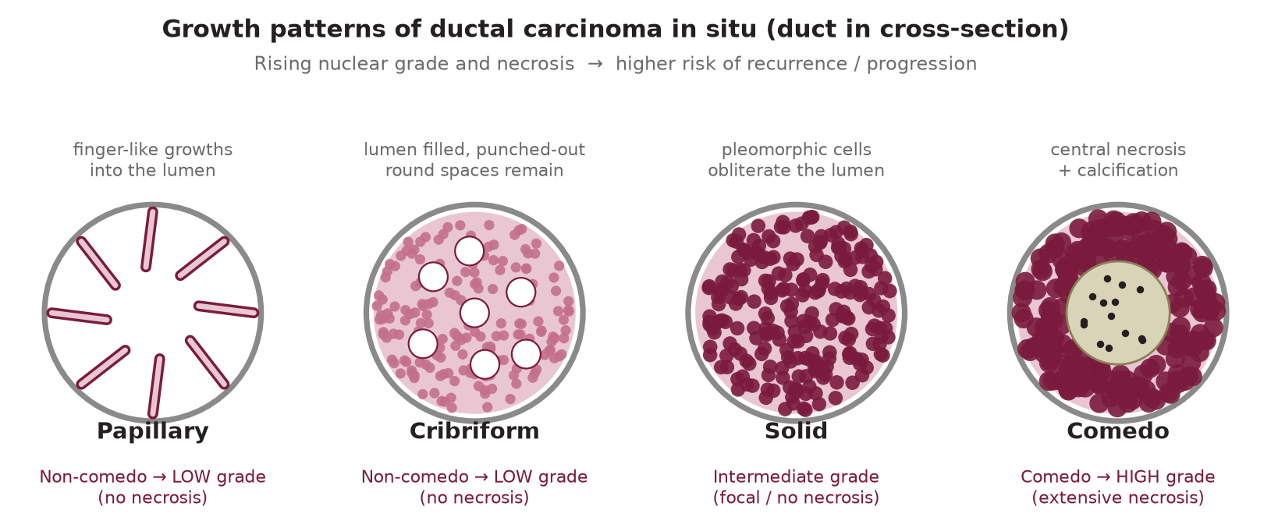
Illustration — DCIS Architectural Growth Patterns
Papillary, cribriform, intermediate-grade, and comedo growth patterns — rising nuclear grade and necrosis correlate with higher recurrence/progression risk
Pathology — In Situ Carcinomas
September 2026
42

Slide 43
SECTION
09
09
Pathology — Invasive Carcinomas
Types, special histologies, IBC, Paget's, Phyllodes
Pathology — Invasive Carcinomas
September 2026
43

Slide 44
Invasive Carcinoma Types
Type | Frequency | Key Features | Prognosis
Invasive ductal carcinoma (NST) | 70–80% | No specific features; heterogeneous; grades 1–3 | Stage-dependent; most common cause BC death
Invasive lobular carcinoma (ILC) | 8–14% | Indian-file pattern; E-cadherin neg; ER+/HER2-; bilateral risk; mammogram-occult | Similar stage-for-stage to IDC; late bone/GI mets
Tubular carcinoma | 1–4% | Well-differentiated tubules; low-grade; ER+ | Excellent: 98% 10-yr survival; rare nodal spread
Mucinous (colloid) | 2–3% | Pools of mucin; ER+; older women | Good; low nodal positivity; rare distant mets
Medullary-like | 1–2% | Pushing borders; lymphocytic infiltrate; ER-/HER2-; BRCA1 | Paradoxically better than grade-matched IDC
Cribriform | 0.3–0.8% | Low-grade; sieves/arches; ER+ | Excellent; often mixed with tubular
Papillary (invasive) | 0.5–1% | Papillary architecture; older women; ER+ | Good prognosis; central location
Metaplastic | 0.2–1% | Squamous/spindle/chondroid/osseous metaplasia; TNBC | Aggressive; chemotherapy-resistant
Micropapillary | 1–2% | Tumor clusters in lacunar spaces; ER+; high LVI | Poor prognosis; high nodal positivity
Pathology — Invasive Carcinomas
September 2026
44

Slide 45
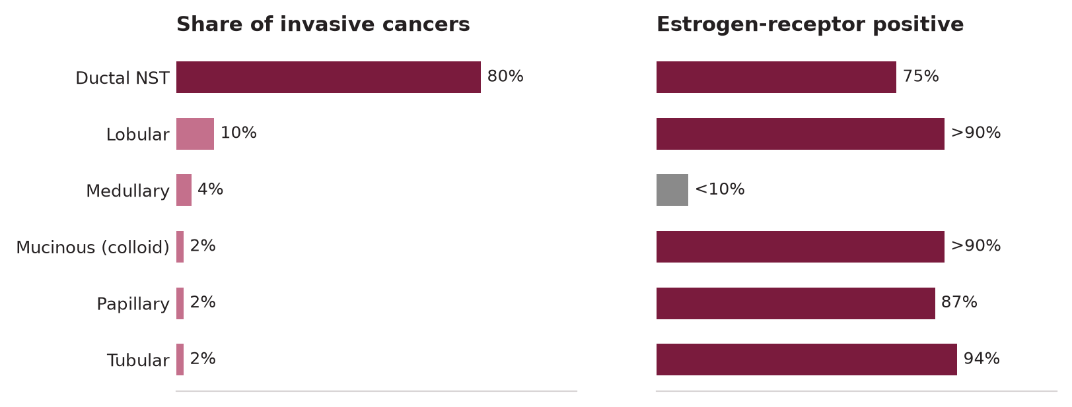
Illustration — Relative Frequency & ER Positivity by Histologic Type
Share of invasive cancers and estrogen-receptor positivity across histologic subtypes
Pathology — Invasive Carcinomas
September 2026
45

Slide 46
Special Histologic Types & Presentations
Inflammatory Breast Cancer (IBC)
Phyllodes Tumor
Clinical diagnosis: rapid onset erythema ≥1/3 breast ± peau d'orange ± nipple retraction
Cause: dermal lymphatic invasion (NOT a skin infection — no fever initially)
Pathologic: may or may not see classic invasive ductal cells in biopsy specimen
ALWAYS cT4d stage; >Stage IIIB; no TNM "T" based on tumor size
Management: NEOADJUVANT chemo first (NOT surgery first); then surgery then RT
Prognosis: 5-year OS ~40%; TNBC and HER2+ subtypes common
Biphasic: epithelial + stromal components; stromal overgrowth key
Classification: benign (50%), borderline (25%), malignant (25%)
Malignant: cellular stroma, high mitoses, permeative borders, stromal overgrowth
Metastasis: hematogenous (lung, bone) — NOT lymphatic (no SLNB needed)
Treatment: wide excision ≥1 cm margin; mastectomy if large; NO chemotherapy (sarcoma)
Recurrence: all grades → wide excision; malignant → consider RT
Paget's Disease of the Nipple
Angiosarcoma of the Breast
Large, pale cells (Paget cells) in nipple epidermis — eczematous nipple rash
Always associated with underlying DCIS (100%) or invasive cancer (50%)
Central (retroareolar) location; unilateral, persistent, non-responsive to topical steroids
Diagnosis: biopsy of nipple epidermis or punch biopsy
Management: total mastectomy (if underlying invasive) or BCS + nipple excision + RT
Prognosis: depends on underlying lesion; Paget's without invasive Ca → excellent
Primary (spontaneous): rare; young women; high-grade; no risk factors
Secondary (post-irradiation): most important form; 6–10 years after RT for BC
Stewart-Treves syndrome: lymphedema-associated angiosarcoma (post-ALND)
Skin: blue-red discoloration, satellite nodules; rapidly enlarging
Treatment: mastectomy + wide excision; no role for sentinel node biopsy
Prognosis: poor; median OS 2–3 years; rapid metastasis to lungs
Pathology — Invasive Carcinomas
September 2026
46

Slide 47
SECTION
10
10
AJCC Staging (TNM)
8th Edition: T, N, M categories and stage groups
AJCC Staging (TNM)
September 2026
47

Slide 48
AJCC 8th Edition — T & N Categories
T Category | Size/Features
Tis | In situ (DCIS, LCIS, Paget's without invasive)
T1mi | Microinvasion ≤1 mm
T1a | >1 mm – ≤5 mm
T1b | >5 mm – ≤10 mm
T1c | >10 mm – ≤20 mm
T2 | >20 mm – ≤50 mm
T3 | >50 mm
T4a | Chest wall invasion (ribs, intercostals, serratus — NOT pectoralis)
T4b | Skin ulceration, satellite nodules, edema (peau d'orange)
T4c | T4a + T4b
T4d | Inflammatory breast cancer
N Category | Definition
pN0 | No nodal metastasis by H&E or IHC
pN1mi | Micrometastasis >0.2mm, ≤2mm
pN1a | 1–3 axillary nodes (macrometastasis)
pN1b | Internal mammary sentinel node
pN1c | 1–3 axillary + internal mammary SLN
pN2a | 4–9 axillary nodes
pN2b | Internal mammary nodes (clinical)
pN3a | ≥10 axillary nodes or infraclavicular (Level III)
pN3b | IMN + ≥1 axillary node; or ≥4 axillary + IMN SLN
pN3c | Supraclavicular nodes
KEY: Chest wall = ribs/intercostals/serratus anterior. Pectoralis muscle involvement does NOT = T4a
AJCC Staging (TNM)
September 2026
48

Slide 49
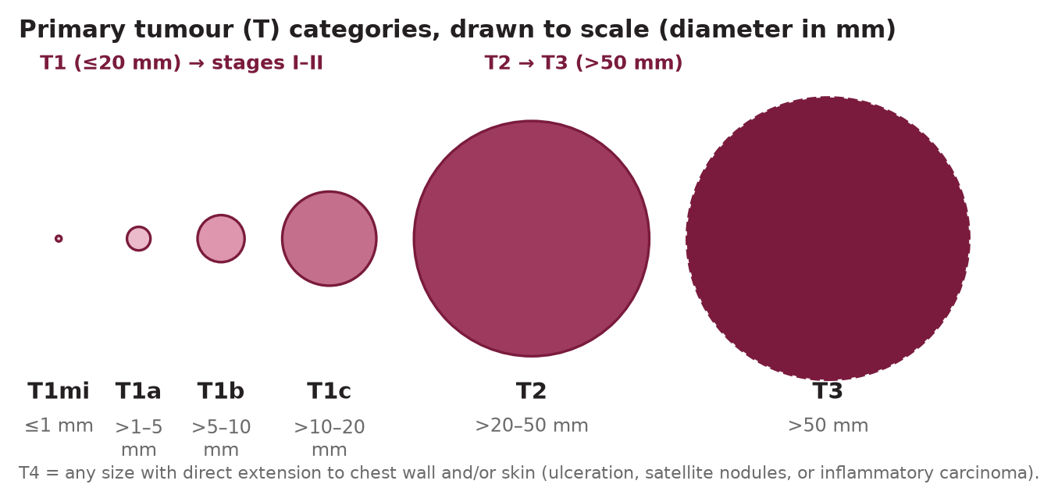
Illustration — Primary Tumor (T) Categories Drawn to Scale
Relative tumor diameters corresponding to AJCC T1mi through T3 categories
AJCC Staging (TNM)
September 2026
49

Slide 50
AJCC Staging Groups & Workup by Stage
Anatomic Stage | T | N | M | 5-Year OS (approx.)
0 (Tis) | Tis | N0 | M0 | ~100%
IA | T1 | N0 | M0 | ~99%
IB | T0–1 | N1mi | M0 | ~98%
IIA | T0–1 / T2 | N1 / N0 | M0 | ~91%
IIB | T2 / T3 | N1 / N0 | M0 | ~80%
IIIA | T0–3 / T3 | N2 / N1–2 | M0 | ~67%
IIIB | T4 | N0–2 | M0 | ~52%
IIIC | Any T | N3 | M0 | ~48%
IV | Any T | Any N | M1 | ~27% (5-yr, improving)
Staging Workup by Stage
Stage I–IIA (asymptomatic): H&P + bilateral mammo + tumor biomarkers only; NO routine CT/bone scan
Stage IIB–III: CT chest/abdomen/pelvis + bone scan OR PET-CT
Stage IV: CT + bone scan or PET-CT; liver US; consider brain MRI if symptoms
NCCN: routine CBC, LFTs, ALP; CXR; selective MRI breast for extent
AJCC 8th Edition — Prognostic Staging
8th ed introduced "Prognostic Stage Groups" incorporating biomarkers:
→ T, N, M + Grade + ER/PR/HER2 status + Oncotype DX RS (if used)
Prognostic stage may differ from anatomic stage (e.g., T2N1 ER+/HER2-/Grade1 = Stage IIA anatomic → Stage IB prognostic)
Clinically significant: Stage I tumors may have very different outcomes by biology
Important for treatment decisions, especially adjuvant systemic therapy
AJCC Staging (TNM)
September 2026
50

Slide 51
Cancer Grading Systems — Summary Reference
Feature (1 pt each) | Score 1 (best) | Score 2 | Score 3 (worst)
Tubule/gland formation | >75% tubules formed | 10–75% tubules formed | <10% tubules formed
Nuclear pleomorphism | Small, uniform nuclei | Moderate variation | Marked variation + nucleoli
Mitotic count /10 HPF | Low count | Moderate count | High count
Nottingham (Elston-Ellis / modified SBR) Grade — Invasive Carcinoma: sum the 3 scores (range 3–9) → 3–5 = Grade 1 (well-diff.) 6–7 = Grade 2 (moderate) 8–9 = Grade 3 (poor)
DCIS Nuclear Grade (distinct from Nottingham)
Van Nuys Prognostic Index (VNPI) Recap
Reading This Deck's Classification Systems
Low: monotonous small nuclei, diffuse fine chromatin, rare mitoses, necrosis rare
Intermediate: cytologic features between low and high grade
High: markedly pleomorphic nuclei, coarse chromatin, frequent mitoses, comedo necrosis common
→ Graded on nuclear features alone — DCIS has no tubule-formation score (no invasion to assess)
4 factors each scored 1 (best)–3 (worst): size, margin width, grade+necrosis, age
Sum 4–12 pts, re-mapped to a 3–9 reporting scale (Section 08)
3–4: BCS alone 5–7: BCS + RT 8–9: mastectomy
Used specifically to individualize DCIS radiation decisions
BIRADS 0–6: imaging suspicion → biopsy threshold (Sec.06)
Nottingham/SBR 1–3: invasive tumor differentiation (above)
AJCC T/N/M + Grade: anatomic + prognostic STAGE (below)
Oncotype DX RS 0–100: genomic chemo-benefit score (Sec.11)
ESCAT I–IV / MCBS 1–5: 2026 target actionability / benefit size (Sec.15)
AJCC Staging (TNM)
September 2026
51

Slide 52
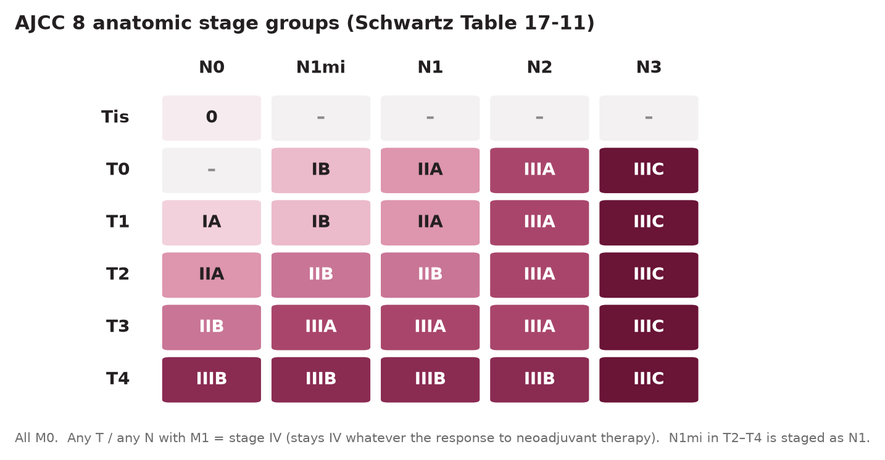
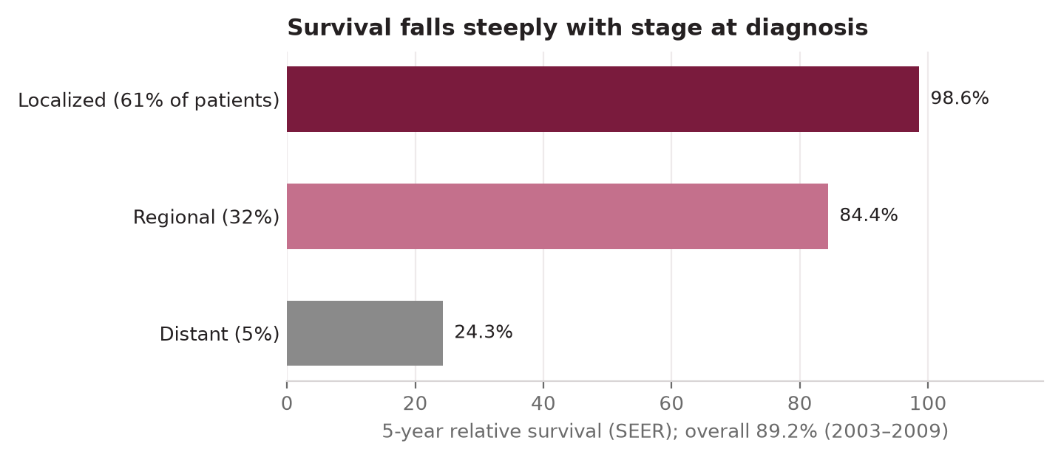
Illustration — AJCC Stage Groups & Survival by Stage
AJCC 8th edition anatomic stage groups (left, Schwartz Table 17-11) and SEER 5-year relative survival by stage at diagnosis (right)
AJCC Staging (TNM)
September 2026
52

Slide 53
SECTION
11
11
Prognostic Factors & Molecular Subtypes
Traditional biomarkers, multigene assays, intrinsic subtypes
Prognostic Factors & Molecular Subtypes
September 2026
53

Slide 54
Traditional Prognostic & Predictive Factors
Pathologic Prognostic Factors
Other Key Factors
Lymph node status: #1 predictor; each additional positive node decrements survival
Tumor size: T1 < T2 < T3; continuous variable, not threshold-dependent
Histologic grade (Elston-Ellis/Nottingham): tubule formation (1–3) + nuclear pleomorphism (1–3) + mitotic rate (1–3)
Grade 1 (3–5 pts): low; Grade 2 (6–7): intermediate; Grade 3 (8–9): high
Lymphovascular invasion (LVI): predicts nodal involvement + distant recurrence
Surgical margins: adequate margin reduces IBTR risk (negative = "no ink on tumor")
Age: younger patients (<35): ↑ recurrence risk; more aggressive biology; BRCA testing
Race/ethnicity: Black women → higher TNBC rate; biologic and systemic disparities
Androgen receptor (AR): positive in 70–95% ER+ BC and ~50% TNBC (emerging target)
TILs (tumor-infiltrating lymphocytes): high TILs → improved pCR in TNBC/HER2+
Residual cancer burden (RCB): RCB-0 (pCR) → best OS; RCB-III → worst
Predictive Biomarkers
Complete Pathologic Response (pCR)
ER (Estrogen Receptor): ≥1% IHC positive → endocrine therapy benefit (NCCN)
ER-low (1–10%): technically positive; biologically heterogeneous → full risk assessment
PR (Progesterone Receptor): ER+/PR+ best response; ER+/PR- intermediate; correlates with HER2
HER2 (ERBB2): IHC 3+ or FISH amplified → trastuzumab + pertuzumab benefit
HER2-low: IHC 1+ or 2+/FISH negative → T-DXd eligibility (DESTINY-Breast04)
Ki-67: surrogate for proliferative activity; >20–30% = high; threshold varies by lab
pCR = no residual invasive cancer in breast + lymph nodes after neoadjuvant therapy
Standard definition: ypT0 ypN0 (NSABP) or ypT0/Tis ypN0
Surrogate endpoint for improved OS in TNBC and HER2+ (CREATE-X, KATHERINE)
pCR rates: TNBC ~30–55% with platinum-containing NAC; HER2+ up to 60–70%
Residual disease in TNBC → capecitabine 6–8 cycles improves OS (CREATE-X)
Residual disease in HER2+ → T-DM1 (ado-trastuzumab emtansine) improves DFS (KATHERINE)
Prognostic Factors & Molecular Subtypes
September 2026
54

Slide 55
Multigene Assays — Oncotype DX & MammaPrint
Oncotype DX (21-gene RT-PCR)
MammaPrint (70-gene expression)
Recurrence Score (RS) 0–100: validated in ER+/HER2-, N0 and N1 (1–3 nodes)
RS <18 (low): endocrine alone — chemo adds no benefit (TAILORx, RxPONDER)
RS 18–30 (intermediate): chemo benefit uncertain; menopausal status critical
RS >30 (high): chemotherapy adds significant benefit
Premenopausal RS 16–25: may benefit from chemo (partly via ovarian suppression)
SIGNIFICANCE: avoids overtreatment (low-risk) AND undertreatment (high-risk) — practice-changing genomic test in ER+/HER2- BC
Microarray: classifies BC as Low Risk (LR) vs High Risk (HR) for distant recurrence
MINDACT trial: "Ultra-low risk" subset: clinical high / genomic low → can omit chemo
~46% clinical-high/genomic-low: chemotherapy omission safe at 5 years
Best suited for: ER+/HER2- early BC when additional genomic context needed
Validated for both pre- and postmenopausal; pN0 and limited N1 disease
RxPONDER Trial (N1 disease)
Other Multigene Assays
Phase III: 5083 women, ER+/HER2-, N1(1–3 nodes), RS ≤25
Postmenopausal: no chemo benefit (adds only toxicity)
Premenopausal RS ≤25 N1: chemo improved iDFS (HR 0.64) — possibly via ovarian suppression
Clinical implication: postmenopausal N1 RS≤25 → endocrine therapy alone safe
Premenopausal N1 → consider chemo + ovarian suppression
PAM50 / Prosigna (50 gene): reports Intrinsic Subtype + ROR (Risk of Recurrence) 0–100
Endopredict (EP): 12-gene; binary low/high; used in postmenopausal N0/N1 ER+ HER2-
Breast Cancer Index (BCI): predicts late recurrence (years 5–10); guides extended endocrine therapy
All validated for chemotherapy decision in ER+/HER2- early BC — not interchangeable
NCCN prefers Oncotype DX but accepts validated alternatives for specific clinical scenarios
Prognostic Factors & Molecular Subtypes
September 2026
55

Slide 56
Molecular Subtypes (Intrinsic/Sorlie–Perou Classification)
Subtype | Biomarker Profile | Frequency | Key Biology | Treatment Backbone
Luminal A | ER+/PR+, HER2-, Low Ki-67, Grade 1–2 | 40–50% | Highly endocrine responsive; good prognosis | Endocrine therapy alone (± CDK4/6)
Luminal B | ER+/PR±, HER2-, High Ki-67 OR HER2+ | 20–30% | More aggressive; endocrine + chemo needed | Endocrine + CT ± CDK4/6
HER2-enriched | HER2+ (ER-, PR-) | 15–20% | HER2 gene amplification dominant; aggressive | Anti-HER2 + chemo ± endocrine
Triple Negative (TNBC) | ER-, PR-, HER2- | 10–15% | Basal-like (mostly); BRCA1 assoc.; high grade | Chemo ± pembrolizumab ± PARP inhibitor
Normal breast-like | Low expression all markers | Rare | Contaminated specimen or normal tissue | Usually excluded from analysis
TNBC Subclassification (Lehmann 2011)
HER2-Low — New Clinical Entity
BL1 (Basal-like 1): highest pCR; cell cycle genes; responds to platinum
BL2 (Basal-like 2): growth factor signaling; lower pCR
M (Mesenchymal): EMT-related; low pCR; responds to PI3K pathway inhibitors
IM (Immunomodulatory): high TILs; responds to immunotherapy (pembrolizumab)
LAR (Luminal AR): AR-positive; responds to anti-androgen therapy (enzalutamide)
Definition: IHC 1+ or IHC 2+/ISH negative (previously called "HER2 negative")
Frequency: ~55–60% of all HER2-negative BC are actually HER2-low
T-DXd (trastuzumab deruxtecan): proven efficacy in HER2-low (DESTINY-Breast04)
DESTINY-Breast04: HR 0.49 for PFS; HR 0.64 for OS in HR+ HER2-low MBC
IMPORTANT: HER2-low is not a biologic subtype — it is a treatment eligibility criterion
Prognostic Factors & Molecular Subtypes
September 2026
56

Slide 57
SECTION
12
12
Local-Regional Therapy
Surgery: BCS vs mastectomy, axillary management, radiation, reconstruction
Local-Regional Therapy
September 2026
57

Slide 58
Breast-Conserving Surgery (BCS) vs Mastectomy
BCS (Lumpectomy) — Indications & Requirements
Mastectomy — Types
BCS EQUIVALENT to mastectomy in OS (6 RCTs: NSABP B-06, Milan I, others)
IDEAL candidates: single tumor with adequate breast-to-tumor ratio
Must achieve negative margins (no ink on invasive tumor for IDC; ≥2mm for DCIS)
Post-BCS radiation: WBRT standard; partial breast RT in selected low-risk patients
BCS PREFERRED when possible for quality of life; equivalent survival
Oncoplastic techniques expand BCS eligibility (therapeutic mammoplasty)
Total (simple) mastectomy: breast only; no axillary dissection; used for prophylaxis
MRM (Modified Radical Mastectomy): breast + levels I-III axilla; preserve pec major
Skin-sparing mastectomy: remove nipple-areolar complex; preserve breast skin envelope
Nipple-sparing mastectomy (NSM): preserve NAC; oncologically acceptable if retroareolar margin negative
Halsted radical (historical): also removes pec major/minor; rarely indicated today
Absolute Contraindications to BCS
When Mastectomy Is Preferred
Prior breast irradiation to the same breast (skin tolerance exceeded)
Diffuse suspicious microcalcifications (multicentric extent)
Two separate primary tumors in different quadrants (multicentric)
Persistently positive margins despite re-excision (inability to achieve clear margins)
Active systemic lupus or scleroderma (relative — not absolute per all guidelines)
Pregnancy (relative — WBRT after delivery acceptable in 3rd trimester)
Large tumor:breast ratio (cannot achieve negative margins with acceptable cosmesis)
Strong patient preference (informed choice — equivalent survival)
Genetic predisposition (BRCA carrier): prophylactic contralateral mastectomy option
Inflammatory BC: mastectomy AFTER neoadjuvant chemotherapy
Multifocal/multicentric disease in different quadrants
Failed prior BCS (persistent positive margins or IBTR)
Local-Regional Therapy
September 2026
58

Slide 59
Axillary Surgery — SLNB & Z0011 Trial
Sentinel Lymph Node Biopsy (SLNB)
After Neoadjuvant — Targeted Axillary Dissection (TAD)
Technique: dual tracer (Tc-99m sulfur colloid + isosulfan blue dye) — sensitivity 97%
False-negative rate: ~5–8% with dual tracer; acceptable for clinical practice
cN0 disease: SLNB standard; if sentinel node negative → ALND not needed
Frozen section: controversial (defer final decision to permanent section in most centers)
Learning curve: 20+ cases required for competency; must be ≥95% identification rate
Contraindications to SLNB: cN2-3, prior axillary surgery, inflammatory BC
Initially cN1+: clip suspicious node at diagnosis biopsy
After neoadjuvant: if pathologic N0 on imaging → SLNB + remove clipped node (TAD)
TAD reduces FNR from 14% (SLNB alone) to ~2% (TAD) in post-neoadjuvant setting
SENTINA/ACOSOG Z1071: validated TAD approach for ycN0 after chemo
If 3+ SLN removed and targeted node negative → may avoid ALND
Z0011 Trial — Key Findings
ALND Indications (Remaining)
ACOSOG Z0011: cT1-2 cN0; BCS + WBRT; 1–2 positive SLNs (macro)
ALND vs no ALND: no difference in OS or DFS at 10 years
Z0011 criteria: cT1-2, clinically N0, BCS, receiving WBRT, 1–2 positive SLNs
ALND NOT needed if Z0011 criteria met — even with macrometastasis in SLNs
Key: cannot apply Z0011 to mastectomy, neoadjuvant, or >2 positive SLNs
cN2–3 disease (clinically positive multiple nodes) — upfront surgery patients
Post-neoadjuvant: residual nodal disease (ycN+) confirmed by TAD
Failed SLNB mapping (no sentinel node identified)
Inflammatory BC (after neoadjuvant therapy)
>2 positive SLNs in patients NOT meeting Z0011 criteria
ALND extent: levels I and II standard; level III if gross disease or frozen positive at level II
Local-Regional Therapy
September 2026
59

Slide 60
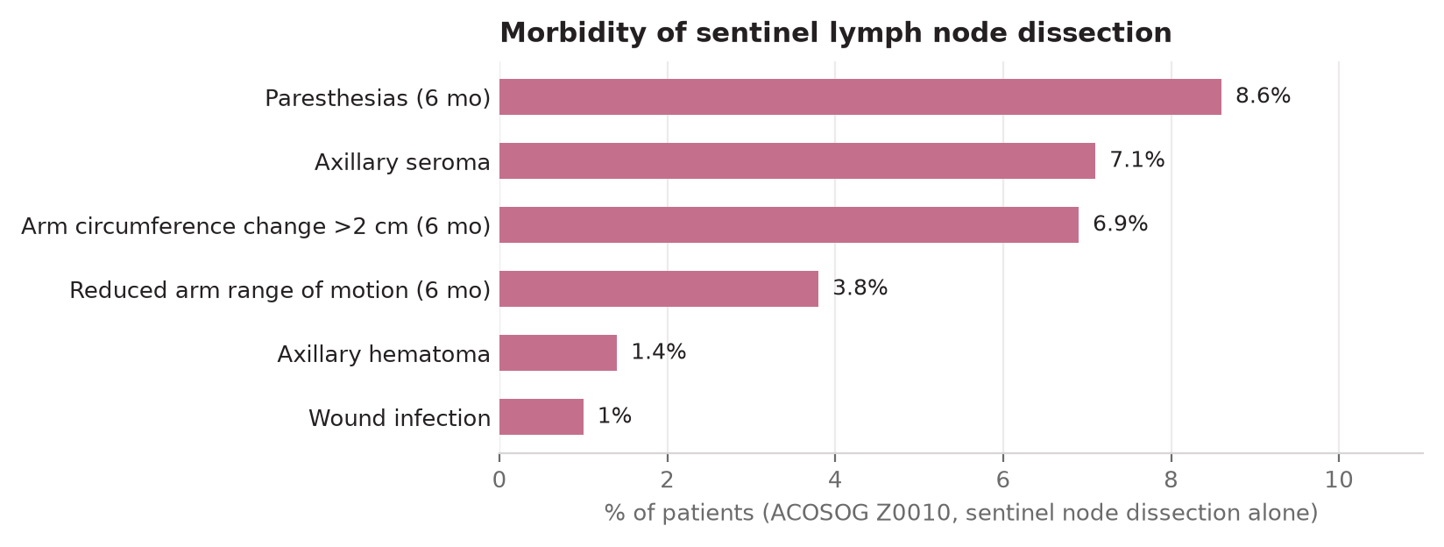
Illustration — Morbidity of Sentinel Node vs Completion Axillary Dissection
Rates of paresthesia, lymphedema, and other morbidity at one year (ACOSOG Z0010/Z0011 cohorts)
Local-Regional Therapy
September 2026
60

Slide 61
Radiation Therapy in Breast Cancer
Whole Breast RT (WBRT) After BCS
Regional Nodal Irradiation (RNI)
Standard after BCS: reduces IBTR by ~50–70% (EBCTCG meta-analysis)
Dose: 40–50 Gy in 15–25 fractions; boost 10–16 Gy to tumor bed (high-risk)
Hypofractionation (40 Gy in 15 fractions): equivalent to conventional; preferred
RT omission: age ≥65–70, T1, ER+/HER2-, negative nodes, on endocrine therapy (PRIME II)
DCIS after BCS: RT standard; margin ≥2 mm critical
Partial Breast Irradiation (APBI): selected low-risk patients; ASTRO criteria
Include IMN and supraclavicular nodes when regional disease risk is high
MA.20 trial: WBRT + RNI vs WBRT alone: ↑ DFS but not OS; ↑ toxicity
DBCG-IMN: IMN RT improved OS in right-sided tumors with positive nodes
Indications: ≥4 positive nodes; 1–3 nodes + medial/central tumor; high-risk N1
Post-Mastectomy RT (PMRT)
RT Toxicity & Late Effects
Indicated for: T3–4 tumors; ≥4 positive nodes; 1–3 positive nodes in high-risk (NCCN)
1–3 positive nodes: PMRT reduced locoregional recurrence (EBCTCG 2014 meta-analysis)
Dose: 46–50 Gy to chest wall ± regional nodes
Target volumes: chest wall + IMN + supraclavicular nodes (varies by center)
Reconstructed patients: implant-based reconstruction + PMRT → higher complication rate
Timing: after completion of chemotherapy; before hormonal therapy in some protocols
Skin: early: acute radiodermatitis; late: fibrosis, telangiectasia
Lymphedema: WBRT + ALND: 20–30%; WBRT + SLNB: 5–7%
Cardiac: left-sided RT historical → coronary artery disease, pericarditis (now reduced with modern planning)
Pulmonary: radiation pneumonitis (1–3%); late fibrosis
Brachial plexus neuropathy: <1% with modern techniques
Secondary malignancy: angiosarcoma (rare but serious; 6–10 yrs post-RT)
Local-Regional Therapy
September 2026
61

Slide 62
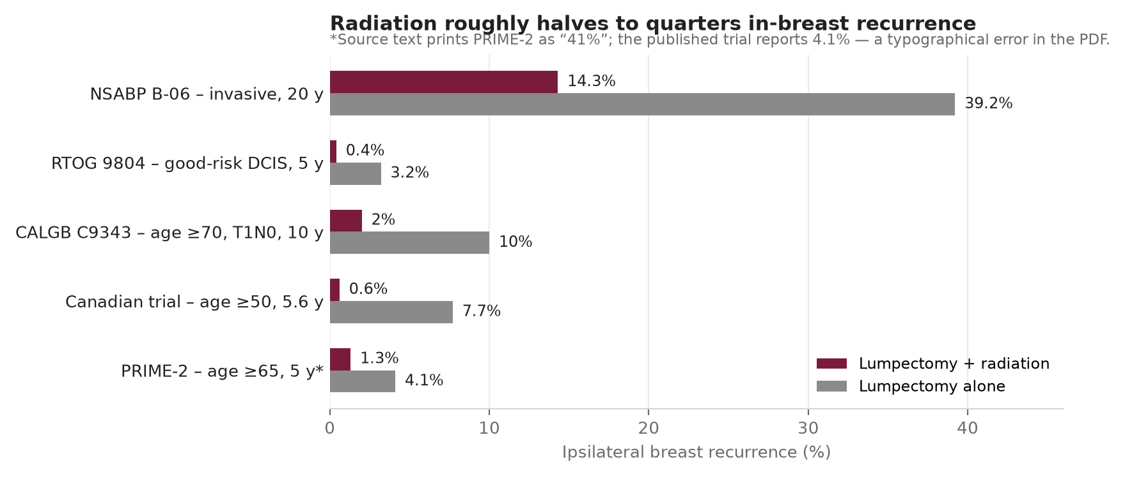
Illustration — Radiation Therapy Reduces In-Breast Recurrence
Ipsilateral breast recurrence with vs without radiation across NSABP B-06 and other randomized trials
Local-Regional Therapy
September 2026
62

Slide 63
Mastectomy Types & Reconstruction
Mastectomy Type | Extent | Indication | Key Consideration
Total (Simple) | Breast tissue only; no ALND | Prophylaxis; DCIS; stage IV palliation | SLNB can be added if needed
MRM | Breast + ALND (levels I–III); preserve pec major | Standard for invasive BC requiring mastectomy | Most common mastectomy in practice
Skin-sparing | MRM + preserve breast skin (remove NAC) | Immediate reconstruction; excellent cosmesis | Equivalent oncologic outcome to MRM
Nipple-sparing (NSM) | Preserve NAC; remove all breast tissue | Prophylaxis; small central-quadrant tumors; BRCA | Retroareolar margin must be negative; discuss risk
Halsted Radical (historical) | Breast + pec major + pec minor + ALND | Pec muscle involvement by tumor (rare) | No OS benefit vs MRM; abandoned for most cases
Reconstruction Options
Oncoplastic BCS
Implant-based: tissue expander → definitive implant (2 stages); most common
Direct-to-implant: single-stage; requires adequate soft tissue coverage
Latissimus dorsi (LD) flap: pedicled; provides additional soft tissue for coverage
TRAM/DIEP flap: autologous; gold standard for natural feel; higher morbidity
Volume displacement: tissue rearrangement within the breast (therapeutic mammoplasty)
Volume replacement: local/regional flap to fill defect (latissimus mini-flap)
Allows larger resections with acceptable cosmesis; reduces rates of positive margins
Requires oncoplastic training; contralateral symmetrization often needed
Local-Regional Therapy
September 2026
63

Slide 64
SECTION
13
13
Systemic Therapy (Adjuvant)
Endocrine therapy, chemotherapy regimens, HER2-targeted therapy, neoadjuvant
Systemic Therapy (Adjuvant)
September 2026
64

Slide 65
Adjuvant Endocrine Therapy
Drug | Class | Population | Duration | Key Data
Tamoxifen 20mg | SERM | Pre/Postmenopausal ER+ | 5–10 yrs | ATLAS: 10 yrs → OS benefit; ↓ recurrence vs 5 yrs
Anastrozole 1mg | NSAI | Postmenopausal ER+ | 5 yrs (+ up to 5 more) | ATAC: superior DFS vs Tam; ↓ contralateral BC
Letrozole 2.5mg | NSAI | Postmenopausal ER+ | 5 yrs (+ up to 5 more) | BIG 1-98: superior to Tam alone
Exemestane 25mg | SAI | Postmenopausal ER+ | 5 yrs | After 2–3 yrs Tam → IES trial
Tamoxifen + OFS | SERM + GnRHa | Premenopausal high-risk ER+ | 5 yrs OFS | SOFT/TEXT: OFS + Tam improves DFS vs Tam alone
Exemestane + OFS | SAI + GnRHa | Premenopausal high-risk ER+ | 5 yrs | SOFT/TEXT: OFS + Exe superior (younger/higher-risk)
Abemaciclib + ET | CDK4/6i | HR+/HER2- high-risk early BC | 2 yrs (abema) + 5+ yrs ET | monarchE: IDFS benefit in N+ high Ki-67
Extended Adjuvant
CDK4/6 Adjuvant (monarchE)
MA.17R: Letrozole extended to 10 yrs: ↓ contralateral BC; ↑ bone loss
NCCN: consider 7.5–10 yrs AI in high-risk N+ postmenopausal patients
Abemaciclib: N2+ or N1+ with G3 or Ki-67 ≥20% + T≥5cm criteria
2 yrs abemaciclib → iDFS HR 0.664; effect maintained beyond treatment
Systemic Therapy (Adjuvant)
September 2026
65

Slide 66
Adjuvant Chemotherapy Regimens
Regimen | Drugs & Doses | Subtype | Key Points
ddAC→ddT (dose-dense) | ddAC × 4 → ddPaclitaxel × 4 (q14d) | All subtypes (standard) | CALGB 9741: ↓ recurrence vs q21d; G-CSF required
TC × 4–6 (taxane+cycloph.) | Docetaxel + Cyclophosphamide q21d × 6 | Lower-risk ER+ HER2-; avoid anthracyclines | USO 9735: TC×6 > AC×4 (DFS); omits anthracycline
AC × 4 (anthracycline only) | Doxorubicin 60 + Cycloph. 600 q21d | Lower-risk patients; older regimen | Now often replaced by TC for lower-risk
Carboplatin addition (TNBC) | Carboplatin + standard chemo | TNBC especially BRCA1/2 | BrighTNess: pCR 57% with carbo vs 31% without
Capecitabine (residual TNBC) | Capecitabine 1000–1250 mg/m² PO bid × 6–8 cycles | TNBC with residual dz after NAC | CREATE-X: 74% → 78% 5-yr DFS; OS benefit (HR 0.59)
CMF (historical) | Cycloph + Methotrexate + 5FU | Historical; now rarely used | Cooper regimen era (1970s)
Chemotherapy Key Points: Toxicity monitoring: LVEF (anthracyclines), neuropathy (taxanes), neutropenia. G-CSF required with dose-dense regimens. Cardiomyopathy risk: lifetime doxorubicin dose <550 mg/m².
Chemotherapy Key Points: Toxicity monitoring: LVEF (anthracyclines), neuropathy (taxanes), neutropenia. G-CSF required with dose-dense regimens. Cardiomyopathy risk: lifetime doxorubicin dose <550 mg/m².
Systemic Therapy (Adjuvant)
September 2026
66

Slide 67
HER2-Targeted Therapy
Drug | Target/Mechanism | Indication | Key Trial
Trastuzumab (Herceptin) | Anti-HER2 mAb; ADCC + HER2 signaling block | HER2+ adjuvant (12 months) + metastatic | HERA: 50% ↓ recurrence; NSABP B-31 confirmed
Pertuzumab (Perjeta) | Anti-HER2 domain 2 mAb; blocks HER2-HER3 dimerization | HER2+ stage III or high-risk II (neo+adj) | APHINITY: ↑ iDFS in N+ (HR 0.76); benefit modest overall
T-DM1/ado-trastuzumab | ADC: trastuzumab + DM1 (maytansinoid) | Residual HER2+ after neoadjuvant | KATHERINE: iDFS HR 0.50 vs trastuzumab alone; standard of care
T-DXd (trastuzumab deruxtecan) | ADC: trastuzumab + deruxtecan (topo I inhibitor) | 2nd line+ HER2+ MBC; HER2-low MBC | DESTINY-Breast01/02/04; ~50% objective response; ILD risk
Lapatinib (Tykerb) | Dual EGFR/HER2 TKI (reversible) | HER2+ MBC (now rarely first-line) | EGF100151; less used with T-DXd, tucatinib available
Neratinib (Nerlynx) | Irreversible pan-HER TKI | Extended adjuvant after 1 yr trastuzumab | ExteNET: ↑ iDFS especially in HR+ HER2+ (↑ diarrhea)
Tucatinib (Tukysa) | HER2-selective TKI | HER2+ MBC (+ trastuzumab + capecitabine) | HER2CLIMB: OS benefit incl. brain mets (preferred for CNS+)
Margetuximab | Fc-engineered anti-HER2 mAb | HER2+ MBC (3rd line+) | SOPHIA: modest PFS benefit; specific FcγR polymorphism
★ ESMO 2026: T-DXd preferred 2nd-line HER2+ MBC over other anti-HER2 options. Tucatinib+Tras+Cape: preferred for brain metastases.
Systemic Therapy (Adjuvant)
September 2026
67

Slide 68
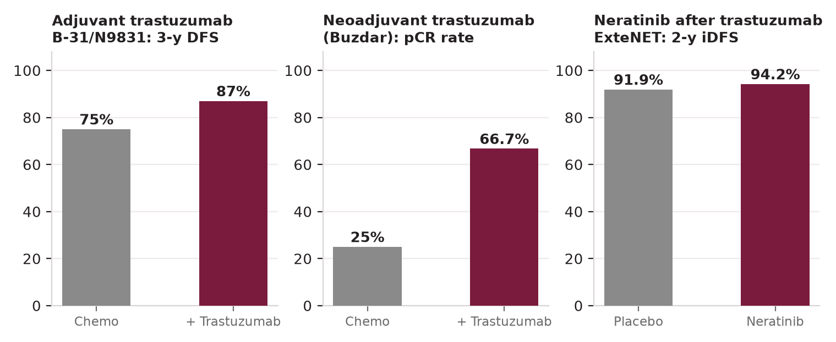
Illustration — Anti-HER2 Therapy: Landmark Trial Outcomes
Adjuvant trastuzumab 3-year DFS (NSABP B-31/N9831), neoadjuvant trastuzumab pCR rate, and extended neratinib iDFS (ExteNET)
Systemic Therapy (Adjuvant)
September 2026
68

Slide 69
Neoadjuvant (Preoperative) Systemic Therapy
Indications for Neoadjuvant Therapy
Pembrolizumab in Early TNBC (KEYNOTE-522)
Standard for: IBC (inflammatory BC — always neoadjuvant first)
Stage III (LABC): downstage tumor + nodal disease
Stage II HER2+ or TNBC: improve pCR rate; guide post-neoadjuvant therapy
Goal BCS: large tumor → relative contraindication → neoadjuvant to achieve BCS eligibility
Research/prognostic: pCR correlates with improved DFS/OS in TNBC and HER2+
Response-adaptive treatment: residual disease → escalate (CREATE-X, KATHERINE)
KEYNOTE-522: Stage II–III TNBC; pembrolizumab × 8 cycles neoadjuvant + 9 cycles adjuvant
pCR: 64.8% (pembro) vs 51.2% (placebo); EFS HR 0.63
FDA approved 2021: pembrolizumab + chemo → surgery → pembrolizumab for 9 cycles
irAE monitoring: immune-related toxicities (endocrinopathies, pneumonitis)
Note: PD-L1 testing NOT required for neoadjuvant eligibility in TNBC
Olaparib adjuvant: for BRCA1/2 germline, HER2-neg, residual disease or high-risk
Neoadjuvant Regimens by Subtype
Monitoring Response to Neoadjuvant
TNBC: ddAC + paclitaxel ± pembrolizumab (KEYNOTE-522: ↑ pCR 64.8% vs 51.2%)
TNBC BRCA1/2: add carboplatin; pCR 55–60%
HER2+: docetaxel + carbo + trastuzumab + pertuzumab (TCbHP — NEOSPHERE)
ER+/HER2-: chemo before surgery; endocrine for postmenopausal elderly if non-responders
Residual TNBC after NAC: capecitabine × 6–8 cycles (CREATE-X)
Residual HER2+ after NAC: T-DM1 × 14 cycles (KATHERINE)
Clinical: tumor size (calipers/US) every 2 cycles; reassess at mid-point
Imaging: MRI best for residual disease (85% correlation with pathology)
Axillary: US ± FNA for suspicious nodes; place clip for TAD (targeted axillary dissection)
Insufficient response: switch regimen vs proceed to surgery (≥4–6 cycles typical)
pCR assessment at surgery: ypT0/Tis ypN0 = pCR (NSABP/CTRC-AACR definition)
Pathologic response guides adjuvant decisions (see Residual Cancer Burden scale)
Systemic Therapy (Adjuvant)
September 2026
69

Slide 70
SECTION
14
14
Management by Stage
Stage 0 through IV: algorithms and treatment principles
Management by Stage
September 2026
70

Slide 71
Stage 0 — In Situ Disease Management
DCIS Management
Paget's Disease — Stage 0
BCS + WBRT: standard (Cat 1); reduces IBTR ~50–70%
BCS alone (selected low-risk): VNPI 3–4; low-grade; <2.5 cm; margin ≥10 mm
Mastectomy: multicentric; large size; cosmesis not achievable; patient preference
Margin: ≥2 mm required with WBRT; ≥3 mm for BCS alone (B-17 criteria)
SLNB: not routine for pure DCIS; YES with mastectomy (TAD becomes difficult later)
Endocrine therapy: ER+ DCIS → tamoxifen 5 yrs (↓ recurrence + contralateral risk)
Pure Paget's (no underlying invasive): central excision + WBRT
Paget's + underlying DCIS: same management as DCIS ± Paget's-specific approach
Mastectomy: Paget's + multifocal DCIS or if BCS not achievable
SLNB: as for DCIS/invasive component (perform with mastectomy)
LCIS Management
Stage 0 Adjuvant Points
Classic LCIS: observation + chemoprevention + annual mammography
No surgical re-excision required for classic LCIS at core biopsy margin
Chemoprevention: tamoxifen or raloxifene (NSABP P-2); reduces bilateral risk ~50%
Pleomorphic LCIS: excision to clear margins (similar to high-grade DCIS)
Bilateral risk-reducing mastectomy: option for highest-risk patients (strong FH + BRCA)
Annual MRI: consider for LCIS patients with additional risk factors
Endocrine therapy for chemoprevention: ER+ DCIS after BCS ± RT
Tamoxifen 20 mg/day × 5 yrs: ↓ ipsilateral + contralateral breast events (B-24)
AI (postmenopausal): anastrozole 1mg × 5 yrs reduces recurrence (IBIS-II DCIS)
No role for chemotherapy in pure DCIS/LCIS
Follow-up: annual mammo; H&P every 6 months × 5 yrs then annually
Management by Stage
September 2026
71

Slide 72
Stage I–IIB — Curative Intent Management
Work-up: Triple assessment, staging, biomarkers, genetics
Neoadjuvant vs Adjuvant Approach
Neoadjuvant preferred: HER2+ Stage II+, TNBC Stage II+, LABC, goal BCS
Adjuvant preferred: pT1 pN0 low-risk ER+/HER2-, older/frail patients
Stage IIA ER+/HER2- N0: Oncotype DX RS guides chemo decision (TAILORx)
Stage IIB-N1 ER+/HER2-: consider neoadjuvant or direct surgery then adjuvant
Key numbers:
→ T1N0 ER+ HER2-: excellent prognosis; chemo often not needed if RS ≤25
→ T2N1 HER2+: neoadjuvant HP-based; residual → T-DM1
→ T2N1 TNBC: neoadjuvant pembro-chemo; residual → capecitabine
→ T1-2 N0 TNBC RS<50: adjuvant chemo; pembro only with neoadjuvant path
Fertility preservation: discuss before chemotherapy in premenopausal patients
GnRH agonist during chemo: reduces premature ovarian failure (POEMS trial)
▼
BCS eligible?
YES →
BCS + SLNB
Mastectomy
NO →
SLNB (± ALND)
▼
Adjuvant RT: WBRT after BCS; PMRT if T3/T4 or ≥4 nodes
Systemic Therapy by Subtype (Adjuvant)
ER+/HER2-: endocrine ± chemo (by Oncotype DX RS); CDK4/6 (abemaciclib) if high-risk N+
HER2+: chemo + trastuzumab ± pertuzumab (N+ or high risk T2+)
TNBC Stage II: chemo ± pembrolizumab neoadjuvant (preferred); capecitabine if residual
BRCA1/2: olaparib adjuvant 1 yr if residual disease or pN+ after NAC
Duration endocrine: 5–10 yrs depending on risk; OFS for premenopausal high-risk
Management by Stage
September 2026
72

Slide 73
Stage III — Locally Advanced Breast Cancer (LABC)
Definition & Staging
IBC-Specific Management
Stage IIIA: T3N1; T0-3N2 (fixed/matted axillary or IMN nodes)
Stage IIIB: T4 (any) including IBC (T4d); T4N0-2
Stage IIIC: Any T, N3 (infraclavicular, supraclavicular, IMN + axillary)
Inflammatory BC (T4d): rapid onset; clinical diagnosis; always Stage ≥IIIB
Workup: CT C/A/P + bone scan or PET-CT; brain MRI if symptomatic
NEVER surgery first in IBC — neoadjuvant chemotherapy MANDATORY
Anthracycline + taxane backbone ± platinum ± anti-HER2 (if HER2+)
Surgery: MRM after ≥4–6 cycles (even if "complete clinical response")
PMRT: ALL IBC patients (even if pCR); target chest wall + regional nodes
Adjuvant: capecitabine (TNBC residual); T-DM1 (HER2+ residual); endocrine
Prognosis: 5-yr OS ~40%; TNBC-IBC worst; HER2+ IBC improved with targeted
Treatment Algorithm for LABC
Radiotherapy in LABC
Step 1: Biopsy + biomarkers (ER/PR/HER2/Ki-67) + full staging
Step 2: Neoadjuvant systemic therapy (NAC ± targeted) — ALL subtypes
Step 3: MRM after neoadjuvant (BCS if excellent response; IBC → MRM mandatory)
Step 4: Axillary dissection (ALND level I-II) for all N+ cases
Step 5: PMRT (chest wall + regional nodes) — ALL Stage III patients
Step 6: Adjuvant systemic (response-adapted): T-DM1 if HER2+ residual; capecitabine if TNBC residual; endocrine for ER+
PMRT: All Stage III patients — both after BCS and mastectomy
Dose: 46–50 Gy to chest wall + 10 Gy boost for close margins
Target volumes: chest wall/residual breast + axilla + SCF + IMN
Timing: after completion of chemotherapy; before or concurrent with endocrine
Reconstruction + PMRT: expander should be partially deflated during RT; complications
Hypofractionation: FAST-Forward shows 26 Gy × 5 non-inferior for WBRT (selected)
Management by Stage
September 2026
73

Slide 74
Stage IV — Metastatic Breast Cancer (MBC)
Principles of MBC Management
Metastatic BC: incurable but treatable; goal = extend survival + maintain QoL
Complete reassessment: rebiopsy metastatic site for ER/PR/HER2 (15–25% discordance)
Test for actionable mutations: ESR1 (cfDNA), PIK3CA/PTEN/AKT1, BRCA1/2 (germline+somatic)
Preferred sites for rebiopsy: bone (decalcified limited), liver, skin/lymph node
ECOG performance status: critical for treatment selection
Bone-only MBC: best prognosis; bone-modifying agents (zoledronic acid/denosumab)
Subtype | 1st Line (NCCN/ESMO 2026) | 2nd Line Options
HR+/HER2- postmeno | CDK4/6i (ribociclib/abema/palbociclib) + AI | Fulvestrant ± inavolisib; elacestrant/imlunestrant if ESR1 mut
HR+/HER2- premeno | CDK4/6i + AI + OFS | Capivasertib + fulvestrant (PIK3CA/AKT1/PTEN mut); ET options
HER2+ | Pertuzumab + trastuzumab + docetaxel (CLEOPATRA) | T-DXd (preferred 2nd line, DESTINY-Breast03)
HER2+ brain mets | HP + docetaxel + trastuzumab | Tucatinib + tras + capecitabine (HER2CLIMB; preferred CNS)
TNBC PD-L1+ (CPS≥10) | Pembrolizumab + chemo (KEYNOTE-522) | Sacituzumab govitecan (SG); dato-DXd
TNBC PD-L1- | Chemo (gem/carbo; capecitabine) | SG; T-DXd (HER2-low); dato-DXd
BRCA1/2 mutated | Olaparib or talazoparib (HER2-neg) | SG; cabo after progression; chemo
★ See ESMO 2026 slide for full updated algorithms with new agents
Management by Stage
September 2026
74

Slide 75
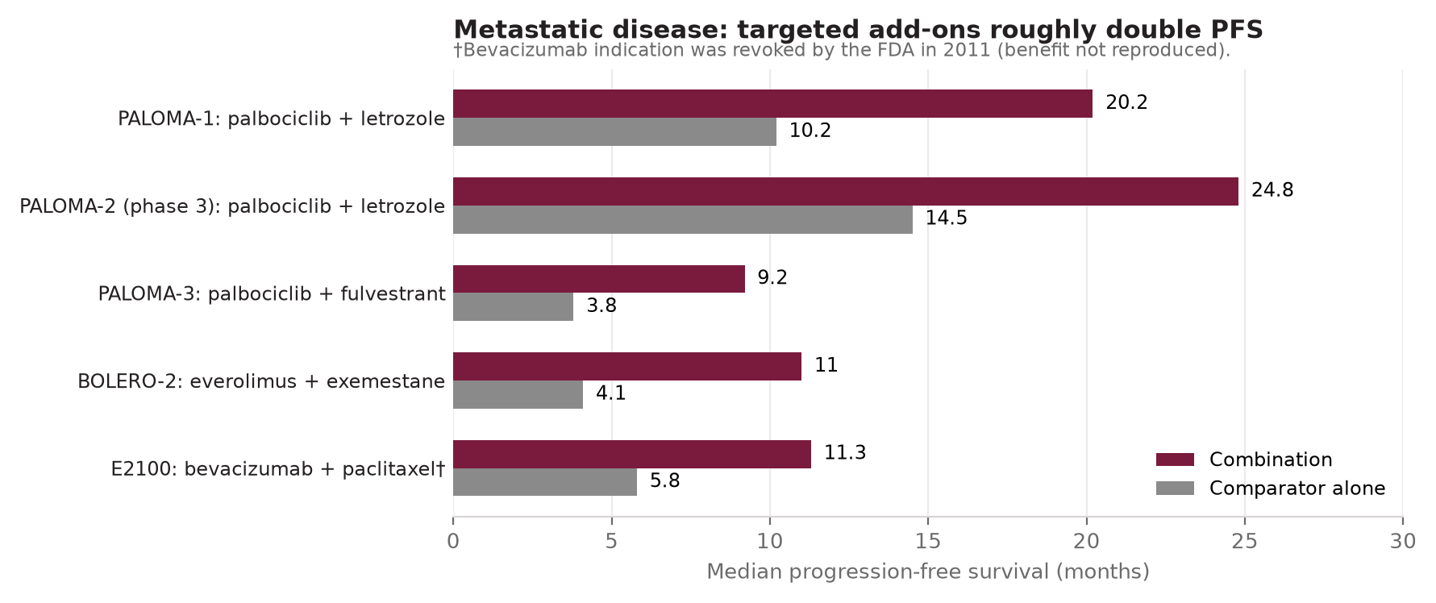
Illustration — Targeted Add-On Therapy Roughly Doubles Progression-Free Survival
Median progression-free survival, combination targeted therapy vs comparator alone, across landmark metastatic trials (PALOMA, MONALEESA, BOLERO-2, SOPHIA)
Management by Stage
September 2026
75

Slide 76
SECTION
15
15
ESMO 2026 — Metastatic BC Updates
New agents, ESR1/PIK3CA/TROP2 pathways, ESCAT scoring, HER2-low
ESMO 2026 — MBC Updates
September 2026
76

Slide 77
★ ESMO 2026 — HR+/HER2− MBC: ESR1 & PI3K/AKT Updates
★ ESMO 2026 MBC Guidelines Update — ER+/HER2- Metastatic Breast Cancer
After CDK4/6 Inhibitor Progression: ESR1 Pathway
ESMO ESCAT Scoring System
ESR1 mutations: acquired endocrine resistance mechanism; present in ~40% post-CDK4/6
Test: liquid biopsy (ctDNA) for ESR1 Y537S/D538G mutations before 2nd-line ET
Elacestrant (EMERALD trial): oral SERD; ESR1-mutated: PFS HR 0.55 vs standard ET
Imlunestrant (EMBER-3 trial): next-gen oral SERD; ESR1-mutated: ↑ PFS vs ET
ESCAT level: IA for ESR1-mutated (elacestrant); oral SERDs preferred over injections
Key: cfDNA testing (cell-free DNA liquid biopsy) before selecting 2nd-line ET
ESCAT = ESMO Scale for Clinical Actionability of Molecular Targets
Tier I: Ready for routine use in clinical practice (level IA/IB)
Tier II: Promising but lacking definitive evidence
Tier III: Uncertain clinical utility — investigational
Tier IV: Evidence for lack of utility — do not use
Purpose: triage molecular test findings for clinical decision-making
Used to prioritize which actionable alterations drive treatment selection
PIK3CA/AKT1/PTEN Pathway
MCBS v2.0 (Magnitude of Clinical Benefit Scale)
PIK3CA mutation: ~35–40% of ER+/HER2- BC; activates PI3K/AKT/mTOR pathway
Inavolisib + palbociclib + fulvestrant: for PIK3CA-mutated, CDK4/6-pretreated
→ INAVO120: PFS median 15.0 vs 7.3 months (HR 0.43) — practice-changing
Capivasertib + fulvestrant: AKT1/PIK3CA/PTEN-altered; CAPItello-291 trial (PFS HR 0.60)
Everolimus + exemestane: mTOR inhibitor; BOLERO-2 (older; still used)
Scores benefit of new agents on 1–5 (palliative) or A-C (curative)
Score 5 (highest) = meets ESMO threshold for substantial benefit: PFS HR <0.65 or ≥6 mo improvement
T-DXd HER2+: Score 5; Tucatinib + T+C: Score 4; Capivasertib: Score 3-4
Guides formulary decisions in resource-limited settings (e.g., Ethiopia)
Elacestrant ESR1-mutated: MCBS Score 3 — meaningful but limited benefit magnitude
ESMO 2026 — MBC Updates
September 2026
77

Slide 78
★ ESMO 2026 — HER2+ & TNBC MBC: New Agent Algorithms
★ ESMO 2026 MBC Update — HER2+ and TNBC: ADC era and immunotherapy algorithms
HER2+ MBC: Updated Sequence
TNBC MBC: 2026 Algorithm
1st line: Pertuzumab + Trastuzumab + Taxane (CLEOPATRA — OS benefit maintained)
2nd line: T-DXd (trastuzumab deruxtecan) — DESTINY-Breast03: PFS HR 0.28 vs T-DM1
→ T-DXd: PREFERRED 2nd line HER2+ by both ESMO and NCCN 2026
3rd line: Tucatinib + trastuzumab + capecitabine (HER2CLIMB)
Brain metastases present: Tucatinib preferred (CNS penetration; intracranial ORR 47%)
ILD: T-DXd-associated interstitial lung disease (2–13%); monitor with CT; dose modify
PD-L1+ (CPS ≥10): pembrolizumab + chemotherapy (KEYNOTE-119/522)
PD-L1-: chemotherapy (gem/carbo; capecitabine/vinorelbine); TROP2-targeted ADC
Sacituzumab govitecan (SG): anti-TROP2 ADC; ASCENT: OS HR 0.48 vs single chemo
Dato-DXd (datopotamab deruxtecan): anti-TROP2 ADC; TROPION-Breast01: PFS HR 0.63
Pembrolizumab + SG: KEYNOTE-890 ongoing — promising combination
BRCA1/2 mut TNBC: olaparib or talazoparib → PARP inhibitor first in BRCA carriers
HER2-Low: New Standard (DESTINY-Breast04)
ESMO 2026 — Ethiopia Context
HER2-low = IHC 1+ or IHC 2+/FISH-negative
DESTINY-Breast04: T-DXd vs physician's choice chemo in HER2-low MBC (previously treated)
HR+ HER2-low: PFS HR 0.51; OS HR 0.64
TNBC HER2-low: PFS HR 0.46 — also significant benefit
Now standard 2nd/3rd line for HER2-low MBC (HR+ and TNBC) — ESMO Grade A
Must test HER2 by IHC to identify HER2-low — IHC 0 is NOT eligible for T-DXd
Most ESMO 2026 agents (T-DXd, inavolisib, elacestrant, SG) NOT yet available in Ethiopia
Ethiopian approach: established regimens (AC→T, CMF, tamoxifen, trastuzumab where available)
Trastuzumab access: expanding at tertiary centers; not universally available
CDK4/6 inhibitors: not yet routinely available in Ethiopian public health system
MCBS scoring: guides priority for import/affordable access negotiations (WHO EML)
🇪🇹 Gap: Ethiopia ≈ 2010-era treatment availability vs 2026 standards
ESMO 2026 — MBC Updates
September 2026
78

Slide 79
SECTION
16
16
Recurrence — Types & Management
Classification, definitions, management by recurrence site/type
Recurrence — Types & Management
September 2026
79

Slide 80
Recurrence — Classification & Definitions
Locoregional Recurrence (LRR)
Recurrence Type | Definition (Standard) | Prognosis | Management Goal
IBTR (true local) | Ipsilateral breast recurrence after BCS — same site, same histology | Salvageable; 60–70% 10-yr OS | Salvage mastectomy ± systemic; re-staging
New ipsilateral primary | Different quadrant or ≥5 yrs or different biomarkers | Treat as new primary — better prognosis | Stage + full systemic workup; re-treat per stage
Chest wall (post-mastectomy) | Skin/soft tissue at mastectomy site | Variable; 25–40% distant mets within 2 yrs | Excision ± RT; systemic staging; re-irradiate (selected)
Regional (nodal) | Ipsilateral axillary, SCF, IMN recurrence | 20–30% eventually develop distant mets | Surgery ± RT; full staging; systemic therapy
Distant metastatic | Any site beyond locoregional | Median OS 2–5 yrs (improving) | Systemic therapy; local control as needed; QoL focus
Local recurrence: recurrence at the ipsilateral breast (after BCS) or chest wall (after mastectomy)
Regional recurrence: ipsilateral axillary, supraclavicular, infraclavicular, or IMN nodes
LRR incidence: ~5–10% at 10 years with modern therapy
IBTR (ipsilateral breast tumor recurrence): at original tumor site vs new primary?
→ True recurrence: within 2–3 cm of original site, same histology, <5 years
→ New primary: different quadrant, OR ≥5 years, OR different histology/biomarkers
Distant (Systemic) Recurrence
Distant metastasis: any organ outside the breast/regional nodes
Bone: most common (50–70% of distant recurrence); may be first site
Visceral: liver (20–30%), lung (10–15%), brain (especially HER2+ and TNBC)
Leptomeningeal: rare; HER2+ and TNBC; poor prognosis
Time to recurrence: ER+ late (years 5–20+); TNBC/HER2+ early (<3 yrs)
Annual hazard rate: peaks at ~2 yrs for TNBC, ~3–4 yrs for HER2+, bimodal ER+
Recurrence — Types & Management
September 2026
80

Slide 81
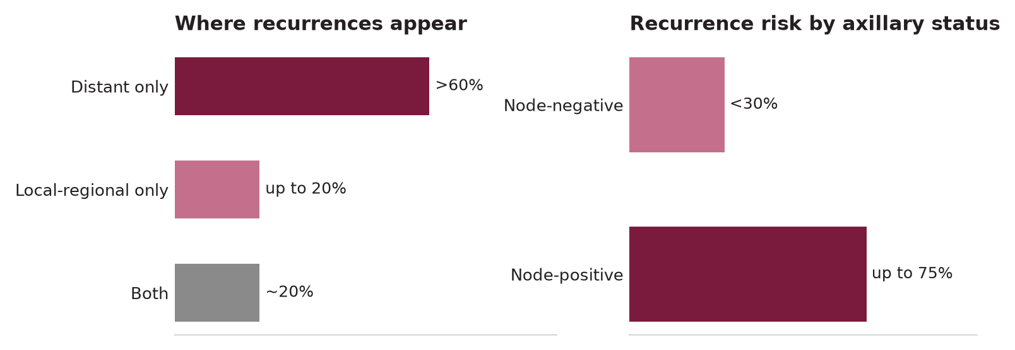
Illustration — Patterns of Breast Cancer Recurrence
Site of first recurrence, distant-only vs local-regional-only (left); recurrence risk stratified by axillary nodal status (right)
Recurrence — Types & Management
September 2026
81

Slide 82
Locoregional Recurrence — Management Algorithm
Risk Factors for LRR
Chest Wall Recurrence (Post-Mastectomy)
High grade + large tumor size (T3–4)
Positive or close surgical margins after prior BCS
No prior radiation therapy to the breast/chest wall
Young age (<40): higher absolute LRR risk independent of other factors
Lymphovascular invasion (LVI): strong predictor of nodal/locoregional recurrence
Triple negative and HER2-enriched subtypes: early LRR within 2–3 years
ER-negative tumors: front-loaded recurrence pattern; no late recurrences
Full staging workup before local treatment
Isolated chest wall: excision (wide local) + RT (if not previously irradiated)
Previously irradiated field: re-irradiation possible at expert centers (IMRT/SBRT)
Systemic therapy: by current tumor biomarkers; resistance patterns
Prognosis: isolated chest wall LRR → 25–35% 5-yr OS
Concurrent distant mets found: systemic therapy is primary; local control adjunctive
IBTR After BCS — Management
Regional Recurrence — Axillary/Supraclavicular
Re-staging: CT C/A/P + bone scan (or PET) → exclude distant disease
Surgical salvage: mastectomy (standard for IBTR after BCS + prior RT)
Second BCS: possible if NO prior RT and lesion is amenable to resection with clear margins
Post-mastectomy RT: required if chest wall not previously irradiated
Systemic therapy: treat by new biomarker profile (rebiopsied sample)
Prognosis: 5-yr OS ~60–70% for isolated IBTR (better if ER+, long disease-free interval)
Ipsilateral axillary recurrence after prior SLNB: full ALND (levels I–III)
Axillary recurrence after prior ALND: surgical excision ± radiotherapy
Supraclavicular recurrence: radiotherapy ± systemic; surgical rarely feasible
All regional recurrences: full staging to exclude distant mets
Systemic therapy: based on new biomarker testing + prior treatment history
Isolation perfusion: selective for in-transit (rare in BC); HILP (hyperthermic limb)
Recurrence — Types & Management
September 2026
82

Slide 83
SECTION
17
17
Special Situations
Pregnancy-associated BC, male BC, nipple discharge, IBC, rare presentations
Special Situations
September 2026
83

Slide 84
Special Situations: Pregnancy, Male BC & Nipple Discharge
Breast Cancer in Pregnancy (PABC)
Male Breast Cancer
Incidence: 1 in 3,000 pregnancies; most common cancer in pregnancy
Diagnosis: US (safe in pregnancy); MRI without gadolinium acceptable
Mammography: low radiation dose to fetus (shields); if clinically warranted — OK
Surgery: all trimesters safe; avoid sentinel node mapping with blue dye (Tc-99m acceptable)
Chemotherapy: AVOID in 1st trimester (organogenesis); AC-T safe after 14 weeks
Termination: NOT recommended for cancer treatment; does not improve prognosis
1% of all BC; higher in Sub-Saharan Africa (~6%) — may reflect BRCA2/Klinefelter
Risk factors: BRCA2 (most important gene), Klinefelter (XXY), exogenous estrogen, radiation
Biology: ER+ in ~90%; HER2+ uncommon; TNBC rare
Presentation: central retroareolar mass, often later than female BC
Treatment: MRM (standard); BCS rare (limited breast tissue); tamoxifen for ER+
Aromatase inhibitors: less effective (androgens compete); tamoxifen preferred
NCCN 2026: BRCA2 male carriers → annual PSA from age 40–45 (prostate Ca risk)
PABC — Drug & RT Considerations
Nipple Discharge
Taxanes: use with caution in 2nd/3rd trimester; limited data
Trastuzumab: CONTRAINDICATED in pregnancy (oligohydramnios, fetal renal failure)
Radiation: AVOID during pregnancy (fetal dose exposure); defer to postpartum
Tamoxifen: TERATOGENIC — contraindicated; start after delivery/breastfeeding cessation
Breastfeeding: not recommended during chemotherapy
Prognosis: stage-for-stage equivalent to non-pregnant; delayed diagnosis → worse outcomes
Benign: bilateral, milky, multiple ducts, non-spontaneous → hormonal/galactorrhea
Concerning: unilateral, bloody/serosanguineous, single duct, spontaneous
Bloody discharge: #1 cause = intraductal papilloma; #2 = DCIS (must exclude)
Workup: bilateral mammogram + US ± ductography ± MRI ± ductoscopy
Subareolar excision: for persistent single-duct discharge after imaging
Pathology: exclude DCIS; papilloma excision → 10% upgrade to DCIS or invasive
Special Situations
September 2026
84

Slide 85
Inflammatory BC, Local-Regional Recurrence & Rare Cancers
Inflammatory Breast Cancer (IBC) — Summary
Occult Primary BC (OPC) — Axillary Mass
Clinical diagnosis: rapid onset; ≥1/3 breast erythema + peau d'orange ± nipple retraction
Often misdiagnosed as mastitis/abscess — key: NO fever response to antibiotics
Always T4d; Stage ≥IIIB at minimum
Mandatory sequence: biopsy → biomarkers → neoadjuvant chemo → MRM → PMRT
NEVER primary surgery; surgery without prior chemo = wrong approach
HER2+ IBC: add trastuzumab + pertuzumab (excellent neoadjuvant response ~60–70% pCR)
Definition: axillary nodal metastasis with no identifiable breast primary on standard imaging
Incidence: ~1% of breast cancer presentations
Workup: mammogram + US → MRI breast (identifies primary in 70% of OPC)
If MRI identifies primary: treat as standard invasive BC
If MRI negative: still likely breast origin (ER/PR/GCDFP-15 IHC)
Management: ALND + whole-breast RT (vs MRM); systemic therapy as per biology
Bilateral Breast Cancer
Rare Breast Presentations
Synchronous: bilateral BC diagnosed simultaneously (within 3 months)
Metachronous: second primary BC ≥3 months after first
Lifetime risk of contralateral primary BC: 0.5–1% per year after first BC
Higher in: BRCA carriers, younger patients, lobular histology
Staging: both primaries staged independently; combined stage uses worst primary
Treatment: both breast surgeries staged (immediate or sequential); systemic therapy by higher-risk tumor
Bilateral synchronous IBC: extremely rare; treat each breast with neoadjuvant
Dermal metastasis (breast carcinoma en cuirasse): skin involvement by lymphatic spread
Lymphoma of breast: rare primary; biopsy essential; not amenable to surgery (treat systemically)
Sarcoma of breast: excision with wide margins; no sentinel node; no routine chemotherapy
Granular cell tumor: benign; subareolar; mimics BC clinically — excision curative
Hamartoma: mammographically distinct "breast-within-breast"; excision for diagnosis
Special Situations
September 2026
85

Slide 86
SECTION
18
18
Ethiopian Guideline 2024
FMOH Breast Cancer Guideline: 3 pillars, treatment tiers, gaps vs international standard
Ethiopian Guideline 2024 Integration
September 2026
86

Slide 87
🇪🇹 Ethiopian BC Guideline 2024 — Overview & Three Pillars
🇪🇹 ETHIOPIAN FMOH 2024 — FIRST NATIONAL BREAST CANCER GUIDELINE (2024-2028)
Background & Goals
Pillar 2 — Timely Diagnosis
First-ever national BC guideline for Ethiopia (2024–2028)
16,133 new BC cases/year; ASI 41.5/100,000 — #1 cancer in Ethiopian women
Overall Goal: reduce BC mortality aligned with WHO Global Breast Cancer Initiative (GBCI)
Three-tier health system: primary (PHCU) → secondary (general hosp.) → tertiary (specialized)
3 Targets (60:60:80 aligned with WHO GBCI):
→ 60% of invasive BC diagnosed at Stage I or II
→ 60-day turnaround from referral to full diagnosis + start treatment
→ 80% of patients completing multidisciplinary treatment
Goal: Full diagnosis (evaluation + imaging + pathology) within 60 days
Triple assessment: CBE + US ± mammography + FNAC/CNB
FNAC first approach (resource-pragmatic) → CNB if needed
Diagnostic algorithm: women ≥30 with lump/skin change/nipple change → US + FNAC → confirm/refer
Secondary hospitals: ideal location for diagnostic services (geographic access)
Pathology: histology + ER/PR; HER2 testing expanding at tertiary
Pillar 1 — Health Promotion & Early Detection
Pillar 3 — Comprehensive BC Management
Goal: >60% breast cancer detected at Stage I and II
CBE from age ≥30 annually (no population mammography)
BSE (breast self-exam) education: women ≥20 years monthly
Integration with MCH services: ANC, postnatal, family planning
Health Extension Workers (HEWs): trained for CBE and referral
School education on BC risk factors for children/adolescents
Community mobilization: faith-based, community-based orgs
Goal: 80% of patients completing multidisciplinary treatment
MDT approach: surgeon + oncologist + pathologist + radiologist + social worker + nurse
MDT currently only at tertiary centers (Tikur Anbessa, JUSH, ALERT)
Treatment available: surgery (MRM standard), chemotherapy (24 public hospitals)
Radiotherapy: available at TASH + 2 regional hospitals; 4 more in development
Hormonal therapy: tamoxifen routinely available
HER2-targeted: expanding but not universally available
Ethiopian Guideline 2024 Integration
September 2026
87

Slide 88
🇪🇹 Ethiopia — Treatment Scope by Healthcare Tier
🇪🇹 ETHIOPIAN GUIDELINE 2024 — Scope of Practice by Health System Tier
Service Level | Population Served | BC Responsibilities | Referral Pathway
Health Post / Health Center | 3,000–40,000 | CBE training, BHA education, identify suspicious findings, counseling on risk factors, first contact | → Primary Hospital or higher for any CBE-suspicious finding
Primary Hospital (PHCU) | 60,000–100,000 | CBE, risk factor counseling, basic breast US (if available), FNAC (selected), initiate referral | → General Hospital for imaging, biopsy, staging
General / Secondary Hospital | 500,000–1.5 million | Full diagnostic imaging (US, mammo), CNB, staging, basic chemotherapy, MRM/BCS surgery, follow-up | → Specialized Hospital for complex surgery, RT, HER2-targeted, MDT
Specialized / Tertiary Hospital | 3.5–5 million | Full MDT, complex surgery (reconstruction), radiotherapy, all systemic therapies, advanced diagnostics, research | Hub for all cases; should provide outreach support to secondary level
Ethiopia MDT Approach
Patient Navigation & Support
Multidisciplinary Team: required for all BC management decisions at tertiary
Team members: breast surgeon, medical oncologist, radiation oncologist, radiologist, pathologist, clinical nurse specialist, social worker
Second consultation required when discussing cancer management plans
Patient navigation program: standardized follow-up contact to reduce loss to follow-up
Navigator: reduces loss to follow-up between referral levels
Clear referral pathway written: from primary → tertiary care
Appointment calendar: standardized scheduling tools (Appendix D)
Psychosocial support: integrate social worker into MDT
Patient support groups: connect survivors with newly diagnosed patients
Financial navigation: high cost is key barrier to treatment completion
Ethiopian Guideline 2024 Integration
September 2026
88

Slide 89
🇪🇹 Ethiopia vs International Standard — Key Gaps & Priorities
🇪🇹 CRITICAL DIFFERENCES: Ethiopian Practice vs International Standard (NCCN/ESMO 2026)
Domain | International Standard (NCCN/ESMO 2026) | Ethiopian Current Practice (2024 Guideline) | Priority Action
Screening | Annual mammography from age 40 (NCCN) / 45 (ACS) | CBE annually from age 30; mammography only if available | Scale-up CBE; advocate mammography expansion
Stage at diagnosis | <30% Stage III-IV in USA/Europe | 65–75% Stage III-IV → poor outcomes | Shift to early detection programs (60:60:80 goal)
Biomarker testing | ER/PR/HER2/Ki-67 all biopsy specimens | ER/PR routinely; HER2 expanding (inconsistent) | Standardize HER2 testing nationally
Genomic testing | Oncotype DX RS for ER+/HER2- adjuvant decisions | Not available | Not feasible short-term; future aspiration
CDK4/6 inhibitors | Palbociclib/ribociclib/abemaciclib standard 1st-line MBC | Not routinely available in public system | WHO EML advocacy; access programs
HER2-targeted | Trastuzumab standard; T-DXd 2nd line; pertuzumab | Trastuzumab expanding; T-DXd not available | Secure trastuzumab supply chain first
Immunotherapy | Pembrolizumab + chemo for TNBC Stage II-IV | Not available | Long-term access program; WHO EML
Radiotherapy | Available all centers; PMRT standard for Stage III | Limited centers (3 in Ethiopia) | Expand RT centers (4 more planned)
Systemic adjuvant | Capecitabine residual TNBC; T-DM1 residual HER2+ | Capecitabine increasingly available | Procure capecitabine for residual TNBC
Ethiopian Guideline 2024 Integration
September 2026
89

Slide 90
SECTION
19
19
Follow-Up & Quick Reference
ASCO follow-up guidelines, key numbers, drug reference tables
Follow-Up & Quick Reference
September 2026
90

Slide 91
Follow-Up Guidelines (ASCO Recommendations)
Parameter | Year 1–5 | Year 5+ | Notes
H&P (History & Physical) | Every 3–6 months | Annually | Focus on: new symptoms, toxicity, recurrence signs
Ipsilateral mammogram (after BCS) | 6–12 months post-RT, then annually | Annually | Earlier if concerns; MRI in BRCA carriers
Contralateral mammogram | Annually | Annually | Regardless of surgery type
Pelvic exam | Annually (tamoxifen → endometrial risk) | Annually | Report abnormal bleeding immediately
Bone density (on AIs) | Baseline, then q1–2 years | Per result | Calcium/Vit D + exercise; bisphosphonate if T-score <−2.0
LFTs / CBC / tumor markers | NOT routinely recommended | NOT routinely | Only if clinically indicated; markers not proven to improve OS
CT/Bone scan/PET | NOT routine (asymptomatic) | NOT routine | Only if symptomatic or signs of recurrence
Genetic counseling | Offer if not done at diagnosis | As appropriate | Update testing criteria change (NCCN 2026 panels)
KEY PRINCIPLE: No imaging or tumor markers (CA 15-3, CEA) in asymptomatic patients — not proven to improve OS. Symptoms drive investigations.
Follow-Up & Quick Reference
September 2026
91

Slide 92
Quick Reference — LCIS vs DCIS & Key Numbers
Comparison | LCIS | DCIS
Nature | Risk marker (bilateral) | Obligate precursor (→invasive if untreated)
Laterality | Bilateral risk | Unilateral (usually)
Margins required? | NO | YES (≥2 mm)
Radiation indicated? | NO | YES (after BCS)
Axillary staging? | NO (unless invasive) | Only if mastectomy/invasion suspected
Tamoxifen benefit? | YES (BRCA2, ADH subgroup) | YES (ER+ DCIS)
Key Numbers
Key Number | Value
Lifetime BC risk in US women | 12.5% (1 in 8)
Mammography mortality reduction | ~15–25%
Tamoxifen chemoprevention (P-1) | 49% ↓ in ER+ BC risk
BCS = mastectomy for survival | 6 RCTs confirmed
SLNB false-negative rate | ~5–8% (dual tracer)
Key Number | Value
Z0011: ALND vs SLNB (OS) | No difference (N=891)
Trastuzumab benefit (HERA) | 50% ↓ in recurrence
pCR in TNBC with chemo | ~30–55%
DCIS upgrade at excision | ~20%
IMN location | ICS 1–6, <3cm sternal
Follow-Up & Quick Reference
September 2026
92

Slide 93
Quick Reference — Drug Mechanism & Indication
Drug | Mechanism | Indication
Tamoxifen | SERM — blocks ER in breast tissue | Pre/post-menopausal ER+ adj; chemoprevention
Letrozole/Anastrozole | Non-steroidal AI — blocks peripheral aromatization | Post-menopausal ER+ adjuvant (superior to tamoxifen)
Trastuzumab | Anti-HER2 mAb — ADCC + signaling inhibition | HER2+ adjuvant + metastatic; 1 year duration
Palbociclib/Ribociclib | CDK4/6 inhibitor — arrests cell cycle G1 | ER+/HER2− metastatic 1st line (+ AI)
Olaparib/Talazoparib | PARP inhibitor — synthetic lethality in BRCA mut. | BRCA1/2-mutated HER2-neg metastatic BC
T-DXd (trastuzumab deruxtecan) | ADC: T + deruxtecan (topo I inhib) | HER2+ 2nd line MBC; HER2-low MBC (★ ESMO 2026)
Sacituzumab govitecan | ADC: anti-TROP2 + SN-38 payload | TNBC 2nd+ line; HR+ HER2- 3rd+ line (★ ESMO 2026)
Follow-Up & Quick Reference
September 2026
93

Slide 94
Quick Reference — Reading the Grading/Staging/Genomic Alphabet
How This Deck's Classification Systems Relate (full detail: Section 10)
Step 1 — Imaging suspicion: BIRADS 0–6 (Section 06) decides whether to biopsy at all
Step 2 — Tumor biology: Nottingham/SBR histologic Grade 1–3, or DCIS nuclear grade low/int/high (Section 10 Grading Summary)
Step 3 — Anatomic + prognostic extent: AJCC T/N/M category, combined with Grade + ER/PR/HER2 + Oncotype RS = "Prognostic Stage" (Section 10)
Step 4 — Genomic chemo-benefit: Oncotype DX Recurrence Score 0–100 refines the chemotherapy decision within a given stage (Section 11)
Step 5 — 2026 metastatic-setting evidence grading: ESCAT I–IV scores how actionable a molecular target is; MCBS 1–5 scores how LARGE the benefit is (Section 15)
Each step answers a DIFFERENT question — none replaces another; a tumor is fully characterized only when all five are known
Follow-Up & Quick Reference
September 2026
94

Slide 95
SUMMARY
Key Take-Home Messages
Breast cancer is biologically heterogeneous — molecular subtyping (ER/PR/HER2/grade + genomics) drives modern management
BCS + RT = mastectomy for survival; Z0011 supports SLNB alone in cT1-2N1 BCS patients — ALND not needed
ER+ BC: endocrine therapy backbone; Oncotype DX guides chemo (avoids over/under-treatment); CDK4/6 inhibitors adjuvant for high-risk N+
HER2+ BC: dual anti-HER2 (HP) neoadjuvant; residual disease → T-DM1; T-DXd preferred 2nd-line MBC (ESMO 2026)
TNBC: pembrolizumab + chemo neoadjuvant (KEYNOTE-522 pCR 65%); capecitabine for residual; SG/dato-DXd MBC
Grading & staging are distinct, complementary tools: histologic grade (biology) + AJCC TNM (anatomy) + genomics (RS/ESCAT/MCBS) together set risk and treatment — see Section 10 Grading Summary
🇪🇹 Ethiopia: CBE-based screening, 65-75% Stage III-IV, limited access to targeted therapies — bridging the gap is the priority
Sources: Schwartz 11th Ed. (Ch.17) | DeVita 10th Ed. (Ch.106) | ESMO 2026 MBC Guidelines | NCCN v6.2026 | JNCCN v2.2026 | Ethiopian FMOH 2024
Compiled for GSR-3 Surgical Oncology Residency — September 2026
Dr. Muluamlak — EBS Unit
Follow-Up & Quick Reference
September 2026
95

