Slide 1
BREAST CANCER MANAGEMENT
ADVISORS: EBS Unit
Prepared by: Dr. Muluamlak – GSR-3

Slide 2
Outlines
Brief anatomy
Epidemiology and Risk factors for breast cancer
Risk assessment and screening of breast cancer
Histopathology of breast cancer
Diagnosis of breast cancer
Staging of breast cancer
Treatment of breast cancer
References

Slide 3
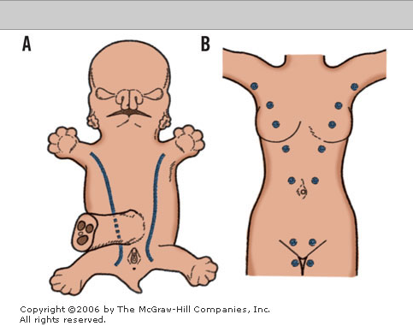
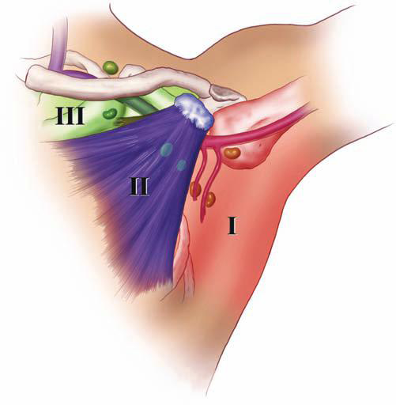
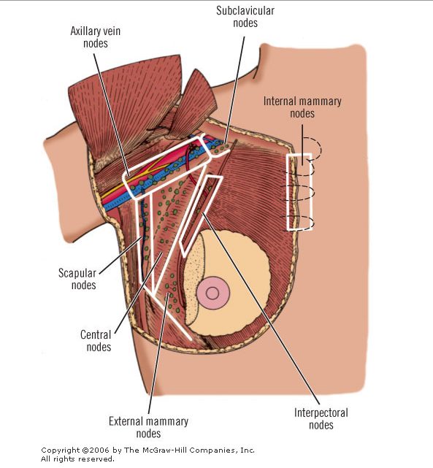
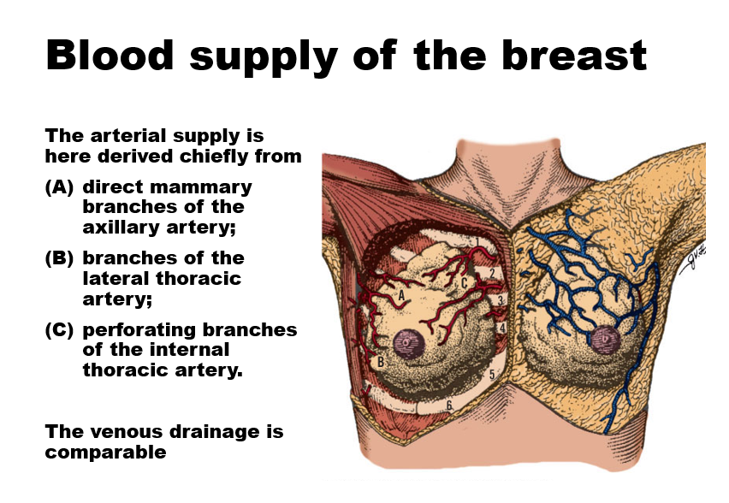
Brief Anatomy
Embryology
  "Milk line" (axilla to groin) at ≈5 weeks; nipple = proliferation of the stratum spinosum
Gross anatomy
  15–20 lobes → lactiferous ducts; lobes = TDLUs, the origin of most cancers
Blood & lymphatics
  Internal/lateral thoracic, thoracodorsal, intercostal vessels
  ≈97% of lymph → axillary nodes; ≈3% → internal mammary chain
Nerves at risk
  Intercostobrachial, long thoracic, thoracodorsal, medial pectoral

Slide 4
Physiology of the Breast
Estrogen
  ductal elongation and branching - Puberty (thelarche): mean onset ≈10–11 years
  Menopause: estrogen withdrawal → glandular involution and replacement by fat
Progesterone
  lobulo-alveolar (secretory) differentiation
Prolactin
  milk-protein synthesis and lactogenesis
  sustains milk production; suckling triggers the oxytocin let-down reflex
Oxytocin
  myoepithelial contraction and the milk-ejection (let-down) reflex
Pregnancy: marked lobulo-alveolar proliferation under estrogen, progesterone, prolactin and placental lactogen

Slide 5
Epidemiology and Risk Factors
Second leading cause of cancer death in women (after lung); ≈40,920 deaths/year in the US
More than 2 million new cases diagnosed worldwide every year
Accounts for ≈30% of all newly diagnosed cancers in women and ≈14% of cancer deaths in women
Average lifetime risk for a newborn US woman is ≈12% (≈1 in 8)
Disproportionate incidence-vs-mortality gap is largest where screening, pathology and treatment access are limited

Slide 6
Ethiopia
Females — total 52,621 cases | Cases | %
1. Breast | 16,904 | 32.1%
2. Cervix uteri | 8,168 | 15.5%
3. Colorectum | 3,204 | 6.1%
4. Ovary | 2,696 | 5.1%
5. Thyroid | 2,352 | 4.5%
Others | 19,297 | 36.7%
Both sexes — total 80,334 cases | Cases | %
1. Breast | 16,904 | 21.0%
2. Cervix uteri | 8,168 | 10.2%
3. Colorectum | 6,551 | 8.2%
4. Leukaemia | 4,721 | 5.9%
5. NHL | 3,568 | 4.4%
Others | 40,422 | 50.3%
New cancer cases, Ethiopia 2022, all ages (Global Cancer Observatory / GLOBOCAN)

Slide 7
Risk Factors for Breast Cancer
Risk Factors That Cannot Be Modified
  Age (risk rises steadily after 40); female sex
  Early menarche (<12y), late menopause (>55y)
  Nulliparity, or first birth after age 30
  Family history; BRCA1/BRCA2 and other genes (PALB2, TP53, PTEN, CDH1)
  Personal history of breast cancer, dense breasts, chest radiation age 10–30y
Risk Factors That Can Be Modified
  Obesity, particularly after menopause
  Alcohol intake, physical inactivity
  Combined hormone-replacement therapy (≈26% higher risk vs placebo)
  Not breastfeeding, smoking
Histologic Risk Factors
  Atypical ductal/lobular hyperplasia — ≈4-fold relative risk
  LCIS — ≈7–10-fold relative risk

Slide 8
Risk Assessment
Because risk factors interact, judging overall risk qualitatively is unreliable — use a validated statistical model
Gail model¹: no genetics; used to select tamoxifen chemoprevention (5-year risk ≥1.66%)
Claus model and Tyrer-Cuzick (IBIS): weight detailed family history — better for a strong family history
BRCAPRO: estimates the probability of carrying a BRCA1/2 mutation
All models have modest discriminatory accuracy; genetic counselling and clinical judgement remain essential
¹ Gail model: derived from white US screening populations; tends to underestimate risk in women of other ancestries or with a strong family history.

Slide 9
Risk Assessment Models
Model | Key inputs | Best used when
Tyrer-Cuzick (IBIS) | Personal factors (BMI, Ashkenazi heritage, breast density); family history of breast & ovarian cancer (both degrees, age of onset); reproductive history; personal history (atypical hyperplasia, LCIS); BRCA1/2 genetic testing | Most detailed model — preferred when family history is strong or genetic status is known
Gail | Age 35–85, race/ethnicity, first-degree family history of breast cancer, age at menarche and first live birth, prior breast biopsies / atypical hyperplasia | Selecting patients for chemoprevention (5-year risk ≥1.66%); not valid for BRCA carriers or prior LCIS/DCIS
BRCAPRO | No age restriction; Ashkenazi heritage; first/second-degree family history of breast & ovarian cancer, including age of onset, bilateral disease and male breast cancer | Estimating the probability of carrying a BRCA1/2 mutation
Claus | Age 20–79; first/second-degree family history of breast cancer and age of onset | A simple family-history-based estimate when reproductive/genetic detail is unavailable
All four estimate future breast-cancer risk from personal, reproductive and family-history data; none replaces genetic counselling.

Slide 10
Risk Management
Three pillars of risk management:
  Breast Cancer Screening
  Chemoprevention
  Risk-Reducing Surgery
Choice depends on the quantified risk category: average, moderate (15–20% lifetime) or high (≥20–25% lifetime)
Shared decision-making, with psychosocial support especially before risk-reducing surgery

Slide 11
Breast Cancer Screening
Mammography
  Screening (asymptomatic; two views — MLO and CC)
  Diagnostic (symptomatic or recalled; adds spot-compression / magnification views)
  Digital mammography / tomosynthesis improve detection and cut recalls, especially in dense breasts
Ultrasonography
  Adjunct in dense breasts; distinguishes cystic vs solid; preferred first test in young or pregnant women
MRI
  High-risk screening (from ≈30y), extent of disease, occult primary; high sensitivity but more false positives

Slide 12
Breast Cancer Screening
Routine screening mammography in women ≥50 years reduces breast-cancer mortality by ≈25%
ACS, USPSTF, and NCCN all endorse population screening but differ on start age/interval
Risk stratification guides intensity:
  High lifetime risk 20–25%+ → annual MRI + mammography
  Moderate lifetime risk 15–20% → individualise, consider MRI
  Average lifetime risk ≈12% → mammography alone

Slide 13
Recommendations… Average Risk
Average-risk screening - current public guidance
ACS: age 40-44 option to start annual; 45-54 annual; 55+ every 1-2 years while healthy.
USPSTF (2024): every 2 years age 40-74; insufficient evidence for routine screening >=75.
Digital mammography and DBT are effective screening modalities.

Slide 14
Recommendations… High Risk
High-risk screening
Annual breast MRI + mammography is recommended by ACS for women with lifetime risk about 20-25%+ or selected genetic/chest-radiation risk.
Usually start around age 30. MRI is additive to mammography, not a replacement.

Slide 15
Chemo-Prevention
Risk-reducing medication - updated framing
USPSTF: offer tamoxifen, raloxifene or an aromatase inhibitor to women >=35 at increased breast-cancer risk who have low risk of medication harms.
Tamoxifen: pre- or postmenopausal; raloxifene and AIs: postmenopausal.
Decision = absolute cancer risk + expected benefit - VTE/endometrial/bone/menopausal toxicity.

Slide 16
Risk-Reducing Surgery
High-risk woman
  Bilateral risk-reducing (prophylactic) mastectomy reduces breast-cancer risk by >90%, including in BRCA1/2 carriers
  Nipple-sparing techniques with reconstruction are acceptable in selected women
  Risk-reducing salpingo-oophorectomy (BRCA1 at 35–40y; BRCA2 at 40–45y, after childbearing)
    Reduces ovarian-cancer and all-cause mortality
    Also lowers breast-cancer risk in premenopausal carriers
Contralateral risk-reducing mastectomy is considered for unilateral-cancer patients with strong hereditary risk

Slide 17
BRCA Associated Cancers
BRCA 1
  ≈45% of hereditary breast cancer and ≥80% of hereditary ovarian cancer
  Lifetime breast-cancer risk up to 85% (older estimates)¹; ≈70–72% in prospective cohorts¹
  Lifetime ovarian-cancer risk up to 40%
  Typically triple-negative, poorly differentiated, early onset, bilateral
  Other cancers: colon, prostate
¹ Older figures come from high-risk clinic cohorts; more recent prospective, population-based studies give lower, more representative estimates.
BRCA 2
  Breast-cancer risk up to 85% (older); ≈69% (prospective)
  Lifetime ovarian-cancer risk ≈17–20%
  Usually ER/PR-positive, well differentiated
  Male carriers: ≈6% lifetime breast-cancer risk
  Associated cancers: ovarian, prostate, pancreatic, gallbladder/bile duct
Notes:
most well-studied breast cancer susceptibility genes, are very rare (much less than 1%) in the general population but occur slightly more often in certain ethnic or geographically isolated groups, such as those of Ashkenazi (Eastern European) Jewish descent (about 2%).

Slide 18
Natural History of Breast Cancer
Bloom and colleagues described the natural history of breast cancer based on the records of 250 women with untreated breast CA
  The median survival was 2.7 years after initial diagnosis
  The 5- and 10-year survival rates were 18.0% and 3.6%, respectively
  Only 0.8% survived for 15 years or longer.
Autopsy data confirmed that 95% of these women died of breast cancer,
Almost 75% developed ulceration, during the course of the disease.
The longest surviving patient died in the 19th year after diagnosis.
This pre-treatment cohort is the benchmark against which the survival benefit of modern therapy (Chapters 10–13) is measured.

Slide 19
Natural History…
Primary Breast Cancer
  Local growth → skin/nipple retraction
  Peau d’orange (dermal lymphatic invasion) → ulceration in advanced disease
Axillary Lymph Node Metastases
  Via the lymphatic network of the breast, usually level I → II → III
Distant Metastases (haematogenous)
  Common sites, in order of frequency: bone, lung, pleura, soft tissues, and liver
Number of involved axillary nodes remains one of the strongest predictors of 10- and 20-year survival

Slide 20
Histopathology of Breast Cancer
Noninvasive
  A. LCIS — a risk marker, not an obligate precursor
  B. DCIS — a true, direct precursor of invasive carcinoma
Invasive
  A. Invasive ductal (no special type, NST) — ≈70–80%
  B. Invasive lobular — ≈10%
  C. Other special histologic types (tubular, mucinous, medullary, papillary, cribriform) — usually a better prognosis
AJCC/WHO grading combines tubule formation, nuclear pleomorphism and mitotic count into grade 1–3

Slide 21
LCIS
Arises in the terminal duct-lobular unit (TDLU); develops only in the female breast
The average age at diagnosis is 45 years; often multicentric and bilateral
A marker of increased risk rather than an anatomic precursor — invasive cancer follows in 25% to 35%, in either breast
Pleomorphic or florid LCIS (aggressive variants) behave more like DCIS — consider excision to clear margins

Slide 22
DCIS
A direct, non-obligate precursor of invasive carcinoma — proliferation of the epithelium lining the minor ducts
If untreated, invasive cancer develops in 25% to 70% of cases, always in the ipsilateral breast
Growth patterns: comedo, cribriform, papillary, solid, and micropapillary
Graded low / intermediate / high nuclear grade — grade and size guide treatment intensity
Detected mammographically in the great majority of cases, usually as clustered pleomorphic microcalcifications

Slide 23
Invasive Breast Cancer
Foote and Stewart original classification
1. Paget’s disease of the nipple
2. Invasive ductal carcinoma—Adenocarcinoma with productive fibrosis (scirrhous, simplex, NST), 80%
3. Medullary carcinoma, 4%
4. Mucinous (colloid) carcinoma, 2%
5. Papillary carcinoma, 2%
6. Tubular carcinoma, 2%
7. Invasive lobular carcinoma, 10%
8. Rare cancers (adenoid cystic, squamous cell, apocrine)
Pure special types (tubular, mucinous, papillary) are usually strongly ER-positive with a better prognosis

Slide 24
Diagnosis of Breast Cancer
In ≈30% of cases, the woman discovers a lump herself
Other signs: nipple discharge or retraction, skin dimpling/erythema, an axillary mass
Up to 50% of women presenting with breast complaints have no physical sign of breast pathology
Diagnosis rests on TRIPLE ASSESSMENT — clinical examination + imaging + core-needle biopsy — the three must agree

Slide 25
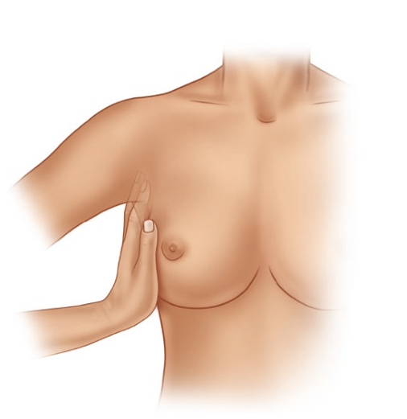





Examination
Inspection
  Symmetry, size and shape, edema (peau d’orange), nipple or skin retraction, or erythema.
Palpation
  Systematic palpation of all quadrants and the tail of Spence
  Examination of the axilla, supraclavicular and infraclavicular nodal basins
Document size, position (clock-face/quadrant, distance from nipple), fixation to skin/pectoralis/chest wall, and node status to assign cTNM

Slide 26
Imaging Techniques
Mammography
  Screening v diagnostic
  Ductography for single-duct discharge
  Contrast-enhanced digital mammography
Ultrasonography — dense breasts, cystic vs solid, axilla, biopsy guidance
MRI — high-risk screening, extent of disease, occult primary, treatment response
All suspicious findings are reported by BI-RADS category (0–6) to standardise management

Slide 27
Mammography
Screening-- is used to detect unexpected breast cancer in asymptomatic women.
  MLO and CC views,
Diagnostic mammography-- is used to evaluate women with abnormal findings such as mass or nipple discharge.
  MLO and CC views, 90° lateral and spot compression/magnification views
Findings are reported by BI-RADS category; BI-RADS 4–5 warrants tissue biopsy

Slide 28
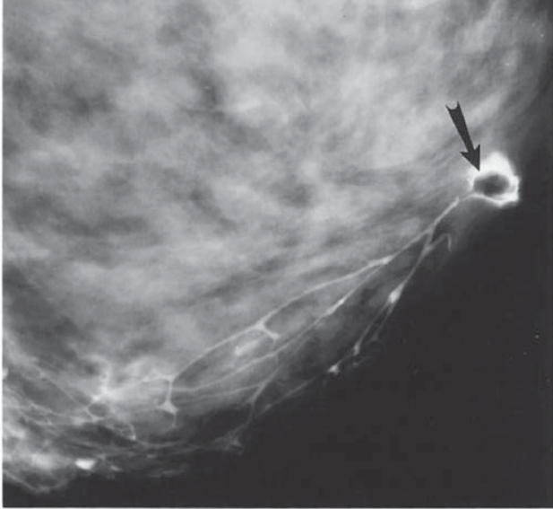
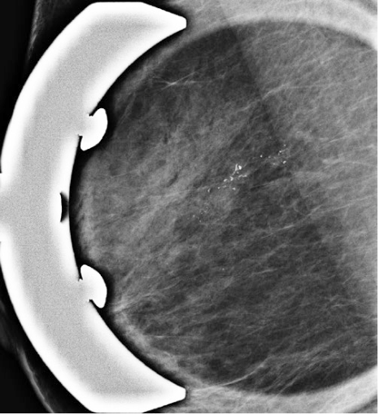
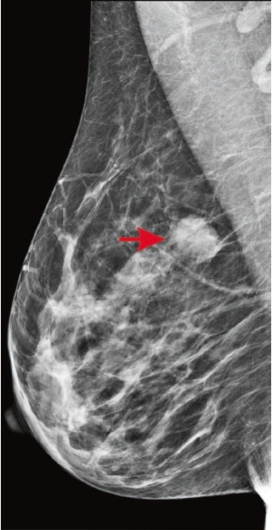
Mammography (Cont.)
Specific mammographic features that suggest breast cancer include
  a solid mass with or without stellate features,
  asymmetric thickening of breast tissues,
  clustered pleomorphic microcalcifications and fine, stippled calcium around a suspicious lesion
These correspond to BI-RADS¹ 4 (suspicious) or 5 (highly suggestive of malignancy) — both need tissue biopsy
¹ BI-RADS 0 incomplete (more imaging needed); 1 negative; 2 benign; 3 probably benign (<2% malignant); 4 suspicious (2–95%); 5 highly suggestive (>95%); 6 biopsy-proven malignancy.

Slide 29
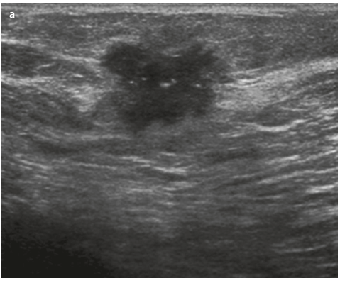
Ultrasonography
Equivocal mammographic findings,
Defining cystic masses, and demonstrating the echogenic qualities of specific solid abnormalities.
On ultrasound examination, breast cancer characteristically has irregular walls/margins but may have smooth margins with acoustic enhancement.
Also the preferred first imaging test in young or pregnant women, and used to guide core-needle biopsy

Slide 30
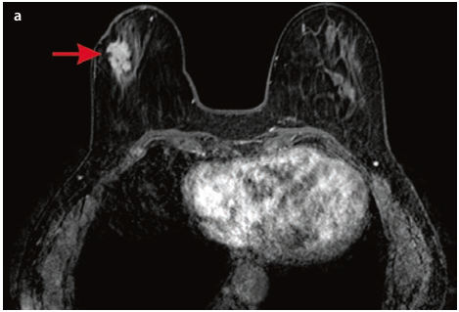
MRI
Current interest in the use of MRI to screen the breasts of
  high-risk women and
  women with a newly diagnosed breast cancer (contralateral breast, extent of disease)
  surgical treatment planning
High sensitivity but lower specificity than mammography — more false positives, so it is not used for routine average-risk screening

Slide 31
Breast Biopsy
FNA biopsy
  Cytologic evaluation; sensitivity/specificity approach 100% for a clinically and mammographically suspicious mass
Core-needle biopsy (preferred method)
  14-gauge automated, or vacuum-assisted 8–10-gauge (4–12 samples) under image guidance
  Analysis of breast tissue architecture, grade, invasion and ER/PR/HER2
  A radiopaque clip is placed at every biopsy site for future localisation
The combination of diagnostic mammography, ultrasound or stereotactic localization, and FNA/core biopsy achieves almost 100% accuracy in the preoperative diagnosis of breast cancer.
A benign result does not rule out cancer if imaging is suspicious — clinical, imaging and pathologic findings must all agree

Slide 32
Diagnostic Pathway: Triple Assessment
Clinical presentation: palpable mass, abnormal screening mammogram,
nipple discharge/retraction, or skin change
Clinical breast &
axillary examination
Diagnostic mammography
± ultrasound (BI-RADS)
MRI (selected: dense
breast, high risk, extent)
Core-needle biopsy (image-guided; clip placed) — ER/PR/HER2 on every
invasive cancer
Triple assessment: clinical + imaging + pathology concordant?
Yes → proceed to staging &
multidisciplinary treatment planning
No → MDT review: repeat
imaging/biopsy or excisional biopsy

Slide 33
Breast Cancer Staging and Biomarkers
The clinical stage –determined primarily through
  examination of the skin,
  breast tissue, and
  regional lymph nodes (axillary, supraclavicular, and internal mammary).
Pathologic stage combines pathologic examination
  resected primary breast cancer and axillary or other regional lymph nodes.
Pathologic T takes precedence over clinical T; the number of involved nodes is one of the strongest survival predictors

Slide 34
TNM Stage Groupings
T | N | M | Stage
Tis | N0 | M0 | 0
T1 | N0 | M0 | IA
T0 | N1mi | M0 | IB
T1 | N1mi | M0 | IB
T0 | N1 | M0 | IIA
T1 | N1 | M0 | IIA
T2 | N0 | M0 | IIA
T2 | N1 | M0 | IIB
T3 | N0 | M0 | IIB
T0 | N2 | M0 | IIIA
T1 | N2 | M0 | IIIA
T2 | N2 | M0 | IIIA
T3 | N1 | M0 | IIIA
T3 | N2 | M0 | IIIA
T4 | N0 | M0 | IIIB
T4 | N1 | M0 | IIIB
T4 | N2 | M0 | IIIB
Any T | N3 | M0 | IIIC
Any T | Any N | M1 | IV
AJCC 8th edition staging of breast ca
  LCIS not included as Tis
  Allow for staging based on findings from the internal mammary sentinel nodes
  Clinical or pathologic evidence of metastatic spread to supraclavicular lymph nodes is no longer considered stage IV disease (now N3c / stage IIIC)
  Pathologic T takes precedence over clinical T when both are available

Slide 35
Biomarkers
ER/PR by immunohistochemistry — ≥1% nuclear staining is positive; tested on every invasive cancer (and ER on DCIS)
HER2 — IHC 3+ or ISH-amplified is positive; IHC 2+ needs reflex ISH; "HER2-low"¹ is now clinically relevant for antibody-drug conjugates
Ki-67 and grade estimate proliferation and refine risk
Others
  Indices of Proliferation-PCNA, Indices of Angiogenesis-VEGF, Indices of Apoptosis- bax–bcl-2
Genomic assays (Oncotype DX, MammaPrint) further individualise the adjuvant chemotherapy decision in HR+/HER2− disease
¹ HER2-low = IHC 1+, or IHC 2+ with a negative reflex ISH — not "HER2-positive", but now a target for HER2-directed antibody–drug conjugates (e.g. trastuzumab deruxtecan).

Slide 36
Breast Cancer Therapy
Multidisciplinary Team
  Surgery, medical oncology, radiation oncology, pathology, radiology, plastic surgery, nursing
Determined by
  the stage of the disease
  the biologic subtype (ER/PR/HER2/grade)
  the general health status and preferences of the individual
Before initiating local therapy, the surgeon should confirm
  the clinical stage
  histologic subtype and grade
  ER/PR/HER2 biomarker status

Slide 37
Overview: Treatment Pathway by Stage
Confirmed diagnosis: histologic subtype, grade, ER/PR/HER2, and clinical stage
Stage 0
(LCIS / DCIS)
Stage I–II
(early invasive)
Stage III
(locally advanced /
inflammatory)
Stage IV
(metastatic)
Excision ± RT
± endocrine therapy
BCS or mastectomy
+ SLNB → RT ±
systemic therapy
Neoadjuvant therapy
→ surgery → RT →
adjuvant therapy
Systemic therapy
(endocrine/chemo/
targeted) ± palliation

Slide 38
Non-Invasive Breast Cancer (Stage 0): LCIS
Goal: prevent or detect early the invasive cancer that follows in 25–35% of women with classic LCIS
Classic LCIS / ALH: observation when radiology-pathology concordant; clinical + imaging follow-up. Consider risk-reducing medication after risk discussion.
Risk reduction: tamoxifen (and postmenopausal raloxifene/AIs when appropriate).
Pleomorphic/florid LCIS: diagnostic excision is generally recommended; negative margins emphasized in 2026 ASBrS/SBI/CAP guidance.
No benefit to excising classic LCIS alone — disease is diffuse and risk is equal in both breasts. Pleomorphic or florid LCIS (aggressive variants) behave more like DCIS — consider excision to clear margins.

Slide 39
Non-Invasive Breast Cancer (Stage 0): DCIS
Breast-Conserving Surgery + Whole-Breast RT
Mastectomy
Localized DCIS -> BCS is appropriate when negative margins and acceptable cosmesis are achievable; RT is commonly added. Selected favorable cases may consider RT omission.
Extensive/multicentric disease, inability to achieve acceptable margins/cosmesis, or RT not suitable -> mastectomy. Add SLNB with mastectomy because later mapping may be unreliable.
ER-positive DCIS: adjuvant tamoxifen (or an aromatase inhibitor postmenopausally) for 5 years after BCS+RT lowers ipsilateral recurrence.

Slide 40
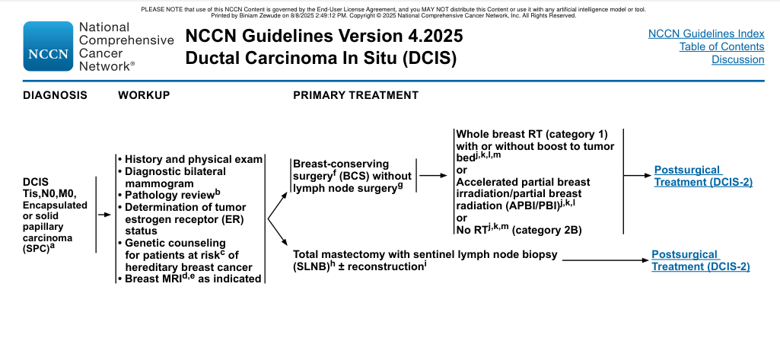
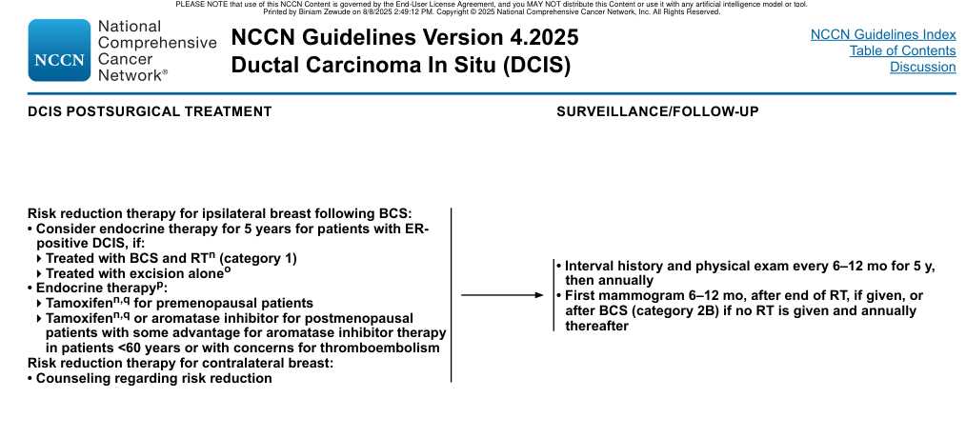
DCIS - current management update
Local treatment
BCS is appropriate for selected localized DCIS when complete excision and acceptable cosmesis are feasible.
Whole-breast RT reduces ipsilateral recurrence; partial-breast RT is an option for selected favorable patients.
Mastectomy is used for extensive/multicentric disease or when BCS/RT is unsuitable.
Systemic / prevention
ER-positive DCIS: endocrine therapy may reduce new breast events after BCS-based treatment.
Endocrine therapy is not a substitute for adequate local therapy.
After bilateral mastectomy, endocrine therapy for DCIS is generally not indicated.

Slide 41
Early Invasive Breast Cancer (Stage I, IIA, or IIB)
Local therapy: BCS + RT or mastectomy give equivalent survival in appropriately selected patients. Consider disease extent, margin feasibility, prior RT, genetics, anatomy and preference. BRCA1/2 does not automatically prohibit BCS; mastectomy may be discussed for future-risk reduction. Axillary staging and RT are risk-adapted.

Slide 42
Adjuvant Chemotherapy Regimens by HER2 Status
Biologic setting | Representative systemic approach | 2026 teaching point
HER2-negative / HR-negative | Taxane- and anthracycline/platinum-based regimens selected by stage; TNBC may use pembrolizumab-based neoadjuvant therapy when eligible. | Pathologic response can determine postoperative escalation/de-escalation.
HER2-positive | Neoadjuvant chemotherapy + HER2-directed therapy for many stage II-III tumors; selected 2026 FDA pathways now include T-DXd. | Residual invasive disease after neoadjuvant therapy is a key trigger for postoperative escalation.
HR-positive / HER2-negative | Endocrine therapy is the backbone; chemotherapy is individualized; selected high-risk patients may receive adjuvant CDK4/6 inhibition. | Use clinical + pathologic + genomic risk, not a single variable.
AC = doxorubicin + cyclophosphamide; TC = docetaxel + cyclophosphamide; TCH(P) = docetaxel + carboplatin + trastuzumab ± pertuzumab; KEYNOTE-522 = pembrolizumab-based regimen for stage II–III triple-negative disease. Complete anti-HER2 therapy to 1 year. Add capecitabine (CREATE-X) or olaparib (OlympiA, if germline BRCA) for residual disease after neoadjuvant therapy.

Slide 43
Endocrine Therapy: Agents and Use
Agent / strategy | Typical setting | Key update
Tamoxifen | Premenopausal and postmenopausal HR+ early disease; also DCIS/risk reduction; usual endocrine backbone in men. | Five years is a common starting course; longer therapy may be appropriate depending on recurrence risk and tolerance.
Aromatase inhibitors | Postmenopausal HR+ early disease; premenopausal only with ovarian suppression. | Bone health and menopausal adverse effects require active management.
Ovarian function suppression | Selected higher-risk premenopausal HR+ disease. | Long-term SOFT/TEXT data reinforce greater benefit in higher-risk groups.
Adjuvant CDK4/6 inhibition | Selected high-risk HR+/HER2- early disease. | Eligibility depends on current regulatory label and risk features.

Slide 44
HER2-Targeted Therapy Across the Disease Course
Setting | Representative strategy | 2026 update
Neoadjuvant stage II-III | Chemotherapy + trastuzumab/pertuzumab; T-DXd-based option now FDA-approved in selected HER2+ stage II-III patients. | T-DXd followed by THP is a new U.S. FDA neoadjuvant pathway (May 2026).
Residual invasive disease after neoadjuvant therapy | Postoperative HER2-directed escalation. | T-DXd approved by FDA for residual invasive HER2+ early disease after selected neoadjuvant treatment.
Small node-negative stage I | Selected lower-risk patients may receive de-escalated paclitaxel + trastuzumab-based therapy. | Choice depends on tumor size, cardiac risk and multidisciplinary assessment.
Metastatic HER2+ | HER2-directed therapy + taxane is a major first-line paradigm; later ADC/TKI sequencing depends on prior treatment and CNS disease. | HR+ HER2+ patients may also receive endocrine therapy; 2026 FDA added maintenance palbociclib in selected patients after induction.
Metastatic | Trastuzumab deruxtecan; trastuzumab + pertuzumab + taxane | Median overall survival ≈57 months with first-line triplet

Slide 45
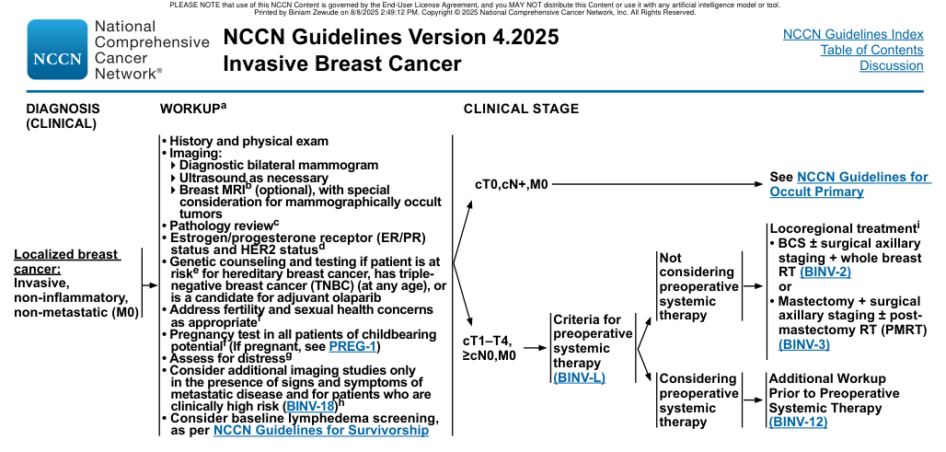
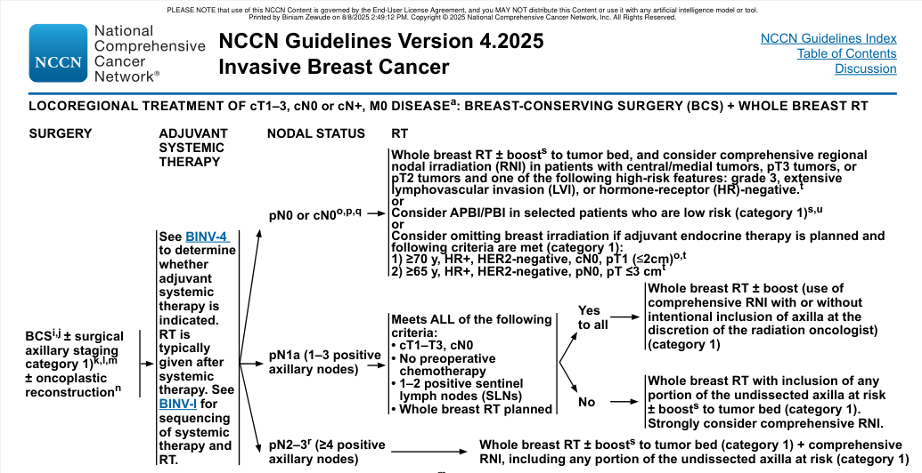
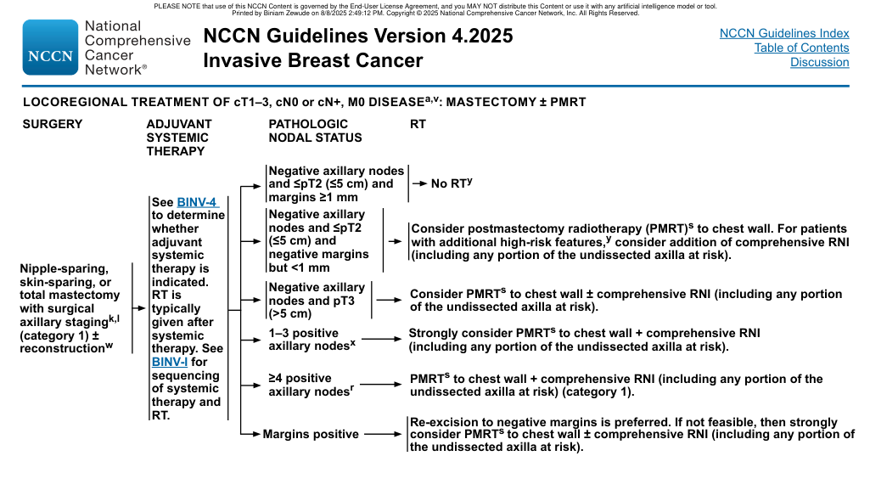
Early invasive breast cancer - treatment selection after staging
1. Decide local sequence
Neoadjuvant systemic therapy when response can change surgery or postoperative systemic therapy.
Upfront surgery remains appropriate for selected operable cancers.
2. Match biology
HR+/HER2-: endocrine backbone; add chemotherapy/targeted therapy according to risk.
HER2+: HER2-directed therapy + chemotherapy; use response to guide escalation.
TNBC: neoadjuvant chemo-immunotherapy for eligible high-risk disease.
3. Complete multimodal plan
Breast surgery + axillary strategy.
Radiation according to breast/axillary/PMRT indications.
Adjuvant systemic therapy based on pathology, biomarkers and residual disease.

Slide 46
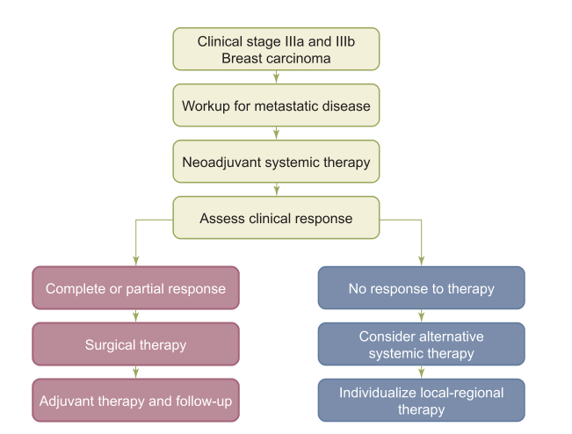
Advanced Local-Regional Breast Cancer (Stage IIIA or IIIB)
Stage III / locally advanced disease: generally neoadjuvant systemic therapy -> surgery -> radiation -> adjuvant systemic therapy. Use modern HER2/TNBC regimens by biology; the 2025 ASTRO/ASCO/SSO PMRT guideline emphasizes individualized PMRT indications after upfront surgery and after neoadjuvant therapy.

Slide 47
Distant Metastases (Stage IV)
Metastatic disease: treatment is usually disease-control / symptom-control rather than cure. HR+/HER2- without visceral crisis -> endocrine-based therapy + targeted therapy such as CDK4/6 inhibition. Reassess ESR1, PIK3CA/AKT/PTEN, germline BRCA and HER2 status when results can change therapy. 'Visceral crisis' means imminent organ failure, not merely visceral metastases.

Slide 48
Stage IV: Systemic Therapy by Subtype
Subtype | Core strategy | Selected 2026 U.S. updates
HR+ / HER2- | Endocrine + CDK4/6 inhibitor for most patients without visceral crisis; later therapy is biomarker- and prior-exposure driven. | ESR1-directed options expanded: vepdegestrant, imlunestrant, imlunestrant + abemaciclib, camizestrant + CDK4/6i (accelerated); gedatolisib in selected PIK3CA-wild-type disease.
HER2+ | Taxane + trastuzumab + pertuzumab is a major first-line paradigm; later ADC/TKI sequencing depends on prior therapy and CNS disease. | 2026 FDA maintenance palbociclib added for selected HR+/HER2+ patients after induction.
TNBC | PD-L1, germline BRCA, prior ICI/ADC and disease tempo guide therapy. | 2026 FDA: sacituzumab + pembrolizumab in selected PD-L1 CPS>=10 first-line disease; sacituzumab monotherapy when PD-1/PD-L1 unsuitable; datopotamab deruxtecan in selected PD-1/PD-L1-ineligible metastatic TNBC.
CDK4/6i = cyclin-dependent kinase 4/6 inhibitor; T-DXd = trastuzumab deruxtecan; T-DM1 = ado-trastuzumab emtansine; PARP inhibitor = poly(ADP-ribose) polymerase inhibitor. Bone-modifying agents (zoledronic acid or denosumab) and palliative radiotherapy/surgery are used alongside systemic therapy as indicated.

Slide 49
Stage IV: Local Therapy for Palliation
Local & systemic palliative measures for stage IV disease
Organ / Structural
Bone
Brain metastasis (SRS / WBRT)
Pleural or pericardial effusion (drainage)
Biliary or ureteral obstruction (stenting)
Spinal cord compression (urgent MRI + steroids + RT/surgery)
Bone metastases: RT for pain/threatened fracture; surgery for instability/pathologic fracture; bone-modifying agent (denosumab or bisphosphonate) to reduce skeletal-related events. Brain/CNS symptoms -> targeted neuroimaging and CNS-directed therapy. Urgent spinal cord compression -> MRI + steroids + surgery/RT.
Whether to resect the primary tumour in de novo stage IV disease remains controversial; reserve for palliation of symptomatic/fungating disease or multidisciplinary-selected oligometastatic cases.

Slide 50
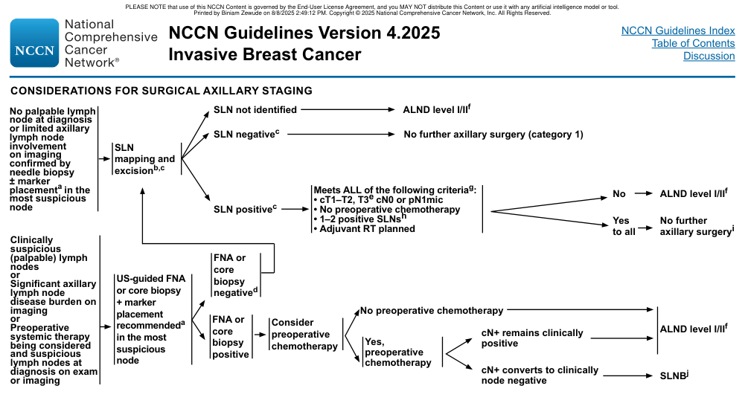
Axillary management - 2026 de-escalation points
Clinically node-negative
SLNB remains a major staging option for many invasive cancers.
SOUND/INSEMA data support omission in selected low-risk clinically node-negative patients when strict criteria are met.
Do not extrapolate omission to every cN0 patient.
Limited SLN-positive disease
Z0011-era criteria already permit ALND omission in selected BCS + whole-breast RT patients with 1-2 positive SLNs.
2026 ASCO reporting from SENOMAC further supports ALND omission for selected patients with 1-2 positive SLNs.
Neoadjuvant setting and residual nodal disease require separate decision rules.

Slide 51
Axillary Staging: Decision Pathway
Clinically node-negative axilla
Clinically suspicious / palpable node
Sentinel lymph node biopsy
(dual tracer; ≥10% rule)
Ultrasound-guided FNA
or core biopsy of the node
SLN negative: no further surgery.
1–2 SLN+ with BCS + whole-breast RT:
ALND often omitted (Z0011)
Node-positive: neoadjuvant systemic
therapy, or proceed to ALND
≥3 positive nodes, failed mapping, or residual disease after neoadjuvant therapy → axillary lymph node dissection (levels I–II).

Slide 52
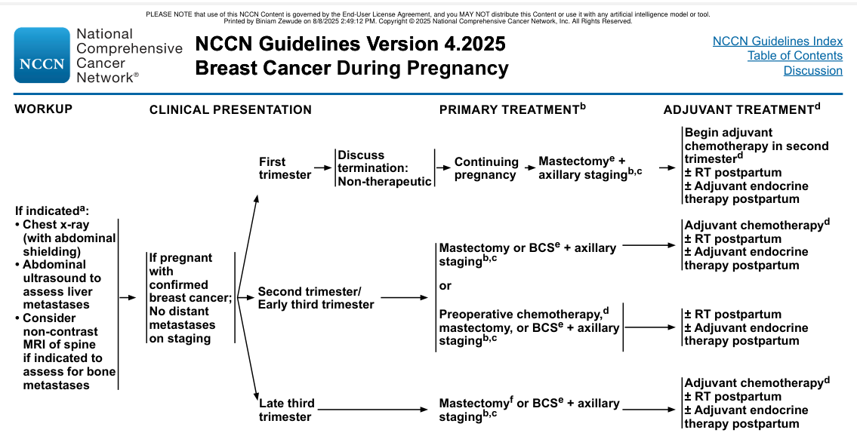
Breast cancer during pregnancy - what changes
Diagnosis / staging
Ultrasound and core biopsy are central.
Use ionizing radiation only when necessary; imaging is adapted to gestation.
Multidisciplinary maternal-fetal medicine + oncology planning is essential.
Treatment timing
Surgery is generally feasible during pregnancy.
Selected chemotherapy can be given after the first trimester.
Radiation, endocrine therapy and HER2-targeted therapy are generally deferred until after delivery.

Slide 53
Inflammatory Breast Carcinoma
Clinical stage IIIB (T4d); accounts for <3% of breast cancers.
This cancer is characterized by the skin changes of brawny induration, erythema with a raised edge, and edema (peau d’orange), with rapid onset over weeks.
Dermal lymphatic invasion is supportive on skin biopsy but not required for diagnosis
75% present with palpable axillary lymphadenopathy, and distant metastases are present in ≈25% at diagnosis
usually HR-negative and is more frequently HER2-positive than non-inflammatory locally advanced cancer
Easily mistaken for mastitis — a failed short course of antibiotics should prompt biopsy

Slide 54
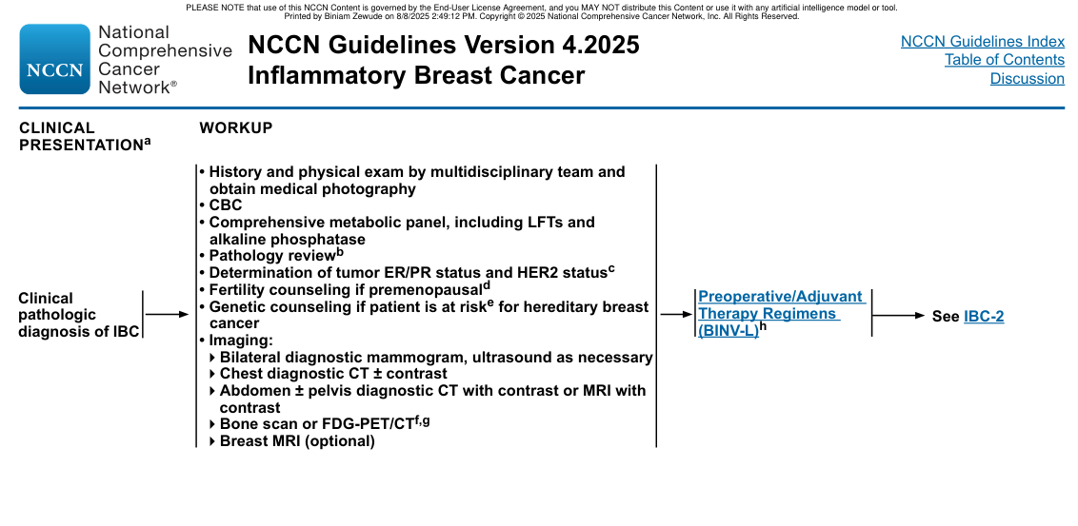
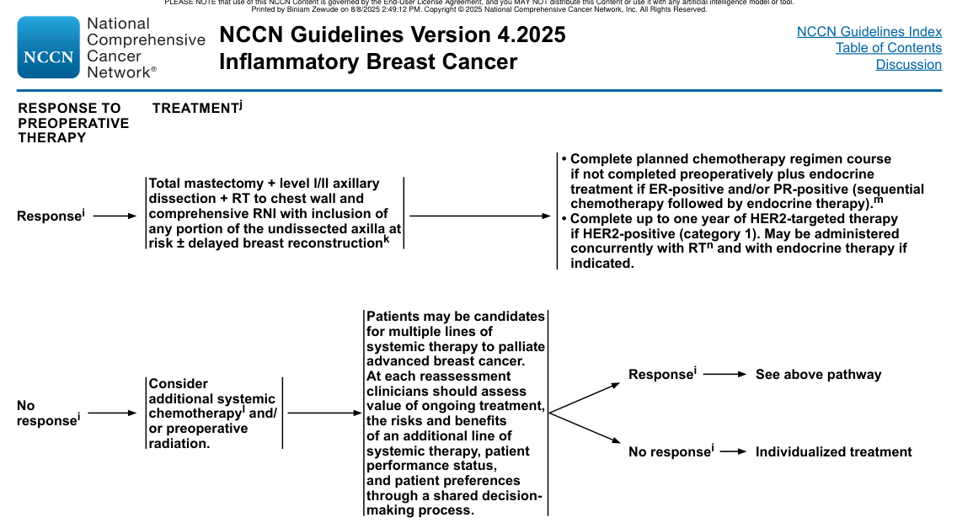
Inflammatory breast cancer - modern trimodality pathway
1. Neoadjuvant systemic therapy
Treat according to biology: HER2-directed therapy for HER2+; TNBC chemo-immunotherapy when appropriate; endocrine-sensitive disease receives systemic treatment as indicated.
Response assessment helps define surgery and postoperative therapy.
2. Surgery + radiation
Total mastectomy with appropriate axillary surgery is standard local therapy after response.
Comprehensive chest-wall and regional-node RT follows surgery.
Reconstruction timing is individualized, often deferred when postoperative RT is anticipated.

Slide 55
Male Breast Cancer
Male breast cancer is <1% of breast cancer and usually presents at older age. Staging is identical to female breast cancer. Most tumors are HR-positive; BRCA2 and other hereditary factors are important. Mastectomy is common because of limited breast tissue, but selected men can undergo breast-conserving surgery.

Slide 56
Male Breast Cancer (Cont.)
Endocrine therapy: tamoxifen is the usual backbone for HR-positive disease. If an AI is used, add gonadal suppression; AI monotherapy is not adequate in men. Use chemotherapy/HER2-directed therapy according to the same biologic principles as in women. Offer genetic counseling/testing.

Slide 57
2026 treatment updates to remember
• HER2+ early disease: new FDA-approved T-DXd neoadjuvant and adjuvant indications in selected settings.
• TNBC metastatic: sacituzumab-based first-line options and datopotamab deruxtecan broaden the ADC landscape.
• HR+/HER2- metastatic: multiple new ESR1-directed agents/combination strategies were FDA-approved in 2026.
• Clinical trials and local formulary/label rules still determine real-world access and sequencing.

Slide 58
Follow-Up and Survivorship
Element | Current practical approach
History & examination | Regularly during the first years, then less frequently; exact interval follows local follow-up guideline and recurrence risk.
Breast imaging | Annual mammography after completion of breast-conserving treatment; timing of first post-treatment study depends on surgery/RT schedule.
Routine CT/PET/bone scan or tumor markers | Not recommended for asymptomatic survivors after curative-intent treatment; evaluate new symptoms or signs promptly.
Endocrine therapy / toxicity | Review adherence, menopausal symptoms, bone health, cardiovascular risk and drug interactions throughout therapy.
Late effects | Lymphedema, neuropathy, cardiac toxicity, bone loss, sexual health, fertility/menopause and psychosocial needs.
New symptoms | Use symptom-directed imaging and biopsy of suspected recurrence when it will establish diagnosis and guide treatment.

Slide 59
References
Selected references for the 2026 update
1. ACS Breast Cancer Screening Recommendations.
2. USPSTF Breast Cancer Screening (2024).
3. USPSTF Breast Cancer Medication Risk Reduction.
4. NCI Breast Cancer Treatment PDQ.
5. NCI Breast Cancer Treatment During Pregnancy PDQ.
6. NCI Male Breast Cancer Treatment PDQ.
7. ASTRO/ASCO/SSO Postmastectomy Radiation Therapy Guideline (2025).
8. ASTRO/ASCO/SSO Partial Breast Irradiation Guideline.
9. ASCO 2026 axillary de-escalation update.
10. ASBrS/SBI/CAP 2026 LCIS/atypia guideline.
11-19. ESMO Breast Cancer Pocket Guideline + 2026 FDA breast-cancer approvals.
NCCN screenshots were removed rather than reproduced; consult the current licensed NCCN document directly when authorized.

Slide 60
Thank you

Slide 61
NCCN Breast Cancer v6.2026 — Clinical Update Addendum
Comprehensive, concise management bullets derived from the supplied NCCN 2026 Breast Cancer and Breast Cancer Risk Reduction PDFs. Use with the current licensed NCCN algorithms at the bedside or for formal guideline interpretation.
September 22, 2026
Management of breast cancer
61

Slide 62
How to read the NCCN 6.2026 framework
NCCN 6.2026
Core inputs
• Anatomic extent: T, N, M and resectability.
• Biology: ER, PR, HER2, grade and selected molecular/genomic tests.
• Patient factors: age, menopause, pregnancy, genetics, comorbidity, fertility and preferences.
• Neoadjuvant response: pCR versus residual invasive disease can change postoperative treatment.
Evidence / categories
• NCCN states that recommendations are Category 2A unless otherwise indicated.
• Category 1: high-level evidence with uniform NCCN consensus.
• Category 2A: lower-level evidence but uniform consensus.
• Category 2B: lower-level evidence with NCCN consensus, but less uniform.
• Category 3: major disagreement; use only in defined circumstances.
NCCN source: NCCN Breast Cancer v6.2026; Evidence Blocks definitions
September 22, 2026
Management of breast cancer
62

Slide 63
Initial work-up of newly diagnosed invasive breast cancer
NCCN 6.2026
Clinical + imaging
• History and physical examination; bilateral diagnostic mammography.
• Targeted ultrasound as needed; axillary US when surgical nodal staging may be omitted or nodal disease is suspected.
• Breast MRI is optional/selective, especially for mammographically occult disease or extent questions.
• Do not order routine metastatic imaging in asymptomatic low-risk patients; target additional imaging to symptoms/high-risk presentations.
Pathology + patient factors
• Pathology review: histology, grade, ER/PR and HER2 using validated testing.
• Genetic counseling/testing when hereditary risk is present, for TNBC at any age, or when an adjuvant PARP inhibitor may be relevant.
• Address fertility, birth control and sexual health; pregnancy testing when pregnancy is possible.
• Assess distress and consider baseline lymphedema assessment where relevant.
NCCN source: BINV-1; BINV-A; BINV-C; BINV-D
September 22, 2026
Management of breast cancer
63

Slide 64
DCIS — 2026 NCCN primary treatment
NCCN 6.2026
Breast-conserving route
• BCS without routine axillary surgery for pure, biopsy-diagnosed DCIS.
• Re-excision may be used to obtain acceptable margins; mastectomy if adequate excision cannot be achieved.
• Whole-breast RT is Category 1 after BCS; APBI/PBI is an option in selected patients.
• RT omission is Category 2B only for carefully selected favorable disease; do not generalize omission to all small DCIS.
Mastectomy route
• Total mastectomy is appropriate for extensive/multicentric disease or when BCS/RT is unsuitable.
• SLNB is generally performed with mastectomy because subsequent mapping can be compromised.
• NCCN permits selected SLNB omission in patients >50 years with nonpalpable low-grade ER-positive DCIS, normal axilla, and patient-preference-driven mastectomy.
• Any invasive cancer discovered on final pathology is then managed by invasive-cancer algorithms.
NCCN source: DCIS-1; BINV-D; BINV-F
September 22, 2026
Management of breast cancer
64

Slide 65
DCIS — postsurgical treatment, endocrine therapy and surveillance
NCCN 6.2026
Adjuvant / risk reduction
• For ER-positive DCIS, consider 5 years of endocrine therapy after BCS + RT or after excision alone.
• Premenopausal: tamoxifen; postmenopausal: tamoxifen or aromatase inhibitor.
• Low-dose tamoxifen is an option for selected symptomatic/intolerant patients; evidence is less mature in premenopausal patients.
• Endocrine therapy reduces subsequent breast events; a survival advantage has not been demonstrated.
Follow-up
• History and physical examination every 6–12 months for 5 years, then annually.
• First mammogram 6–12 months after completion of RT, or after BCS if no RT, then annually.
• Monitor bone health when aromatase inhibitors are used; calcium/vitamin D and antiresorptive therapy may be appropriate in selected patients.
• CYP2D6 genotype testing is not recommended to select tamoxifen therapy.
NCCN source: DCIS-2
September 22, 2026
Management of breast cancer
65

Slide 66
Surgery, margins, axilla and radiation
These slides update common textbook teaching with the current NCCN de-escalation and response-adapted framework.
September 22, 2026
Management of breast cancer
66

Slide 67
BCS versus mastectomy — NCCN selection principles
NCCN 6.2026
Breast conservation
• BCS is appropriate when complete excision with acceptable cosmesis is feasible and adjuvant RT can be delivered.
• Oncoplastic techniques can expand BCS by permitting larger resections while improving contour.
• Mammographic/MRI extent must be reconciled with the ability to obtain a clear margin.
• BRCA1/2 status does not automatically prohibit BCS; future contralateral/ipsilateral risk should be discussed separately.
Mastectomy favored / required
• Inflammatory breast cancer or extensive skin/dermal lymphatic involvement.
• Diffuse suspicious or malignant microcalcifications.
• Persistent positive margins despite feasible re-excision.
• Inability to receive required breast RT.
• Selected extensive multicentric disease or cN2–N3 disease; exact BCS eligibility is individualized.
NCCN source: BINV-G; BINV-H; BINV-1
September 22, 2026
Management of breast cancer
67

Slide 68
Margins after BCS — what NCCN expects surgeons to know
NCCN 6.2026
Invasive cancer
• For stage I–II invasive cancer treated with BCS, a positive margin is “ink on tumor” (invasive cancer or DCIS).
• Adequate negative margin = no tumor on ink; wider routine margins do not replace appropriate RT.
• Positive margins generally require re-excision or mastectomy.
• Specimen orientation and communication with pathology are essential, especially for re-excision and oncoplastic cases.
DCIS
• With BCS + whole-breast RT, the SSO/ASTRO/ASCO consensus incorporated by NCCN supports a 2-mm margin as the standard target.
• Wider margins than 2 mm have not been shown to produce proportionate benefit when RT is given.
• Residual calcifications, the anatomic location of a close margin, and overall recurrence risk still matter.
• When DCIS is admixed with invasive cancer, use the invasive-cancer “no ink on tumor” standard.
NCCN source: BINV-F; NCCN discussion MS-56; SSO/ASTRO/ASCO margin consensus
September 22, 2026
Management of breast cancer
68

Slide 69
Axillary staging — clinically node-negative patients
NCCN 6.2026
When SLNB remains standard
• SLNB remains the principal staging procedure for many clinically node-negative invasive cancers.
• Use appropriate mapping technique; document whether the axilla was truly clinically/imaging negative.
• If suspicious nodes are present, obtain US-guided FNA/core biopsy rather than assuming cN0.
When omission is entering practice
• NCCN incorporates selective omission pathways for very favorable cN0 patients when strict clinical, imaging and treatment criteria are satisfied.
• Omission is not a universal recommendation for every cN0 tumor.
• The decision must fit the planned breast surgery, radiation, age/biology and nodal-risk context.
• Do not extrapolate data from low-risk populations to locally advanced, TNBC, HER2-positive or clearly node-positive disease.
NCCN source: BINV-D; NCCN axillary staging algorithm; cited SOUND/INSEMA/Z0011/AMAROS/SENOMAC evidence
September 22, 2026
Management of breast cancer
69

Slide 70
Positive sentinel nodes — axillary de-escalation
NCCN 6.2026
Selected BCS patients
• For cT1–T2 (selected T3), cN0 disease treated with upfront surgery, 1–2 positive SLNs and planned breast RT, completion ALND can often be omitted.
• This is the Z0011-era principle incorporated into NCCN; limited data exist for ≥3 positive SLNs.
• Regional nodal irradiation/undissected axillary coverage may provide the needed local-regional treatment when ALND is omitted.
When ALND remains relevant
• More extensive nodal burden or failure of the patient to meet omission criteria.
• Persistent clinically positive axilla after neoadjuvant therapy.
• Failed sentinel mapping or other situations in which adequate staging/control cannot be achieved by less surgery.
• Mastectomy pathways require separate consideration of chest-wall/axillary radiation and residual nodal burden.
NCCN source: BINV-D; Z0011; AMAROS; SENOMAC and related evidence
September 22, 2026
Management of breast cancer
70

Slide 71
Initially node-positive → clinically node-negative after neoadjuvant therapy
NCCN 6.2026
Before systemic therapy
• Biopsy the most suspicious axillary node with US-guided FNA/core when feasible.
• Place a marker/clip in the biopsied positive node so the original disease site can be identified later.
• Document baseline nodal burden and imaging carefully.
After neoadjuvant therapy
• If the axilla clinically converts to node-negative, SLNB can be used with optimized technique.
• NCCN emphasizes dual tracers, retrieval of an adequate number of SLNs and removal of the marked/clipped node — targeted axillary dissection (TAD).
• Persistent clinically positive nodal disease generally leads to ALND or other definitive nodal treatment.
• Residual nodal disease after neoadjuvant therapy must be integrated with PMRT/RNI and systemic escalation plans.
NCCN source: BINV-D; NCCN discussion citing SENTINA, Z1071, SN-FNAC and TAD data
September 22, 2026
Management of breast cancer
71

Slide 72
Radiation after breast-conserving surgery
NCCN 6.2026
Whole breast / partial breast
• Adjuvant breast RT is a core component of breast conservation.
• Hypofractionated whole-breast RT is standard for many patients.
• Accelerated partial-breast irradiation is appropriate for selected favorable invasive cancers and DCIS when guideline criteria are met.
• RT omission is reserved for selected biologically favorable/older patients or specific low-risk DCIS circumstances—not for routine BCS.
Boost and coordination
• Tumor-bed boost is individualized by age, grade, margins, recurrence risk and treatment setting.
• Clip the cavity at BCS, particularly after oncoplastic tissue rearrangement.
• Close communication between surgery, radiation oncology and pathology is essential for accurate boost/cavity localization.
NCCN source: BINV-I; BINV-H; NCCN discussion on APBI and DCIS RT
September 22, 2026
Management of breast cancer
72

Slide 73
Postmastectomy radiation — modern decision-making
NCCN 6.2026
Core indications
• PMRT is determined by nodal burden, tumor extent, margins and overall locoregional risk.
• Skin-sparing/nipple-sparing techniques do not change the oncologic criteria for PMRT.
• Regional nodal irradiation may be required in addition to chest-wall treatment.
After neoadjuvant therapy
• Do not base PMRT solely on ypT/ypN; integrate pretreatment clinical stage with post-treatment response and biologic risk.
• The current multidisciplinary approach explicitly considers residual disease and the clinical stage at presentation.
• Reconstruction planning must anticipate PMRT whenever it is likely or uncertain.
NCCN source: BINV-I; NCCN discussion; multidisciplinary PMRT framework
September 22, 2026
Management of breast cancer
73

Slide 74
Subtype-specific early invasive disease
Use biology and response to determine the sequence and intensity of systemic therapy.
September 22, 2026
Management of breast cancer
74

Slide 75
HR-positive / HER2-negative early breast cancer — systemic framework
NCCN 6.2026
Backbone
• Endocrine therapy is the foundation of treatment.
• Premenopausal: tamoxifen ± ovarian function suppression; higher-risk patients may use AI + ovarian suppression.
• Postmenopausal: AI-based therapy is central; tamoxifen is an alternative when appropriate.
• Treatment duration is commonly at least 5 years, with extension individualized by recurrence risk and tolerability.
Who needs chemotherapy?
• Integrate tumor size, grade, nodal status, age/menopausal status and genomic assay information where validated.
• Multigene assays can identify groups with low distant-recurrence risk and limited chemotherapy benefit.
• Do not use a genomic assay outside its validated clinical context or as a substitute for multidisciplinary judgment.
NCCN source: BINV-K; BINV-M; NCCN discussion on multigene assays
September 22, 2026
Management of breast cancer
75

Slide 76
HR+/HER2− early disease — escalation beyond endocrine therapy
NCCN 6.2026
CDK4/6 inhibition
• Adjuvant abemaciclib: high-risk HR+/HER2− disease; NCCN discussion highlights ≥4 positive nodes or 1–3 nodes with grade 3 and/or tumor ≥5 cm.
• Adjuvant ribociclib: NCCN incorporates stage II–III use with endocrine therapy based on NATALEE evidence and current labeling/eligibility.
• Palbociclib is not an adjuvant standard based on negative adjuvant trial results.
PARP / bone-modifying therapy
• For selected high-risk HER2-negative germline BRCA1/2 carriers, 1 year of adjuvant olaparib is an NCCN-supported option after appropriate systemic therapy.
• Olaparib may be used concurrently with endocrine therapy in relevant HR-positive disease.
• Consider adjuvant bisphosphonate therapy in postmenopausal patients with higher-risk node-negative or node-positive disease for reduction of distant recurrence risk.
NCCN source: BINV-K; BINV-M; NCCN MS-44 and related evidence
September 22, 2026
Management of breast cancer
76

Slide 77
HER2-positive early breast cancer — risk-adapted treatment
NCCN 6.2026
Smaller / node-negative tumors
• For pT1a–b, N0 HER2-positive disease, absolute benefit from HER2 therapy may be small and must be balanced against cardiotoxicity and other toxicity.
• For larger node-negative tumors (especially >1 cm), trastuzumab-based chemotherapy is a Category 1 cornerstone.
• HR-positive tumors also receive endocrine therapy.
Node-positive / larger tumors
• For pT1c–T3 or node-positive disease, chemotherapy + trastuzumab is Category 1; pertuzumab is added in selected higher-risk settings.
• Neoadjuvant therapy is important for stage II–III disease because response can guide postoperative escalation.
• For residual invasive disease after neoadjuvant HER2-directed therapy, postoperative escalation is indicated; current NCCN discussion now incorporates contemporary T-DXd evidence.
NCCN source: BINV-5; BINV-L/M; NCCN HER2 early-disease discussion
September 22, 2026
Management of breast cancer
77

Slide 78
Triple-negative early breast cancer — high-risk neoadjuvant pathway
NCCN 6.2026
Before surgery
• High-risk stage II–III TNBC is commonly approached with neoadjuvant chemotherapy plus pembrolizumab when eligible.
• Carboplatin/taxane and anthracycline-containing strategies are used according to the specific regimen and patient factors.
• Genetic testing is important; germline BRCA1/2 status can change postoperative therapy.
After surgery
• pCR is favorable but does not eliminate the need for planned local and systemic treatment completion.
• Residual invasive disease is a major trigger for postoperative treatment escalation according to current NCCN pathways.
• Selected germline BRCA1/2 carriers with high-risk HER2-negative disease may receive adjuvant olaparib.
• The exact regimen and sequencing depend on what was delivered preoperatively and what residual disease remains.
NCCN source: BINV-L/M; KEYNOTE-522 evidence; NCCN TNBC pathways
September 22, 2026
Management of breast cancer
78

Slide 79
Favorable histologies and very small tumors
NCCN 6.2026
Favorable histologies
• Pure tubular, mucinous and cribriform carcinomas generally have more favorable biology.
• For ER-positive/HER2-negative, pN0/pN1mi favorable histologies, endocrine therapy may be the principal systemic therapy.
• Very small tumors may require only risk-reduction endocrine therapy depending on size, grade and pathology.
Clinical caution
• Do not let a favorable histologic label override HER2 positivity, nodal burden or other high-risk features.
• Metaplastic carcinoma is often treatment-resistant, but NCCN recognizes rare low-grade subtypes with favorable behavior.
• Every small tumor still requires integration of histology, biomarkers and patient factors.
NCCN source: BINV-11; NCCN systemic adjuvant treatment tables
September 22, 2026
Management of breast cancer
79

Slide 80
Locally advanced, inflammatory and special breast cancers
The sequence of therapy is often as important as the individual treatment modality.
September 22, 2026
Management of breast cancer
80

Slide 81
Stage III / inoperable or locally advanced breast cancer
NCCN 6.2026
General sequence
• Most stage III disease requires multimodality curative-intent treatment.
• Typical sequence: neoadjuvant systemic therapy → definitive breast/axillary surgery → radiation → completion of systemic therapy as indicated.
• Choose neoadjuvant regimen by subtype: HER2-directed therapy for HER2-positive disease; TNBC chemo-immunotherapy when eligible; endocrine-sensitive disease may use endocrine-based neoadjuvant treatment in selected circumstances.
Why sequence matters
• Neoadjuvant therapy may downstage the breast and axilla.
• Response identifies residual-risk biology and enables postoperative escalation/de-escalation.
• Surgery should not be delayed indefinitely in a nonresponder; reassess for additional systemic therapy, alternate therapy or preoperative RT in selected cases.
NCCN source: BINV-L; BINV-M; BINV-I; NCCN locally advanced disease pathways
September 22, 2026
Management of breast cancer
81

Slide 82
Inflammatory breast cancer — NCCN diagnostic essentials
NCCN 6.2026
Clinical diagnosis
• Rapid onset (≤6 months) of erythema, edema/peau d’orange involving ≥1/3 of the breast, with or without a mass.
• Pathologic confirmation of invasive breast cancer is required.
• Dermal lymphatic invasion may be present but is not required; a negative skin biopsy does not exclude IBC.
Work-up
• Multidisciplinary history/exam with clinical photography.
• CBC/CMP, ER/PR/HER2, fertility/genetic/distress assessment as applicable.
• Bilateral diagnostic mammography ± US, CT chest, CT/MRI abdomen/pelvis, bone scan or FDG-PET/CT; breast MRI optional.
• Biopsy suspicious distant lesions whenever feasible to confirm stage IV disease.
NCCN source: IBC-1
September 22, 2026
Management of breast cancer
82

Slide 83
Inflammatory breast cancer — treatment sequence
NCCN 6.2026
Systemic therapy first
• All clinical/pathologic IBC should receive preoperative systemic therapy before surgery.
• HER2-positive IBC: include HER2-directed therapy; pertuzumab-containing preoperative therapy may be used.
• Complete the planned chemotherapy course if feasible before mastectomy; finish any remaining therapy postoperatively.
Definitive local therapy
• Responders: total mastectomy + level I/II ALND.
• Skin-sparing and nipple-sparing mastectomy are contraindicated.
• Breast conservation is not recommended for true IBC.
• Postmastectomy RT to chest wall + comprehensive regional nodes; include IMNs when clinically/pathologically involved.
• Delayed reconstruction is generally preferred when PMRT is anticipated.
NCCN source: IBC-2; NCCN MS-94–96
September 22, 2026
Management of breast cancer
83

Slide 84
Paget disease — modern local management
NCCN 6.2026
Diagnosis
• Persistent eczematous/bleeding/ulcerated nipple-areolar lesion warrants full-thickness NAC biopsy.
• Diagnostic breast imaging for an associated lesion; MRI is recommended after positive Paget diagnosis to define extent.
• Underlying disease can be DCIS or invasive cancer and may be remote from the nipple.
Surgery
• Mastectomy remains appropriate.
• Selected patients can undergo BCS with complete NAC excision + negative margins and treatment of any underlying lesion, followed by WBRT.
• No axillary staging for Paget + pure DCIS treated with BCS when invasion is excluded; stage the axilla for invasive disease as usual.
• At mastectomy, axillary staging should generally be considered because later SLNB may not be feasible.
NCCN source: PAGET-1; NCCN MS-88
September 22, 2026
Management of breast cancer
84

Slide 85
Male breast cancer — NCCN 6.2026
NCCN 6.2026
What is the same
• Staging and most oncologic principles are extrapolated from female breast cancer because male trial enrollment is limited.
• Clinically node-negative invasive disease: SLNB.
• BCS can be considered using the same oncologic criteria when anatomy permits.
• Chemotherapy/HER2-targeted therapy indications follow female-breast-cancer principles.
What is different
• Consider germline genetic testing in all males with breast cancer.
• Most tumors are HR-positive; tamoxifen is the usual endocrine backbone.
• If an AI is used, add GnRH suppression/ablation; AI monotherapy is inadequate.
• Data for molecular assays are limited but 21-gene recurrence score has prognostic evidence in men.
NCCN source: BINV-J
September 22, 2026
Management of breast cancer
85

Slide 86
Breast cancer during pregnancy — NCCN practical points
NCCN 6.2026
Diagnosis / staging
• Do not delay tissue diagnosis because of pregnancy.
• Ultrasound and core biopsy are central; use mammography/other ionizing imaging when needed with appropriate shielding/protection.
• MRI without gadolinium may be considered; gadolinium is generally avoided unless it will change management.
• Coordinate surgery, oncology and maternal-fetal medicine.
Therapy
• Surgery is feasible during pregnancy when indicated.
• Chemotherapy is generally deferred until after the first trimester and selected regimens are used.
• Endocrine therapy, anti-HER2 therapy, ADCs, PARP inhibitors and immune-checkpoint inhibitors are deferred/avoided during pregnancy.
• Radiation is generally postponed until after delivery.
• Supportive care: use pregnancy-compatible antiemetics/steroids; avoid dexamethasone/betamethasone when possible; G-CSF may be used cautiously.
NCCN source: PREG-1/PREG-2
September 22, 2026
Management of breast cancer
86

Slide 87
Recurrent and metastatic breast cancer
Treat stage IV disease as a biologically dynamic, longitudinal condition with repeated biomarker-informed decisions.
September 22, 2026
Management of breast cancer
87

Slide 88
Stage IV — universal NCCN principles
NCCN 6.2026
Re-characterize disease
• When feasible, biopsy a metastatic site to confirm malignancy and reassess ER/PR/HER2 because phenotype can differ from the primary tumor.
• Obtain germline BRCA1/2 assessment in recurrent/metastatic disease when results could identify PARP-inhibitor candidates.
• Use molecular profiling selectively to identify actionable alterations.
Treatment intent
• Primary goals: prolong survival, control symptoms, preserve function and quality of life.
• Most patients are candidates for multiple lines of therapy; reassess benefit, toxicity, performance status and preferences at every progression.
• Sequential single-agent chemotherapy is generally preferred over routine combination chemotherapy; combinations are reserved for high burden, rapid progression or visceral crisis contexts.
NCCN source: BINV-21–28; BINV-Q; BINV-R
September 22, 2026
Management of breast cancer
88

Slide 89
HR+/HER2− metastatic breast cancer — NCCN sequence
NCCN 6.2026
No visceral crisis
• First-line endocrine therapy + CDK4/6 inhibitor is a core preferred strategy.
• Premenopausal/perimenopausal patients should receive ovarian suppression/ablation with endocrine therapy.
• Choice of endocrine partner depends on prior endocrine therapy and disease-free interval.
• Continue systemic therapy until progression or unacceptable toxicity.
Molecularly selected progression
• After endocrine resistance, use biomarker-directed therapy when appropriate.
• PIK3CA-activating mutation: fulvestrant + inavolisib + palbociclib is an NCCN Category 1 option in the defined early-relapse setting.
• ESR1 mutation: use an ESR1-directed endocrine strategy when eligible.
• If endocrine therapy has produced durable control, alternate endocrine combinations remain appropriate before cytotoxic therapy in many patients.
NCCN source: BINV-22/23; BINV-P
September 22, 2026
Management of breast cancer
89

Slide 90
Visceral crisis — do not confuse it with visceral metastasis
NCCN 6.2026
Definition
• Visceral crisis = severe organ dysfunction caused by rapidly progressive disease requiring the most rapidly effective systemic control.
• It is NOT simply the presence of liver/lung/other visceral metastases.
• Signs, symptoms, laboratory abnormalities and rapid progression determine the urgency.
Management implication
• Cytotoxic therapy is generally favored when rapid response is essential.
• Selected endocrine + targeted combinations may still be considered in specific circumstances, but treatment must prioritize speed and clinical stability.
• Reassess early; if rapid response occurs or disease stabilizes, an endocrine-based maintenance strategy may again be appropriate.
• Supportive/palliative care remains integrated throughout.
NCCN source: BINV-22; NCCN definition based on ESO-ESMO consensus
September 22, 2026
Management of breast cancer
90

Slide 91
HER2-positive metastatic breast cancer — current NCCN pathway
NCCN 6.2026
First line
• Preferred paradigm: a taxane + trastuzumab + pertuzumab, followed by maintenance HER2 blockade.
• Paclitaxel or docetaxel may be used according to patient factors and regimen selection.
• HR-positive tumors may also receive endocrine therapy; selected 2026 pathways incorporate CDK4/6 inhibition.
Later lines / CNS disease
• Trastuzumab deruxtecan is a major subsequent-line option; sequencing depends on prior exposure and CNS status.
• Tucatinib + capecitabine + trastuzumab is particularly important when brain/CNS disease is present or progresses systemically.
• Continue HER2-targeted therapy beyond progression when clinically appropriate; the exact optimal sequence remains unsettled.
• Monitor for T-DXd-associated interstitial lung disease/pneumonitis and for cardiac toxicity with HER2-directed therapy.
NCCN source: BINV-24/26; BINV-Q-4; NCCN HER2 metastatic pathways
September 22, 2026
Management of breast cancer
91

Slide 92
Metastatic TNBC / HER2 non-amplified disease — biomarker-driven treatment
NCCN 6.2026
Key biomarkers
• PD-L1 testing uses the 22C3 assay with CPS thresholding in NCCN pathways.
• Assess germline BRCA1/2 in recurrent/metastatic disease.
• Record HER2 IHC precisely: IHC 0/0+, 1+, or 2+/ISH-negative can affect later ADC eligibility.
• Consider actionable genomic biomarkers such as MSI-H, TMB-H and NTRK/RET fusions where clinically relevant.
Treatment themes
• Immunotherapy is used in biomarker-selected TNBC.
• PARP inhibitors are preferred targeted options for eligible germline BRCA disease.
• ADCs such as sacituzumab govitecan and datopotamab deruxtecan are important current options, with line placement depending on prior treatment.
• For HER2 IHC 1+ or 2+/ISH-negative metastatic disease, fam-trastuzumab deruxtecan is an NCCN-supported option in defined settings.
NCCN source: BINV-Q 3–8; BINV-A HER2 testing
September 22, 2026
Management of breast cancer
92

Slide 93
Bone, brain and other metastatic complications
NCCN 6.2026
Bone disease
• For bone metastasis with expected survival ≥3 months and adequate renal function, denosumab, zoledronic acid or pamidronate should accompany systemic/endocrine therapy (Category 1).
• Calcium/vitamin D and preventive dental assessment are required; monitor for osteonecrosis risk.
• RT is used for painful or threatening lesions; surgery is used for instability/pathologic fracture or selected impending fracture.
CNS / structural complications
• Brain metastases require CNS-specific assessment and local therapy when indicated (SRS, WBRT, surgery depending on disease pattern).
• Spinal cord compression: urgent MRI + corticosteroids + surgery and/or RT.
• Pleural/pericardial effusions, biliary obstruction, ureteric obstruction and other mechanical complications require symptom-directed procedures plus systemic control.
NCCN source: BINV-21; BINV-Q; NCCN CNS/Palliative/Supportive Care guidance
September 22, 2026
Management of breast cancer
93

Slide 94
Oligometastatic stage IV — what NCCN actually says
NCCN 6.2026
Evidence limits
• Routine resection of the primary tumor or ablation of all metastatic sites has not been shown to improve survival in prospective trials.
• Local therapy may reduce local progression and palliate symptoms.
• De novo oligometastatic disease may have a more favorable biology than recurrent oligometastatic disease.
Selected individualized escalation
• An aggressive multimodality approach may be considered for highly selected patients with favorable biology and limited disease burden.
• Favorable features include HER2-positive or ER-positive disease, bone-only disease, limited metastatic sites, young age/long expected survival, and conversion to NED after optimal systemic therapy.
• Decisions should be multidisciplinary and should not be presented as a routine survival-prolonging standard.
NCCN source: BINV-21, oligometastatic disease footnote
September 22, 2026
Management of breast cancer
94

Slide 95
Locoregional recurrence — reassess, resect when appropriate, then re-stage biology
NCCN 6.2026
After prior mastectomy
• Resect isolated chest-wall recurrence when feasible with limited morbidity and aim for clear margins.
• Use involved-field RT when the area has not been adequately irradiated or when safe additional RT is possible.
• Unresectable recurrence without prior RT can be treated with RT for local control.
After prior BCS + RT
• For most isolated local recurrences after breast conservation, mastectomy is the consensus NCCN local therapy approach.
• Repeat SLNB can be considered in selected situations, but its accuracy/prognostic meaning is limited after prior surgery.
• Systemic therapy is chosen according to current tumor biology; CALOR supports chemotherapy benefit particularly for ER-negative isolated locoregional recurrence.
NCCN source: BINV-18; NCCN MS-56; CALOR evidence
September 22, 2026
Management of breast cancer
95

Slide 96
Monitoring metastatic disease — what NOT to do routinely
NCCN 6.2026
Assessment
• Monitor symptoms, examination, appropriate imaging and disease-specific laboratory parameters according to the treatment and clinical scenario.
• Do not use serial tumor markers, CTCs or ctDNA as standalone triggers to switch therapy when they are not validated for that purpose.
• NCCN 6.2026 does not incorporate routine ctDNA/CTC monitoring for metastatic disease assessment or treatment switching.
Treatment continuation
• Continue a regimen while clinical/radiographic benefit persists and toxicity remains acceptable.
• At each progression, weigh expected benefit against cumulative toxicity and performance status.
• When disease is stable for a prolonged period, reassessment intervals may be individualized.
NCCN source: BINV-R; NCCN discussion MS-88
September 22, 2026
Management of breast cancer
96

Slide 97
Survivorship and risk reduction
The NCCN 2026 documents treat prevention, survivorship and quality of life as part of breast-cancer management—not separate afterthoughts.
September 22, 2026
Management of breast cancer
97

Slide 98
Post-treatment surveillance — NCCN 6.2026
NCCN 6.2026
Follow-up
• History and physical examination 1–4 times/year as clinically appropriate for 5 years, then annually.
• Annual mammography: begin about 6 months or more after completion of BCS + RT; continue every 12 months.
• Routine imaging of a reconstructed breast after mastectomy is not indicated unless symptoms/findings warrant it.
• Asymptomatic survivors do not need routine laboratory tests or metastatic imaging solely for surveillance.
Long-term care
• Monitor adherence to endocrine therapy and manage toxicity.
• Baseline and periodic bone mineral density for patients at risk who receive AI therapy or treatment-induced ovarian failure.
• Assess cardiotoxicity risk after anthracyclines, HER2-targeted therapy or left-sided RT as appropriate.
• Address lymphedema, fertility, sexual health, psychosocial distress, lifestyle and comorbidity management.
NCCN source: BINV-17; Survivorship principles
September 22, 2026
Management of breast cancer
98

Slide 99
NCCN breast-cancer risk reduction — who should be considered for RRM?
NCCN 6.2026
Risk-reducing mastectomy
• Generally considered for pathogenic/likely pathogenic variants in high-penetrance breast-cancer susceptibility genes.
• Also considered for a compelling family history or chest-wall RT received before age 30.
• NCCN does not recommend a single numerical risk cutoff for RRM; risk estimation is individualized.
• For moderate-/low-penetrance variants without compelling family history, established benefit from RRM is generally lacking.
LCIS / shared decision-making
• Risk-reducing mastectomy is not the default strategy for classic LCIS; endocrine risk reduction and surveillance are preferred.
• Discuss genetics, absolute risk, reconstructive choices, body image and sexual health before risk-reducing surgery.
• Polygenic risk scores are not recommended as standard-of-care risk tools by NCCN 2026.
NCCN source: NCCN Breast Cancer Risk Reduction v1.2026; BRISK sections
September 22, 2026
Management of breast cancer
99

Slide 100
NCCN risk-reducing endocrine therapy
NCCN 6.2026
Tamoxifen
• NCCN supports tamoxifen 20 mg/day for healthy patients ≥35 years with sufficient life expectancy and elevated risk (including ≥1.7% 5-year Gail risk) or LCIS.
• Option for premenopausal and postmenopausal patients; risk/benefit changes with age, uterus and comorbidity.
• Low-dose tamoxifen is an option in selected patients who cannot tolerate standard dosing.
Postmenopausal options
• Raloxifene is an alternative SERM for postmenopausal risk reduction; toxicity and long-term comparative efficacy influence selection.
• Anastrozole or exemestane can reduce risk in selected postmenopausal patients, but bone health must be assessed and monitored.
• CYP2D6 genotype testing is not recommended to select tamoxifen; avoid or substitute strong CYP2D6-inhibiting medications when possible.
NCCN source: NCCN Breast Cancer Risk Reduction v1.2026; BRISK-6
September 22, 2026
Management of breast cancer
100

Slide 101
Risk reduction — lifestyle, surveillance and genetic assessment
NCCN 6.2026
Lifestyle / survivorship
• Weight management, physical activity and limiting alcohol are part of risk-reduction counseling.
• Avoid smoking and address modifiable cardiometabolic risk factors.
• Discuss reproductive history, breastfeeding where applicable, and hormone-therapy risks in context.
Genetic / screening pathway
• Reassess family history over time; changes can trigger new genetic evaluation.
• Use validated risk models for screening decisions; no model replaces genetics expertise and clinical judgment.
• High-risk patients need the dedicated NCCN screening/genetic-familial pathways rather than average-risk screening alone.
NCCN source: NCCN Breast Cancer Risk Reduction v1.2026; BRISK-1–7
September 22, 2026
Management of breast cancer
101

Slide 102
High-yield NCCN 6.2026 pitfalls for surgeons
NCCN 6.2026
• Do not equate “mastectomy” with better survival when BCS + RT is oncologically appropriate.
• Do not use “ink on tumor” and “2-mm margin” interchangeably: the first is for invasive BCS, the second is the established DCIS target with WBRT.
• Do not perform routine axillary surgery for pure DCIS treated by BCS.
• Do not perform ALND for every positive SLN; apply the Z0011/AMAROS/SENOMAC-era criteria and the patient’s radiation plan.
• Do not omit the clipped node or optimized mapping after neoadjuvant therapy in an initially node-positive axilla.
• Do not treat IBC with upfront surgery; systemic therapy comes first and definitive surgery is mastectomy + axillary treatment.
• Do not interpret visceral metastasis as visceral crisis; reserve urgent cytotoxic strategies for true rapid organ-threatening disease.
• Do not monitor asymptomatic survivors with routine CT/PET/tumor markers; surveillance is primarily clinical + annual breast imaging.
• Do not make contralateral prophylactic mastectomy routine in average-risk unilateral breast cancer.
• Do not label HER2-low as a formal pathology category; record the actual HER2 IHC/ISH result.
NCCN source: NCCN v6.2026 BINV-A, D, F, I, 17, 21–28; Risk Reduction v1.2026
September 22, 2026
Management of breast cancer
102

Slide 103
NCCN 6.2026 — master management algorithm
NCCN 6.2026
1. Define the cancer
• Histology + grade
• ER / PR / HER2
• Genetic risk / germline testing when indicated
• Clinical stage and resectability
2. Decide sequence
• Upfront surgery for selected operable disease
• Neoadjuvant therapy when downstaging or response can change treatment
• Stage III/IBC usually systemic therapy first
• Stage IV: systemic therapy based on current biology
3. Integrate local therapy
• BCS + RT or mastectomy
• SLNB / selective omission / TAD / ALND
• PMRT/RNI based on clinical + pathologic risk
• Reconstruction coordinated with RT plan
4. Reassess and adapt
• pCR vs residual invasive disease
• Escalate/de-escalate postoperative therapy as indicated
• At recurrence: biopsy when feasible, re-stage, re-check biomarkers
• Survivorship and supportive care throughout
NCCN source: NCCN Breast Cancer v6.2026 — integrated interpretation of BINV-1 through BINV-28
September 22, 2026
Management of breast cancer
103

Slide 104
NCCN source map for presentation preparation
NCCN 6.2026
Local disease
• DCIS-1/2 — DCIS diagnosis, surgery, RT, endocrine therapy, follow-up
• BINV-1–17 — invasive staging, local therapy, systemic therapy, RT, surveillance
• BINV-D — axillary staging and omission criteria
• BINV-F — BCS margin standards
• BINV-G/H/I — BCS contraindications, reconstruction, radiation
Advanced / special situations
• BINV-21–28 — recurrent/stage IV systemic treatment
• BINV-P/Q/R — endocrine/targeted therapy, cytotoxic regimens, monitoring
• BINV-J — male breast cancer
• PREG-1/2 — pregnancy-associated breast cancer
• IBC-1/2 — inflammatory breast cancer
• PAGET-1 — Paget disease
• BRISK — risk reduction, genetics, endocrine prevention and risk-reducing surgery
NCCN source: Supplied NCCN Breast Cancer v6.2026 and Breast Cancer Risk Reduction v1.2026
September 22, 2026
Management of breast cancer
104

