Slide 1
GEOGRAPHY OF ETHIOPIA AND THE HORN OF AFRICA
(GeES 101)
2012 E.C

Slide 2
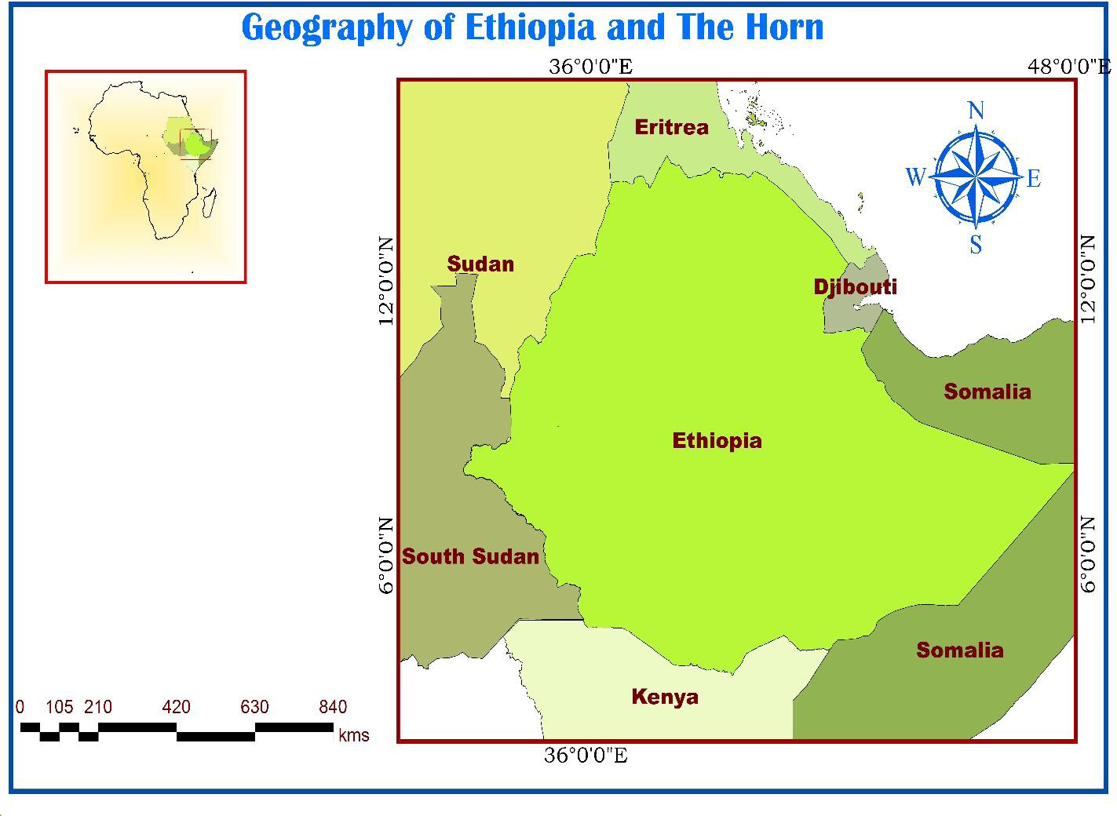

Slide 3
Course Aims
to familiarize students with the basic geographic concepts particularly in relation to Ethiopia and the Horn of Africa
to provide students a sense of place and time (geographic literacy)

Slide 4
Course Objectives
Describe the location, shape and size of Ethiopia and the Horn
Explain the implications of location, shape and size of Ethiopia and the Horn on the physical environment, socioeconomic and political aspects.
Elaborate the major geological events; the resultant landforms and mineral resources of Ethiopia and the Horn
Identify the major drainage systems and water resources of Ethiopia and their implications for regional development and integration
Develop an understanding of the climate of Ethiopia, its dynamics and implications on the livelihoods of its inhabitants

Slide 5
Examine the spatio-temporal distribution and abundance of natural vegetation, wildlife and Soil resources of Ethiopia
Discuss the demographic attributes and dynamics as well as the ethnic diversity of Ethiopia
Read maps as well as compute basic demographic and climatic rates
Comprehend the effects of globalization on the socioeconomic development of Ethiopian and the Horn.
Appreciate the biophysical and socio-cultural diversities in Ethiopia and the Horn

Slide 6
CHAPTER ONE INTRODUCTION
Meaning of Geography
It is difficult to forward a definition acceptable to all geographers at all times and places because of the dynamic nature of the discipline and the changes in its scope and method of study.
However, the following may be accepted as a working definition.
Geography is the scientific study of the Earth that describes and analyses spatial and temporal variations of physical, biological and human phenomena, and their interrelationships and dynamism over the surface of the Earth.

Slide 7
2. The Scope, Approaches and Themes of Geography
Geography has now acquired the status of science that explains the arrangements of various natural and cultural features on the Earth surface.
the scope of Geography is the surface of the Earth, which is the very thin zone that is the interface of the atmosphere, lithosphere, hydrosphere, Anthroposphere and biosphere which provides the habitable zone in which humans are able to live.
Geography can be approached by considering two continuums: a human-physical continuum and a topical-regional continuum.

Slide 8
The topical (systematic) fields of Geography view particular categories of physical or human phenomena as distributed over the Earth while regional geography is concerned with the associations within regions of all or some of the elements and their interrelationships.
Geography has five basic themes namely location, place, human-environment interaction, movement, and region.
1. Location
Location is defined as a particular place or position. Most studies of geography begin with the mention of location. Location can be of two types: absolute location and relative location.

Slide 9
2. Place
Place refers to the physical and human aspects of a location.
This theme of geography is associated with toponym (the name of a place), site (the description of the features of the place), and situation (the environmental conditions of the place).
Each place in the world has its unique characteristics

Slide 10
3. Human-Environment Interaction
Humans have always been on ceaseless interaction with their natural environment.
No other species that has lived on our planet has a profound effect on the environment as humans.
Humans have adapted to the environment in ways that have allowed them to dominate all other species on Earth.

Slide 11
Thus, human-environment interaction involves three distinct aspects: dependency, adaptation, and modification.
Dependency refers to the ways in which humans are dependent on nature for a living.
Adaptation relates to how humans modify themselves, their lifestyles and their behavior to live in a new environment with new challenges.
Modification allowed humans to “conquer” the world for their comfortable living.

Slide 12
4. Movement
Movement entails to the translocation of human beings, their goods, and their ideas from one end of the planet to another.
The physical movement of people allowed the human race to inhabit all the continents and islands of the world.
the transport of goods from one place on the Earth to another.
The third type of movement is the flow of ideas that allows the unification of the human civilization and promotes its growth and prosperity.

Slide 13
5. Region
A region is a geographic area having distinctive characteristics that distinguishes itself from adjacent unit(s) of space.
It could be a formal region that is characterized by homogeneity in terms of a certain phenomenon (soil, temperature, rainfall, or other cultural elements like language, religion, and economy).

Slide 14
Location, Shape and Size of Ethiopia and the Horn
The Horn of Africa is the easternmost extension of African land defined as the region that is home to the countries of Djibouti, Eritrea, Ethiopia, and Somalia, whose cultures have been linked throughout their long history.
In terms of size, Ethiopia is the largest of all the Horn of African countries, while Djibouti is the smallest.
The Horn contains such diverse areas as the highlands of the Ethiopian Plateau, the Ogaden desert, and the Eritrean and Somali coasts. Its coasts are washed by the Red Sea, the Gulf of Aden, and the Indian Ocean,

Slide 15
Location of Ethiopia
The location of a country or a place on a map or a globe is expressed in two different ways. These are astronomical and relative locations.
Astronomical location, also known as absolute or mathematical location, states location of places using the lines of latitudes and longitudes. Astronomically, Ethiopia is a landlocked country located between 3oN (Moyale) and 15oN (Bademe - the northernmost tip of Tigray) latitudes and 33oE (Akobo) to 48oE (the tip of Ogaden in the east) longitudes.

Slide 16
The east west distance (150) is longer than the north-south distance (120).
The latitudinal and longitudinal extensions are important in two ways.
First, as a result of its latitudinal extension the country experiences tropical climate and
secondly due to its longitudinal extension there is a difference of one hour between the most easterly and most westerly points of the country.
It is only for convenience that the 3 hours-time zone is used in all parts of the country.

Slide 17
Relative location expresses the location of countries or places with reference to the location of other countries (vicinal), landmasses or water bodies. The relative location of Ethiopia is indicated as
East of Sudan
North west of South Sudan
West of Djibouti
North of Kenya
South of Eritrea
North west of the Indian ocean
In the Nile basin
South of Europe etc

Slide 18
The implications of the location of Ethiopia are described as follows:
Climate: The fact that Ethiopia is located between 30N and 150N (between the Equator and Tropic of Cancer) implies that the country has a tropical climate, though modified by its altitude.
Socio-cultural: Ethiopia is one of the earliest recipients of the major world religions namely Christianity, Islam and Judaism due to its proximity to the Middle East, which was the origin of these religions.
C. Political: The political history of Ethiopia has been considerably influenced by:
Geopolitical considerations of superpowers.
Adjacency to the Red Sea (a major global trade route).
The Middle East geopolitical paradigms

Slide 19
Size of Ethiopia
Ethiopia with a total area of approximately 1,106,000 square kilometers is the 8th largest country in Africa and 25th in the World.
It extends about 1,639 kilometers East-West, and 1,577 kilometers North-South.
About 0.7% of the country is covered by water bodies.
Advantages and of Ethiopia's large size
1. Possess diverse agro ecological zones
2. Possess Variety of natural resources
3. Own extensive arable land
4. Have larger population size
Home for diverse cultures

Slide 20
disadvantages of Ethiopia's large size
1. Demands greater capital to construct infrastructural facilities
2. Requires large army to protect its territory
3. Difficult for effective administration
4. Difficult for socio-economic integration

Slide 21
The shape of Ethiopia and its Implication
Countries of the World have different kinds of shape that can be divided into five main categories: compact, fragmented, elongated, perforated ( a country completely surrounds by another country like Lesotho) and protruded (one portion that is much more elongated than the rest of the country like Myanmar and Eritrea .
There are four most commonly used measures of compactness. These are:
The ratio of area of country to its boundary length: Area-Boundary ratio. The higher the A/B ratio, the greater the degree of compactness.
2. Boundary-Circumference ratio. It measures how far the boundary of a country approximates the circumference of a circle of its own size. Therefore, the nearer the ratio to 1 the more compact the country is.

Slide 22
3. The ratio of the area of the country to the circumference of the smallest inscribing circle: Area-Circumference ratio. It compares the area of the country with the circumference of a circle that passes touching the extreme points on the boundary of the country. The higher the A/C ratio, the greater the degree of compactness.
4. The ratio of the actual area of a country to the smallest possible inscribing circle: Area-Area (A/A‟) ratio. The area of the inscribing circle is the area of the smallest possible circle whose circumference passes through the extreme points on the boundary. Half-length of the longest distance between two extreme points gives radius of the inscribing circle. The nearer the ratio to 1, the more compact the country is.

Slide 23
Basic Skills of Map Reading
A map is a two-dimensional scaled representation of part or whole of the Earth surface on a flat body such as piece of paper, black board, wood or cloth.
Importance of maps
Provide the basis for making geographical facts of an area such as relief, drainage, settlement etc.
Maps are useful for giving location of geographical features by varied methods of grid reference, place naming etc.
Maps are used on various disciplines like land use planning, military science, aviation, tourism, marine science, population studies, epidemiology, geology, economics, history, archaeology, agriculture etc.

Slide 24
Maps are potentially used to asses‟ reliable measurements of
the geographical features. The measurements can be of area, distance, direction etc.
Types of Map
There are many types of maps according to their purpose and functions. Generally, they are grouped in to topographical and statistical maps.
1. Topographical maps: shows two or more natural and cultural features of an area.
They could be small, medium or large scale depending on the size of the area represented.
Contents of topographical maps depend on purpose of a map, scale of a map, date of publication, and nature of the land represented

Slide 25
2. Special purpose/statistical maps: show only one geographical element such as temperature, rainfall, settlement, vegetation etc
Marginal Information on Maps (Elements of Maps)
Marginal information is shown on a map to enable the reading and interpretation of the geographical information of an area represented. This includes:
Title is the heading of the given map which tells what the map is all about
Key (legend): It is the list of all convectional symbols and signs shown on the map with their interpretation.

Slide 26
Scale: It is the ratio between the distance on the map and the actual ground distance.
Scales enable the map user to interpret the ground measurement like road distance, areal sizes, gradient etc.
It can be expressed as representative fraction, statements/verbal scale, and linear (graphic) scale.
North arrow: It is indicated with the north direction on a map; used to know the other important directions of the mapped area like east, south, and west.
Date of compilation: It is a date of map publication. This enables map users to realize whether the map is updated or outdated.

Slide 27
CHAPTER TWO THE GEOLOGY OF ETHIOPIA AND THE HORN
Geology is an Earth science that studies the evolution of the earth, the materials of which it is made of and the processes acting upon them.
Much of Geology is concerned with events that took place in the remote past when no one was around to witness them and with features which are far beneath the earth's surface where no one can see them.
A great deal of geological understanding must be obtained by inference, using clues from what can be seen and what can be measured.
There are many such clues not only the rocks and landforms which can be observed and studied at the Earth's surface, but also those provided by indirect methods
such as geophysics (studying earthquake waves which can penetrate deep beneath the Earth's surface), geochemistry (analysis of the detailed composition of rocks which can give clues as to their origin) and geochronology (methods for finding the ages of rocks, usually from the radioactive elements they contain).

Slide 28
Australian Climatologist Alfred Wagener proposed the hypothesis that the continents were once assembled together as a supercontinent, called the Continental drift Theory.
The earth's continents were once bunched up together in to a single huge continent called Pangaea. The large super continent was then split into Gondwanaland where Africa is a part and Laurasia; and later into smaller fragments over the last million years. These then drifted apart to form the present arrangement of continents.
Wagener's principal observations were:
Fit of the continents: The opposing coastlines of continents often fit together
2. Match of mountain belts, rock types: If the continents are reassembled as Pangaea, mountains in West Africa, North America, Greenland, and Western Europe match up
3. Paleoclimates: rocks formed 200 million years ago in India, Australia, South America, and southern Africa all exhibited evidence of continental glaciations.

Slide 29
The Geologic Processes: Endogenic and Exogenic Force
The internal processes (endogenic) include volcanic activity and all the tectonic processes (folding, faulting, orogenesis (mountain building), and epeirogenesis (slow rising and sinking of the landmass). These processes result in building of structural and volcanic features like plateaus, rift valleys, Block Mountains, volcanic mountains, etc.
The external (exogenic) processes are geomorphic processes. They include weathering, mass transfer, erosion and deposition. They act upon the volcanic and structural landforms by modifying, roughening and lowering them down.

Slide 30
Major geological events of the four era
1. Precambrian Era
earliest rock formation (4 billion years ago)
Earliest fossils recorded (3.5 billion years ago)
Marine fossil invertebrates (600 million)
2. Paleozoic Era
Great diversity of marine invertebrates
First fish appeared
First land animals and first forests (408)
Coal-forming forests
First reptile

Slide 31
3. Mesozoic Era
First mammals, birds, flowering plants and dinosaurs
Pangaea (one land mass) begins to break up (200 million years ago)
Dinosaurs extinct (65 million years ago)
4. Cenozoic Era
Rocky Mountains (65 million years ago)
individual continents take shape.
Major glaciers in North America and Europe (1.5 million years ago)
Formation of the Greatst East African Rift Valley
Evolution of modern man

Slide 32
Age Dating Techniques
There are two techniques of knowing the age of rocks: Relative and absolute age dating.
Relative Dating
Relative dating uses geological evidence to assign comparative ages of fossils.
Hence, we can use two ways to know the relative age of a rock:
one way is to look at any fossils the rock may contain. If any of the fossils are unique to one of the geologic time periods, then the rock was formed during that particular time period.
The second way is to use the "What is on top of the older rocks?" When you find layers of rocks in a cliff or hillside, younger rocks are on top of older rocks. But these two methods only give the relative age of rocks -which one is younger and which is older.

Slide 33
B. Absolute Dating
Also known as Radiometric techniques. This technique was developed with discovery of radioactivity in 1896. The regular rates of decay for unstable radioactive elements were found to constitute virtual “clocks” within the earth's rocks. Radioactive elements such as uranium (U) and thorium (Th) decay naturally to form different elements or isotopes of the same element. Every radioactive element has its own half-life.
At the end of the period constituting one half-life, half of the original quantity of radioactive element has decayed; after another half-life, half of what was left is halved again, leaving one-fourth of the original, and so on. One of the major techniques include:

Slide 34
Carbon-14 Technique: Upon the organism's death, carbon-14 begins to disintegrate at a known rate, and no further replacement of carbon from atmospheric carbon dioxide can take place.
Carbon-14 has half-life of 5730 years.
Notes:
34

Slide 35
The Spatial Extent of the Rift Valley
The Ethiopian Rift Valley is part of the Great East African Rift system that extends from Palestine-Jordan in the north to Malawi-Mozambique in the south, for a distance of about 7,200 km, 5,600 km in Africa and 1,700 km in Eritrea and Ethiopia.
On land, the widest part of the Rift Valley is the Afar Triangle (200-300 km).
The Red Sea, the Gulf of Aden, and the East African System meet and form the triangular depression of the Afar where the Kobar Sink lies about 125 meters below sea level.
The Rift Valley region of Ethiopian is the most unstable part of the country. There are numerous hot springs, fumaroles, active volcanoes and frequent earthquakes.

Slide 36
The formation of the Rift Valley has the following structural (physiographic) effects:
It divides the Ethiopian Plateau into two
It separates the Arabian landmass from African landmass
It causes the formation of the Dead Sea, Red Sea and the Gulf of Aden
It creates basins and fault depressions on which the Rift Valley lakes are formed.

Slide 37
CHAPTER THREE THE TOPOGRAPHY OF ETHIOPIA AND THE HORN
General Characteristics of the Ethiopian Physiography
The Ethiopian landform is characterized by great diversity. There are flat-topped plateaus, high and rugged mountains, deep river gorges and vast plains.
Altitude ranges from 125 meters below sea level (Kobar Sink) to the highest mountain in Ethiopia, Mount Ras Dashen (4,620 m.a.s.l), which is the fourth highest mountain in Africa.
Ethiopia has the largest proportion of elevated landmass in the African continent. It is sometimes described as the Roof of East Africa because of its height and large area.
More than 50% of the Ethiopian landmass is above 1,000 meters of elevation; and above 1,500 meters makes 44% of the country. Half of this, in turn, is at more than 2,000 meters above sea level.
Most of the Ethiopian Highlands are part of central and northern Ethiopia, and its northernmost portion extends into Eritrea.

Slide 38
The highland core, on the other hand, is encircled by semi-arid and lowlands.
The Ethiopian Highlands are rugged mass of mountains, situated in the Horn of Africa.
They have been dissected by several rivers and ravines which have cut deep gorges.
They have been divided into several regions and mountain systems.
Most of the country consists of high plateau and mountain ranges that are sources of many rivers and streams that made the country to be described as the “Water Tower of East Africa”.
The diversity in topography is accompanied by differences in other natural features such as soil, climate, vegetation and wild life. Likewise, the socio-cultural and economic phenomena are also affected by the topography.

Slide 39
Taking the 1,000 meters contour line for the highland-lowland demarcation, one observes the following contrasting features between the Ethiopian highlands and lowlands:
Characteristics of Ethiopian highlands:
Moderate and high amount of rainfall (>600 mm per year).
Lower mean annual temperature (<200C).
The climate is favorable for biotic life.
Rain-fed agriculture is possible.
Free from tropical diseases.
Attractive for human habitation and densely settled.
These highlands make up nearly 56% of the area of Ethiopia.
This is further subdivided into lower highland (1,000 - 2,00masl), which make up 35% and higher highland (>2,000 masl) constituting nearly 21%.

Slide 40
Characteristics of Ethiopian lowlands:
accounts for about 44%
Fewer amounts of rainfall and higher temperature.
High prevalence of tropical diseases.
Lower population densities.
Nomadic and semi-nomadic economic life.
Vast plain lands favorable for irrigation agriculture along the lower river basins.

Slide 41
The Physiographic Divisions of Ethiopia
Following the structural divisions brought about by the geologic processes of the Cenozoic Era, three major physiographic units can be identified in Ethiopia. These are:
1. The Western highlands and lowlands
2. The South-eastern (Eastern) highlands and lowlands
3. The Rift Valley
1. The Western Highlands and Lowlands
This physiographic unit includes all the area west of the Rift Valley. It extends from north to south encompassing nearly the whole western half of Ethiopia.
It makes up about 44% of the area of the country. In the east the western escarpment of the Rift Valley bound it, whereas westward, the land gradually descends in altitude until it merges into the western foothills and lowlands, along the Sudan and South Sudan border.
This region is further subdivided into four groups of highlands (76.3%) and four groups of lowlands (23.7%).

Slide 42
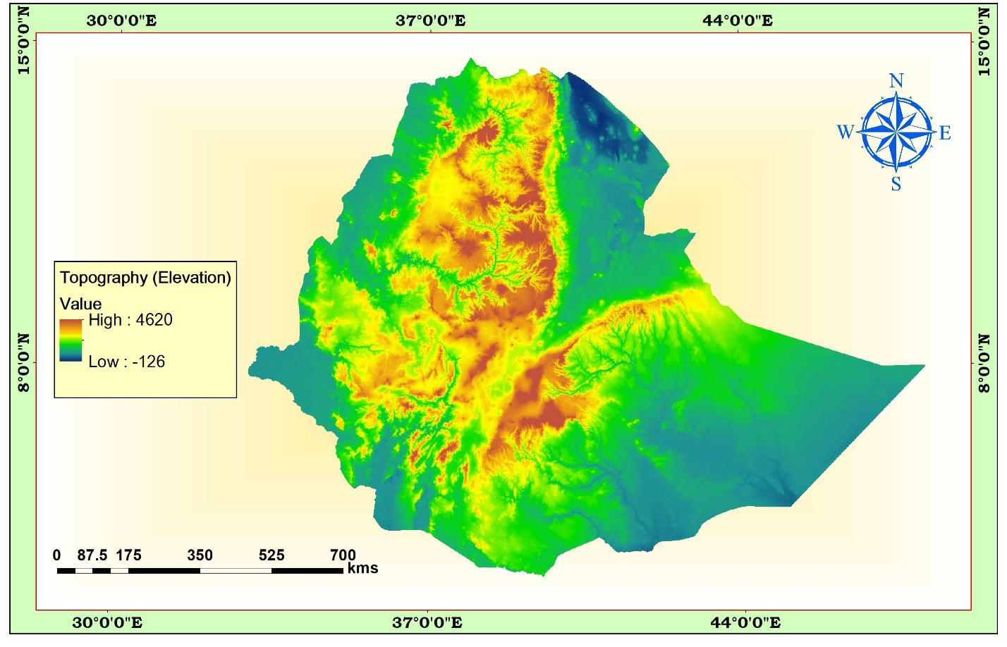

Slide 43
The Western Highlands
The Tigray Plateau
. It extends from the Tekeze gorge in the south to central Eritrean highlands.
. It lies to the southeast of the upper course of the Mereb/Gash River and to the northeast of Tekeze River Gorge.
. It constitutes about 13% of the area of the region.
. It is an elongated highland with most of the land being in between 1,000 and 2,000 meters above sea level.
There are high mountains in this plateau with elevations of over 3000 meters, namely Mount Tsibet (3988 m.a.s.l), Mount Ambalage (3291 m.a.s.l), and Mount Assimba (3248 m.a.s.l).
The famous monastery at Debre-Damo, a tableland that can only be climbed by a rope pulley is also located in this plateau region.

Slide 44
B. North Central Massifs
. This Physiographic division is the largest in the western highlands.
. Much of its northern and southern limit follows the Abay and Tekeze gorges.
. The Abay, Tekeze and their tributaries have cut into this region a maze of gorges, steep sided river valleys, dividing the land into many isolated plateau blocks, precipitous tablelands and other rugged surface forms.
. But much of these plateau and tablelands are still capped by the Trappean lava.
. In its central part, the physiographic unit also accommodates the Lake Tana basin surrounded by plains of Fogera and Dembia in the north and an upland plain in its south.

Slide 45
58% of the region is at an altitude of more than 2,000 meters. The region consists of the Gonder, Wello and Gojjam Massifs.
Out of the 26 mountain peaks with altitude of more than 4,000m.a.s.l in Ethiopia, 19 mountain peaks are found in this physiographic region.
The Mountain systems in Gonder and Gojjam are separated from the eastern group of mountains in Wello by impenetrable and deep gorges. At one point though, they are connected by Yeju-Wadla Delanta land bridge (ridge).
Among the most popular mounts Mount Ras Dashen (4,620 m.a.s.l), Mount Weynobar/Ancua (4462 m.a.s.l), and Mount Bwahit (4437 m.a.s.l) in the Simen Mountain System.
Mount Guna (4,231m.a.s.l) in the Debre Tabour Mountain System,
Abune Yoseph (4,260 m.a.s.l) in the Lasta highlands of Wello and Mount Birhan (4,154 m.a.s.l) in the Choke Mountain System in Gojjam

Slide 46
C. The Shewa Plateau/central highlands
The Shewan plateau is bounded by the Rift Valley in the east and southeast, by the Abay gorge in its northern and western limit, and the Omo gorge in the south and west.
This plateau occupies a central geographical position in Ethiopia.
the Shewa Plateau is the smallest of the Western highlands. Nearly three-fourth of its area is at an altitude of more than 2,000 m.a.m.s.l
It has a dome shaped elevated ground.
The Shewa plateau is drained, outward in all directions by the tributaries of Abay, Omo, and Awash, It, therefore, forms a water divide for these three river basins.

Slide 47
The highest mountain in the Shewan plateau is Mount Abuye-Meda (4,000 m.a.s.l) in Northern Shewa, Mount Guraghe in the south is 3,721 meters high.
D. The Southwestern Highlands
This Physiographic subdivision consists of the highlands of Wellega, Illuababora, Jimma, Kaffa, Gamo and Gofa.
This region is separated from the adjacent highlands by the Abay and Omo river valleys.
It extends from the Abay gorge in the north to the Kenya border and Chew Bahir in the south. It accounts for 22.7% of the area of the region.
The region is the second largest in the Western highlands. About 70% of its area is lies within 1,000-2,000 meters altitude.

Slide 48
The southwestern plateau is the wettest in Ethiopia.
It is drained by Dabus, Deddessa (tributaries of Abay), Baro, Akobo and the Ghibe/Omo rivers.
Guge Mountain With a height of 4,200m.a.s.l, is the highest peak in this physiographic subdivision.

Slide 49
The Western Lowlands
These are the western foothills and border plains that extend from Western Tigray in the north to southern Gamo-Gofa in the South.
They make 11% of the area of the physiographic region.
The general elevation ranges between 500 and 1000 meters above sea level.
This physiographic sub-region is subdivided into four, these are Tekeze lowland, Abay-Dinder lowland, Baro lowland, and Ghibe lowlands.
With the exception of the Baro lowland (the wettest), the region is generally characterized by arid or semi-arid conditions.
Pastoral or semi-pastoral economic activities dominate the area.
there are small but important towns. Their importance could be related to agriculture, history, or are simply border towns and frontier ports.
These are Humera, Metema, Omedla, Kurmuk, Gambella etc.

Slide 50
2. The Southeastern Highlands and Lowlands
This physiographic region is the second largest in terms of area. It accounts for 37% of the area of Ethiopia. The highlands make up 46% of the physiographic division while the rest is lowland.
These are further subdivided into two units of highlands and two units of extensive lowlands. These are briefly discussed as follows.
The Southeastern Highlands
A. The Arsi-Bale-Sidama Highlands
These highlands are found to the east of the Lakes Region. They are located in the south western section of the physiographic region.
They make up 28.5% of the area of the region and 62% of the south - Eastern Highlands.

Slide 51
The Arsi Highlands are made up of flat rolling uplands and dissected mountains. The well-known mountains in this area are Mount Kaka (4,180 m.a.s.l), Mount Bada (4,139 m.a.s.l) and Mount Chilalo (4,036 m.a.s.l).
The Bale highlands are separated from the Arsi highlands by the head and main stream of Wabishebelle.
The highest mountain peaks in this region are Tulu-Demtu (4,377 m.a.s.l) and Mount Batu (4,307 m.a.s.l).
The Arsi-Bale Highlands are important grains producing areas with still high potential.
The Sidama Highlands are separated from the Bale Highlands by the Ghenale river valley. The prominent feature here is the Jemjem plateau, an important coffee growing area.

Slide 52
Rivers Wabishebelle and Ghenale along with their tributaries have dissected this physiographic region. Specially, Weyb River, tributary of Ghenale, has cut an underground passage (Sof Omar cave) through the Mesozoic Limestone rocks.
The cave is found near Bale Mountains. It is one of the World's most spectacular and extensive underground caverns creating a magnificent view accessible only by an underground stream.
B. The Hararghe Plateau
It extends from the Chercher highlands in the south-west to Jigjiga in the east.
It makes up 38% of the South Eastern highlands.
It has the smallest proportion of highland (>2,000 meters).
It is a low lying and elongated region.
The highest mountain here is Mount Gara-Muleta (3,381 m.a.s.l)

Slide 53
The Southeastern Lowlands
The Southeastern lowlands are located in the southeastern part of the country and they are the most extensive lowlands in Ethiopia.
They make up 54% of the area of the physiographic region and around one-fifth of the country.
This region is divided into Wabishebelle plain (60%) and the Ghenale Plain (40%).
They include the plains of Ogaden, Elkere, Borena and Bnadir.
These extensive plains are interrupted here and there, by low hills, low ridges, inselbergs and by shallow and broad river valleys and depressions.
Because of the harsh climatic conditions, these lowlands are little used and support very small population.
They are sparsely inhabited by pastoral and semi-pastoral communities.
The economic potential for this region includes animal husbandry, irrigation, agriculture and perhaps exploitation of petroleum and natural gas.

Slide 54
3. The Rift Valley
It is bounded by two major and more or less parallel escarpments.
The formation of the Rift Valley has separated the Ethiopian Highlands and Lowlands in to two.
It extends from the Afar triangle in the north to Chew Bahir for about 1,700 km. It covers 9% of the area of Ethiopia.
It is elongated and cone shaped. It opens out in the Afar Triangle, where it is the widest, and narrows down to the south.
Altitude in the floor ranges from 125 m.b.m.s.l at Dallol Depression, to as high as 2,000 meters above sea level in the Lakes region.
the climate also varies from warm, hot and dry to cool and moderately moist conditions.

Slide 55
There are places, which are desolate (population desert) and sparsely inhabited by pastoralists where as in others parts people practice some rain-fed agriculture.
The Rift Valley is further subdivided into three physiographic sub-regions; the Afar Triangle, the Main Ethiopian Rift, and the Chew Bahir Rift.
The Afar Triangle
The Afar Triangle is the largest and widest part of the Rift Valley.
It makes up 54% of the Rift Valley area.
The area is generally of low altitude (125mbmsl -700 masl).
The area is characterized by faulted depressions (grabens), volcanic hills, active volcanoes, volcanic ridges, lava fields and low lava platforms.
Lakes (Abe, Asale, and Afdera) occupy some of these basins.

Slide 56
A prominent feature in this region is the Denakil Depression (Kobar Sink).
A larger part of this is covered by thick and extensive salt plain.
Lake Asale and Lake Afdera occupy the lowest parts of this sunken depression.
The Afar Triangle is generally hot and dry. The only respite one gets in the Southern part is from the waters of the Awash River.
The economic importance of this region includes salt extraction, irrigation along the Awash River and electric potential from geothermal energy.

Slide 57
ii. The Main Ethiopian Rift/Central Rift
.It refers to the narrow belt of the Rift Valley that extends from Awash River in the north to Lake Chamo in the south.
. This part of the Rift Valley is the narrowest and the highest.
. It has an average width of 50-80 kilometers and general elevation of 1,000-2,000 meters above sea level.
The floor in many places is dotted by volcanic mountains.
The big ones include Mount Fentale, Boseti-guda (near Adama), Aletu (north of Lake Ziway) and Chebi (north of Lake Hawasa).
The northern section has more of these cinder cones and lava fields.
The prominent features, however, are the numerous lakes formed on tectonic sags and fault depressions.

Slide 58
Because of altitude, the lakes region of the Main Ethiopian Rift is generally wet and watery.
Here rain-fed agriculture is practiced.
Other resource bases include the recreational value of the lakes, the agricultural importance of some streams and lakes, and the geothermal energy potential.
iii. The Chew Bahir Rift
This is the smallest and the southern-most part of the Rift Valley. The highlands of Konso and the surrounding highlands separate it from the Main Ethiopian Rift to the north.
The main characteristic of this region is the broad and shallow depression, which is a swampy area covered by tall grass, into which the Segen and Woito streams drain.

Slide 59
The Impacts of Relief on Biophysical and Socio-economic Conditions
The highly dissected character of the landscape over much of the country's territory along with the limited extent to which flat surfaces are present influence the various socio-economic aspects of Ethiopia is presented here under.
1. Agricultural practices
Relief influences farm size and shape in that in an area of rugged terrain the farmlands are small in size and fragmented and tend to be irregular in shape.
Choice of farming techniques and farm implements are highly influenced by relief
Relief influences crop production as some corps are well adapted to higher altitudes (barley, wheat) and others to low altitude (sorghum, maize).

Slide 60
The practice of animal husbandry is also influenced by relief as most equines and sheep are reared in the higher altitudes and camels and goat are well adapted to lower altitudes
2. Settlement pattern
Highlands of Ethiopia that experience a temperate type of climatic condition that are mainly free from most of the tropical diseases are densely settled.
Rugged and difficult terrain hinders the development of settlement and its expansion.
The highlands of Ethiopia are characterized by sedentary life and permanent settlements while lowlands that are inhabited by pastoralists have temporary settlements.

Slide 61
3. Transportation and communication
The highly dissected nature of the landscape is a barrier to the development of internal surface transportation that resulted in the long-term isolation of many communities
The difficult terrain makes infrastructure development and maintenance costly.
TV and radio communications are also highly influenced by relief.
The rugged topography rendered rivers less navigable due to the waterfalls, deep gorges and steep cliffs.
4. Hydroelectric power potent
The great difference in altitude coupled with high rainfall created suitable conditions for a very high potential for the production of hydroelectric power in Ethiopia, but now at its low level of development b/c of many factors.

Slide 62
5. Socio-cultural feeling
The rugged terrain as a result of excessive surface dissection resulted in the long-term isolation of communities that led to the occurrence of cultural diversity.
People who live in the highlands have been identifying themselves as degegnas (mountaineers) and those who live in the lowlands as kollegnas (lowlanders).
6. Impacts on climate
The climate of Ethiopia is a result of the tropical position of the country and the great altitudinal variation of the general topography.
Highlands with higher amount of rainfall and lower rate of evapo-transpiration tend to be moisture surplus compared to the moisture deficit lowlands.

Slide 63
7. Impacts on soil
Steep mountain slopes provide low angle of rest, unstable surface materials and subject to degradation processes and relatively form shallow and little developed soils.
8. Impacts on natural vegetation
Relief through its effect on climate and hydrology affect the type of natural vegetation grown in an area.

Slide 64
CHAPTER FOUR DRAINAGE SYSTEMS AND WATER RESOURCE OF ETHIOPIA AND THE HORN
Major Drainage System of Ethiopia
The flow of water through well-defined channel is known as drainage.
A drainage system is made up of a principal river and its tributaries.
A river system begins at a place called the source or headwater and ends at a point called mouth. Therefore, a drainage system is the direction and destination of the major river and its tributaries.
The drainage pattern of an area is the outcome of the geological processes, nature and structure of rocks, topography, slope, amount and the periodicity of the flow.

Slide 65
A drainage basin is the topographic region from which a river and its tributaries collect both the surface runoff and subsurface flow.
It is bounded by and separated from other river basins by a water divide or topographic divide.
The Major Drainage Systems
Ethiopia possesses three broadly classified drainage systems namely Western, Southeastern and Rift Valley Drainage Systems.
Western and the Southeastern drainage systems are separated by the Rift Valley system.
The Western Drainage Systems
The Western Drainage Systems are the largest of all drainage systems draining 40%of the total area of the country and carry 60%of the annual water flow.
Most of the catchment area extends with the westward sloping part of the western highlands and western lowlands.

Slide 66
This drainage system comprises four major river basins namely the Tekeze, Abay and Baro-Akobo.
The Abay, Tekeze and Baro flow westward ultimately joining the Nile which finally ends at Mediterranean Sea.
The largest river both in volumetric discharge and coverage in the western drainage systems is the Abay.
Abay river basin covers an area of 199,812 km2, covering parts of Amhara, Oromia and Benishangul-Gumuz regional states.
More than 60 streams drain the Abay within elevation ranging between 500 - 4261 meters above sea level.
Similarly, the Tekeze and its tributaries, carrying 12 percent of the annual water flow of the region drains 82,350 Km2 of land surface within elevation ranging between 536-4517 meters above sea level

Slide 67
Tekeze River is termed Atbara in Sudan, which is a tributary of the Nile. The total mean annual flow from the basin is estimated to be 8.2 billion metric cubes.
The Baro-Akobo river drain the wettest highlands in the south and southwestern Ethiopia. They carry 17% of the annual water flow.
the Baro River flows across an extensive marshy land. Baro Akobo river basin has an area of 75,912 km2, covering parts of the Benishangul-Gumuz, Gambella, Oromia, and SNNPR.
The total mean annual flow from the river basin is estimated to be 23.6 BMC. The Baro together with Akobo forms the Sobat River in South Sudan.

Slide 68
2. The Southeastern Drainage Systems
Nearly the entire physiographic region of southeastern part of Ethiopia is drained by the southeastern drainage systems.
The basin which is mainly drained by Wabishebelle and Ghenale, slopes south-eastwards across large water deficient plains.
Major highlands of this basin include plateaus of Arsi, Bale, Sidama and Harerghe. Wabshebelle and Ghenale rivers cross the border into Somalia, carrying 25 percent of the annual water flow of Ethiopia.
Ghenale River basin has an area of 171,042 km2, covering parts of Oromia, SNNPR, and Somali regions. Ghenale, which has fewer tributaries but carries more water than Wabishebelle, reaches the Indian Ocean.
The basin flows estimated to be 5.8 BMC within elevation ranging between 171-4385 meters above sea level.
In Somalia it is named the Juba River.

Slide 69
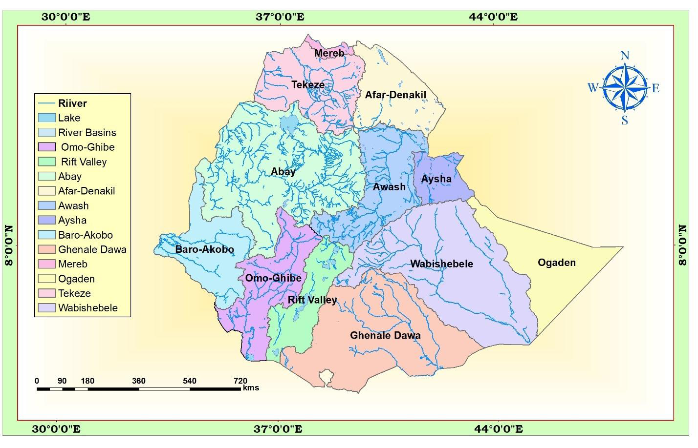

Slide 70
Wabishebelle with a total catchment area of 202,697 km2, is the largest river in terms catchment area.
It drains parts of Oromia, Harari and the Somali regions.
the Wabishebelle fails to reach the Indian Ocean where at the end of its journey it flows parallel to the coast before its water disappears in the sands, just near the Juba River.
3.The Rift Valley Drainage System
The Rift Valley drainage system is an area of small amount of rainfall, high evaporation and small catchment area.
Awash river basin has a catchment area of 114,123 km2 and has an average annual discharge of 4.9BMC.
The Awash River originates from Shewan plateau in central highlands of Ethiopia, and flows 1250 kms.
It covers parts of the Amhara, Oromia, Afar, Somali, DD, and AA City Administration. Awash is the most utilized river in the country.

Slide 71
CHAPTER FIVE THE CLIMATE OF ETHIOPIA AND THE HORN
What is weather and climate?
Elements of Weather and Climate
1. Temperature
2. Precipitation (rainfall)
3. Winds and
4. air pressure
Controls of Weather and Climate
1. Latitude/angle of the Sun
2. Land and water distribution
3. Winds and air pressure
4. Altitude and mountain barriers

Slide 72
Spatiotemporal Distribution of Temperature
Altitude is an important element in determining temperature of Ethiopia and the Horn.
The spatial distribution of temperature in Ethiopia is primarily determined by altitude and latitude.
The location of Ethiopia at close proximity to equator, a zone of maximum insolation, resulted for every part of the country to experience overhead sun twice a year.
However, in Ethiopia, as it is a highland country, tropical temperature conditions have no full spatial coverage.
They are limited to the lowlands in the peripheries.
temperature, as it is affected by altitude, decreases towards the interior highlands.
Mean annual temperature varies from over 30⁰C in the tropical lowlands to less than 10⁰C at very high altitudes.

Slide 73
Agro Ecological Zones of Ethiopia
Altitude (meter) | Mean annual Temp (0C) | Description | Local Name
3,300 and above | less 10 | Cool | Wurch
2,300 - 3,300 | 10 – 15 | Cool Temperate | Dega
1,500 - 2,300 | 15 – 20 | Temperate | Woina Dega
500 - 1,500 | 20 – 25 | Warm Temperate | Kola
below 500 | 25 and above | Hot | Bereha

Slide 74
Spatiotemporal Distribution of Rainfall
To encompass the spatialandtemporal ditribution of rainfall, it needs an understanding of the position of Inter Tropical Convergence Zone (ITC) and Trade Winds.
Thus, the rainfall system in Ethiopia is characterized by spatial and temporal variabilities.
Rainfall in Ethiopia is the result is influenced by the position of Intertropical Convergence Zone (ITCZ).
The convergence of Northeast Trade winds and the Equatorial Westerlies forms the ITCZ, which is a low-pressure zone.
Following the position of the overhead sun, the ITCZ shifts north and south of the equator.
As the shift takes place, equatorial westerlies from the south and southwest invade most parts of Ethiopia bringing moist winds.

Slide 75
The ITCZ shifts towards south of equator (Tropic of Capricorn) in January.
During this period, the Northeast Trade Winds carrying non-moisture-laden dominates the region.
Afar and parts of Eritrean coastal areas experience rainfall in this period.
Following the directness of the Sun in March and September around the equator, the ITCZ shifts towards equator.
During this time, the central highlands, southeasternhighlands and lowlands receives rainfall as the south easterlies bring moist winds.

Slide 76
Rainfall Regions of Ethiopia
Summer rainfall region - This region comprises almost all parts of the country, except the southeastern and northeastern lowlands.
ii. All year-round rainfall region - It has many rainy days than any part of the country.
It is a rainfall region in the southwestern part of the country.
Months in summer gain highest rainfall whereas the winter months receive the reduced amount.
The average rainfall in the region varies from 1,400 to over 2,200 mm/year.
iii. Autumn and Spring rainfall regions - South eastern lowlands of Ethiopia receive rain during autumn and spring seasons.
About 60 %of the rain is in autumn and 40 %in spring.
The average rainfall varies from less than 500 to 1,000 mm.

Slide 77
iv. Winter rainfall region - This rainfall region receives rain from the northeasterly winds. During the winter season, the Red sea escarpments and some parts of the Afar region receive their main rain.
V. Summer, Spring and Autumn – covers very small area around the border of the southeastern highlands and the rift valley.

Slide 78
CHAPTER SEVEN POPULATION OF ETHIOPIA AND THE HORN
Population Data: Uses and Sources
. Regular and reliable population data are vital for effective socioeconomic development planning and administration.
. Such data are needed to plan for the provision of infrastructures such as schools, hospitals, roads, water and sewerage facilities, housing, establishing voting district boundaries, estimating future tax revenue and designing public programs.
. Hence, demographic data are crucial to administrators, businessmen, researchers, academicians and planners.
. The population of a country is an agent as well as a beneficiary of any planned socio-economic development undertaken

Slide 79
Therefore, it becomes inescapable to have population information as the demography influences production, distribution, consumption, defense and administrative services at any administrative or natural unit considered.
There are three conventional sources of obtaining population data namely census, sample survey and vital registration.
A. Census
A census could be defined as the total process of collecting, compiling and publishing demographic, economic and social data pertaining at a specified time (s) to all persons in a defined territory.
Its major characteristics include:
Universality: inclusion of all persons in a given area during the count
Government sponsorship being an expensive endeavour, and publication

Slide 80
There are two procedures for collecting census data: dejure and defacto approaches
Dejure approach: it involves counting people according to their usual place of residence (where he/she lives most of the time).
Defacto approach: each individual is recorded at the place where he/she was found at the time of the census.
B. Sample Survey
This is a method in which a defined population/sample/ is selected with the view that information acquired would represent the entire population.
This method is advantageous over census as costs can be greatly reduced; and it is simple to administer and taken much faster.

Slide 81
Data from most censuses and sample surveys include geographic location, age, sex, marital status, citizenship, and place of birth, relationship to the head of household, religion, educational characteristics, occupation, fertility, income, language, ethnic characteristics, disabilities and migration.
C. Vital Registration
Vital registration is a system of continuous, permanent, compulsory and legal recording of the occurrence and the characteristics of vital events like births, deaths, marriages, divorces, and adoptions.
Problems of population data
poor and inadequately financed methods of collection;
poorly trained enumerator
suspicion and ignorance of censuses and false statements specially of age and income;

Slide 82
Population Dynamics: Fertility, Mortality and Migration
What is fertility and mortality?
Measures of fertility
1. Crude Birth Rate refers to the number of live births per 1000 population
2. General Fertility Rate refers to the total number of live births per women of reproductive age
3. Total Fertility Rate (T.F.R.) refers to the average number of children that a woman would have at the end of her reproductive period if the current age specific fertility rate remains unchanged.
4. Crude Death Rate refers to the number of deaths per one thousand population in a year
5. Infant Mortality rate refers to the total number of deaths of infants per one thousand live Birth

Slide 83
6. Maternal Mortality Rate: refers to death of mothers in connection from pregnancy and birth complications per thousand live birth.
7. Life Expectancy at birth: refers to the average number of years that a newly born baby is expected to live.
8. Natural Rate of Increase - is the difference between crude birth rate and crude death rate expressed in percentage.
As opposed to declining death rates, birth rates have remained high due to:
Little family planning practices, lack of population education and religion;
Lower status of women
Early marriage, particularly of females
Parents consideration of children as assets
The relatively high infant and child mortality rates, that trigger couples to have more births to compensate for the loses and

Slide 84
Some of the consequences of this rapid population growth
low per capita GNP
increased unemployment and under -employment
increasing social ills such as destitution, begging, theft, prostitution
shortage of cultivated land and food shortages
overcrowding of infrastructural and social facilities; housing problems and increase in urban slums and squatter settlements
Environmental problems such as deforestation, soil erosion, loss of biodiversity and pollution

Slide 85
Migration in Ethiopia and the Horn
Migration is an old and inevitable phenomenon, although human mobility has accelerated these days as a result of economic and technological progress especially in the fields of communication and transportation.
It is considered as a form of geographic mobility involving a permanent or semi-permanent change of residence between clearly defined geographic units.
What is internal and international migration?

Slide 86
Age Structure of Ethiopian Population
Age Structure refers to the distribution of population by age groups.
The most used age groups are five-year age groups (0-4, 5-9, 10-14, ..., 60-64, 65 and above) and broad age groups (0-14, 15-64, 65 and above).
Age groups 0-14, 15-64 and 65 and above are known as young age, working age and old age, respectively.
Our young age population is very large, about half of the population, while the old age population is very small.
Because of the predominance of young age population.
The high percentage for the young age group is the result of high birth rate and natural increase,
while the small percentage of the old age group is the reflection of high mortality rate, which results in low life expectancy.

Slide 87
What is Age dependency ratio (A.D.R.)?
Sex Structure
Sex structure refers to the ratio of male population to female population at different age groups.
The 1994 census result shows that it was 101.3 for the country and 102.6, 93.3 and 94, respectively, for rural areas, urban areas and Addis Ababa.
Sex ratios are generally lower for urban areas, and higher for rural areas primarily due to larger female in-migration to urban areas.

Slide 88
Population Distribution in Ethiopia
Population distribution refers to the arrangement of people over space that is provided for them to settle and make a living through exploiting resources.
The distribution of population in Ethiopia is very uneven as a result of physical and human factors operating together.
The most important physical factors that affect population distribution include climate, soil, vegetation, drainage and slope
while the historical(Human) pattern of population movement, the type of economic activity, urbanization, industrialized and the demographic variables.

Slide 89
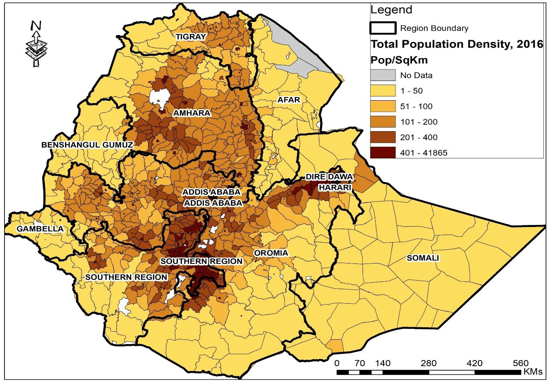

Slide 90
Population Density
Population density refers to the number of people per unit area.
Measures ofpopulation density
A. Crude Density - is found by dividing total population to total area.
Some zones in Ethiopia are very high densities like Gedeo, Sidama, Kambata, Guraghe, Wolayta and Hadiya; where densities exceed 300 persons per sq.km.
On the other hand, peripheral zones such as Kamashi, and Metekel have population densities of less than 20 persons/km2.
B. Physiological Density - is a ratio between total population and arable part of a country.
C. Agricultural Density
Is divided the agricultural population by cultivated land.

Slide 91
Languages Families and Languages of Ethiopia
Ethiopia is a country where about 80 languages are spoken.
According to the 2007 Population and Housing Census of Ethiopia, Afan Oromo and Amharic were the major mother tounges in the country accounting 33.8% sand 29.3% respectively.
Somaligna (6.2%), Tigrigna (5.9%), Sidamigna (4.0%), Wolaytigna (2.2%), Guragigna (2%), Afarigna (1.7%), Hadyigna (1.7%), and Gamogna (1.5%) do have significant number of speakers.
On the other hand, some of the languages are spoken by a few thousands.
The Ethiopian languages belong to two Supper Families: Afro-Asiatic and Nilo-Saharan.
Most Ethiopian languages belong to the Afro-Asiatic Supper Family.

Slide 92
A. Afro-Asiatic
The Afro-Asiatic Supper Family, is divided into three families, namely: Semitic, Cushitic and Omotic.
Cushitic -
The Cushitic languages are predominantly spoken in central, southern, eastern and northeastern parts of Ethiopia mainly in Afar, Oromia and Somali Regional States.
It has the largest number of speakers and the widest spatial coverage.
This family of languages consists of many individual languages such as Oromigna, Somaligna, Sidamigna, Afarigna, Kembatigna, Hadiyigna, Alabigna, Gedeogna, and others.

Slide 93
Semetic
The Semitic languages are spoken in northern, central and eastern parts of Ethiopia particularly in the regional states of Tigray, Amhara, Harari and Southern Nations, Nationalities and Peoples' Regional State.
Some of the Semitic Languages include Amarigna, Tigrigna, Guragigna, Siltigna, Aderigna, and Argobigna.
Omotic
Wolaitigna, Gamogna, Kullogna, Kefigna, and Kontigna are some of the languages in this family spoken by millions and many thousands of people.
Relatively small number of people speaks most of the languages in this group.

Slide 94
B. NiloSaharan
The Nilo-Saharan languages are spoken in the western lowlands of Ethiopia along the border with Sudan, in Gambella and Benishangul Gumuz Regional States.
These Languages are spoken by small numbers of people often less than 500,000 people.
The individual languages of Nilo-Saharan Supper Family include Kunamigna, Bejigna, Gumuzigna, Maogna, Kewamigna, Nuerigna, Annukigna, and others.

Slide 95
Settlement Types and Patterns
Settlements are places that are inhabited by people more or less on a permanent basis, and where people carry out a variety of activities such as agriculture, manufacturing and commerce.
Different settlement types develop mainly in response to some physical and human factors.
Settlements are divided into two, namely, rural and urban on the bases of the dominant economic activity, population densities and availability of socioeconomic and infrastructural facilities.
Towns or urban centers have non-agricultural activities as dominant, while rural areas are almost totally agricultural.
Population densities are generally very high in urban area compared to densities in rural areas.

Slide 96
Rural Settlement
The vast majority of the Ethiopian population still lives in rural settlements consisting of hamlets and villages. Rural settlements can be temporary or permanent
Temporary / Mobile Settlements
The lowlands in most parts of the Rift Valley and peripheral areas, being generally hot and dry, are characterized by pastoral herding and mobile settlements. The settlements are mobile because pastoralists have always been searching for new sites for water and pasture for their livestock.
The major problem often mentioned about mobile settlements is that of providing social services like clean water, schools, hospitals, electricity etc to the people.
Permanent settlements are of two types. One of them is scattered (also called diffused or dispersed), while the other one is known as grouped/ clustered or nucleated.

Slide 97
Urban Settlements and Urbanization in Ethiopia
Urbanization refers to the increase in the percentage of the population living in urban centers.
It entails the process of becoming urban, moving to cities and changing from agriculture to other pursuits of life which are common to towns and, with a corresponding change of behavioral patterns.
The major criteria used to classify settlements as urban in Ethiopia are :
Minimum of 2,000 people
Two-thirds of the population engaged in non-agricultural activities
Chartered municipality and
The presence of social services and facilities.
The number of cities in 1984 was about 322, 1994 about 539 and in 2007 the number rose to 927.

Slide 98
In the words of some writers, Ethiopia is regarded as a 'vast urban desert'. The country‟s low level of urbanization can be attributed to:
The self-sufficiency of agriculture which reinforced rural peasant life;
Low level of industrialization, low level structural transformation and economic development
The morphology of the country that hindered transportation and communication
The continual warfare for centuries between kingdoms in to which the country is divided; and the frequent changes of the royal residence
Lack of employment, and housing shortage in urban areas that discourage in migration;
Political instability, ethnic conflict and social unrest

Slide 99
Some of the conditions which have been contributing to expansion of urban areas are (drivers of urbanization):
The establishment of Addis Ababa as a centre of expansion, and its permanency thereof.
The construction of the Ethio-Djibouti railway line along which many stations have developed into important towns.
The five-year Italian occupation which has contributed to road building, the establishment of small-scale industries and service giving institutions.
The integration of the provincial capitals and major administrative centres found in all directions by all-weather roads radiating from Addis Ababa.
Political decentralization and provision of administrative status of some urban settlements

Slide 100
High Population density and growth rates in the populous highlands of Ethiopia facilitate the emergence of towns
Presence of new and large commercial farms, mining areas, and agro-industries such as sugar factories, cement factories that attract people
Large infrastructure investments such as airports, highways, and dry ports that attract investment and create jobs encourage urbanisation
Opening of Universities that support entrepreneurial activity and innovation in their local economies
Tourism assets and attractions such as parks, resort centres, and heritage cities and sites contribute to urban expansion.
Development of border towns with strengthened inter-country trade

Slide 101
Distribution of Urban Centers in Ethiopia
The Ministry of Urban Development and Construction identified the following hierarchy of urban centers:
1. The Addis Ababa Metropolitan cluster includes Addis Ababa and its surrounding towns; and Adama and its surrounding towns
2. Secondary city clusters consist of:
Lake Tana Urban Cluster: Bahir Dar, Gondar Debre Tabour, Debre Markos
South Rift Valley Urban Cluster: Hawassa-Shashemene-Dila; and Hosana-Sodo-Arba Minch
Eastern Urban Cluster: Dire Dawa, Harar, Jigjiga
Mekelle Urban Cluster: Mekelle, Adigrat, Shire, Axum
Dessie- Kombolcha Urban Cluster.
Jima Urban Cluster: Jima, Agaro, Mizan, Tepi, Gambella

Slide 102
3. Tertiary urban clusters include:
Nekemte Urban Cluster: Nekemte, Dembidolo, Gimbi, Metu, Assosa
Gode - Kebri Dahar oasis city network
Semera-Mille – Asaita oasis city network
Like most developing countries, Ethiopia‟s urban population is concentrated in one primate city, Addis Ababa.
The population of Addis Ababa grew from 1.4 million in 1984 to 2.2 million in 1995, and to 2.7 million in 2007 representing about 29% of the urban population of the country.
Its current estimated population is over four million.

