Slide 1

Sales Analytics: A Dashboard Perspective
Mulweli Mudau

Slide 2
Introduction
Aim & Objectives: This research aims to develop a Sales Performance Dashboard that analyzes key data factors impacting product sales and provides actionable insights.
Overview:
Data Summary & Description.
Data wrangling.
Dashboard Overview.
Breakdown of Dashboard.
Findings & Recommendations.

Slide 3
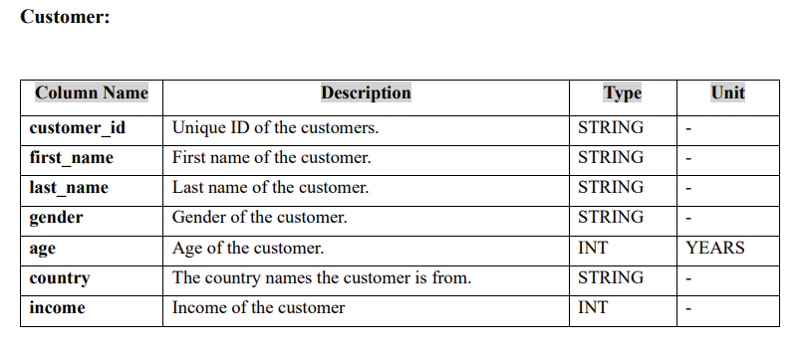
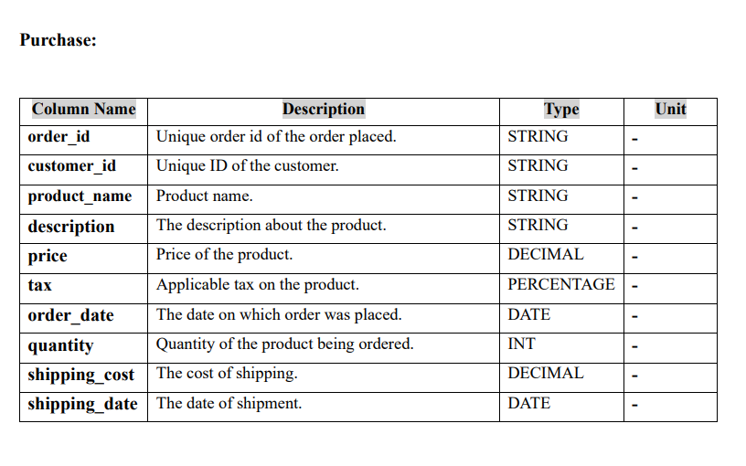
Data Summary & Description
Customer details:
Purchase details:

Slide 4
Data wrangling
Steps taken:
Uploading data to Power BI: Upload customer CVS file and press transform and then upload purchase CVS file
Transformation: - Promote first row to header for customers and purchase data. - The customer data we change age and income from string to whole number. - Convert the "Quantity" column in the purchase data from a string to a whole number. - The purchase data convert price and shipping cost columns from string to decimal. - In the purchase transform tax column from string to percentage. - Purchase data delete discount column since not used. - Purchase data transform order and shipping dates format from string to date.
Loading data : load the transformed data to begin building dashboard.

Slide 5

Dashboard Overview
Page 1

Slide 6
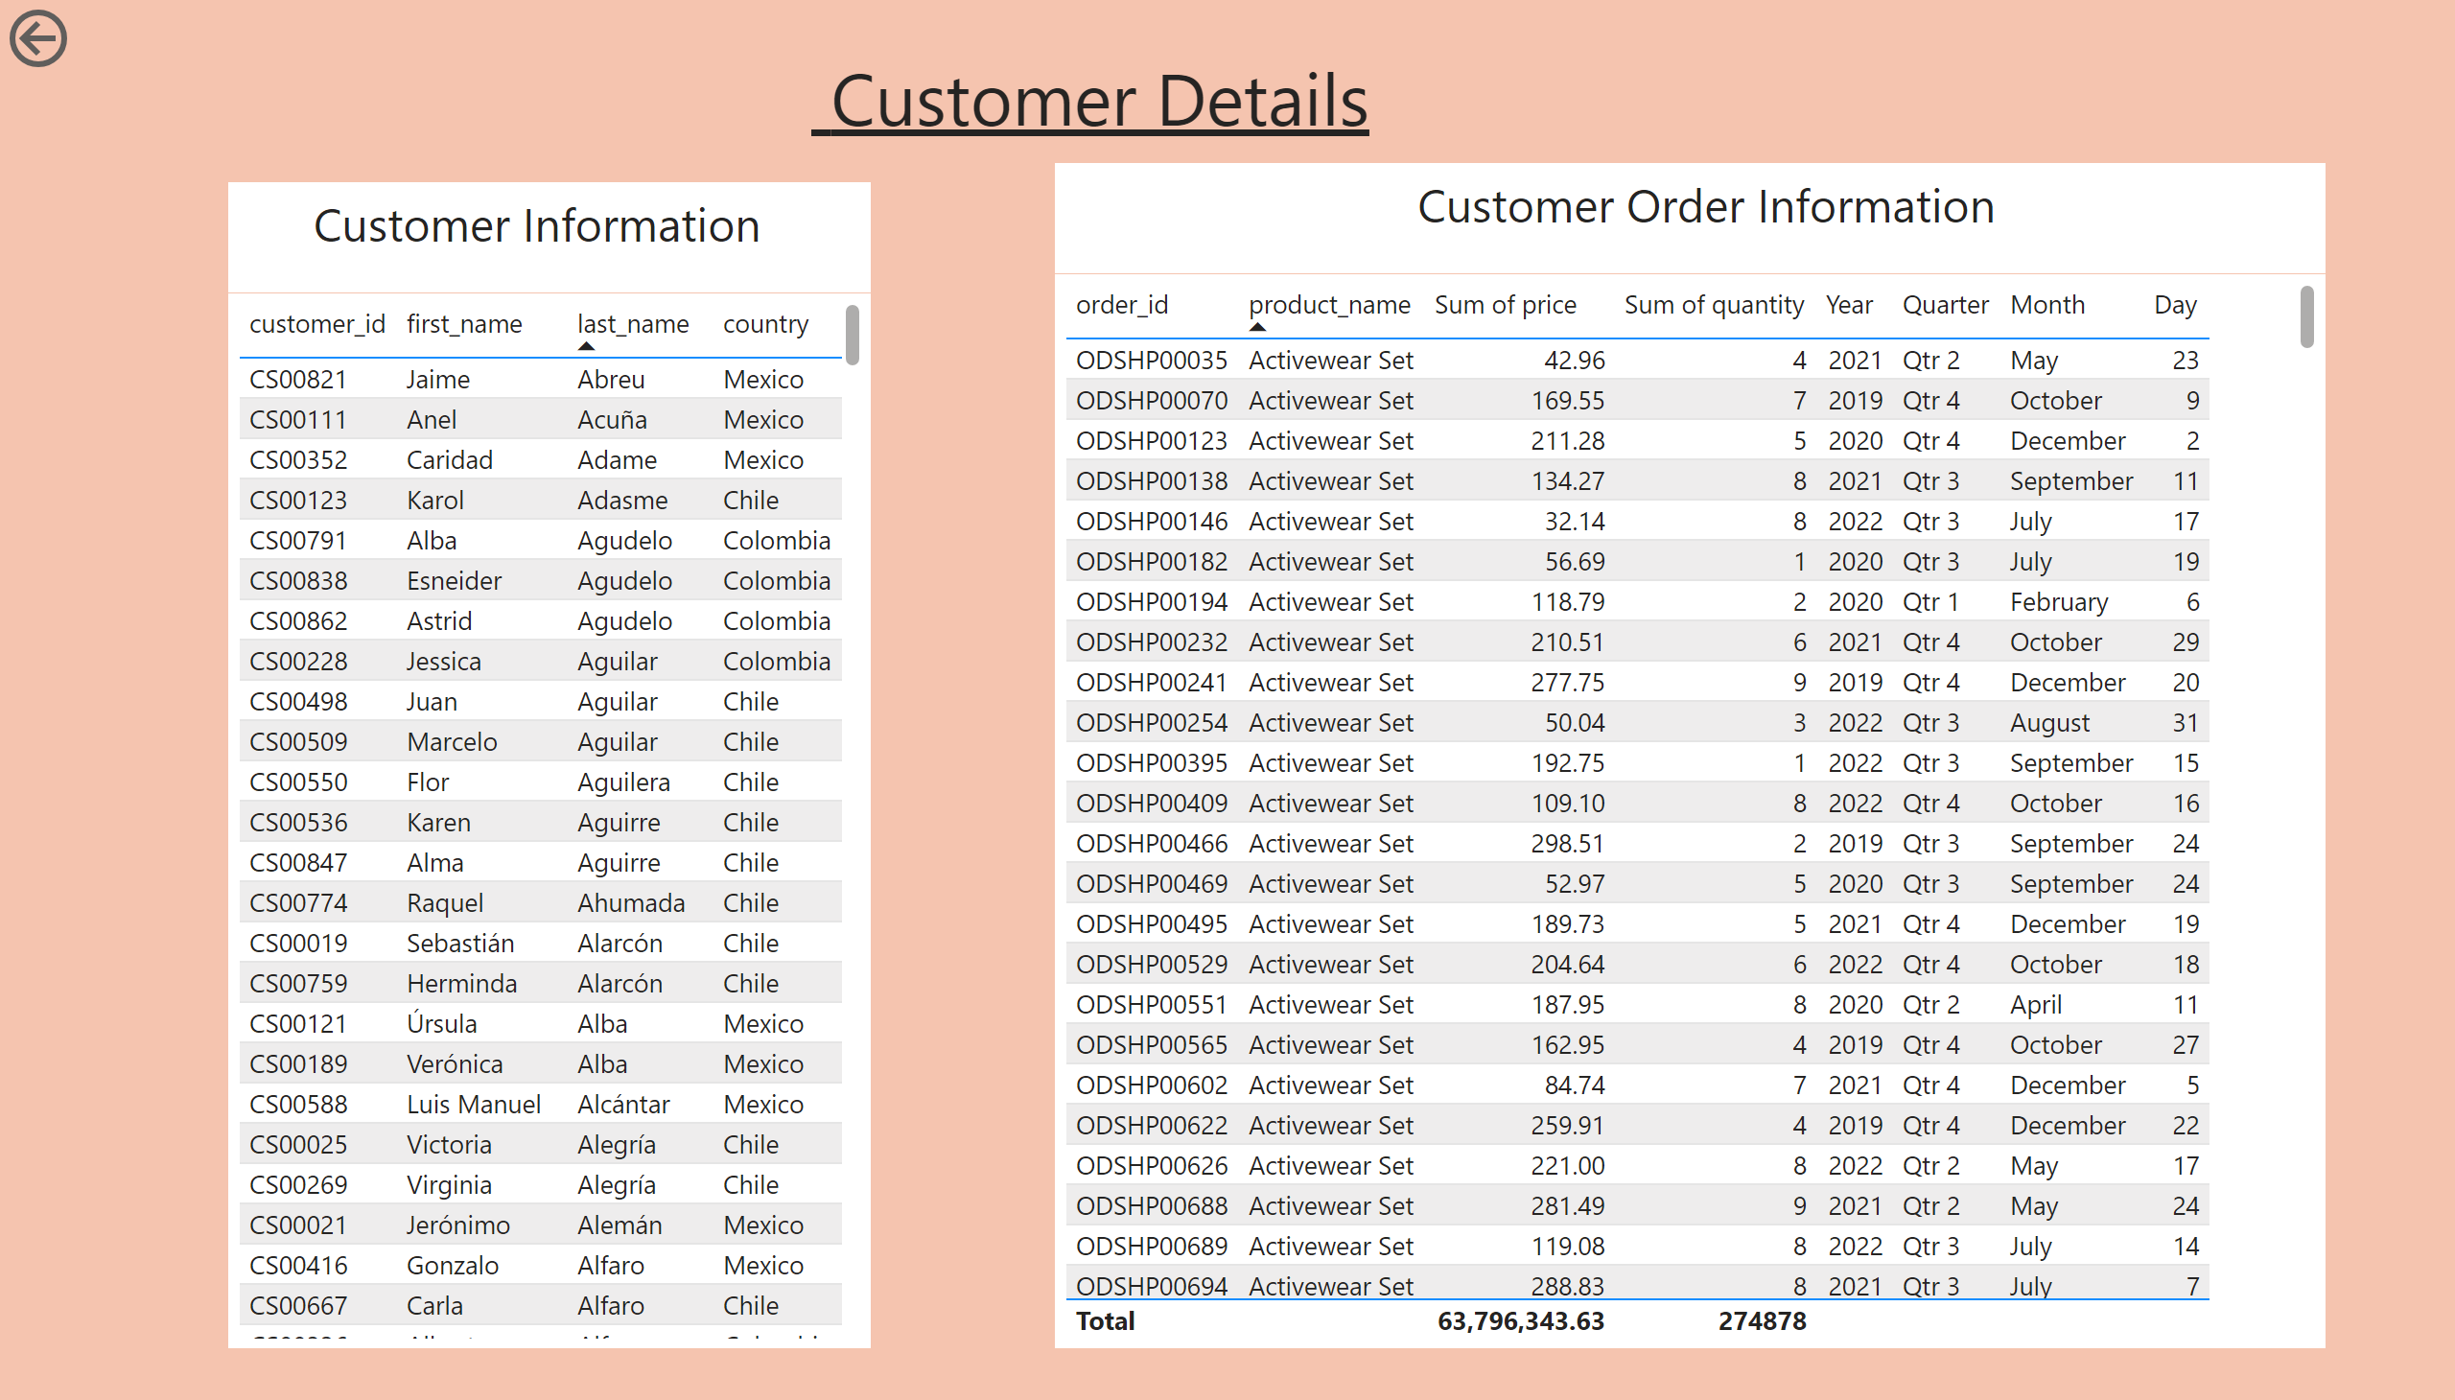
Dashboard Overview Continued
Page 2

Slide 7
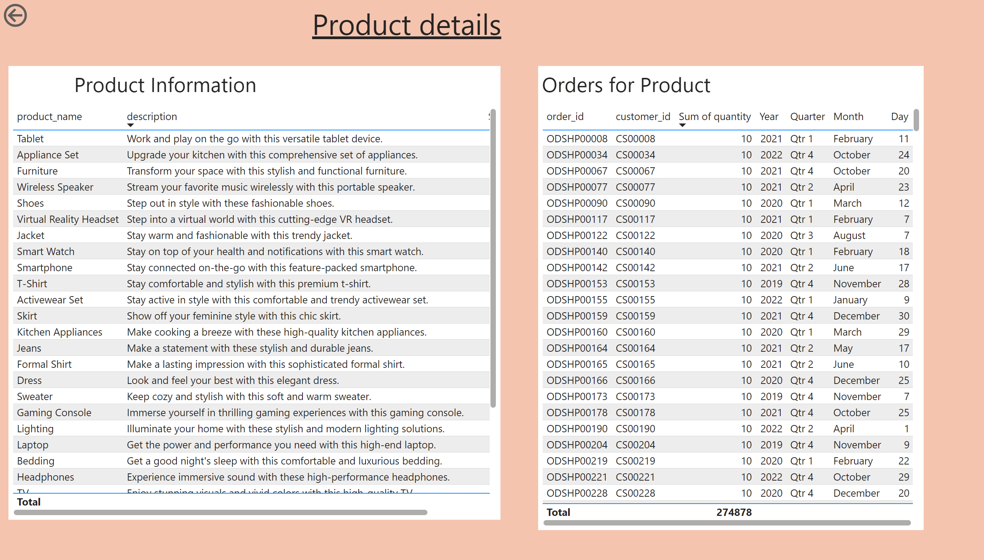
Page 3
Dashboard Overview Continued
Page 3
Notes:
tableEx
No alt text provided
tableEx
No alt text provided
actionButton
No alt text provided
textbox
No alt text provided
textbox
No alt text provided
textbox
No alt text provided

Slide 8
Breakdown of Dashboard
Total sales across the countries:
The card represent total sale of all products across the four countries from 15/08/2019 till 01/01/2023.

Slide 9
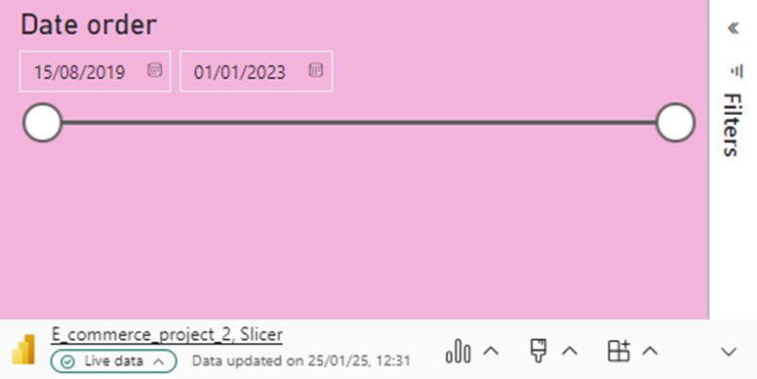
Breakdown of Dashboard
Country slicer:
Date slicer:
This slicer gives us option to view sales in specific country.
The date slicer allows us to look at the sales performance in the given time interval our data was captured.

Slide 10
Breakdown of Dashboard
Map showing total sales by country:
Using the country slicer we are able to get a view op the map the total sales of that country.

Slide 11
Breakdown of Dashboard
Total sales of each product:
The sum of sales for each product are given by figure on the left. It allows us to drill through to page 3 of the dashboard we build where the product information and orders for product.
The chart shows that home appliances have highest total sales of over 20M. Followed by Entertainment devices . Clothing made lowest sales of approximately 1.5 M.

Slide 12
Breakdown of Dashboard
Total sales distribution chart:
Table of top ten costumers by total sales:
The chart below presents distribution of sales by gender. It can be observed that males have more total sales.
The table gives top ten customers names and their total sales.
We can drill through to page 2 of dashboard to view other customer details and orders information.

Slide 13
Findings & Recommendations
Findings:
Home appliances recorded the highest total sales, exceeding 20 million.
Entertainment devices ranked second in total sales.
Clothing had the lowest sales, approximately 1.5 million.
Sales distribution by gender indicates that males have higher total sales than females.
Recommendations:
Boost Clothing Sales – Implement targeted marketing strategies, discounts, or promotions to increase clothing sales.
Leverage High-Performing Categories – Invest more in home appliances and entertainment devices to maximize profitability.
Analyze Gender-Based Preferences – Use the gender sales data to create personalized promotions that appeal to different customer groups.
Customer Engagement Strategies – Focus on retaining top customers by offering loyalty programs or personalized incentives.

Slide 14
Thank You!
&
Questions?

