Slide 1

Real Estate Resale Trends: Insights & Analysis
Mulweli Mudau

Slide 2
Introduction & Objective
Aims & objective: The objective of this research is to build a resale price dashboard using flat resale data. The dashboard provides insights and recommendations based on the data.
Outline:
Data Summary and Description.
Data processing and Transformation.
Dashboard Overview.
Breakdown of Dashboard.
Key Findings & Recommendations.

Slide 3
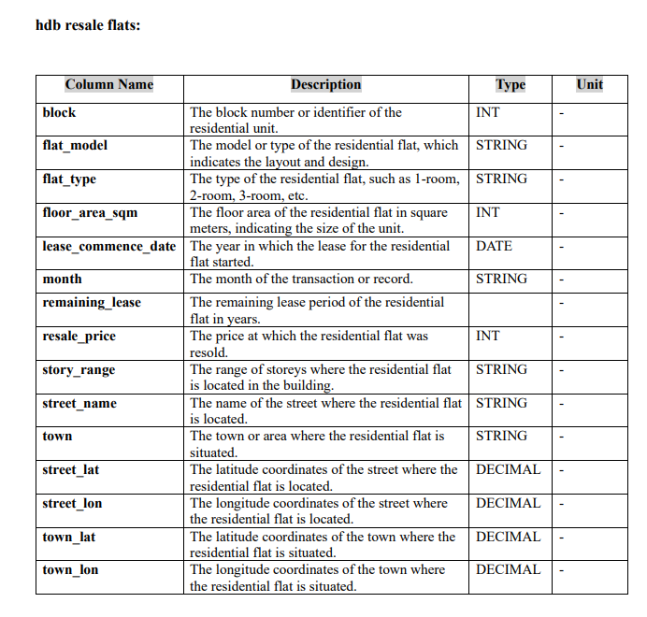
Data Summary & Description
Hdb resale flats data:

Slide 4
Data Processing & Transformation
Steps taken:
Importing file: Upload the hbd resale flats CVS file to Power BI.
Transformation:
- Promote first row to headers.
- Convert floor area square metre and resale price from string to whole number. - Change the street latitude and longitude, town latitude and longitude to from string to decimal. -Change month column from string to month format date. -Transform lease commence date from string to date format. - Delete the remaining lease columns since its empty.
Loading data: The data is loaded to the report to start building the dashboard.

Slide 5

Page 1
Dashboard Overview
Page 1:
Notes:
Sum of resale price by month
No alt text provided
Sum of resale price by town
No alt text provided
Sum of resale price by flat_type
No alt text provided
Flat Model
No alt text provided
slicer
No alt text provided
slicer
No alt text provided
Sum of resale price by town
No alt text provided
Total resales
No alt text provided
Sum of floor area sqm by flat model
No alt text provided
textbox
No alt text provided

Slide 6
Page 2
Dashboard Overview
Page 2:

Slide 7
Breakdown of Dashboard
Town Slicer:
Flat model Slicer:
The slicer above allows us to view resales of specific town.
The flat model slicer allows one to check resales based on the model of the flat.

Slide 8
Breakdown of Dashboard
Flat Type slicer:
Total resales across different estates in towns.
The slicer allows to view based on room type.
The card above gives total resales, the total sales are about 63 billion.

Slide 9
Breakdown of Dashboard
Pie Chart showing distribution floor area square metres by flat model:
The pie chart gives distribution of floor area square metres by flat model. This enables us to see which model has takes more area.
The chart shows us that Model A and Improved flat models takes more area respectively with each one being 4 metres.
There is a drill through on the chart that leads to page 2, giving information of the flat and total resales of each flat model.

Slide 10
Breakdown of Dashboard
Total sales by flat type chart:
The chart gives total sales for each flat time.
We can observe from the chart that 4 room type of flats have highest resales and 1 room type flats have lowest resales.
There is drill trough on the chat to see information of the flat and sum of resales by flat model for each flat type.

Slide 11
Breakdown of Dashboard
Total resales by town:
The chart illustrates the sum of resale price for individual towns in our data.
The chart shows that top four towns have total resales more than 4 billion, with JURONG WEST town having highest resales prices.

Slide 12
Breakdown of Dashboard
Total resales price over 12 months:
The graph gives the resale prices over different months.
From the graph we observe that resales are lowest by 2nd months with resales just over 3 billions and the resales are highest from 3rd month to 5th month and start dropping after reaching over 6 billions.

Slide 13
Key Findings & Recommendations
Key findings:
Highest resales occur in 4-room flats, while 1-room flats have the lowest demand.
Model A and Improved flats take up the most floor area, each around 4 square metres.
Jurong West has the highest resale prices, with the top four towns exceeding 4 billion in total resales.
Resales peak between the 3rd and 5th months, dropping after reaching over 6 billion.
Recommendations:
Investors should focus on 4-room flats and high-demand areas like Jurong West.
Developers should prioritize Model A & Improved flats due to their larger floor area.
Adjust pricing and marketing strategies to boost sales during low-demand months.
Policymakers should explore ways to increase demand for 1-room flats.

Slide 14
Thank You!
&
Questions ?

