Slide 1
V Care Foundations
Statement :- To implement a user-friendly and compact platform for smooth functioning of the organization.

Slide 2
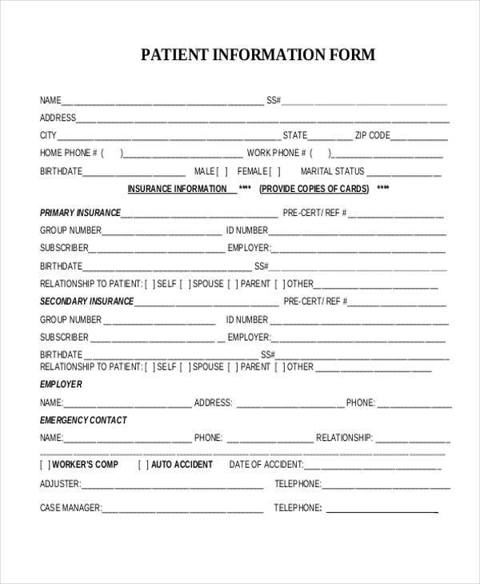

Domains Covered
Patient Setup
Details.
Application Status.

Slide 3


Volunteer Setup and Volunteer-Patient Interface.
Verification and Selection of patients.

Slide 4
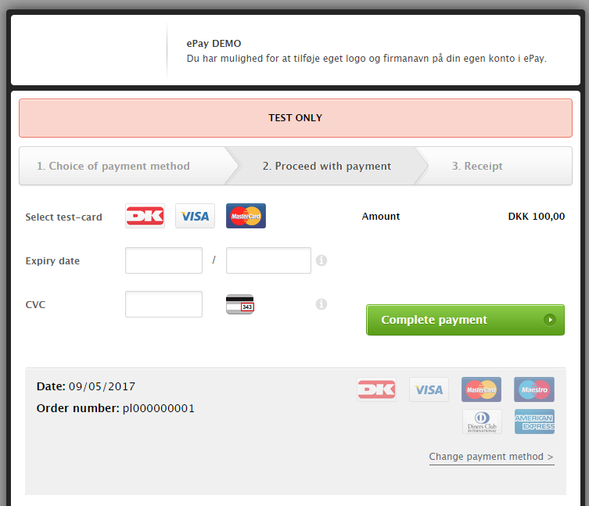

Donor Setup.
Payment window.
Money Tracking.

Slide 5



Admin Setup
Inventory Management.
Budget Allocation.
Database of all users.

Slide 6
Health Care App
Establishes an emotional connection with the patient.

Slide 7
Future Scope
Incorporate Machine Learning And AI.

