Slide 1

An Insight Into ATMA
In association with Presented by Team 6
Akash Shah
Kushal Vyas
Nidhi Singh
Chaitanya Suvarna
Sarthak Langde
Shreya Sen

Slide 2
Challenges faced by the ATMA currently

Slide 3
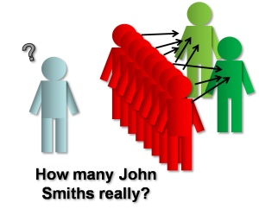

Slide 4

What is the way out?

Slide 5
Let us have an
“INSIGHT”

Slide 6
Now let us have a look at some MATH

Slide 7


1. Tracking System
BEFORE
AFTER
Make an excel sheet
and Insert data 2-6 hours
Track the required
data 1-2 hours
Sort from the
redundant data 1-2 hours
Total Time:
Upto 8-10 hours!!
Data Insertion 4 clicks away!
Data Tracking 3 clicks away!
Total Time:
8-10 minutes
MAXIMUM!!

Slide 8

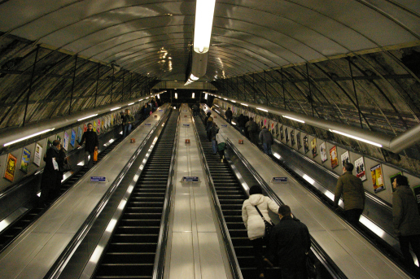
2. Volunteer Selection
BEFORE: Manual
AFTER: Automated

Slide 9

3. Statistics of the working hours
Want to earn that title??
Beat the boy who worked for 20 hours per week last month

Slide 10
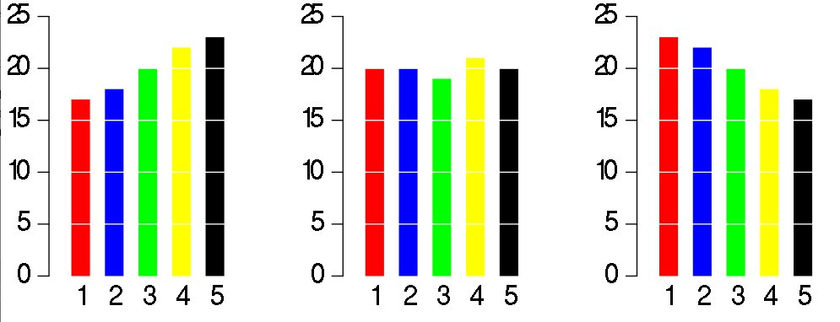
4. Survey Analysis
Get the feedback from your partner NGO about the –
Partner Manager
Volunteer
Project

Slide 11

1. ONE click information generation! 2. Lure the volunteers by glorifying them. 3. Your previous excel data won’t go waste!

Slide 12
We hope we delivered your services efficiently !
Thank You ATMA!

