Slide 1
MAKE A WISH
Team 13-Analyzers
Shreekara Udupa
Amol Jayabhaye
Aashtha Joshi
Dennis Mistry
Unma Desai
Akshayanand Raut

Slide 2
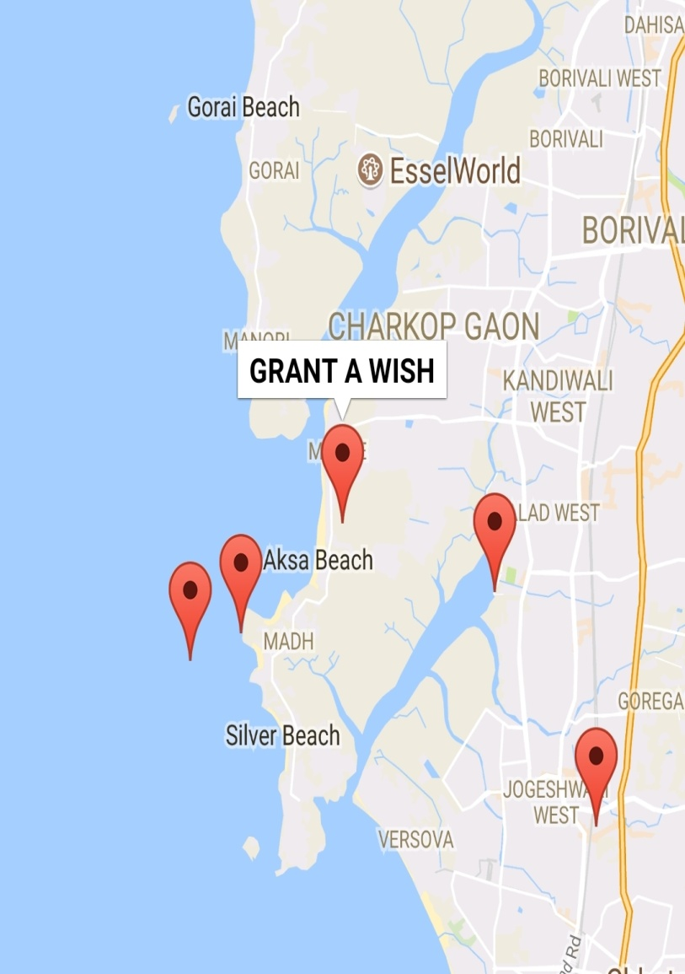
Solution
Volunteer attraction to join the social cause .
Publicizing the brand so more people can get to know about the initiative .
Scale- Create an api or library of the code and provide it to social media marketing .

Slide 3
Solution
List View of all analyzed data which will shown to donor and also an option of fiter by any specific city or according to average cost per wish .
Scale- Instant easy payment as u select a particular donor along with additional functionality to Donor .

