Slide 1

Team 3

Slide 2



Team 3
Key features of our prototype
Capture information from various stakeholder
Speech to text conversion to ease capture from volunteer
Attracting other volunteers using contacts of existing volunteers
Upload photos of fulfilled wishes

Slide 3




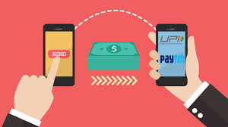
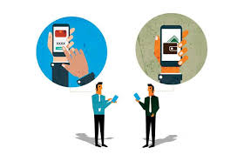
Future Scope
Reward Management
Sentiment Analysis
Payment Gateway

Slide 4


