Slide 1
Welcome To Our Presentation

Slide 2
Topic: Pandemic Covid-19 in Bangladesh
Group Members:
Huray Jannat Dipty 172-15-9720
Md Tarikul Aziz 172-15-9721
Bhaskar Majumdar 172-15-9988
Mumenunnessa Keya 172-15-10100

Slide 3
What is COVID-19:
COVID -19 is an infectious disease caused by the recently found virus known as SARS-COV-2 (or coronavirus). Before the outbreak originated in Wuhan, China on December 2019, there was no information about this virus.

Slide 4
About COVID-19:
'CO' stands for corona, 'VI' for virus, and 'D' for disease. Formerly, this disease was referred to as '2019 novel coronavirus' or '2019-nCoV.' The COVID-19 virus is a new virus linked to the same family of viruses as Severe Acute Respiratory Syndrome (SARS) and some types of common cold.It was initially reported to the WHO on December 31, 2019. On January 30, 2020, the WHO declared the COVID-19 outbreak a global health emergency. On March 11, 2020, the WHO declared COVID-19 a global pandemic, its first such designation since declaring H1N1 influenza a pandemic in 2009.

Slide 5
Symptoms of COVID-19
High Fever: The body temperature can exceed 37.3 celsius degrees or 99 Fahrenheit degrees.
Tiredness: The body feels completely tired and without energy to perform normal tasks.
Dry Cough: Irritation and constant coughing without expelling any mucus.

Slide 6
How It Can Be Spread
People: This disease can spread from person to person through small droplets from the nose or the mouth when the infected person coughs or exales.
Surfaces: This smalldroplets land on surfaces. Which means any person that touches these surface and then their eyes, nose or mouth can be infected.

Slide 7
Parpose Of The Project
The main focus of this project is about online system for monitoring Pandemic Covid-19 in Bangladesh satiation. In this System user puts his or her own user-name, email, phone no , syndrome and there personal comments.

Slide 8
Methodology
After submitting the information data it will be stored in database and we can find easily who is sick or who is well. Using our system we can know or learn easily about Corona and its symptoms and its protected way. It’ll provide the basic information about the infection and how it spread.

Slide 9

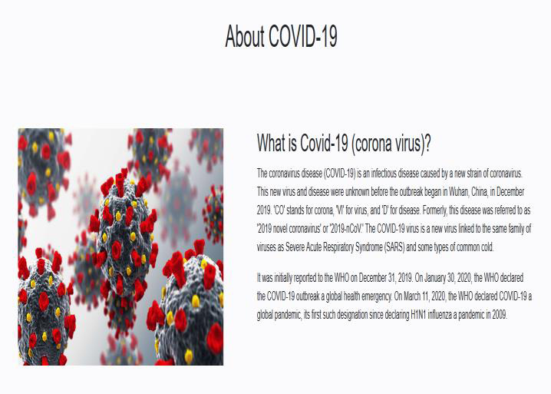
Here Are Some Screen Shots

Slide 10
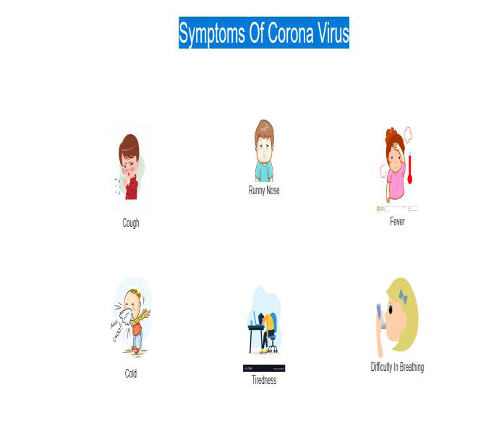
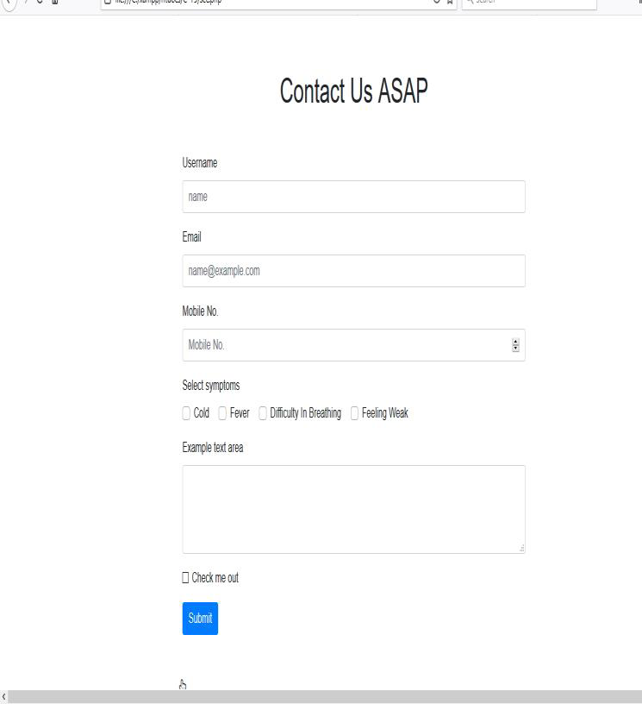

Slide 11
Tools And Technologies:
Html,
Css,
Php,
MySql database,
VS code,
Sublime Text,
Xampp,
Client server is Web browser.

Slide 12
Conclusion
user can know our current update of corona virus like- Infected Patient In Whole World, Active Covid Case In Bangladesh, Cured/Discharged Case In Bangladesh, Death Case In Bangladesh. Then user can learn about corona virus and its short history. Next user can learn about the symptoms of Corona virus. Then user can know few prevention against Corona virus. At last part user can gives his own name, email, phone no, select symptoms and his own comments.

Slide 13
Thank you

