Slide 1

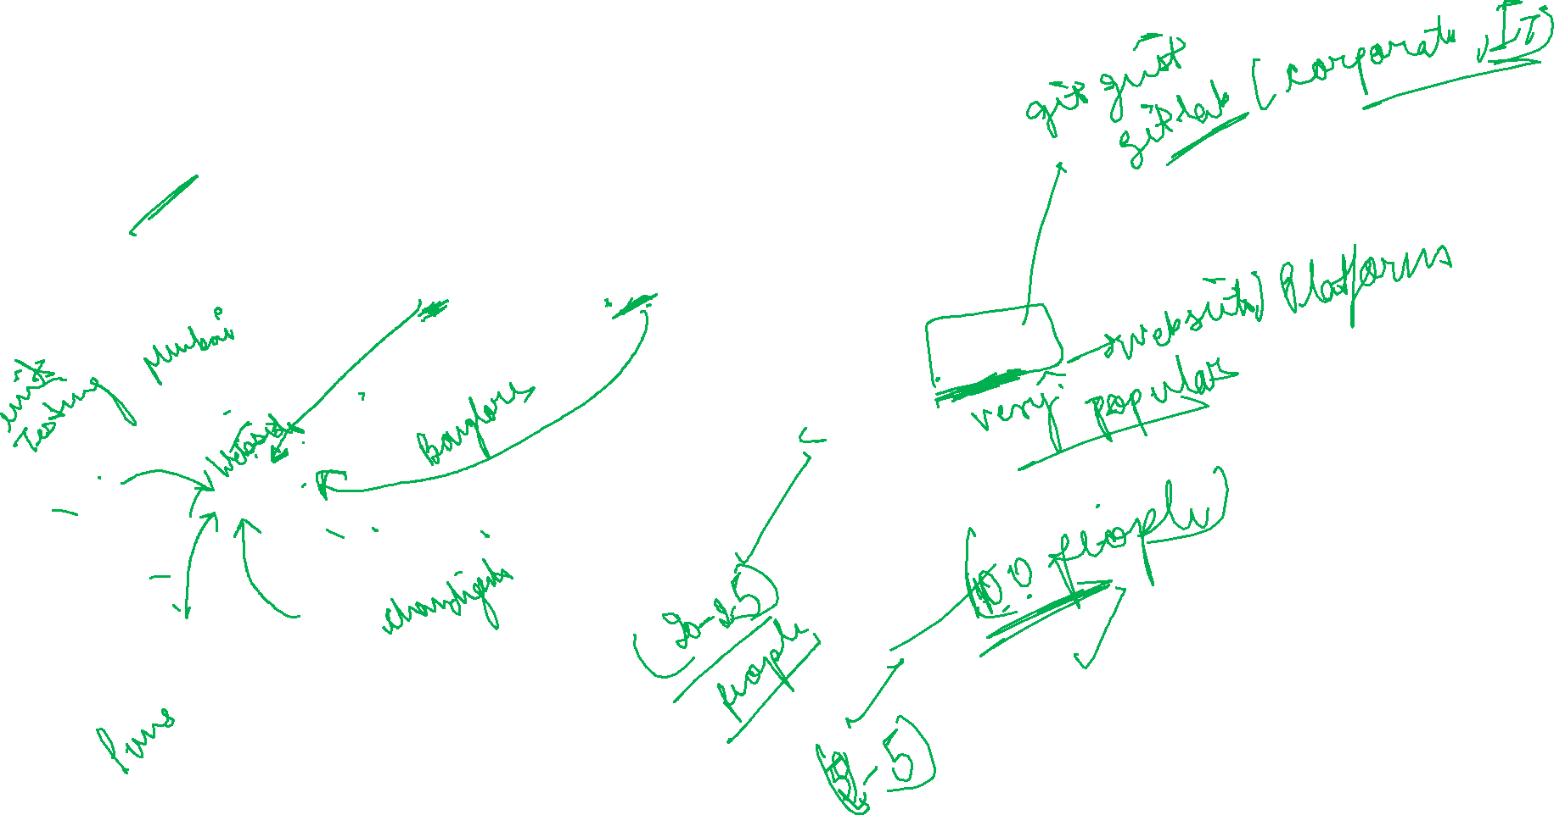
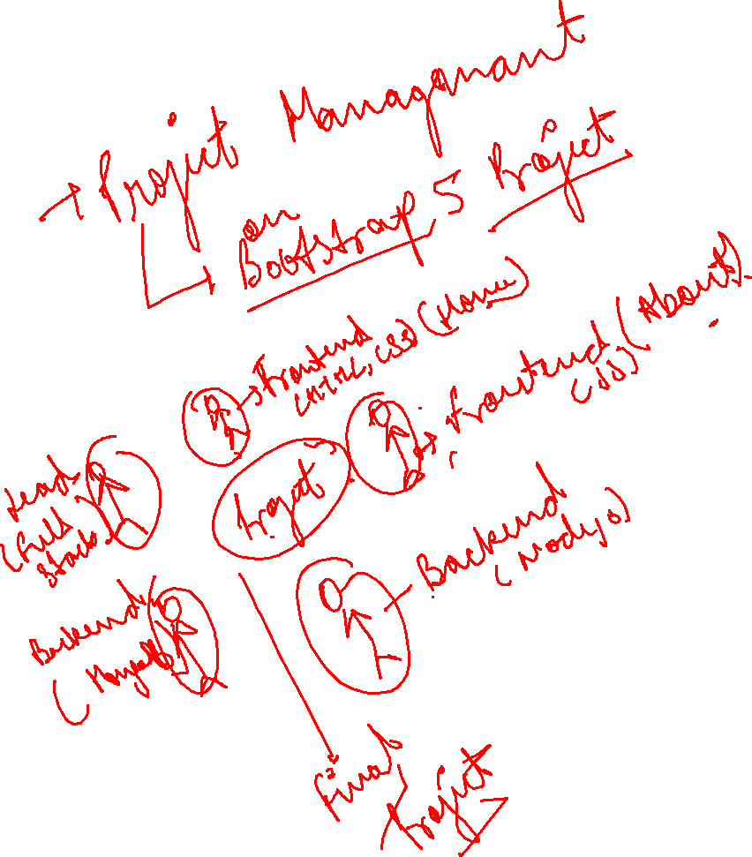

Today’s Agenda
Git and GitHub

Slide 2
What is Git and GitHub?
It is a open-source solution.
Git is a version control system that lets you manage and keep track of your source code history.
GitHub is a cloud-based hosting service that lets you manage Git repositories
GitHub is a code hosting platform for version control and collaboration. It lets you and others work together on projects from anywhere. It includes GitHub essentials like repositories, branches, commits, push and pull requests.

Slide 3
Setup GitHub
Create an account on Github: https://github.com/
Install Git: https://git-scm.com/downloads
Create a repository on GitHub.
Add you local code to GitHub, using git bash (Commands are already mentioned on the page, when you create a repository).
Documentation: https://docs.github.com/en/get-started/getting-started-with-git/setting-your-username-in-git

