Slide 1

Today’s Agenda
Axios

Slide 2
Asynchronous
Functions running in parallel with other functions are called asynchronous
Ways to make JavaScript Asynchronous
Callbacks
Promises
Async/await

Slide 3
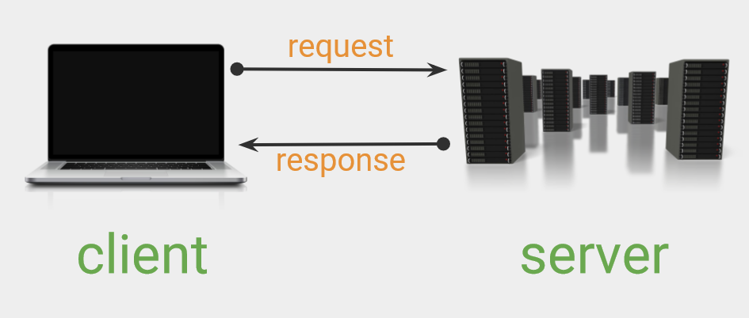

Slide 4
Axios
Axios is a modern, Promise-based HTTP client library.
This means that Axios is used to send an HTTP request and handle their responses, all using JavaScript's promises.
Axios supports both Node.js and JavaScript in the browser.

