Slide 1

Welcome to
New age upskilling platform for high growth careers
By Urvshi Singla

Slide 2
Session Agenda
Semantic vs non-semantic
Link
Lists
Tables
Form Elememts

Slide 3
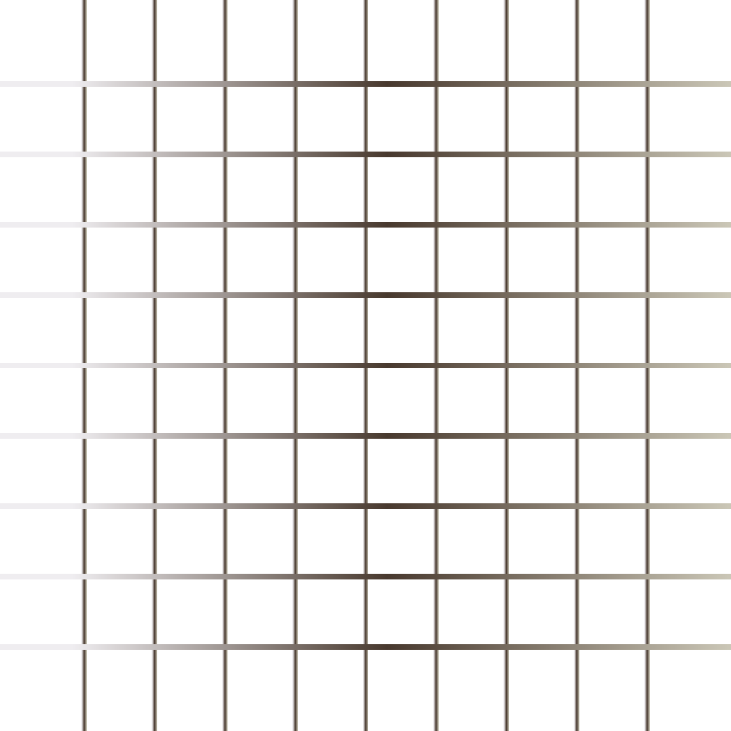
Semantic & Non-Semantic
Semantic elements describe the meaning of the element and content. e.g.
<header>: Introductory content e.g. set of navigation links
<footer>: Define the footer section containing copyright, social media links, sitemap, etc.
<section>: Defines a section of a document.
<nav>: It define the navigation links.
Non-Semantic elements define nothing about the content. e.g.
div: tag is used to define division/section in an HTML document. It is used as a container for HTML elements. Any sort of content can be added in the div tag.
span: tag is an inline container to mark up a part of the text of document.

Slide 4
Links
HTML links are hyperlinks. You can click on a link and jump to another document.
When you move the mouse over a link, the mouse arrow will turn into a little hand. Links are found in nearly all web pages. Links allow users to click their way from page to page
Links are appear as follows in browser:
An unvisited link is underlined and blue
A visited link is underlined and purple
An active link is underlined and red

Slide 5
Lists, block & Inline
Lists
We group related data into list on web browser.
There are three types of list:
Unordered List
Ordered List
Description List
Block & Inline Elements

Slide 6
Tables
HTML tables allow us to organize data into rows and columns.
tr: define each row
td: define each table cell/ they are data containers
th: define the table header
caption: Use the HTML <caption> element to define a table caption

Slide 7
Forms
Forms is used to collect user input.
Form Elements: label input, select, option, textarea, button, fieldset, legend.
Form Attributes: method, target, action

Slide 8
Q & A

Slide 9
Thank You

