Slide 1

Welcome to
New age upskilling platform for high growth careers
By Urvshi Singla

Slide 2
Session Agenda
Position
Animation
Transform
Transition

Slide 3

Position
The position property specifies the type of positioning method used for an element.
There are five different position values:
static
relative
fixed
absolute
sticky

Slide 4
Animations
CSS allows animation of HTML elements without using JavaScript.
An animation lets an element gradually change from one style to another.
You can change as many CSS properties you want, as many times as you want.
To use CSS animation, you must first specify some keyframes for the animation.
Animation Properties: animation-name animation-duration animation-timing-function animation-delay animation-iteration-count animation-direction

Slide 5
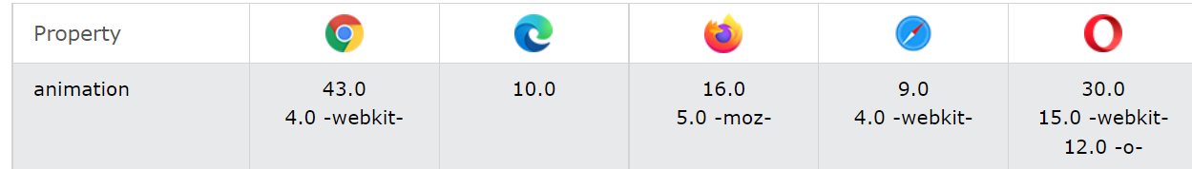
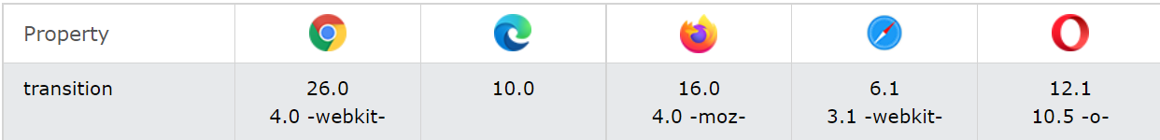
Browser Support

Slide 6
Transitions
CSS transitions allows you to change property values smoothly, over a given duration.
transition
transition-delay
transition-duration
transition-property
transition-timing-function

Slide 7
Browser Support

Slide 8
Transform (2D)
CSS transforms allow you to move, rotate, scale, and skew elements.
Following 2D transform methods:
translate()
rotate()
scaleX()
scaleY()
scale()
skewX()
skewY()
skew()
matrix()

Slide 9
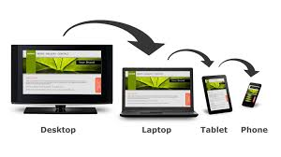
Responsive Design
What is responsive website?
Viewport
How to use media query
How to make images responsive

Slide 10
How to use media query?
Media query is a CSS technique introduced in CSS3.
It uses the @media rule to include a block of CSS properties only if a certain
condition is true.
Mobile First means designing for mobile before designing for desktop or any other device (This will make the page display faster on smaller devices).
This means that we must make some changes in our CSS.

Slide 11
What is responsive website?
Responsive web design makes your web page look good on all devices.
Responsive web design uses only HTML and CSS.
Responsive web design is not a program or a JavaScript.
Viewport
The viewport is the user's visible area of a web page.
The viewport varies with the device, and than on a computer screen. will be smaller on a mobile phone
Before tablets and mobile phones, web pages were designed only for computer screens, and it was common for web pages to have a static design and a fixed size.

Slide 12
Q & A

Slide 13
Thank You

