Slide 1
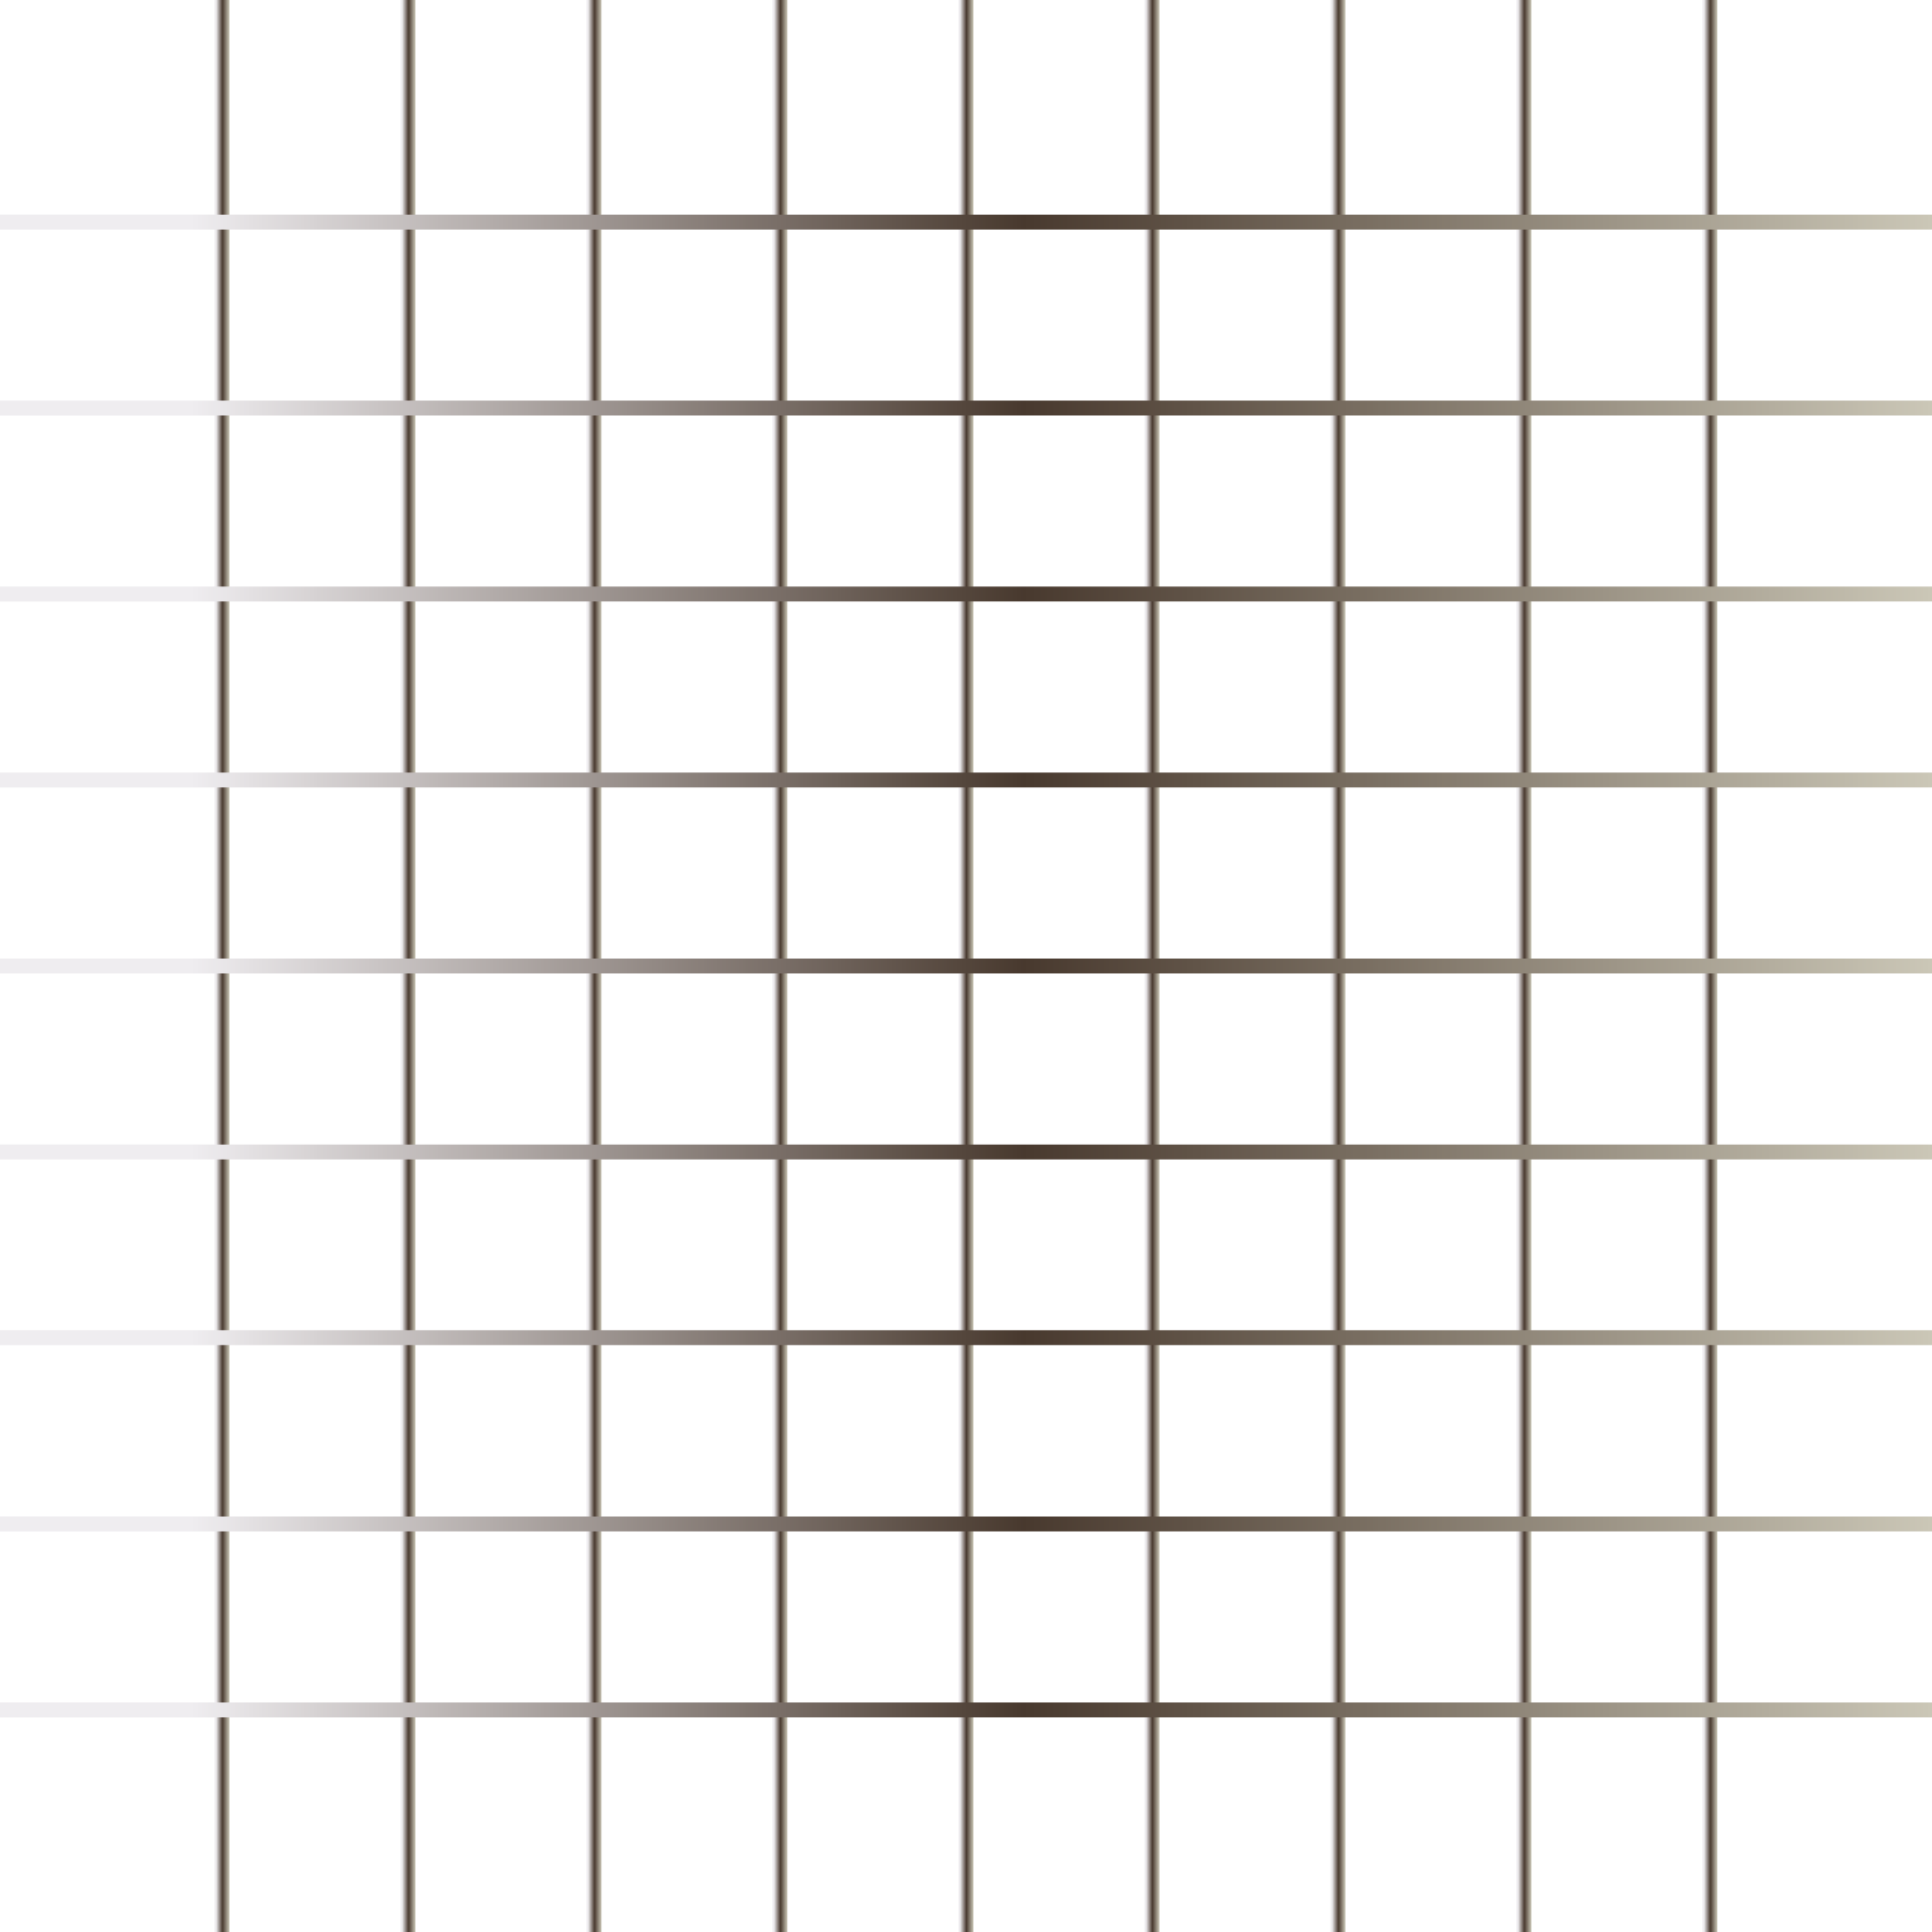
Today’s Agenda
Manipulation
Selectors
Events

Slide 2
Selectors
getElementById
getElementsByClassname
getElementsByTagName
Query Selectors

Slide 3
Creating and adding elements
We can insert html element and attribute through js using DOM methods
ClassList

Slide 4
JavaScript- Events
An HTML event can be something the browser does, or something a user does.
Event handlers and Event Listener.
To assign events to HTML elements you can use event attributes.
Event handlers can be used to handle and verify user input, user actions, and browser actions.
DOM Event Property + addEventListener

Slide 5
JavaScript- Events
Mouse Events
Keyboard Events: keyup, keydown, keypressed.
Form Events: onChange, onInput, onFocus, onBlur, onSubmit.
Default Behaviour, e.preventDefault()

Slide 6
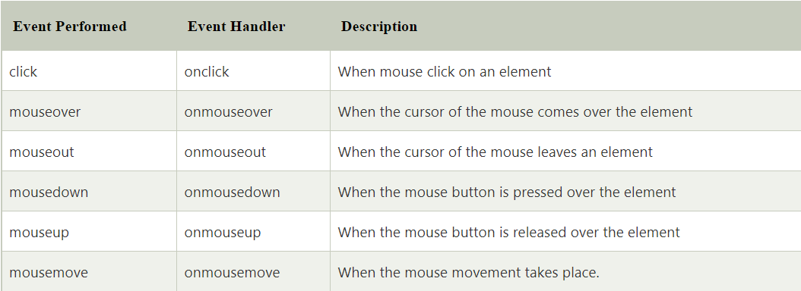
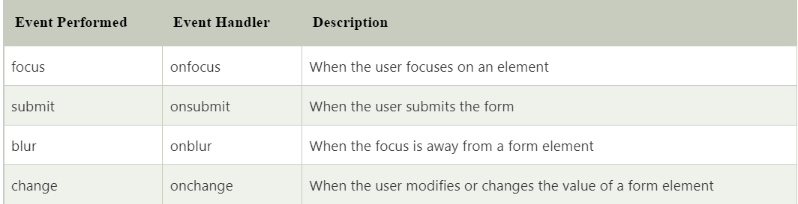
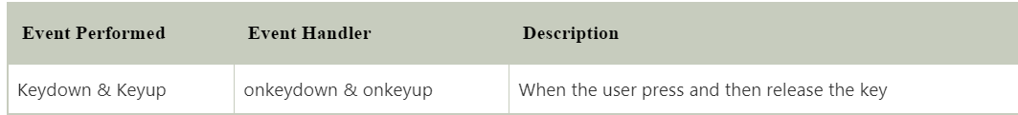
JavaScript- Events

