Slide 1
Movie Analysis Project.
Movie Data Analysis for Microsoft.

Slide 2
Summary
This project provides information to help Microsoft start a new movie studio.
It explores various aspects of the movie industry to provide insights of the perfomance of different genres and give out strategies on how to perform well a a starter movie studio.

Slide 3
Outline
Business Problem
Data
Methods
Results
Conclusions

Slide 4
Business Problem
The movie industry is highly competitive and for a new studio entering the industry, there are challenges that it is going to face. Microsoft is a huge brand and it would not have a hard timepromoting its content. However, it does not have the insights to understand the trends and preferences onhow to be successful studio in this industry. Microsoft needs enough insights on how to effectivelr target and engage the target audience.

Slide 5
Data
There are 3 datasets used for this analysis.
Title basics which show the movie titles.
Title ratings which shows the movie title ratings.
Box office movies with foreign and domestic gross.

Slide 6
Methods
Loaded the data sets and cleaned them separately. Checked for duplicated values and missing values and got rid of them if there were any. After, merged the datasets to gain a comprehensive understanding of the industry landscape.
For exploratory data analysis, performed statistical analysis to identify patterns, trends and correlation within the merged dataset. Data visualization with different graphs to show different relationships of the factors to consider in the movie industry.

Slide 7
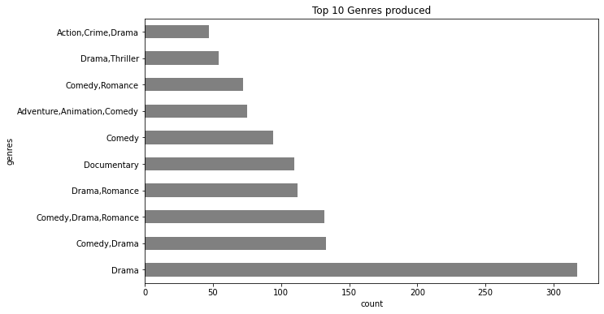
The graph below shows which genres are the most produced in the movie industry. This shows Drama is the genre that is appreciated more by the general audience.

Slide 8
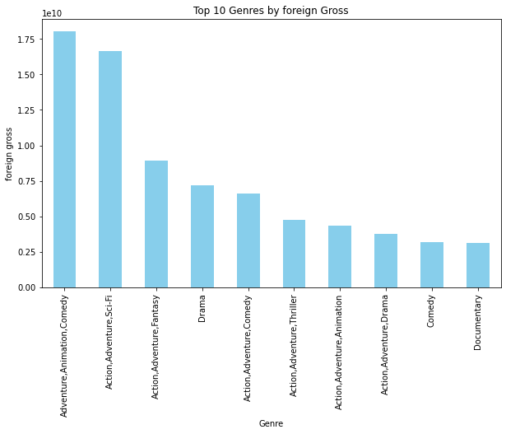
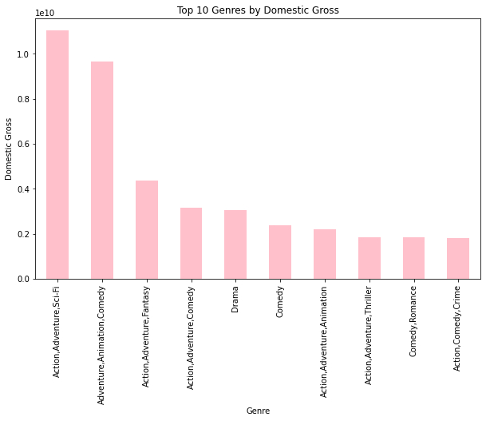
The 2 graphs below show the relationship between the top 10 genres produced between the domestic and foreign gross
Adventure, Animation, Comedy seems to provide the highest foreign gross.
Action,Adventure,Sci-Fi provides the highest foreign gross

Slide 9
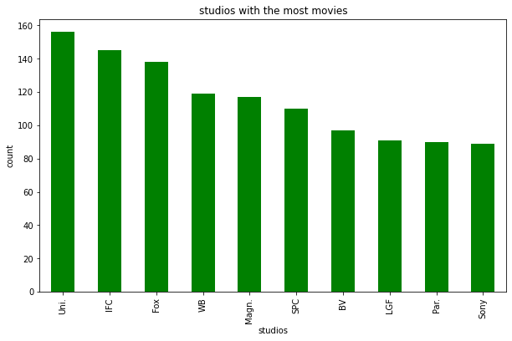
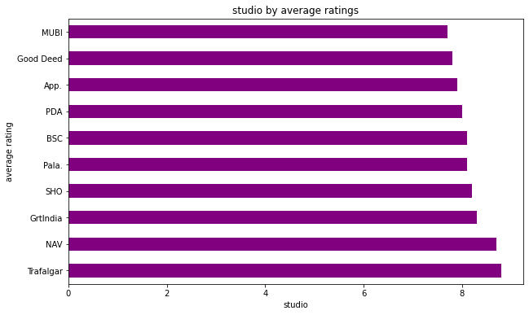
The below graphs shows the studios which produce the most movies, and the studios which have movies with the highest average ratings. Shows which studios are the biggest competitors in the industry.
Studios which produce the most movies
Studios with the highest average ratings.

Slide 10
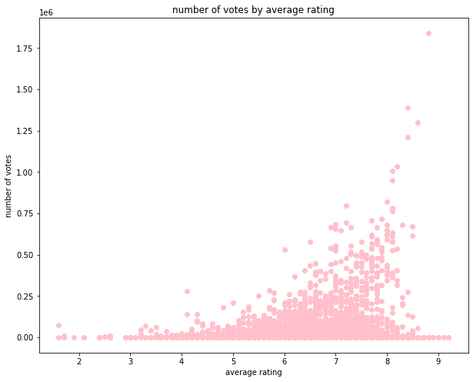
This graph shows the relationship between the number of votes and the average rating. The higher the average rating, the higher the number of votes which means a larger audience watches the genres with a high average rating.

Slide 11
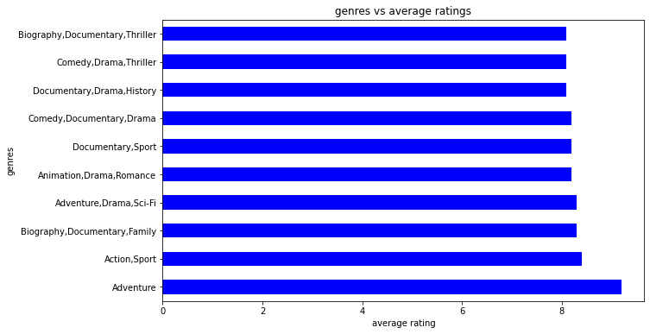
Adventure is the genre with a high average rating. From the graph before, we established that the higher the rating, the higher the number of votes. It would be advisable to assume Adventure reaches out to a larger audience.

Slide 12
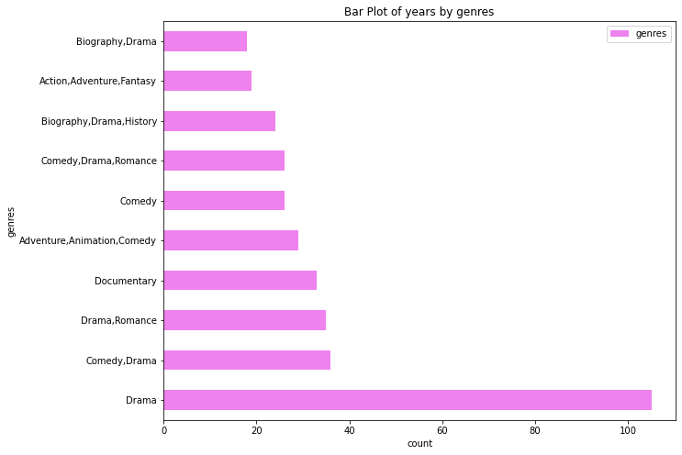
Graph that shows the most produced genres in the years [2018,2017,2016]

Slide 13
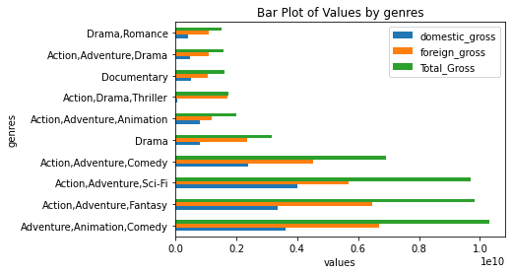
Relationship between the genres that were most produced in the years [2018,2017,2016] and the foreign, domestic and total gross made.

Slide 14
Conclusions
From the analysis done, Drama, [Adventure, Animation,Comedy], Adventure and [Action,Adventure, Sci-Fi] are the genres that would be advisable to start producing for a starter movie studio.
Drama since it is the genre that is watched a lot, [Adventure,Animation,Comedy] since it generates the most foreign gross, Adventure since it is assumed to reach a larger audience and [Action,Adventure,Sci-Fi] is the genre that generates the most domestic gross.

Slide 15
The average foreign gross is 54753156 and the average domestic gross is 30457073.
Microsoft should aim to generate the above amount when producing movies that would stream within and outside the country.
The average runtime for movies is 106 minutes.
The most watched genres in the years [2018,2017,2016] is Drama and the genre that generated the most foreign and domestic gross in the past years mentioned is [Adventure, Animation, Comedy].

Slide 16
Recommendations.
Check out for insights and strategies that the studios which produce the most genres and which have the highest average ratings.
Instead of competing with these studios, Microsoft could focus on a niche genre ,targeting the audience which have unique preferences, in this case, Adventure and genres that are generate the most foreign gross.
It could also considering partnering with the studio that has movies with the highest average ratings.
It should also focus on producing quality movies over a lot of movies with poor quality, that is the runtime should be an average of 106 minutes.
Microsoft should also produce genres that are trending lately, genres produced in the years [2018,2017,2016].

Slide 17
For future improvement, Microsoft should stay informed about technology advancements and industry trends. It should also foster a continuous adaptation , innovation and learning within the studio.

Slide 18
Thank You!
Email: mualukomumo@email.com
GitHub: Mumo001

