Slide 1

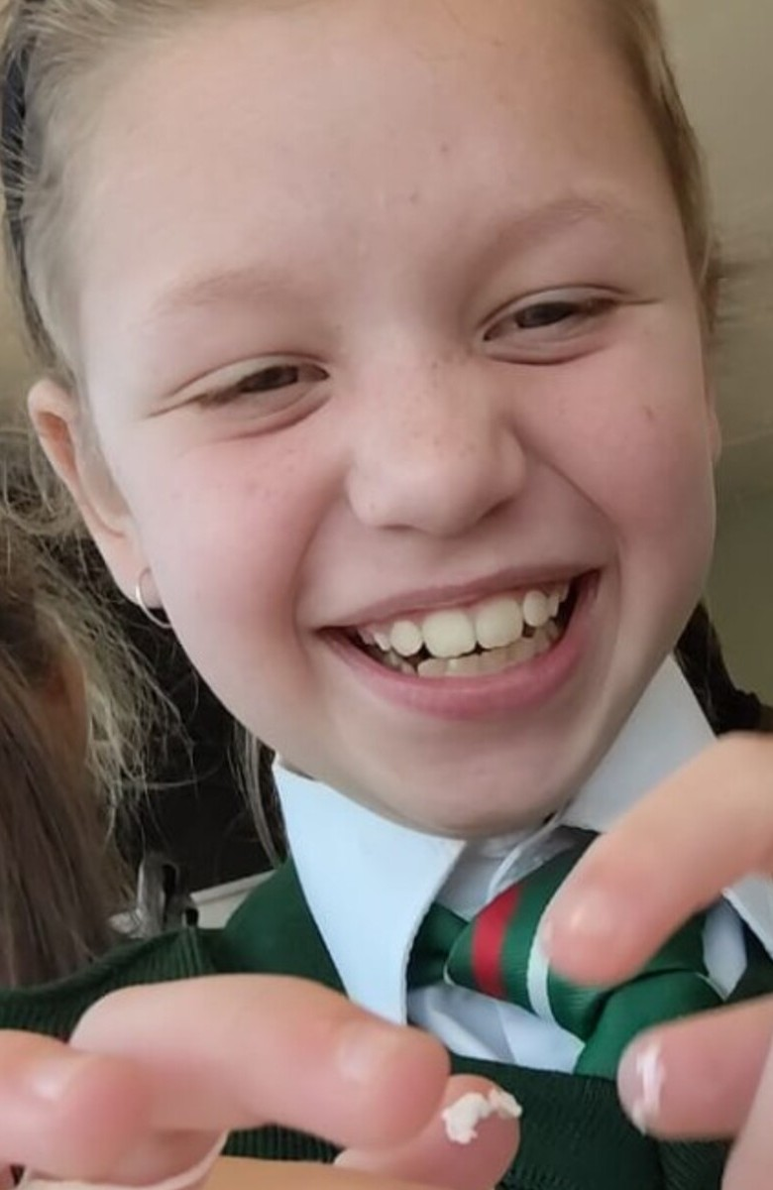
PANORAMA PRIMARY SCHOOL
MY SOUTH AFRICAN HERO
Natalie
du Toit
Presented by Luchelle Crafford
GRADE 3A1 • PANORAMA PRIMARY SCHOOL
01 / 07
Notes:
Good day everyone. My South African hero is Natalie du Toit.

Slide 2
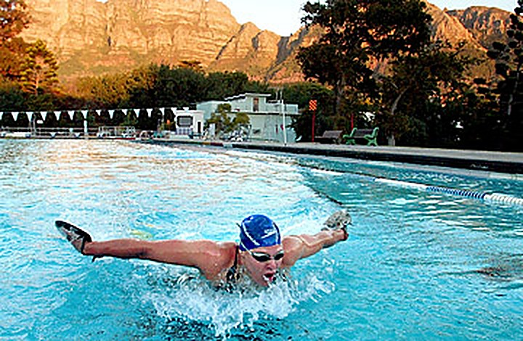
MEET MY HERO
A swimmer from
Cape Town
★
Born in Cape Town
≈
Loved swimming from a young age
TRAINING IN CAPE TOWN
✓
Became a famous South African swimmer
02 / 07
Notes:
Natalie is a famous South African swimmer. She was born in Cape Town and loved swimming from a young age.

Slide 3
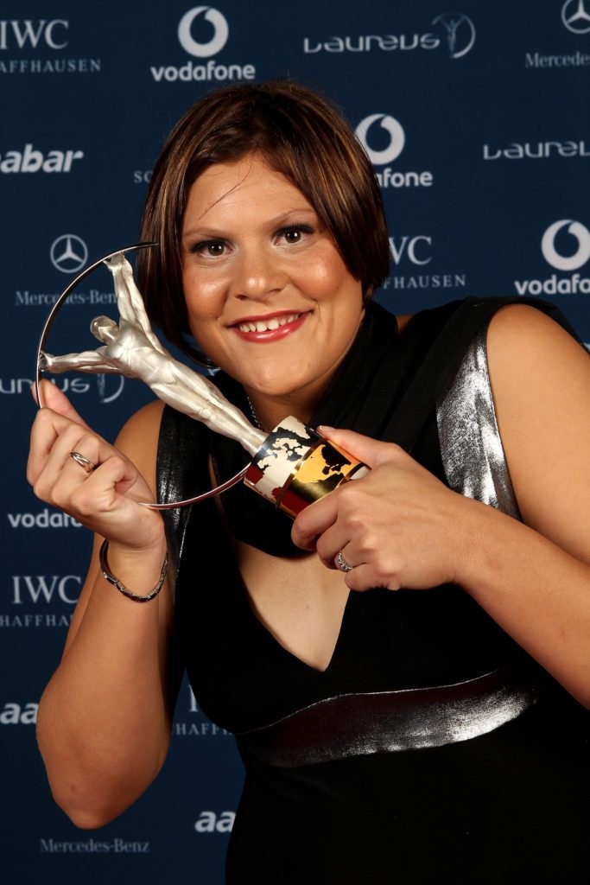
A serious scooter accident changed her life.
17
Doctors had to amputate her left leg.
YEARS OLD
BRAVE
DID NOT GIVE UP
Natalie with her Laureus award
03 / 07
Notes:
When Natalie was 17 years old, she was involved in a serious scooter accident. Doctors had to amputate her left leg. That could have stopped her from following her dreams. However, she was brave and did not give up.

Slide 4
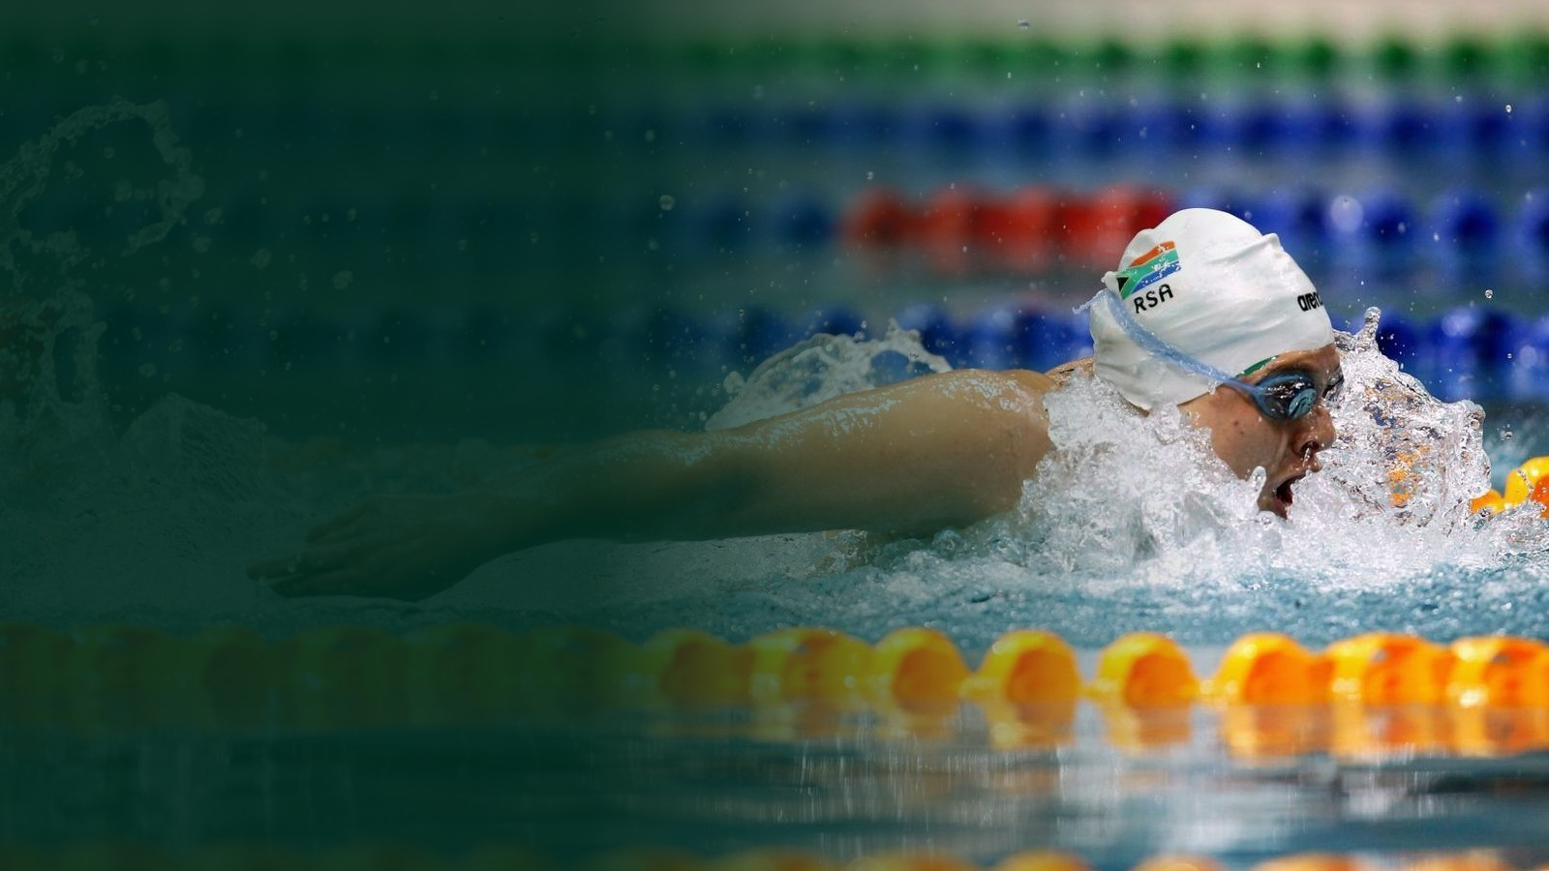
COURAGE IN ACTION
She chose to
start again.
She worked hard every day
and returned to the pool.
04 / 07
Notes:
Natalie worked hard every day and started swimming again. She became a champion Paralympic swimmer. She even competed against swimmers without disabilities.

Slide 5
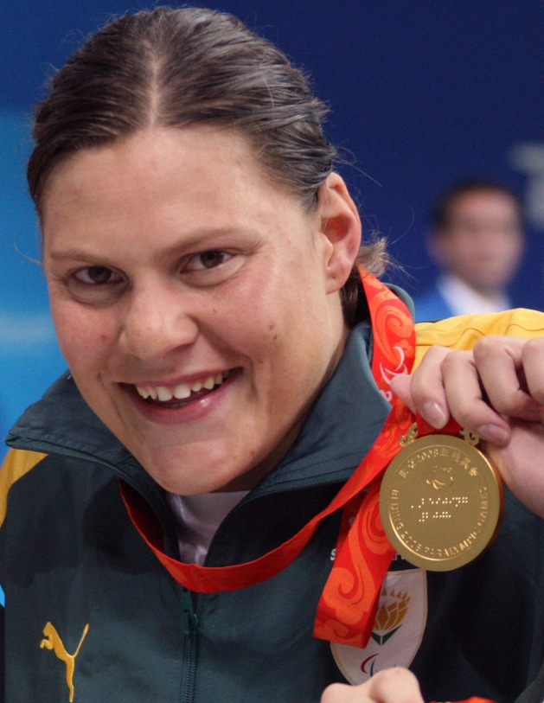
2008
OLYMPIC GAMES
BEIJING
She represented
South Africa.
BEIJING 2008 • GOLD MEDAL
05 / 07
Notes:
Natalie represented South Africa at the 2008 Olympic Games in Beijing. She competed in the 10-kilometre open-water race and showed that courage can take you further than anyone expects.

Slide 6
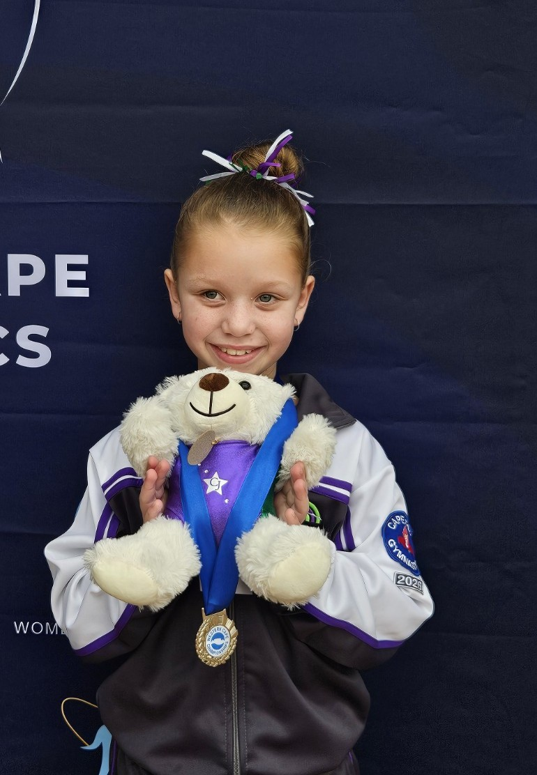
JUST LIKE MY HERO, I KEEP GOING
Why she is my hero
She was a great swimmer.
Most importantly,
she never gave up.
Luchelle with her gymnastics medal
06 / 07
Notes:
I chose Natalie du Toit as my South African hero because she was a great swimmer, but more importantly, she never gave up on her dream. Her story makes me feel proud. She showed the world what a South African can achieve with courage and hard work.

Slide 7
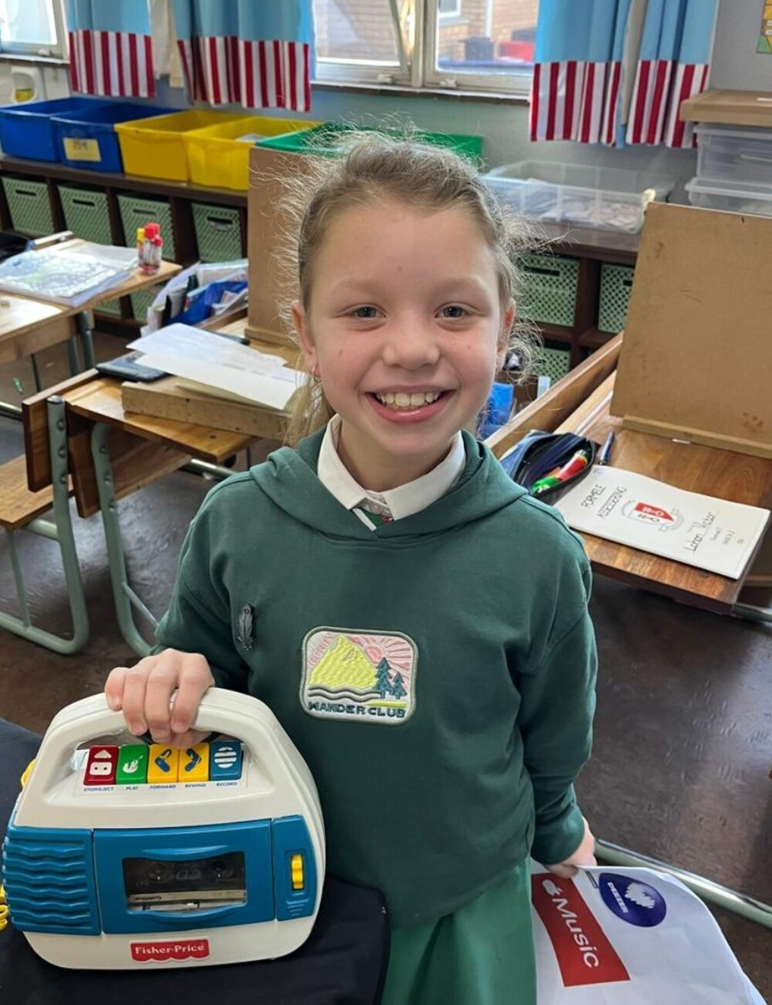
PANORAMA PRIMARY SCHOOL
Natalie taught me to…
✓
KEEP TRYING
✓
BELIEVE IN MYSELF
✓
WORK HARD
✓
NEVER GIVE UP
“You inspire me to never give up
on my dreams.”
LUCHELLE • GRADE 3A1
07 / 07
Notes:
Natalie taught me that when something difficult happens, I must keep trying, believe in myself, work hard, and never give up. If Natalie were standing in front of me today, I would say: Natalie, you are a great swimmer, and you inspire me to never give up on my dreams. Thank you for listening.
SOURCES (facts verified 1 September 2026): Encyclopaedia Britannica - Natalie du Toit (britannica.com/biography/Natalie-du-Toit); ESPN/AP, 3 May 2008 (espn.com/olympics/swimming/news/story?id=3379722); The Independent - 'If I can achieve a dream, then anyone can'; Paralympic.org - The day Natalie du Toit made Olympic history. IMAGE CREDITS: Beijing 2008 medal photo - Heath Campanaro / Australian Paralympic Committee, via Wikimedia Commons, CC BY-SA 3.0; swimming photo via Commonwealth Sport; Cape Town training photo and Laureus photo via swimhistory.co.za; school crest - Panorama Primary School (panoramaps.co.za); photographs of Luchelle supplied by the Crafford family.

