Slide 1
Lab Project on Inventory Management Course Title: DATABASE SYSTEMS Course Code: 414 by
Mumtahina Ahmed- 16701067
Esrat Arisha Ema - 16701045
Safayet Hossain - 16701012
Fakrul Islam Rubel - 16701005
Shahriar Sadik - 16701065

Slide 2
Inventory Management :
Inventory management is a system for
tracking different inventories, their amounts, other related information and sales details of products .
Companies use inventory management software to avoid product overstock and outages. It is a tool for organizing inventory data that before was generally stored in hard-copy form or in spreadsheets.

Slide 3
Inventory Management Tools are useful for A company's management team and additionally for customers also.
Customers can easily search for their required inventories , get necessary information. They can also deal with a product’s review.
In this project “Inventory Management” we have created a simplified version of these tools.

Slide 4
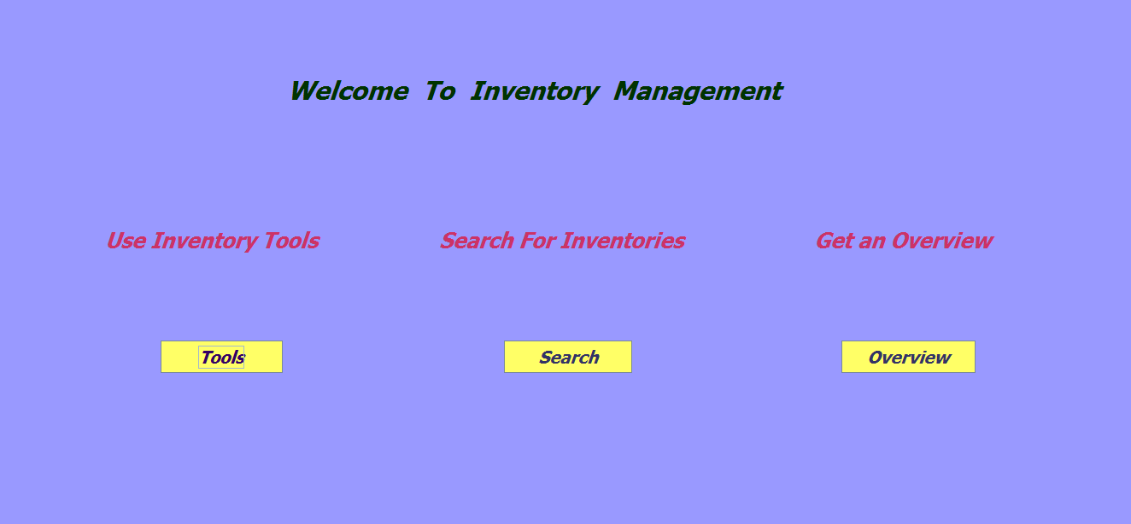
In the main Frame we have got three options that delivers three different tools for tracking products. The Inventory Tools option is specially reserved for Management Team. Other two options Search and Overview are open for all.

Slide 5
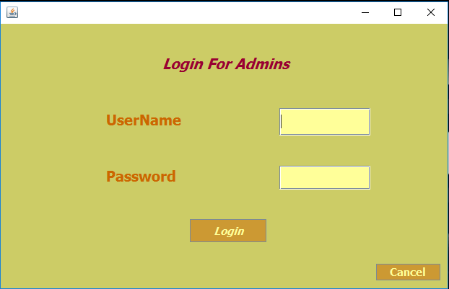
Amongst these three options Inventory Tools can be accessed only by the Admin. But before it a login frame appears that requires accurate username and password to proceed on next.

Slide 6
Inventory Tools: This Inventory Management Application stores product’s name, quantity, price ,id and category using a database file. These are represented in a table in the frame Inventory Tools. There are options insert, delete and update. Products can be inserted or removed from the list and information of specific products can be edited. The table is updated as performed action

Slide 7
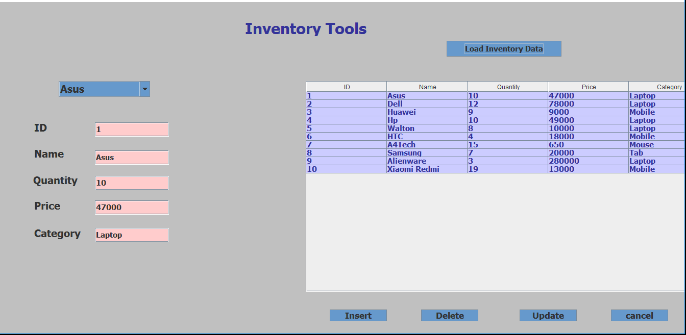

Slide 8
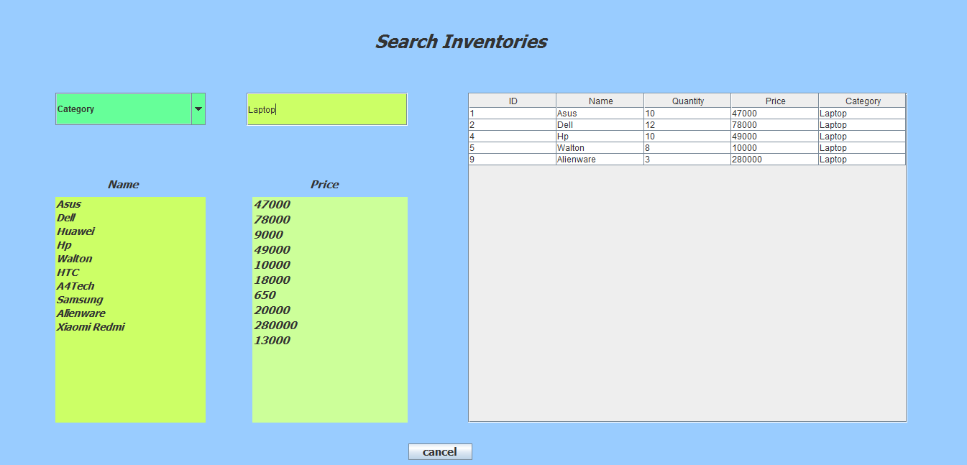
Searching: One can search for products by it’s information categorized in the combo box. There are also lists of names and prices of stored products for searching ease.

Slide 9
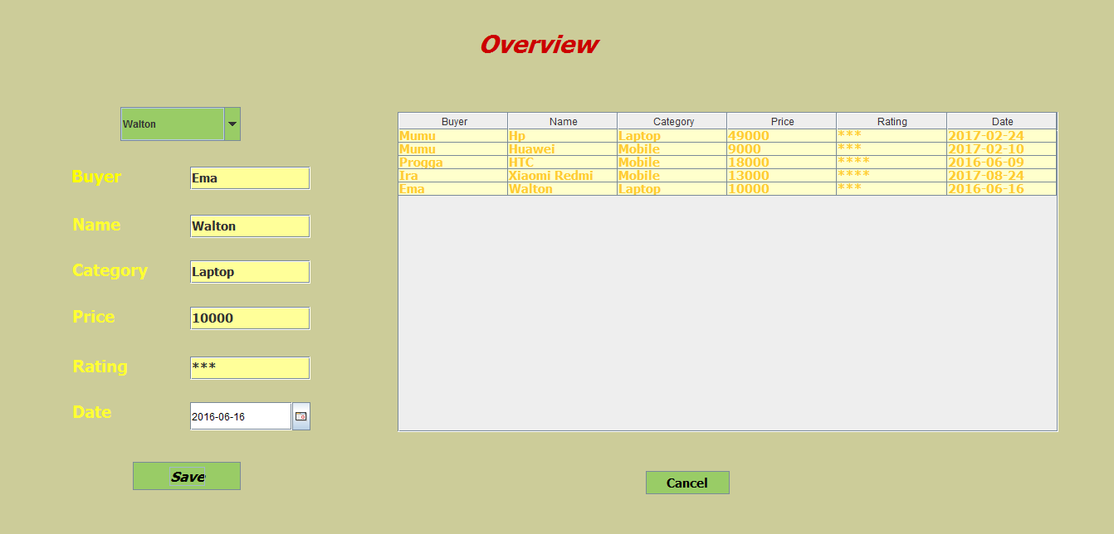
Overview: Customers can store their purchase information through overview. They need to select their product name from the combo box, then related information will be present in the textfield. Then adding personal info, they can create a personal review about products.

Slide 10
In our project , we have used sqlite database to store our product’s information. A database file is created using this software. DB files store data information, usually stored in a series of tables, table fields, and field data values. The information is then stored and organized according to the data model, the most common model structure being the relational model.

Slide 11
Schema Diagram
Inventory Info
ID
Name
Quantity
Price
Category
Overview
Buyer_ID
Name
Category
Price
Rating
Date
LoginInfo
UserName
Password

Slide 12
E-R Diagram
Inv_overview
Inventory Info
ID
Name
Quantity
Price
Category
Overview
Buyer_ID
Name
Category
Price
Rating
Date

