Slide 1
Lab Project on Inventory Management Course Title: Object Oriented Programming Course Code : 313 by
Mumtahina Ahmed- 16701067
Esrat Arisha Ema - 16701045
Safayet Hossain - 16701012
Fakrul Islam Rubel - 16701005
Shahriar Sadik - 16701065

Slide 2
Inventory Management :
Inventory Management Tools are used in different industries to keep track of products and their quantities.
In this project we have created a simplified version of these tools.
Inventory Summary : This Inventory Management Application stores product’s name, quantity, price ,id and category using a directory file. These are represented in a table in our application window

Slide 3
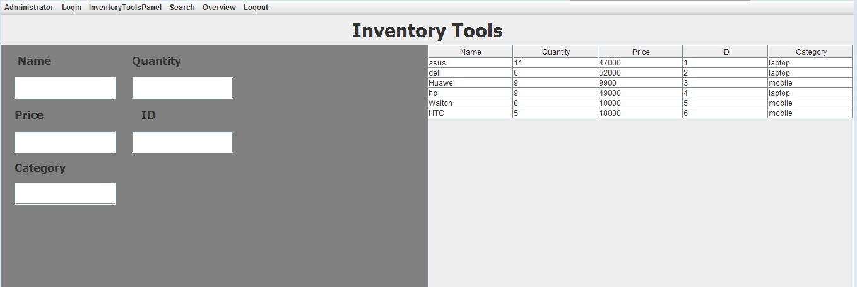
Insertion and Removal: In Inventory Tools panel here is to option insert and remove . Products can be inserted or removed from the list. And the table is updated as performed action

Slide 4
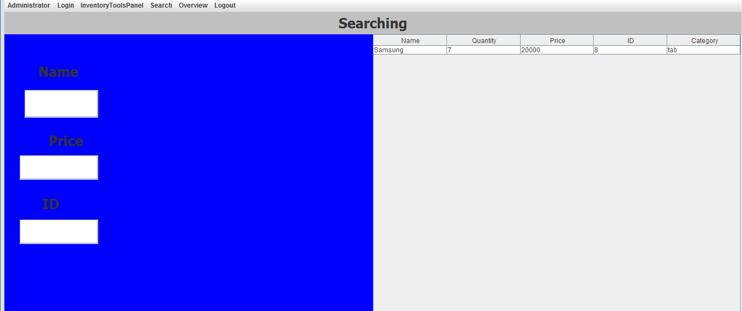
Search: One can search products by product name , id or price and get details of that product.

Slide 5
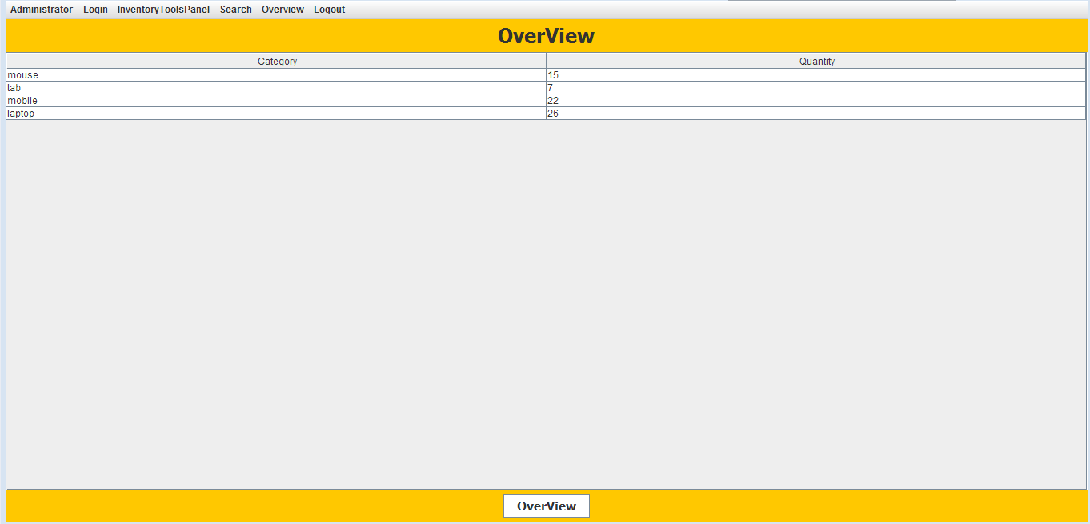
Quick Overview: An overall description of current products is displayed through a table .

Slide 6
A notification message is showed if quantity of any inventory is low.. Here the limitation of product quantity is 5. less than this quantity displays a warning message
One must insert correct Username and Password to use this application. And the logout option is also visible here!

Slide 7
Class Diagram:
InventoryManagement
frame inventoryToolsPanel SearchPanel OverviewPanel
main() login() Initialize()
Inventory
Name – String Price - String Quantity – String ID - String Category - String
Inventory() getInventoryInfo() get() Set()

Slide 8
FileOperations
myFile
addNewInventories() addNeweInventory() getAllInventories() SearchAnInventory()
InventoryFileOperation
Myfile fileName
OpenFormatter() addInventory() getInventories() writeInventory()

Slide 9
InventoryToolsPanel
allInventories table
InventoryToolsPanel() loadTable() saveInventoryData()
SearchPanel
allInventories table
SearchPanel() loadTable() searchinventories

Slide 10
OverView
allInventories table
OverView() loadTable()

Slide 11
Relation Among Classes
LoginFileOperation
loginInfo
Administration
Login
Logout
InventoryManagement
InventoryToolsPanel
Search
Overview
InventoryFileOperations
Inventory
FileOperations

Slide 12
Thank You !

