Slide 1
Group 03 : CU Online App Store
Members:
16701010 : Anik Dey Shaon
16701041 : S. M. Shafkat Raihan
16701045 : Esrat Arisha Ema
16701046 : Md. Muhtadir Rahman
16701067 : Mumtahina Ahmed

Slide 2
Problem Statement
No established way to reserve and promote apps developed by students of CU.
Difficulty in uploading apps to renowned app stores.
Programmers and developers face problems in storing and advertising their works.

Slide 3
Objectives
3
Developing an app store of our own and creating an identity for apps developed by the students of Chittagong University.
Teachers and even alumni will also get privilege for storing and advertising their works.
Every entity will be able to upload their apps for free.

Slide 4
Requirement Engineering
Stackholders :
Primary: Users of the application.
Who are looking for applications developed by students of CU.
Secondary: Administration of CU. Developers of the stored apps.
Tertiary: Developers of the application

Slide 5
Requirement Engineering
Why do we need to develop separate app store instead of having renowned app stores like Google Play?
For making a platform to upload and promote apps with free of cost and create a separate identity of our own apps.
Who would be the developers of the apps?
Current students, teachers and alumnus of CU.
How the authentication and upload will held?
Developers will have to register, login then they can submit, update and manage their apps.

Slide 6
Requirement Engineering
Who will assure the approval of the apps?
Developers or Admin.
What would be the uploaded file types?
Android , web apps and also java apps may be uploaded.
What is the process of app identification or ownership?
Developers would provide and update descriptions of apps.
What is the installation process of apps ?
Apps should be installed into the same device where they are accessed and downloaded.

Slide 7
Design Content
Design
Use case Diagram
Activity Diagram
Sequence Diagram

Slide 8
USE CASE DIAGRAM
Create Account
Login
View App
Admin
Search App
Review App
Upload App
System Developer
Update App
Delete App
Download App
Verified User
Manage Requests

Slide 9
Activity Diagram : SignUP Activity
Open the web application
View Home Page
Press ‘Sign Up’ Button
Verify Account
Click on
‘Create Account’ button
Enter Credentials

Slide 10
Activity Diagram : Login Activity
Open the web application
View Home Page
Press ‘Login’ Button
Wrong Username & Password
[No]
[Successful?]
Enter Credentials
[Yes]

Slide 11
Activity Diagram : View App Activity
[Search]
S
Arrive at Home Page (H)
Click App Icon
View App
Item Drawer

Slide 12
Activity Diagram : Search Activity
[Make Decision]
[found]
Search Item
View Item
S
[Not found]

Slide 13
Activity Diagram : Review App Activity
Arrive at Home page
Select App
View App profile
Share your experience
[Comment]
Rate App
[Rate]

Slide 14
Activity Diagram : Upload App Activity
Arrive at Home Page (H)
Choose the category
Provide app information
Click the ‘upload’ button
Choose file to upload from your device location
[Successful]
[Failed]
Upload Correctly
Upload Successful

Slide 15
Activity Diagram : Update App Activity
Arrive at Home Page (H)
Select your app
Press ‘update’ button
Update app information
Click the ‘update’ button
Choose file to upload from your device location
App updated
[Successful]
[Failed]
Update Correctly

Slide 16
Activity Diagram : Download App Activity
Permission
Press Install APK
[Reject]
[Accept]
Wait
While download
[Wait until finished]
Show successfull

Slide 17
Activity Diagram : Delete App Activity
[Show options]
Arrive at Home Page (H)
[Yes]
Press ‘delete’ button
Select your app
Confirm deletion
[Cancel]

Slide 18
Activity Diagram : Manage Requests Activity
Arrive at Home page
Choose request option
Choose a request
[Verify]
Approve request
[Valid]
[Invalid]

Slide 19
Sequence diagram : Create an account
Home Page
Login Page
Database
User
Click Signup button
Open Signup page
Displays Signup Page
loop
Entering Required data
Authenticate Required Data i.e. Save in DB
AppStore’s
Member ID
Displays Home page

Slide 20
Sequence diagram : Log in
Home Page
Login Page
Database
User
Click login button
Open Login page
Displays Login Page
loop
Entering Student ID and password
Authenticate Student ID and Password.
Displays Home Page
Student ID

Slide 21
Sequence diagram : Search App
User
Home Page
Database
Go to “Search Here” option()
Waiting for keyboard Input
Alt
Push(keywords)
Search(keywords)
(Displaying app list)
msg(app list)
[Exists]
[Doesn’t Exist]
msg(null)
(No item found)

Slide 22
Sequence diagram : View App
Home Page
App Profile
User
Open Web App
loop
Click on Icon(app)
Show profile(APP ID)
msg(app profile)
(Displaying app
profile)

Slide 23
Sequence diagram : Review App
Home Page
App Profile
Database
USER
Open web app()
Select App()
Displays App Profile()
Comment on app()
Store Comment()
Enter Comment()
Successful()
Comments stored()
Rate App()
Enter Rating()
Store Ratings()
Rating successful()
Rating stored()
Displays app profile()

Slide 24
Sequence diagram : Upload App
Home Page
Upload Page
Login Page
Database
User
Open web app()
Select Upload
Section()
Alt
(Page
loaded)
(loading)
Upload
Request(info)
[User Logged in]
Enter(info)
Upload (info)
(Upload
Successful)
msg(ok)
[User not Logged in]
Please Login()
Login()
Login confirmed()
Upload Request(info)
Enter(info)
Upload (info)
(Upload
successfull)
msg(ok)

Slide 25
Sequence diagram : Update App
Home Page
Update Page
Login Page
Database
User
Open web app()
Select App()
(Displaying)
(Displays App Profile)
Select_button(update)
Update ()
Alt
(Showing)
(update option)
Update
Request(info)
[User Logged in]
Enter(info)
Update (info)
(Updating
successfull)
msg(ok)
[User not Logged in]
Please Login()
Login()
(Showing) (update option)
Login confirmed()
Update Request(info)
Enter(info)
Update (info)
(Successfull)
(Updating successfull)
msg(ok)

Slide 26
Sequence diagram : Delete App
Home Page
App Profile
Login Page
Database
User
Open web app()
Select App()
Delete app()
Displays App Profile()
Delete()
Alt
Shows prompt (confirm cancel)
Delete Request(App ID)
[User Logged in]
Confirm deletion()
Delete app()
(Successful)
(App Deleted)
msg(ok)
[User not Logged in]
Please Login()
Login()
Shows prompt (confirm cancel)
Login confirmed()
Confirm deletion()
Delete Request()
Delete app()
(Successful)
(App Deleted)
msg(ok)

Slide 27
Sequence diagram : Download App
Home Page
App Profile
Login Page
Database
User
Open web app()
Select App()
Download app()
Displays App Profile()
Download()
Alt
Shows download prompt()
[User Logged in]
Download Request(App ID)
Confirm Download()
Download app()
(Successful)
(Downloading)
msg(app)
[User not Logged in]
Please Login()
Login()
Shows prompt (confirm cancel)
Login confirmed()
Confirm Download()
Dowload Request(App ID)
Download app()
(Successful)
(Downloading)
msg(app)

Slide 28
Sequence diagram : Manage Requests
Home Page
Approval Page
Database
USER
Open web app()
View verification requests()
Displays requests()
Authenticate information()
Choose a request()
Verify request()
validity information()
return object()
Complete()
Alt
Select request()
Approve Request()
Store user information()
[Valid]
Validity confirmed()
Info stored()
successful()
[Invalid]
Select request()
Delete Request()
Ok()
Complete()

Slide 29
Implementation: Platforms
Frameworks:
Django
Bootstrap
Database:
SQLite
Languages:
HTML
CSS
Python

Slide 30
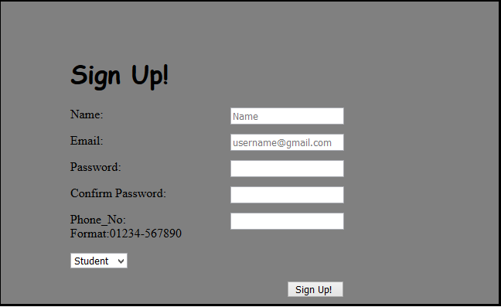
Screenshot : Sign Up
User will provide their primary information to create an account. The users can be a student, a teacher or an alumni.

Slide 31
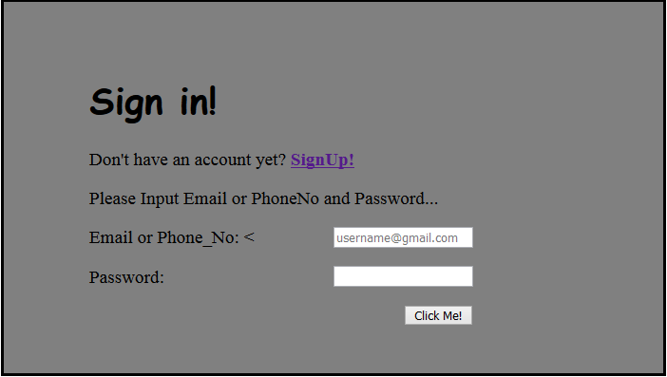
Screenshot : Sign In
Registered users will need to enter their credentials for signing in into the “App Store”.

Slide 32
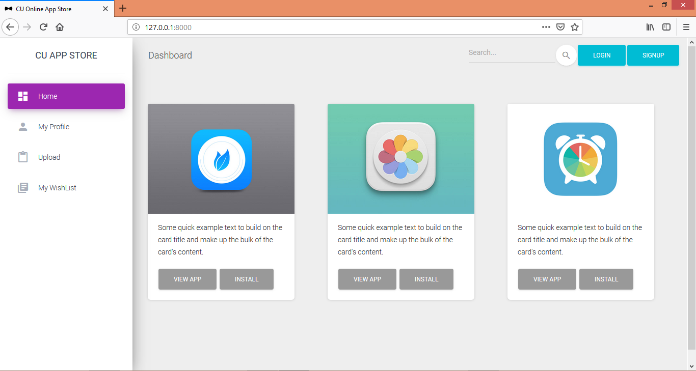
Screenshot: Home
The suggested apps will be seen randomly from the home screen. Here, an user can select their own operations. An user can also directly install or view any app from here.

Slide 33
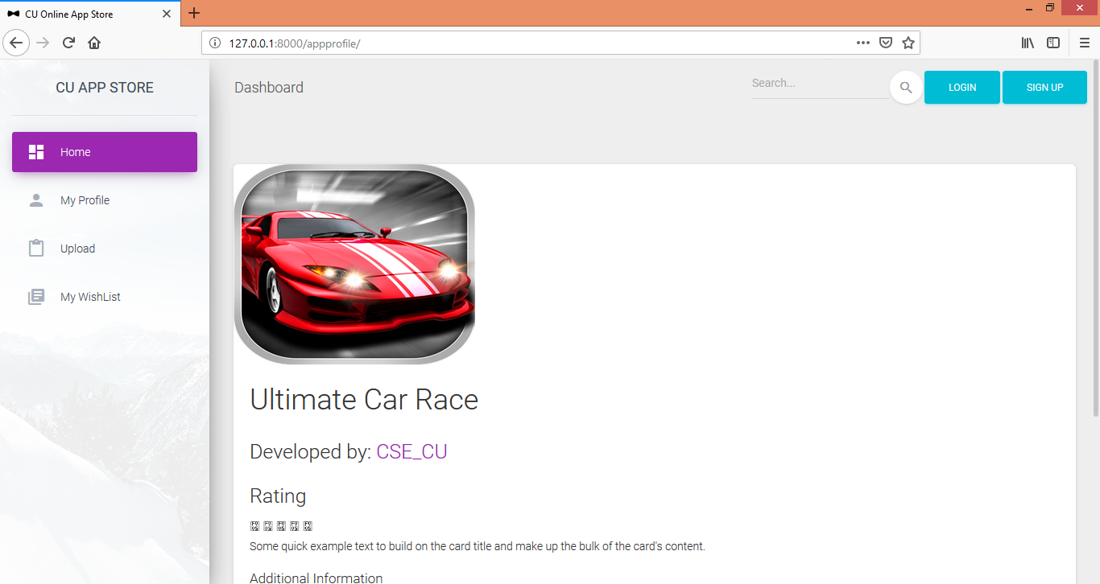
Screenshot : App Profile
While clicked the “View App” option, users wiil directly be surfed to the “App Profile” for seeing app specifications of that specific app.

Slide 34
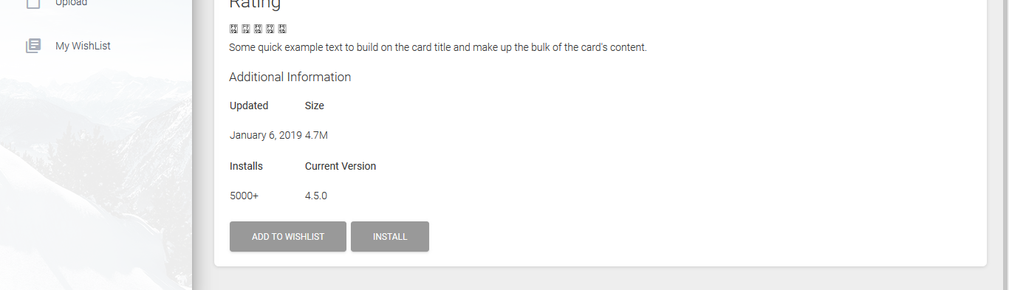
Screenshot : App Profile (continution)_
There are also options for adding apps to the wishlist and install in the “App Profile” page.

Slide 35
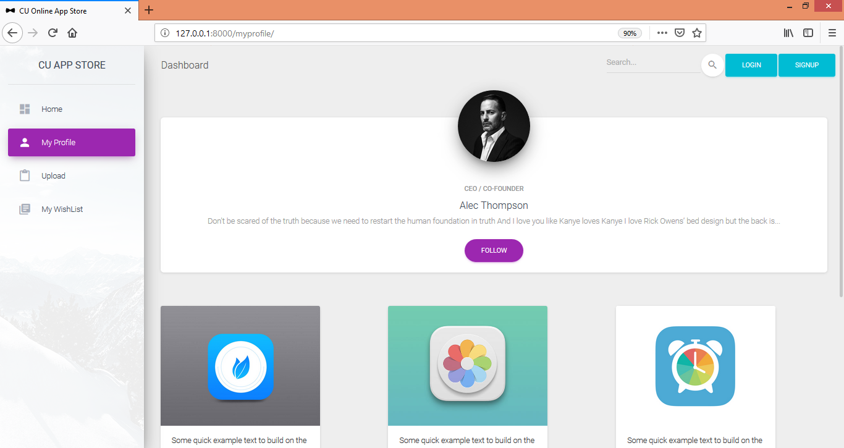
Screenshot : My Profile
This is the individual’s profile where a developer can see his/her own profile. He will also be able to see his her works here so that he can update and delete any of his app from the store.

Slide 36
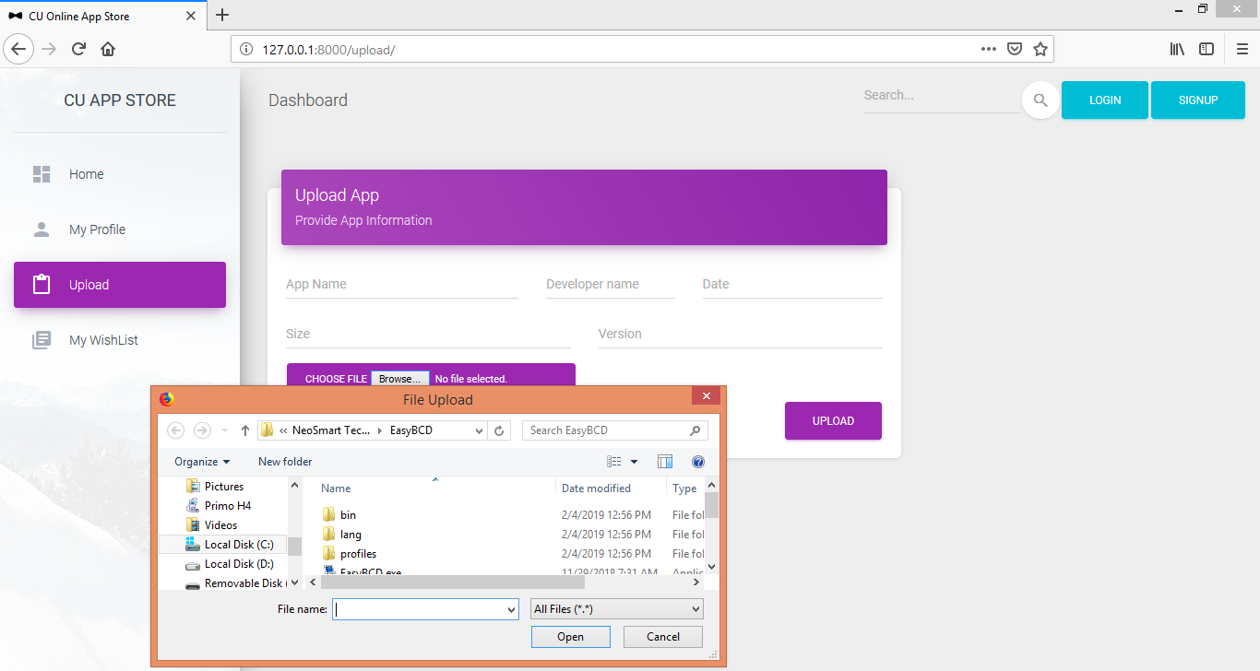
Screenshot : Upload
Developers will upload their app from this option. Theywill give their app a name, and other basic information. Then they will be able to select their app by clicking “browse” so that the file opener gets open and they can select their apk file. Clicking upload button will publish their work to the store.

Slide 37
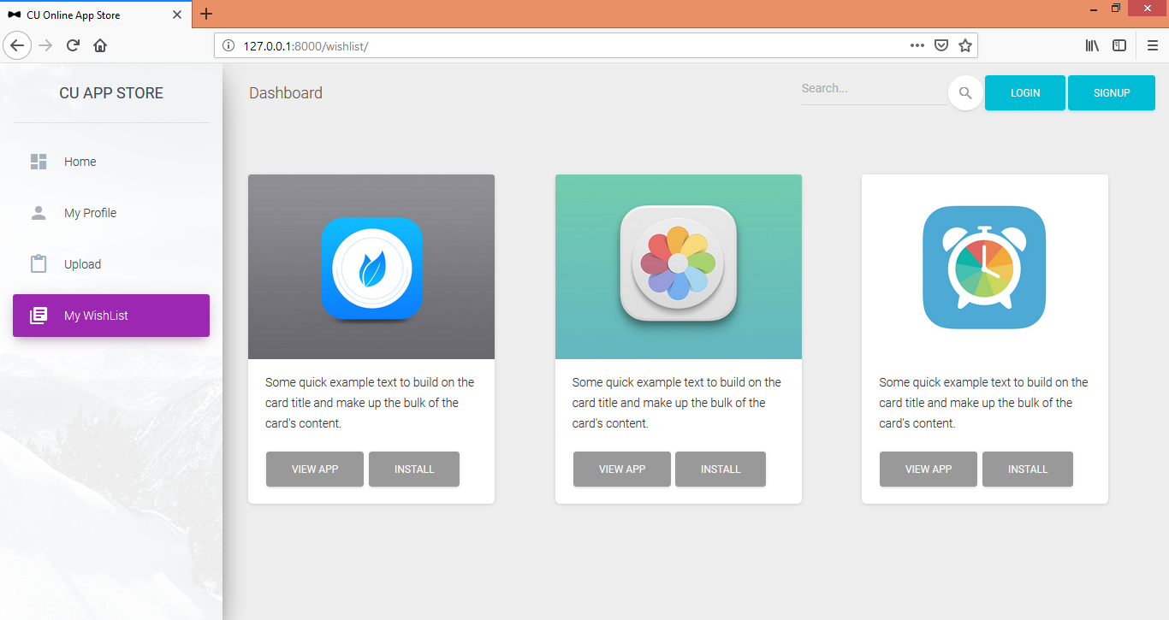
Screenshot : My Wishlist
Users will also see their wished apps list throughing the “My Wishlist” option

Slide 38
Testing: Levels
Unit Testing:
The web pages, corresponding CSS files, images and Database were each tested individually after creation
Integration Testing:
The units were each tested again as in Unit testing after integrating them with the system. The integration was done using Django
System Testing:
After all the units were integrated the system was tested

Slide 39
Testing: Web Application
Link Testing:
The links between the html pages were tested. Also the links connecting the CSS and image files were tested.
Browser Testing:
The application was tested on the latest versions of the two popular browsers Google Chrome and Mozilla Firefox
Security Testing:
The admin login and user login mechanisms were tested

Slide 40
Future Works
Subscription
Improving developer sign up mechanism
App suggestion
App review
Powerful Searching mechanism

Slide 41
Thank you

