Slide 1
TRENDS AND SUCCESS IN Kickstarter
An Analysis of Kickstarter Projects Types and Trends
Muna Radhi

Slide 2
OVERVIEW
Key Points
Success varies by project type.
Fastest-growing categories in funding.
Categories that often fail.
Seasonal trends impact performance.
Goals:
Find most & least successful types.
Highlight funding growth.
Identify risky categories.
Spot top-contributing subtypes.
Understand seasonal effects.

Slide 3
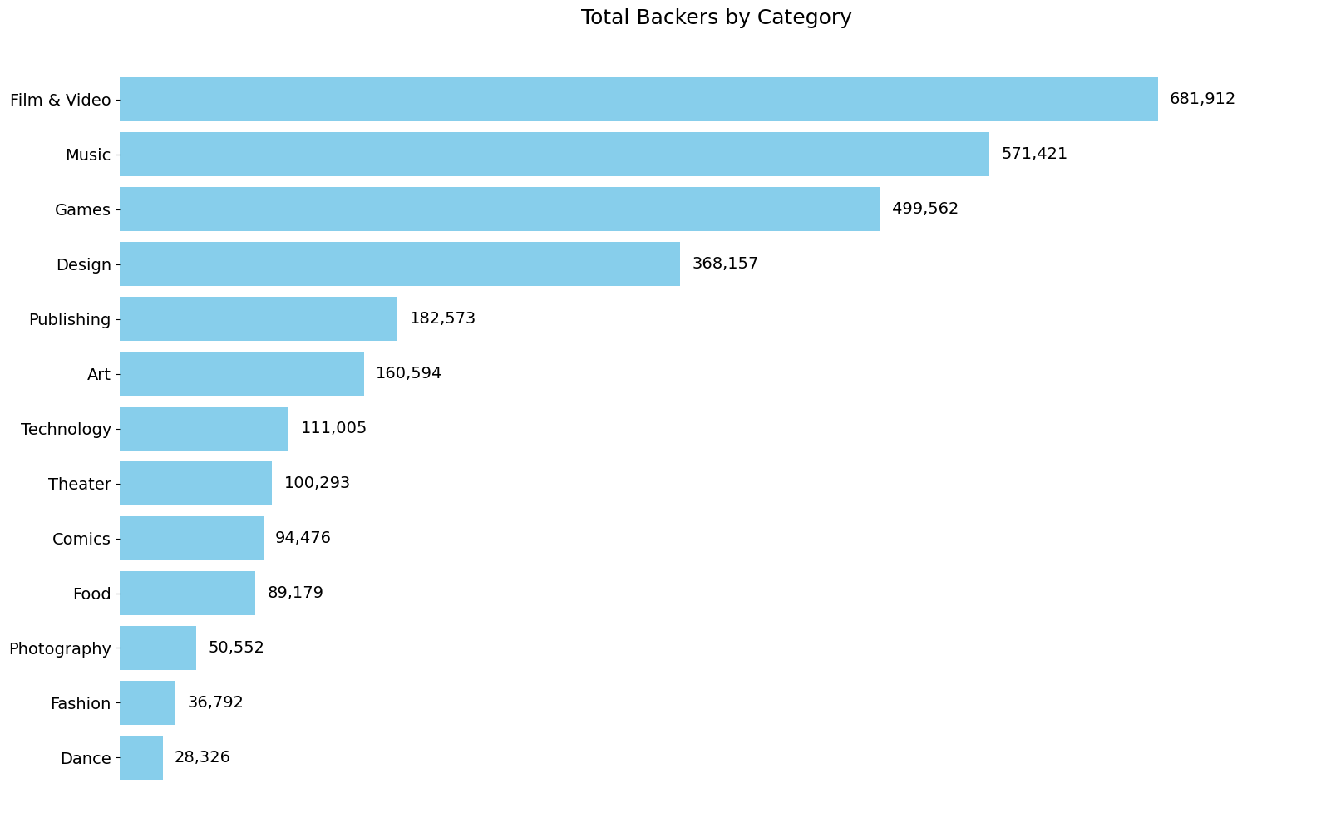
Most Popular Category
Film , Music & Games
Most popular
Indicating High Competition

Slide 4
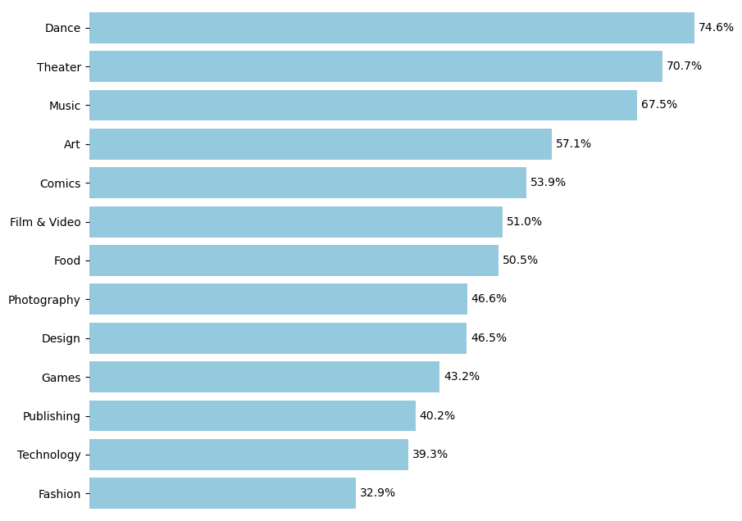
Success Rate by Project Type
performing arts
are the top
Intangible Rewards
Lower Risk of Production Delays

Slide 5
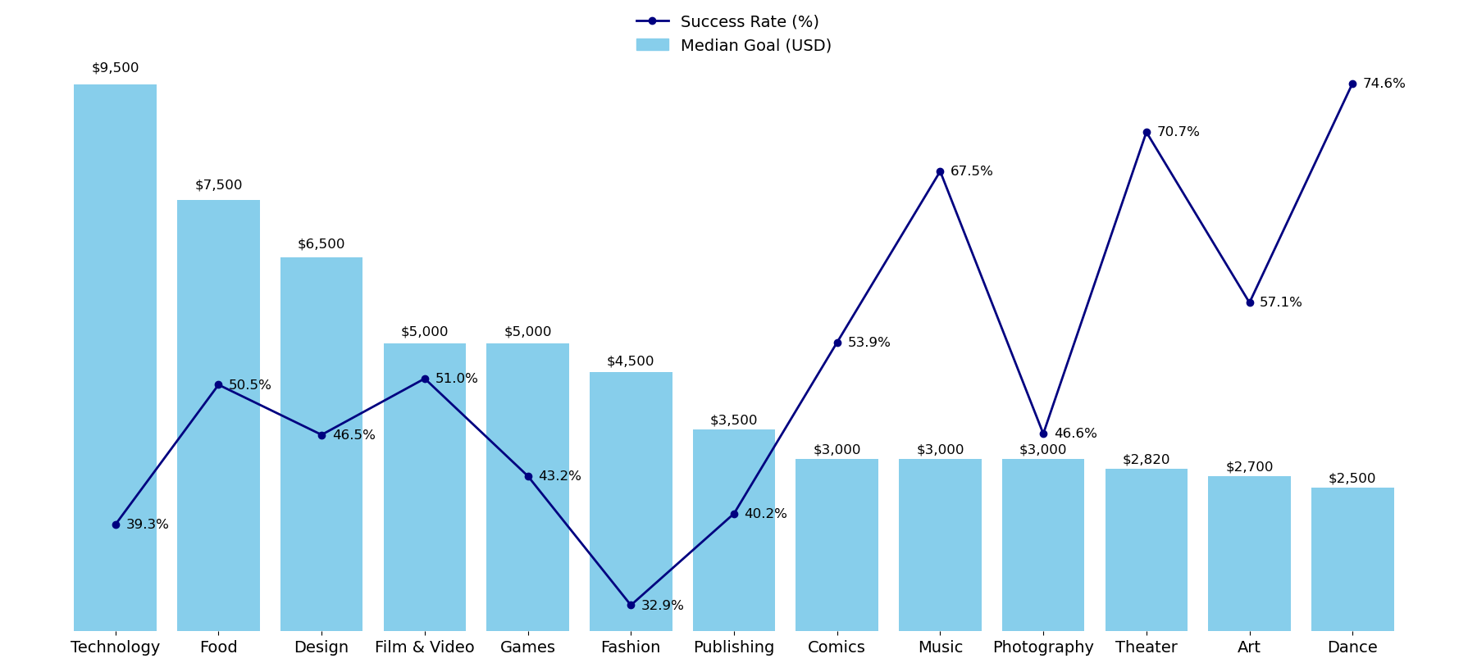
Meeting the Goal

Slide 6
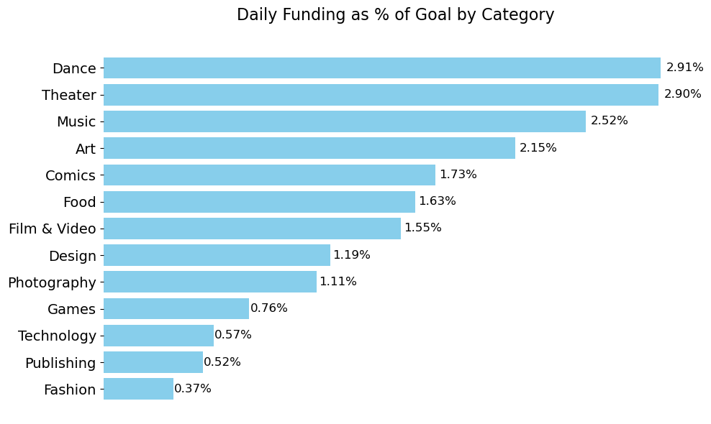

Funding Speed to goal
Pre-existing Audience

Slide 7
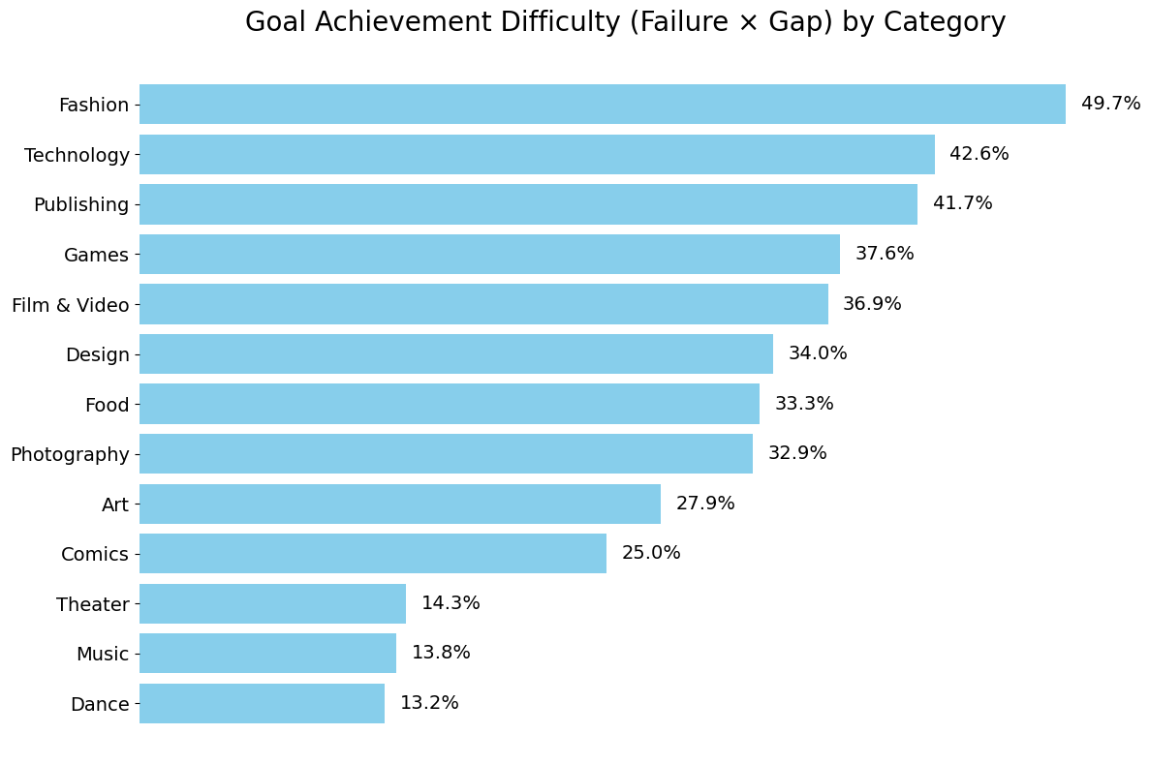
Struggling Projects
Fashion /Technology
are the most struggling
High cost for manufacturing & Material
Possible Risk of Production Delays

Slide 8
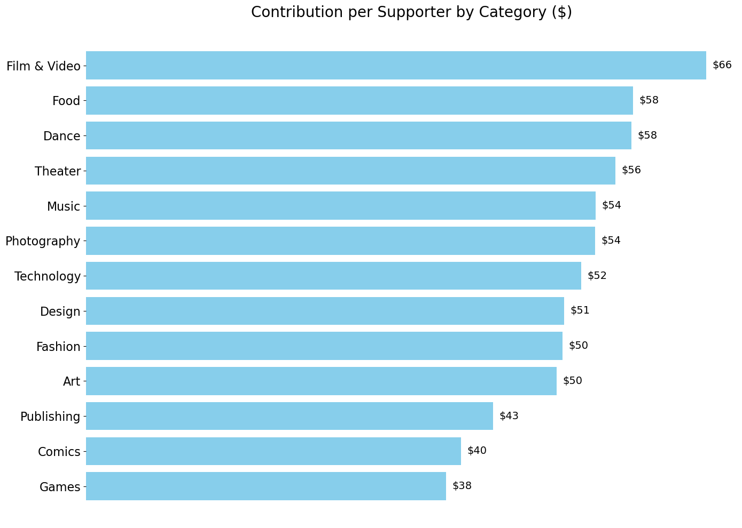

Contribution per Backer
Film & food & Dance
Passionate Community
The All-or-Nothing Model
Reduces the risk

Slide 9
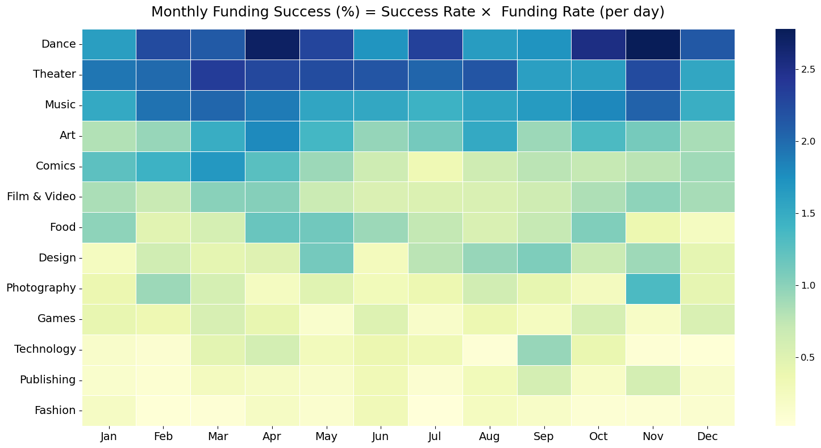
Seasonal Performance Trends
Before Holidays/ festivals
Peak food supplies production
Photoghraphy Before End of Year holidays
Tech Companies launch new products

Slide 10
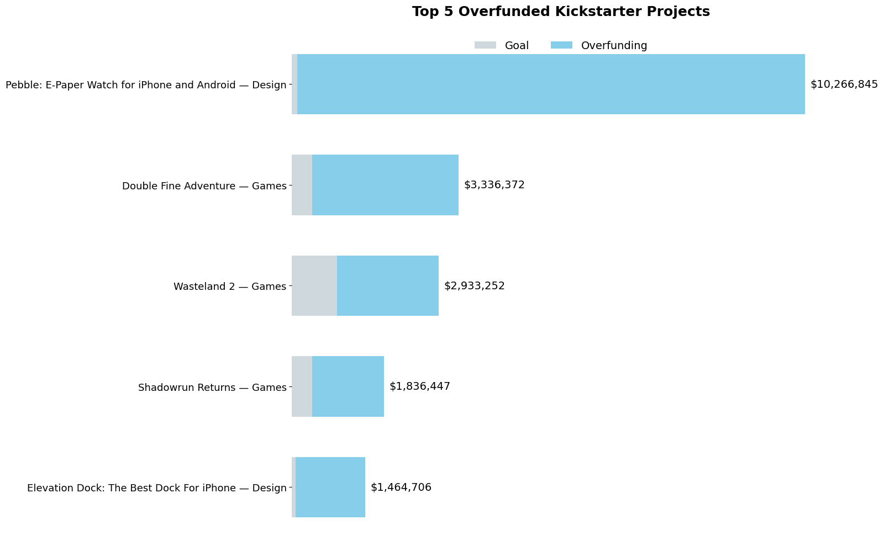
Top Funded Projects

Slide 11
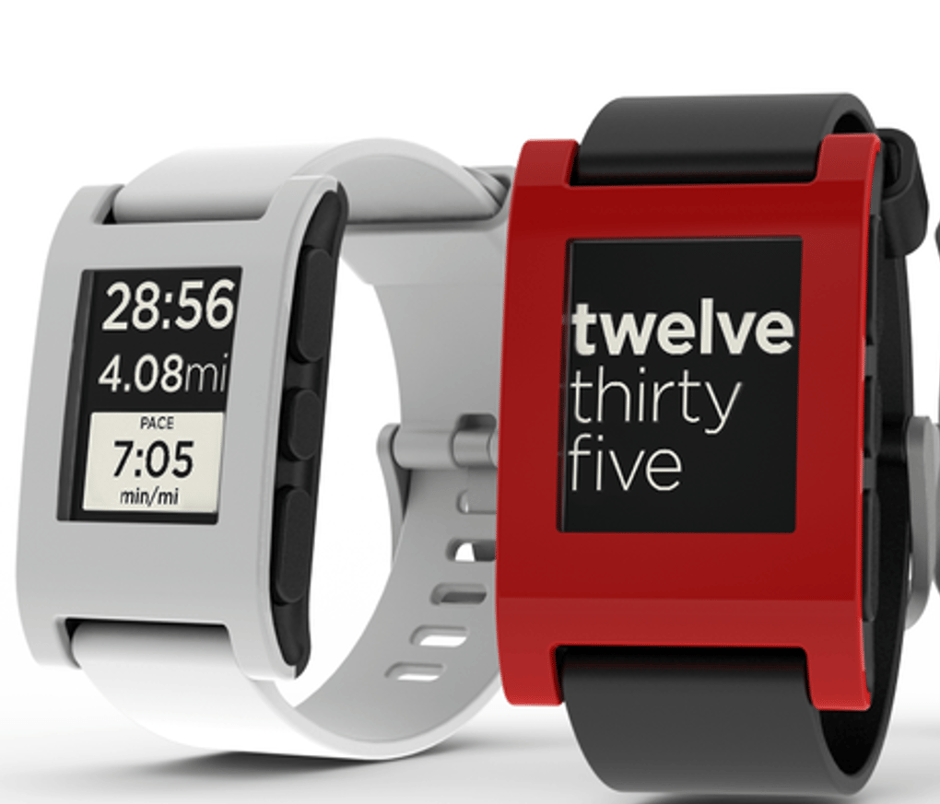
Top Funded Projects
Innovation
Building community
Strong Visuals
Perfect Timing
Affordable pledge
99$ Smartwatch
Pebble Technology

Slide 12
Insights & Recommendation
Top Success: Dance (74.6%), Theatre (70.7%), Music (67.5%) – creative projects with clear goals succeed more.
Risky Categories: Fashion, Technology – high costs and complex logistics; set realistic goals.
Popularity ≠ Success: Film & Video, Music, Games have many backers, but smaller, engaged audiences (e.g., Dance) often fund more reliably.
High Contribution: Some categories attract higher pledges per backer; focus on engagement and uniqueness.
Timing Matters: Launch strategically – e.g., Games/Tech before holidays, Art in spring – for better funding outcomes.

