Slide 1
Analysis of India's Top 500 Companies
Based on Market Capitalization, Earnings, Revenue, Employees, Dividend Yield
Date : 24 June 2024
Presented By: Munaf K.

Slide 2
Introduction
Objective:
To understand the market position and performance of India's top 500 companies.
Data Source:
Dataset from CompaniesMarketCap site.
(Note: Data varies over time, and this analysis is based on data available at the time of analysis)

Slide 3
Key Metrics Overview
Total Market Cap: $4.241 trillion
Total Earnings: $239.34 billion
Total Revenue: $1.67 trillion
Total Employees: 7.186 million
Average Dividend Yield: 0.725%
Number of Companies: 570

Slide 4
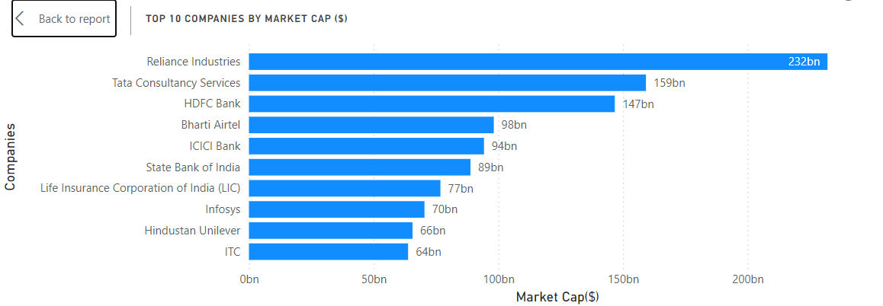
Top 10 Companies by Market Capitalization
Reliance Industries is the largest with a market cap of $232 billion, followed by Tata Consultancy Services at $159 billion.

Slide 5
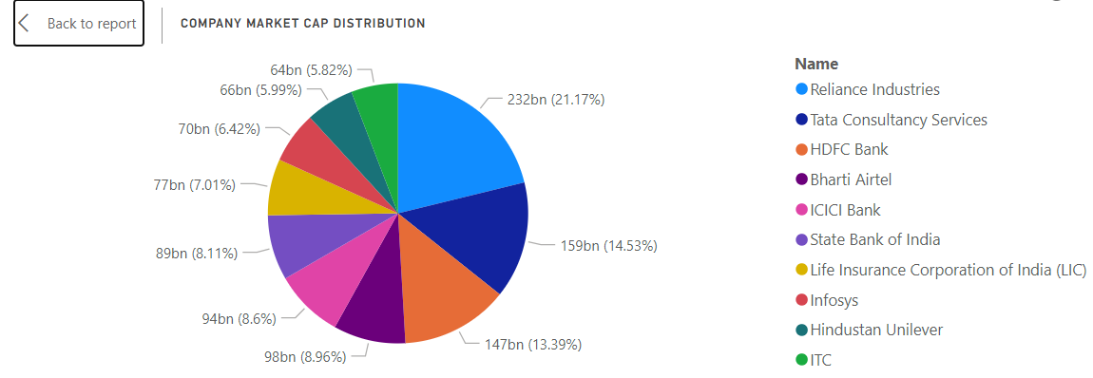
Market Cap Distribution
Reliance Industries holds the largest share at 21.17%.

Slide 6
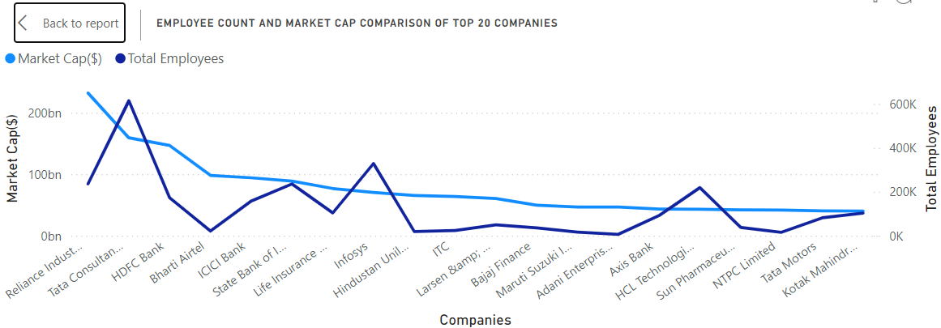
Employee Count and Market Cap Comparison
Companies with higher market caps often have more employees, but there are exceptions.

Slide 7
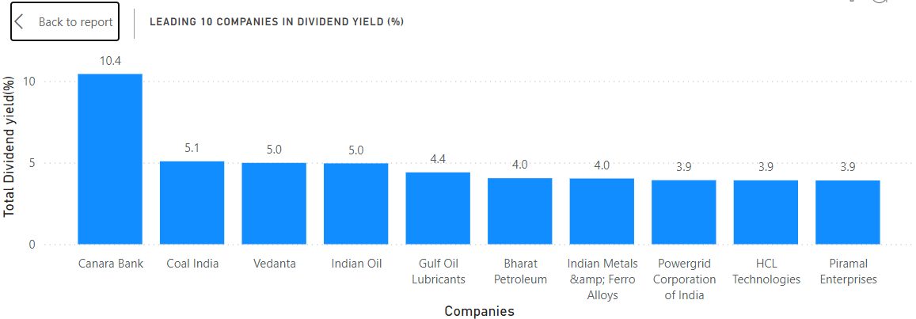
Top 10 Companies by Dividend Yield
Canara Bank offers the highest dividend yield at 10.4%, followed by Coal India at 5.1%.

Slide 8
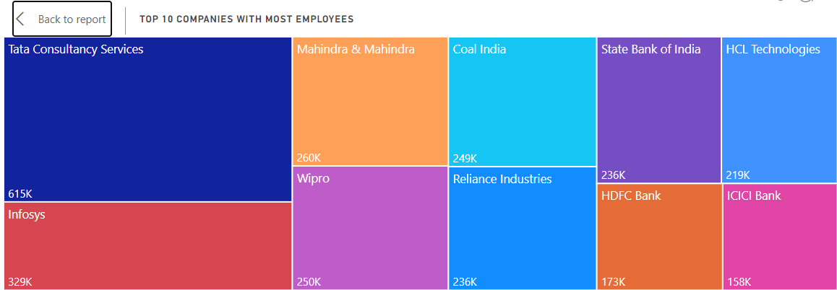
Top 10 Companies by Employee Count
Tata Consultancy Services employs the most people, with over 615,000 employees.

Slide 9
Key Insights
Reliance Industries dominates the market in terms of capitalization and revenue.
Larger companies tend to have more employees and higher sales.
Dividend yield varies significantly, with financial and energy companies often offering higher yields.

Slide 10
Unique Findings Based on Analysis
1. Market Capitalization Concentration
Top 10 Companies: The top 10 companies hold over 25% of the total market cap among the top 500 companies. This concentration indicates that a small number of companies dominate the market.
Companies Included: Reliance Industries, Tata Consultancy Services, HDFC Bank, Bharti Airtel, ICICI Bank, State Bank of India, Life Insurance Corporation, and Infosys.

Slide 11
Unique Findings Based on Analysis
2. Diversity in Sector Dominance
Technology and Finance: Tata Consultancy Services and HDFC Bank are prominent leaders in the technology and financial sectors, respectively.
Energy Sector: Reliance Industries and Coal India highlight the significant role of the energy sector in market capitalization and dividend yields.

Slide 12
Unique Findings Based on Analysis
3. Significant Dividend Yields in Financial and Energy Sectors
Financial Sector Leaders: Canara Bank show high dividend yields of 10.4%, offering attractive returns for investors.
Energy Sector Contribution: Coal India and Vedanta also provide substantial dividend yields, reinforcing the attractiveness of the energy sector for income-focused investments.

Slide 13
Unique Findings Based on Analysis
4. Top Companies by Employee Count
Major Employers: Tata Consultancy Services, Infosys, Mahindra & Mahindra, and Wipro are among the top employers, highlighting the employment generation capability of the IT and automotive sectors.
Significant Workforce: Tata Consultancy Services employs over 615,000 individuals, the highest among the top companies.

Slide 14
Unique Findings Based on Analysis
5. Average Share Price Insight
High Share Price: HDFC Bank stands out with an average share price of $57.89, indicating strong market valuation.
Technology Sector Valuation: Tata Consultancy Services and Infosys have average share prices of $44.01 and $16.75, respectively, reflecting investor confidence in the technology sector.

Slide 15
Unique Findings Based on Analysis
6. Employee Distribution Across Sectors
Technology Sector: Employs a substantial portion of the workforce with Tata Consultancy Services and Infosys leading.
Banking Sector: Significant employment by State Bank of India and HDFC Bank highlights the sector's contribution to job creation.

Slide 16
Recommendations
Focus on high-cap companies for stable investment opportunities.
Consider dividend yield when looking for income-generating investments.
Diversify investments across various sectors to mitigate risks.
Identify companies with strong growth potential.
Analyze macroeconomic factors that may influence company performance.

Slide 17
Conclusion
Market Dominance: The top 10 companies hold over 25% of the total market cap.
Sector Leaders: Technology and finance sectors lead in market cap and employment.
Dividend Opportunities: Financial and energy sectors offer the highest dividend yields.
Investment Focus: High-cap companies and those with strong growth potential present the best opportunities.

Slide 18
Thank You!

