Slide 1


EDSA Individual Task
Spain ELECTRICITY SHORTFALL CHALLENGE

Slide 2


Introduction
With a population of 47.1 million people, Spain is Europe's sixth-largest energy user.
Over time, there has been an increase in power generation. Including energy produced by fossil fuels and many renewable sources.
This presentation is based on a model that we created to assist the Spanish government in forecasting energy shortages.

Slide 3
Objective
Building a model that will assist the Spanish government in precisely forecasting the three hourly energy deficits - for the country of Spain - provided by fossil fuels and diverse renewable sources.
The daily deficit, or goal variable, will be modeled as a function of several city-specific meteorological factors.

Slide 4

Model design Approach

Slide 5

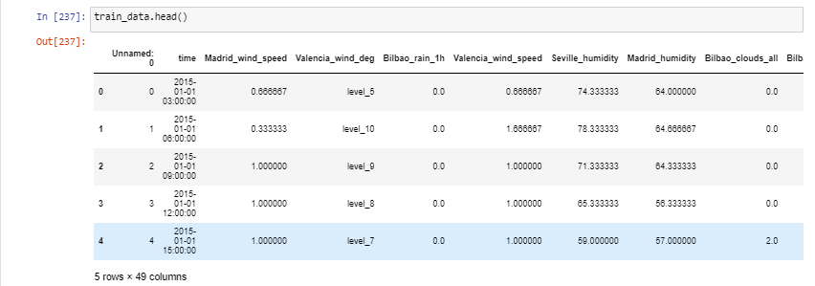



Exploratory Data Analysis
Checking the head of the training data.

Slide 6
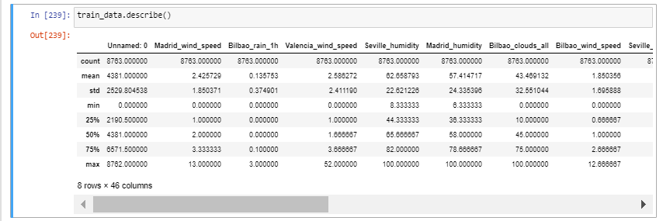
Exploratory Data Analysis
The description of the given data in the form of the five number summary, as shown in the above figure.

Slide 7
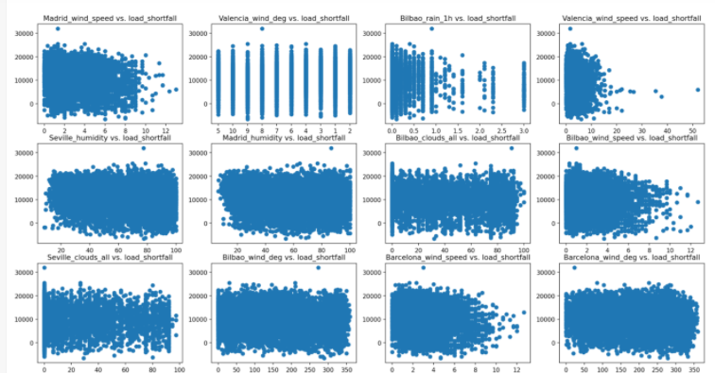
The scatter plots above show the association between meteorological variables in all Spanish cities and load shortage. This scatter plot is used to demonstrate key relationships and data dispersion.

Slide 8
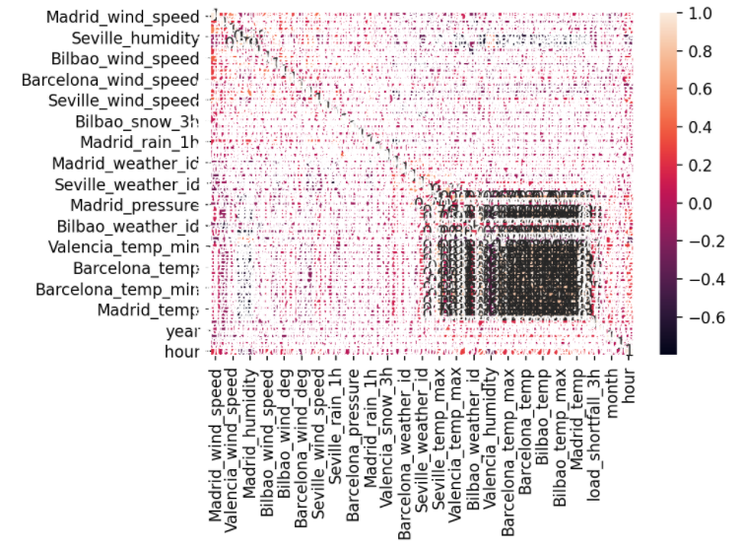
The purpose of this heat map is to look at the strong links between meteorological elements and load shortage in all of Spain's towns.

Slide 9
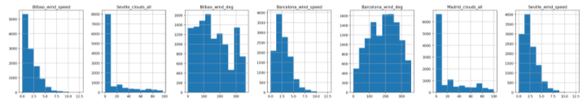
The histogram, as illustrated in the diagram above, is used to check the distribution of characteristics in a given dataset. Because most of the offered characteristics utilize a different scale or the data is not standardized, our data is not in a proper format, as seen in the picture above. The load shortfall 3h column's normal distribution shows that the load shortfall is more likely to be in the range of 9000 to 13000 since the likelihood is higher there.

Slide 10
Data Engineering
Check the proportion of missing values. Valencia has a pressure rating of 23.59 percent. Impute missing values to fill up the gaps.
The mean, median and mode values are approximately the same for both sets of data hence we chose to replace the nulls with mode since this indicate the most common pressure value on the respective data frame columns

Slide 11
Data Engineering
we check the data type of all columns in our data in order to make sure that all variables are stored in the correct data type
Examine the datatypes: Regression models cannot be used with non-numerical data types.
Seville Pressure: Object to float
Valencia Wind degree: Object to float
Time: Object to dateTime

Slide 12
New Features
To check what value each day, hour, year, and month will have on the Target variable, divide the time variable into day, hour, year, and month.
The Time and Unnamed columns were dropped since they do not add any value to our model prediction.
Numbers were extracted from Valencia_wind_deg and Seville_pressure columns.

Slide 13
Modeling
This section covers all of the steps involved in developing the prediction models to forecast the load shortage for the Spanish government.
Split the training data frame into train and test data (this is done to train and assess the model's performance on visible and unknown data). Because the provided test data lacks the values of the response variable, we are obliged to partition the training data into train and test data.

Slide 14
Modelling
5 Regression models used
1. Linear Regression
2. Ridge
3. Lasso
4. Decision Tree
5. Random Forest

Slide 15

Model Evaluation

Slide 16
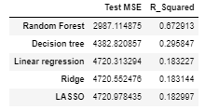
Model performance:

Slide 17

Supervisor - Jamie Snyders Student - Munangiwa Hlongwane

