Slide 1






EDSA Group 3
Climate Change Belief Analysis

Slide 2


Intro: Companies want to know Sentiment

Slide 3



Objective: Predict Sentiment

Slide 4
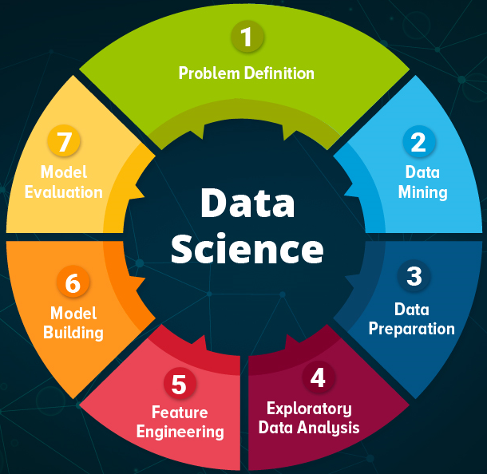
Process

Slide 5
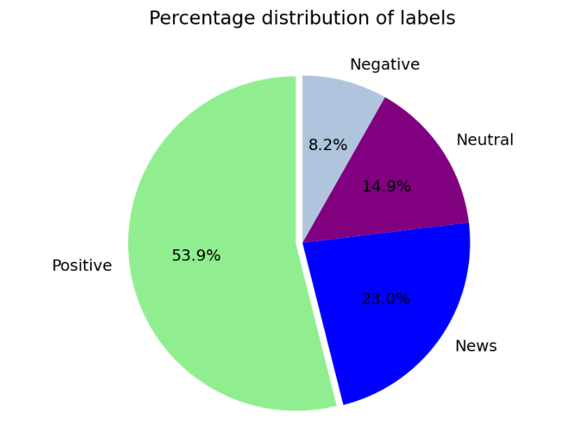
EDA: Distribution of Data

Slide 6
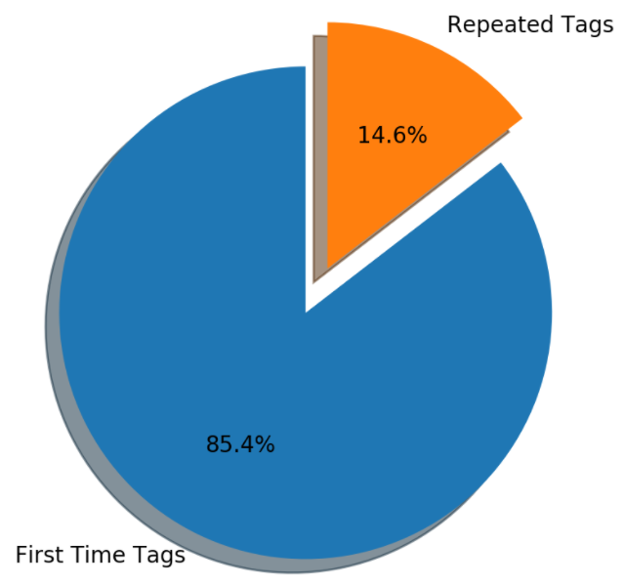
EDA:
Repeater Tweeters?
Or a wide cross section of opinions?

Slide 7
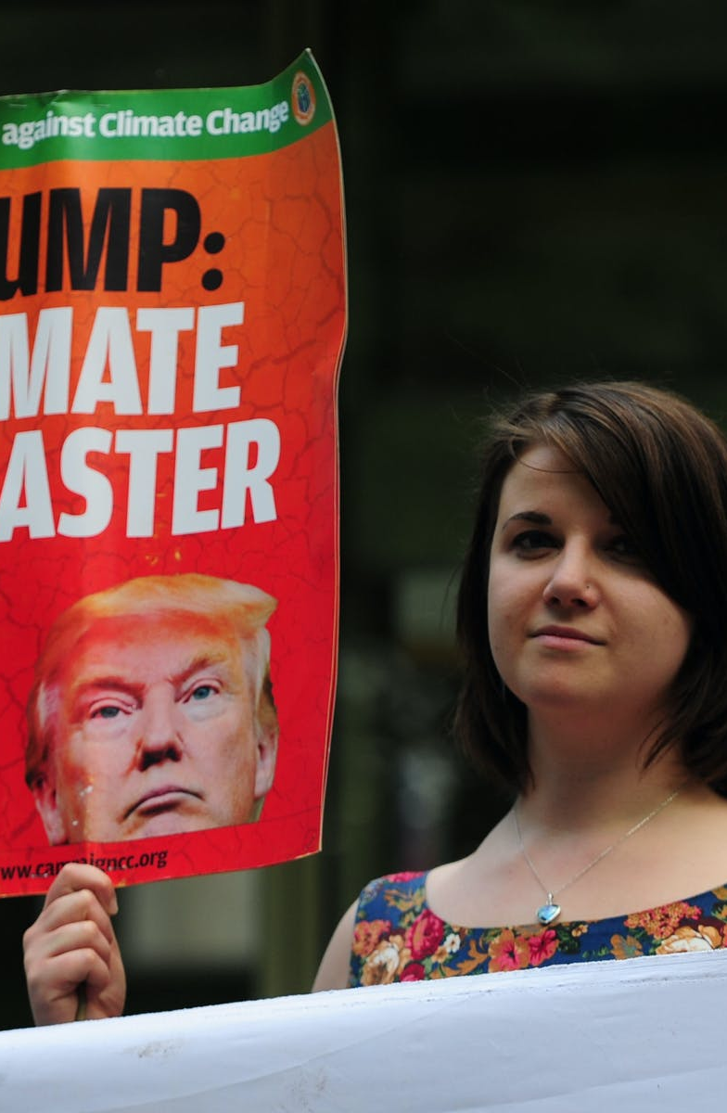
A politized agenda:
Trump has the most negative tweets about climate change
But only 50 in 15 000

Slide 8
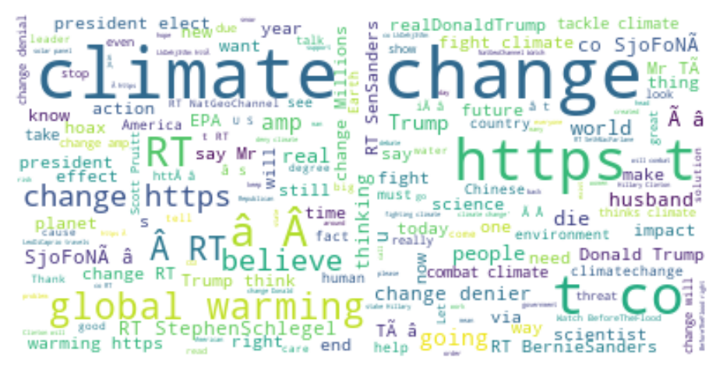
Wordcloud

Slide 9
Modelling
10 MODELS
1. Logistic Regression
2. Linear SVC Model
3. SVC Model
4. Decision Tree Classifier
5. Random Forest Classifier
6. MLP Classifier
7. KNeighbors Classifier
8. Multinomial NB
9. Complement NB
10. SGD Classifier

Slide 10

Model Evaluation

Slide 11

TF-IDF Vectorization

Slide 12
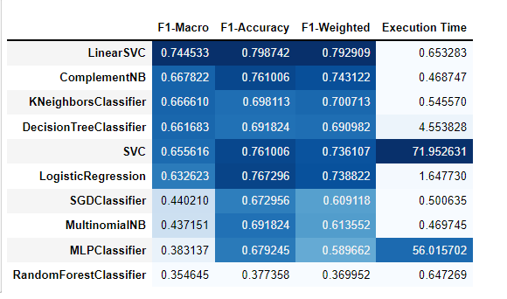
Model performance Before Oversampling

Slide 13
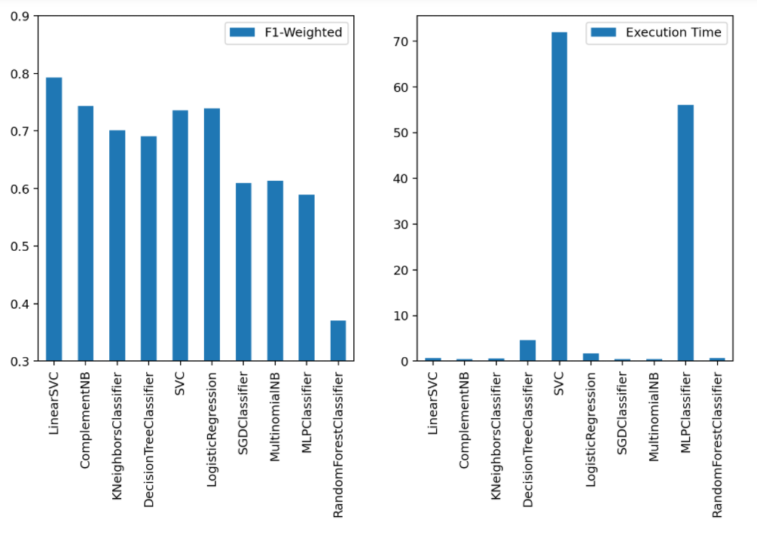
Model performance Before Oversampling

Slide 14
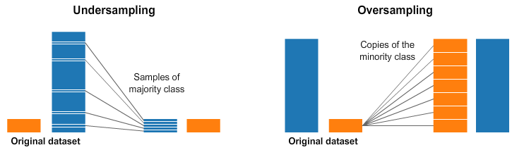
HANDLING Imbalanced data

Slide 15
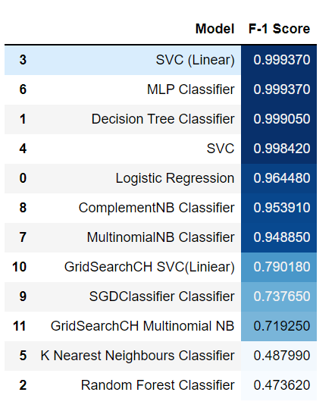
Model performance After Oversampling With Hyperparameter Tuning

Slide 16

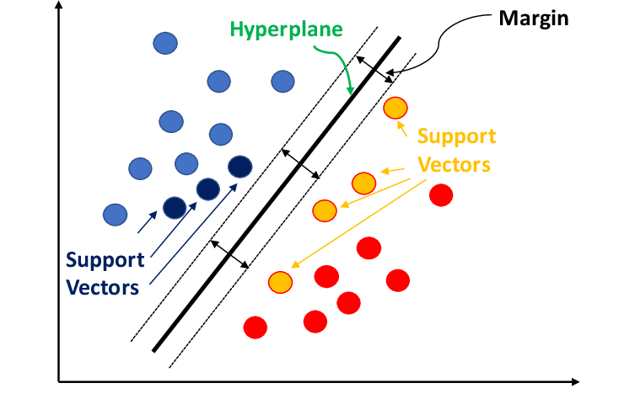

Our best Model : Linear Support Vector Machine Model after hyper-parameter tuning

Slide 17

Deployment: Cloud Hosted API

Slide 18

Supervisor – Jamie Snyders Team 3 Members: 1. Drikus de Wet 2. Munangiwa Hlongwane 3. Tshegofatso Sekgobela 4. Nokulunga Twala 5. Mashudu Selepe

