Slide 1


COVID-19 Prediction Using Machine Learning
Name - Muna Pun
Londonmet ID- 23048838
CU6051NP – Artificial Intelligence

Slide 2






AI Used
1
2
Supervised Learning
Regression Techniques
Uses labeled data to learn patterns and make predictions.
Uses two methods: Linear Regression for trends and Random Forest for stronger predictions.
3
Model Evaluation
Measured using MAE, RMSE, and MAPE metrics.

Slide 3

Research & Evidence
COVID-19 Data Analytics: WHO and Johns Hopkins datasets for analysis and prediction.
Model Effectiveness: ML models excel at short-term disease trend forecasting.
Supervised Learning in Healthcare: Proven methodology for disease trend prediction.
These established methods provide a strong foundation for the reliability and impact of our predictive model.

Slide 4




Why This Topic Matters
Methodology
Social Relevance
Full AI pipeline: data to visualization.
COVID-19 impact makes accurate prediction crucial for public health.
Practical Importance
Learning Opportunity
Enables healthcare planning and resource allocation.
Real-world AI application bridging theory and practice.

Slide 5
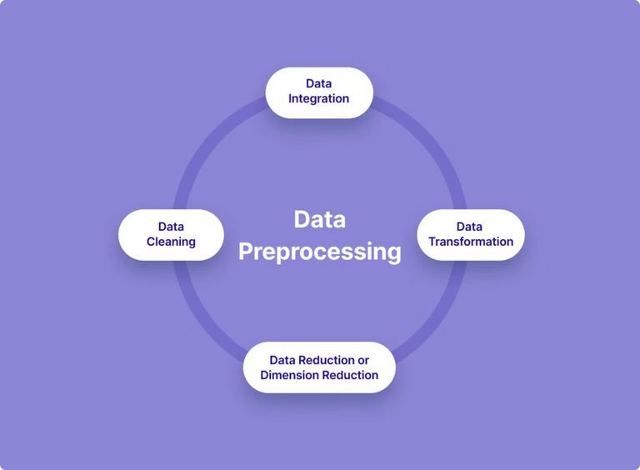
Our Solution: Predictive Application
Data Preparation
Model Training
Cleaned COVID-19 datasets and split into training and testing sets.
Trained Linear Regression and Random Forest models and evaluated them using MAE, RMSE, and MAPE metrics
Implementation
Built application for case prediction with graph-based visualization.

Slide 6
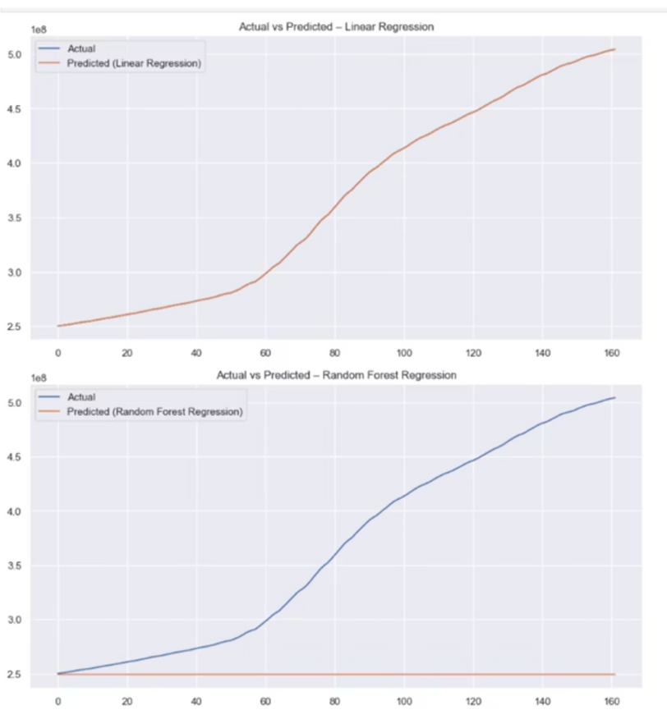




Results
Model Performance
Our model consistently delivered stable and reliable short-term predictions with remarkably low prediction error rates.
Insights Gained
The model successfully identified rising and declining trends, providing a deeper understanding of COVID-19 spread patterns.

Slide 7
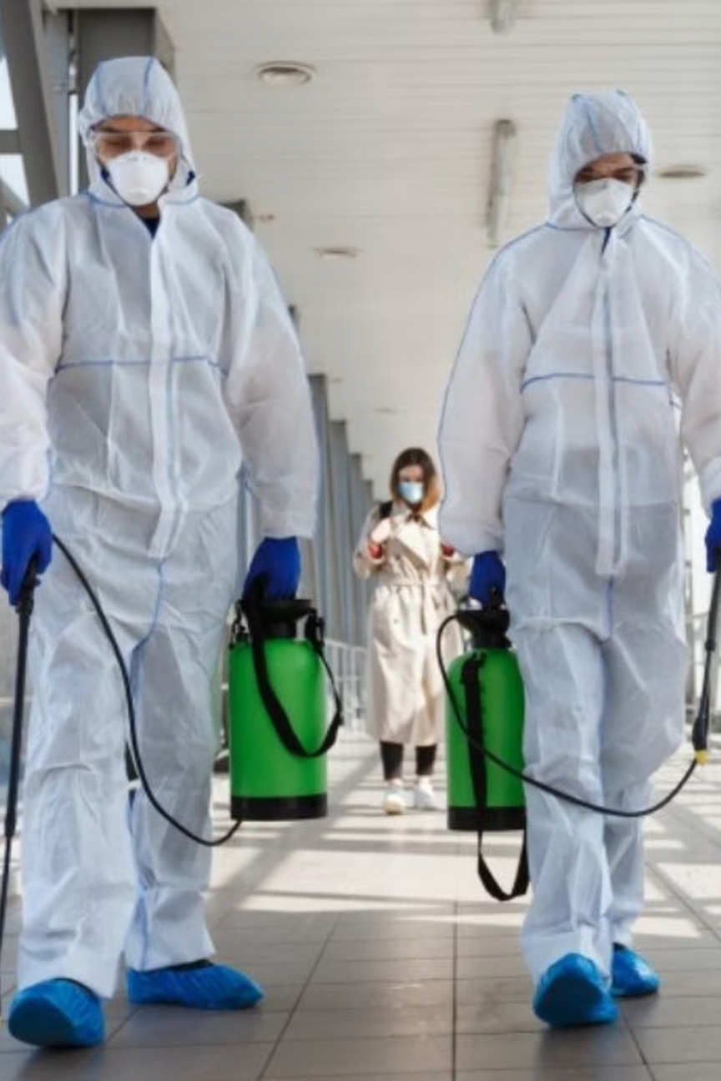



Real-World Impact & Applications
Healthcare Preparedness
Government Planning
Helps hospitals prepare for case surges and manage resources better.
Supports policy decisions and guides public health response.
Early Warning System
Alerts authorities early to prevent outbreak surges.

Slide 8
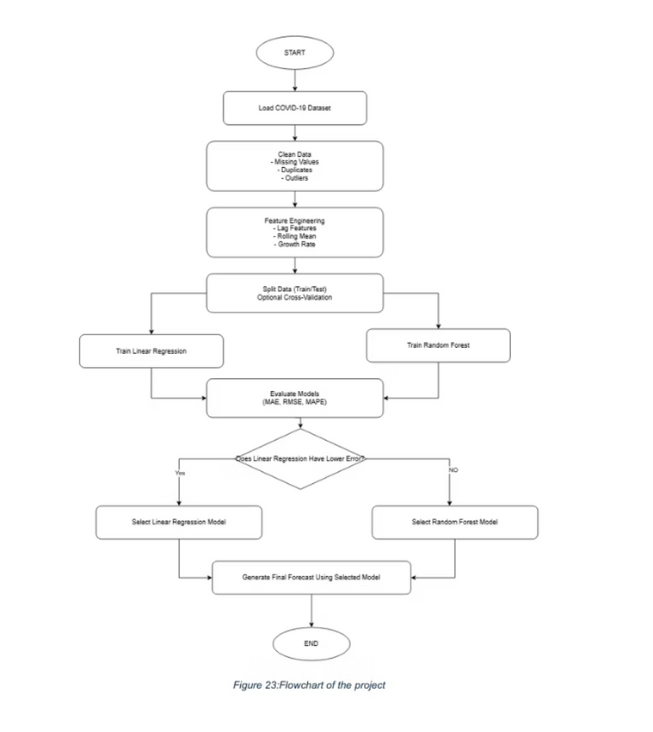
System Architecture: Flowchart
This flowchart illustrates the sequential steps involved in our COVID-19 prediction model, from raw data ingestion to final visualization of results.

Slide 9


Algorithmic Logic: Pseudocode
Start
Load COVID-19 dataset
Clean and preprocess data
Perform feature engineering
Split dataset into training and testing
Train Linear Regression model
Train Random Forest Regression model
Evaluate models using MAE, RMSE, and MAPE
Select best performing model
Predict future cases using the best model
Visualize prediction results and trends
End
This pseudocode outlines the core computational logic behind our machine learning prediction system, detailing each major phase.

Slide 10

Thank You
Any Questions?

