Slide 1
Bank Query Chat-Bot Using Machine Learning
Presented By
Manjula Das
Under the guidance of
Hitendra

Slide 2
Agenda
Introduction
Objective
Flow of the project
Project design with Flask architecture
About the dataset and EDA
Data Visualization
Pre-processing of data
Feature extraction
Algorithms applied
Performance measurement of each model
Python files for handling data cleansing and bot response
Screenshot of output on the terminal
Result: Screenshot of output on web-app

Slide 3
Introduction
This project is about building a chatbot for a bank where the end users can communicate with the Bot on any banking related questions and get instant reply
A banking chatbot with FAQ where the user interacts with a chatbot via the app UI.
Thus providing a guide to the bank customers who is available 24/7 to accept any query
We would apply MULTIPLE ml ALGORITHEM to solve this multi classification problem. In this code pattern, we will train the model with dataset containing both question and answers related to banking. The chatbot will detect the category and accordingly be enhanced by using Natural Language Understanding to identify the answers or say solutions. For FAQs, a call to one of the service or dataset used for training will be used to retrieve the answers from a collection of documents. We would be creating a Flask api for the web-app.
Focus of this project =>
Converse via a web UI chatbot
Use dataset for retrieval to find answers in FAQ documents

Slide 4
Objective
To effectively predict the answer to the customers question.
To use a predictive model which gives the highest accuracy score by comparing the algorithms.
To make bridge between the customers and the bank

Slide 5
Flow of the project
User interacts with a chatbot via the app UI
User input is processed with Natural Language Understanding(NLU). The context is enriched with NLU-detected entities and keywords (e.g., a category questions belong to like loan, account etc..)
The input and enriched context is sent to Assistant(bot). Assistant recognizes intent, entities and categories. It responds with a reply and/or action.

Slide 6
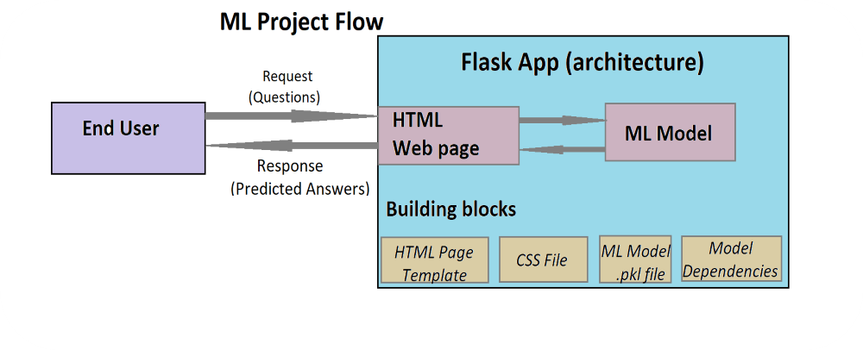
Project design with Flask architecture

Slide 7
About the dataset and EDA The csv file consists a raw data from M&N baking queries. These queries are recorded from real-time BPO call tracks made from bank customers The dataset consists queries and responses along with multiple categories depending on the type of queries.
Dataset consists
Count of queries belonging to each categories
Size of dataset
Columns | 3
Rows | 1773
Categories | 7
Null values | None
Duplicates | 430
Categories | Numbers of queries
Accounts | 315
Cards | 403
fundtransfer | 14
Insurance | 469
investments | 140
Loans | 375
Security | 57
Total Count of queries | 1773
Queries before cleaning
Duplicate Queries
430
Queries after cleaning
1343
1773

Slide 8
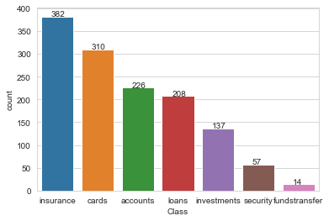
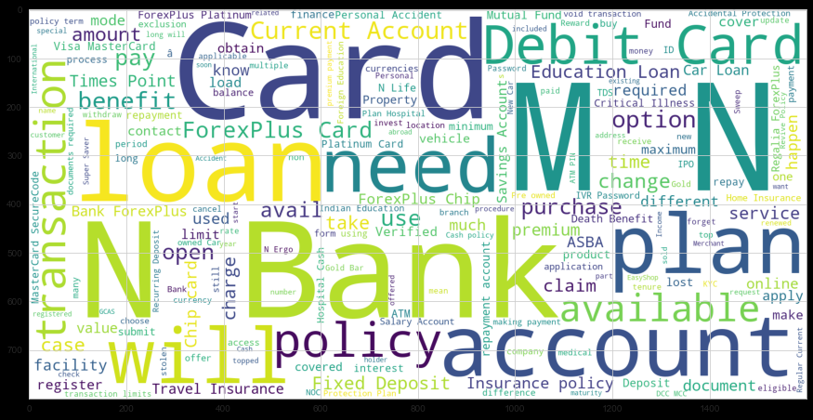
Data Visualization
Have used seaborn and matplotlib for EDA and visualizing the data
Count plot and histogram plot is used on Class column to see how they are distributed.
Used ‘wordcloud’ on Question and Answer to view the frequency of words used in the respective columns.

Slide 9
Pre-processing of Data
Below techniques have been implemented for pre-processing the data-
Casing - handling conversion of uppercase/lowercase
Noise Removal - unwanted characters punctuation marks, special char, etc
Tokenization - to convert all texts into tokens(all tokens would be words separated by spaces)
Stop words removal - some words don't contribute much to ML model so remove them(they don’t contain any important significance)
Text Normalization (Stemming/lemmatization)- this is based on stemming and lemmatization

Slide 10
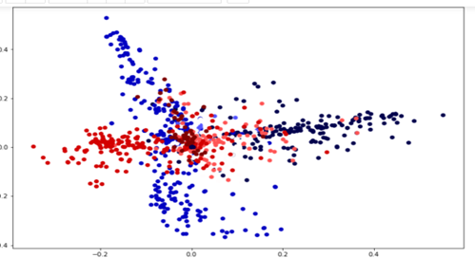
Feature Extraction
Used vectorization on the independent column
Labelled dependent column using Label Encoder to get the string values in numeric form
Used dimensionality reduction(truncatedSVD) on vectorized variable and plotted the graph to see how all 7 classes are scattered

Slide 11
Algorithms Applied
To solve this multiclassification problem I have tried 4 different algorithms to see which model would give better accuracy.
Logistic Regression(multinomial)
SVC(kernel= ‘linear’)
SVC(kernel= ‘poly’)
Random Forest

Slide 12
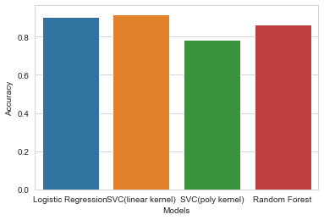
Performance Measurements of models
Models | Accuracy
Logistic Regression(multinomial) | 90%
SVC(kernel= ‘linear’) | 92%
SVC(kernel= ‘poly’) | 78%
Random Forest | 86%
Saved SVC(linear) model in pickle file as its giving the highest accuracy score
Successfully responding to end user’s questions with appropriate answers

Slide 13
Python files for handling data cleansing and bot response
In a separate python file , created a function where nlp techniques are used to clean, tokenize any external text data. Named it as ‘cleaning_function.py’
Created a new python file named ‘response.py’ which is integrated with ‘cleaning_function.py’ and predicts the class to which external question belongs to. Compared the external question with the set of questions we have in our data-frame belonging to the same class. This function will return the Answer of that corresponding index number (of Question)from our data-frame

Slide 14
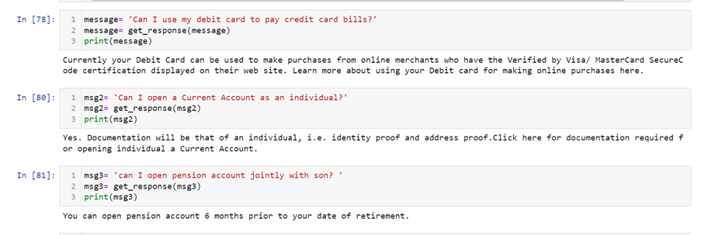
Screenshot of output on the terminal

Slide 15
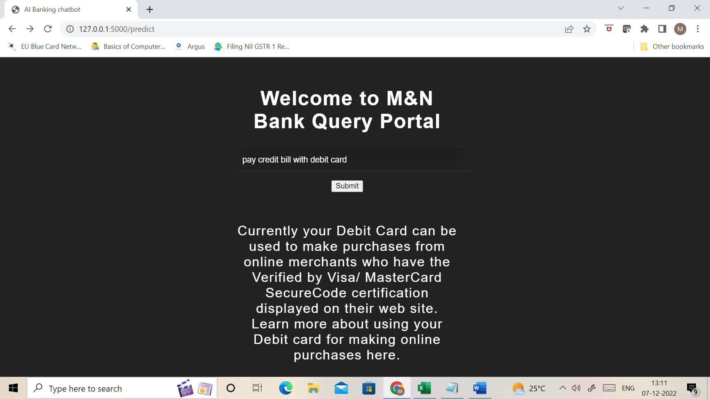
Screenshot of output on web-app

Slide 16


