Slide 1
GStar Assignment 2
Linear attention
and Kimi Delta Attention
Forward kernels from scratch
01
Notes:
Introduce GStar Assignment 2. Students implement forward operators from scratch, beginning with a PyTorch mathematical foundation and progressing to Triton kernels. The final target is chunked Kimi Delta Attention (KDA). The assignment folder contains all starter code, local references and student documentation. Source: README.md and docs/00_overview.pdf.

Slide 2
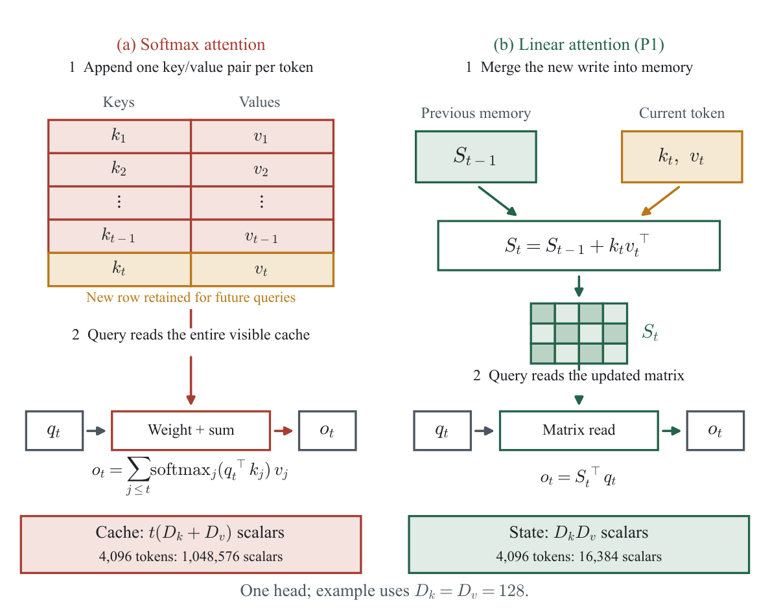
Two ways to carry history
Token cache
Each new token adds
a key and a value.
Matrix memory
Each new token changes
the same-sized state.
02
Notes:
Use the diagram to trace token t. Softmax attention appends its current key and value to the visible cache. The query compares with every visible key and combines the values. P1 instead writes an outer product into a fixed matrix before the query reads it. These are different attention operators. The matrix combines associations and does not preserve arbitrary tokens as separately addressable entries. State/cache counts exclude all weights and temporary buffers. Source figure: docs/figures/overview_memory_mechanism.pdf; handout/motivation.tex; P1.

Slide 3



Efficient inference in frontier models
Recurrent state stays the same size as context grows.
Qwen3-Next
Kimi K3
Nemotron 3 Super
Gated DeltaNet (GDN)
+ full attention
Kimi Delta Attention (KDA)
+ full attention (MLA)
Mamba-2 state space
+ full attention
3B active / 80B total
104B active / 2.8T total
12B active / 120B total
Less history to read can improve throughput and batch capacity.
Sparse MoE, lower precision and optimized kernels can also lower inference cost.
Nemotron uses a linear-time state-space model. All three retain full-attention layers.
03
Notes:
Efficiency comes from several architectural and systems choices. In the recurrent layers, bounded attention/state-space memory avoids a growing token KV cache and can reduce long-context history traffic. This can improve batch capacity and decoding throughput. Full-attention layers in these hybrid models still retain token-dependent caches, so model-wide memory is not constant. Sparse MoE activates a subset of parameters per token; lower precision, MTP/speculative decoding, optimized GPU kernels and serving choices also contribute. This slide does not claim uniform speedups, measured prices, or that linear attention alone causes low API prices.
Qwen3-Next uses Gated DeltaNet with full Gated Attention and activates 3B of 80B parameters. Source: https://huggingface.co/Qwen/Qwen3-Next-80B-A3B-Instruct/blob/main/README.md and https://qwen.ai/blog?id=qwen3-next .
Kimi K3 combines KDA with Gated MLA, activates 104B of 2.8T parameters, and supports low-precision inference. Source: https://github.com/MoonshotAI/Kimi-K3 .
Nemotron 3 Super combines Mamba-2 state-space layers, full attention and Latent MoE, with 12B active of 120B total parameters. Mamba-2 is a related linear-time SSM; it is not a GDN or KDA layer. Source: https://developer.nvidia.com/blog/introducing-nemotron-3-super-an-open-hybrid-mamba-transformer-moe-for-agentic-reasoning/ .
Logo sources and files: docs/slides/assets/brand_sources.json. Logos identify the model providers.

Slide 4
Kimi K3 at one million tokens
74%
less attention-history
storage
69 KDA + 24 MLA layers
versus 93 MLA layers
One request at 2²⁰ tokens. Calculated storage, before sharding. The all-MLA case is hypothetical.
BF16 MLA cache + FP32 KDA states. Excludes weights, convolution states and temporary buffers.
04
Notes:
Primary sources: https://github.com/MoonshotAI/Kimi-K3 and https://huggingface.co/moonshotai/Kimi-K3/blob/main/config.json . Bundled provenance and formulas: docs/data/kimi_k3_memory_config.json, docs/data/README.md and docs/data/kimi_k3_memory_estimates.json. For one request at 2^20 tokens, 24 compressed MLA caches plus 69 KDA current matrices require 27.404296875 GiB. Counterfactual: replace all 69 KDA layers with the same compressed-cache MLA, giving 93 MLA layers and 104.625 GiB. Storage reduction is 73.8071%. This retains MLA compression. This is an analytical storage estimate, not measured VRAM or a trained ablation. Assumptions: BF16 MLA cache, FP32 KDA matrices, before sharding. Excludes weights, convolution states, temporary buffers, padding, extra checkpoints and replication.

Slide 5
The nine-problem path
Matrix memory
Forgetting and correction
Kimi Delta Attention
P1
PyTorch foundation
P4
Gated linear attention
P7
Gated DeltaNet
P2
Recurrent Triton
P5
Recurrent DeltaNet
P8
KDA recurrence + scores
P3
Chunked linear attention
P6
Chunked DeltaNet / WY
P9
Complete chunked KDA
Each stage gives the next stage a recurrence, a kernel pattern or a reusable primitive.
05
Notes:
Students proceed in problem order. P1: sequential and chunked PyTorch linear attention. P2: recurrent linear Triton. P3: chunked linear Triton. P4: GLA recurrence, chunk-local channel prefix scan and chunk state/output. P5: recurrent DeltaNet. P6: triangular inverse, WY factors and chunked DeltaNet, with P3 output reuse. P7: recurrent/chunked Gated DeltaNet. P8: recurrent KDA and stable channel-gated scores. P9: complete chunked KDA. Source: README.md, The nine problems; each problem PDF.

Slide 6
P1: remember by updating a fixed state
A growing history. One matrix to carry.
Sₜ = Sₜ₋₁ + kₜ vₜᵀ
oₜ = Sₜᵀ qₜ
Every token changes the contents.
The shape stays Dₖ × Dᵥ.
Your first task
Make the recurrence and
chunk form agree in PyTorch.
06
Notes:
Linear attention changes the operator from softmax attention. Its matrix state merges key/value associations, so it does not preserve arbitrary past tokens as individually addressable entries. The state dimensions are independent of the token count. Read after the current write. P1 implements recurrent and chunked forms in PyTorch. Query scaling is omitted from mathematical notation. Source: docs/problem_1.pdf and problem_1.py.

Slide 7
P2: make one memory update a GPU kernel
Read the old memory.
Write the current association.
Answer from the updated memory.
Each Triton program owns a tile of value columns.
It carries that tile through the token loop.
07
Notes:
P2 implements the same additive memory as P1 using Triton. Each program owns one value-column tile, updates its own state and reduces over key channels for the query read. Programs need no cross-program reduction for separate value columns. The token loop remains sequential within each program. State is updated before output. Query scaling is omitted from mathematical notation. Source: docs/problem_2.pdf and problem_2.py.

Slide 8
P3: process a prompt in chunks
During decoding
During prompt processing
One new token.
One state update.
Many tokens.
Chunked matrix products.
Each output combines
earlier history in the entry state
+ visible writes inside the current chunk
08
Notes:
A token recurrence is convenient for decoding but serial over the prompt. P3 builds entry states for each chunk and then launches output programs independently across chunks. Each output combines an entry-memory read with local inclusive causal interactions. This is exact regrouping of the same linear operator, not truncation of context. Boundary states are saved intermediates; current recurrent state size remains fixed. Query scaling is omitted from mathematical notation. Source: docs/problem_3.pdf and problem_3.py.

Slide 9
P4: make room for new information
An old association can outlive its usefulness.
Keep adding forever, and old writes still influence later reads.
First reduce what the state retains.
Then write the new association.
P4 adds forgetting while keeping the same matrix size.
09
Notes:
Additive memory retains every write, and associations can interfere. GLA attenuates existing memory before adding the new association. This changes retention without changing state shape. Students implement recurrent decay, the chunk-local prefix scan, and chunked state/output transport. This slide deliberately uses no gate plots or numerical decay visualization. Query scaling is omitted from mathematical notation. Source: docs/problem_4.pdf and problem_4.py.

Slide 10
P5: correct an association
The same key first asks for 3, then asks for 7.
Add another value
Correct the prediction
3 + 7 = 10
3 + (7 − 3) = 7
Predict what memory already says. Write only the residual.
Scalar illustration: unit key and query; full correction strength.
10
Notes:
Exact scalar example: unit key, unit query, no forgetting, beta=1 and zero initial state. First target is 3 and second target is 7. Additive memory reads 10 after the second write. DeltaNet predicts 3 and writes the residual 4, so the keyed read becomes 7. Exact replacement requires a unit-norm key and beta=1; correlated keys may still interfere. P5 implements prediction, residual write and updated query read. Query scaling is omitted from mathematical notation. Source: docs/problem_5.pdf and problem_5.py.

Slide 11
P6: keep corrections in causal order
Token 1 changes the memory
that token 2 uses to predict.
Independent writes would miss that dependency.
The triangular solve preserves the order
inside a chunk of corrections.
Build the correction factors, then reuse P3’s output kernel.
11
Notes:
Delta corrections are dependent: token 2 predicts from the state after token 1's correction. Independently predicting all tokens from a chunk entry would give different writes. A strict lower-triangular system encodes these dependencies. P6 implements its inverse, forms compact W/U factors and computes P=U-W S_in for the actual chunk entry. It reuses P3's output kernel. Do not claim the entire sequence becomes independent or all operations run in parallel. Query scaling is omitted from mathematical notation. Source: docs/problem_6.pdf and problem_6.py.

Slide 12
P7: forget stale memory and correct the current key
Forgetting
Correction
Reduce the influence
of old memory.
Revise the association
addressed by this key.
Forget first. Predict from what remains. Correct it.
P7 combines both ideas in Gated DeltaNet.
12
Notes:
Forgetting and delta correction have different roles. Delta correction changes the association addressed by the current key; directions orthogonal to that key remain unchanged. Scalar forgetting affects the whole previous state. Gated DeltaNet forgets first, then predicts from the decayed state and writes its residual. P7 combines these in recurrent and chunked forms using the P6 inverse. No gate plot is shown. Query scaling is omitted from mathematical notation. Source: docs/problem_7.pdf and problem_7.py.

Slide 13
P8: let different associations age differently
Some information should persist.
Some should fade sooner.
KDA refines forgetting across the key channels
of the same fixed-size memory.
It still predicts and corrects the current association.
P8: recurrent KDA + stable scores for the chunked algorithm.
13
Notes:
KDA makes forgetting channel-wise while retaining the delta correction. Key channels form a learned representation; they are not named human facts or separate token slots. The diagonal forgetting precedes the residual prediction and rank-one correction; changing that order changes the operator. P8 implements recurrent KDA and stable channel-aware score construction with secondary tiling. No gate values, gate diagrams, retention curves or matrix-order visualizations are shown. Query scaling is omitted from mathematical notation. Source: docs/problem_8.pdf and problem_8.py.

Slide 14
P9: assemble the complete KDA forward pass
Your earlier kernels become the final implementation.
Earlier work | Role in KDA
P4: prefix scan | Transport retained memory through a chunk
P6: triangular inverse | Preserve the order of delta corrections
P8: stable scores | Build the channel-aware interactions
Build local factors. Carry memory across chunks. Read outputs.
14
Notes:
P9 combines the scan from P4, triangular inverse from P6, and score primitive from P8. It builds chunk-local W/U factors, uses the entry state to compute actual pseudo-values, advances memory and reads outputs. Chunk-local factor construction is separate from the sequential entry-state dependence. The completed operator must match the independent recurrence for outputs and final state, including segmented calls. Query scaling is omitted from mathematical notation. Source: docs/problem_9.pdf and problem_9.py.

Slide 15
Implementation and correctness
Forward pass only
P1 uses PyTorch. P2–P9 use Triton on CUDA.
The checker compares outputs and final state
against an independent recurrence.
Important cases
Partial chunks, nonzero memory, unequal dimensions
and state carried between two calls.
15
Notes:
Problems contain named masked regions. Students preserve signatures and region markers. P1 may run on CPU with PyTorch. P2–P9 require CUDA and Triton. reference.py uses an independent sequential recurrence. The checker compares outputs and final state, checks intermediate factors, validates state passing across non-boundary splits, covers unequal dimensions and nonzero state, partial chunks, gates, query scales and padding. Correctness and performance are distinct. Benchmark only after correctness. Public tolerances remain provisional pending instructor GPU calibration. Source: docs/10_verification.pdf, autograder.py, README.md. No backward implementation is required.

Slide 16
The first implementation session
1
Read the overview and P1 mathematics.
2
Implement the sequential and chunked forms.
3
Check both outputs and the final memory.
python autograder.py --p1 --device cpu
Run from the GStar-Assignment-2 folder. Readings: docs/README.md
16
Notes:
Suggested first session: read docs/00_overview.pdf and the mathematical background in docs/problem_1.pdf. Implement the named P1 regions, preserving APIs. Run the CPU P1 checker from the assignment folder. Then prepare the Linux/CUDA/Triton environment and proceed to P2. The documentation index lists separate PDFs for each problem, verification and implementation reference. Source: README.md and docs/README.md. Independent numerical checks do not certify that a required chunked kernel was actually used, so students should also explain the required implementation and reuse.

