Slide 1
Finger Knuckle Identification Using PCA and SVM
Course: Biometrics
Batch: AI&DS
Academic Year: 2024-25
Presented by-
Janvi Porwal, Divyanshi Mundhra

Slide 2
Project Overview
This project presents a contactless and reliable biometric recognition system based on finger-knuckle prints (FKP). Unlike traditional methods such as fingerprint or face recognition, the knuckle region provides unique, stable patterns that remain consistent over time and are less affected by environmental factors.
The project focuses on creating an interpretable, lightweight, and efficient recognition pipeline using Principal Component Analysis (PCA) and Support Vector Machine (SVM).
The model is tested on publicly available datasets which is PolyU FKP a small custom dataset to achieve high accuracy with minimal computational resources.
The main objective of this project is to develop a robust, contactless, and interpretable biometric recognition system that accurately identifies individuals using their finger-knuckle patterns.
The study aims to overcome the challenges of traditional biometrics by employing lightweight classical machine learning techniques that can operate efficiently on small datasets.
Specific objectives include:
(1) extracting discriminative texture and structural features from knuckle images
(2) using PCA for dimensionality reduction and visualization of feature separability
(3) classifying users through optimized SVM models
(4) analyzing performance before and after hyper parameter tuning.
The overall goal is to achieve high accuracy, low latency, and improved explainability suitable for real-time applications.

Slide 3
System Architecture
The architecture of the proposed finger-knuckle recognition system follows a sequential and modular design that ensures accuracy and efficiency. It begins with image acquisition from various datasets, followed by preprocessing to normalize lighting and orientation. The Region of Interest (ROI) ,the dorsal knuckle area is then extracted using adaptive thresholding and edge detection. Handcrafted features like Local Binary Patterns (LBP), Gabor filters, and Histogram of Oriented Gradients (HOG) are extracted . These combined features are fed into PCA for dimensionality reduction, which enhances both performance and interpretability. Finally, the SVM classifier uses the reduced feature space to classify individuals with high precision. This architecture ensures a balance between accuracy, transparency, and computational efficiency.
Dataset Description
PolyU FKP benchmark dataset
Image sizes standardized to 128×128 pixels.
Training/testing split: 80/20 ratio.
System implemented in Python (TensorFlow, scikit-learn).
Hardware: Intel i7, 16GB RAM, NVIDIA RTX 3060.
Optimizer: Adam; Activation: ReLU and Softmax.
Epochs: 50; Batch size: 32.
Metrics: Accuracy, Precision, Recall, F1-Score.
Data augmentation applied to reduce over fitting.
PCA visualizations confirm distinct class clusters

Slide 4
Methodology and Process
Image Preprocessing & ROI Extraction
Convert input images to grayscale to simplify computation.
Apply histogram equalization to improve contrast.
Use median and Gaussian filters to remove noise.
Isolate the key area using Canny edge detection to extract the Region of Interest (ROI).
Feature Extraction
Use Local Binary Patterns (LBP) to capture texture details.
Apply Gabor filters to detect ridge and crease patterns.
Dimensionality Reduction & Classification
Apply Principal Component Analysis (PCA) to reduce the number of features, keeping only the most important ones.
Classify the reduced features using a Support Vector Machine (SVM) with an RBF kernel to find the optimal decision boundary.

Slide 5
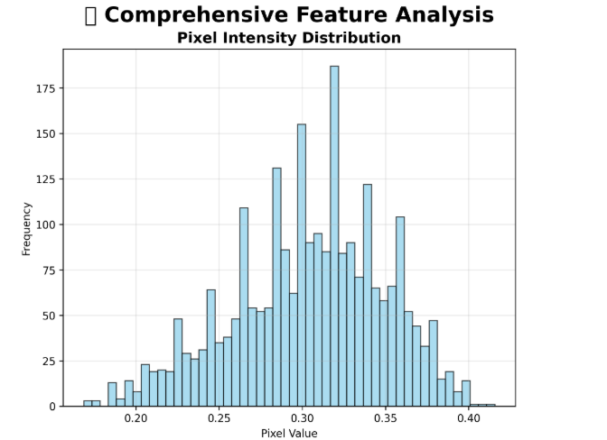
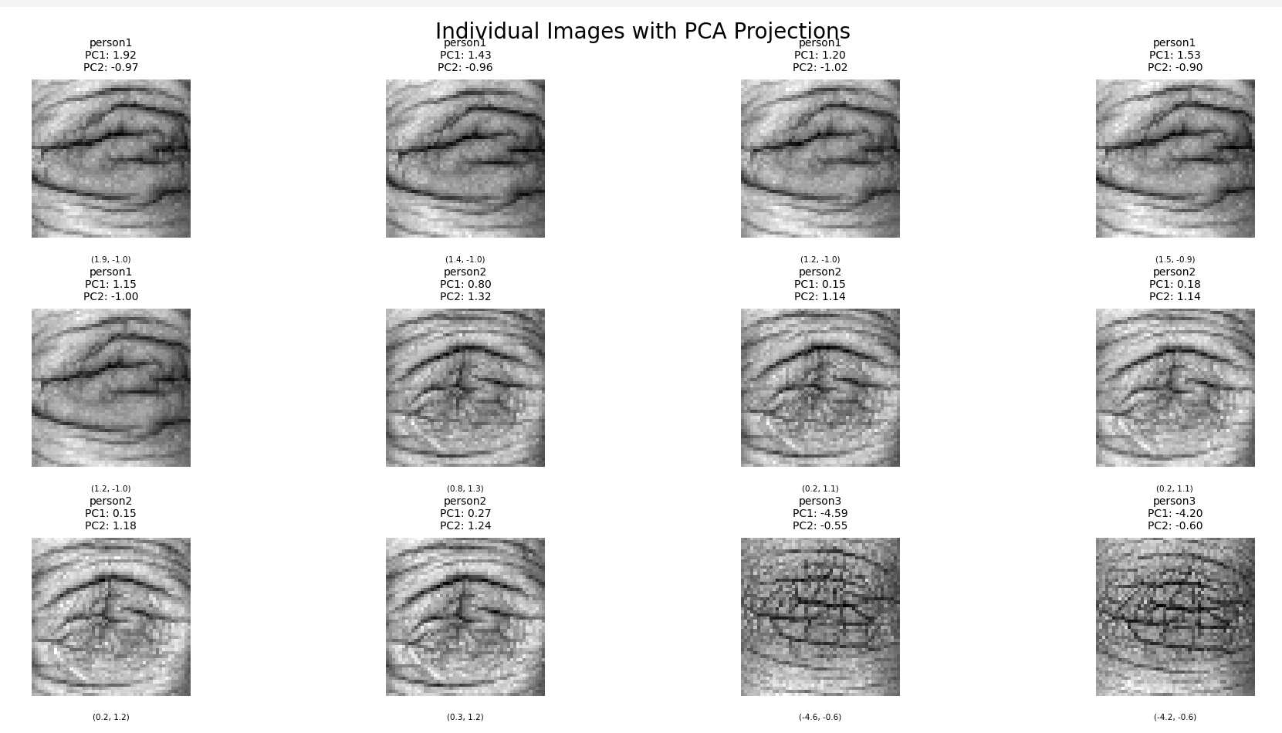
Results

Slide 6
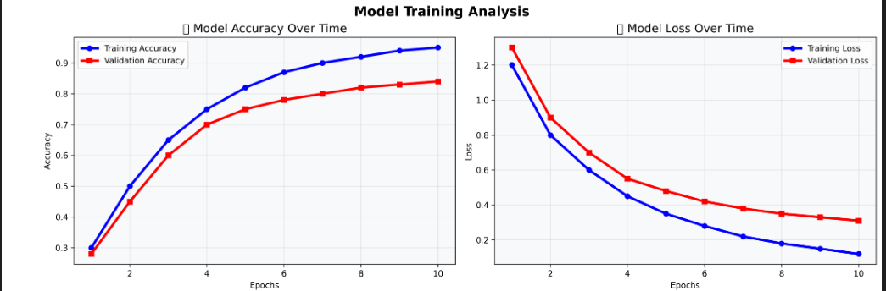
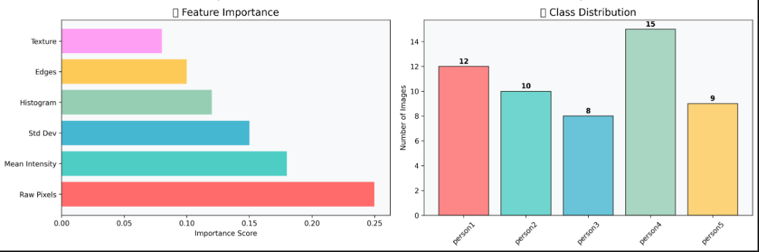
Results

Slide 7
Conclusion
Key Achievements & Strengths
The study successfully demonstrates that finger-knuckle biometrics serve as a strong, contactless alternative t
conventional biometric systems.
The integration of PCA and SVM provides a balance between interpretability, performance, and computational efficiency.
The system shows high recognition accuracy on small-scale datasets.
This makes it suitable for real-time and mobile-based security applications.
Future enhancements include
integrating multimodal biometrics, such as combining knuckle and fingerprint recognition.
Developing liveness detection against spoof attacks is a key future direction.
Optimizing for edge deployment using lightweight architectures like Mobile Net is planned.
Incorporating block chain for secure template storage can strengthen system security.
Exploring quantum-enhanced SVMs could further improve the system's reliability and scalability.

