Slide 1
Betting Data Warehouse Analytics
Insights from Daily Betting Volume, User Behavior, Match Popularity & More
Muneeb Ali
13 May 2025

Slide 2
Project Overview
Purpose: Build a robust betting data warehouse for actionable business insights
Key Features :
Star schema design with fact and dimension tables
Handling missing data and anonymous users
Slowly Changing Dimensions for accurate historical analysis
Benefits:
Data-driven decision making in betting,data modelling for Machine learning

Slide 3
Data Warehouse Design Highlights
Fact table: Bets with transaction details
Dimension tables: Customers, Sports, Leagues, Matches
Surrogate keys and SCD Type 2 implemented for tracking customer changes
Anonymous users identified by IP address to avoid data loss

Slide 4
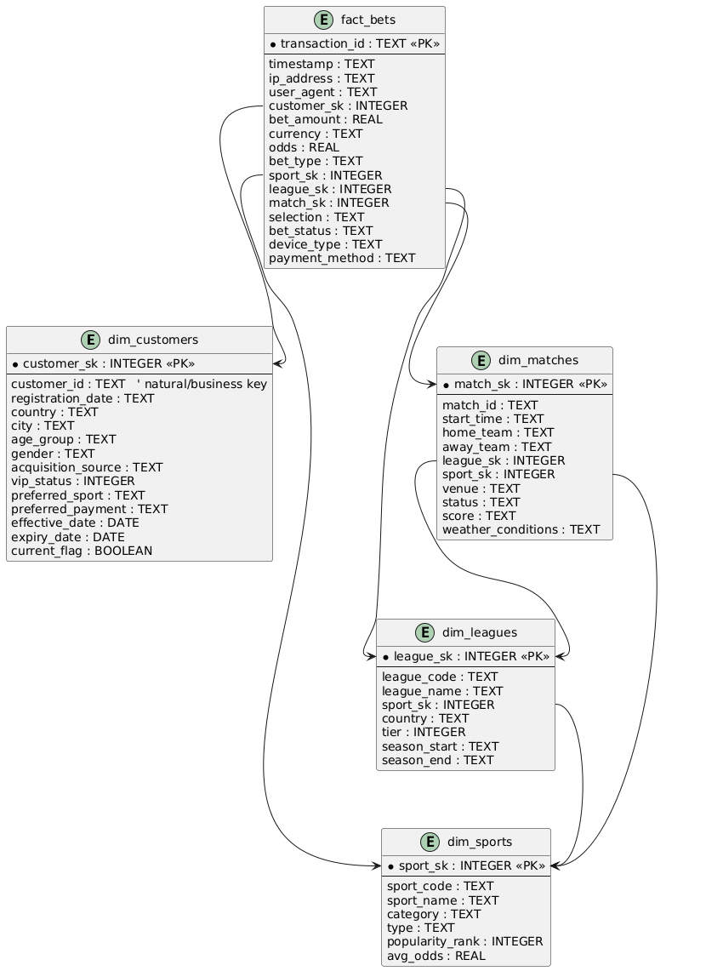
Data Warehouse Design Highlights

Slide 5
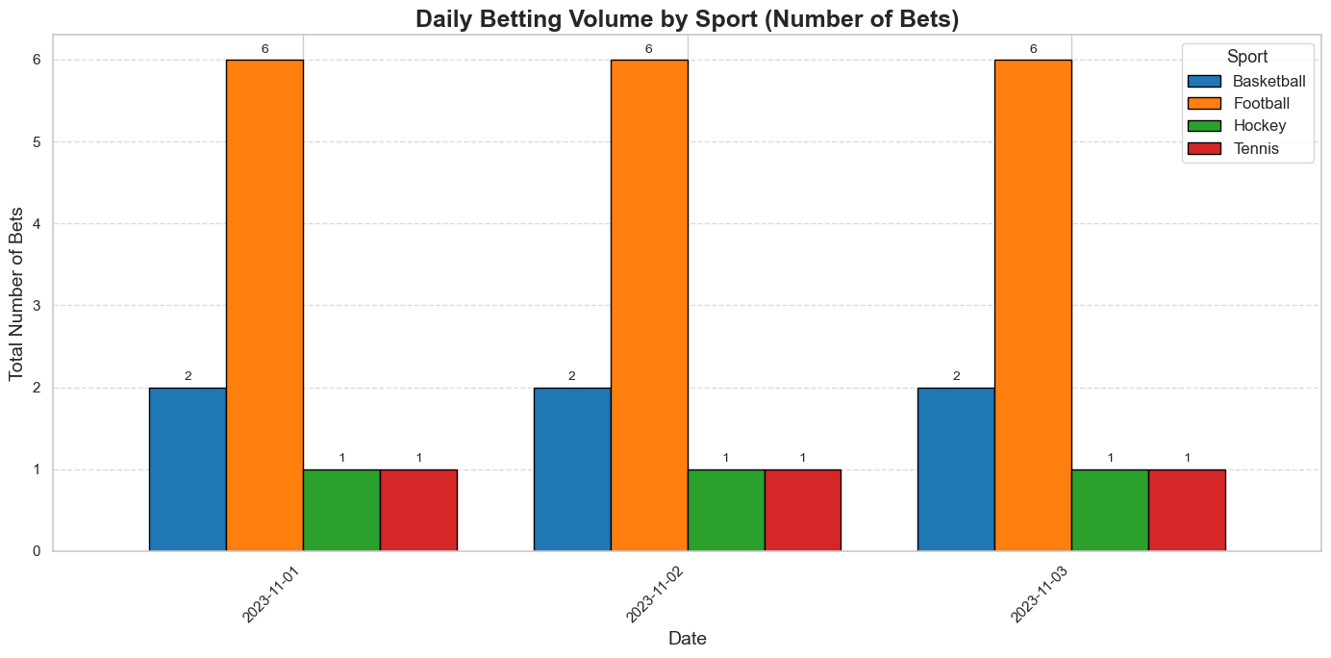
Query 1 - Daily Betting Volume by Sport

Slide 6
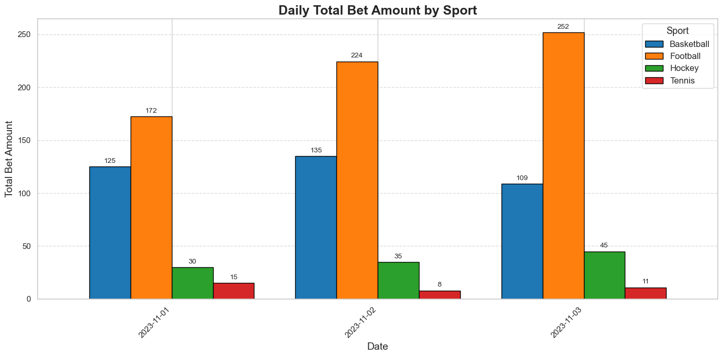
Query 1 - Daily Betting Volume by Sport

Slide 7
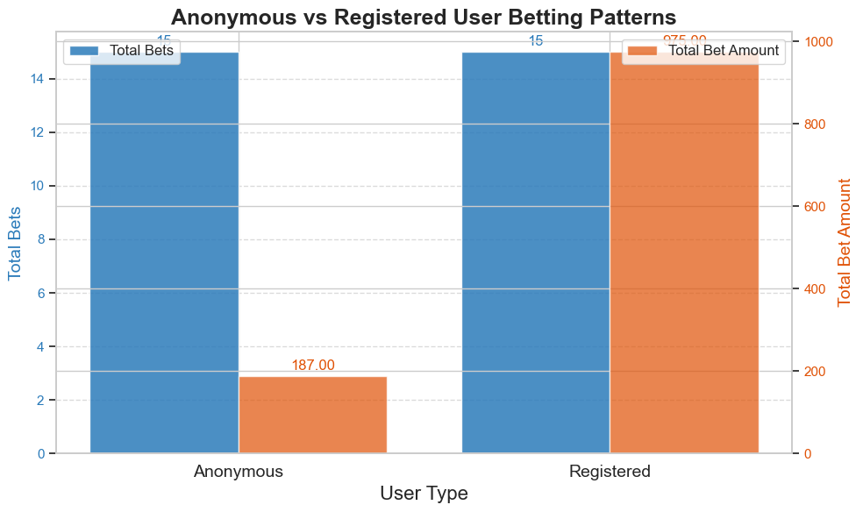
Query 2 - Anonymous vs Registered User Betting Patterns

Slide 8
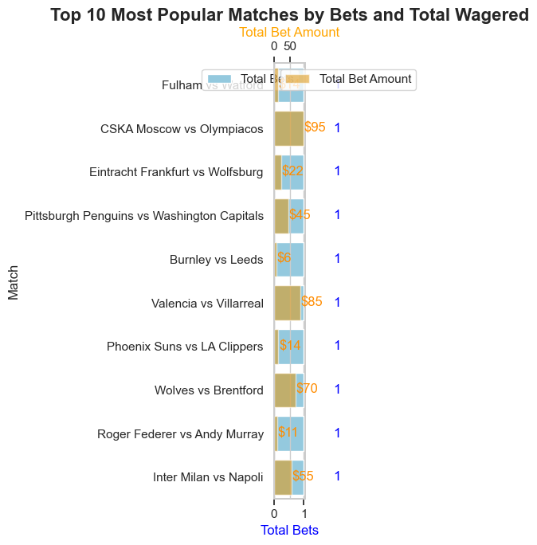
Query 3 - Match Popularity and Betting Performance

Slide 9
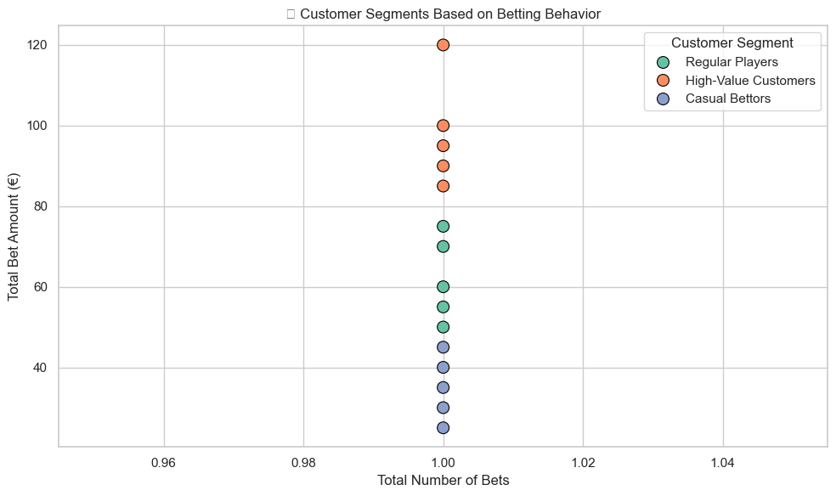
Query 4 - Customer Segmentation by Betting Behavior

Slide 10
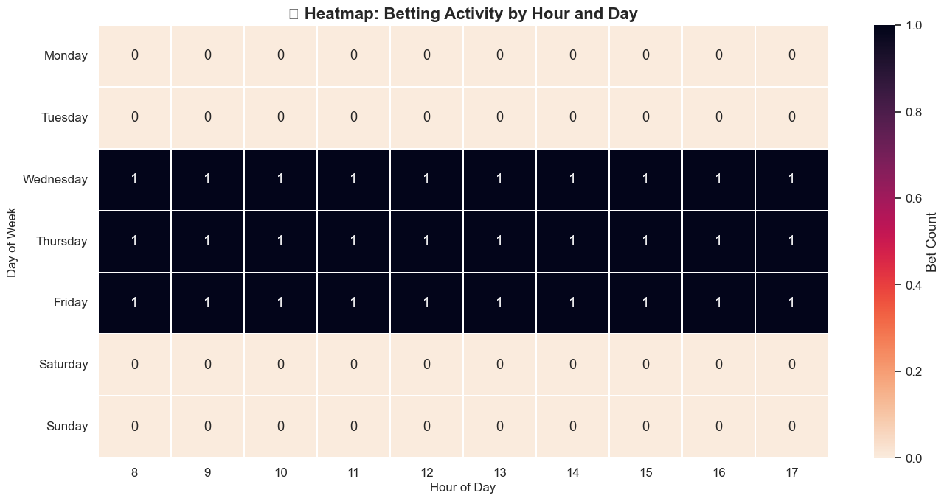
Query 5 - Temporal Analysis of Betting Patterns

Slide 11
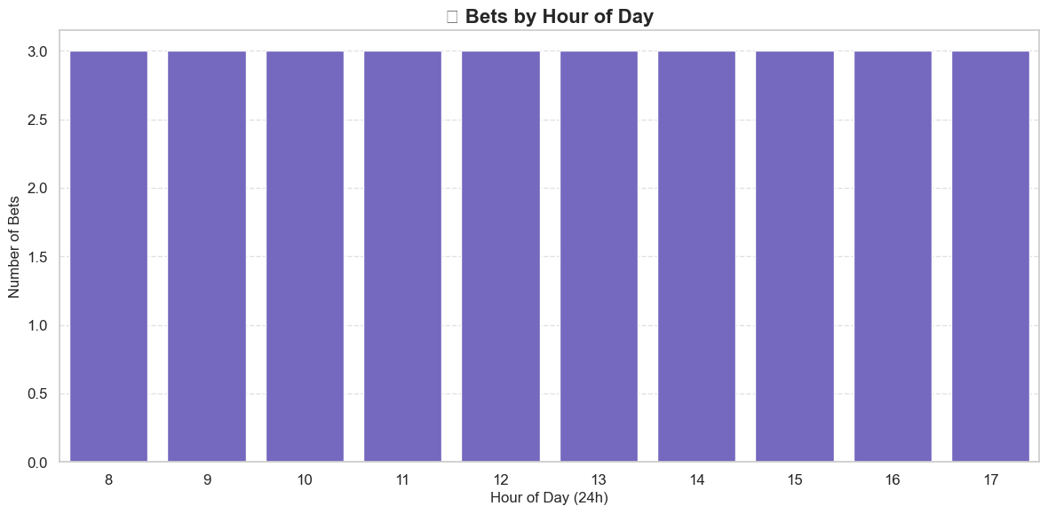
Query 5 - Temporal Analysis of Betting Patterns

Slide 12
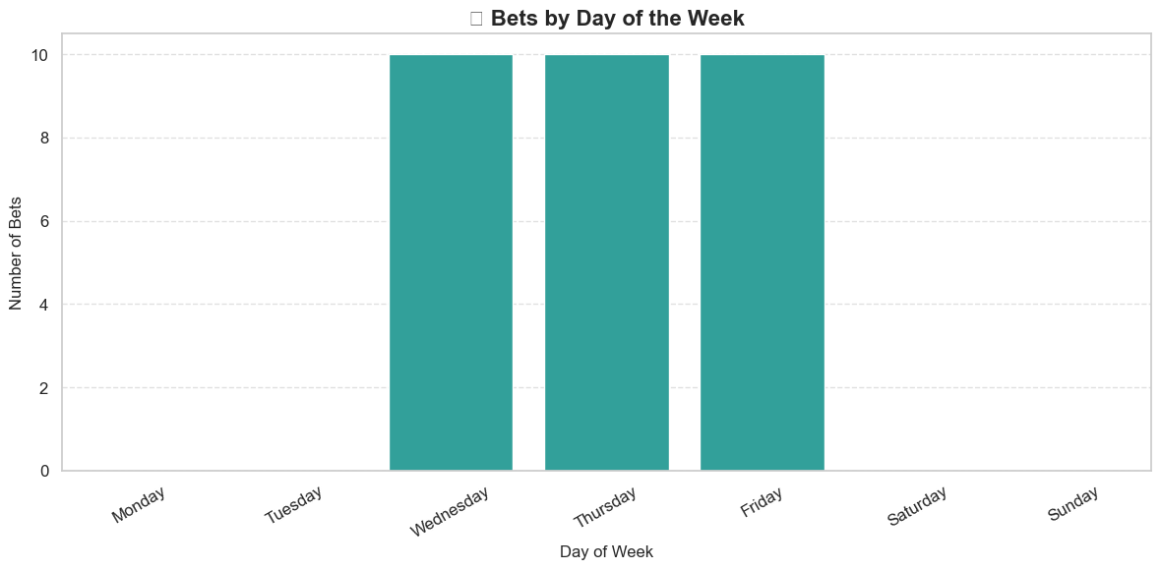
Query 5 - Temporal Analysis of Betting Patterns

