Slide 1
What is VCS(Version control System)
To keep track of changes (when ,where and who) made in a file, document, application code , computer programs etc. we use VCS.
VCS(Version control system is independent of technology/project/framework etc.
If you are working as a team then VCS is more in picture for collaboration.
VCS allows you to merge all changes into one common version.
Save different version of your projects
Allows you to restore previous version if required.
Easy detection of bugs
VCS is also known as Revision Control or Source control system
You can restore previous version of codes, can identify error in code easily using VCS
VCS provides backup of codes. If central server is down then evey individual also has copy of the code and you can made his PC as server to run the application

Slide 2
Types of VCS
VSS ::: Visual Source Safe is source control program…developed by Microsoft …for small software development project….no more in use now a days…drawback is ..one user can work on a file at a time..
SVN::: sub version…introduced by Apache… it’s a centralized version control system.. All code is available on centralized server and every user has spefic file of that code….Drawback is every user does not a full copy of code.
GIT::: designed by one of the contributor of linux creator… It is distributed version control system…every user has full copy of working project. And every user can keep track of changes without submitting to central system.
Centralized version control system (CVCS)
Distributed version control system (DVCS)
In this system…if you commit the changes then it would be available on central system else not. SVN follows CVCS
GIT follows DVCS

Slide 3
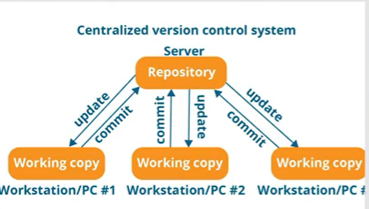
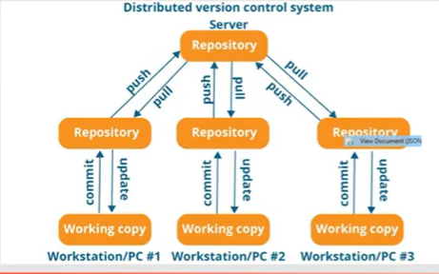
Types of VCS CVCS DVCS

Slide 4
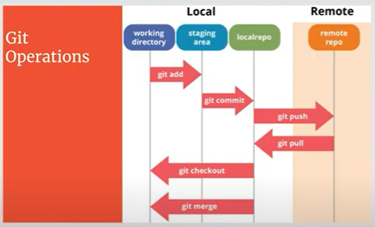
GIT
GIT is Distributed Version Control System(DVCS) for tracking in changes in source code during software development

Slide 5
GIT BASIC Operations
Initialize:→ git initialize → to bring your working directory under git umbrella
Status:→git status→ tells you the status of all your files .. How many untracked, how many on staging phase etc.
Add:→git add filename→ to place a file from working directory to staging place. Only specified file will be moved to staging
Commit:→ git commit → to push all files from staging place to local repo…creates local snapshot keeping track of changes
Push:→git push→ to push files from local repo to remote/cloud repo
Pull→git pull→ to get/retrieve files from remote/cloud repo to local repo
GIT Advance Operations
Branching: you have a master branch
Merging: Merge one branch code with other
Rebasing: it mege also branch code however we can not distinguish who created and what merged.

Slide 6
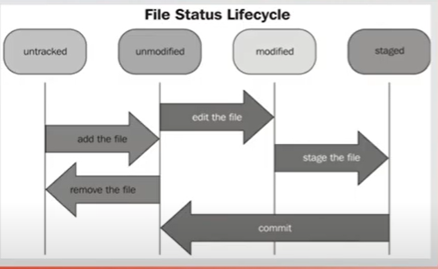
Repository: its kind of database where VCS stores all the versions and meta data. In git, Repository is just hidden folder named git in the root directory of your project Working Directory: The root folder of your project is called working directory. This is the directory of your local computer which keeps all files of your project File Status: files in working directory can be in below status untracked: file is under working directory but not tracked by git unmodified: once file is added(git add)at staging phase first time.now its tracked by git modified: when the file is at staging phase and some changings are made in the file..we have to add it agin (git add)..this is modified file at staging phase staged:

Slide 7
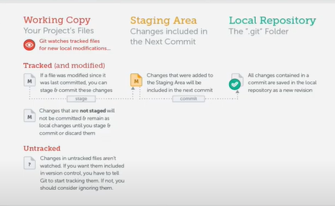

Slide 8
Head:- refers the current branch Commit Hash: every commit has unique identifier of 40 characters Ignoring Files: In every project there are couple of files which you don’t want to be version controlled. We create an empty file .It has no name but with extension .gitignore in root folder. You can ignore specific file, files with specific extensions, specific folder. Gitignore file itself will be visible and committed. For Example, if you write below in .gitigonre file
abc.csv →ignores csv file named as abc.
*.xls → ignores all xls files
\foldername\ → ignore all files in mentioned folder.

Slide 9
Branching:: called also context. In Your application, you have different sections/feature. You can create different branches for each feature to work independently . Branch is mandatory (not optional)… When you initialize your project/working directory. Be default MASTER branch will be created. When you create a new branch …it has the same status of parent branch…Means same commit. Same folder..same code. When you make any changes or create a new file and also commit it. These new changes or new files will not be reflected in other branches until you merge it Production and Development stages: In production stage, application is live and operational. In Development Stage, You are under testing phase of whole application. If you create a new branch and switch to that new branch…then all the changes(like new file creation, code changes) you will made in this branch will not be visible to other branches two types of Branch : Short lived and Long lived Short Lived:- for single topic and feaure. And removed once work done with them Long lived:- long term and Permanent like development When two or more than 2 devlopers are working on the same project ,same file and make some changes on the same line..It will crate “MERGE CONFLICT”..You can manage merge conflict y=through any tool(Smart git)

Slide 10
STASH: commits save changes permanently while stash save changes temporarily. Its like clip board where you can save your code temporarily without commenting. If you have to switch from one branch to another..you have to commit all you changes else your changes will lost. So you need to save all changes in way that can be used later. STASH comes then in the picture. Save you code at stash (clipboard) without committing. STASH is temporary place in git which store info for long period

Slide 11
Remote Repo:: Local repo reside on local machine which can’t be accessible to your teammate. Remote repos are hosted on server which are accessible to team mates. You can make your own server but you have to manage, maintain this sever then which is expensive GItHUB is online service for remote Repo. You may use other server like gitlab etc. Github acts like back ..You can change online code/files at remote Repo..but its not standard practice.. Generally Remote repository name is origin and branch name is master/main by deafault. Local Repo can be connected and send data to multiple Remote Repos. Origin: is the URL of remote Repo. You may use below commands on your local repo -git clone Remote Repo URL --- to clone the codes from remote repo into your local repo…It will create new project(folder/repo) in your local working directory.. All Available files/code of Remote Repo will be available in local repo…Please remember that this command will create a new repo/folder in local machine . -git remote add < remote RepoURL> --- to add new / additional Remote repo with existing local Repo .. you can change remote Repo as well

Slide 12
Ways to work with Remote Repo
1. If You don’t have local repo…then you will clone remote repo… git clone repo URL..will create local repo in current working directory.
2. If you already have local repo..then you will add remote Repo.. git add remote origin Remote URL… You will use git push –u origin URL for first time to push data towards remote Repo.
When you publish data from local report with a branch which is not exist in Remote ..then a new branch (with same name) will be created in remote Repo.
You can also create a new remote branch in Remote Repo ..and pull it in local repo

Slide 13
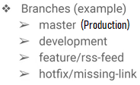
When are working in team, there should be some rules to be followed by all .there should be branching model. There should be specific branches for specific purpose and we should follow branching model You have to create pull Request to merge one branch into other. Pull Request is GIT HUB feature not GIT feature. PULL REQYEST feature I sued to merge the branches You can add rule under setting to block direct merging → Setting → Branches→Branch Protection Rule→ Require a pull request before merging You can add other developers to access your repo ..add user under setting
Git Workflow
Fork:
Fork is Git HB feature and not git feature
Fork is a clone from one server side to other server side
You can clone repository of others into your Githib account
when you don’t have write access on public projects/open source projects available in Git hub. You can fork them into your account, and then can create branches,commit,push into your account to Modify the code etc.
You can clone(store on local machine) then this fork repo. You local repo(cloned) can interact with your remote repo as well as with Original repo.
Mostly done with open source community project to contribute
You can create pull request for fork project ..this request will go the Parent repo owner.

Slide 14
Delete Branches: You can delete branches if you want UNDO Local Changes: if you have local changes which are not committed yet (till staging phase)..you can revert this changes by using special command :: 1. git checkout head → to discard changes in single file . 2. git reset –hard HEAD -→ to discard changes in all files UNOD Committed changes: You can even revert/reset the committed changes..there are 3 commands. 1. git revert (commithash)..it will crerate a new commit..old commint history will also be there however changes/content of that commnet will be deleted.If you revert a commit available in th middle of commits..only geiven commit will be be removed ..commit before and after will not chane ..which is not in case of we use below commands 2. git reset – hard (commithash).. it rollback the commit and moves your head to back at the position of given commithash. 3. git reset – keep (commithash).. it rollback the commit and moves you to back at the position of given commithash and keeps the history locally of deleted committs.

Slide 15
Rebase
There are 2 types of integrate changes made in different branches
Merging: easiest way to integrate changes of different changes: It create history of all commits of all branch. In merging ..we have two possibilities
Fast forward:: when you have changes in one branch and merge these changes in other branch, called FFM
Merge commit:- when you have additional changes in both branches . In that case you have to run merge command in both branches…additional comment(in first merging) will create to show that there is different comments in both..and when you run merging command in second branch it will act like fast forward branch. Because changes are already mde in first merge.
Rebase: more complex technique than merging. It does not consist main split merging commet.. It is applied when both branches have different comments…All the changes in different branches are maintained in single line. Looks like single branch is evolved. Changes of other branch is included in first branch after the common point of comment…and then at the end, the first branch commits added

Slide 16
Mark Down: this is light weight language to add formatting elements in plain text documents. This language created in 2004 by John Gurber… This language is used to add format in a files such as readme to create rich text. Git hub released it own language based on original markdown language.its called GFM(Git hub flavoured Markdown)language. Once you apply formatting in your readme file..then commit and push it to see its formatted version in Git hub. You can directly modify changes in readme file at github to avide commit again and again.

