Slide 1
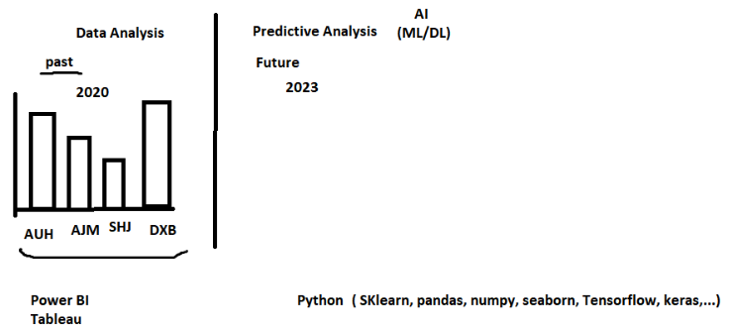

Slide 3
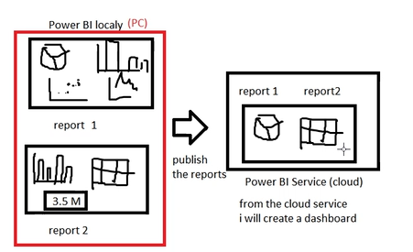

Slide 4
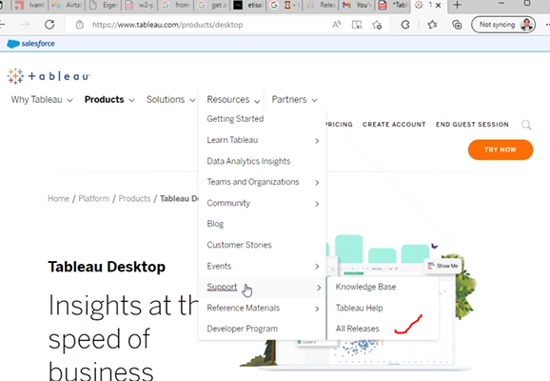
To find different releases of Tableau Desktop software

Slide 5
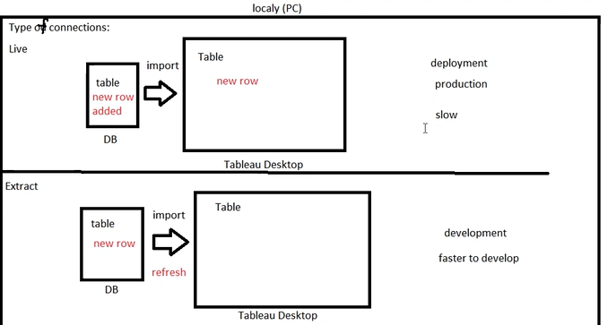

Slide 6
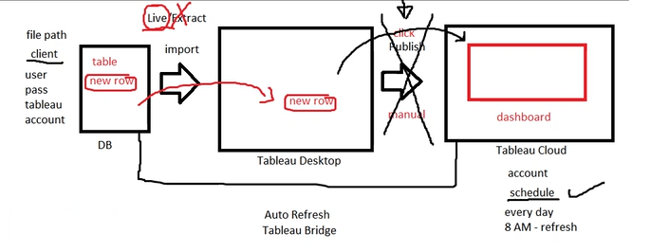


Slide 7
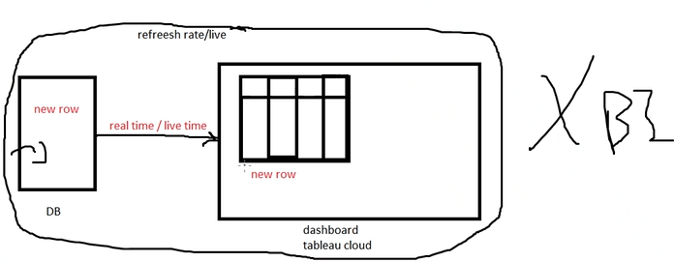
Real time refreshing is not possible (Min 15 Min refresh time

Slide 8
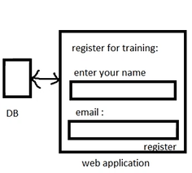
Difference b/w Desktop dashboard and Web Application
You can manuplate/edit the data in web Application which is not possible in Dashboard

Slide 9
