Slide 1
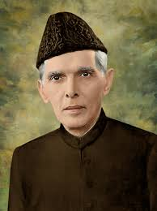
1937-1948:
1937: Elections of 1937.
1940: Pakistan resolution.
1944: Gandhi- Jinnah Talks
1945; Election of 1945
1948: problems after partition.

Slide 2
1937-40:
Election of 1937.
Unite all the muslims and started campaign.
Build up more support for party.
Pakistan resolution was passed in 1940.

Slide 3
1944-45:
Gandhi-jinnah talks
Jinnah oppose Gandhi’s demands.
Jinnah was only concerned with two nation theory.
Took part in simla conference in 1945.
Elections of 1945.

Slide 4
1947-1948:
Held the post of governor general.
Spread the idea of one nation.
Emphasis on the Islamic law.
Secure member ship in uno in 1947.
Solve the administration problems.
Solve economical problems.
Form national security.

