Slide 1
Floater Finder
Prostate-biopsy fragment dependence
A CONCH safety experiment for pathologist review
Ashby Hackathon 2026
Measured development results. Clinical usefulness remains unverified.
01
Notes:
Floater Finder measures whether a pathology model depends on a small tissue fragment, and whether that evidence supports useful review. We completed a real-data pipeline and controlled stress experiments. We also rejected two review policies when they failed our development targets. This is a safety experiment with explicit failure gates.
Sources and disclosures:
Development evidence through commit 06c7b77. No held-out test predictions.

Slide 2
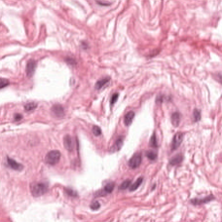
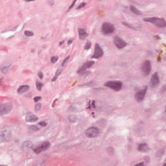
The specimen-consistency problem
Extraneous tissue can create a diagnostic discrepancy
Actual Radboud tiles
Native benign / GP4 annotations
No confirmed floater shown
A disease classifier can recognize cancer without establishing that the tissue belongs to the specimen.
The intended action is focused pathologist review. Original tissue and predictions remain intact.
02
Notes:
Extraneous tissue can create diagnostic discrepancies. A disease classifier can recognize cancer without establishing that it belongs to the specimen. These are actual PANDA tiles with native benign and pattern-four annotations. Neither is a verified natural floater. The intended output is evidence for pathologist review, while preserving the tissue.
Sources and disclosures:
Clinical context: Sapp et al. 2021, doi:10.14309/crj.0000000000000583. Tiles: media/provenance.json.
Lu et al., Nature Medicine 2024, https://doi.org/10.1038/s41591-024-02856-4
Bulten et al., Nature Medicine 2022, https://doi.org/10.1038/s41591-021-01620-2
Sapp et al., ACG Case Reports Journal 2021, https://doi.org/10.14309/crj.0000000000000583

Slide 3
CONCH and the review question
CONCH supplies reusable visual representations
Fixed morphology prompts support an engineering benign/cancer scorer. They do not certify specimen identity.
Disease prediction
Review evidence
Which component is unusual and consequential, and what uncertainty remains?
What does the sampled tissue resemble?
03
Notes:
CONCH provides reusable histology representations. Frozen morphology prompts supply our engineering disease scorer. Specimen consistency is a separate task. We therefore examine visual inconsistency, prediction influence and physical context separately. A piece can influence the cancer prediction and still be entirely genuine.
Sources and disclosures:
Lu et al., Nature Medicine 2024, doi:10.1038/s41591-024-02856-4. Frozen prompts/config: configs/panda_morphology_v1.yaml.

Slide 4
120 real slides and 50,729 embeddings
40 benign 40 GG1 40 ISUP 4–5
72 training 24 calibration 24 held-out
112 µm tissue fields, spatial coordinates and native mask fractions
512-dimensional normalized CONCH v1 embeddings
119 usable masks. Distinct slide splits, patient identity unknown.
Delta Slurm handled WSI processing and GPU encoding. Subsequent stress tests reuse saved features on CPU.
04
Notes:
Our cohort contains one hundred twenty Radboud biopsies and fifty thousand seven hundred twenty-nine verified embeddings. Slides split seventy-two, twenty-four and twenty-four across training, calibration and held-out test. Patient identities are unavailable. Clean sampling ignores cancer masks. Delta Slurm handled WSI processing and GPU encoding. Subsequent experiments reuse cached features on CPU.
Sources and disclosures:
reports/panda_s1_and_piece_results_20261020.md; reports/panda_embeddings_verified_23055022.json; reports/manifests/panda_verified_120_20261020.csv.

Slide 5
Clean benign/cancer baseline
Frozen top-5% pooling, calibration only
Original slide label | Predicted benign | Predicted cancer
Benign | 5 | 3
Cancer | 1 | 15
20 / 24
Accuracy 83.3%
Balanced accuracy 78.1%
Only 5 of 8 benign hosts start correct. New contamination errors must use those five as the denominator.
05
Notes:
The clean top-five-percent scorer is correct on twenty of twenty-four calibration slides, with seventy-eight-point-one percent balanced accuracy. It identifies fifteen of sixteen cancer slides, but only five of eight benign slides. Those five originally correct benign hosts define the new-error denominator. The three initial false positives cannot become new contamination errors.
Sources and disclosures:
reports/panda_clean_baseline_23055022.json, calibration/benign_cancer/top5pct. Rows truth, columns prediction.

Slide 6
S1: a controlled cancer-fragment stress test
32 benign host slides, 21 reused donor slides
192 trials across 0, 0.5, 1, 2, 5 and 10% doses
Dose = injected tiles / original host tiles, rounded up
Each donor fragment uses unique four-connected saved tiles with ≥10% native cancer annotation per tile.
Synthetic embedding mixtures and translated placement. No assertion of natural floaters or independent patients.
06
Notes:
S1 inserts connected, annotated cancer-positive donor features into benign hosts at six doses. We use thirty-two host slides and twenty-one reused donor slides. Dose means donor tiles divided by original host tiles, rounded up. A new error conflicts with the original host label. The mixture truly contains donor cancer, so this does not prove misrecognition of its pixels.
Sources and disclosures:
reports/panda_s1_summary_23065666.json; reports/panda_s1_donor_audit_23065666.json; frozen protocol configs/panda_s1_development_v1.json.

Slide 7
Small fragments can change the prediction
Top-5% new errors
1/5, 1/5, 2/5, 2/5, 2/5
Originally correct benign hosts
Doses 0.5 / 1 / 2 / 5 / 10%
8 error instances across
2 unique calibration hosts
Mean
Top 1%
Top 5%
Y: prediction changes (% of 8 calibration hosts). X: requested dose categories (%)
07
Notes:
Pooling changes sensitivity. For our primary top-five-percent scorer, positive-dose new errors are one, one, two, two and two out of five originally correct calibration hosts. These are eight error instances involving two unique hosts, rather than eight patients. Every original S1 trial passes exact oracle restoration. That validates pipeline integrity, not detector performance.
Sources and disclosures:
Editable chart transcribes calibration prediction_changes/hosts from reports/panda_s1_summary_23065666.json. Original figure: reports/figures/panda_s1_development_23065666/stress_curves.png. Induced-error denominators: reports/panda_scientific_audit_v1.json.

Slide 8
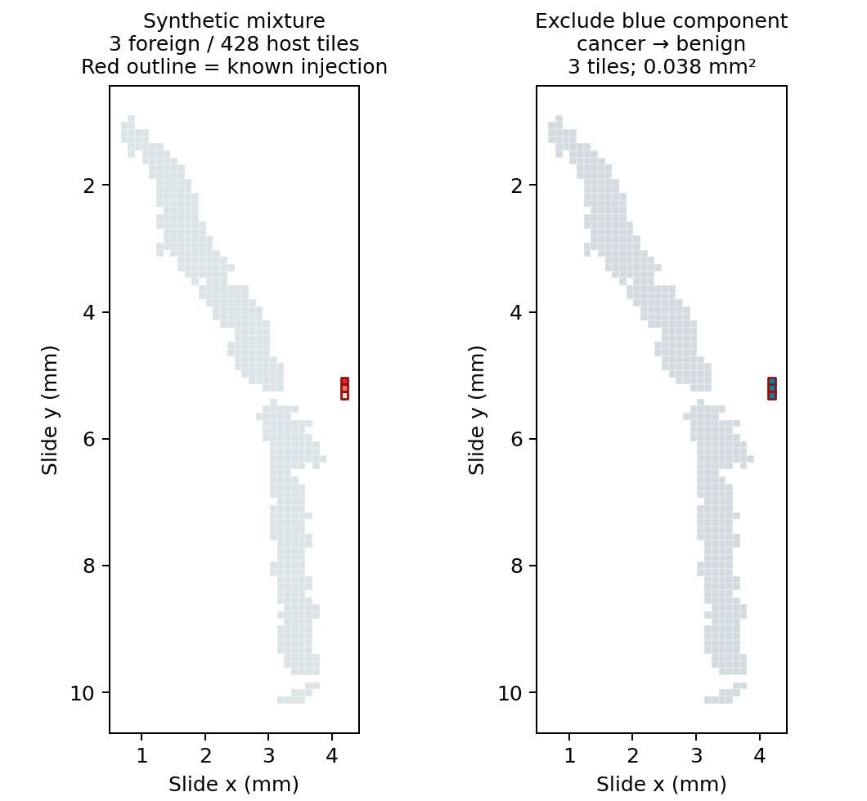
Known synthetic donor component
3 donor tiles
0.0375 mm² injected footprint
428 original host tiles
Cancer before exclusion
Benign after exclusion
Known injection in a saved-feature mixture. These are tile footprints, not a microscopy composite.
08
Notes:
This known synthetic insertion contains three cancer-positive donor tiles in a four-hundred-twenty-eight-tile host. Excluding the red-outlined fragment changes cancer back to benign. The measured footprint is zero-point-zero-three-seven-five square millimeters. This plot shows saved coordinates, not natural contamination or a microscopy composite.
Sources and disclosures:
reports/panda_piece_synthetic_foreign_example_23065744.json; original right two panels from reports/figures/panda_piece_development_23065744/piece_examples.png. Crop hashes/coordinates: media/provenance.json.

Slide 9
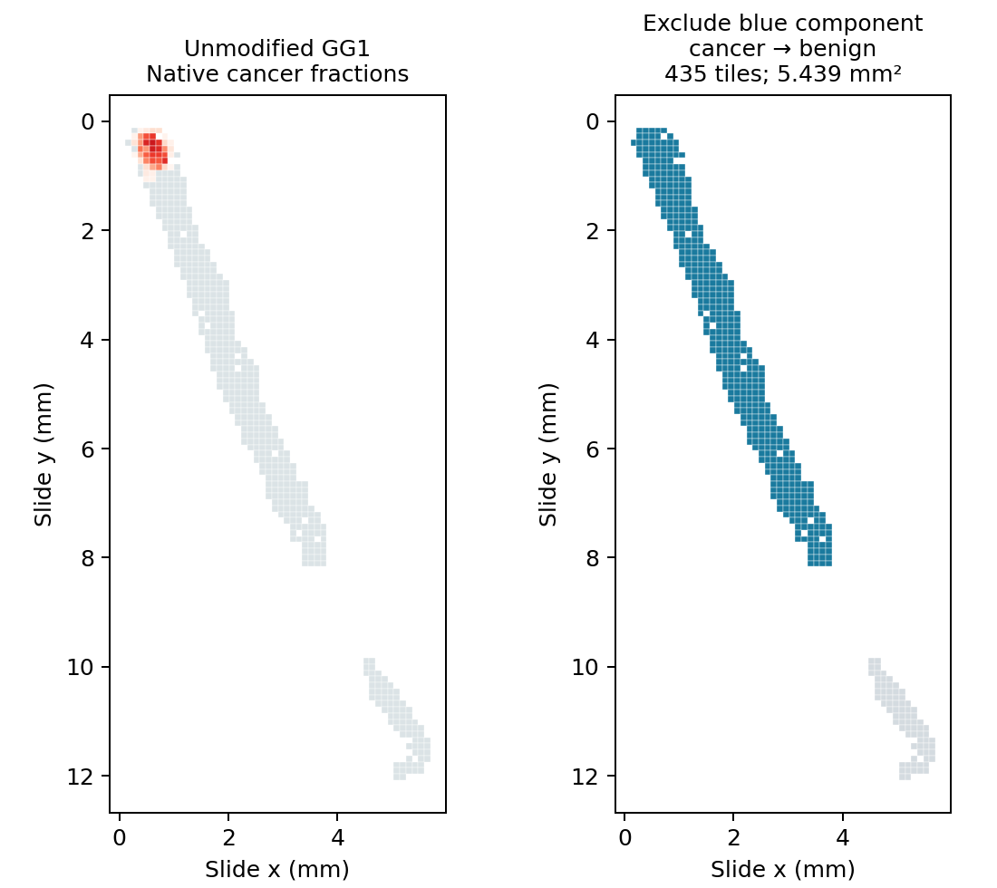
Genuine cancer can also change the decision
Native annotated cancer
0.171 mm² annotation within
a 5.439 mm² sampled footprint
435 tiles in this component
Cancer before exclusion
Benign after exclusion
Red shading shows native cancer fraction. Dependence alone does not establish foreignness.
09
Notes:
The genuine-cancer counterexample produces the same decision change. Excluding this unmodified four-hundred-thirty-five-tile component changes cancer to benign. It contains zero-point-one-seven-one square millimeters of native cancer annotation inside a five-point-four-three-nine-square-millimeter sampled footprint. The component is not a tiny tumor focus or a confirmed whole piece. Influence alone cannot establish foreignness.
Sources and disclosures:
reports/panda_piece_genuine_cancer_example_23065744.json; original left two panels from reports/figures/panda_piece_development_23065744/piece_examples.png. Native-cancer colorbar 0–1 is omitted from crop, red shading identified explicitly. media/provenance.json.

Slide 10
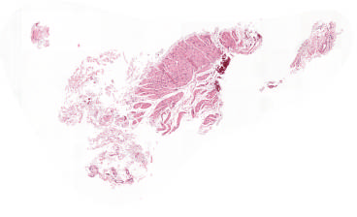
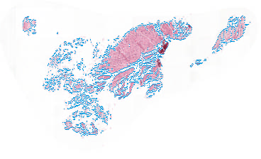
Observed tissue geometry has limits
Actual RGB overview
Observed foreground edge proxy
Worst mapping among training slides: 76% of tiles assigned. Review abstains on this case.
RGB at factor 16, without gap filling. Boundaries are proxies. 4 of 6 formerly single-component calibration cases become multiple.
10
Notes:
Sparse sampled cells can misrepresent physical pieces. We use observed RGB foreground at pyramid factor sixteen without filling gaps. This worst-mapping training example maps only seventy-six percent of tiles, so review abstains. Four of six formerly single-component calibration cases become multiple components. RGB boundaries remain proxies and empty exclusions stay unevaluable.
Sources and disclosures:
Actual training RGB overview and foreground edge output for3c685ed0f92e30f6ffeb5cea7cef5994, selected by lowest training mapping, not classification outcomes. reports/panda_topology_qa_v1/provenance.json. Mapping76/100; observedRGB15components vs sampled4; no pathologist-confirmed boundaries.

Slide 11
Review utility conflicts with reviewer burden
Calibration rule | Fragments hit | Clean slides alerted | Components / slide
Combined | 0 / 40 | 0 / 24 | 0
Visual only | 0 / 40 | 0 / 24 | 0
Decision only | 8 / 40 | 4 / 24 | 0.167
Spatial only | 32 / 40 | 19 / 24 | 3.583
Development targets: ≤10% clean slides alerted and ≤0.5 components per slide
Decision-only hypothetical filtering damages 3/20 originally correct clean predictions and flags 1/26 native cancer components.
40 mixtures reuse 8 hosts. Clean alerts measure review burden, not adjudicated natural-contaminant specificity.
11
Notes:
The detector comparison reveals a burden tradeoff. Spatial rules hit thirty-two of forty fragments but alert on nineteen of twenty-four clean slides. Decision dependence hits eight fragments and recovers eight induced-error instances, but alerts on four clean slides. Hypothetical filtering damages three of twenty initially correct clean predictions and flags a genuine cancer component.
Sources and disclosures:
reports/panda_review_selection_v1.json, comparison calibration. 40 correlated positive-dose mixtures, 24 clean slides, 26 evaluable annotated native-cancer components. Filtering is hypothetical only.

Slide 12
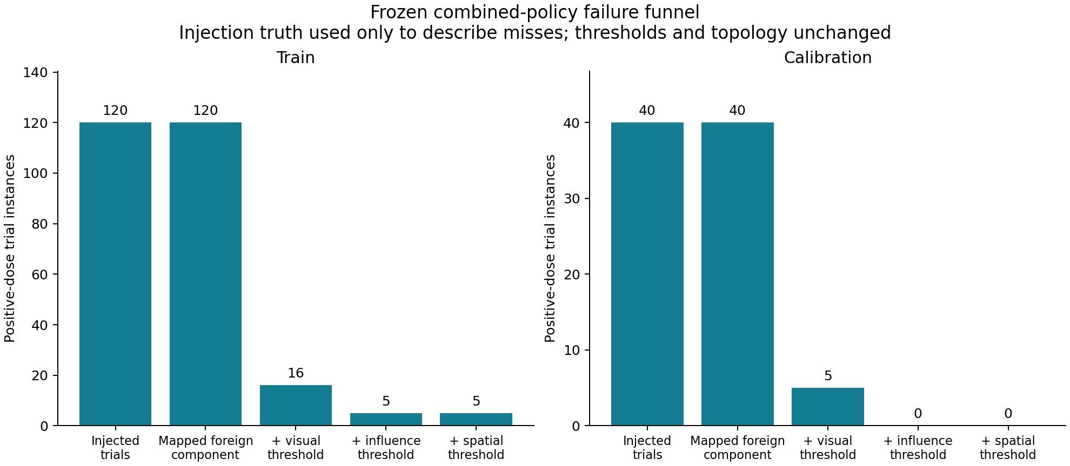
The combined v1 policy failed its utility gate
0 / 40 fragments detected
No useful candidate among
81 preregistered rules
0/24 alerts has a 95%
Wilson interval of 0–13.8%
The frozen protocol records rejection. Its final-test job remains blocked.
12
Notes:
The combined policy misses every calibration fragment. Five mixtures pass its visual criterion, but none also passes influence. Those five mixtures are nested doses from one host. No useful candidate emerges among eighty-one preregistered rules. Zero clean alerts cannot rescue zero recall. We froze the rejection and blocked its final-test job.
Sources and disclosures:
reports/panda_review_diagnostics_v1.json; reports/panda_review_selection_v1.json; configs/panda_frozen_protocol_v1.json unchanged. Budgets: ≤10% clean-slide alerts, ≤0.5 components/slide. Utility: ≥20% fragment recall, ≥25% induced-error recovery. Five visually qualifying mixtures are five nested doses from one calibration host, not five independent hosts. reports/panda_review_v2_results.md.

Slide 13
S2: clean grade scorer before contamination
Mean pooling selected before S2 outcomes
Clean low/high scorer | Training correct | Calibration correct
Mean, primary | 35 / 48 | 12 / 16
Top 1% | 29 / 48 | 10 / 16
Top 5% | 30 / 48 | 11 / 16
Primary calibration: low 8/8, high 4/8. Limited high-grade sensitivity remains explicit.
760 trials across four donor conditions. 32 host slides, 37 donor slides. Exact oracle: 760/760.
13
Notes:
S2 now tests low-versus-high predictions using pattern-four-or-five donor material and same-grade controls. We chose mean pooling before stress outcomes. Its clean calibration baseline gets all eight low-grade slides correct, but only four of eight high-grade slides. That limited sensitivity remains explicit. All seven hundred sixty trial records pass exact oracle restoration.
Sources and disclosures:
Verified CPU Slurm job 23067396; source35e0a8dae57e22808420b45ae040fc2f8c3710a5. reports/panda_s2_results_v1.md; reports/panda_s2_development_v1/clean_audit.json; summary.json; completion.json.

Slide 14
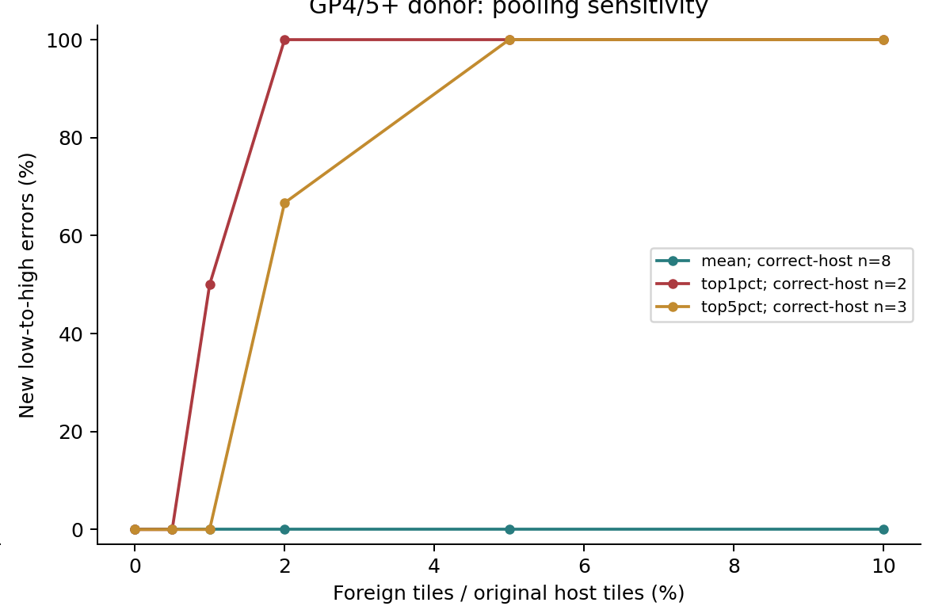
S2 primary result: no calibration label flips
Mean: 0 / 8
New low-to-high errors
at every tested GP4/5 dose
Top 1% at 10%: 2/2
Top 5% at 10%: 3/3
X: requested foreign / original-host tile percentage (ceil-rounded counts)
Same-grade GP3 control also causes 1/3 top-5% new errors at 10%. A binary flip is not a clinical Grade Group upgrade.
14
Notes:
The primary S2 result is negative: zero of eight new calibration errors at every tested requested dose. Training has one of twenty-two at ten percent. Secondary top pooling flips two of two or three of three correct hosts, but misclassifies most clean low-grade slides. Same-grade tissue also causes a flip. Eight pattern-five cases lack capacity. These are binary engineering endpoints, not clinical upgrades.
Sources and disclosures:
reports/panda_s2_results_v1.md; reports/panda_s2_development_v1/analysis.json. Figure upper-right crop from reports/figures/panda_s2_development_23067396/s2_development.png. Per-dose denominator = unique originally correct low-grade hosts. GP5 at10% unavailable, not0error.

Slide 15
Detector v2: a separately versioned ranking study
Training selects rank threshold and review cap
Visual anomaly and prediction influence become separate rank features. Geometry contributes observed area and isolation.
Native annotation, injection truth and donor identity enter evaluation only. They never enter the blinded review features.
Known calibration outcomes make this iterative development, not independent validation.
15
Notes:
Version two tests ranked review instead of requiring every signal to pass a strict conjunction. Training selects thresholds and review caps. Visual, influence and geometry features enter the ranking. Injection truth, donor identity and native annotation remain evaluation-only. Previously seen calibration outcomes make this iterative development, not independent validation.
Sources and disclosures:
Verified CPU job23067454; source668d9b8c4e3e8aa300bda6ff15e416c601c2e024. configs/panda_review_development_v2.json; reports/panda_review_v2_results.json. No model training/test-derived normalization.

Slide 16
Ranked review still fails useful calibration recall
Ranked-review condition | Fragments hit | Clean slides alerted | Clean damage
Selected combined, train | 22 / 120 | 3 / 72 | 3 / 61
Selected combined, known cal | 0 / 40 | 1 / 24 | 0 / 20
Top-one visual + relevance, cal | 21 / 40 | 24 / 24 | 2 / 20
Unbudgeted top-one review flags 14 native cancer components. It exceeds both review-burden targets.
No supported v2 policy and no validated useful improvement over v1. The 24-slide final test remains blocked.
16
Notes:
The selected rank detects twenty-two of one hundred twenty training fragments, but zero of forty on known calibration. Its one clean calibration alert contains native cancer. An unbudgeted ranking hits twenty-one fragments but alerts on every clean slide and flags fourteen native cancer components. That exceeds the burden targets. We found no useful validated improvement over version one.
Sources and disclosures:
reports/panda_review_v2_results.json; reports/panda_review_v2_results.md; selected primary combined_rank and unbudgeted reference visual_relevance_rank, known calibration. Source668d9b8c4e3e8aa300bda6ff15e416c601c2e024; job23067454. Calibration is iterative development. No tissue removed.

Slide 17
What the experiment demonstrates
Demonstrated
Still unverified
Naturally occurring floater detection
Patient-level independence
Clinical cancer or grading validity
Independent final-test performance
Verified PANDA-to-CONCH pipeline
S1 synthetic model-sensitivity effects
S2 null primary calibration outcome
Two review policies rejected honestly
Preserving a negative result is part of the safety check.
17
Notes:
We demonstrate a verified pipeline, S1 sensitivity, a negative primary S2 result and two rejected review policies. We do not establish natural-floater detection or clinical usefulness. Reused donors, unknown patient overlap and representative sampling limit inference. Artificial edge placement also simplifies geometry. The twenty-four final slides remain unscored.
Sources and disclosures:
All numerical claims refer to training/calibration only. reports/panda_scientific_audit_v1.md; reports/panda_review_results_v1.md.

Slide 18
Next evidence requires a new scientific gate
24 final-test slides remain sealed
S3: useful review with genuine-cancer preservation and realistic controls.
S4: external institutions and models, after separate approval and embedding-compatibility checks.
A useful new policy needs a new frozen protocol and explicit final-test authorization. Additional models or GPU work require a separate scope.
Research prototype. Pathologist review only. No automatic tissue removal.
18
Notes:
Next research needs useful review that preserves native cancer, followed by external institutional and model testing. New resources need separate approval. Any final evaluation requires a scientifically useful, newly frozen protocol and explicit authorization. Original tissue remains intact.
Sources and disclosures:
Final preparation verified by CPU preflight job 23066843. No final job submitted. Versioned readiness and command: docs/panda_final_test_v1.md.

Slide 19
Sources and reproducibility
Clinical context
Sapp et al. 2021. doi:10.14309/crj.0000000000000583
Foundation model
Lu et al. Nature Medicine 2024. doi:10.1038/s41591-024-02856-4
Dataset
Bulten et al. Nature Medicine 2022. doi:10.1038/s41591-021-01620-2
Code and measured development evidence
github.com/MuneebHoda/floater-finder/tree/feature/panda-tiling
S1/v1 source: 06c7b77. S2 source: 35e0a8. v2 source: 668d9b8.
Media hashes, source reports and exact protocol paths accompany this deck.
19
Notes:
Reference slide for questions. Sources, media provenance and version hashes accompany the submission. No final-test prediction appears in the deck.
Sources and disclosures:
Lu et al., Nature Medicine 2024, https://doi.org/10.1038/s41591-024-02856-4
Bulten et al., Nature Medicine 2022, https://doi.org/10.1038/s41591-021-01620-2
Sapp et al., ACG Case Reports Journal 2021, https://doi.org/10.14309/crj.0000000000000583
S2: reports/panda_s2_results_v1.md. v2: reports/panda_review_v2_results.json. Sources/hashes in media_manifest.json.

