Slide 1
Bookkeeping App For Fancy Tailor
Muneeb ur Rehman

Slide 2
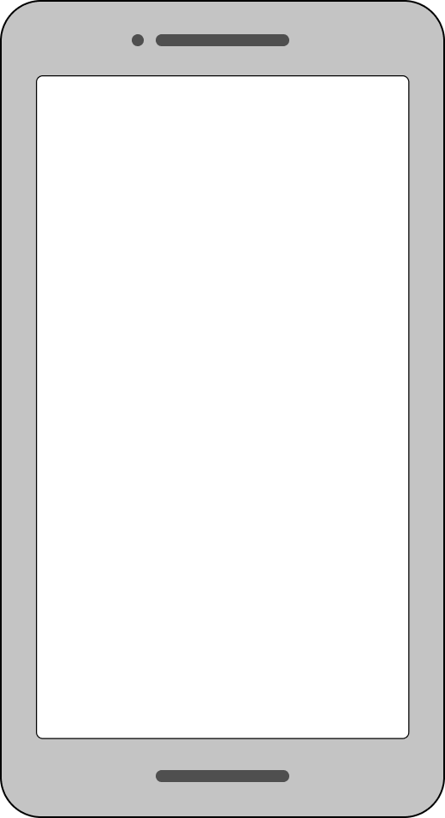
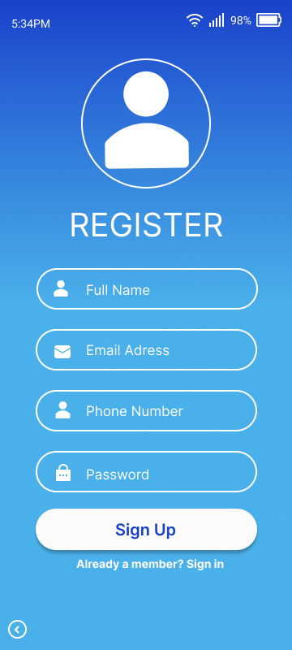
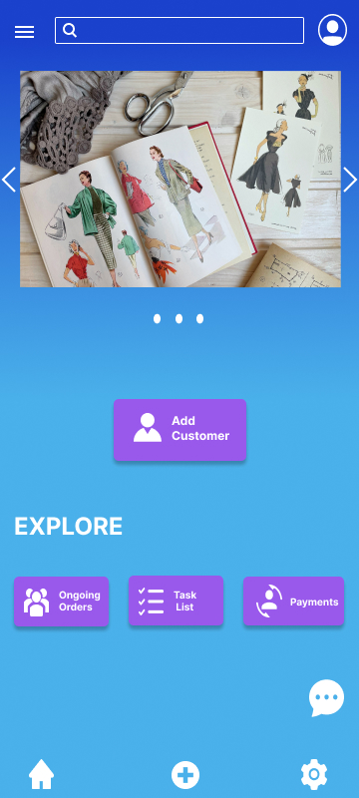
Project overview
The product:
This is a bookkeeping app for fancy tailor. This app is located in Pakistan. This bookkeeping app help tailors to record customer cloth size and save the time and their data.
Project duration:
June to August 2022

Slide 3
Project overview
The problem:
Tailors recorded the customer cloth sizes in the manual book. So, This is a time-consuming activity, and difficult to find the measurements.
The goal:
Our goal is to provide a bookkeeping app to save time and record customer cloth sizes.

Slide 4
Project overview
My role:
UI/UX designer designing an app for Bookkeeping app for fancy tailor from conception to delivery.
Responsibilities:
Conducting interviews, paper and digital wireframing, low and high-fidelity prototyping, conducting usability studies, accounting for accessibility, and iterating on designs.

Slide 5
User research
Personas
Problem statements
User journey maps
Understanding
the user

Slide 6
User research: summary
I conducted interviews and created empathy maps to understand the users I’m
designing for and their needs. A primary user group identified through research that they had difficult to find customer measurement record.
This user group assumption was the users had difficult to find the research

Slide 7
User research: pain points
1
2
3
Time
Accessibility
Data
There is very difficult to find customer cloth sizes in the manual book. It’s a very time taking activity.
There are a lot of people who are not present or come to the tailor shop to give their cloth size or measurements.
If the manual book page destroy or the manual book goes to disappear.

Slide 8
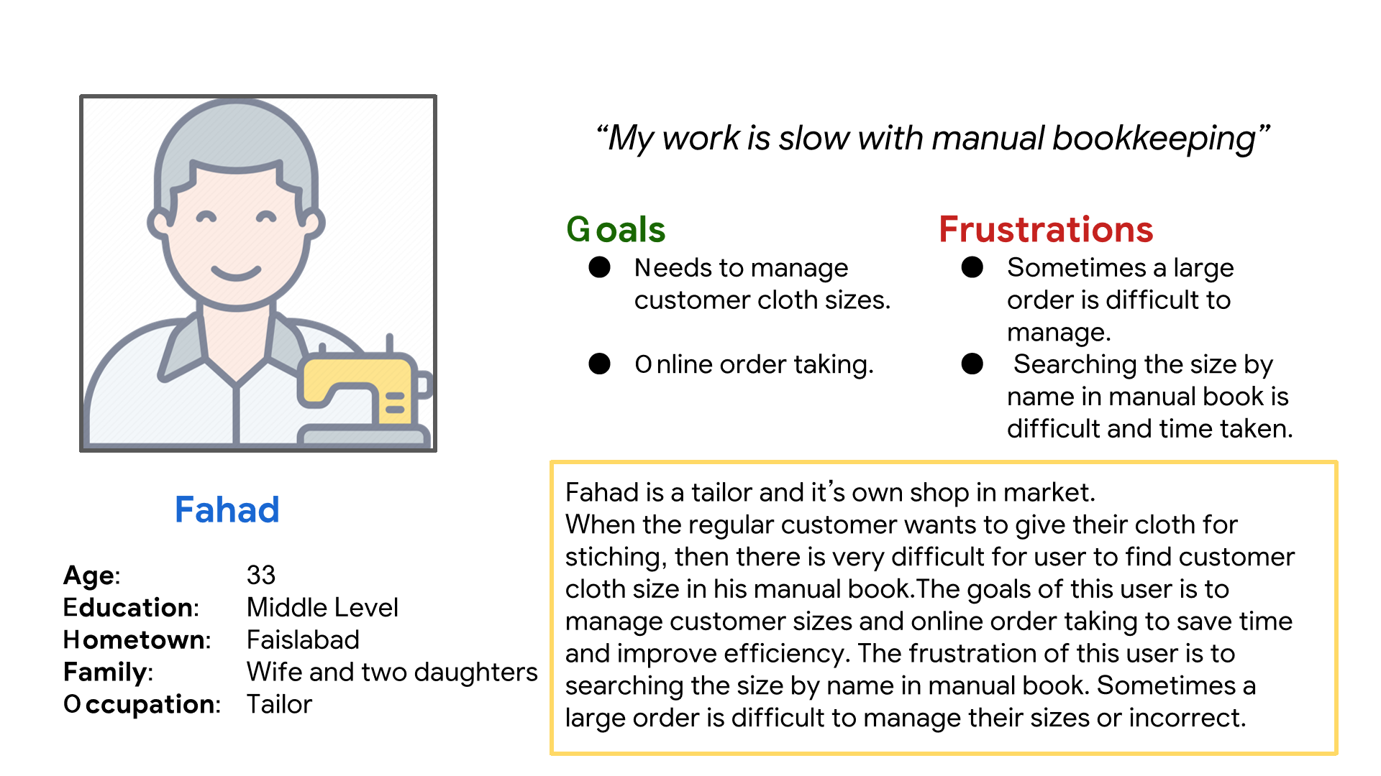
Persona: Fahad
Problem statement:
Fahad is a Tailor
who needs to measure customer cloth sizes in bookkeeping app
because he wants to save the time and data.

Slide 9
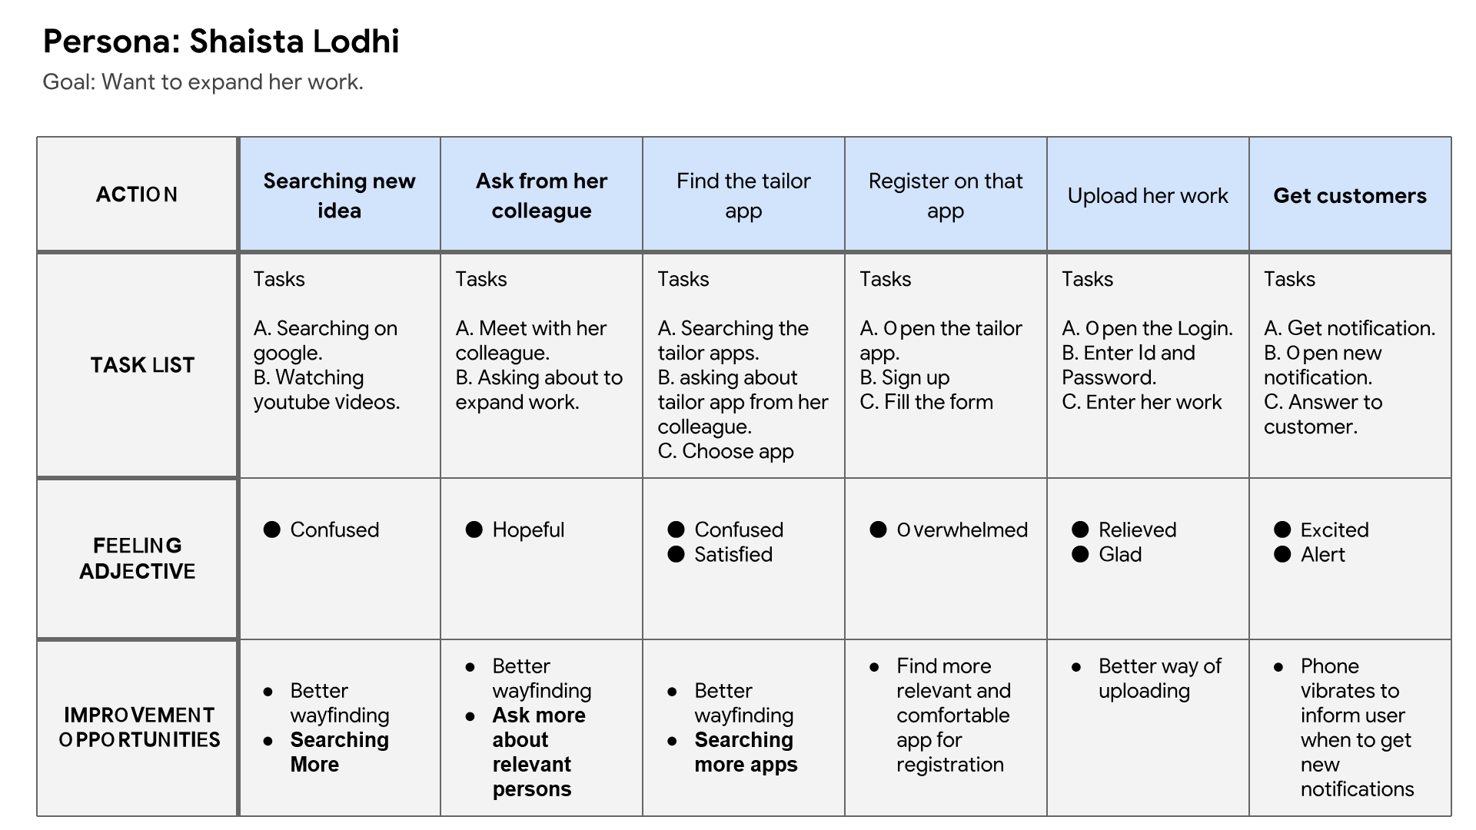
User journey map
Mapping Shaista Lodhi user journey revealed how helpful it would be for users to have access to a dedicated bookkeeping app.

Slide 10
Paper wireframes
Digital wireframes
Low-fidelity prototype
Usability studies
Starting
the design

Slide 11
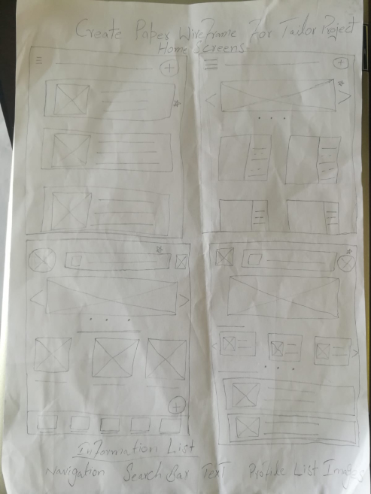
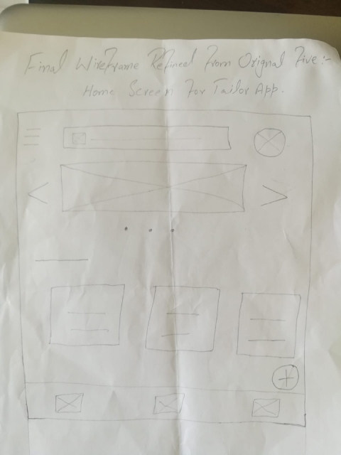
Paper wireframes
Taking the time to draft iterations of each screen of the app on paper ensured that the elements that made it to digital wireframes would be well-suited to address user pain points. For the home screen, I prioritized a quick and easy measurement process to help users save time.

Slide 12
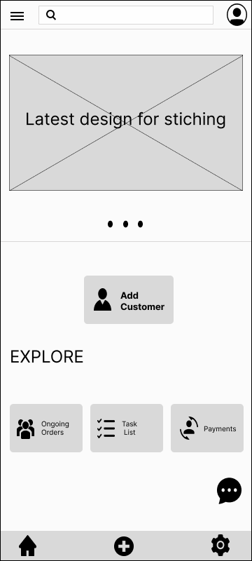
Digital wireframes
This button at the top of the home screen shows the latest design images.
As the initial design phase continued, I made sure to base screen designs on feedback and findings from the user research.
This button at the middle of the home screen makes it fast and easy for users to put bio-data and measurements.

Slide 13
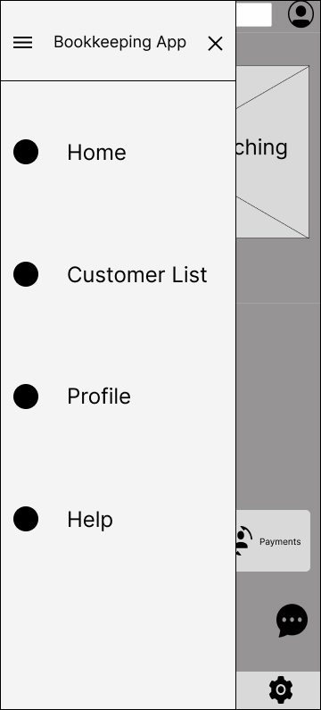
Easy access to navigation that’s screen reader friendly.
Digital wireframes
Easy navigation was a key user need to address in the designs in addition to equipping the app to work with assistive technologies.

Slide 14
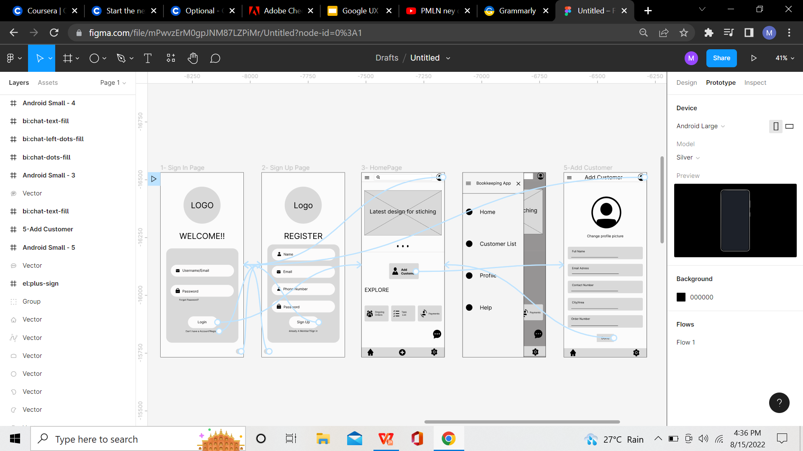
Low-fidelity prototype
Using the completed set of digital wireframes, I created a low-fidelity prototype. The primary user flow I connected was complete detail of customer including measurements, So the prototype could be used in a usability study.
View Bookkeeping App
Low Fidelity Prototype

Slide 15
Usability study: findings
I conducted two rounds of usability studies. Findings from the first study helped guide the designs from wireframes to mockups. The second study used a high-fidelity prototype and revealed what aspects of the mockups needed refining.
Round 1 findings
Round 2 findings
1
User wants quickly record measurement
The homescreen page has too many buttons
1
Users want more customization options
2
There is no customer measurement button in view customer detail.
2
3
User wants to save the data

Slide 16
Refining
the design
Mockups
High-fidelity prototype
Accessibility

Slide 17
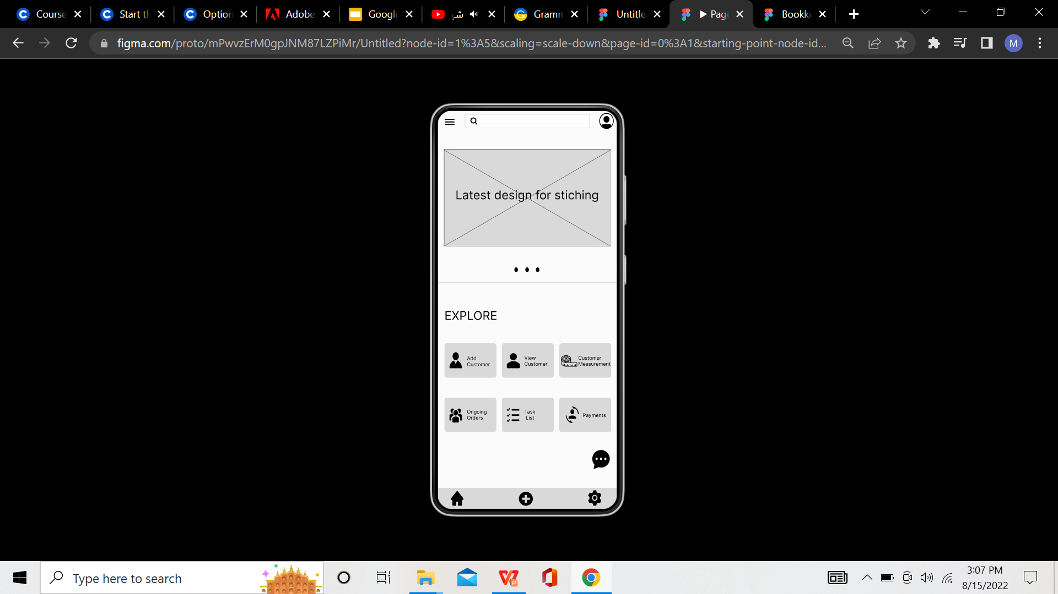

Mockups
Before usability study
After usability study
Early designs have a lot of buttons on the home screen but after the usability studies, I change the home screen buttons with only one big and bold button to start the process. So, It's a proper user flow and the user will easily access the starting point.

Slide 18
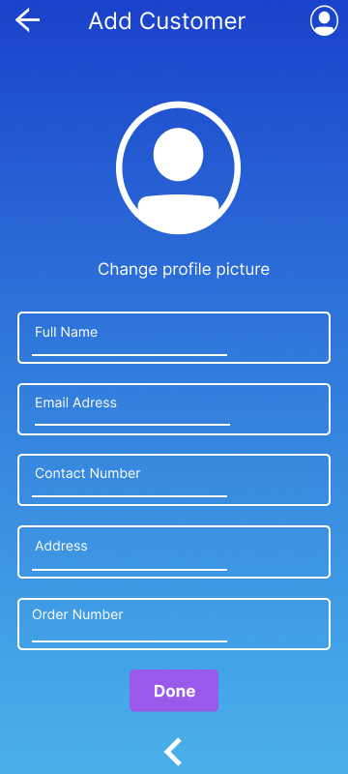
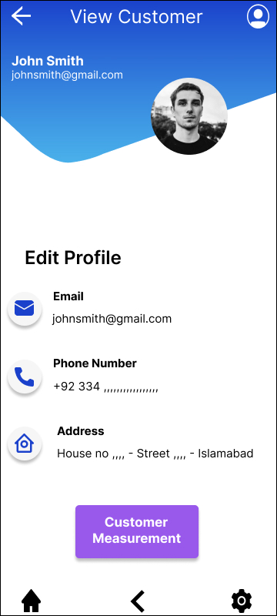
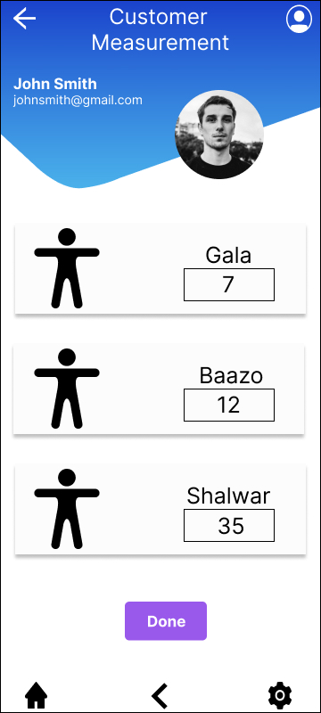
Mockups

Slide 19
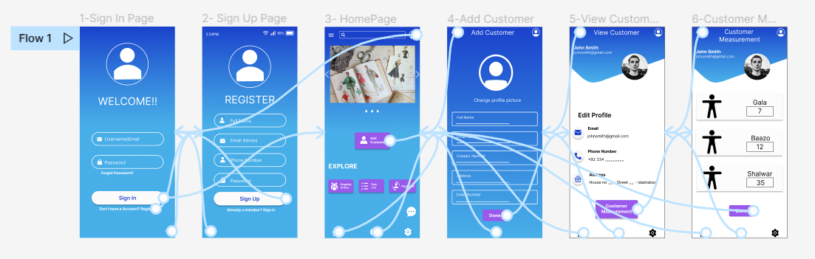
High-fidelity prototype
The final high-fidelity prototype presented cleaner user flows for customer measurement process. It also met user needs to add customer detail as well as more customization.
View the Bookkeeping app high-fidelity prototype

Slide 20
Accessibility considerations
1
2
3
Provided access
to users who are vision impaired through adding alt text to images for screen readers.
Used icons to
help make
navigation easier.
Used detailed
imagery for measurements and bio-data to
help all users
better understand
the designs.

Slide 21
Going forward
Takeaways
Next steps

Slide 22
Takeaways
Impact:
The app makes users feel like Bookkeeping App really thinks about how to meet their needs.
One quote from peer feedback:
“The app made it so easy and useful to complete the customer measurement process. I would definitely use this app to save my time and customer record.
What I learned:
While designing the Bookkeeping App, I learned that the first ideas for the app are only the beginning of the process. Usability studies and peer feedback influenced each iteration of the app’s designs.

Slide 23
Next steps
1
2
Conduct another round of usability studies to validate whether the pain points users experienced have been effectively addressed.
Conduct more user research to determine any new areas of need.

Slide 24
Insert a few sentences summarizing the next steps you would take with this project and why. Feel free to organize next steps in a bullet point list.
Let’s connect!
Thank you for your time reviewing my work on the Bookkeeping App For Fancy Tailor! If you’d like to
see more or get in touch, my contact information is provided below.
Email: muneeb.ur.rehman36316@gmail.com
Contact: +92 334-5036316

Slide 25
Thank you!

