Slide 1


Data Analysis Hackathon
November Month – Presented By : Bravo team

Slide 2
Company’s Background
GDS Mart
FMCG Manufacturer
Gujarat, India.
Surat
Vadodra
Ahmedabad

Slide 3
Problem Statement
Few key customers didn’t renew their annual contract due to service issue
Suspected Reasons
Late delivery
Not delivering in Full

Slide 4

Expectation
Clear understanding of key metrics
on-time delivery (OT) %
In-full delivery (IF) %
OnTime in full (OTIF) %

Slide 5
Who Am I ??
Bravo Team
Data Analyst’s – Supply chain Team

Slide 6

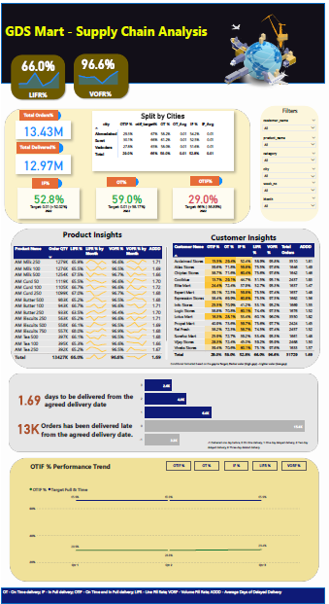



Dashboard Design

Slide 7

Some Major Insights
All the Key Metrics (OT%, IF%, OTIF%) are far behind the target
On an average, orders are delayed 0.42 days from the agreed date of delivery
Lotus Mart, Coolblue, Acclaimed stores have the highest orders as well as delayed the most to deliver the products on time
Is it because we are not estimating the right delivery date?
Is it because we are receiving more orders than expected?
Ghee, curd and butter products are most delayed to deliver.
There is no noticeable improvements in any of the key metrics in the last few months
There is a huge gap in IF% for most of the customers. Is it because of less production?

