Slide 1
SQL Queries at a glance
Proposed by
CM Suvarna Varma

Slide 2
History
SQL (Structured Query Language) is a database sublanguage for querying and modifying relational databases. It was developed by IBM Research in the mid 70's and standardized by ANSI in 1986.
The Relational Model defines two root languages for accessing a relational database –
Relational Algebra and Relational Calculus.
Relational Algebra is a low-level, operator-oriented language. Creating a query in Relational Algebra involves combining relational operators using algebraic notation.
Relational Calculus is a high-level, declarative language. Creating a query in Relational Calculus involves describing what results are desired.

Slide 3
SQL is a version of Relational Calculus. The basic structure in SQL is the statement. Semicolons separate multiple SQL statements.
There are 3 basic categories of SQL Statements:
SQL-Data Statements -- query and modify tables and columns
  SELECT Statement -- query tables and views in the database
  INSERT Statement -- add rows to tables
  DELETE Statement -- remove rows from tables
  UPDATE Statement -- modify columns in table rows

Slide 4
SQL-Transaction Statements -- control transactions
  COMMIT Statement -- commit the current transaction
  ROLLBACK Statement -- roll back the current transaction
SQL-Schema Statements -- maintain schema (catalog)
  CREATE TABLE Statement -- create tables
  CREATE VIEW Statement -- create views
  DROP TABLE Statement -- drop tables
  DROP VIEW Statement -- drop views
  GRANT Statement -- grant privileges on tables and views to other users
  REVOKE Statement -- revoke privileges on tables and views from other users

Slide 5
DDL
Data Definition Language
SQL Schema statements
CREATE
DROP
GRANT
REVOKE

Slide 6
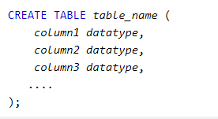
DDL -Create

Slide 7
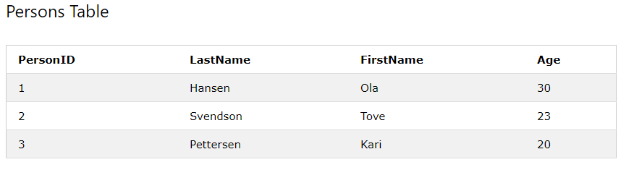
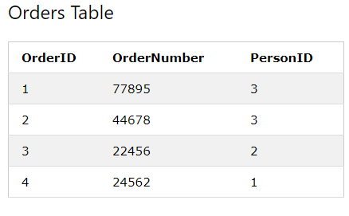

Slide 8
Create tables with primary & foreign keys
CREATE TABLE Persons (
PersonID int NOT NULL PRIMARY KEY,
Lastname varchar2(30),
Firstname varchar2(30),
age int NOT NULL ));
CREATE TABLE Orders (
OrderID int NOT NULL PRIMARY KEY,
OrderNumber int NOT NULL,
PersonId int FOREIGN KEY REFERENCES Persons(PersonID));

Slide 9
ER diagram
Qty
name
PNo
SNo
desc
city
P
S
SP
color

Slide 10
Tables for above ER diagram
Table 1 : p table (parts)
Table 2 : s table (suppliers)
pno | desc | color
P1 | Widget | Blue
P2 | Widget | Red
P3 | Dongle | Green
sno | name | city
S1 | Pierre | Paris
S2 | John | London
S3 | Mario | Rome
Table 3: sp table (suppliers & parts)
sno | pno | qty
S1 | P1 | NULL
S2 | P1 | 200
S3 | P1 | 1000
S3 | P2 | 200

Slide 11
CREATE TABLE
Creating the example tables: with CREATE STATEMENT
CREATE TABLE s (sno VARCHAR(5) NOT NULL PRIMARY KEY, name VARCHAR(16), city VARCHAR(16) )
CREATE TABLE p (pno VARCHAR(5) NOT NULL PRIMARY KEY, descr VARCHAR(16), color VARCHAR(8) )
CREATE TABLE sp (sno VARCHAR(5) NOT NULL REFERENCES s, pno VARCHAR(5) NOT NULL REFERENCES p, qty INT, PRIMARY KEY (sno, pno) )

Slide 12
Constraints
A referential integrity constraint in the CREATE STATEMENT has two forms.
When the foreign key consists of a single column, it can be declared as a column constraint, like:
As a table constraint, it has the following format:
The references-specification has the following format:
column-descr REFERENCES references-specification
FOREIGN KEY (column-list) REFERENCES references-specification
Table-2 [ ( referenced-columns ) ] [ ON UPDATE { CASCADE | SET NULL | NO ACTION }] [ ON DELETE { CASCADE | SET NULL | NO ACTION }]

Slide 13
Examples with constraints
Create for sp with a constraint that the qty column can't be negative:
Example table constraint for referential integrity (for the sp table):
CREATE TABLE sp (sno VARCHAR(5) NOT NULL REFERENCES s, pno VARCHAR(5) NOT NULL REFERENCES p, qty INT CHECK (qty >= 0), PRIMARY KEY (sno, pno) )
CREATE TABLE sp(sno VARCHAR(5) NOT NULL REFERENCES s, pno VARCHAR(5) NOT NULL REFERENCES p, qty INT, PRIMARY KEY (sno, pno) FOREIGN KEY (sno) REFERENCES s(sno) ON DELETE NO ACTION ON UPDATE CASCADE

Slide 14
DROP Table
The DROP TABLE Statement removes a previously created table and its description from the catalog.
It has the following general format:
table-name is the name of an existing base table in the current schema.
The CASCADE and RESTRICT specifiers define the disposition of other objects dependent on the table.
A base table may have two types of dependencies: A view whose query specification references the drop table.
Another base table that references the drop table in a constraint - a CHECK constraint or REFERENCES constraint.
DROP TABLE table-name {CASCADE|RESTRICT}

Slide 15
GRANT
GRANT Statement
The GRANT Statement grants access privileges for database objects to other users.
It has the following general format:
privilege-list is either ALL PRIVILEGES or a comma-separated list of properties:
SELECT, INSERT, UPDATE, DELETE. object-list is a comma-separated list of table and view names. user-list is either PUBLIC or a comma-separated list of user names.
GRANT Statement Examples
GRANT privilege-list ON [TABLE] object-list TO user-list
GRANT SELECT ON s,sp TO PUBLIC GRANT SELECT,INSERT,UPDATE(color) ON p TO art,nan GRANT SELECT ON supplied_parts TO sam WITH GRANT OPTION

Slide 16
REVOKE
REVOKE Statement
The REVOKE Statement revokes access privileges for database objects previously granted to other users.
It has the following general format:
The REVOKE Statement revokes each privilege in privilege-list for each object (table) in object-list from each user in user-list.
All privileges must have been previously granted. The user-list may specify PUBLIC. This must apply to a previous GRANT TO PUBLIC.
REVOKE Statement Examples
REVOKE privilege-list ON [TABLE] object-list FROM user-list
REVOKE SELECT ON s,sp FROM PUBLIC REVOKE SELECT,INSERT,UPDATE(color) ON p FROM art,nan REVOKE SELECT ON supplied_parts FROM sam

Slide 17
DCL
Data Control Language
SQL Transaction statements
COMMIT
ROLLBACK

Slide 18
COMMIT
COMMIT Statement
The COMMIT Statement terminates the current transaction and makes all changes under the transaction persistent.
It commits the changes to the database.
The COMMIT statement has the following general format:
WORK is an optional keyword that does not change the semantics of COMMIT.
COMMIT [WORK]

Slide 19
ROLL BACK
ROLLBACK Statement
The ROLLBACK Statement terminates the current transaction and rescinds all changes made under the transaction.
It rolls back the changes to the database.
The ROLLBACK statement has the following general format:
WORK is an optional keyword that does not change the semantics of ROLLBACK.
ROLLBACK [WORK]

Slide 20
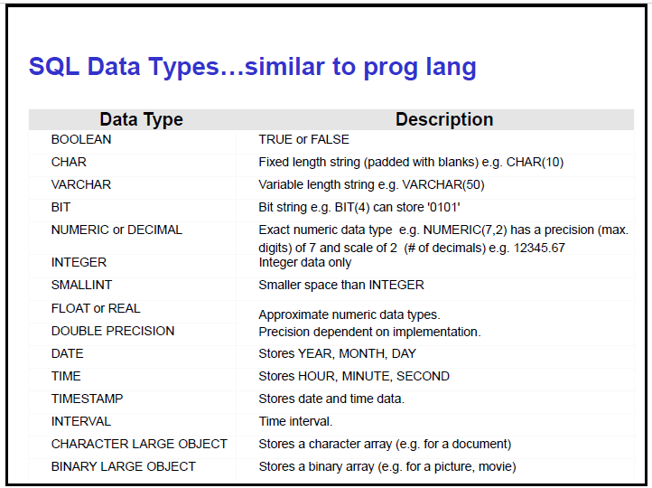

Slide 21
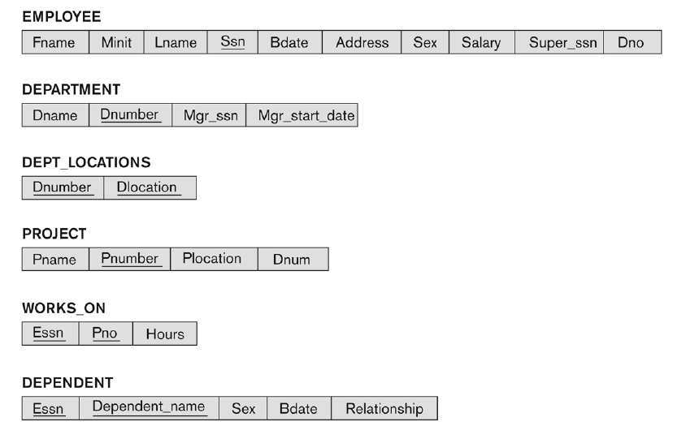

Slide 22
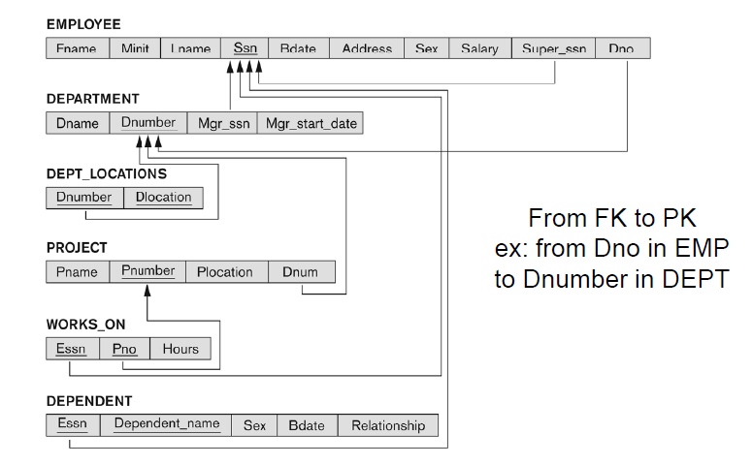

Slide 23
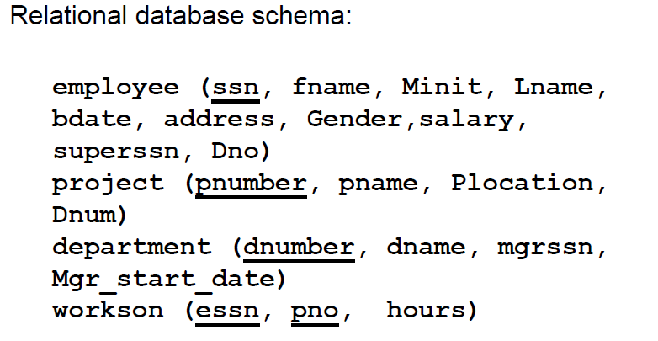

Slide 24
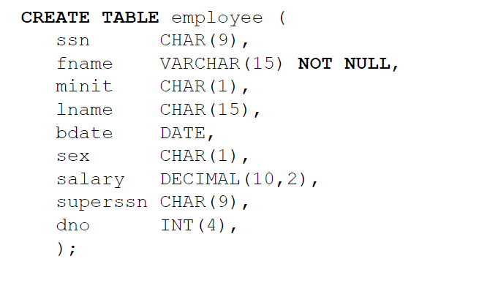

Slide 25
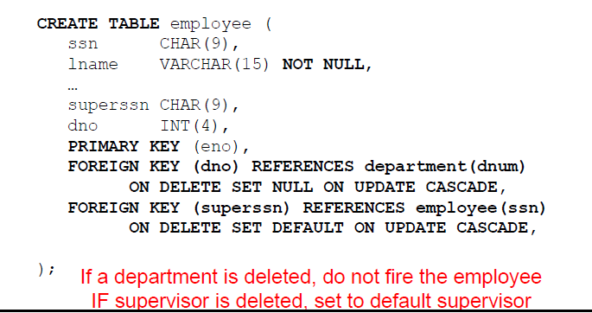

Slide 26
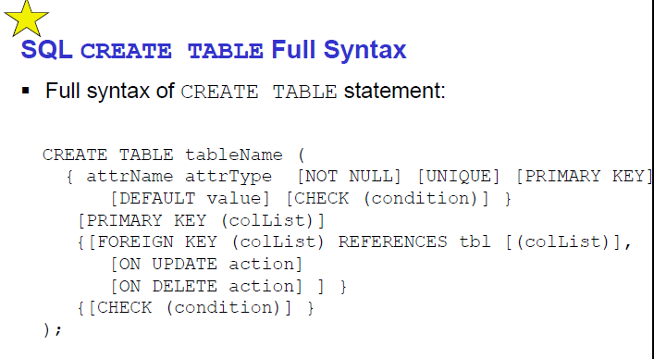

Slide 27
DML
Data Manipulating Language
SQL Data statements
SIDU
SELECT
INSERT
DELETE
UPDATE

Slide 28
INSERT
INSERT Statement
The INSERT Statement adds one or more rows to a table. It has two formats:
The first form inserts a single row into table-1 and explicitly specifies the column values for the row. The second form uses the result of query-specification to insert one or more rows into table-1. The result rows from the query are the rows added to the insert table. Note: the query cannot reference table-1.
INSERT INTO table-1 [(column-list)] VALUES (value-list)
INSERT INTO table-1 [(column-list)] (query-specification)

Slide 29
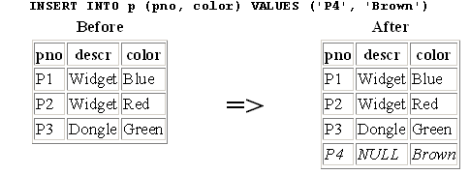
Example- Insert

Slide 30
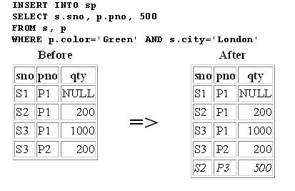

Slide 31
DELETE
The DELETE Statement removes selected rows from a table. It has the following general format:
The optional WHERE Clause has the same format as in the SELECT Statement.
The WHERE clause chooses which table rows to delete. If it is missing, all rows are in table-1 are removed.
The WHERE Clause predicate can contain subqueries, but the subqueries cannot reference table-1.
This prevents situations where results are dependent on the order of processing.
DELETE FROM table-1 [WHERE predicate]

Slide 32
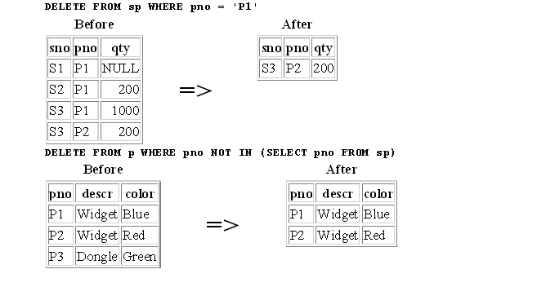
Delete Examples:

Slide 33
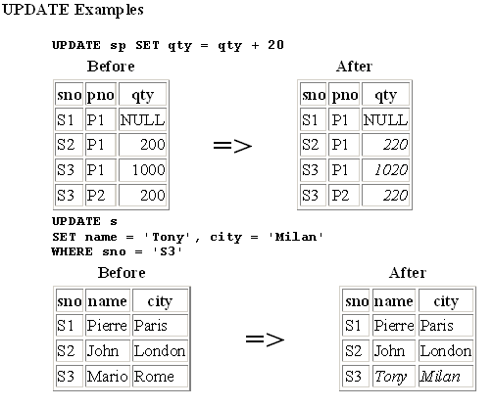
UPDATE
The UPDATE statement modifies columns in selected table rows. It has the following general format:
UPDATE table-1 SET set-list [WHERE predicate]

Slide 34
SELECT
SELECT [ALL|DISTINCT] select-list
SELECT Clause
The SELECT clause is mandatory. It specifies a list of columns to be retrieved from the tables in the FROM clause.
It has the following general format:
select-list is a list of column names separated by commas. The ALL and DISTINCT specifiers are optional. DISTINCT specifies that duplicate rows are discarded.
A duplicate row is when each corresponding select-list column has the same value. The default is ALL, which retains duplicate rows.
SELECT descr, color FROM p
SELECT name supplier, city location FROM s
SELECT p.descr, p.color FROM p

Slide 35
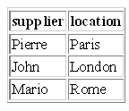
For example,
The column names in the select list can be qualified by the appropriate table name:
A column in the select list can be renamed by following the column name with the new name.
For example:
This produces: [ Location is the alias name of city field]

Slide 36
FLOW Diagram
The below Flow diagram helps us in writing any kind of queries without failing the syntax.
It is a snapshot of all the possible queries including joins.
This is the success mantra for improving the practice of writing queries.
Happy Query programming!

Slide 37
