Slide 1
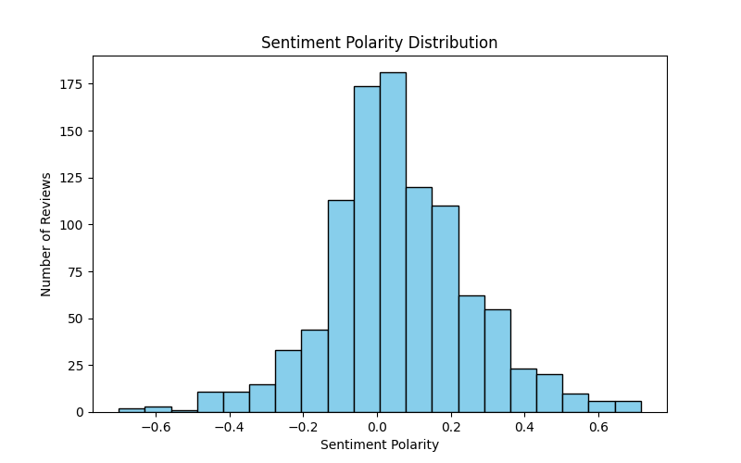
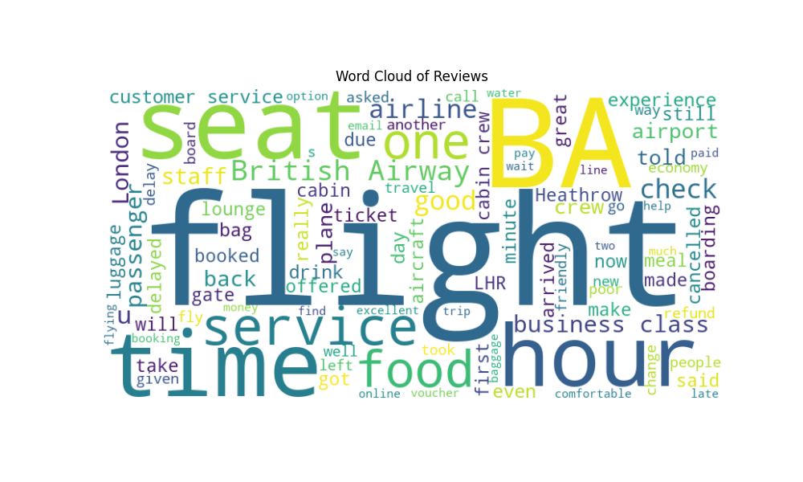
British Airways Review Sentiment Analysis
Average sentiment polarity: 0.15 (mostly positive)
Majority of reviews show positive or neutral sentiment
Common keywords: crew, flight, food, service, seat
Negative feedback mainly about customer service and seating comfort

