Slide 1

Predicting Real-Estate Price in Riyadh
Prepared by
Hayat Aldhahri
Muneera Alshunaifi

Slide 2
Content
Introduction
Data Description
Data Pre-Processing and EDA
Modeling
Conclusion

Slide 3


Introduction
Saudi Arabia’s residential real estate market, is expected to grow further in the coming years on the back of rising demand for housing units.
It is a non-stable market that attempts to grow or fall periodically.
Real-estate prices change dynamically in which it is hard for real-estate owners to measure the pricing criteria well.
+~60%
2021
2030

Slide 4

Introduction
Saudi Arabia housing market is expected to grow in the upcoming years.
Non-stable market and prices are very dynamic
Develop a model to predict housing prices in across Riyadh’s District

Slide 5
Introduction
Web Scraping
Data Pre-Processing
EDA
Modeling
Model Evaluation

Slide 6


Data Description
Data source: www.sa.aqar.fm
Real-estate type: VILLA’s at Riyadh
Size of Extracted data: 5504 rows & 6 columns/features

Slide 7
Data Description
Extracted Features
Feature | Description | Data Type
Price | The price of the villa | float
#BEDROOMS | The number of bedrooms for each villa | Integer
#BATHROOMS | The number of bathrooms for each villa | Integer
SIZE (m²) | The total building area in squared meter of each villa | float
DISTRICT | The district’s name where the villa is located | Object
STREETWIDTH | The street’s width where the villa is located in meter | float

Slide 8

Data Pre-processing and EDA
1
Data cleaning
Ensure data frame are of the same lengths.
Fill nulls “Street Width” with the median.
Filter data only in Riyadh city
Remove unnecessary words from the “district” feature such as "حي“ & "الرياض“.
Remove “م²” from size(m²) data list.
Check nulls on the null and ensured data properly cleaned.
2
Exploratory Data Analysis - EDA
Estimating number of houses for each districts.
Exploring the highest districts in terms of average prices.
Exploring Features correlations

Slide 9
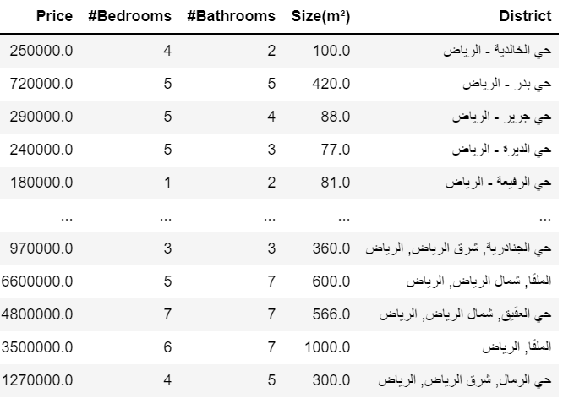
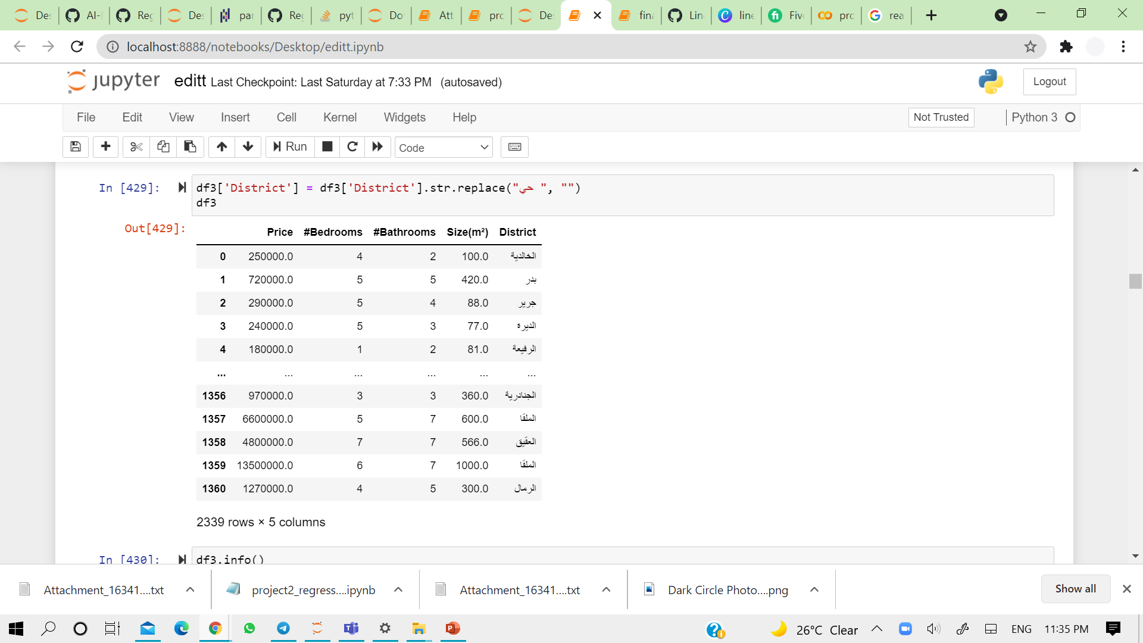
Data Cleaning
Before
After

Slide 10
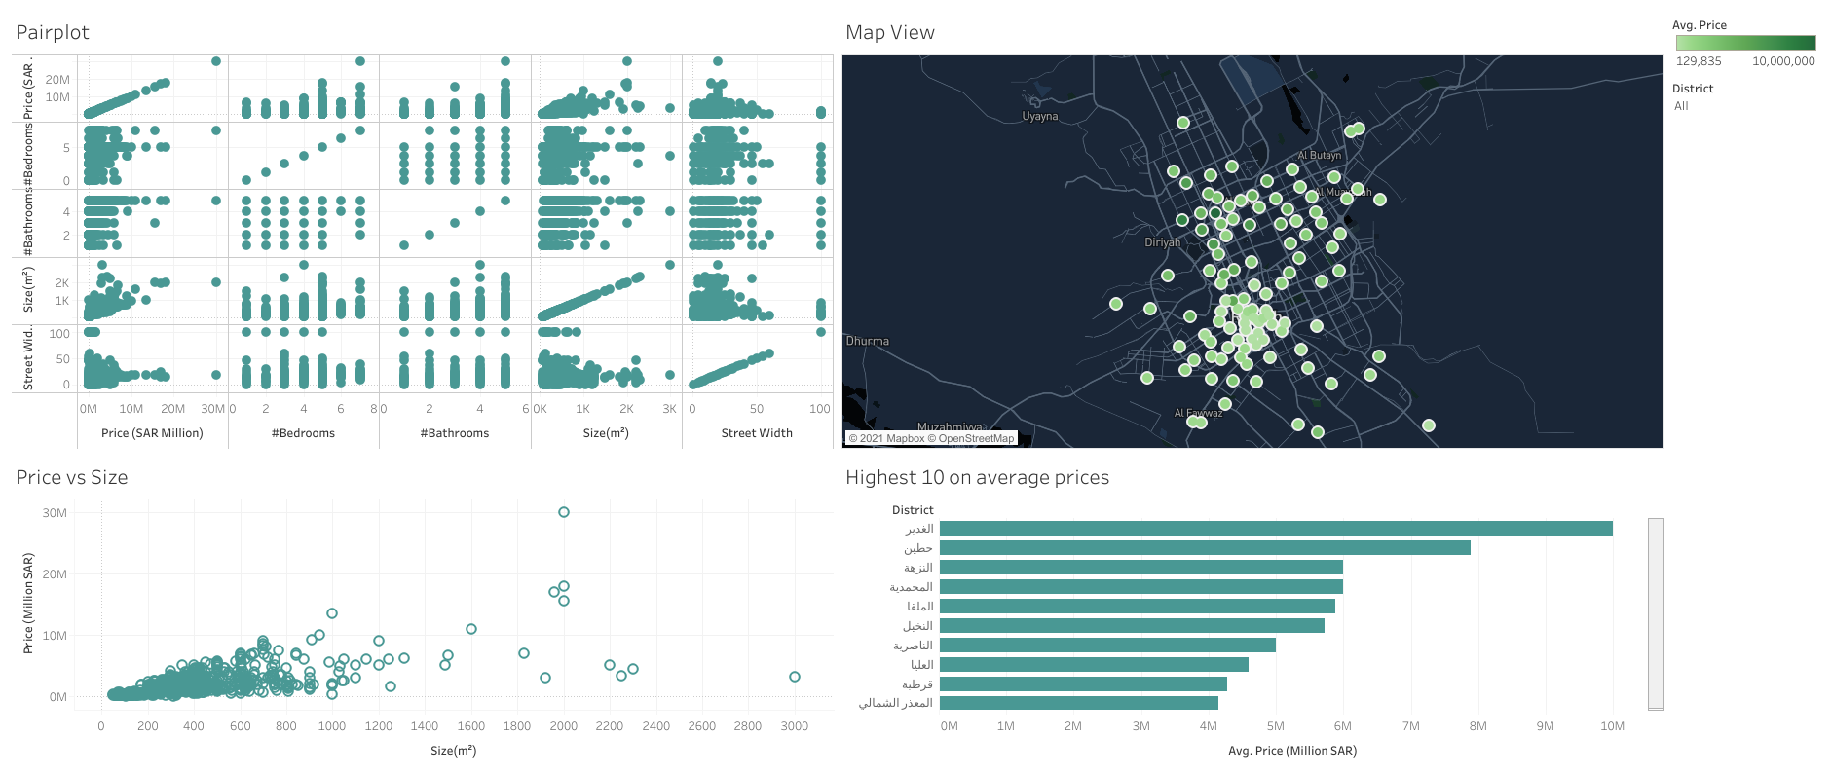
EDA
Data presented using Tableau tool Housing in Riyadh | Tableau Public)

Slide 11
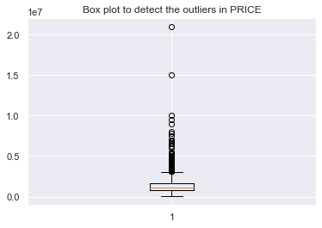
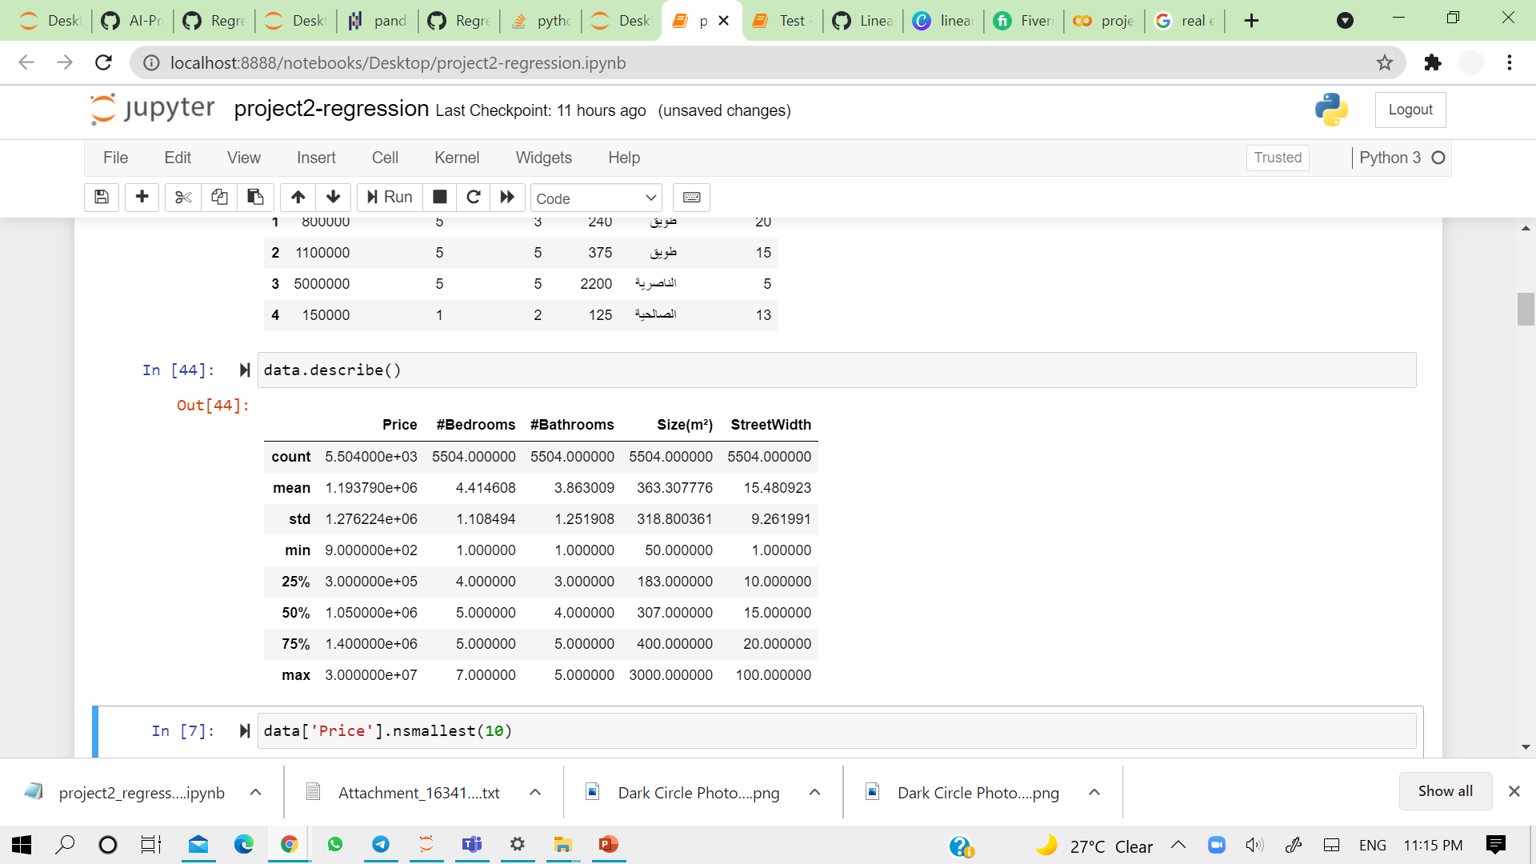
EDA
Insight: Price has Heavy outliers
Insight: Minimum house price: 900 SAR !
Treating outliers: Drop only the house that costs 900 SAR, because removing all outliers will remove data so It will not help us fitting as many values as possible.

Slide 12
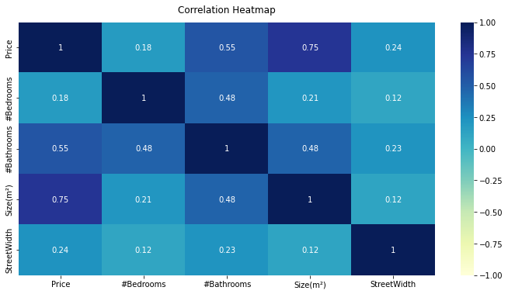
EDA
Heatmap – Features Correlation
The "Size" feature has high positive correlation 0.75 with target "Price“
The "Bathrooms" feature has high positive correlation 0.55 with target "Price“
The "Bedrooms" feature has low positive correlation 0.18 with target "Price“
. The “StreetWidth" feature has low positive correlation 0.24 with target "Price“

Slide 13

Modeling and Evaluation
Linear Regression
Random Forest Regressor
Ridge Regression

Slide 14
Modeling and Evaluation
1
Linear Regression (Baseline model)
Preprocessing: Convert “District” feature to dummy variables
Split data: 30% Test - 70% Train
Results:
Training score | Training error | CV score | Testing score | Testing error
0.86 | 0.14 | 0.75 | 0.84 | 0.1

Slide 15
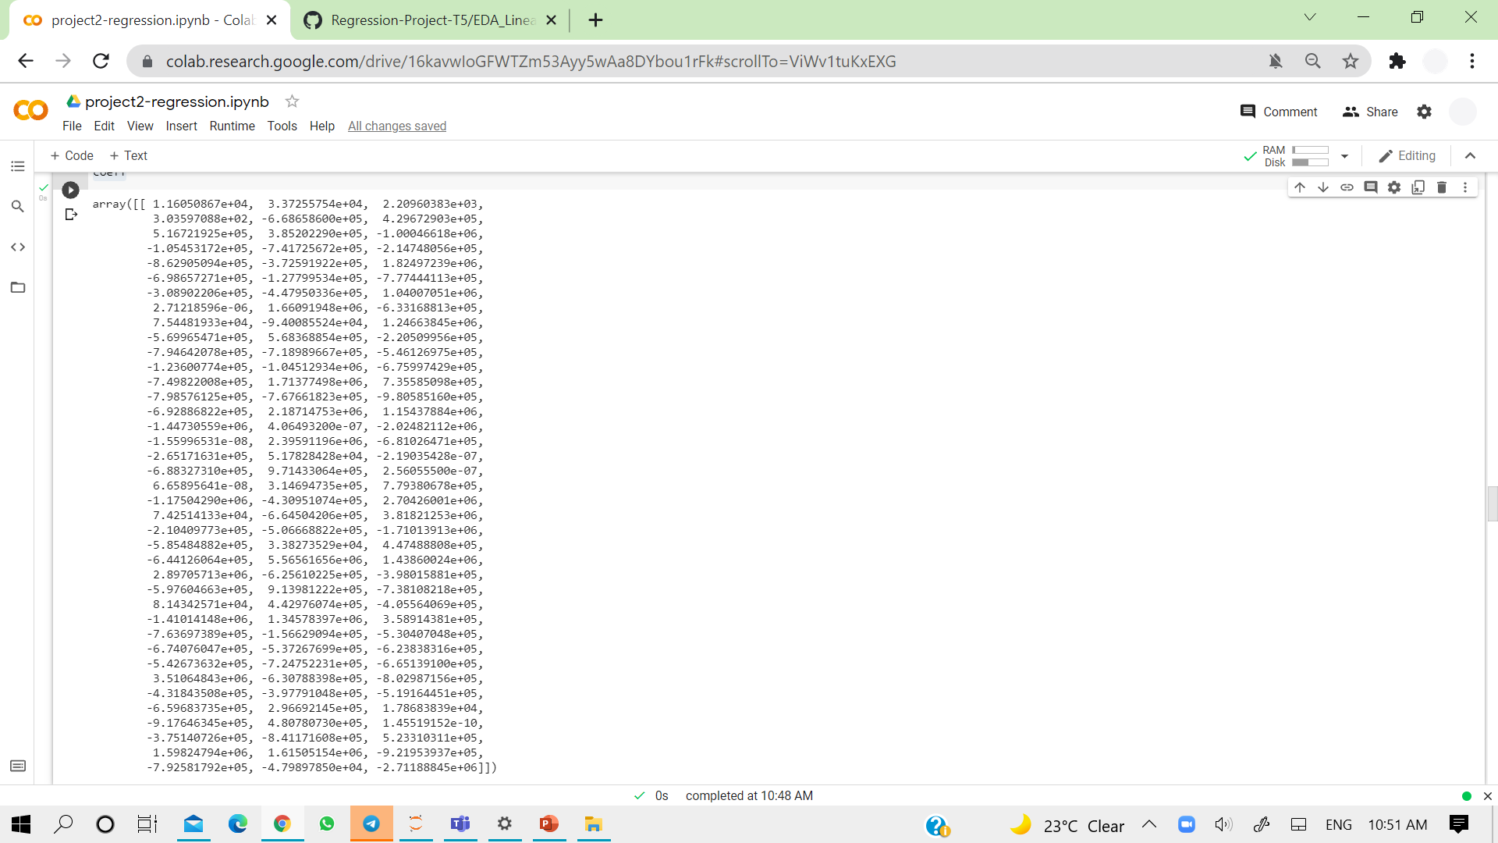
Modeling and Evaluation
1
Linear Regression (Baseline model)
Coefficients.

Slide 16
Modeling and Evaluation
2
Random Forest Regressor
Split data: 30% Test - 70% Train
Results:
Training score | Training error | CV score | Testing score | Testing error
0.98 | 0.02 | 0.78 | 0.89 | 0.1

Slide 17
Modeling and Evaluation
3
Ridge Regression
Split data: 30% Test - 70% Train
Results:
Training score | Training error | CV score | Testing score | Testing error
0.85 | 0.15 | 0.75 | 0.85 | 0.15

Slide 18
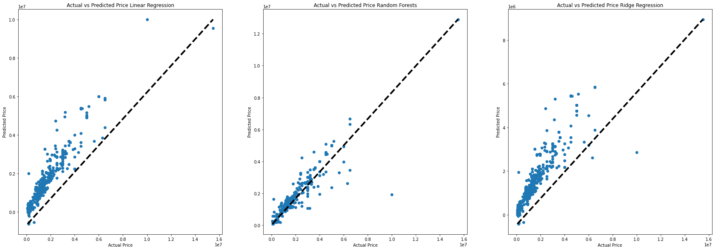
Modeling and Evaluation
Fit line for each model
Linear Regression
Random Forest
Ridge Regression

Slide 19
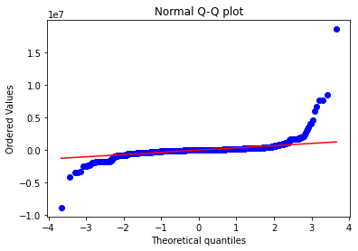
Modeling and Evaluation
Assumption 1: Regression is linear in parameters and correctly specified

Slide 20
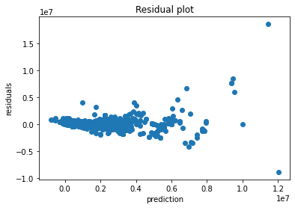
Modeling and Evaluation
Assumption 2: Residuals should be normally distributed with 0 mean
Points are randomly dispersed around the x axis, so we can tell LR working appropriately for our case

Slide 21
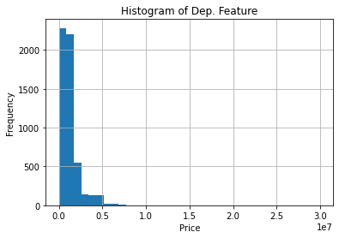
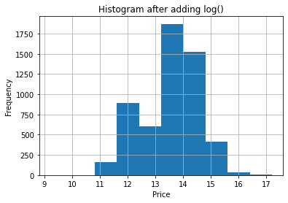
Modeling and Evaluation
Assumption 3: Error Terms must have constant variance

Slide 22



Conclusion
House price is affected by: # of bedrooms, # of bathrooms, Size, Street width and District
All models produce very good results even without using feature selection methodologies
Random forest wins the best performance model among all models

Slide 23
Conclusion
Tools used
Google Colab and Jupyter notebook
Visualization tool: Tableau
Python manipulation, visualization and ML libraries

Slide 24
Thank you!
Any Questions?

