Slide 1
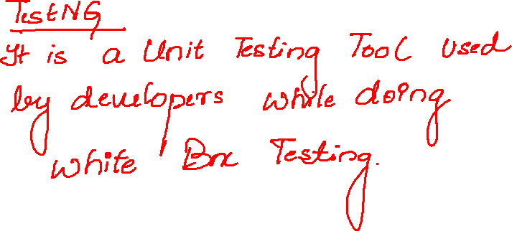

Slide 2
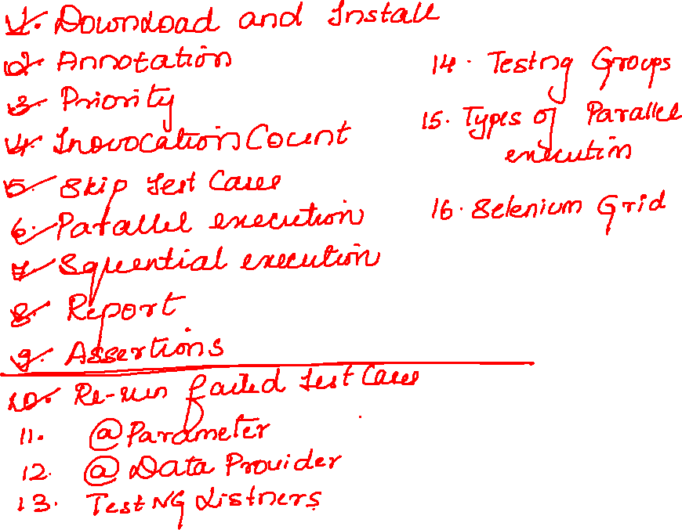


Slide 3
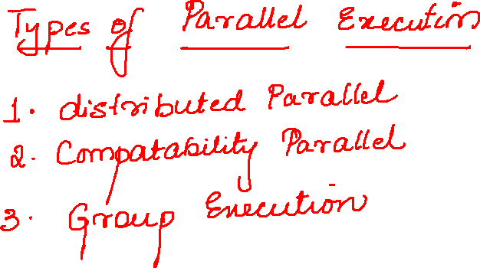

Slide 4
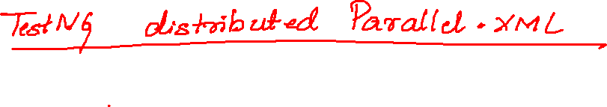
<suite name="Suite" parallel="tests">
<test thread-count="5" name="Test1">
<classes>
<class name="testNG.Test0"/>
<class name="testNG.Test1"/>
</classes>
</test> <!-- Test -->
<test thread-count="5" name="Test2">
<classes>
<class name="testNG.Test3"/>
<class name="testNG.Test4"/>
</classes>
</test> <!-- Test -->
</suite> <!-- Suite -->

Slide 5
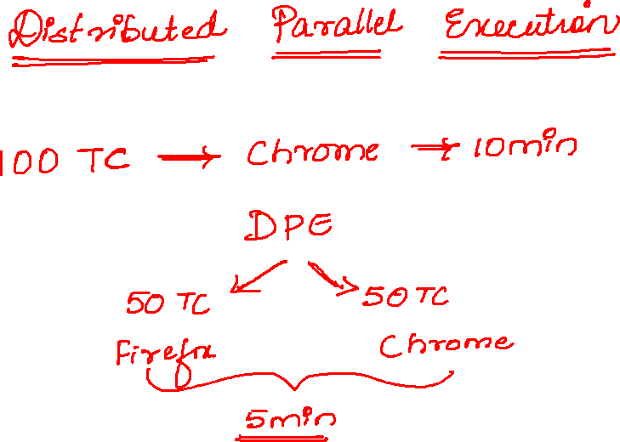

Slide 6
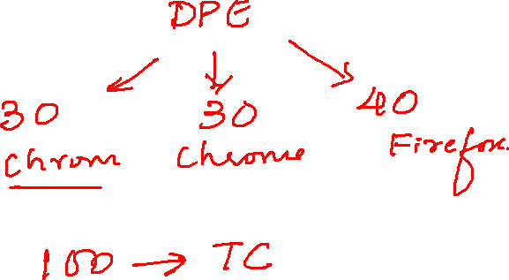

Slide 7


Slide 8
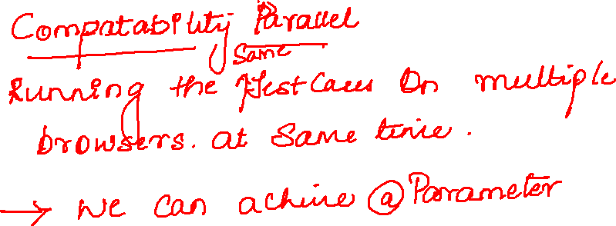

Slide 9
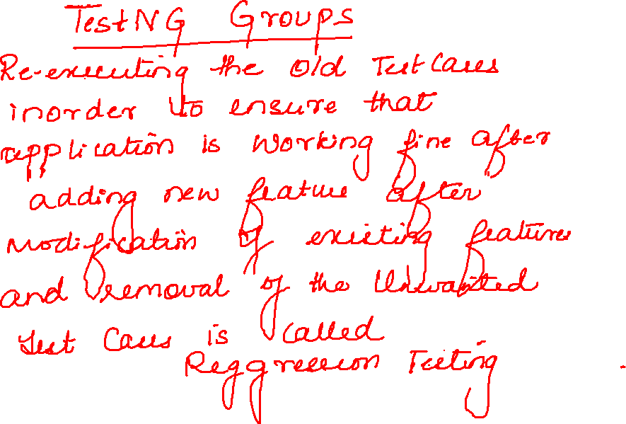

Slide 10
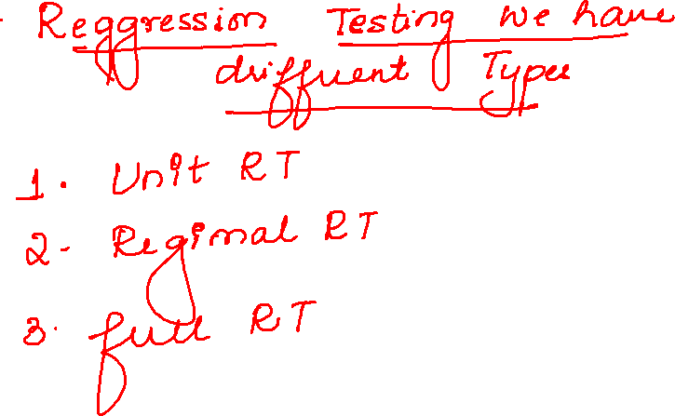

Slide 11
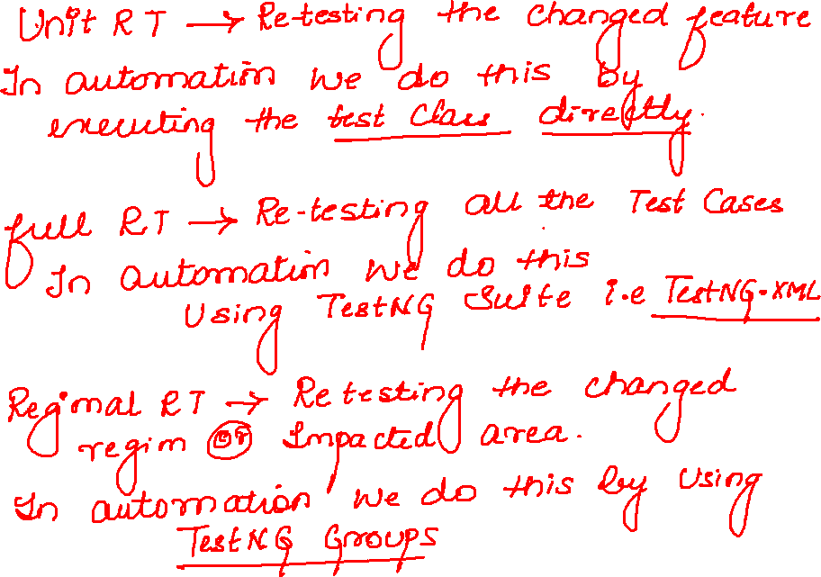

Slide 12
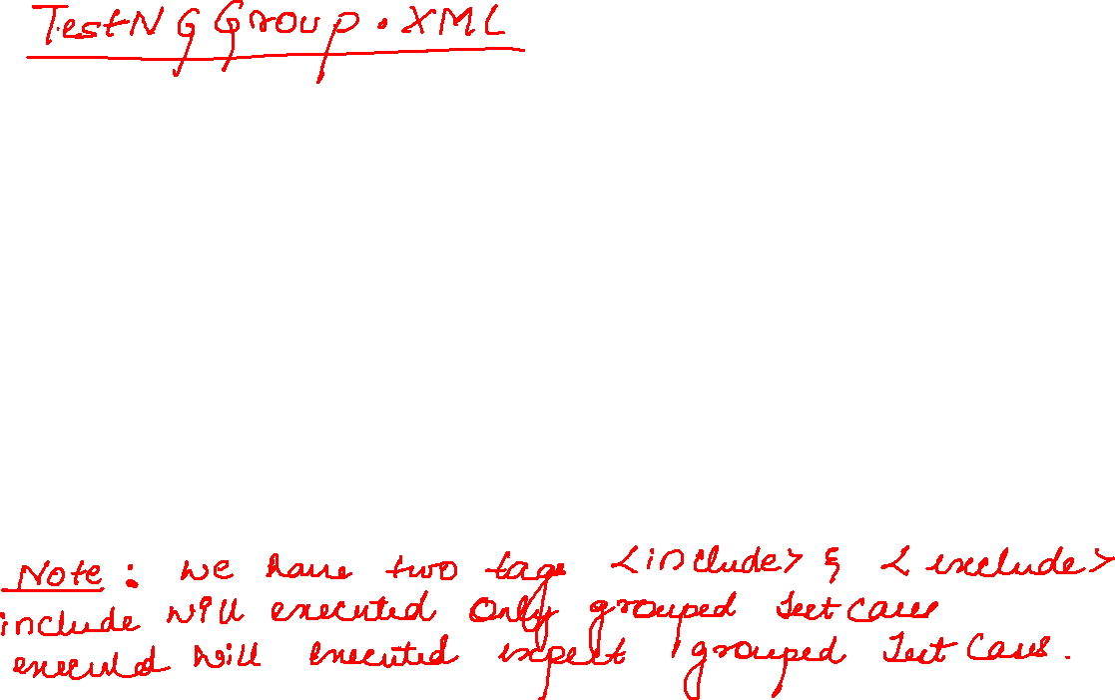
<suite name="Suite">
<groups>
<run>
<include name="deleteCustomer"/>
</run>
</groups>
<test thread-count="5" name="Test">
<classes>
<class name="testNG.Demo"/>
</classes>
</test> <!-- Test -->
</suite> <!-- Suite -->

