Slide 1
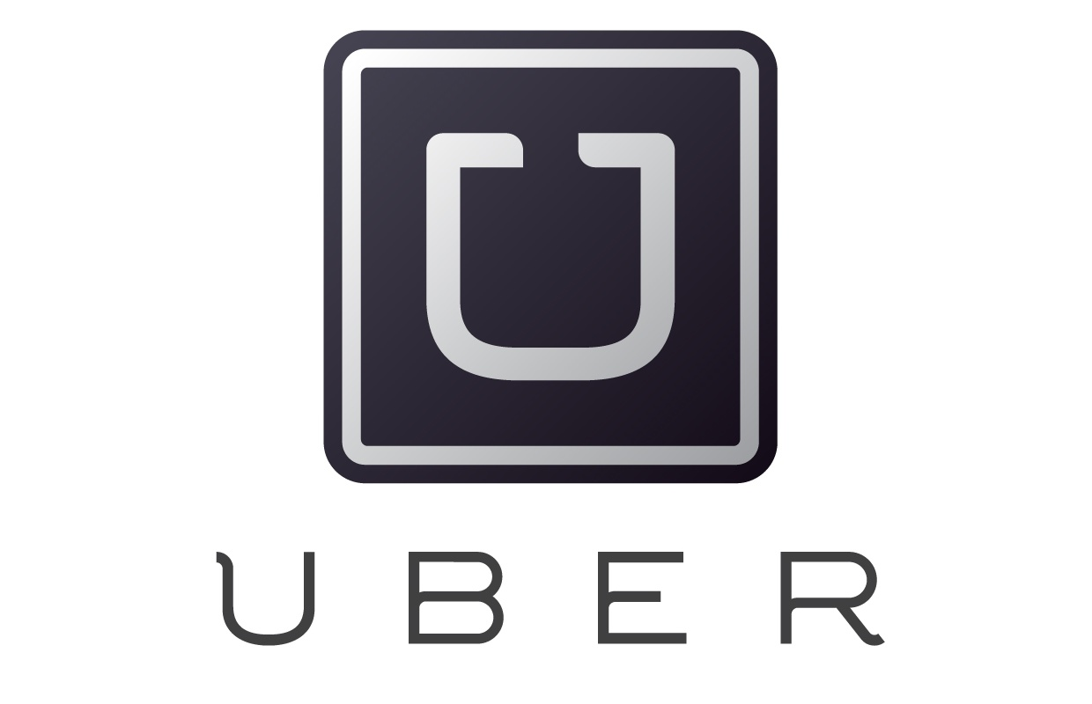
UBER

Slide 2

INTRODUCTION
Uber Technologies Inc. is a transportation network company headquartered in San Francisco, California, United States, operating in 570 cities worldwide.
It develops, markets and operates the Uber car transportation and food delivery mobile apps.
Uber drivers use their own cars,[ although drivers can rent a car to drive with Uber.

Slide 3
The name "Uber" is a reference to the common (and somewhat slangy) word "uber", meaning "topmost" or "super", and having its origins in the German word über, meaning "above".
Uber has been a pioneer in the sharing economy and the changes in industries as a result of the sharing economy have been referred to as "Uberification" or "Uberisation".

Slide 4
SPECIFICATIONS
Formerly called | UberCab (2009–2011)
Type | Privately held company
Industry | Transportation
Founded | March 2009; 8 years ago
Founders | Travis Kalanick Garrett Camp
Headquarters | San Francisco, California
Area served | Worldwide, 570 cities
Products | Mobile app, website

Slide 5

Services | Transportation network company Vehicle for hire Delivery (commerce)
Revenue | US$20 billion (2016)
Operating income | US$6.5 billion (2016)
Net income | US-$2.8 billion (2016)
Number of employees | 6700
Website | Uber.com

Slide 6
FACTS
Uber, which operates in more than 50 countries, has recently made big investment moves into India and China.
In India, this means linking with Bharti Airtel in a deal that will let customers in India pay for rides through the latter’s mobile wallet platform.
In China, Uber said it’s investing $1 billion into the market that CEO Travis Kalanick said could eventually be Uber’s top market. Uber is also said to be investing the same amount in India.

Slide 7
$10.84 BILLION | UBER’S PROJECTED BOOKINGS TOTAL ESTIMATED FOR 2015
While reports in late June indicated that Uber was operating at $470 million in operating losses on $415 million in revenue, the look into its latest reports indicate that Uber may be turning things around.
At that same time, it was reported that the company had plans to sell $1 billion-$1.2 billion in convertible bonds.

Slide 8
$26.12 BILLION | UBER’S PROJECTED BOOKINGS TOTAL ESTIMATED FOR 2016
Given the fact that Uber keeps 20 percent of revenues as bookings, a quick calculation would imply that Uber will see a revenue of about $2 billion this year.
That number would then be expected to grow more than double based on the booking figure projected for next year of $26.12 billion.

Slide 9
Uber: An IPO Candidate in 2016?
In just five years, Uber Technologies, Inc. has ushered in the era of a “sharing economy” and disrupted a long-established industry by linking smartphone technology to anyone with a car who wants to earn some money on the side.
Launched in 2010, the app-based technology/transportation company operates in more than 270 cities and 60 countries. The premise is breathtakingly simple.
Use a smartphone application to connect someone who needs a ride with an Uber driver who happens to be in the area, and do it faster, cheaper and with better customer service than taxi cabs.

Slide 10
Five years after its launch, Uber is said to be valued at around $60 billion, which makes it a prime candidate for an initial public offering (IPO).
But will 2016 be the year for Uber’s coming out? Anxious investors are hoping the answer is yes, but there are several factors that may cause Uber to postpone its IPO for another year or two.
- Uber’s Sky-High Valuation
- A Shaky U.S. Stock Market
- Uber Founders Are Not in a Hurry
- Uber is cash rich

Slide 11


