Slide 1
Slide 1: Title Slide 🌟
Project Title: WHO NCD Risk Projection using Big Data Analytics
Student Name: [Your Name]
Course Code: INSY 8413 | Introduction to Big Data Analytics
Institution: Adventist University of Central Africa
Date: July 26, 2025

Slide 2
Sector Selection 💼: Healthy
•Selected Sector: Health ☕
•Focus: Chronic Diseases (Diabetes, Obesity, Hypertension, Tobacco Use, Alcohol Consumption)
•Why Health?
•Non-Communicable Diseases (NCDs) are a major public health challenge globally.
•Early data-driven risk projections help in formulating preventive strategies.
•Dataset Share Link: https://www.who.int/data/gho/data/themes/topics/ncd-risk-factors

Slide 3
Problem Statement 🔎
•Real-World Problem:
•"How can we leverage historical health indicators to predict NCD risk trends and enable health interventions?“
•Detailed Explanation:
•Chronic diseases such as diabetes, hypertension, and obesity are increasing at alarming rates, especially in developing countries.
•Policymakers and health organizations lack interactive tools that can visualize risk trends over time.
•By analyzing patterns in NCD risk factors, we aim to provide actionable insights that can guide public health campaigns and resource allocation.
•The project focuses on enabling a predictive view of NCD risks rather than reactive treatment-only models.
•
•Objectives:
•Detect patterns and correlations among NCD risk factors.
•Provide an interactive visualization tool for health policy decision-makers.

Slide 4
Dataset Identification 📂
Slide 4: Dataset Identification 📂
•Dataset Title: WHO Global Health Observatory NCD Risk Indicators
•Source Link:
•https://www.who.int/data/gho/data/themes/topics/ncd-risk-factors
•Number of Rows and Columns:
•Rows: 1,067
•Columns: 9
•Data Structure:
•☑ Structured (CSV, Excel)
•Data Status:
•☑ Requires Preprocessing (Handled Missing Values, Cleaned Column Names, Filtered Indicators)

Slide 5
Dataset Attributes 📝
•Columns Used:
•Country — Name of the country.
•Year — The corresponding year of the data record.
•Diabetes (%) — Percentage of population with diabetes.
•Obesity (%) — Percentage of population classified as obese.
•Tobacco Use (%) — Smoking prevalence in the population.
•Hypertension (%) — Percentage of adults with high blood pressure.
•Alcohol Consumption (Liters) — Average liters of pure alcohol consumed per capita.
•Risk_Level — A derived binary column indicating High Risk (1) or Low Risk (0) based on indicator thresholds.
•Explanation:
•The dataset integrates multiple health risk indicators across countries and years.
•Each record represents a snapshot of health factor prevalence in a given country-year.
•'Risk_Level' was engineered to categorize overall NCD risk profile.
•Sample Indicators Explained:
•Prevalence of Diabetes: Measures how widespread diabetes is in the population.
•Prevalence of Obesity: Assesses the obesity rate per country-year.
•Tobacco Use Percentage: Indicates smoking habits, a major contributor to NCDs.
•Hypertension Rates: Tracks the percentage of population with elevated blood pressure.
•Alcohol Consumption Levels: A factor influencing liver diseases and other chronic conditions.

Slide 6
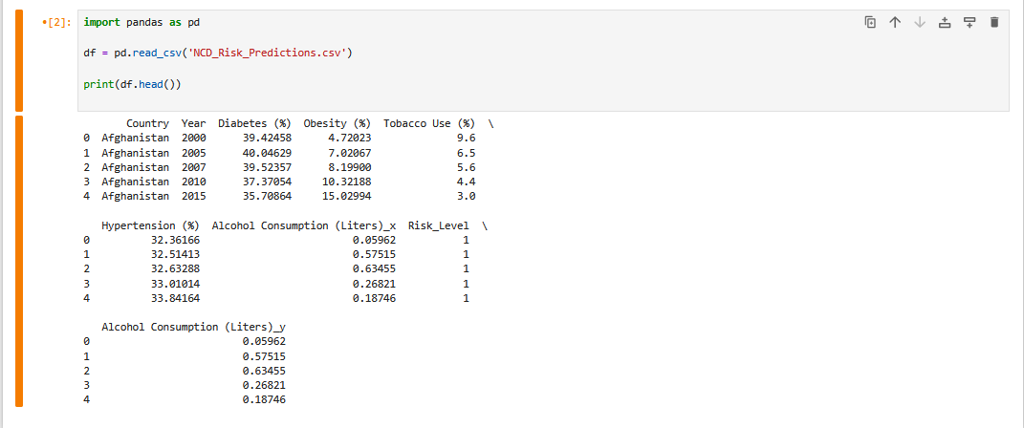

Slide 7
Tools & Technologies 🛠️
•Python (Jupyter Notebook):
•Data Cleaning & Preprocessing (handled missing values, renamed columns).
•Exploratory Data Analysis (EDA) (statistical summaries, histograms, correlation matrix).
•Dataset Merging & Feature Engineering (Risk_Level creation).
•Power BI:
•Interactive Visualizations (line charts, bar charts, pie charts, map visuals).
•Dashboard Design (filters, slicers for Country and Year).
•GitHub Repository:
•Project Documentation & Code Management.
•Organized folder structure (data/raw, data/processed, notebooks, dashboard, reports).

Slide 8
