Slide 1
MiCrosoft
THE MOVIE ANALYSIS

Slide 2
BRIEF INTRO:
THE bom.movie gross(csv ) helps us identify:
i)Between foreign and domestic which has better yields
ii) The correlation between the two
iii) Which studios have better yields and have best productions
The im.db also helps us identify
i)Which genre has more popularity and ratings
ii)Between the top two genres which should be produced
iii)The distribution of ratings

Slide 3
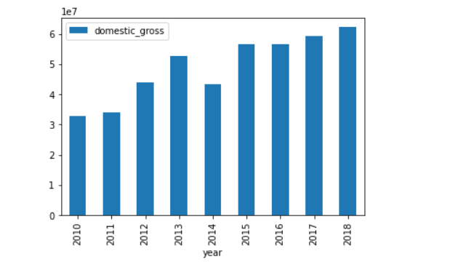
THE INCOME RETURNS
FOREIGN_GROSS : The returns within the countries is seen to be increasing steadily over the past 5 years. Thus can be more promising

Slide 4
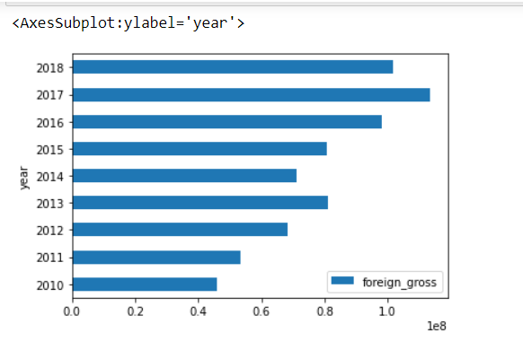
The income returns
FOREIGN RETURNS : IT has not so consistent returns as compared to the domestic returns

Slide 5
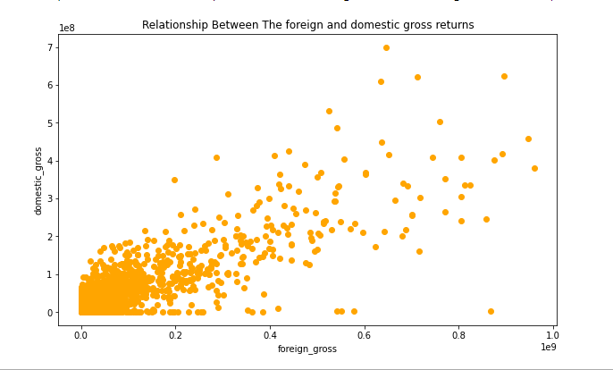
corelation
The domestic and foreign gross have a low positive correlation.Thus showing that the domestic’s movement can affect the foreign returns

Slide 6
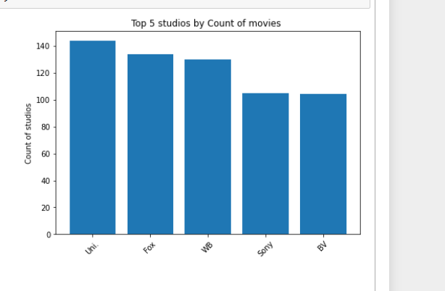
STUDIOS
UNI,FOX,WB,SONY and the BV are top 5 studios with most movies produced
Thus can be advised for movie production by Microsoft.

Slide 7
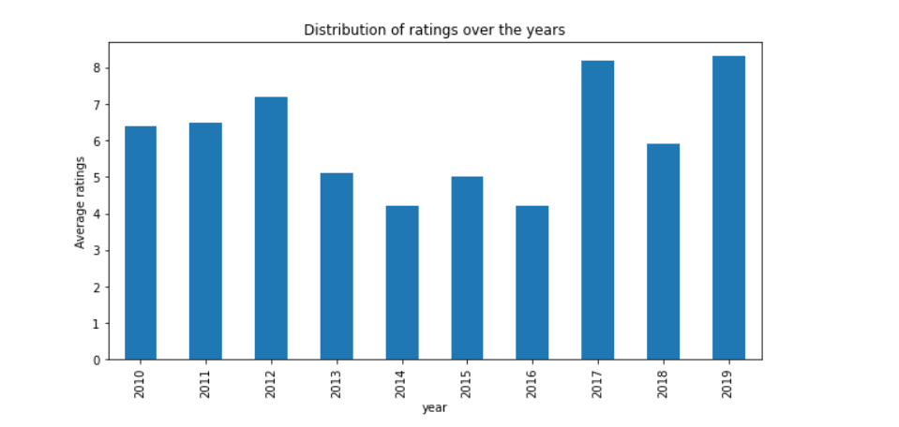
movie basics & movie ratings
Ratings distributions over the years .For the past years the ratings are at max with a rate of 8 in 2019 and 2017

Slide 8
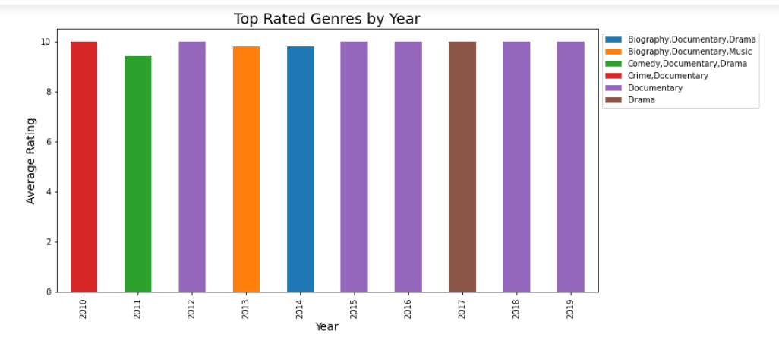
GENRES
The most produced genre over the years is the Documentary.We will dive deeper into it.

Slide 9
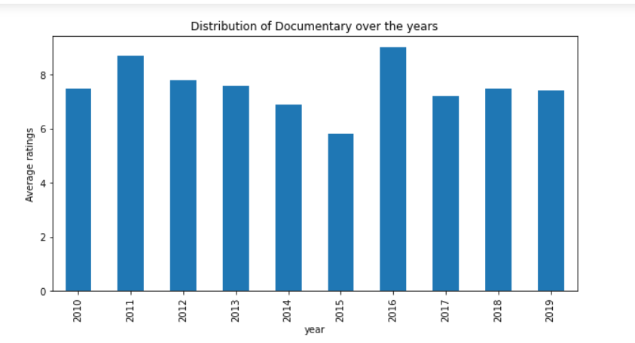
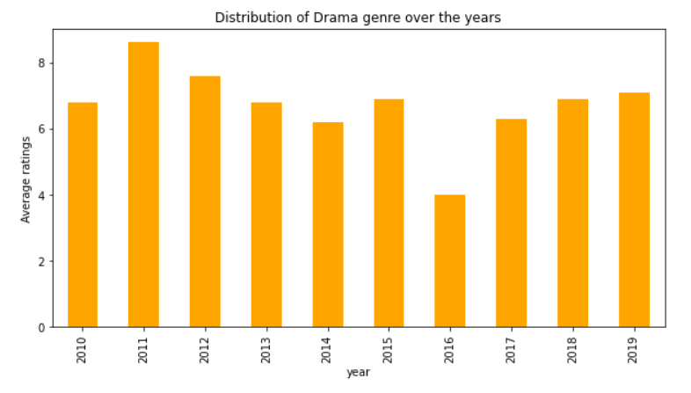
Documentary vs Drama

Slide 10
Conclusion
The Microsoft should go for Documentary (genre) type of movie
The top studios to work with and at are the UNI,FOX,WB,SONY
Domestic gross/returns are increasing steadily and also promising
The average rating and number of votes have a high correlation thus one affects the other.

Slide 11
RECOMENDATIONS
In conclusion the Microsoft should take on either UNI,FOX,WB,SONY and the BV as the type of studios to adopt in their movie production.
The rating number to work with is at 8.
As previous movies with that rating are successful.
They should produce either the Documentary or Drama .But mostly the Documentary as it has most ratings and popularity. Thus most liked

Slide 12
THANK YOU.
HAVE A PRODUCTIVE FILM CREATION

