Slide 1
TestNG - Rest Assured - Framework

Slide 2
Summary:
TestNG Frame work Setup/Tools
Existing Maven/TestNG Project - Import into Eclipse
TestNG Frame work Folder Structure
Framework files description details
Different ways to execute TestNG Frame work
TestNG Execution Reports - (Pass&Fail)
GitHub - Repository
Jenkins - Execution

Slide 3
TestNG - Framework Setup/Tools
Eclipse - Java Editor Tool
Java 8 - Designing Java scripts
Maven - Pom.xml: All Maven Dependencies & Commands
TestNG - TestNG.xml: TestNG framework - Annotations & Assertions
Rest Assured - Rest: API/SOAP: Services
Test Data - Properties file & Json files

Slide 4
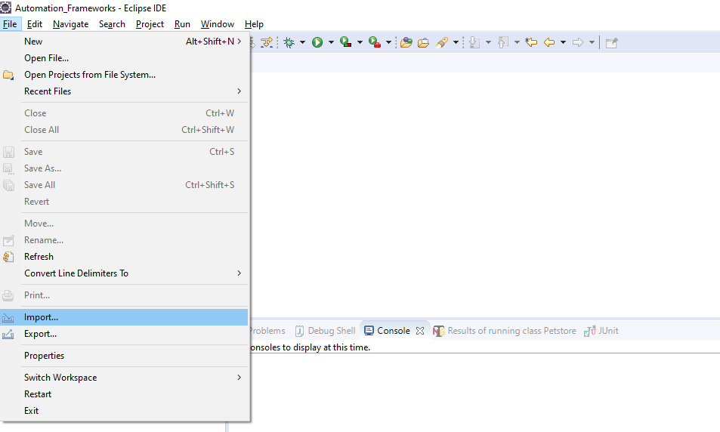
Existing Maven/TestNG Project - Import into Eclipse - Step-1

Slide 5
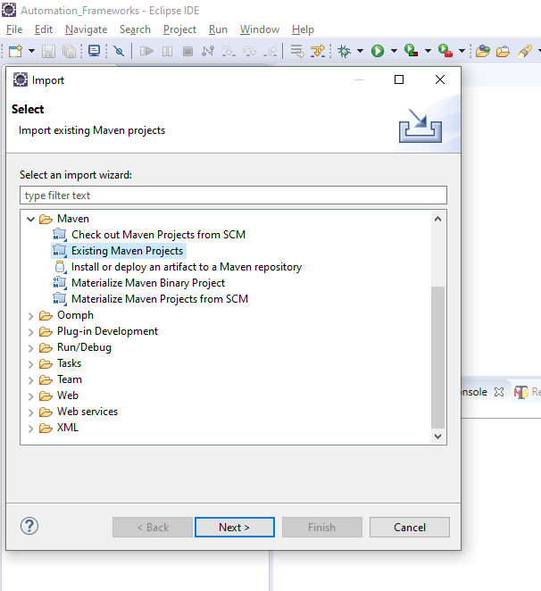
Existing Maven/TestNG Project - Import into Eclipse - Step-2

Slide 6
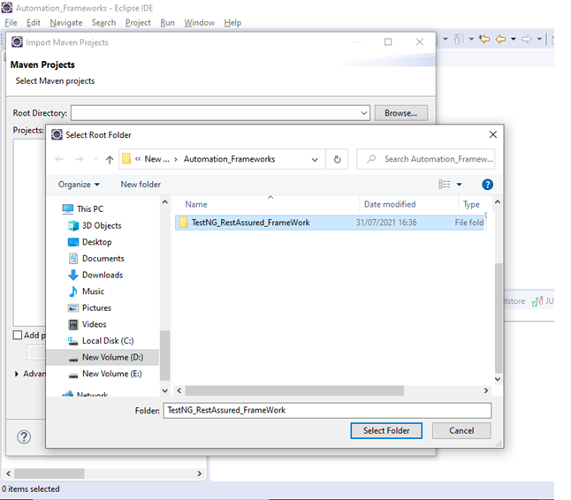
Existing Maven/TestNG Project - Import into Eclipse - Step-3

Slide 7
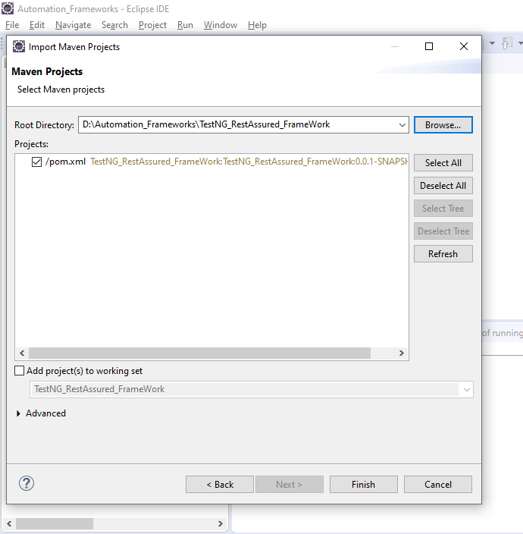
Existing Maven/TestNG Project - Import into Eclipse - Step-4

Slide 8
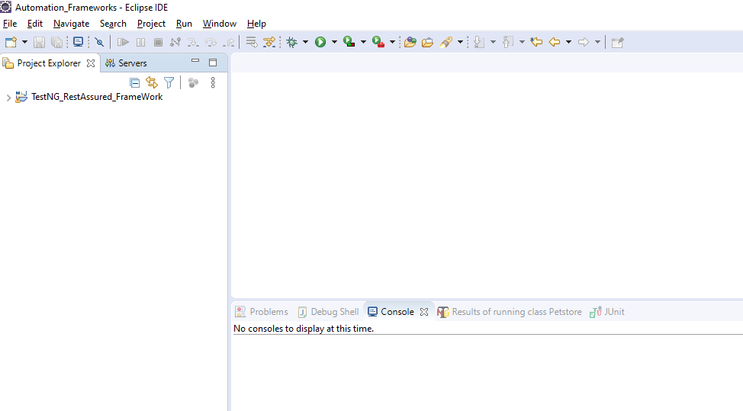
Existing Maven/TestNG Project - Import into Eclipse - Step-5

Slide 9
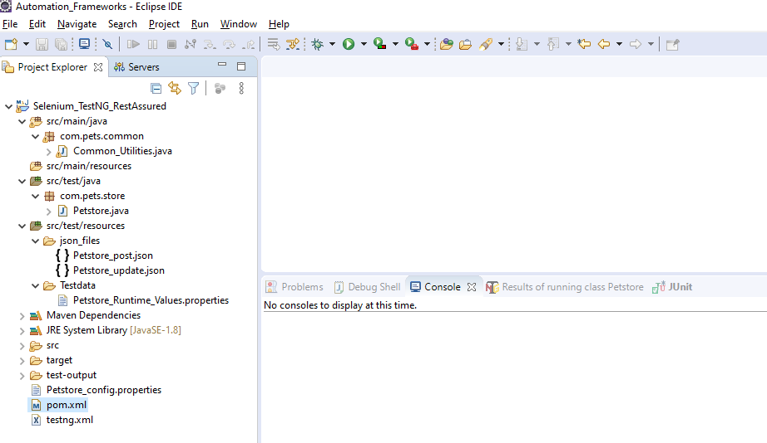
TestNG - Framework - Folder Structure

Slide 10
Framework - Describes the file description details
Common_Utilities.java: Java Common methods across all scripts.
Petstore.java: Main java scripts.
Json_files: Petstore_post.json & Petstore_update.json - input json files.
Test data: Petstore_Runtime_Values.properties - Runtime values storing.
Maven Dependencies: All Maven dependencies location path
test-output: index.html - TestNG Reports
Petstore_config.properties: Input test data(Urls, Status Code, StatusDesc) Etc.
pom.xml: All maven dependencies in the pom.xml file.
testng.xml: com.pets.store.Petstore (package name and class name)

Slide 11
Different ways To Execute TestNG - Framework
Petstore.java - Right Click Run As TestNG Test - Execution
TestNG.xml - Right Click Run As TestNG Suite - Execution
pom.xml - Right Click Run As Maven Test - Execution
CMD - Navigate to Project Folder - Execution - mvn clean test

Slide 12
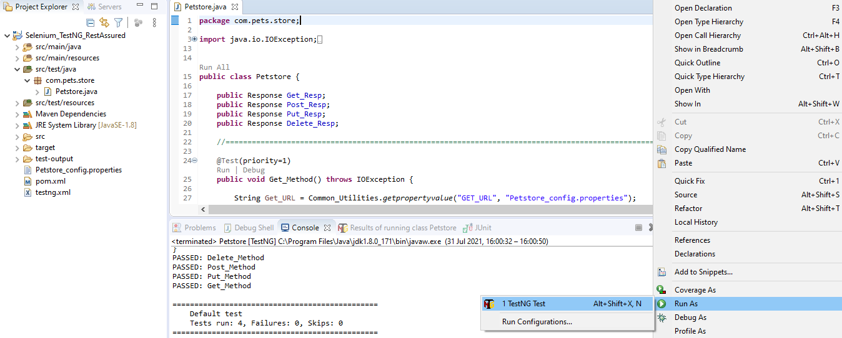
1. Petstore.java - Right Click Run As TestNG Test - Execution

Slide 13
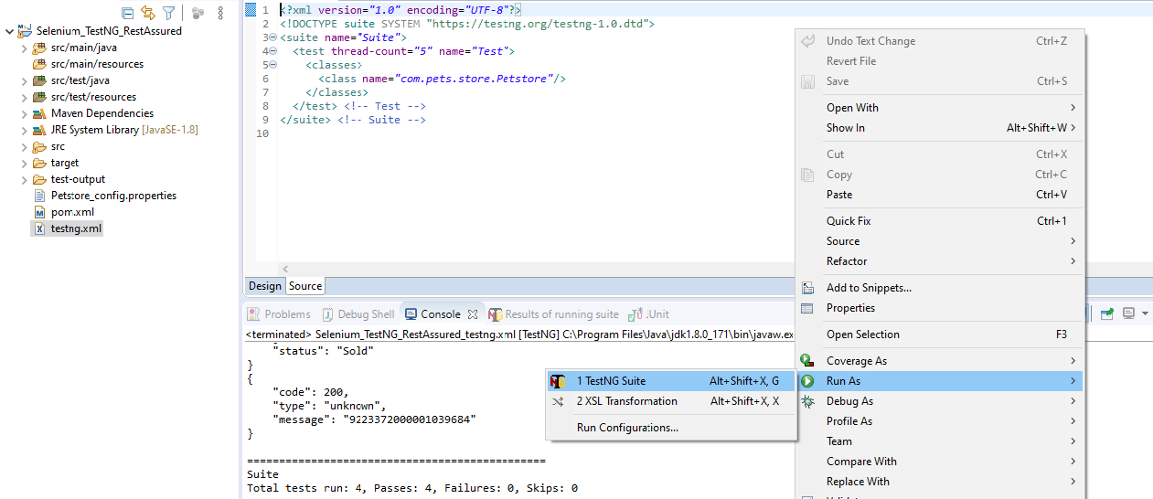
2. TestNG.xml - Right Click - Run As - TestNG Suite - Execution

Slide 14
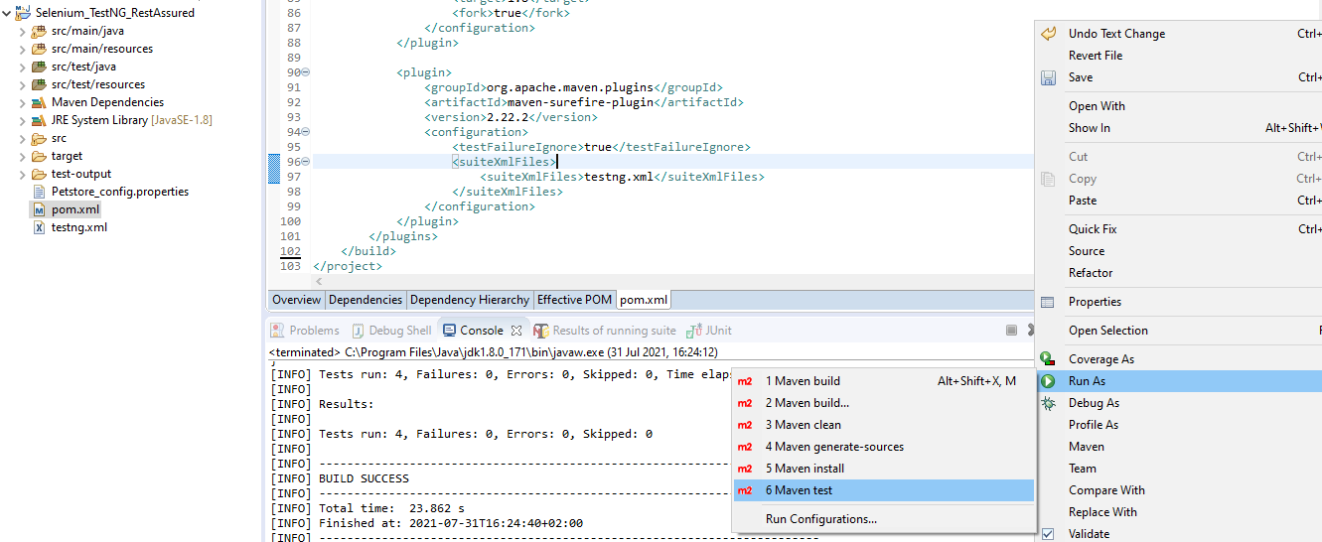
3. pom.xml - Right Click - Run As - Maven Test - Execution

Slide 15
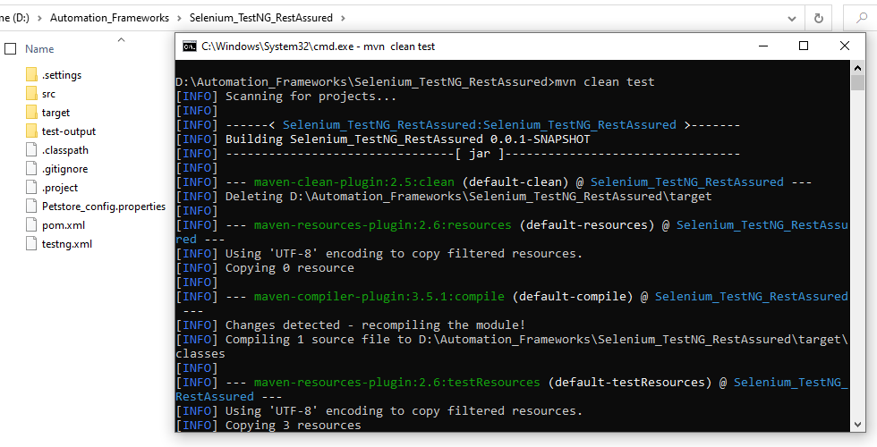
4. CMD - Navigate to the Project Folder - Type - mvn clean test

Slide 16
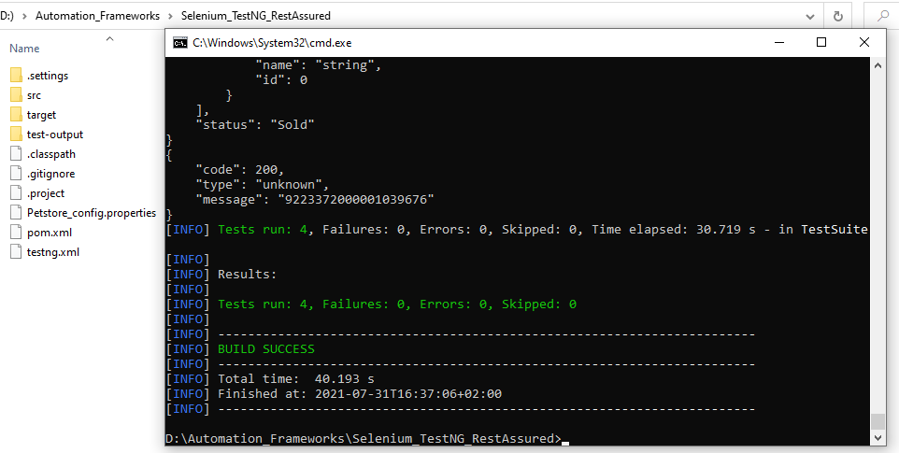
4.1. CMD Continue…:Page-2

Slide 17
TestNG - Reports (Pass & Fail)

Slide 18
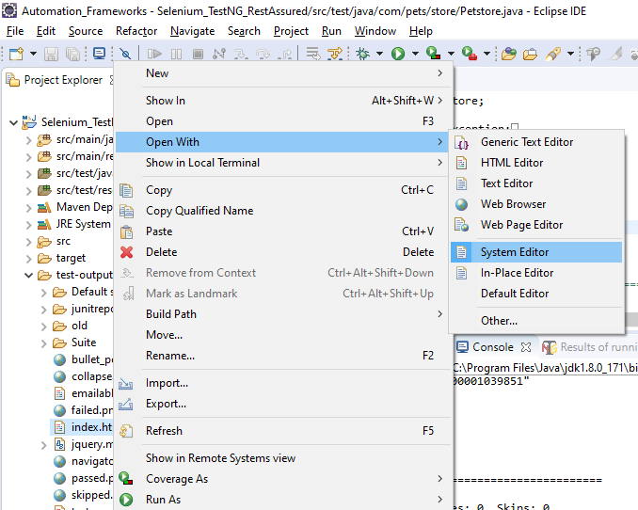
Project (Reports Location) ---> test-output ---> index.html ---> Open With ---> System Editor

Slide 19
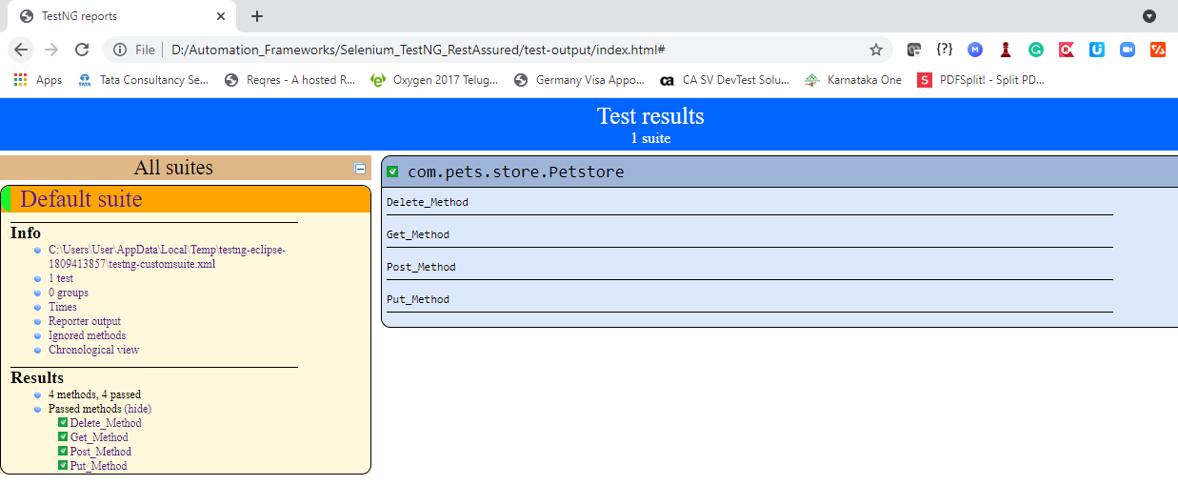
Reports-1: TestNG Results Over view

Slide 20
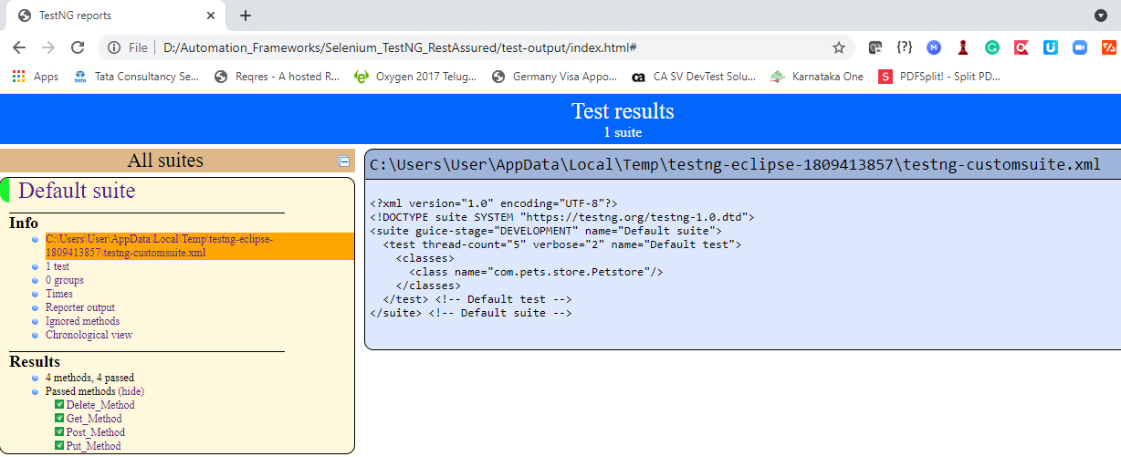
Reports-2: TestNG.xml Structure

Slide 21
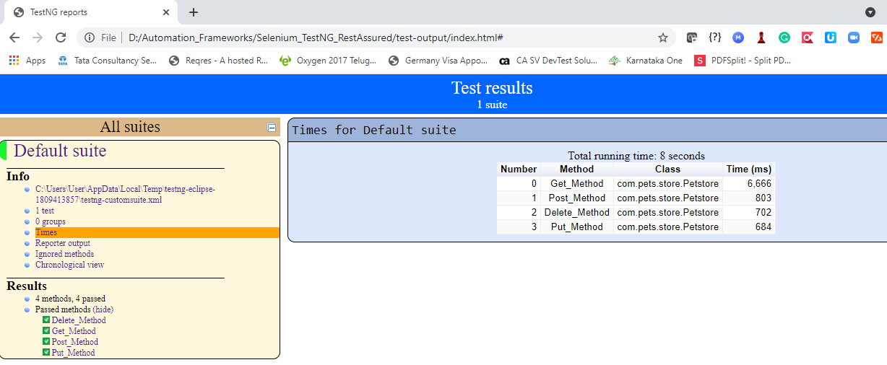
Reports-3: TestNG - Times

Slide 22
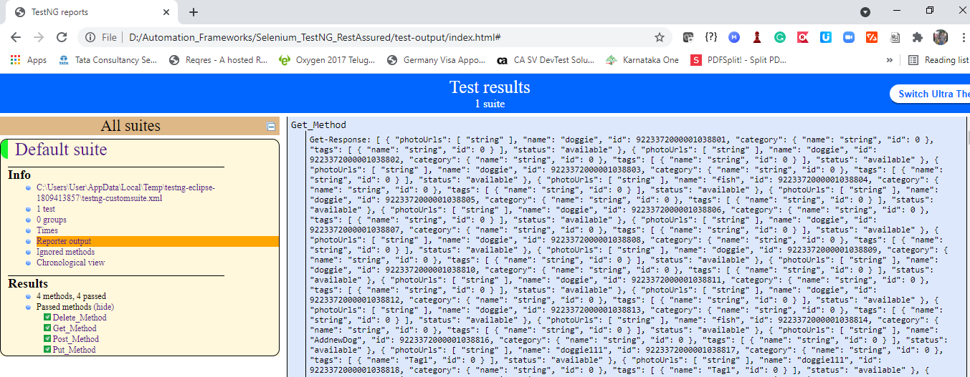
Reports-4: TestNG - Get Method - Available Pets - Logs Etc..

Slide 23
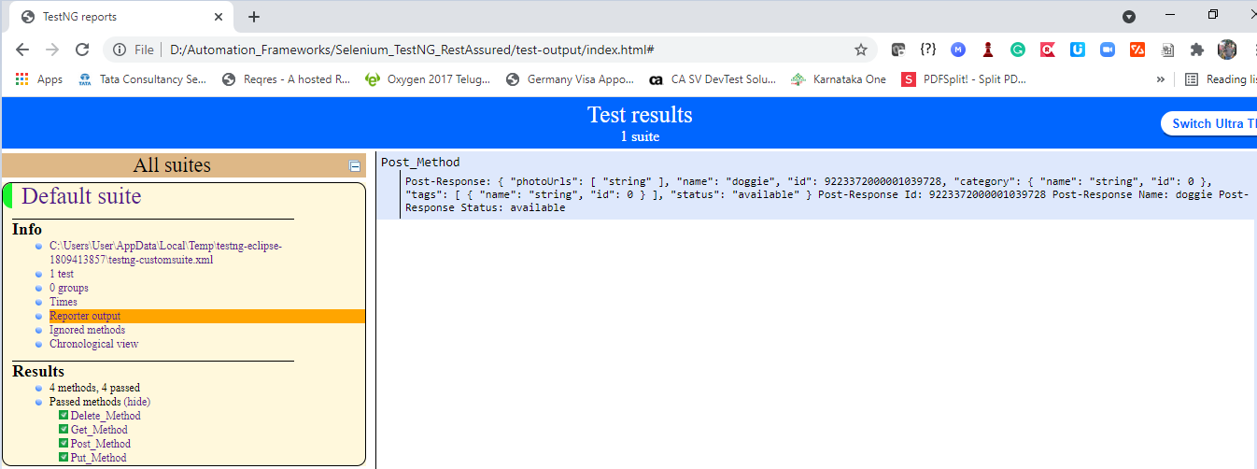
Reports-5: TestNG - Post Method - New Pets Added - Logs

Slide 24
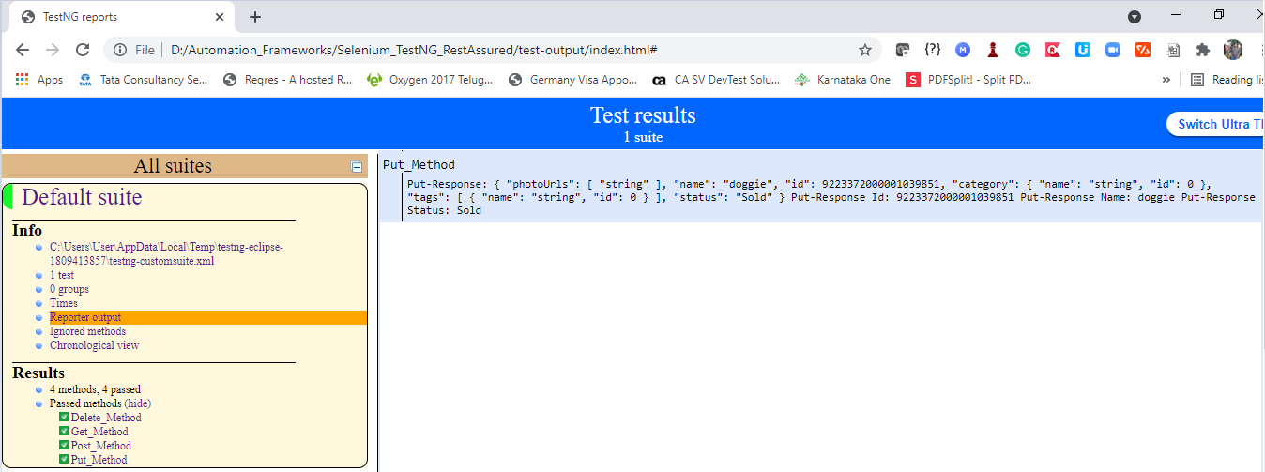
Reports-6: TestNG - Put Method - Sold Status - Logs

Slide 25
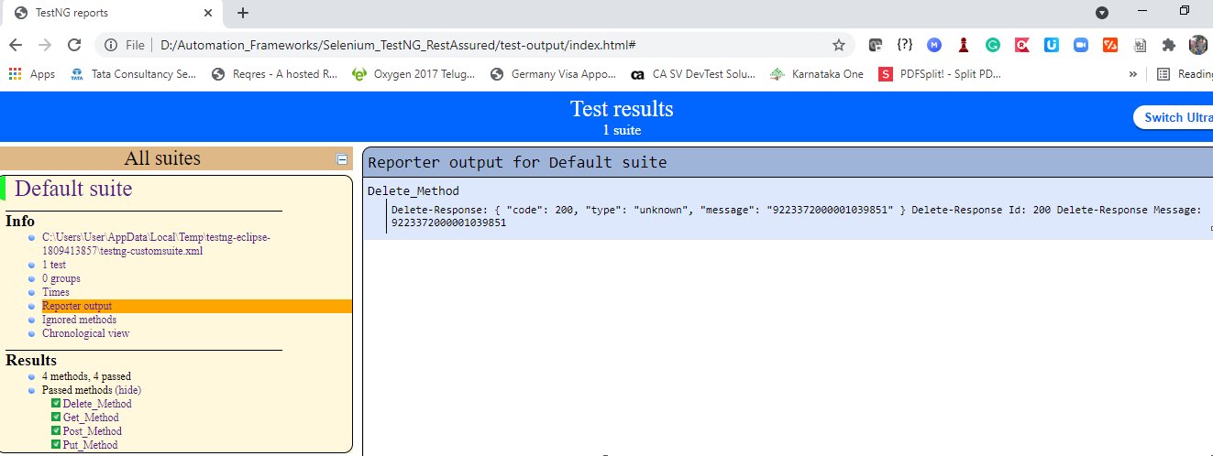
Reports-7: TestNG - Delete Method - Delete Pet - Logs

Slide 26
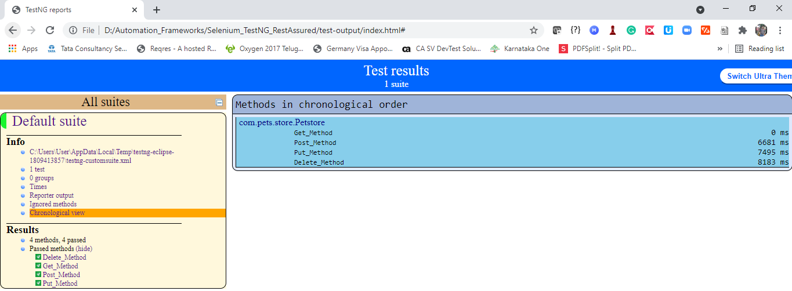
Reports-8: TestNG - Methods Execution Order

Slide 27
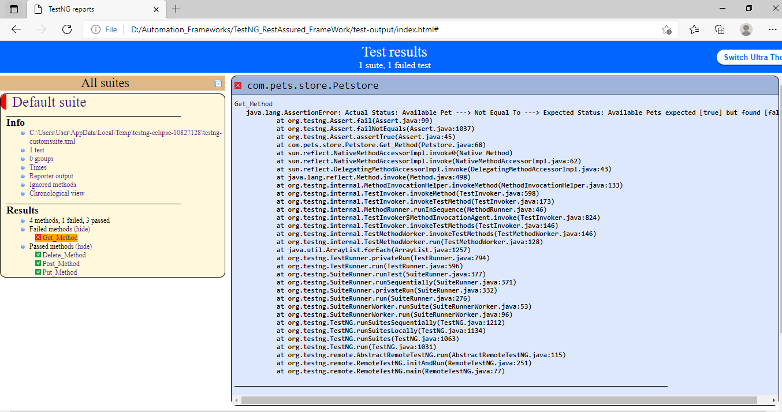
Reports-9: TestNG - Failure Scenario - Overview

Slide 28
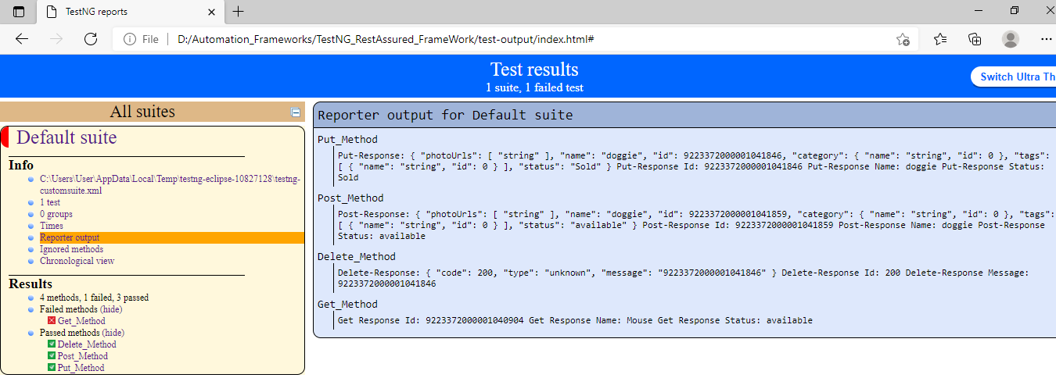
Reports-10: TestNG - Failure Scenario - Test Result Reports

Slide 29
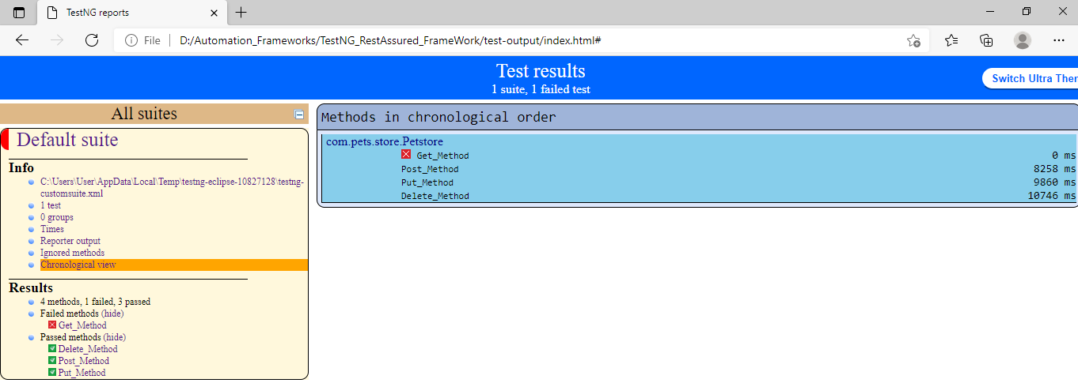
Reports-10: TestNG - Failure Scenario - Execution Order

Slide 30
GitHub - Repository

Slide 31
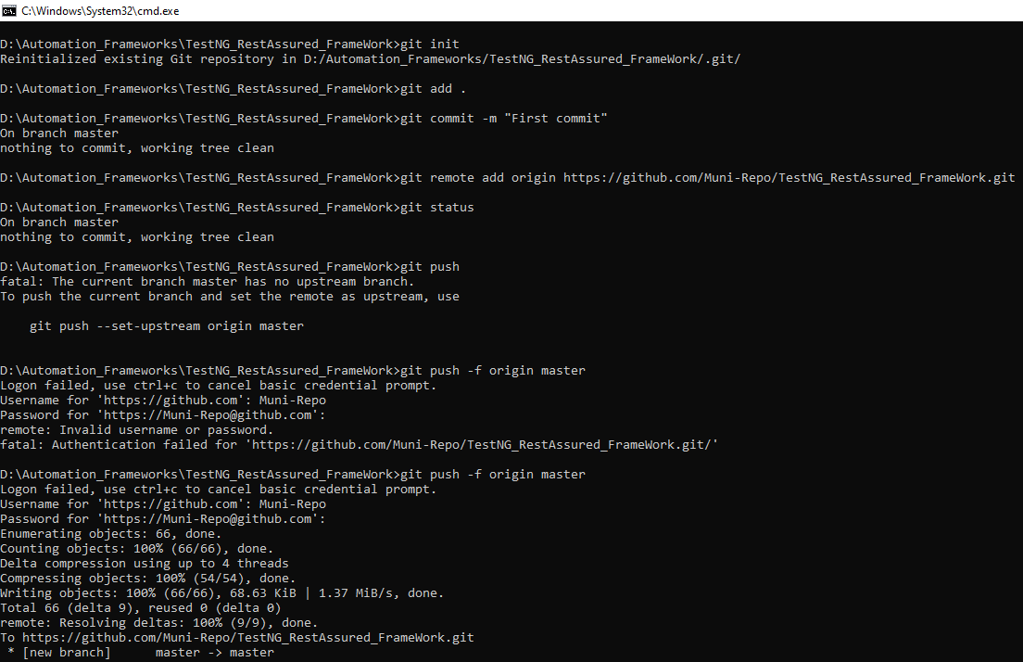
GitHub: Pushing code into GitHub via git commands

Slide 32
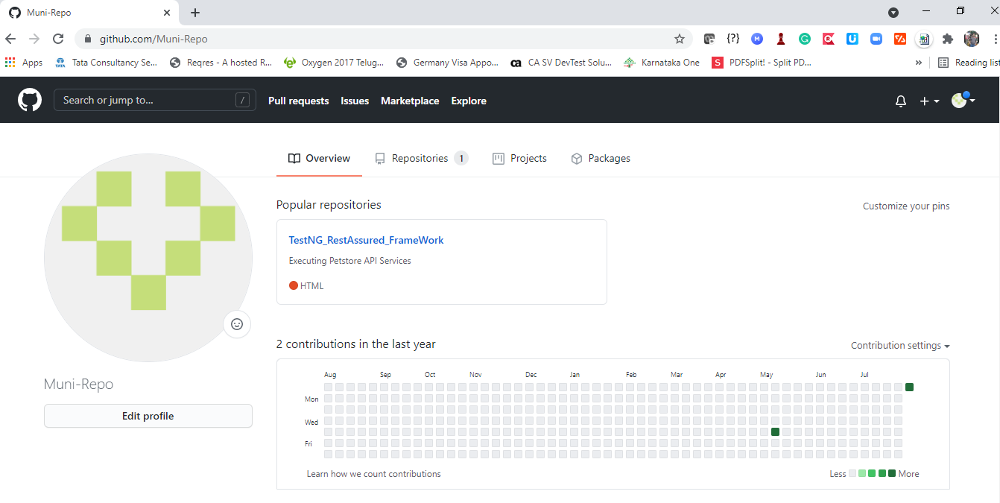
GitHub-Overview

Slide 33
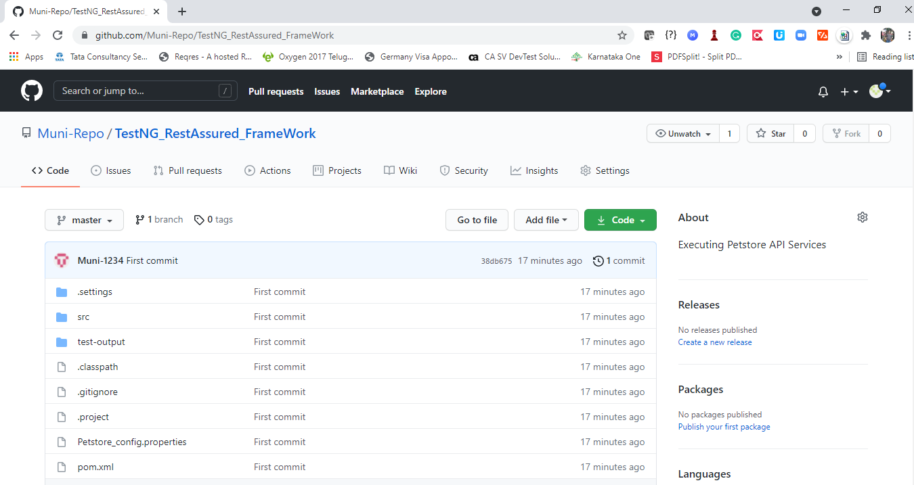
GitHub-Repository

Slide 34
Jenkins - Execution

Slide 35
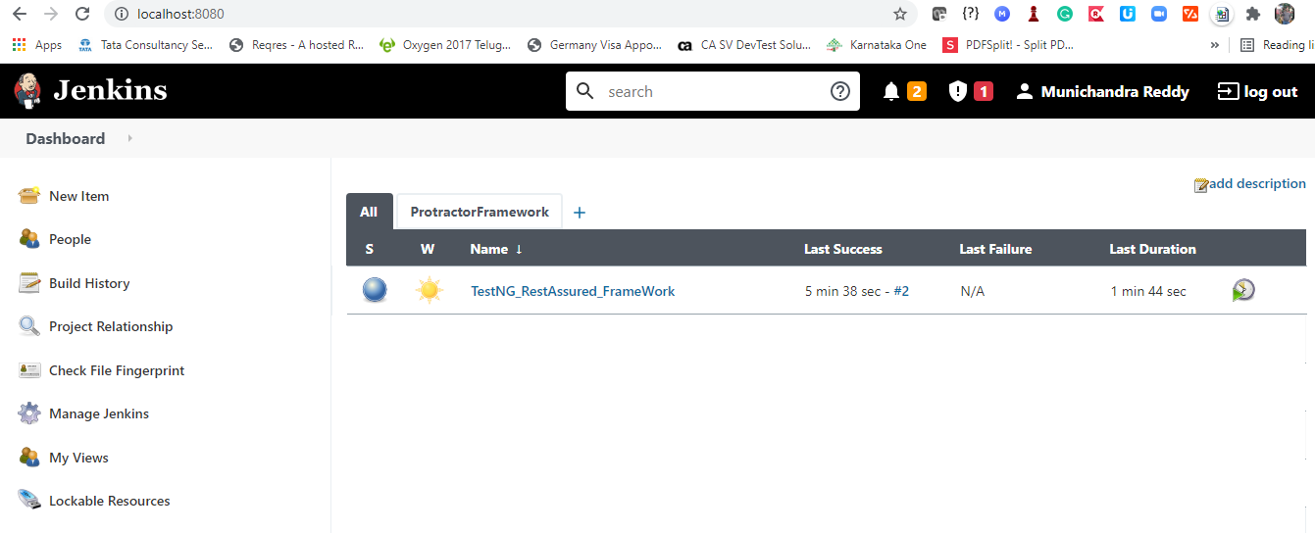
Executing “TestNG - Rest Assured-FrameWork” Jenkins Homepage

Slide 36
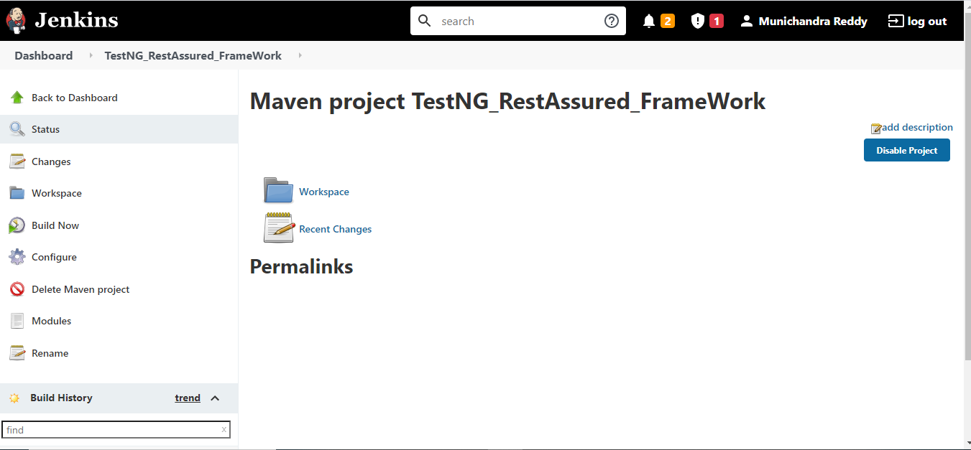
Jenkins - New Project Creation

Slide 37
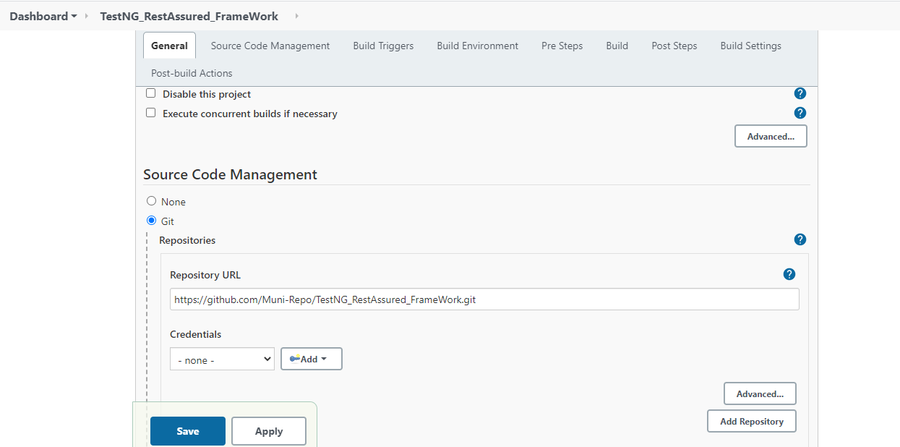
Jenkins - GitHub Repo Configuration

Slide 38
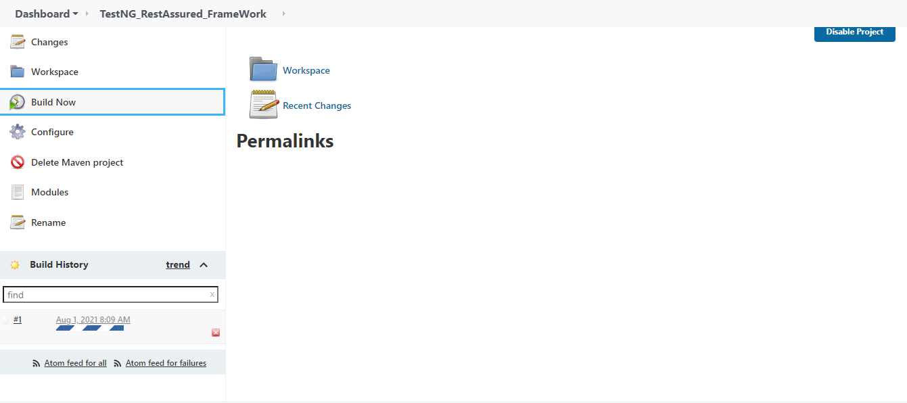
Jenkins - Building the Project

Slide 39
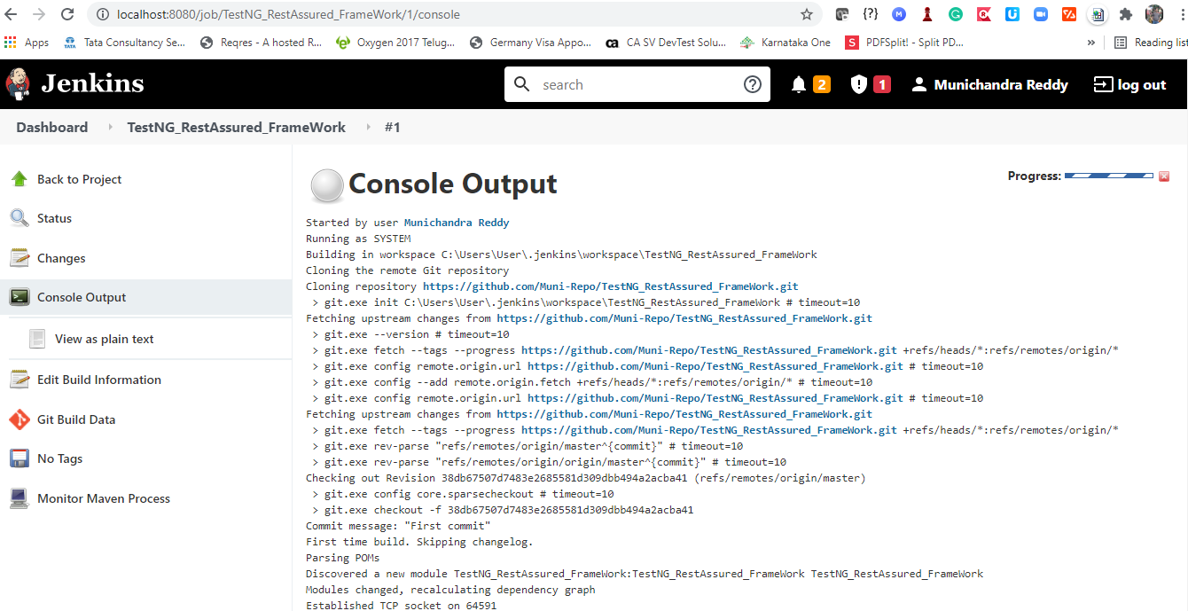
Jenkins - Console Output - Execution

Slide 40
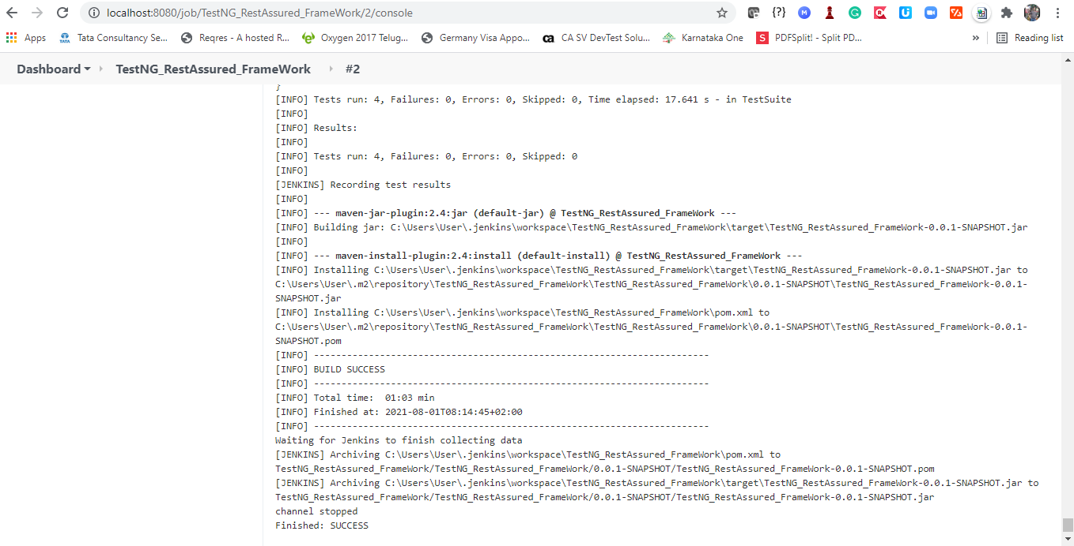
Jenkins - Console Output - BUILD SUCCESS

Slide 41
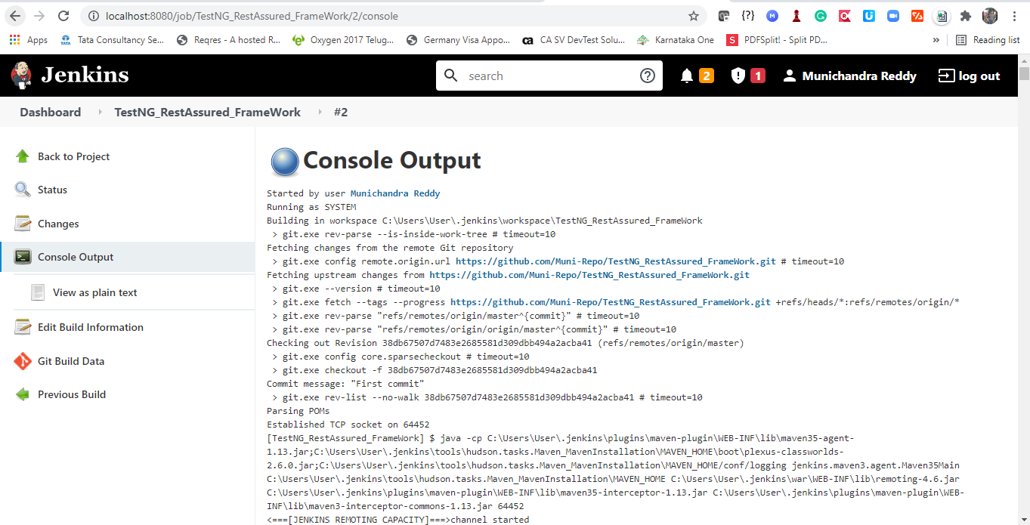
Jenkins - After BUILD SUCCESS Console Output

Slide 42
Any Questions.? & Thank You ….!!! ☺

